Slide 1
The role of NICE in improving clinical practice
Aimee di Marco
MA MBBS MRCS AKC

Slide 2
STAB Module 3 - Learning Objectives
Primary objective
Discuss the role of NICE in improving clinical practice
Secondary objectives
Illustrate the role of heath economics in new technologies
Discuss the role of patient involvement in establishing new technologies, and designing research trials
Defend the regulatory bodies involvement in the establishment a new product

Slide 3
Lecture content
What is NICE?
Who are NICE?
Where does NICE sit within the NHS?
How is NICE funded?
What are the roles of NICE?
Examples of NICE’s involvement in clinical practice

Slide 4
Why is it worth knowing something about NICE?

Slide 5
Why is it worth knowing something about NICE?
It may come up in your exams…
It may come up in a pub quiz….
Junior doctor understanding of NHS structure and NICE’s place in it is generally very poor (recent questionnaire median score of 4/22)
It WILL come up in an interview at some point in your careers
NICE is here to stay – it was given a more important role in the 2011 Health and Social Care Bill
NICE guidance will be relevant to many aspects of ALL careers in healthcare

Slide 7
40% of F1s correct
0 F1s correctly selected both with no other answer
1 F1 selected correctly

Slide 8
Why is it worth knowing something about NICE?
It may come up in your exams…
It may come up in a pub quiz….
Junior doctor understanding of NHS structure and NICE’s place in it is generally very poor (recent questionnaire median score of 4/22)
It WILL come up in an interview at some point in your careers
NICE is here to stay – it was given a more important role in the 2011 Health and Social Care Bill
NICE guidance will be relevant to many aspects of ALL careers in healthcare

Slide 9
What is NICE?

Slide 10
What is NICE?
The National Institute for Clinical Excellence
Established in 1999
Independent body
Set up with the intention of reducing variability in quality and availability of NHS care – ending the ‘postcode lottery’
Aims to bring ‘clarity to quality’

Slide 11
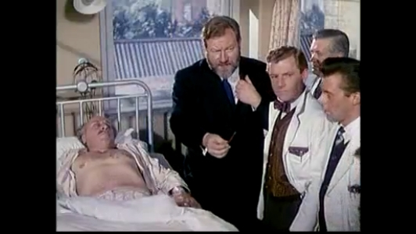
The days before NICE…
Selection of best treatment based largely on single consultant opinion, or perhaps that consultant’s case series
Level of evidence?...
Notes:
Level IV and III

Slide 12
The days before NICE…
Attend Hospital A with your appendicitis and you may wait 2 days, before surgeon Sheridan performs a laparotomy
Or… attend Hospital B and you may get a laparoscopic operation within 12 hours of admission…

Slide 13
Who are NICE?
‘Independent experts’ produce each guideline
Selected clinicians, patients, carers, health economists
NICE Guidance Executive approves guidance
NICE executive directors, guidance centre directors and the communications director
Citizens Council provides advice that reflects the public's perspective on challenging social and moral issues
Group of 30 lay people

Slide 14
The structure of NICE
Centre for Clinical Practice (CCP)
Centre for Public Health Excellence (CPHE)
Centre for Health Technology Evaluation (CHTE)
Communications directorate
Health and social care directorate
Evidence resources directorate
Business, planning and resources directorate

Slide 15
Place of NICE in the NHS
A ‘Special Health Authority’ (SHA)
Independent body receiving funding from the DH
Slight changes dictated by the Health and Social Care Bill 2011, to be brought in from April 2013
NICE to be a ‘Non Departmental Public Body’
NICE to produce guidance on social care sector in addition

Slide 16
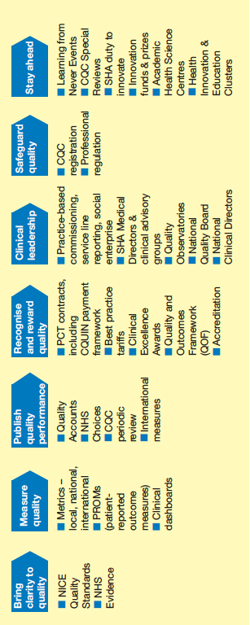
Place of NICE in the NHS

Slide 17
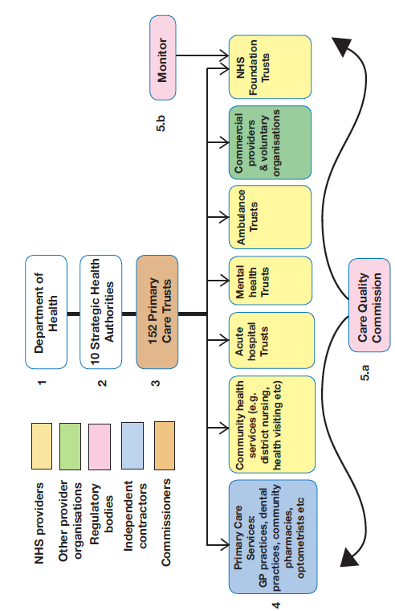
Structure of the NHS
NICE
Notes:
1.The Department of Health enacts the will of Parliament through policy development
2.Strategic Health Authorities (SHAs) manage the NHS locally. They occupy the middle tier between Primary Care Trusts and the Department of Health. They do not manage NHS Foun- dation Trusts.
3.Commissioners are responsible for ensuring adequate services are available for their local population by assessing needs and purchasing services.
4.NHS providers, independent contractors and other provider organisations are responsible for actually providing these services.
5.Regulatory bodies ensure they run appropriately, are well managed (including financially), and that they provide a safe, quality service.
a.The Care Quality Commission (CQC) regulates and inspects providers of health and adult social care in both the public and independent sectors. b.Monitor regulates the finances and governance of NHS Foundation Trusts.

Slide 18
What does NICE do?

Slide 19
What does NICE do?
Produces clinical guidelines
Set standards for high-quality care
Recommendations on drugs
Diagnostics
Interventional procedures
Public health advice
Provide support tools e.g. analysis of uptake / cost analysis
Improve quality of GP care – oversees QOF development (quality and outcomes framework)
Advise health commissioners on development of COF (commissioning outcome framework)
NICE fellows and scholars to disseminate knowledge
NICE international

Slide 20
What does NICE do?
Produces clinical guidelines
Set standards for high-quality care
Recommendations on drugs
Diagnostics
Interventional procedures
Public health advice
Provide support tools e.g. analysis of uptake / cost analysis
Improve quality of GP care – oversees QOF development (quality and outcomes framework)
Advise health commissioners on development of COF (commissioning outcome framework)
NICE fellows and scholars to disseminate knowledge
Produces ‘NHS evidence’
Online resources e.g. ‘NICE pathways’
NICE international

Slide 21
NICE guidelines
Recommendations on specific disease state based on best available evidence
To be used by
Those making health policy
Individual healthcare workers
Those educating healthcare workers
Patients and the public
Versions of guidelines
Full guideline
‘NICE guideline’
NICE pathway
Cancer service guidelines
Supports implementation of ‘NHS Cancer Plan for England’
Aimed at assisting with commissioning of services

Slide 22
Evidence base…
Ia Meta-anlysis of Randomised Controlled Trials
Ib Randomised Controlled Trial – 1 or more
IIa Well designed, controlled, non-randomised trial ≥ 1
IIb Well-designed experimental trial ≥ 1
III Case, correlation, and comparative studies
IV Expert opinion or panel of experts

Slide 23
NICE guideline example…

Slide 24
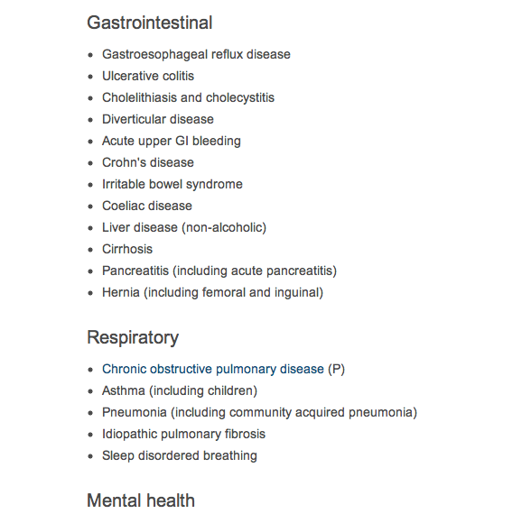
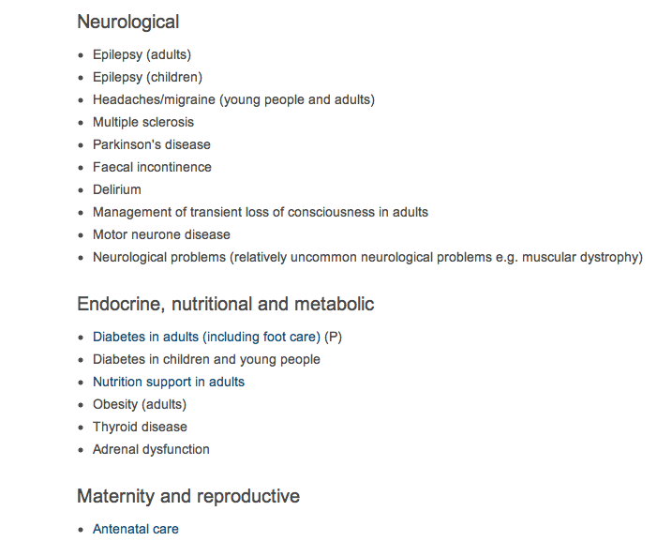
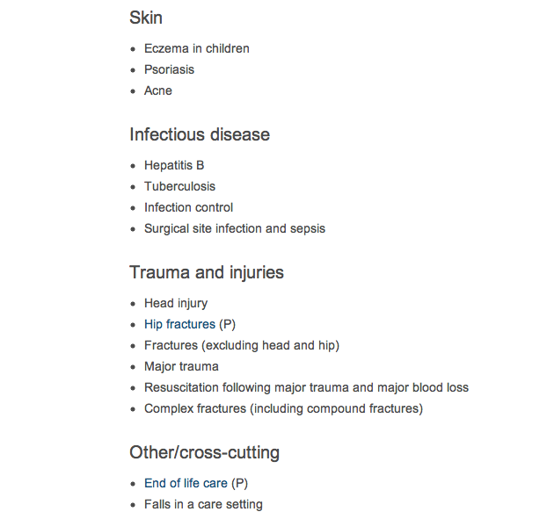
NICE quality standards

Slide 25
NICE quality standards

Slide 26
NICE quality standards

Slide 27
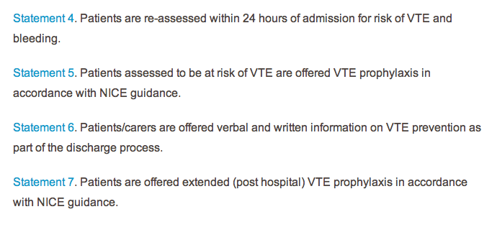

Slide 28
NICE quality standards into practice
Local policy
Online resources
Day-to-day practice e.g. new drug chart covering VTE assessment

Slide 29
NICE technology appraisal
Examines
Medicines
Medical devices (MTEP & MTAC)
Diagnostic techniques (DAP)
Surgical procedures
Health promotion
Recommendations based on
Clinical evidence
Economic evidence
Versions of technology appraisals
Full appraisal
Quick reference
Public information
Decisions
Recommended
Optimised
Only in research
Not recommended

Slide 30
NICE technology appraisal
Applies to ‘new’ and ‘old’ technologies alike
Separate from regulatory approval
Separate committees examine
Diagnostics
Diagnostics Assessment Program (DAP)
Medical devices
Medical Devices Evaluation Program (MDEP)
Medical Technologies Advisory Committee (MTAC)
Selects which devices and procedures are assessed
Assesses the devices / prcedures
Surgical procedures

Slide 32
NICE technology appraisal

Slide 34
NICE pathways
An online tool for clinicians uniting guidelines, standards and technology appraisals under one disease heading

Slide 35
NICE in the news – court uphold NICE Guidance

Slide 37
Court upholds NICE guidance again

Slide 38
How might NICE improve clinical practice?
Guidance to help clinicians
Advice on efficacy of
Drugs
Interventional procedures
diagnostics
Set standards for high-quality care
Act as barrier against adoption of expensive technologies
Influence of DH policy
Influence GP and commissioners frameworks (QOF and COF)
Public health advice
Use of ‘fellows’ to disseminate knowledge
Suport materials to other clinicians via web and ‘NHS evidence’
‘NICE international’ to advise worldwide
Legal standing – case law

Slide 39
QUESTIONS
THANK YOU
adimarco@ic.ac.uk

