Slide 1
Introduction to electromyography
BSc Surgery and Anaesthesia
Paul H Strutton
Department of Surgery and Cancer

Slide 2
Overview
What is EMG?
How can we record it?
What does it tell us?
Summary

Slide 3
Learning Outcomes
By the end of this session you should be able to:
Define electromyography
List what is needed to record EMG
Describe the relationship between surface EMG and force
Describe what EMG signals look like
List the techniques are used to analyse EMG data

Slide 4
Introduction
During muscle activation small electrical currents are generated as ions are exchanged across muscles fibre membranes.
These processes occur during muscle activation but prior to contraction and the generation of force.
The electromyogram (EMG) is the bioeletric signal generated by this exchange of ions.

Slide 5
The motor unit
This is the name given to a single motor neuron together with all the muscle fibres that it innervates. It is the smallest functional unit with which to produce force.
Humans have approximately 420,000 motor neurons and 250 million skeletal muscle fibres.
On average each motor neuron supplies about 600 muscle fibres.
Stimulation of one motor unit causes contraction of all the muscle fibres in that unit.

Slide 6
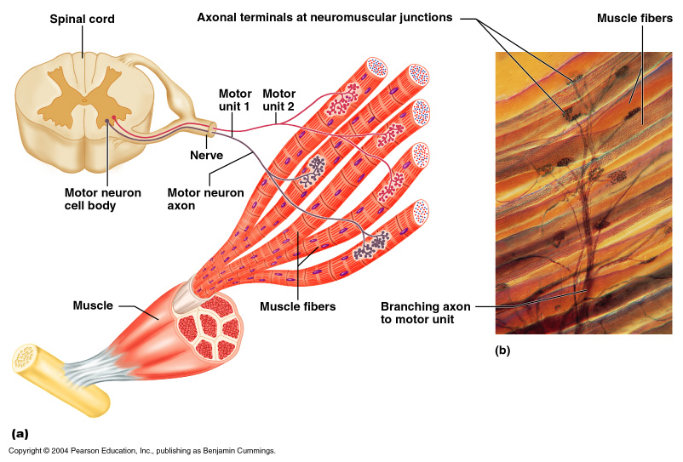
The motor unit

Slide 7
Regulation of muscle force
Two mechanisms by which the brain regulates the force that a single muscle can produce.
RECRUITMENT
Motor units are not randomly recruited. There is an order to this.
Governed by the “Size Principle”. Smaller units are recruited first (these are generally the slow twitch units).
As more force is required, more units are recruited.
This allows fine control (e.g. when writing), under which low force levels are required.
RATE CODING
A motor unit can fire at a range of frequencies.
Slow units fire at a lower frequency.
As the firing rate increases, the force produced by the unit increases.
Summation occurs when units fire at frequency too fast to allow the muscle to relax between arriving action potentials.

Slide 8
Recording EMG
EMG signals are small (100μV – 5mV) in comparison to other ambient signals (interference or noise).
Need to have a recording setup that maximises the signal:noise ratio.
Noise can arise from other muscles, electrical machinery, movements of wires, power lines, fluorescent lighting.
Need to filter the signal.

Slide 9
Electrodes
Surface electrodes - Non-invasive and non-painful – can record global activity of muscle
Indwelling (needle) electrodes - Invasive – can be used to isolate single motor unit activity

Slide 10
Electrode configurations
Monopolar
Single electrode over muscle with respect to reference (this must be located on an electrically neutral tissue). The signal:noise ratio of this setup is inferior to the bipolar setup.
Bipolar
Most commonly used setup. Each electrode detects potentials over muscle, each with respect to a reference electrode. Differential amplification subtracts the signal at one electrode from the signal at the other electrode. Common signal (e.g. noise) is subtracted.

Slide 11
Experimental setup

Slide 12
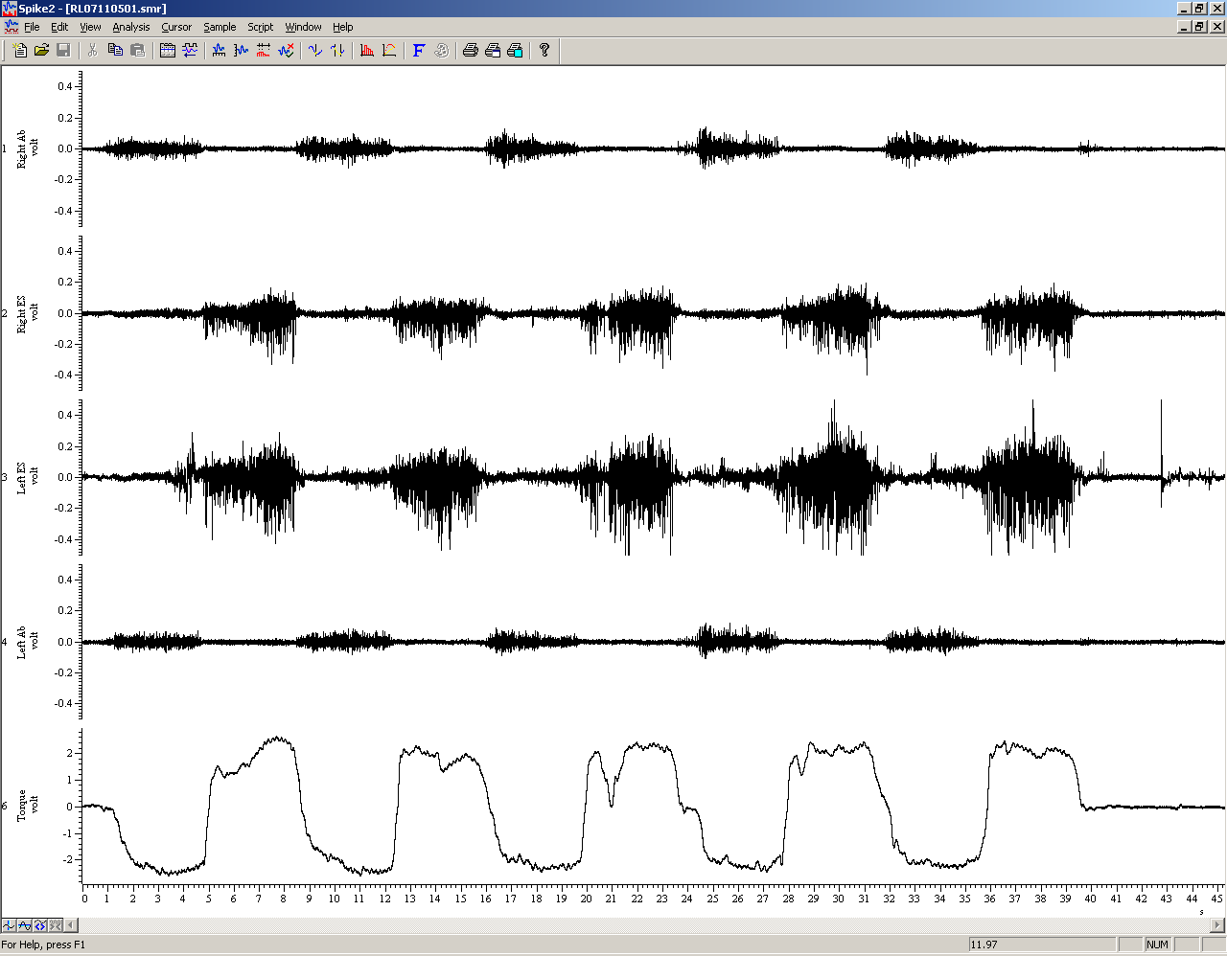
Raw EMG during dynamic contrations

Slide 13
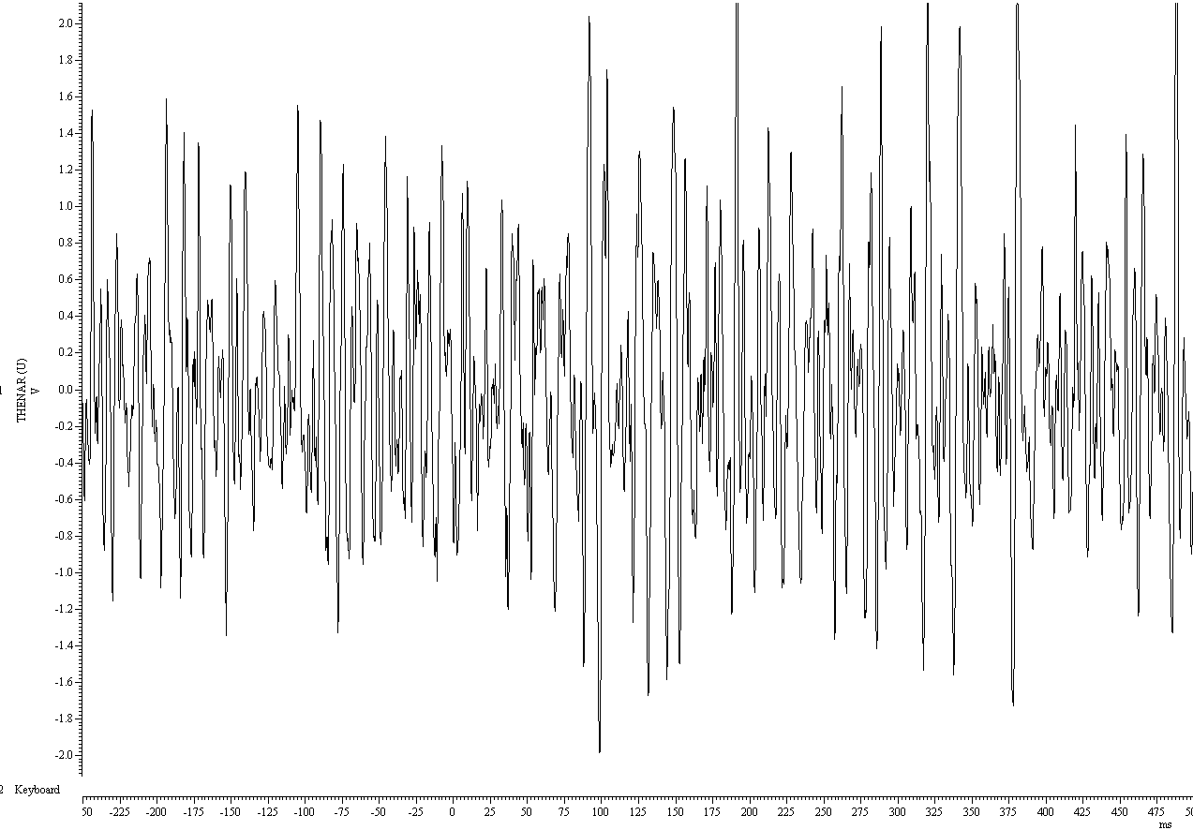
Raw EMG during a maximum voluntary contraction (MVC)

Slide 14
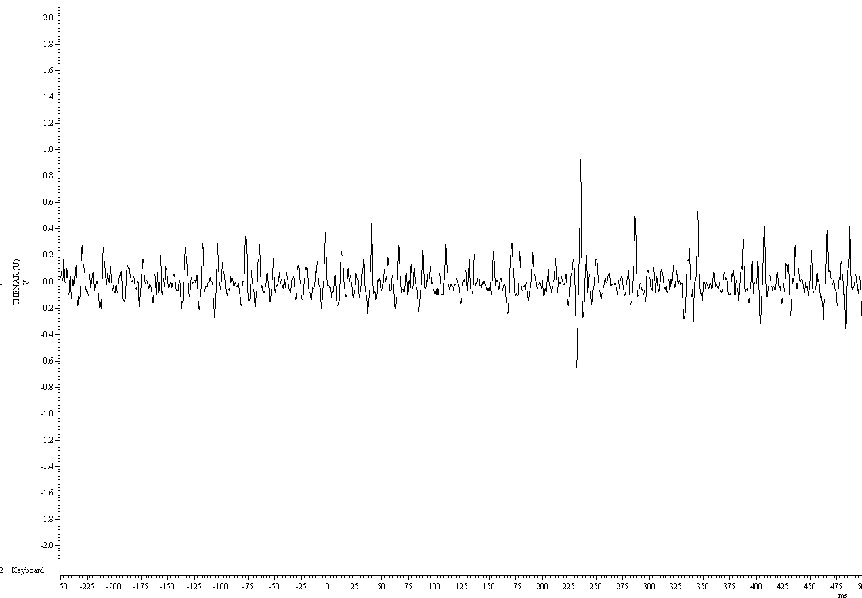
Raw EMG during a 20% contraction

Slide 15
How can we analyse the EMG data?
Average the signal
Calculate the root mean square
Rectify the signal and measure the mean level
Integrate the rectified signal and measure the maximum value
Examine the frequency of the signal

Slide 16
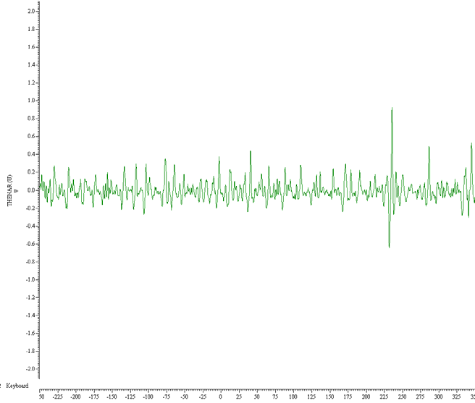
Averaging
This can be used to quantify muscle activity over specific time intervals.
Static contraction Dynamic contractions

Slide 17
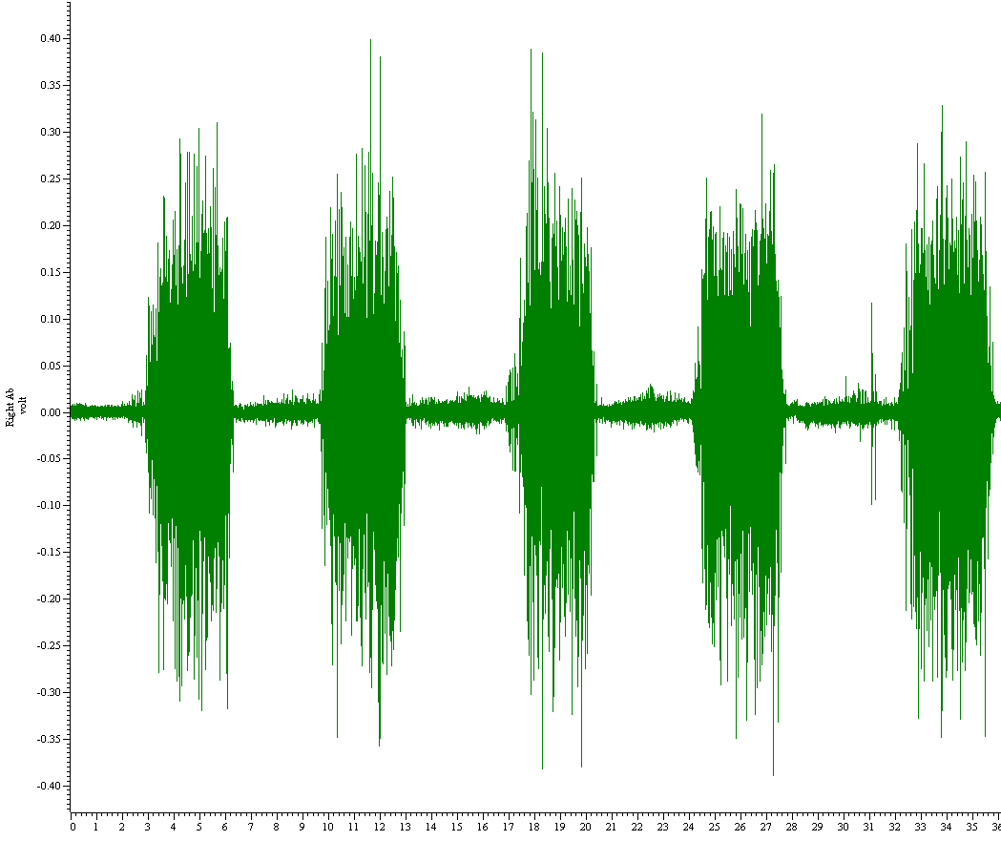
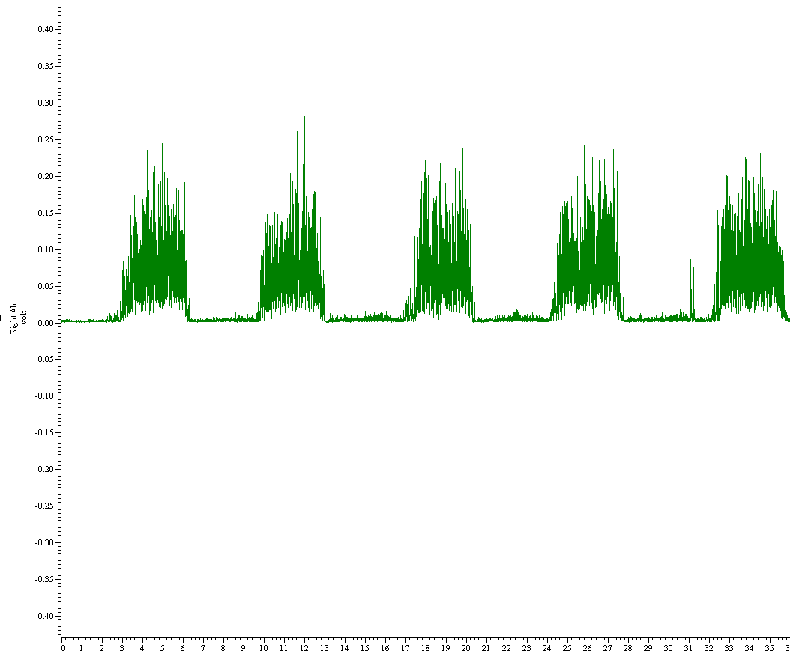
Root Mean Square (RMS) amplitude
RMS is a measure of the magnitude of a varying quantity.
It is especially useful when variates are positive and negative, e.g. in EMG
Mean = 0
Mean = 0.071

Slide 18
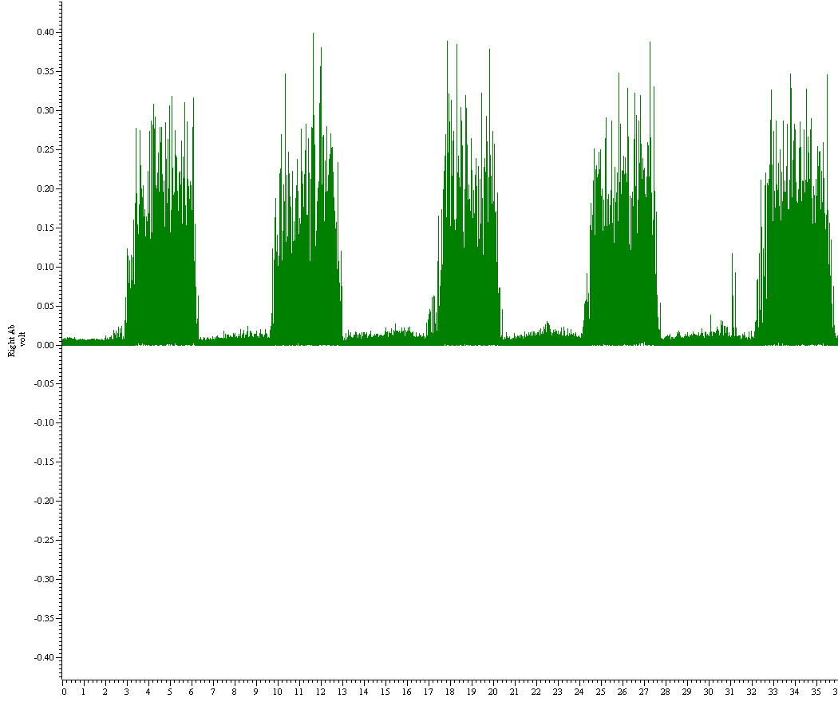
Rectification
EMG has both negative and positive polarity. Rectification converts the signal to a positive polarity so that the mean amplitude of the spikes becomes meaningful.
Mean = 0
Mean = 0.0613

Slide 19
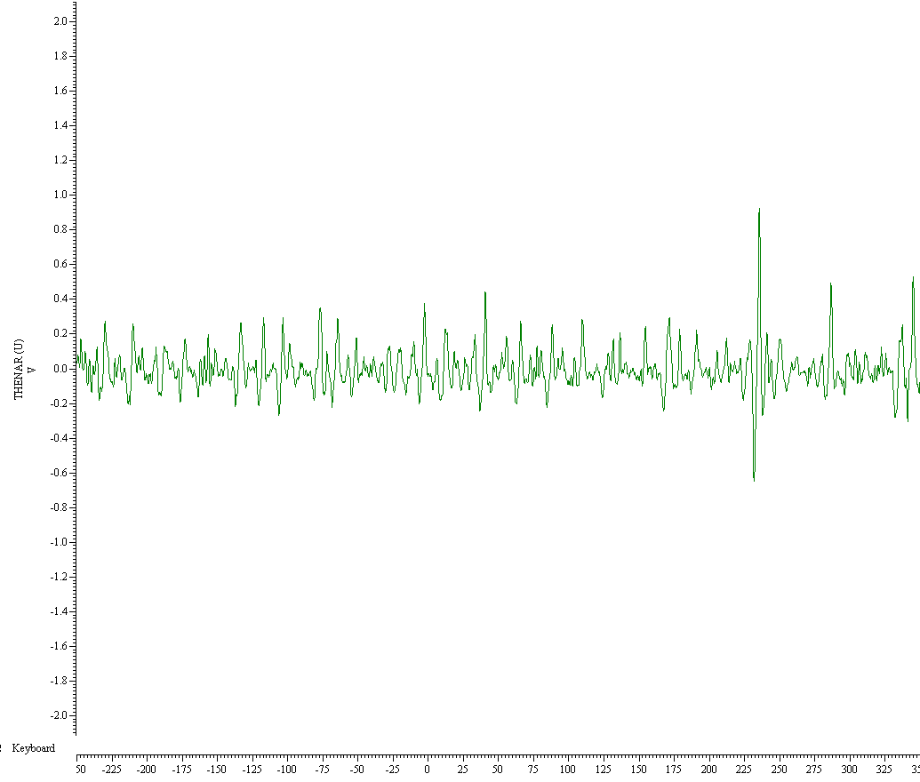
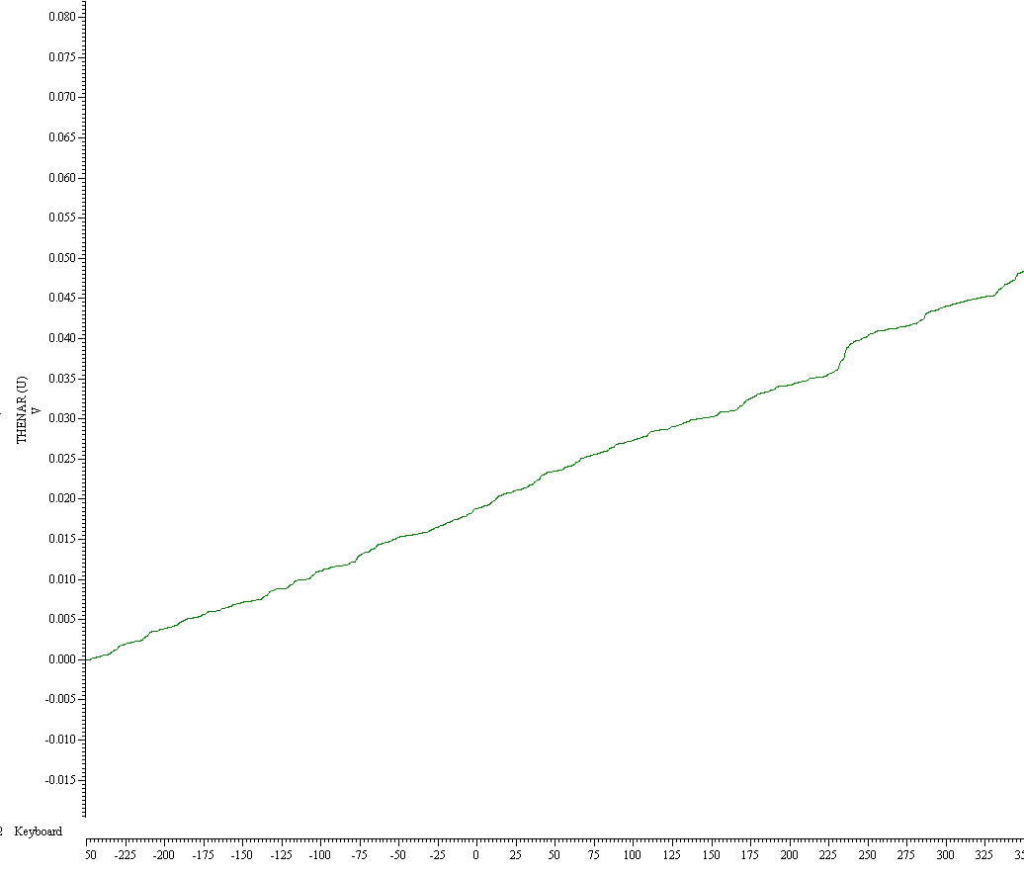
Integrated rectified
Best measure of total muscular effort. Describes how the EMG changes over time.

Slide 20
Frequency analysis
Analysis of the frequency of the waveform

Slide 21
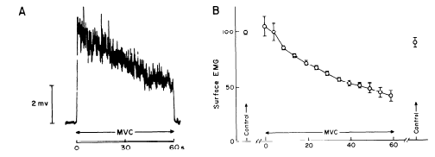
Fatigue analysis
Surface EMG declines during a maximal contraction

Slide 22
Fatigue analysis
Firing rates of motor neurones declines during MVC contractions

Slide 23
Fatigue analysis
Surface EMG INCREASES during a sub-maximal contraction

Slide 24
Fatigue analysis
Decline in median frequency of signal during fatigue

Slide 25
The surface EMG
Surface EMG is related to force produced in the muscles.
As force increases the surface EMG area increases linearly

Slide 26
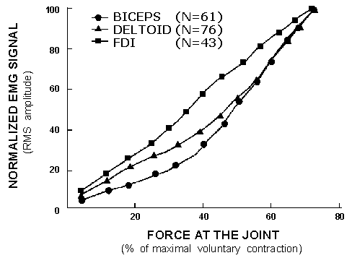
EMG force relationship

Slide 27
20% MVC

