Slide 1
Anaesthetic toxicity
Geoff Lockwood
Hammersmith Hospital

Slide 2
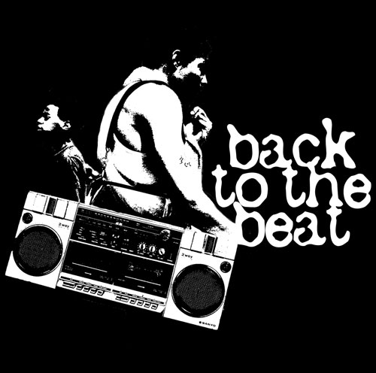

Toxicity
Old school toxicity
  heart
  liver
  kidney
New wave toxicity
  brain

Slide 3
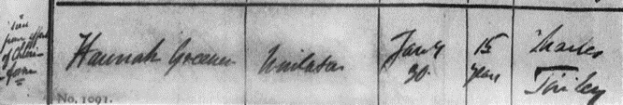
Heart
Hannah Greener, age 15
  first death from anaesthesia, 1848
  possible myocardial dysrhythmia
  possible aspiration
  not really toxicity
  Anesthesiology 2002; 96: 1250-53

Slide 4
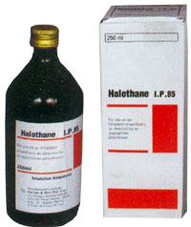
Liver
Post-operative hepatitis reported since earliest days
Big issue following introduction of halothane
1966 National Halothane Enquiry
  halothane is the safest anaesthetic available
  there are rare instances of post-op hepatitis
  probably caused by a metabolite
  probably needs repeat exposure

Slide 5
Halothane metabolism
CF₃-CHClBr → CF₃-COOH + HCl + Br
CF3-COO∙ moiety may form a hapten with hepatocyte membrane
immune response after repeated exposure
reductive metabolism gives nasty toxins
attention turns back to ethers

Slide 6
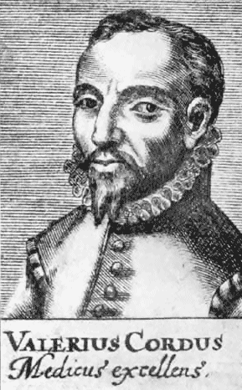

Ethers
Diethyl ether: CH₃CH₂OCH₂CH₃
  Synthesised by Valerius Cordis 1540
Paracelsus said to have seen its effect on chickens
  Paracelsus died 1541
Hard to kill patients
Hard to anaesthetise patients
Nauseating and unpleasant

Slide 7
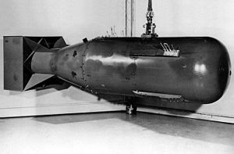
The Manhattan Project series
Enrichment using UF₆
  natural uranium 0.72% U-235
  reactor grade 3-4% U-235
  weapons grade 90% U-235
  ‘Little Boy’ had 64kg 80% enriched uranium
Gas diffusion
  ²³⁵UF₆ 0.852% lighter than ²³⁸UF₆
Gas centrifuge
  more efficient

Slide 8
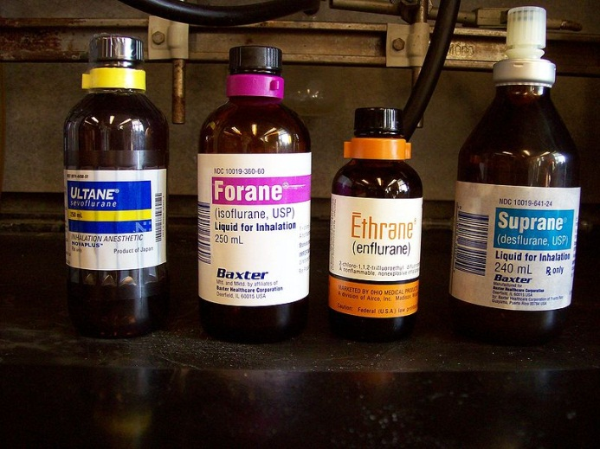
The Manhattan Project series
Methoxyflurane: CHCl₂-CF₂-O-CH₃
Enflurane: CHFCl-CF₂-O-CHF₂
Isoflurane: CF₃-CHCl-O-CHF₂
Desflurane: CF₃-CHF-O-CHF₂
Sevoflurane: CH₂F-O-CH(-CF₃)₂

Slide 9
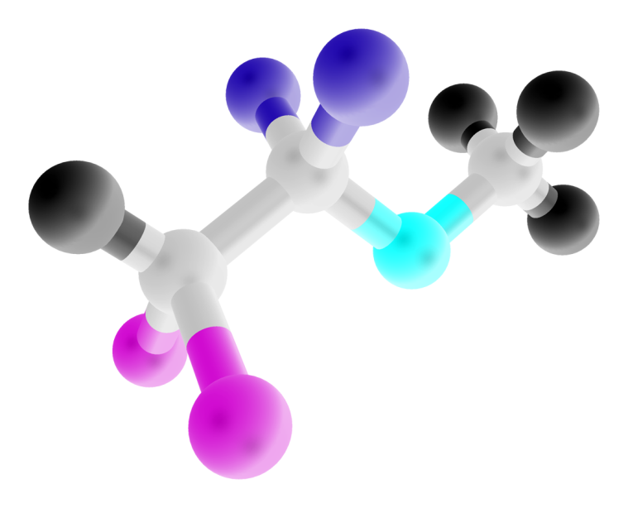
Methoxyflurane: 1960-78
CHCl₂-CF₂-O-CH₃
Very soluble so lingers longer
50-80% metabolised
Metabolism produces fluoride in serum
[F⁻] > 40 µM → renal failure

Slide 10
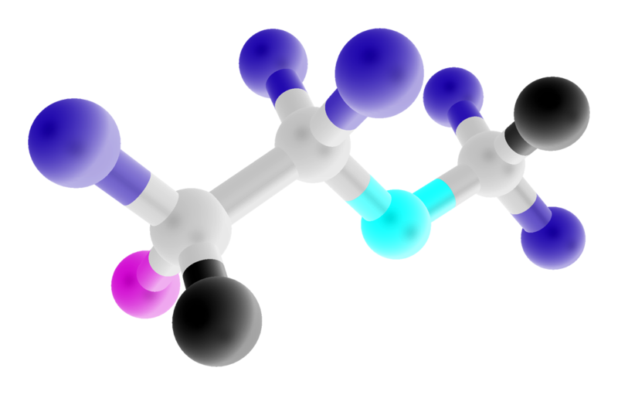
Enflurane: 1966 -
CHFCl-CF₂-O-CHF₂
only 3% of dose metabolised
more after enzyme induction
prolonged use can get [F⁻] > 40 µM
reduced free water clearance common

Slide 11
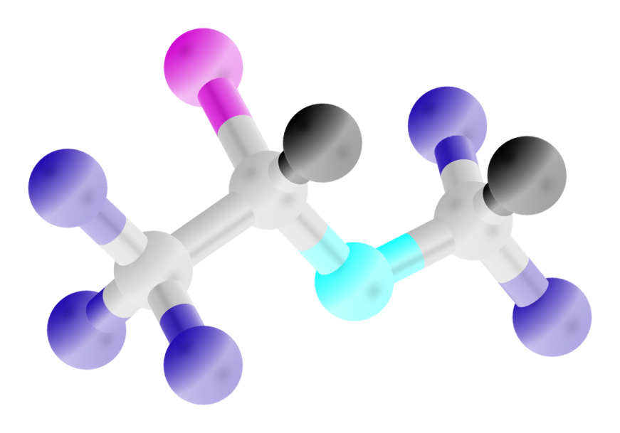
Isoflurane: 1983 -
CF₃-CHCl-O-CHF₂
metabolism 0.1%
forms negligible F⁻ and TFA
hepatitis reported, vanishingly rare

Slide 12
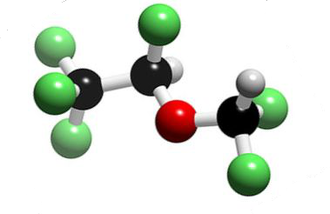
Desflurane: 1992 -
CF₃-CHF-O-CHF₂
metabolism < 0.02%
even less metabolites than isoflurane
one possible case of desflurane hepatitis

Slide 13
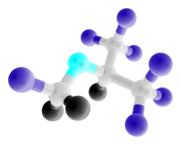
Sevoflurane: 1996 -
CH₂F-O-CH(-CF₃)₂
4% metabolised
HFIP and F⁻ formed
[F⁻] > 40 µM ^{is} easy
No renal dysfunction
  no renal metabolism
  short transit time
No liver dysfunction

Slide 14
Anaesthetic metabolism
P450 2E1
  liver only in humans
  isoniazid, alcohol induce, disulphiram inhibits
  oxidative metabolism of volatile anaesthetics
P450 1A
  liver, kidneys and lungs
  sevoflurane resistant
P450 2A6, P450 3A4
  reductive halothane metabolism
Notes:
14

Slide 15
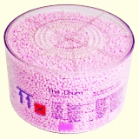
Non-biological degradation
Sevoflurane reacts most with sodalime
  most in normal use, that is
  resulting compounds toxic in rats
  no evidence of injury in humans
Desflurane degrades most in dry sodalime
  up to 36% carboxyhaemoglobin reported
Sevoflurane reacts with Lewis acids
  hydrogen fluoride released
  no evidence of clinical problem

Slide 16
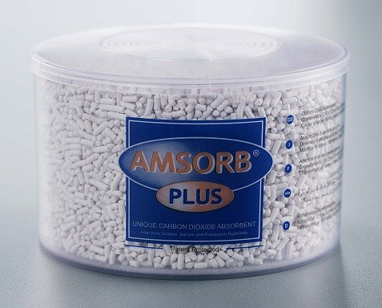
Solutions
Avoid dry sodalime
Use new formulation sodalime
  (NaOH-free, KOH-free)
Water down the sevoflurane
  Lewis acids inhibited by 300ppm water

Slide 17
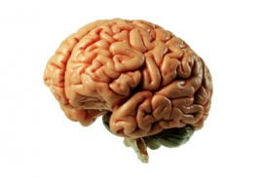
Brain
Anaesthesia and the elderly
Anaesthesia and the developing brain
Separating anaesthesia and surgery

Slide 18
What is POCD?
Measure a bundle of neurocognitive tests
Calculate z-scores
A score of more than 2 in two or more tests

Slide 19
The elderly
POCD common after cardiac surgery
  thought to be embolic or inflammatory
POCD after non-cardiac surgery?
  deterioration in controls noted in cardiac studies
  reports from 2000 of cognitive decline
  surely not the anaesthetic?

Slide 20
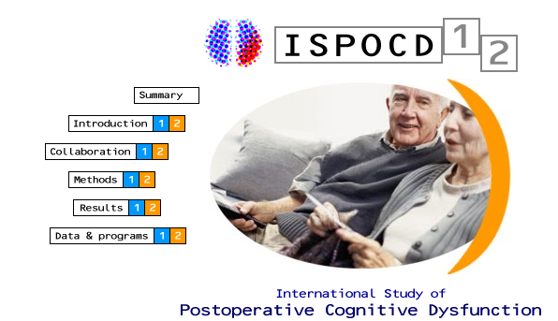
The elderly
ISPOCD1, 1998
  1,218 patients, 60yr or older
  major non-cardiac surgery
  POCD in 26% at 1 week, 10% at 3 months
  risk factors: age and benzodiazepine use
  much variability between hospitals
  UK patients: 3.4% at 1 week, 2.8% at 3 months

Slide 21
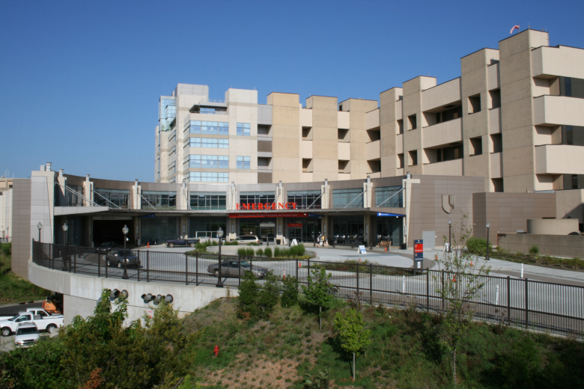
Duke group, 2008
1,064 patients, 18yr or older
Surgery longer than 2hr
Assessed at 1 week and 3 months
Risk factors for POCD at 3 months
  increasing age
  lower educational level
  previous CVA without residual impairment
  POCD at hospital discharge

Slide 22
ISPOCD-2
Tasks addressing questions from ISPOCD-1
1. Long-term POCD in elderly
  no different to controls at 1-2yr (10% dysfunction)
2. POCD after minor surgery in elderly
  more POCD if age >70yr
  less after day case surgery
3. Does local anaesthesia prevent POCD?
  POCD the same after epidural or GA

Slide 23
ISPOCD-2
4. POCD in middle age
  no evidence at 3 months (6.2% v 4.1%)
5. Benzodiazepines and metabolites
  no evidence of benzodiazepine effect at 1 week.
6. Cholinergic function
  rat study of cholinergic receptors
  numbers reduced after repeated anaesthesia

Slide 24
ISPOCD-2
7. CBF and POCD after cardiac surgery
  no correlation in 15 patients
8. Neuron loss after cardiac surgery
  neuronal density of frontal cortex reduced
  no correlation with POCD
9. Biochemical markers of POCD
  NSE at 36hr may predict early, not late, POCD
  S100β no use for anything

Slide 25
Summary
Major stress can take years off your life
Anaesthesia probably incidental

Slide 26

Developing brain
2003: Jevtovic-Todorovic
  7day old rats
  neuronal death after anaesthesia
  impaired LTP in hippocampus
  spatial recognition impaired at 1 and 4.5months
Similar results in other animals since
Humans?
  obvious problems with repeating animal
  experiments

Slide 27
Jevtovic-Todorovic
7-day old rats
6 hr anaesthesia
  midazolam, nitrous oxide, isoflurane
  isoflurane seems to be the culprit
Apoptosis in cingulate
Impaired performance up to 4 months
J Neurosci 2003; 23:876-882

Slide 28

Wilder 2009
Is childhood anaesthesia associated with learning disability later?
  5357 children born in Olmsted County 1976-82
  are test scores lower than predicted by IQ?
  11% had GA before 4yr, 24% of these had multiple
  disability with >1 GA or total 2hr GA
  not due to degree of ill health

Slide 29
Wilder 2009
BUT
  retrospective, dated anaesthesia, no follow-up beyond first diagnosis, no causality

Slide 30
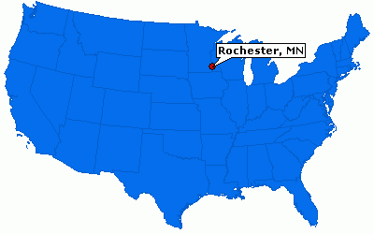
Sprung 2009
Does anaesthesia for LSCS increase learning disability?
  same cohort of children
  compare GA and RA for LSCS
  no increase with GA
  reduction in RA!

Slide 31
Kalkman 2009
Does the timing of anaesthesia affect development?
  368 children had urological procedures under GA
  6-24 months: ‘vulnerable’ children
  2-6yr: controls
  314 of these could be followed up
  243 (77%) behavioural questionnaires returned
  insignificant trend to behavioural impairment in vulnerable group
  underpowered by a factor or 10
  is this the period of vulnerability anyway?

Slide 32
DiMaggio 2011
0 GA
>0 GA
Time to developing behavioural disturbance
NY State Medicaid file search
  635,758 births 1999-2005
    243,238 (38%) procedures age <3yr,
    ²/3 circumcisions - excluded
    60,319 (9.5%) had development/behavioural diagnosis
  5,824 pairs of twins
  304 of these children had GA <3yr
  8.8% non-exposed twins get behavioural diagnosis
  95% CI of relative risk of behavioural disturbance
    1 GA: 0.8-1.4; 2GA: 2.5-3.1; >2GA: 3.5-4.5

Slide 33
DiMaggio 2011
But
  10% exposed twins ‘perinatal hypoxia’ v 5% not exposed
  138 pairs of twins with only 1 having GA
  9 instances of twin with GA having problem
  11 instances of twin without GA having problem
  (number of GAs not reported)

Slide 34
Bartels 2009
Netherlands Twins Registry
  1,143 monozygotic twins
  anaesthetics recorded (0-3yr, 3-12yr)
  educational achievement scores tested age 12
  GA exposure before 3yr associated with lower scores
  BUT no difference between GA and non-GA co-twins

Slide 35
SmartTots
Strategies for Mitigating Anesthesia-Related neuroToxicity in Tots
Collaboration between IARS and FDA
Organisation to obtain grant money
Lots more to come

Slide 36
SmartTots message
No clear evidence of injury in humans
Continuing research
Trust your doctor
Donate to SmartTots

Slide 37
Further reading
Old school toxicity
  any big anaesthetic textbook
New wave toxicity
  Review by Hudson and Hemmings, British Journal of Anaesthesia 2011; 107:30-37 (free access!)
  the Smart Tots issue of Anesthesiology, November 2011, especially the review by Stratmann

