Slide 1

Supraspinal structures and pain
Dafydd Lloyd
Dafydd@imperial.ac.uk

Slide 2
Define pain:

Slide 3
Define pain:
“An unpleasant sensory or emotional experience resulting from a stimulus causing, or likely to cause, tissue damage, or expressed in terms of that damage.” _{A-Z of anaesthesia.}

Slide 4
How many supraspinal structures
handle pain signals?

Slide 5
How many supraspinal structures
handle pain signals?
Most of them.

Slide 6
The way we handle pain is complex:

Slide 7
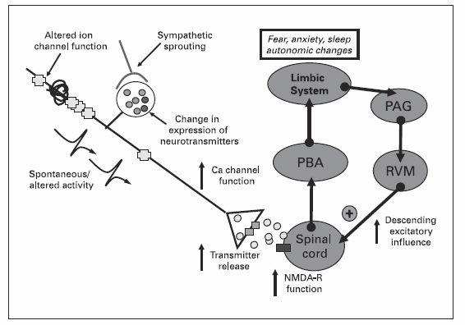
Signals are modulated at many levels:
PAG: Periaqueductal Gray. PBA: Parabrachial area. RVM: Rostral Ventral Medulla.

Slide 8
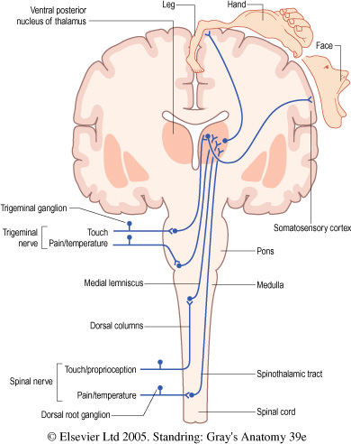
Main sensory pathways:
Notes:
Fig. 12.11 The organization of general sensory pathways showing first-order (green), second-order (blue) and third-order (red) neurones.

Slide 9
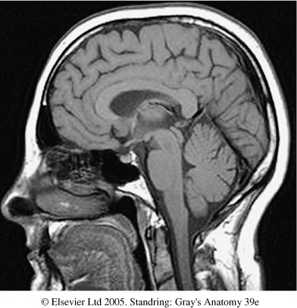
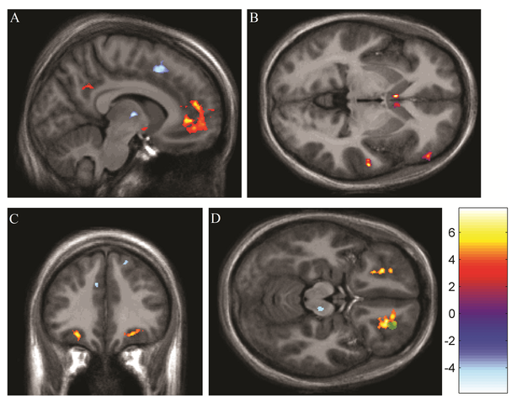
Brain areas involved in handling pain:
Younger et al, PlosOne 2010.
Cerebrum
Amygdala
Hippocampus
Thalamus
Hypothalamus
Periaqueductal grey matter
Reticular formation
Red nucleus
Substantia nigra
Pons
Cerebellum
Medulla oblongata
Forebrain
Midbrain
Hindbrain

Slide 10
Spinothalamic tract:
Pain and temperature, less discriminative touch.
2nd order neurones ascend contralaterally.
Anterio-lateral columns.
Terminate in the Thalamus.
Directly link to analgesia: Spinomesencephalic tract.

Slide 11
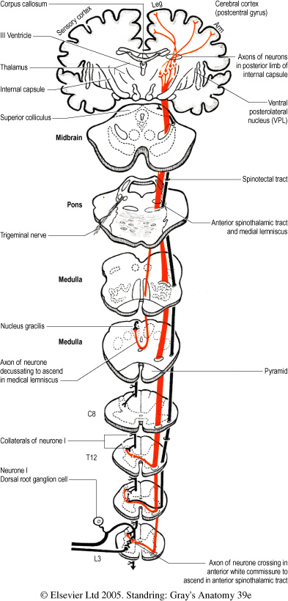
Anterior spinothalamic tract:
Pain, temperature and touch.
Notes:
Fig. 18.17 The ventral (anterior) spinothalamic tract. (From Carpenter MB 1991 Core Text of Neuroanatomy, 4th edn. Baltimore: Williams and Wilkins, by permission of author and publisher.)

Slide 12
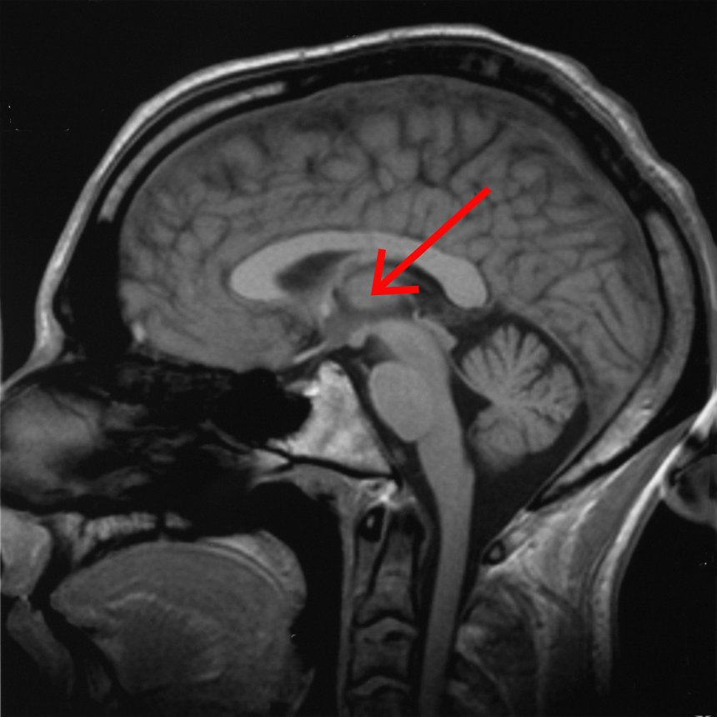
Sensory Thalamus: anatomy
Posterior Forebrain / Superior pole of brainstem.
3cm x 2.5 x 2.
Anterior and posterior circulation.
Adjacent to 3rd ventricle.
Lamellar structure with distinct nuclei.

Slide 13
Thalamic Function:
The Switchboard.
Processes and relays sensory information to all parts of cortex and hippocampus.
Handles all sensory information (except smell)
“Back projections” from the cortex.
Lesions cause ‘Central pain’.

Slide 14
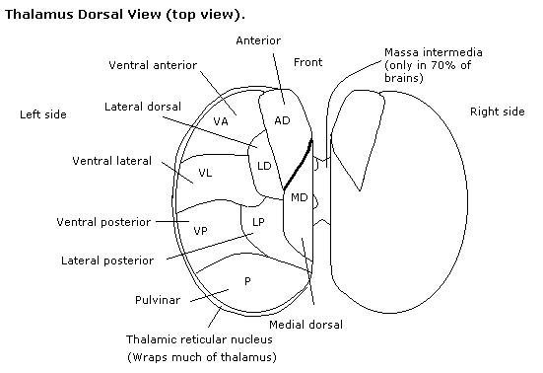
Thalamic nuclei:
Visual: Retina Lateral geniculate nucleus Occipital.
Auditory: midbrain Medial geniculate.
Taste, Somatic + Visceral: Ventral posterior nucleus.
Others are motor.

Slide 15
Ventral posterior nucleus:
2 parts: VPL: Somatic (Spinothalamic) input.
VPM: Head and neck (Trigeminal).
IN: Medial lemniscus OUT: Somatosensory
Spinal lemniscus Reticuloactivating
Spiothalamic
Trigeminothalamic

Slide 16
Cerebral Cortex
Highest level of processing and feedback.
Receives dense input: Thalamic to Spinal
Post-central gyrus: primary sensory area.
Conscious experience of sensory stimuli.
Links to: Limbic system (Emotional response.)
Frontal region (behavioural response.)

Slide 17
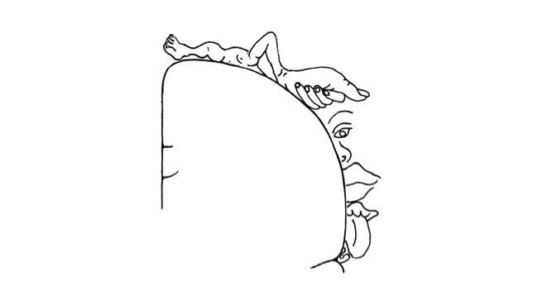
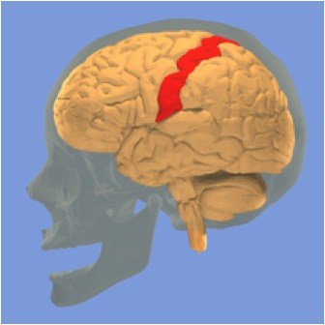
Designated sensory areas:
Postcentral gyrus of Parietal lobe
Sensory Homunculus
Brodman areas 1,2 and 3.

Slide 18
Descending influences:
Cortical.
Midbrain: Periaqueductal Grey: The centre for analgesia
Raphe nuclei: Enkephalins to dorsal horn.
Gate control.
Limbic: Amygdala: Fear and reward, memory.
Brainstem: Locus coereleus: Stress response, panic, Norad.
Nucleus raphe magnus: enkephalin releasing, dorsal horn projections.
Hypothalamus: Links to endocrine function

Slide 19
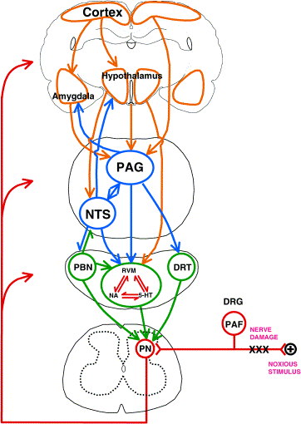
Orchestrating the response to nociceptive information:
PAG: Periaqueductal grey
NTS: Nucleus tractus solitarius
PBN: Parabrachial nucleus
RVM: Rostroventral medulla
DRT: Dorsoreticular nucleus
PN: Project neurons
DRG: Dorsal root ganglion
PAF: Primary afferent fibre
Millan MJ. Prog Neurobio 2002

Slide 20
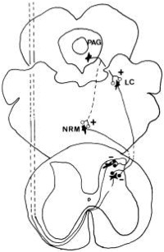
Periaqueductal Grey
Midbrain.
Analgesia centre.
INPUT: Several, including ascending pathways: Spinomesencephalic tract
OUTPUT: Include inhibitory interneurones in dorsal horn.
Enkephalin release.
LC: Locus Coeruleus.
NRM: Nucleus Raphe Magnus

Slide 21
The Raphe nuclei:
Several brainstem nuclei: form the RETICULAR FORMATION.
Medullary (Raphe Magnus), others Pontine and brainstem.
INPUT: Cortex, Limbic system, PAG and other nuclei.
OUTPUT: Widespread, ascending and descending, including direct descending spinal innervation.
Enkephalin and Serotonin (5-HT) release.

Slide 22
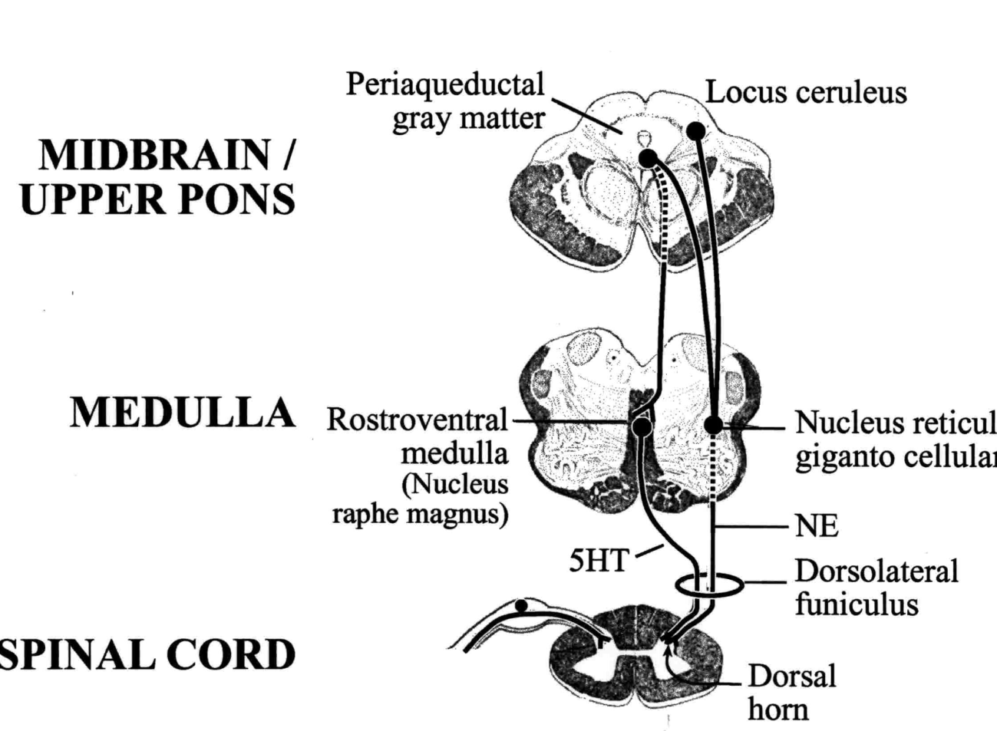
Nucleus Raphe Magnus:
3 populations of cells:
ON: Excitatory.
OFF: Inhibitory.
Neutral: monitoring.
Innervate higher and lower centres.
Enable prioritisation of responses to pain signals

Slide 23
Linking the systems:
Pain triggers varied responses: Physical.
  Autonomic.
  Endocrine.
  Emotional.
Brainstem structured orchestrate these.
Dense, widespread ascending and descending inervation.

Slide 24
Medulla oblongata and PAG:
Relay information from the spinoreticulothalamic tract
to the medial thalamus.
Integrates the animals response at the:
- Cardiorespiratory center.
- Motor centres.
- Limbic centres.
- Alertness centres.

Slide 25
Hypothalamus:
INPUT: Spinohypothalamic tract.
  Spinoparabrachial-hypothalamic tract
OUTPUT: Autonomic effects of pain (CVS, RS, GI).
Links nervous system to Endocrine, via pituitary.

Slide 26
Pain and behaviour:
Pain triggers a motivational-affective response.
Mediated by the Limbic system.
Catecholamine driven.
Lamina I projections from dorsal horns.
Collaterals to all catecholamine groups in Medulla + Pons,
including the Locus Cereleus.

Slide 27
Supraspinal structures and pain.
Dafydd Lloyd
Dafydd@imperial.ac.uk

Slide 28
Ascending pain pathways: II
Posterior columns:
Visceral pain, discriminative touch, position, movement, shape, texture, vibration.
2 point discrimination.
Ascend ipsilaterally.
Cross in caudal half of Medulla.
End in dorsal column nuclei in medulla (Gracilis, Cuneatus).

Slide 29
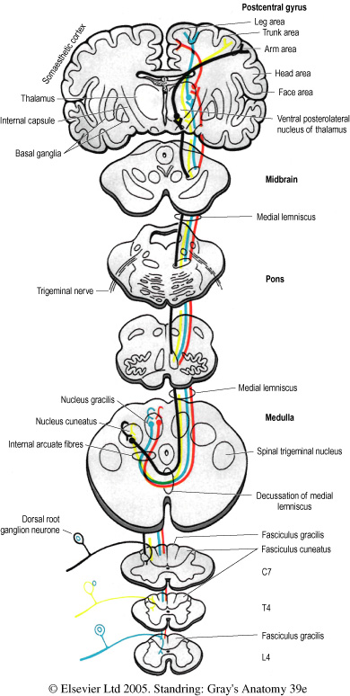
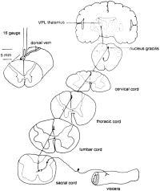
Dorsal columns: Medial lemniscus
Mediating visceral pain
Dorsal
Column
nuclei
Notes:
Fig. 18.14 The dorsal column system. Primary afferent fibres from different levels and their associated second- and third-order neurones are depicted in different colours (sacral: red; lumbar: blue; thoracic: yellow; cervical: black). (From Carpenter MB 1991 Core Text of Neuroanatomy, 4th edn. Baltimore: Williams and Wilkins, by permission of author and publisher.)

Slide 30
Pulvinar:
Role varies between species.
Humans: 40% of the Thalamus.
Dense sensory connections:
Lateral + Inferior: Visual processing + motor.
Posterior: Parietal and visual.
Medial: Limbic, prefrontal cortex.

