Slide 1
Mediators of inflammation II - Soluble mediators
Mike Wilson
Critical Care Research Group
Anaesthetics, Pain Medicine and Intensive Care
Imperial College London
29 Nov 2012

Slide 2
Cytokines / chemokines
General concepts -
Where do they come from?
How are they produced?
What cells do they affect?
What do they do?
pleiotropy & redundancy
Specifics -
Chemokines - IL-8
Cytokines - TNF-
How is the system kept under control?

Slide 3
Cytokines
Small (less than 50 KDa) secreted proteins which mediate and regulate immunity, inflammation, and hematopoiesis.
They generally (although not always) act over short distances and short time spans and at very low concentration.

Slide 4
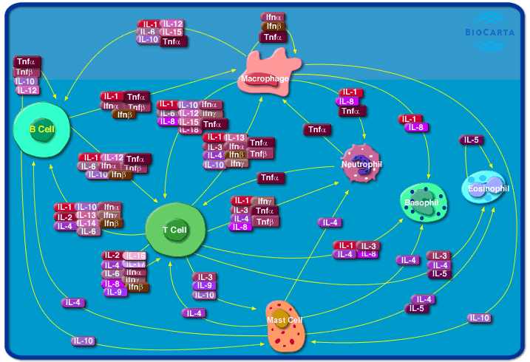
Where do they come from?
Predominantly cells of the immune system (especially monocytes/macrophages), but depends on the cytokine.
www.biocarta.com

Slide 5
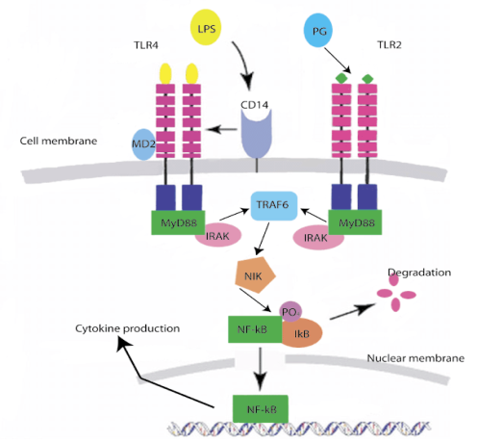
How are they produced?
normally not stored in intracellular compartments
synthesised de novo and released in response to stimulus
can this explain really early cytokines (e.g. TNF)?
Notes:
CD14 plays a bimodal role in the induction of PMN influx and local TNF release in response to intrapulmonary delivery of S-LPS, inhibiting S-LPS effects at high doses while facilitating the effects at low doses. CD14 modulates the effects of R-LPS and S-LPS within the lung in vivo in a similar way, with the important exception that this receptor did not facilitate TNF release at any R-LPS dose. (Anas PlosOne 2010).

Slide 6
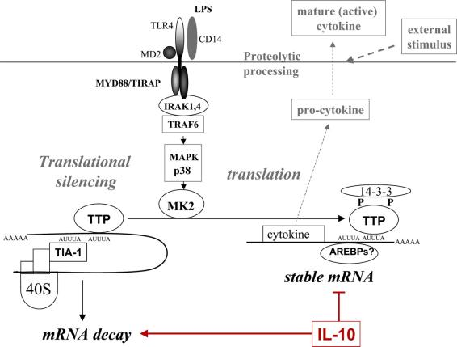
Post-transcriptional regulation – mRNA stabilisation
For initial burst of very early cytokines, major regulation step is post-transcriptional.
TTP (tristetraprolin) is an AREBP (adenosine uridine rich element binding protein)
Grutz. J Leukocyte Biol 2005; 77: 3-15
Notes:
AREBP - Adenosine uridine rich element binding protein.
TIA-1 - T cell intracellular antigen-1
An excess of the AREBP tristetraprolin (TTP) favors mRNA decay. LPS signaling via p38 MAPK and MAPK-activated protein kinase 2 (MK2) leads to phosphorylation of TTP and sequestration from stress granules via binding to 14-3-3. This results in stabilization of mRNA and allows translation.
Mice deficient in TTP show an increased TNF-α production.

Slide 7
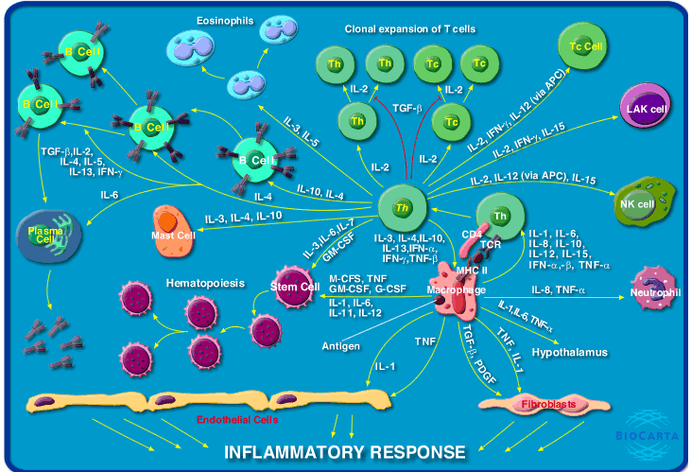
What cells do they affect ?
Whatever cells express specific cell-surface receptors - actions can be auto-, para- or endocrine.
www.biocarta.com

Slide 8
What do they do?
Pleiotropy
Notes:
Producing more than one effect, eg tnf

Slide 9
What do they do?
Pleiotropy
- producing more than one effect; especially :having multiple phenotypic expressions
Most cytokines are capable of inducing a variety of effects - eg.

Slide 10
Which effects occur depend on multiple factors, including -
Notes:
Cell type
Cyt conc
Cytokine Expression
Cytokine mileu – anatagonism or synergism

Slide 11
Redundancy
Notes:
Multiple cytokines producing the same effect. Difficulty in developing treatments which target one cytokine, as another cytokine may ‘take over’

Slide 12
Which effects occur depend on multiple factors, including -
Cell type
Cytokine concentration
Receptor expression (type/level)
Cytokine milieu -
multiple cytokines may act on a target cell - combined effects could be antagonistic or synergistic

Slide 13
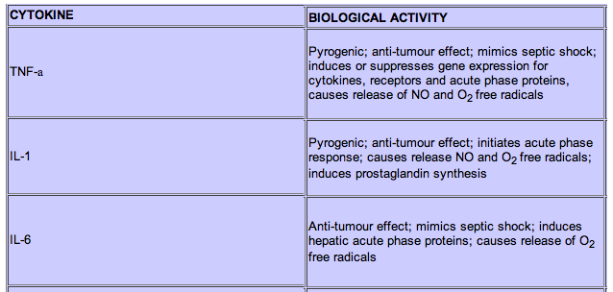
Redundancy
Multiple cytokines may produce the same effect in a given target eg -

Slide 14
Chemokines
Predominantly involved in leukocyte activation and recruitment to sites of inflammation (chemotactic cytokine).
Different chemokine families -
C
CC (eg MCP-1/CCL2) - mononuclear
CXC (eg IL-8/CXCL8) - neutrophils
CX₃C

Slide 15
Burke-Gaffney et al, Vascular Pharmacology 2002; 38: 283-292
Notes:
Named for their structures

Slide 16
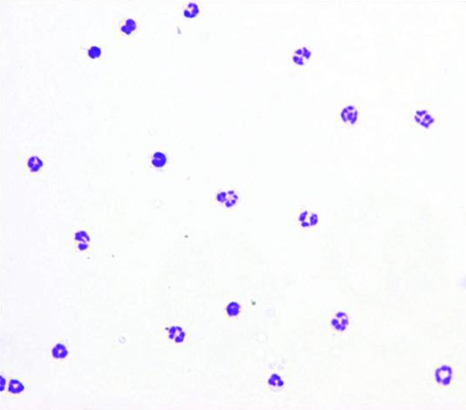
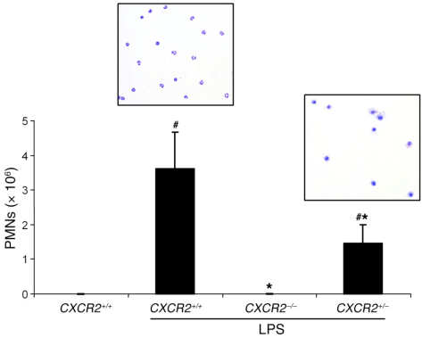
Interleukin -8
Also known as CXCL8
Binds 2 cell surface receptors - CXCR1 & CXCR2
Important in recruiting neutrophils to sites of inflammation
Reutershan, JCI 2006; 16:695-702

Slide 17
Interleukin -8
In rodents there is no single homologue of IL-8
In mice 2 chemokines act as functional homologues
KC (keratinocyte-derived chemokine, aka CXCL1) and MIP-2 (macrophage inflammatory protein-2, aka CXCL2)
Both bind CXCR2
How does a chemokine signal where the neutrophils are required e.g. the lungs?
Notes:
17

Slide 18
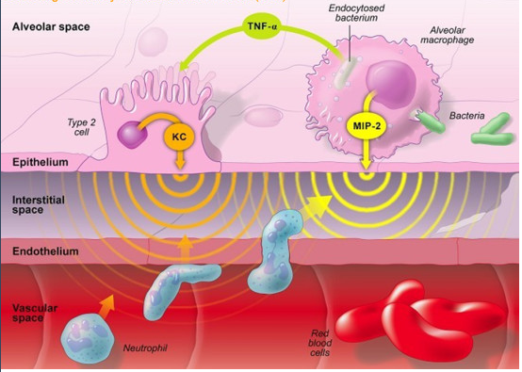
Standard view – soluble chemokine gradient
But is this too simplistic?

Slide 19
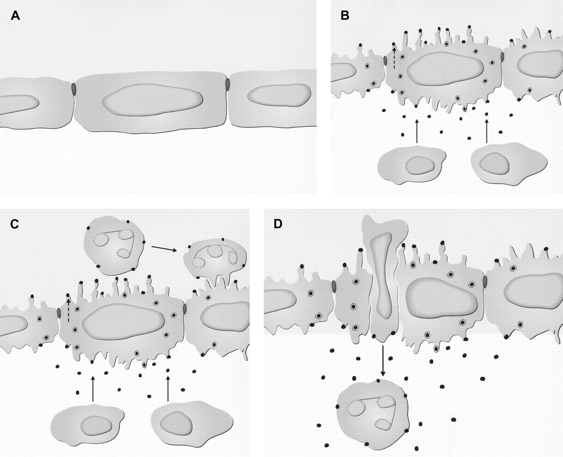
Arrest chemokines - presented on the surface of endothelial cells by glycosaminoglycans or Duffy Antigen
endothelium
e.g. macrophages
Middleton et al, Blood 2002; 100:3853

Slide 20
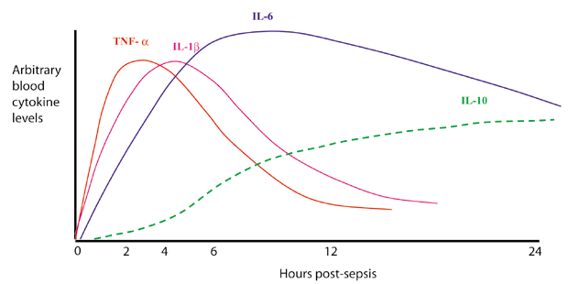
Tumour necrosis factor-  (TNF-)
One of the first cytokines induced during inflammation -‘gate-keeper’ of the inflammatory cascade
Produced in response to virtually any stimulus (eg. LPS, hyperoxia, radiation, chemical, smoke etc) that induces inflammation.

Slide 21
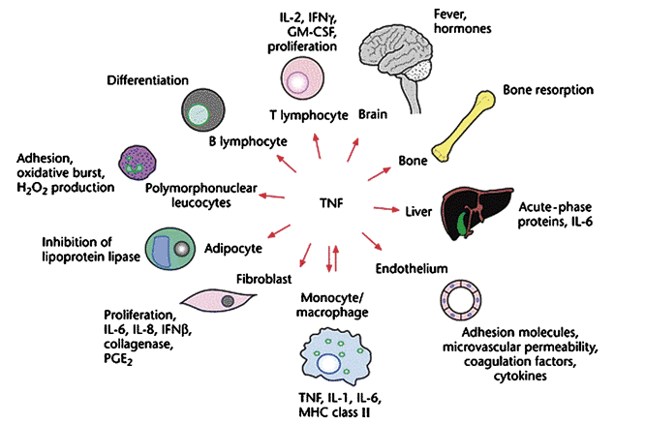
TNF stimulates production of downstream cytokines/chemokines
Upregulates adhesion molecule expression
Directly increases endothelial permeability
Induces apoptosis + many others …

Slide 22
TNF biology is highly complex – different forms of ligand..
‘Classical’ cytokine signalling
TACE
memTNF
solTNF
TNFR

Slide 23
Membrane-bound TNF also capable of cell-cell signalling
cell (eg. monocyte)
memTNF
TNFR
cell (eg. endothelium)
Might be very important in vascular beds

Slide 24
... and different receptors
Two surface receptors for TNF;
p55 (TNFRSF1a) and p75 (p75TNFRSF1b)
p55 expression (virtually) ubiquitous, can be rapidly shed
p75 expression mainly leukocytes but (probably) most other cells, more freely upregulated than p55
Most of the known actions of TNF seemingly occur through p55, with p75 relegated historically to ‘ligand passing’

Slide 25
Ligand passing?
solTNF
p75
p55
We now know that p75 preferentially binds memTNF, and activates different pathways to p55.

Slide 26
There is evidence that in some circumstances p75 may signal in direct opposition to p55.
Almost universally where this is the case, p55 is deleterious, and p75 protective.

Slide 27
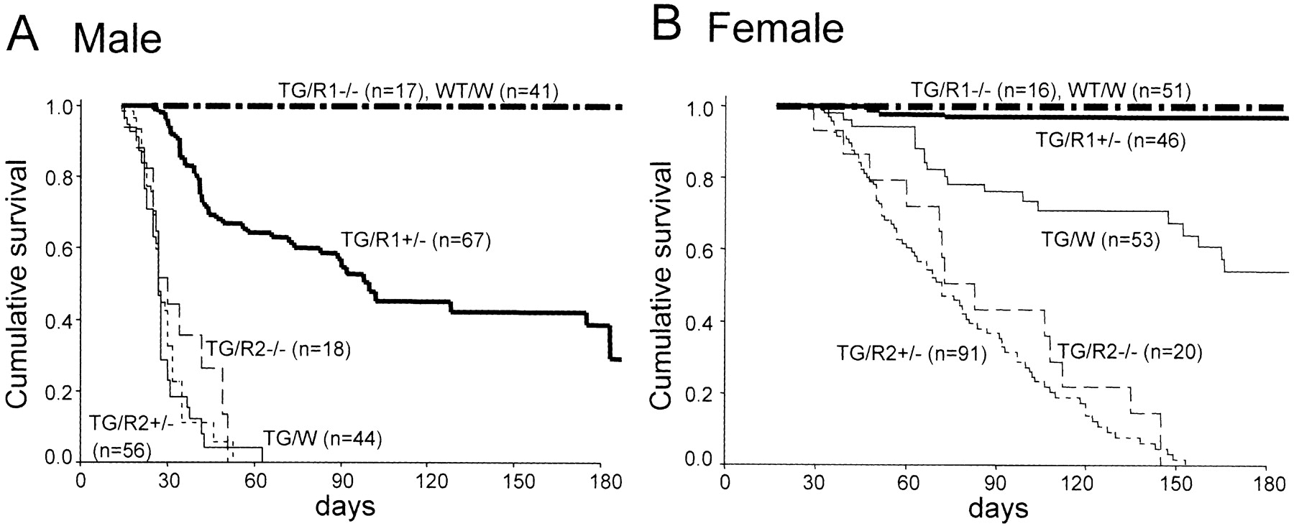
Model of heart failure
TG = mice with cardiac overexpression of TNF
W = normal TNF receptor expression
R1-/- = p55 knockout
R2-/- = p75 knockout
Higuchi Y et al. Circulation 2004;109:1892-1897

Slide 28
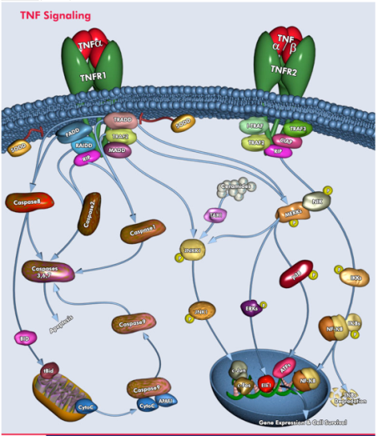
Intracellular signalling pathways are interwoven and poorly understood
apoptosis - through p55 only
www.qiagen.com

Slide 29
What does all this mean?
The 2 receptors do different things,
One is important for ‘systemic’ effects,
The other is important for local,‘contact-mediated’ effects,
Their expression is differentially regulated …
Notes:
TNF can have diff effects in 2 places at the same time. Do we want to just ‘block’ TNF?

Slide 30
How is the system kept under control?
Notes:
30

Slide 31
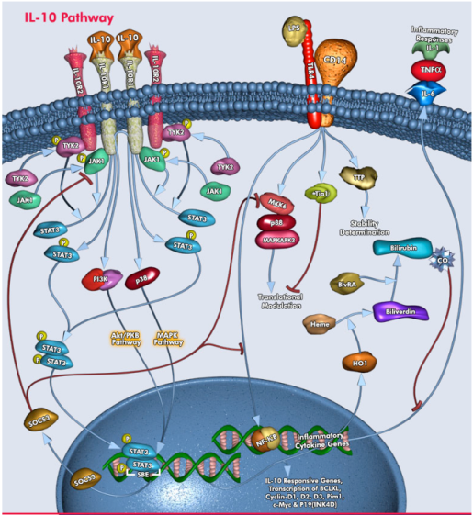
IL-10 blocks production of pro-inflammatory cytokines
SOCS3 – suppressor of cytokine signalling 3

Slide 32
IL-10 decreases cytokine production partly by destabilising mRNA
Grutz. J Leukocyte Biol 2005; 77: 3-15

Slide 33
Summary
Cytokines are small proteins that regulate immune responses. Chemokines are a subset.
Many cell types produce cytokines, and most cell types have cytokine receptors.
A single cytokine can have multiple effects, and cytokines often have overlapping actions.
Overall effect may depend on integration of multiple signals.
System (normally) kept under tight control by negative feedback loops and anti-inflammatory cytokines.

Slide 34
TNF Summary
Membrane-TNF cleaved to soluble TNF (by TACE).
Both membrane and soluble TNF are biologically active
memTNF predominantly local (tissue) signalling
solTNF predominantly distal (systemic)
Two receptors -
p55 main receptor for solTNF
p75 mainly responsive to memTNF
Receptors do different things, potentially antagonistic.

Slide 35
Conclusions
Cytokines/chemokines are orchestrators of inflammation.
Potentially a primary target for treatment of inflammatory states.
But, there are multiple considerations, including –
Pleiotropy
Receptor Specificity
Redundancy
Immunosuppression
Kinetics – too late
Getting antibodies to site
Local vs systemic

