Slide 1

The neurobiology of sleep
Dr Anna Zecharia
Biophysics Section
Imperial College London
anna.zecharia@imperial.ac.uk

Slide 2



What is sleep?

Slide 3
What is sleep?
Natural, reversible state of ‘behavioural quiescence’
Species-specific stereotypic posture
Reduced responsiveness to sensory stimuli
Rebound after deprivation

Slide 4
Why do we sleep?
Plasticity?
  Learning
  Development
  Synaptic ‘downscaling’ after wake-induced increase
Neuronal protection?
  Unfolded protein response?
May have species-specific functions e.g. maintenance of breathing in cetaceans.
Vassali & Dijk 2009, Eur J Neurosci.29(9):1830-41

Slide 5
How does the brain sleep?

Slide 6
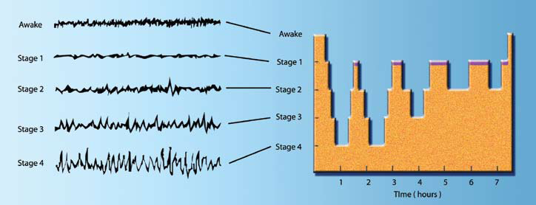
What does a sleeping brain look like?
4 stages of non-rapid eye movement (NREM) sleep
Followed by a period of rapid eye-movement (REM) sleep
Architecture alters throughout the night

Slide 7
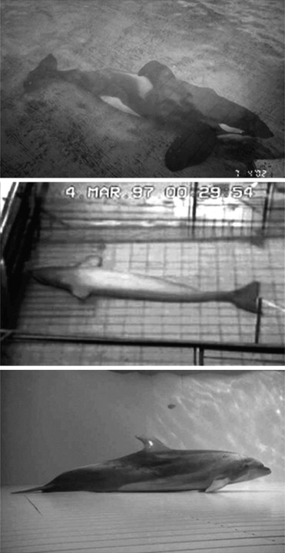
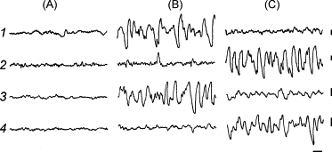
What is sleep?
Cetacean sleep:
Unihemispheric slow waves
Contralateral eye open
Lyamin et al 2008 “Cetacean sleep: an unusual form of mammalian sleep”

Slide 8
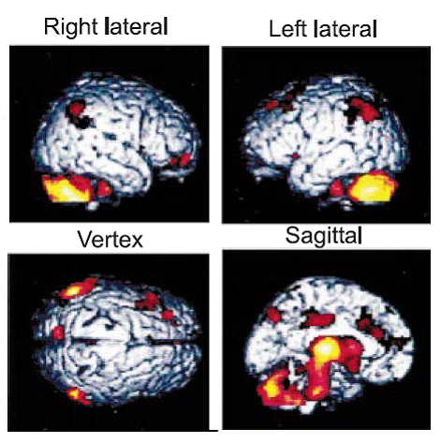
Regional changes in blood flow
Relative decreases in CBF:
  Pons
  Midbrain
  Cerebellum
  Thalamus
  Cortical association areas
(deep SWS v wake, Kajimura et al 1999)
Relative rCBF – normalised for global flow

Slide 9
Sleep is an active process

Slide 10
Sleep is an active process
Morruzi & Magoun (1949)
Focal lesions - ‘ascending reticular activating system’ (ARAS)
Morruzi & Magoun (1959)
  Focal barbiturate application to the caudal brainstem induced wakefulness
  The nucleus of the tractus solitarus (NTS) was identified as a brainstem ‘hypnogenic centre’
Sterman & Clemente (1962)
  Electrical stimulation of the anterior hypothalamus (preoptic) induced sleep
Frederic Bremer (1937)

Slide 11
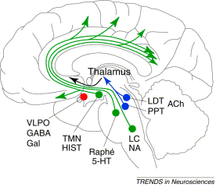
The brain contains ‘wake-active’ and ‘sleep-active’ neurons
The sleep switch: hypothalamic control of sleep and wakefulness
(Saper et al, 2001)

Slide 12
‘Sleep-active’ neurons produce sleep

Slide 13
The preoptic hypothalamus
Constantin von Economo (1923)
  Persistent insomnia:
  Their brains showed cell loss in the preoptic anterior hypothalamus/basal forebrain
  He concluded this was a hypnogenic region
  Encephalitis lethargica: excessive sleep
  Massive cell loss in the posterior hypothalamus and ARAS

Slide 14
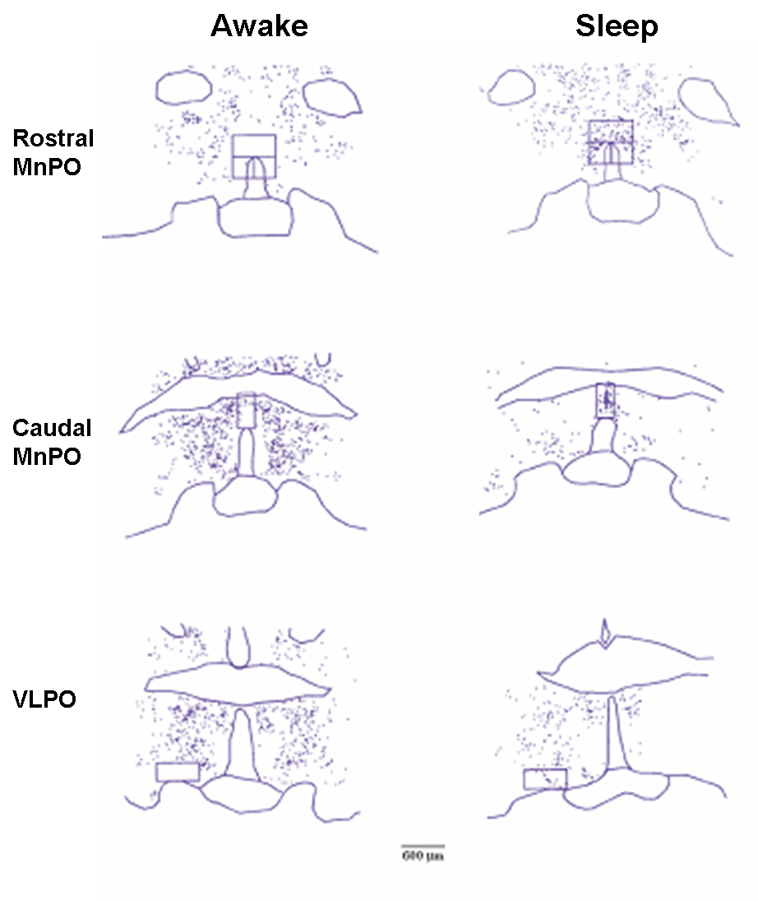
The preoptic hypothalamus – sleep active region
c-fos – immediate early gene that is induced within a few minutes of neuronal activation
The protein c-Fos can be measured for up to half an hour later
(Sherin et al, 1996; McGinty & Szymusiak, 2001)

Slide 15
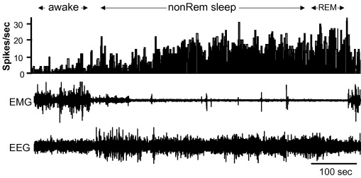
This c-Fos expression correlates with neuronal firing
Extracellular VLPO neuron recording
Shows sleep-related activity
Firing progressively increases from light to deep NREM sleep
(Szymusiak et al, 2007 Review)

Slide 16
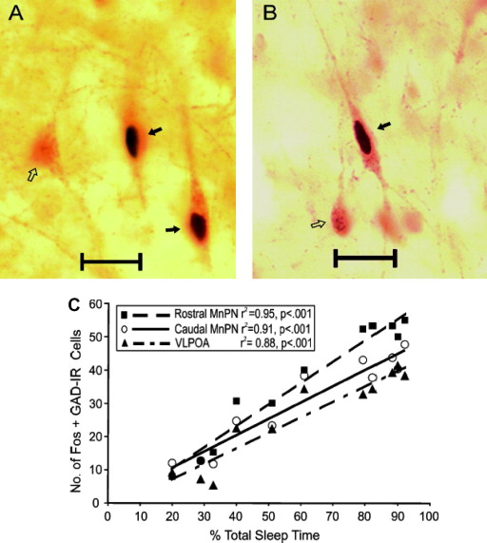
VLPO/MnPN neurons are GABAergic
GABA – major inhibitory neurotransmitter
GABA_{A} (ion channel)
GABA_{B} (G protein)
(Szymusiak et al, 2007 Review)

Slide 17
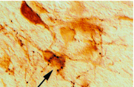
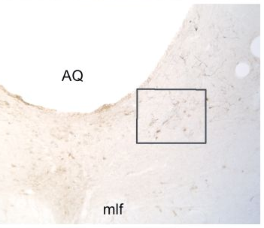
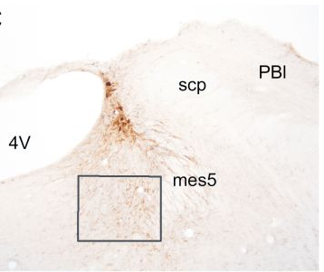
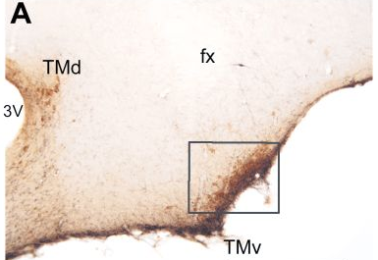
GABAergic sleep-active neurons project to arousal centres
Wake-active:
  A –TMN (histamine)
  B – LC (noradrenaline)
  C – DRN (5-HT)
(TMN; Sherin et al, 1996)
B
C
(Steininger et al, 2001)

Slide 18
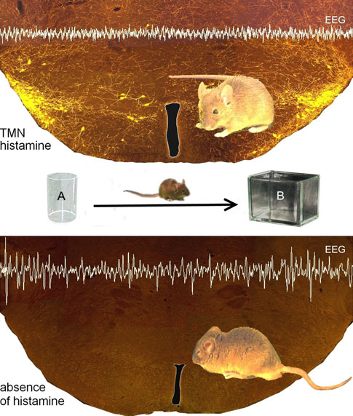
Arousal centres – histamine
Control
HDC^{-/-}
(histidine decarboxylase knockout)
Lin et al, 2011; Cell. Mol. Life Sci. 68:2499–2512

Slide 19
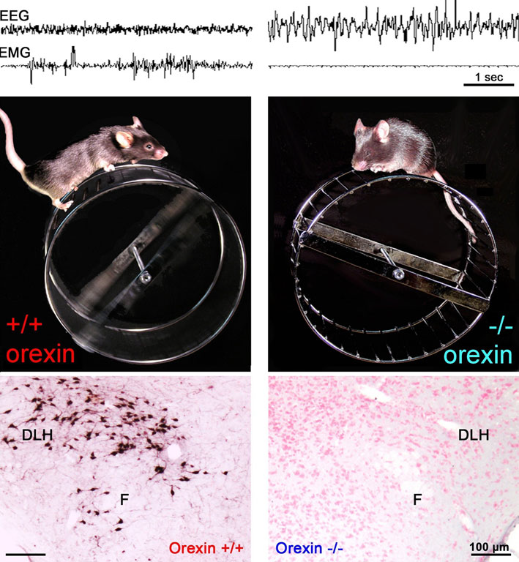
Arousal centres - orexin
Loss of orexin neurons leads to narcolepsy
(modafinil)
Lin et al, 2011; Cell. Mol. Life Sci. 68:2499–2512

Slide 20
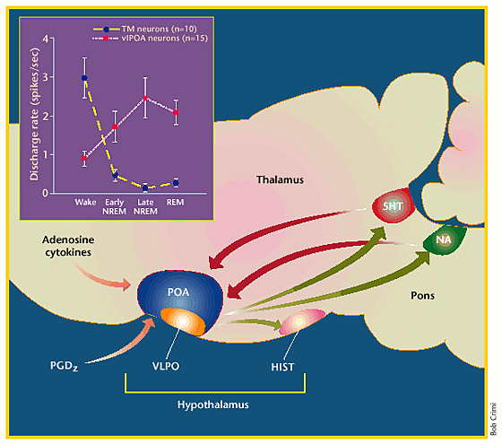
VLPO & arousal centres: reciprocal activity
VLPO begins firing just prior to sleep onset
GABAergic inhibition of the TMN by VLPO
Quietens the wake-related firing activity of e.g. TMN
VLPO firing increases as sleep deepens
(McGinty & Szymusiak, 2001 Review)

Slide 21
What is sleep? An isolated brain?
Natural, reversible state of ‘behavioural quiescence’
Species-specific stereotypic posture
Reduced responsiveness to sensory stimuli
Rebound after deprivation

Slide 22
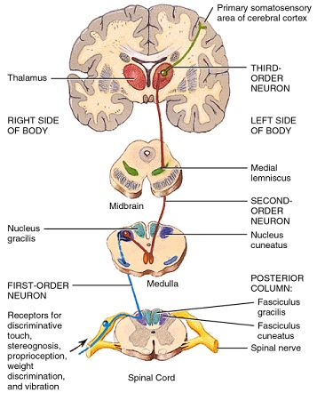
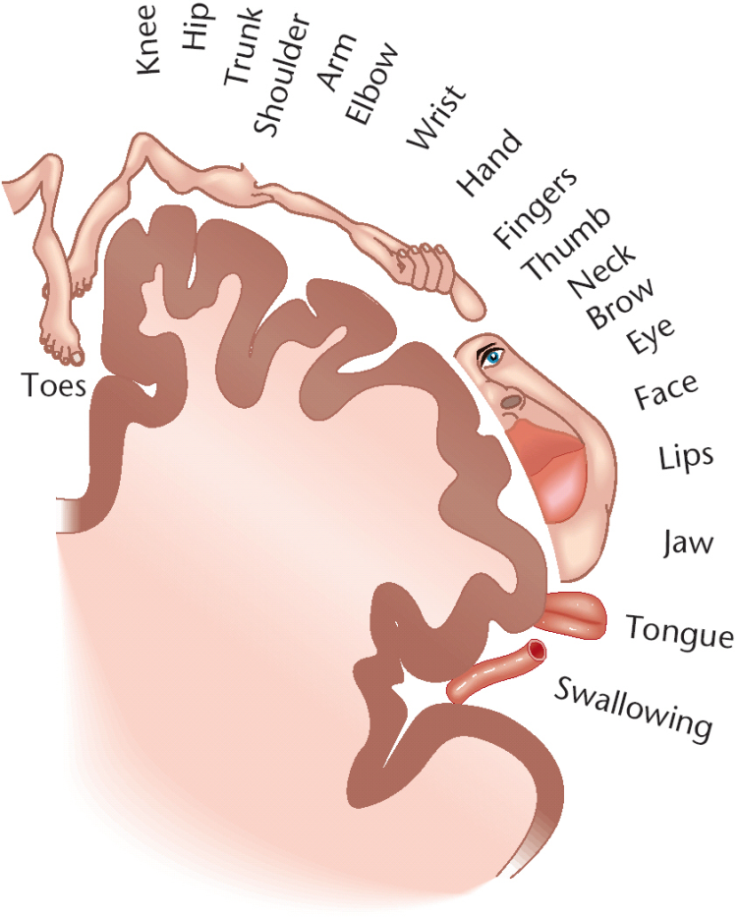
Sensory processing

Slide 23
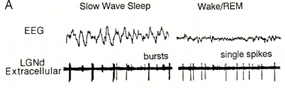
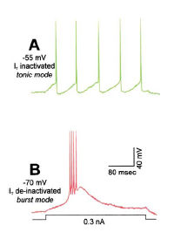
Thalamocortical relay neurons have an ‘awake’ and an ‘asleep’ mode
(McCormick & Bal, 1997)
NREM (SWS) – burst firing
Wake/REM – tonic firing
(Sherman & Guillery, 2002)

Slide 24
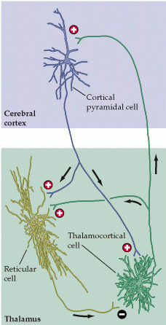
The thalamocortical system
During wakefulness:
  ‘the gateway to the cortex’
During NREM sleep:
  Sensory information becomes distorted

Slide 25
‘Wake-active’ neurons project to thalamus and cortex
The sleep switch: hypothalamic control of sleep and wakefulness
(Saper et al, 2001)

Slide 26
The thalamocortical system
During wakefulness:
  ‘the gateway to the cortex’
During NREM sleep:
  Sensory information becomes distorted
Due to the firing properties of thalamocortical neurons

Slide 27
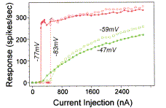
Bursting closes the gateway
Tonic
  Linear spike response to increasing current injections
  Faithful representation of sensory information
Bursting
  Non-linear response
  Distorted information flow
(Sherman & Guillery, 2002)

Slide 28
Acetylcholine, noradrenaline, histamine and glutamate:
  Can switch TC firing mode from burst to tonic
  Due to a direct depolarising effect on TC cells:
(McCormick, 1992)

Slide 29
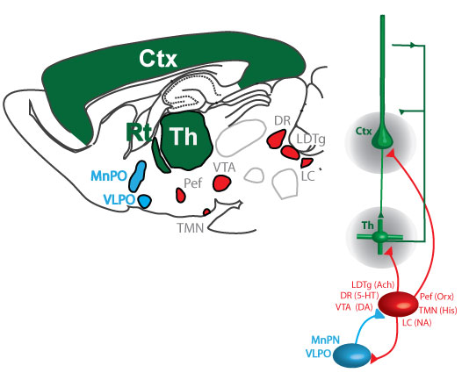

Summary: sleep-wake circuitry
Blue = sleep-active
Red = wake-active
Green = cortex/thalamus
Franks & Zecharia 2011; Canadian Journal of Anesthesia 58(2):139-48

Slide 30
Sleep-active neurons are GABAergic
GABA – major inhibitory neurotransmitter
GABA_{A} (ion channel)
GABA_{B} (G protein)
(Szymusiak et al, 2007 Review)

Slide 31
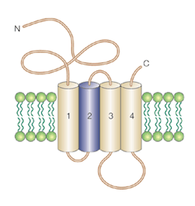
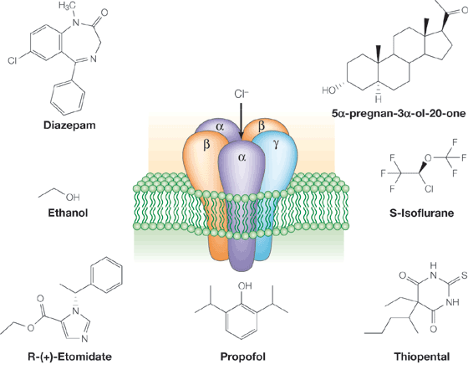
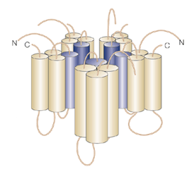
GABA? Interesting…..
A
C
B

Slide 32
Hypothesis: drugs may hijack the sleep-wake circuitry
Blue = sleep-active
Red = wake-active
Green = cortex/thalamus
Franks & Zecharia 2011; Canadian Journal of Anesthesia 58(2):139-48

