Slide 1
Sepsis Cellular and humoural mechanisms
Kieran O’Dea PhD
Critical Care Research Group
Anaesthetics, Pain Medicine and Intensive Care

Slide 2
Areas covered
Innate immune response in sepsis
Targeting inflammation in sepsis
New concepts in sepsis pathogenesis

Slide 3
Innate immunity and sepsis
Innate immunity
Early detection of invasive organisms
Inflammation → microbial killing
Antigen presenting cell → adaptive immunity
Effector cells: macrophages, neutrophils, dendritic cells
Sepsis
Systemic activation of innate response
Excessive response →‘Cytokine Storm’

Slide 4
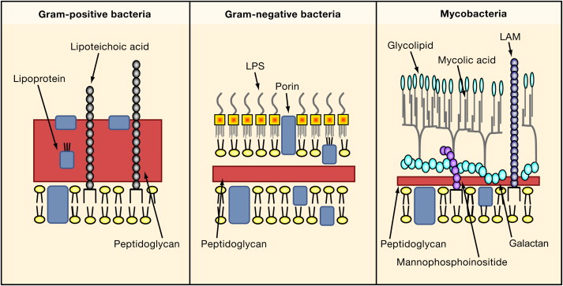
Innate recognition of microbes
PAMPS: Pathogen associated molecule patterns
Conserved structural motifs in molecules common to different microorganisms and not present in higher eukaryotes
Essential for structure and/or function
Gram -ve: lipopolysaccharide (LPS), peptidoglycan
Gram +ve: lipoteichoic acid, peptidoglycan

Slide 5
Pattern Recognition Receptors
Secreted
Extracellular/
membrane
Intracellular/
cytoplasm
Complement
Mannose,
Scavenger
Toll-like
(TLR)
NOD-like
(NLR)
RIG-like
(RLR)
Killing,
Opsonisation
Phagocytosis
Gene expression
Gene expression,
protein maturation
Gene expression

Slide 6
Organisation of PAMP recognition and gene expression
Lipoteichoic acid
Lipopeptides
LPS
Microbial membrane
sensors
TLR 2/1
TLR 2/6
TLR4
Endosome
TLR
3,7,8,9
TLR5
IκB
p50
p65
NLR
NF-κB
AP1
Flagellin
sensors
Pro-IL1,
IL18
Nucleic acid
sensors
Cytokines etc
Caspase 1
(ICE)
IL1, IL18

Slide 7
The LPS as a primary mediator of sepsis
Gram-ve bacterial endotoxin
Abundant: ~70% of outer bacterial wall
Systemic injection reproduces symptoms of sepsis
Extremely potent: 1ug/kg induces shock in humans

Slide 8
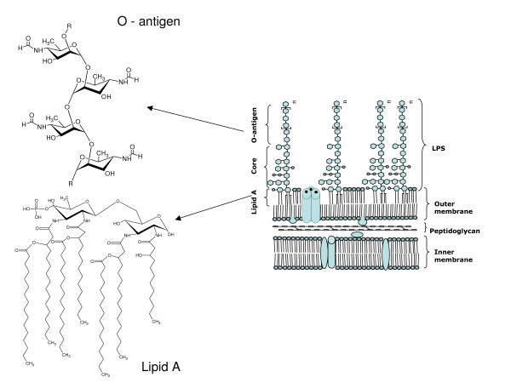
Lipopolysaccharide (LPS) structure-activity
O-antigen polysaccharide: Exposed and structurally diverse region = antigen
Lipid A:
Highly conserved anchoring region = PAMP
Bacterial wall
Glycolipid
Notes:
LPS has been demonstrated to interact with a variety
of serum components, particularly the serum complement
system (7). The lipid A region of LPS has been
shown to interact directly with C1, thus providing an
antibody-independent mechanism for LPS-mediated activation
of the classical pathway of complement (8). In
addition, however, the polysaccharide portion of the LPS
macromolecule has been shown to mediate the activation
of the alternative pathway of complement (9). These interactions
can lead to the production of the spectrum of
potent inflammatory mediators of the complement system
(10 ).

Slide 9
LPS binding cofactors
TLR4-MD2
[LPS]_{n}
+
LBP
LPS
Monocyte
LBP
CD14
+CD14
LBP
LPS
LBP
LPS
Endothelial cell
LBP: LPS Binding Protein
MD-2: myeloid differentiation protein

Slide 10
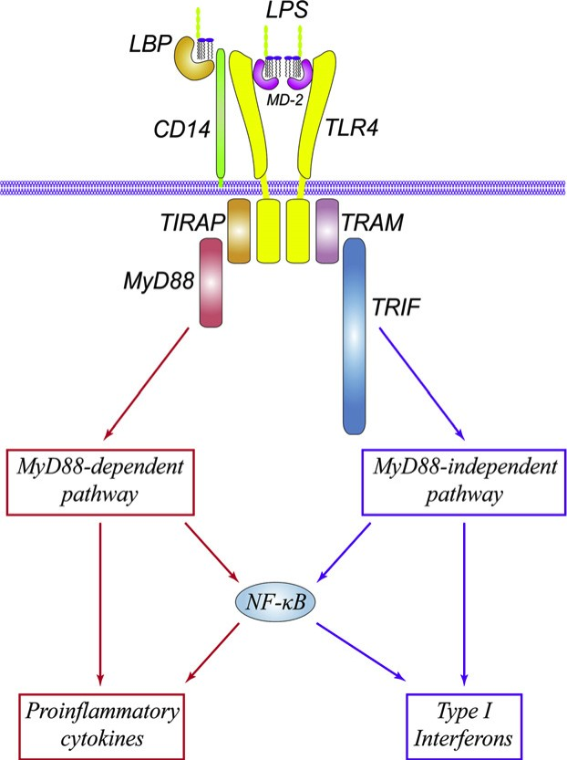
LPS mediated activation of gene transcription by TLR4 signalling
LPS binding to the TLR4/MD-2 complex causes oligomerisation of TLR4
Toll-interleukin 1 receptor (TIR) domain recruits adaptor proteins
MyD88: myeloid differentiation primary response gene
TIRAP: TIR adaptor protein
TRIF: TIR domain-containing adaptor inducing IFN-β
TRAM: TRIF-related adaptor molecule
The MyD88 pathway induces pro-inflammatory genes
The MyD88-independent pathway induces Type I interferon genes (α, β, IP-10)
TIR
(Lu et al. Cytokine 2008;42;145)

Slide 11
MyD88-dependent NF-κB activation triggers a coordinated inflammatory response
Response amplification/transmission:
Tumour necrosis factor
Interleukin-1β
IL-6, IL-12
Activation of endothelium, permeability,
vascular tone:
Inducible nitric oxide synthase
Inducible cyclooxygenase-2
5-Lipoxygenase
Cytosolic phospholipase A2
Increased leukocyte production
GM-CSF
M-CSF
G-CSF
Coagulation:
Tissue factor
Leukocyte mobilisation and recruitment
IL-8
MIP-α,
MCP-1, MCP-3
Anti-inflammatory mediators:
IL-10, IL-11, IL-4, TGF-b
Soluble cytokine antagonists: soluble TNF receptors, IL-1 receptor antagonist
Leukocyte adherence
ICAM-1
VCAM-1
E-selectin

Slide 12
Edwin Deitch: Multiple Organ Failure: Pathophysiology and Potential Future Therapy. 1992. Ann. Surg. 216 (2) 117-134
‘.. the 1990s will see the transition of molecular biology from the laboratory to the clinic…
…it is almost certain that molecular biologic therapies will become part of the therapeutic armamentarium of most practising surgeons’

Slide 13
Clinical trials: anti-inflammatory therapies “Graveyard” for pharmaceutical companies
Anti-endotoxin therapy
Anti-endotoxin monoclonal antibodies | No significant effect on mortality
rBPI (bactericidal/permeability increasing protein) | No significant effect on mortality
TLR4 | Eritoran: no significant effect on mortality (2011)
Anti-cytokine therapy
Anti-TNF monoclonal Ab | No significant effect on mortality
TNF receptor p75 fusion protein | No effect, possible increase in mortality at high dose
TNF receptor p55 fusion protein | No significant effect on mortality
IL-1 receptor antagonist | No significant effect on mortality
Notes:
Eritoran: no significant effect on mortality (2011) In January, Eisai announced
that its worldwide phase 3 randomized trial of a
novel anti–Toll-like receptor (TLR)-4 compound,
eritoran tetrasodium, had failed to demonstrate an
improvement in the primary end point of 28-day all-cause
mortality in a cohort of 2000 patients with severe sepsis.

Slide 14
Anti-coagulation therapy
Anti-thrombin III | No significant effect on mortality Increased risk of haemorrhage when administered with heparin
TFPI (tissue factor pathway inhibitor) | No significant effect on mortality
Activated Protein C | Significant effect on mortality (19% decrease)
Anti-coagulants treatments could have dual effects:
Anti-inflammatory: ↓ Protease Activated Receptor (PAR)-1 and PAR-2 signalling
Activated protein C:
Modulates thrombin-induced PAR-1 signalling to anti-inflammatory, anti-apoptotic effect.

Slide 15
NEJM 2001:Efficacy and safety of recombinant human activated protein C for severe sepsis
Reduction in the relative risk of death of 19.4 percent
NEJM 2005: Drotrecogin alfa (activated) for adults with severe sepsis and a low risk of death
Recommended for only use in severe sepsis because of risk of bleeding
NEJM 2012: Drotrecogin Alfa (Activated) in Adults with Septic Shock
No reduction in mortality 28 or 90 days

Slide 16
Why has translation from the lab to the clinics failed?
Pre-clinical animal models oversimplistic:
Animals too young, no co-morbidities, no antibiotics
No supportive care during organ dysfunction
Immunity:
Inflammatory response is required to control infection
Anti-endotoxin/LPS: wrong molecule!
Gram-positive>Gram-negative>fungal infections
Complexity:
Redundancy, multiple overlapping inflammatory pathways, no magic bullet!
Notes:
The ideal host response to fight infection in the absence
of antibiotics and life support may be very different
from that required in a modern intensive care unit setting.

Slide 17
The compensatory anti-inflammatory response (CARS)
Early
MOD/
shock
Late
MOD/
shock
Pro-inflammatory
Trauma
Burns
Cytokine
storm
Systemic inflammation
Systemic
Infection
(Lungs
Abdomen
Urinary)
SIRS
CARS
Anti-inflammatory
Nosocomial
infection
risk
Notes:
Based on Bone RC. Crit Care Med. 1996 Jan;24(1):163-72.

Slide 18
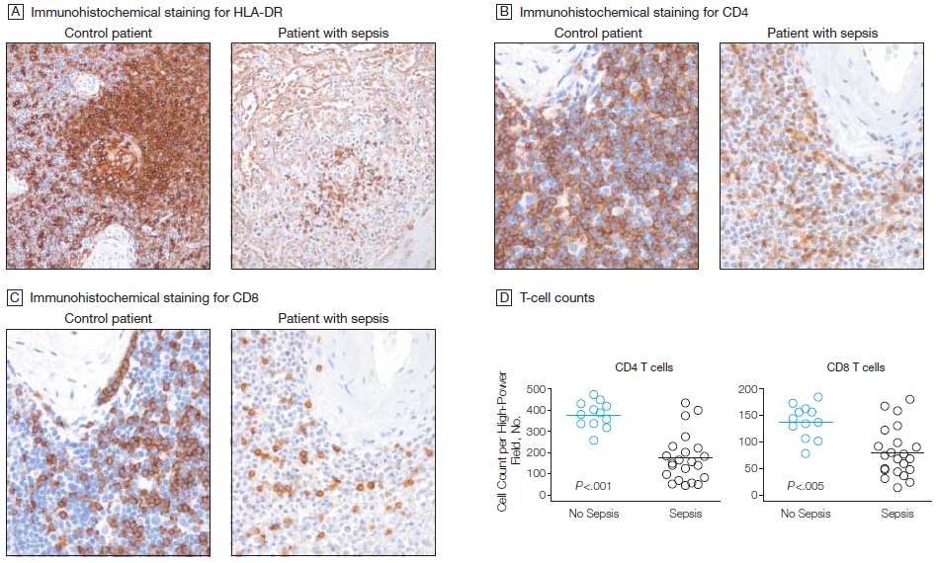
Control
Sepsis
Control
Sepsis
HLA-DR
CD4
Changes in splenocytes
↓ T cell activation
↑ Inhibitory co-receptors
↓ Stimulatory co-receptors
↑ T-regulatory (suppressor cells)
Extensive depletion of CD4 and CD8 T cells
CD8

Slide 19
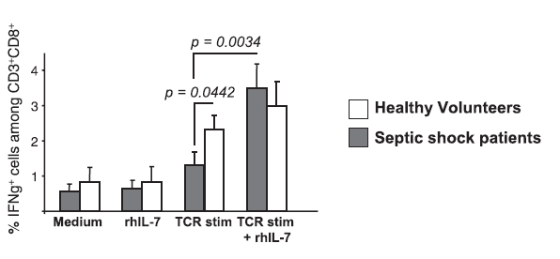
Immunorestoration: IL-7
IL-7 stimulates T cell proliferation and repertoire diversity
Undergoing Phase I and II clinical trials in HIV to restore lymphocyte function

Slide 20
Innate response to danger/damage
Damaged cells release molecules during injury and trauma
Trigger innate immune response
Close off the site and initiate tissue repair
Alarmins or DAMPs: ‘Danger’ or ‘Damage’ Associated Molecular Pattern.
DAMP
PAMP
Immuno-
suppression
Infection
PAMP
SIRS
Cell
death
CARS
Infection
Trauma
DAMP
Early MOD
Late MOD

Slide 21
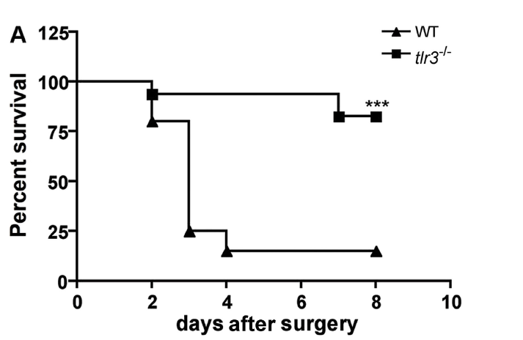
Eukaryotic RNA stimulate TLR3 signalling
TLR3 deficient mice survived peritoneal sepsis
Necrotic neutrophils activate macrophages through TLR3

Slide 22
High-mobility group box 1 (HMGB1)
Nuclear protein in eukaryotic cells
Released from stimulated and necrotic cells (DAMP)
Found in septic patient plasma
Signals through TLR2, TLR4 and RAGE
Neutralisation protective in later stage of sepsis
= Wide therapeutic window

Slide 23
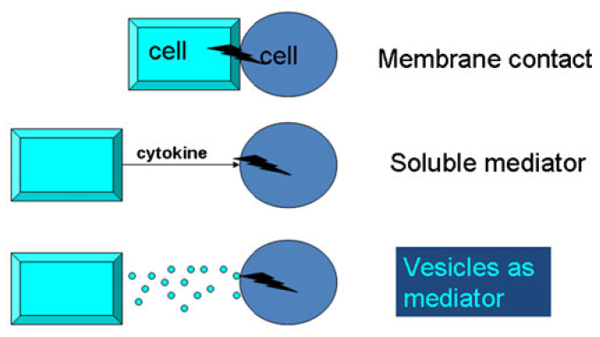
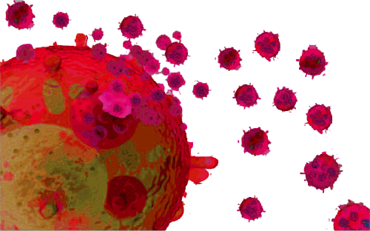
Microvesicles: a new regulator of inflammation in sepsis
Sub-cellular particles released from activated or dying cells
Act as signals between cells over long distances.
Correlations found in sepsis with clinical status
Microvesicles from septic patients induce
organ inflammation when administered to mice

Slide 24
Fundamental role in vascular homeostasis:
Biomarker of endothelial dysfunction in sepsis
Therapeutic target

Slide 25
Summary
Sepsis represents a complex interaction between the innate and adaptive arms of the immune response
Driven by reaction to pathogen and damaged host cells
Therapies should aim to restore system homeostasis

Slide 26
Questions?

Slide 27
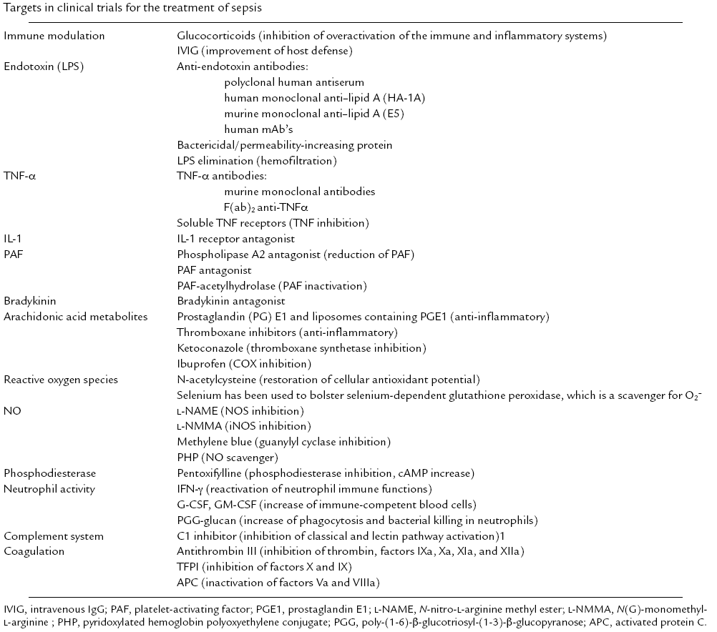

Slide 28
Sepsis produces a pro-coagulant state
Tissue factor expression induced in monocytes, enhancing activation of the coagulation cascade.
Activated protein C (anticoagulant) levels decreased due reduced hepatic synthesis and systemic consumption.
Thrombomodulin expression decreased (TNF, IL-1) and inactivated by neutrophil elastase.
Tissue factor pathway inhibitor administration reduces intravascular coagulation and severity in experimental models of sepsis

Slide 29
The Toll-Like Receptor family
The Toll-Like-Receptor family has principle role in innate recognition
13 TLR indentified in mammals.
Single TLR types recognise different molecules
All pathogens: Bacteria, viruses, fungi, protozoan and helminth parasites.
TLR
dimer
Ligand
Recognition domain:
Leucine-rich repeats
+
Toll/IL-1R homology
(TIR) domain
Activation signal
Conformational
changes

Slide 30
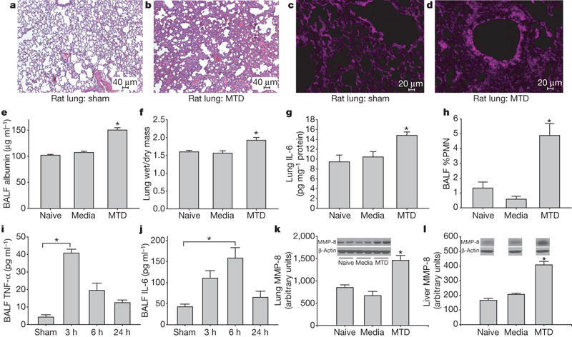
Circulating mitochondrial PAMPS/DAMPS cause inflammatory responses to injury. Nature 2010. Zhang et al. 464, 104-108
Lung: eosin/haematoxylin
Oxidant stain
Mitochondria contain bacterial-like DNA (CpG repeats) and formylated peptides
Mitochondrial DNA levels elevated in trauma patient plasma, 1000x normal levels
Mitochondrial DAMPS activate signaling (p38 MAPK, Ca²⁺) and IL-8/MMP8 expression in neutrophils.
Mitochondrial DAMPS induce systemic inflammation and acute lung injury (↑TNF, IL6, PMN influx, oedema)
Notes:
Injury causes a systemic inflammatory response syndrome (SIRS)
that is clinically much like sepsis1. Microbial pathogen-associated
molecular patterns (PAMPs) activate innate immunocytes
through pattern recognition receptors2. Similarly, cellular injury
can release endogenous ‘damage’-associated molecular patterns
(DAMPs) that activate innate immunity3. Mitochondria are evolutionary
endosymbionts that were derived from bacteria4 and so
might bear bacterial molecular motifs. Here we show that injury
releases mitochondrial DAMPs (MTDs) into the circulation with
functionally important immune consequences. MTDs include
formyl peptides and mitochondrial DNA. These activate human
polymorphonuclear neutrophils (PMNs) through formyl peptide
receptor-1 and Toll-like receptor (TLR) 9, respectively. MTDs
promote PMN Ca21 flux and phosphorylation of mitogenactivated
protein (MAP) kinases, thus leading to PMN migration
and degranulation in vitro and in vivo. Circulating MTDs can elicit
neutrophil-mediated organ injury. Cellular disruption by trauma
releases mitochondrial DAMPs with evolutionarily conserved
similarities to bacterial PAMPs into the circulation. These signal
through innate immune pathways identical to those activated in
sepsis to create a sepsis-like state. The release of such mitochondrial
‘enemies within’ by cellular injury is a key link between
trauma, inflammation and SIRS.

Slide 31
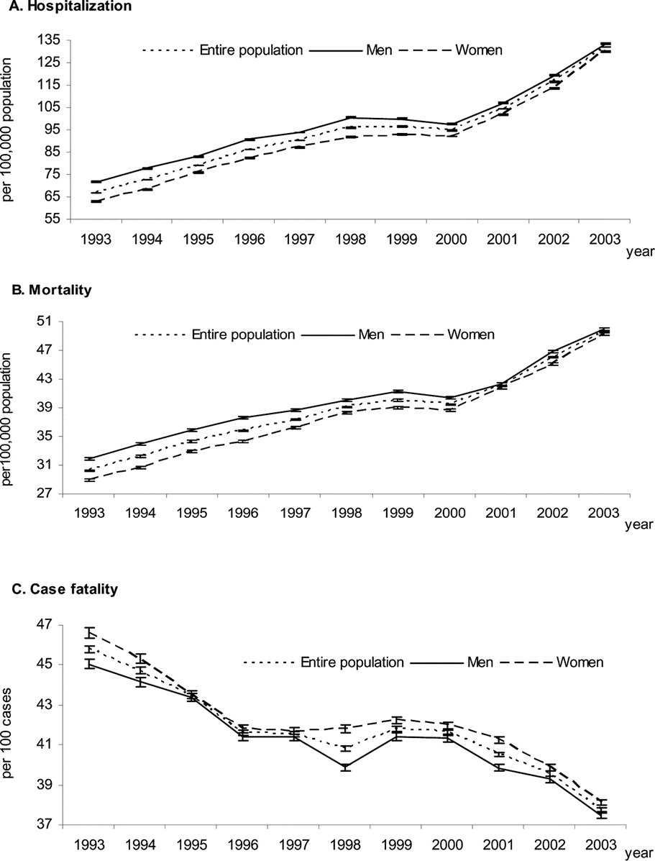
Reduction in case fatality rates
Improvements cited: Low-dose corticosteroids; intensive glucose control;
‘early goal directed resuscitation’
Dombrovskiy et al. Critical Care Medicine 2007, 35; 1244-1250
Notes:
Recent advances in treatment
Low-dose corticosteroids
Intensive glucose control
‘early goal directed resuscitation’
Dotrecogin alpha

