Slide 1



Neuropathic pain 2
Andrew SC Rice
a.rice@imperial.ac.uk
www.lpc.ac.uk

Slide 2
Assessment of patients with neuropathic pain
Treatment options for neuropathic pain

Slide 3
Assessment of Neuropathic Pain in the Clinic
NeuPSIG guidelines on neuropathic pain assessment.
Haanpaa et al. Pain 2011;152:14-27.

Slide 4
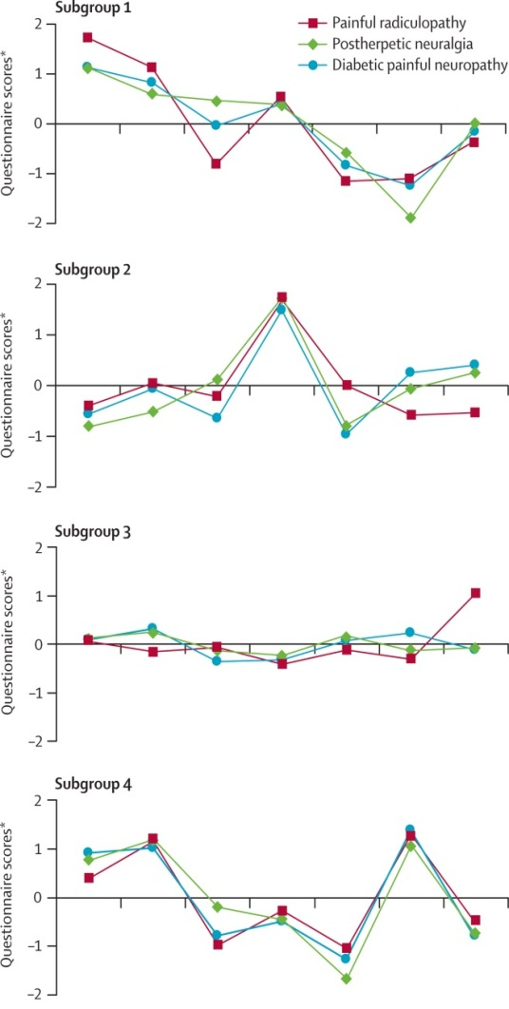
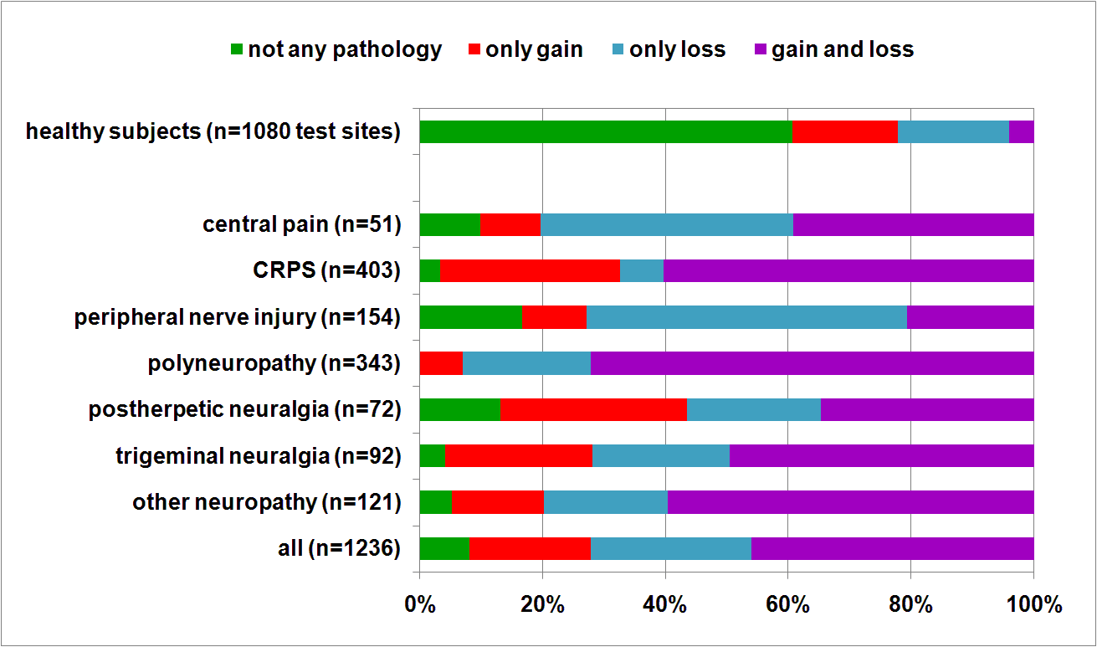
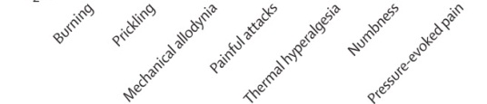
Clinical Heterogeneity of Neuropathic Pain – Symptoms & Signs
SYMPTOM PROFILES
SENSORY SIGN (QST) PROFILES
Maier et al Pain 2010;150:439
Baron et al Lancet Neurol.2012;11:999 - 1005
Notes:
Also Backonja & stacey 64 % mechaical 38% thermal hypersesnitivuty

Slide 5
Diagnosis & Assessment of Neuropathic Pain
Investigation of underlying disease.
Is there a lesion or disease of the somatosensory system?
Is the pain neuropathic?
How severe is the pain?
What is the impact of the pain?

Slide 6
Diagnosis & Assessment of Neuropathic Pain
Investigation of underlying disease.
Is there a lesion or disease of the somatosensory system?
Is the pain neuropathic?
How severe is the pain?
What is the impact of the pain?

Slide 7
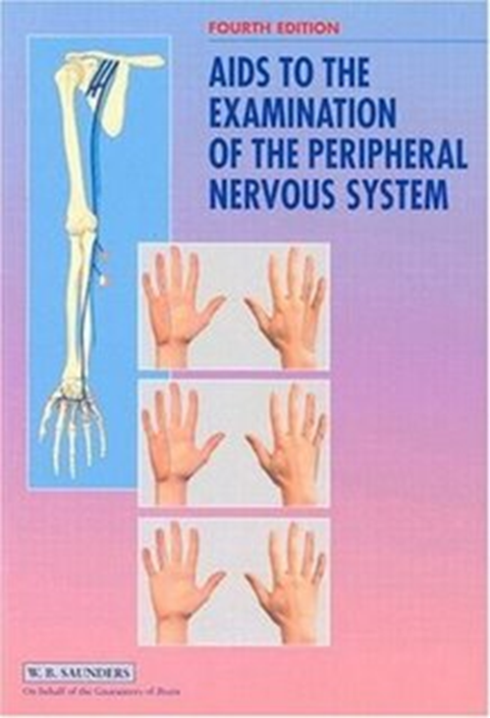

Is there a lesion or disease of the somatosensory system?
  Clinical history and examination:
    Neurological deficits
    Signs of sensory loss
    Signs of sensory gain
    Map deficits

Slide 8
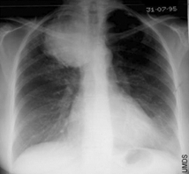
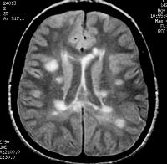
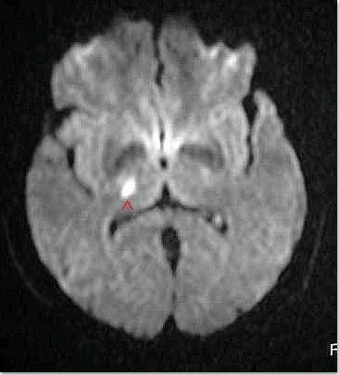
Is there a lesion or disease of the somatosensory system?
  Clinical history and examination
  Imaging

Slide 9
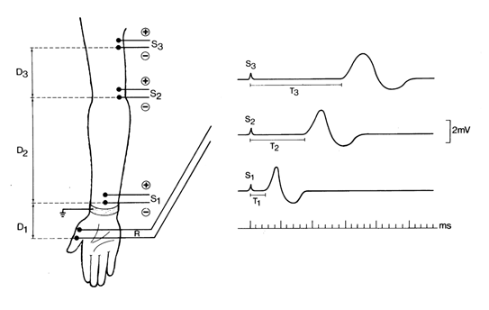
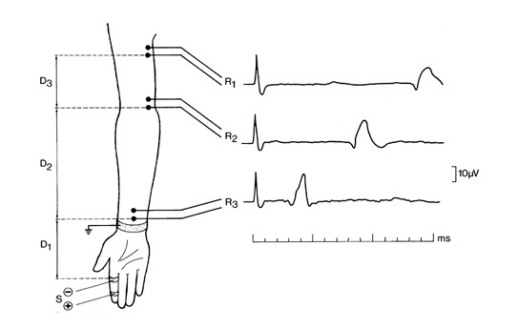
Is there a lesion or disease of the somatosensory system?
  Clinical history and examination
  Imaging
  Electrophysiological studies
    EMG/Motor NCS/Sensory NCS
      Can determine site of focal lesion
      Can differentiate between:
        Axonal loss - ↓ CAP amplitude
        Demyelination - ↓ CV
      Sensitive to functional changes in large fibres, but not small fibres

Slide 10
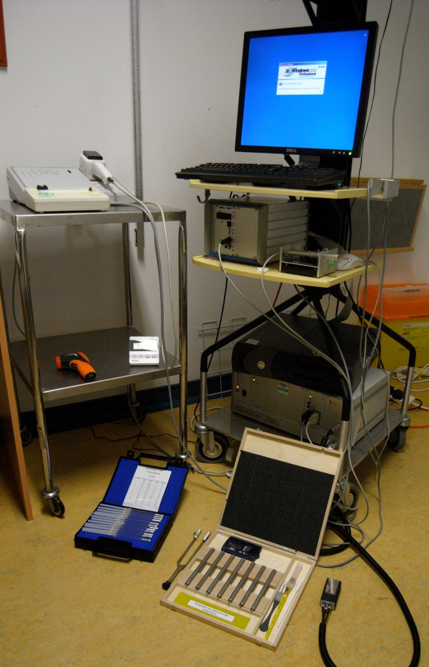
Is there a lesion or disease of the somatosensory system?
  Clinical history and examination
  Imaging
  Electrophysiological studies
  Quantitative sensory testing:
    Determines sensory phenotype
    Thermal thresholds for diagnosis of small fibre neuropathies
Notes:
Editors: Warrell, David A.; Cox, Timothy M.; Firth, John D.; Benz, Edward J.
Title: Oxford Textbook of Medicine, 4th Edition
Copyright ©2003 Oxford University Press
> Table of Contents > Volume 3 > 24 - Neurology > 24.2 - Electrophysiology of the central and peripheral nervous systems > Studies of the peripheral neuromuscular system > Nerve conduction studies
Nerve conduction studies
Motor and sensory nerve conduction studies of peripheral nerves are performed by recording the propagated responses evoked by supramaximal electrical nerve stimulation. The responses reflect the summation of action potentials from individual sensory nerve fibres (the compound sensory action potential, CSAP) or motor units (the compound motor action potential, CMAP), and their amplitudes represent a semiquantitative measure of the number of activated myelinated fibres. The CSAP amplitude is an
P.3.919
expression of activity in large fibres with diameters greater than 7 µm, whereas small fibres in the nerve contribute only slightly to the response. The CMAP amplitude is a reflection of the number of α-motor neurones. A reduction of the CSAP or the CMAP amplitudes is an indicator of fibre loss. However, the CMAP amplitude is also influenced by the size of the motor-unit response. During chronic axonal loss, collateral spouting causes an increase of the MUP, which partially or completely may compensate for the fibre loss. Since reinnervation does not have the same effect on sensory nerves, the CMAP is a less sensitive measure for determining the degree of fibre loss in chronic axonal lesions than the amplitude of the CSAP. Conduction studies are supplemented with EMG to ascertain whether motor fibres are affected by the pathological process.
Method
Investigations of motor and sensory fibres are carried out separately.
Motor conduction studies
The nerve is stimulated by an electrical pulse of 0.1- to 0.2-ms duration applied to the nerve at well-defined sites, with the cathode (depolarizing electrode) being placed over the nerve distal to the anode if a longitudinal electrode placement is used. It is essential that the stimulation pulse is supramaximal, defined as being 10 to 20 per cent above the stimulus strength that elicits a maximal CMAP. This stimulation strength requires that the output of the stimulator provides a stimulus at least four times higher than threshold when surface electrodes are used, and ensures that all fibres in the nerve remain activated even though the stimulation electrode may move slightly. The CMAP is recorded from the muscle, preferably using surface electrodes or a subcutaneous needle electrode to ensure that activity from all the muscle fibres in the muscle can be ‘seen’ by the recording electrode. Usually a belly-tendon montage is used, with the reference electrode being placed over a remote site. Recording of the CMAP with a concentric electrode is usually discouraged since the amplitude is highly dependent on how close the electrode is in relation to the active muscle fibres. However, a concentric needle electrode is useful in very atrophic muscles, as it allows a sharp deflection from the baseline to be measured. The response is amplified at a frequency band between 10 (or 20) Hz and 10 kHz.
Measurements
The parameters include latencies, conduction velocities, amplitudes, areas, durations, and shapes of the CMAPs (Fig. 12). The latency is measured to the first deflection from the baseline, which is negative when the CMAP is recorded from the endplate zone. Motor nerve conduction velocities (MNCV) between two sites of stimulation are calculated by dividing the distance between stimulation sites by the difference in latencies (Fig. 12).
Fig. 12 Motor and sensory conduction studies of a normal ulnar nerve from a patient with diffuse complaints from the arm. Above: compound sensory action potentials, evoked by electrical stimulation at digit V (DV), were recorded via needle electrodes at the wrist (WR), below the elbow (DE), and above the elbow (PE). The latencies were measured to the first positive peak (arrows) and the sensory nerve conduction velocities (SNCV), indicated above the traces, were calculated as indicated in the Method section. Below: compound muscle action potentials, evoked by stimulation at the wrist (WR), below the elbow (DE), and above the elbow (PE) were recorded via a surface electrode over the abductor digiti minimi muscle (ADM). The latencies were measured to the first deflection from the baseline (arrows). DML (distal motor latency) and MNCV (motor nerve conduction velocities), indicated above the traces were obtained as described in the Method section.
P.3.920
Distance between stimulation sites (mm)Difference between distal and proximal latencies (ms) = MNCV (m/s)
An MNCV is not calculated for the most distal site of stimulation since the latency includes conduction along terminal motor-axon branches and the neuromuscular transmission delay. In this instance, the delay is designated the distal motor latency (DML) (Fig. 12).
The CMAP amplitude (in mV) is measured either at the negative phase or peak-to-peak. The negative phase is usually preferred since it is less subject to influence by the positioning of the reference electrode. The area and duration of the negative phase are useful in evaluating temporal dispersion or conduction block.
Sensory conduction studies
In contrast to the CMAP, the compound sensory action potential (in µV) is recorded directly from active nerve fibres, and it is therefore only about 1/500th to 1/1000th of the CMAP amplitude. The response may be recorded through surface electrodes placed on the skin above the nerve or through needle electrodes placed close to the nerve. Surface electrodes are easy to apply but have a lower sensitivity than needle electrodes. In some normal, elderly people a CSAP from the lower limbs may, therefore, not be recorded through surface electrodes that have a resolution of about 1 µV, whereas near-nerve needle electrodes allow the recording of responses with an amplitude as low as 0.1 µV. In addition, the use of needle electrodes allow simultaneous recording from several sites along the nerve, which are usually not possible using surface electrodes (Fig. 12).
Sensory responses may be recorded antidromically (proximal stimulation, distal recording) or orthodromically (distal stimulation, proximal recording). The recording and reference electrodes may be placed longitudinally in relation to the nerve (bipolar recording), or the reference electrode may be placed transversely at a remote site (unipolar recording). The recording arrangements have advantages and disadvantages: the main advantage of bipolar recording being a smaller stimulus artefact; and the main disadvantage that the potential recorded by the reference electrode influences the CSAP shape and amplitude. Due to the low amplitude of the CSAP, electronic averaging is usually required to obtain a clear response that is suitably free of noise.
Measurements
The parameters include latencies, conduction velocities, amplitudes, and shapes of the CSAPs. The latency is measured to the first positive phase of the CSAP. This indicates conduction along the largest fibres in the nerve. Since the conduction path between the sites of stimulation and recording does not include synaptic transmission, a distal sensory nerve conduction velocity (SNCV) may be calculated (Fig. 12):
Distance between stimulation and recording sites (mm)Latency (ms) = Distal SNCV (m/s)
When the orthodromically conducted CSAPs are recorded at several sites along the nerve, the SNCV is calculated using a similar procedure as that used to calculate the MNCV:
Distance between proximal and distal recording sites (mm)Differernce between proximal and distal latencies (ms) = SNCV (m/s)
In some laboratories, the latency of the CSAP is measured to the first negative phase. This is to be discouraged, since this part of the response is a summation of both large and small fibres. A change in summation due to temporal dispersion therefore precludes measurements to the same group of fibres.
The amplitude of the CSAP (in µV) is measured peak-to-peak. The shape is usually bi- or triphasic. In both axonal and demyelinating neuropathies the shape may become dispersed, and when recorded with a needle electrode, the shape may become polyphasic. Due to temporal dispersion, the conduction distance has a marked influence on the shape of the CSAP. At long conduction distances a polyphasic shape may be normal.
Clinical correlations
The motor and sensory nerve conduction velocities (MNCV, SNCV) are measures of conduction of the largest motor and sensory fibres in the nerve. These limitations should be considered when the results of the studies are interpreted as, for example, a small-fibre neuropathy may escape detection. Similarly, if just a single large motor fibre is preserved, the motor conduction velocity may remain normal, indicating that the conduction velocity cannot be used in isolation to establish the presence of a neuropathy.
Focal nerve lesions
The number of patients referred to the clinical neurophysiology laboratory with possible focal nerve lesions due to compression or entrapment at root level, or along the course of the nerve, far outweighs that for other neuromuscular disorders. In entrapment and focal compression neuropathy, the main pathological abnormalities comprise demyelination at the site of the lesion, which is complicated by axonal loss in advanced lesions. Accordingly, the electrophysiological findings display a disproportionate slowing of conduction at the site of the compression, and also, in some cases, a loss of fibres as demonstrated by reduced amplitudes of the CMAP and the CSAP. This is illustrated in Fig. 13 from a patient with ulnar nerve entrapment at the elbow; the MNCV and SNCV across the elbow were markedly reduced compared to the conduction velocities distal to the elbow, consistent with a focal demyelinating lesion. The CSAP amplitudes were, in addition, markedly diminished, thus indicating axonal loss (Fig. 13(b)), and the slight reduction in SNCV distal to the elbow is commensurate with a loss of large fast-conducting fibres. The apparent sparing of the CMAP
P.3.921
amplitude is due to collateral reinnervation masking the motor fibre loss revealed by EMG examination (see above). The slight MNCV reduction distal to the elbow is due to the fibre loss (Fig. 13(a)). Similar methods are used to study focal nerve lesions in patients with compression of the peroneal nerve at the fibular head and in patients with Saturday night palsy (compression of the radial nerve in the spiral groove).
Fig. 13 Conduction studies in a patient with clinical signs of an ulnar nerve lesion. Both (a) motor and (b) sensory conduction showed a marked reduction of conduction velocities across the elbow (57 per cent and 41 per cent reduced between distal to the ulnar sulcus (DS) and proximal to the sulcus (PS), respectively). In addition, there was motor and sensory axonal loss, as indicated by the reduction in amplitudes of the CMAP and the CSAPs. The mild–moderate slowing of conduction distal to the elbow was probably due to a loss of large fibres.
In patients with carpal tunnel syndrome, the distal motor latency of the CMAP to the abductor pollicis brevis muscle, evoked by stimulation at the wrist, is prolonged, indicating a slowing of conduction beneath the flexor retinaculum. However, because it is difficult to stimulate motor fibres distal to the entrapment, differential attenuation of the MNCV is therefore not assessed. To ensure that the median nerve is selectively affected, the latency to the non-affected ulnar nerve should be normal. The SNCV, by contrast, may be tested both distal to and across the carpal tunnel, and is disproportionately reduced along this segment of the nerve compared with that distal to it. Variations on the study paradigm have been devised to increase the sensitivity of the electrophysiological studies.
On the other hand, it is usually not possible to directly study conduction across the compressed nerve segment in patients with very proximal lesions located at spinal roots or the brachial plexus across a cervical rib or band. In these situations, the anatomical distribution of EMG signs of chronic partial denervation is important in the differential diagnosis. For example, EMG findings in patients with apparent involvement of the ulnar nerve due to a C8 lesion or a thoracic outlet syndrome include abnormalities in non-ulnar nerve innervated muscles (for instance, the abductor pollicis brevis and the extensor digitorum communis muscles). This distribution of motor axon loss, and the absence of focal MNCV changes at the elbow (Fig. 14(a)), show that a single nerve lesion is not the cause of the clinical deficit, but it does not distinguish between a radicular and a brachial plexus lesion. By contrast, sensory conduction studies in root lesions usually remain normal, provided that the lesion is located proximal to the dorsal root ganglion, whereas the CSAP from digit V in the thoracic outlet syndrome is diminished due to sensory fibre loss at the level of the brachial plexus (Fig. 14(b)).
Fig. 14 Conduction studies in a patient with clinical signs of an ulnar nerve lesion that was clinically localized at the brachial plexus or the spinal roots, as indicated by the extent of sensory complaints along the medial forearm and upper arm. Both (a) motor and (b) sensory conduction showed normal conduction velocities distal to and across the elbow. However, the amplitudes of the CMAPs and the CSAPs were markedly decreased, indicating diffuse axonal loss. The loss of sensory fibres is inconsistent with a root lesion and indicates entrapment at the brachial plexus.
Generalized nerve lesions (peripheral neuropathy)
The electrophysiological study in patients with suspected polyneuropathy should document that pathological abnormalities are widely distributed. It is therefore a prerequisite that several motor and sensory nerves in the upper and lower limbs are investigated. However, the study should be individually tailored to delineate the distribution of changes, and the strategy should reflect the symptoms and clinical findings and hence address the question of the differential diagnosis. For example, it may be necessary to investigate certain nerves bilaterally if the symptoms are asymmetrical. This would allow the investigation to show whether the patient may have a mononeuropathy, a multiple mononeuropathy, or a polyneuropathy with asymmetrical features.
Axonal polyneuropathy
The underlying pathology in most patients with peripheral neuropathy is axonal loss in a symmetrical distribution, primarily located at distal nerve segments and more pronounced in the legs than in the arms. The electrophysiological characteristics in these patients are due to a loss of nerve fibres, that is associated with EMG signs of chronic partial denervation and conduction studies that show diminished amplitudes of evoked CMAPs and CSAPs. The remaining fibres in the nerve may conduct normally, and the MNCV and the SNCV in these patients may therefore be normal or show a reduction consistent with a large-fibre loss (Fig. 15). In some patients, the pathological changes may primarily be present at the distal nerve segments, thus studies of these segments will also be required (Fig. 15).
Fig. 15 Motor and sensory conduction studies of the peroneal nerve in a patient with diabetic neuropathy. The findings in this patient were consistent with axonal loss, primarily present in the very distal segment of the nerve. Top panel: orthodromic compound sensory action potentials (CSAPs), evoked at the deep peroneal nerve in the first dorsal interstice (ToeI), were recorded at the ankle (ankle) and the fibular head (CF). The amplitudes were more than 95 per cent diminished. The SNCVs were moderately diminished due to large-fibre loss. Middle panel: CSAP of the superficial peroneal nerve evoked at the superior retinaculum (RetSup) at the ankle and recorded at the CF. The amplitude was slightly diminished, and the SNCV was normal. Lower panel: compound muscle action potentials (CMAPs) of the deep peroneal nerve, evoked at the ankle and the fibular head, were recorded at the extensor digitorum brevis muscle (EDB). The distal motor latency (DML) was prolonged and the MNCV was reduced due to fibre loss.
Only motor or sensory fibres are involved in the rarer types of neuropathy, and demonstration of such a distribution may have important implications in the differential diagnosis. A sensory neuronopathy in a 47-year-old woman with profound sensory ataxia is illustrated in Fig. 16. The motor nerve conduction studies and the EMG were normal, but the sensory conduction studies were profoundly abnormal, and the sural nerve biopsy showed a 95 per cent loss of myelinated fibres (Fig. 16(a) and Fig. 16(b)). The SNCV was at the lower normal range, consistent with the slightly diminished diameter of the largest remaining fibres being around 10 µm (Fig. 16(b) and Fig. 16(c)). These findings were consistent with an autoimmune sensory neuronopathy.
Fig. 16 Morphometric and electrophysiological studies of the sural nerve in a 47-year-old woman with sensory neuronopathy. (a) Transverse semithin sections of the sural nerve showed a generalized severe fibre loss without evidence of degeneration or regeneration. (b) A total of 328 myelinated fibres were counted in the whole nerve. The fibre-diameter distribution showed a loss of both small and large fibres with a maximal diameter of 10 to 11 µm. (c) Conduction studies in the sural nerve showed a pronounced reduction of the CSAP amplitude and a dispersed shape. The SNCV was at the lower normal limit, consistent with the diameters of the largest fibres at morphometry. (Histological studies by courtesy of H. Schmalbruch, University of Copenhagen.)
Demyelinating neuropathy
Primary demyelination usually has a hereditary, inflammatory, or autoimmune basis. Although demyelinating neuropathy is rare compared to axonal neuropathy, it has become increasingly important to be able to diagnose acquired demyelinating neuropathy with a high degree of certainty since acute or chronic inflammatory demyelinating neuropathy may respond to immunomodulatory therapy. The primary electrophysiological sign of demyelination is a markedly reduced conduction velocity that is beyond the diminution caused by large-fibre loss. In hereditary motor and sensory neuropathy, type I and III, the MNCV and the SNCV are markedly diminished to less than 50 per cent of the lower limit of normal throughout the nerves, consistent with primary demyelination. In these conditions the amplitudes of the CMAPs and the CSAPs are, however, also markedly reduced and nerve biopsy confirms a marked loss of myelinated nerve fibres. Pure demyelination without axonal loss does not occur in these hereditary conditions and is extremely rare in acquired demyelinating neuropathy. The distinguishing features in acquired demyelinating neuropathy include widespread demyelination, often in a multifocal pattern, as indicated by focal temporal dispersion or conduction block or both of CMAPs
P.3.922
and CSAPs. Criteria have been established to assist in the diagnosis of these demyelinating neuropathies (Table 3).
Table 3 Criteria for the classification of acquired demyelinating polyneuropathies
Nerve conduction parameter
Albers and Kelly, 1989
Ho et al., 1997
Copenhagen values
Upper limbs
Lower limbs
Distal motor latency
>115% of UNL (amp. nl.)
>110% of UNL (amp. nl.)
4.5 ms
6.4 ms
>125% of UNL (amp. <nl.)
>120% of UNL (amp. <nl.)
5.4 ms
7.7 ms
Motor conduction
<90% of LNL (amp. nl.)
<95% of LNL (amp. >50% of LNL)
45 m/s
35 m/s
velocity
<80% of LNL (amp. <nl.)
<85% of LNL (amp. <50% of LNL)
38 m/s
30 m/s
Focal conduction
Temporal dispersion (>10–15%
Temporal dispersion
changes
increased duration). Proximal/
distal amplitude ratio, <0.7
F-wave latency
>125% of UNL
>120% of UNL
LNL, lower normal 95 per cent confidence limit; UNL, upper normal 96 per cent confidence limit; amp., amplitude of CMAP; nl., normal.
A weakness or sensory loss does not result solely from a diminished conduction velocity, but also as a consequence of nerve fibre loss or a block of conduction between the CNS and the target muscle. Conduction block is a partial or complete inability of fibres to propagate action potentials along a segment of the nerve, and is demonstrated by recording a larger motor or sensory response more distal to than proximal to the site of the block (Fig. 17(a)). This reduction in amplitude should be greater than that associated with a temporal dispersion of the conducting fibres. Therefore to demonstrate a block of motor fibres, the CMAP should show a reduction of at least 50 per cent (Fig. 17(a)). Conduction block may occur in acquired acute or chronic inflammatory demyelinating neuropathy and in some cases of monoclonal gammopathy. It does not occur in hereditary demyelinating neuropathy and probably not in gammopathy with IgM anti-MAG antibodies. However, demyelination due to compression may also cause a conduction block, and in demyelinating neuropathy a conduction block must therefore be demonstrated outside the usual sites of entrapment or compression. The pathophysiological changes in inflammatory demyelinating diseases usually show a multifocal pattern, with some nerves showing pronounced changes while other nerves or nerve segments have normal conduction.
Fig. 17 Motor conduction studies of the median and ulnar nerves of a 29-year-old woman with electrophysiological signs of demyelinating neuropathy and clinical signs of relapsing chronic inflammatory demyelinating neuropathy. Clinical examination showed marked weakness of the thenar and forearm median innervated muscles. The force in ulnar innervated muscles was normal. Left panel: CMAP recorded from the abductor pollicis brevis muscle (APB). Stimulation at the wrist (WR) and elbow (EL) elicited normal CMAPs and the DML and MNCV along the forearm were normal. Stimulation at the axilla (AX) resulted in a markedly reduced CMAP amplitude and a reduced MNCV between the elbow and axilla, consistent with a partial conduction block. Right panel: stimulation of the ulnar nerve at the wrist and axilla evoked CMAPs at the abductor digiti minimi (ADM) of normal amplitudes, DML and MNCV, indicating that motor fibres were not affected.
Apparent conduction block may be found in acute neuropathies due to vasculitis. However, conduction along the nerve segment distal to a focal lesion may continue for several days before Wallerian degeneration takes place, and repeated studies should therefore be carried out to exclude this possibility.
Motor disorders (motor neurone disease and motor neuropathy)
Conduction studies in motor neurone disease are normal at early stages of the disease, but at late stages the CMAP amplitudes are reduced. The distal motor latencies of weak and wasted muscles are often prolonged, and the MNCV slightly to moderately reduced due to a loss of large α-motor axons. In ALS, sensory conduction studies are usually normal, though the CSAP amplitudes may be slightly diminished. Therefore, conduction studies are mainly of use in the diagnosis of ALS in that they are normal in the face of widespread neurogenic changes at EMG. However, patients with X-linked bulbospinal muscular atrophy (Kennedy's syndrome) are characterized by a marked reduction of CSAP amplitudes, while the EMG examination shows abnormalities characteristic of motor neurone disease (fasciculations, widespread denervation, markedly enlarged and prolonged MUPs, and discrete high-amplitude recruitment at maximal effort).
Asymmetrical or focal weakness, atrophy, fasciculations (see Fig. 7), without or with only slight sensory symptoms, due to multifocal motor neuropathy may be mistaken for the early stages of spinal forms of motor neurone disease. The course is, however, prolonged over several years, and there is no involvement of bulbar muscles and no signs of corticospinal involvement. The electrophysiological features in these patients are distinct, with conduction block of motor fibres indicating focal demyelination. Usually there is also EMG evidence of chronic partial denervation, indicating fibre loss. The sensory conduction studies through affected nerve segments are normal. These patients frequently have high titres of anti-GM1 antibodies, and often respond clinically and electrophysiologically to intravenous infusions of immunoglobulin. Patients with chronic inflammatory demyelinating neuropathy may have mainly motor symptoms, with only minimal sensory deficits. Motor conduction studies in chronic inflammatory demyelinating neuropathy show signs of mixed demyelination, including conduction block, and fibre loss; sensory conduction studies are abnormal, with small CSAP amplitudes and often reduced SNCV. This is an important distinction, since patients with chronic inflammatory demyelinating neuropathy may respond to treatment with corticosteroids and other immune-modulating strategies that have no effect on multifocal motor neuropathy.
Andrew S.C. Rice MB BS MD FRCA FFPMRCA
Professor of Pain Research
Department of Anaesthetics, Pain Medicine and Intensive Care
Imperial College London
Chelsea & Westminster Hospital Campus
369 Fulham Road,
London SW10 9NH,
United Kingdom
Tel: +44 (0) 20 8746 8816
Fax: +44 (0)20 8237 5109
email a.rice@imperial.ac.uk
Sensory conduction in the median, ulnar, and radial nerves can be measured by applying stimuli through ring electrodes upon a finger (Fig. 2.19) and then recording the sensory nerve action potential through cutaneous electrodes applied over the trunk of the nerve (orthodromic conduction). For other nerves, such as the sural, the nerve trunk is stimulated and sensory nerve action potentials recorded from surface electrodes (antidromic or orthodromic conduction). The sensory nerve action potential (SNAP) is so small that averaging techniques are required following multiple stimuli, and occasionally needle recording electrodes inserted close to the nerve are required (Kimura 1983; Liveson and Ma 1992; Binnie et al. 1995).
View Figure
Fig. 2.19. Diagrammatic representation of the technique of measuring the sensory nerve action potential (SNAP) in the median nerve (at points R₁, R₂, R₃) after orthodromic stimulation of the finger(s) (reproduced from Bradley 1974).
Sensory nerve action potential amplitudes generally range from 5 to 50 µV, depending upon the particular nerve being studied, and drop in amplitude, or absence of the potential, occurs in axonal degenerative, demyelinating, or compressive neuropathies. Thus a diminished SNAP cannot in itself distinguish between these types of neuropathy. Sensory nerve action potentials reflect the integrity of the distal axonal branch of the dorsal root ganglion sensory neurons. They remain normal in disease such as spondylitic radiculopathy affecting the spinal nerve roots containing the proximal axonal branches because the dorsal root ganglia cell bodies lie outside the intervertebral foramina (Aminoff et al. 1985). The only exception to this can occur in the lower lumbar and sacral nerve roots, in which the dorsal root ganglia can lie within the intervertebral foramina, and loss of sensory nerve action potentials may occur with spinal disease as well as with peripheral nerve disease. Radiculopathy may be confirmed by the finding of denervation within limb and paraspinal muscles innervated by the same segment. Sensory nerve conduction latencies and velocities can be measured but generally find little usefulness in diagnostic clinical practice. Routine techniques for measuring possible conduction block in sensory nerves have not been established.
Andrew S.C. Rice MB BS MD FRCA FFPMRCA
Professor of Pain Research
Department of Anaesthetics, Pain Medicine and Intensive Care
Imperial College London
Chelsea & Westminster Hospital Campus
369 Fulham Road,
London SW10 9NH,
United Kingdom
Tel: +44 (0) 20 8746 8816
Fax: +44 (0)20 8237 5109
email a.rice@imperial.ac.uk

Slide 11
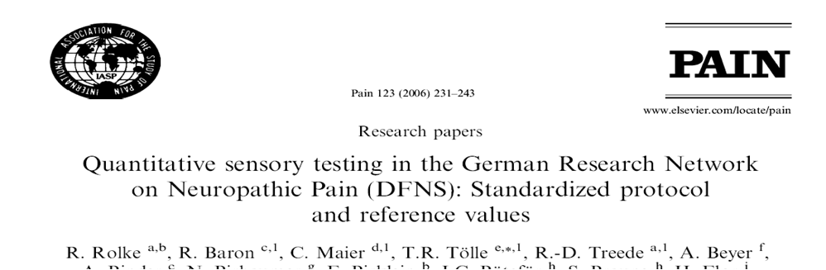
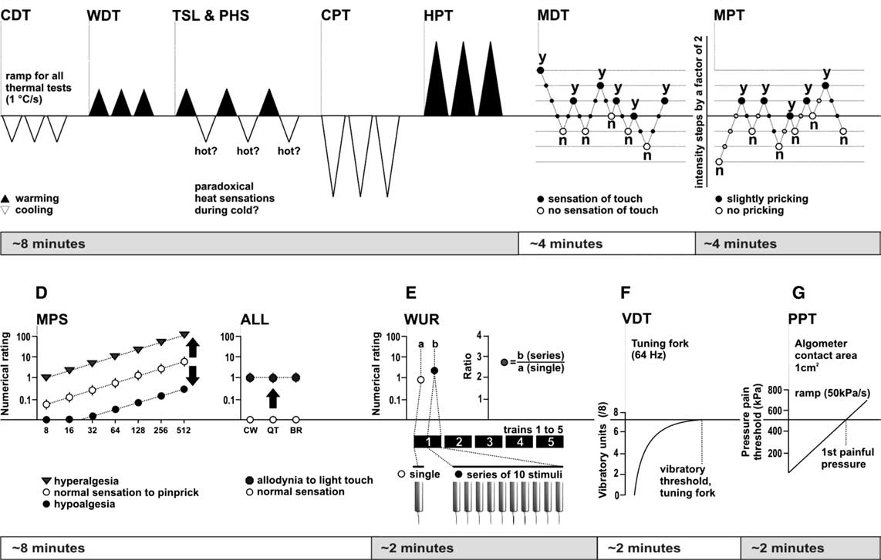

Slide 12
DFNS QST Protocol
Non-noxious; noxious
Rolke et al Eur. J. Pain 2006;10:77–88

Slide 13
Clinical Heterogeneity of Neuropathic Pain – Clinical Signs
↑Sensory
Gain
Normal
range
HIV +ve, no neuropathy
↓Sensory
Loss
HIV +ve, neuropathy

Slide 14
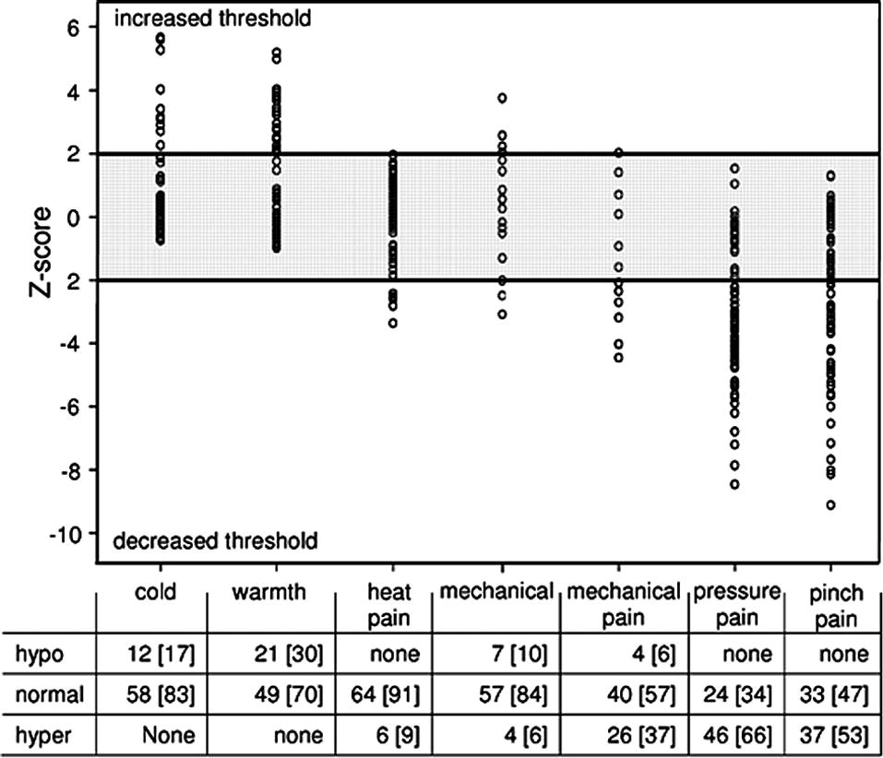
Inguinal Hernia- Post Surgical Neuropathic Pain
Aasvang et al; PAIN 2010;150:237-242
Notes:
Distribution of Z-values for sensory functions on the pain-full side in 70 persistent postherniotomy pain patients. Shaded interval=normal values based upon 40 pain-free patients operated>1year previously. Hypo=hypoesthesia/algesia, Hyper=hyperesthesia/algesia.

Slide 15
Clinical Heterogeneity of Neuropathic Pain – Clinical Signs
Maier C et al Pain 2010; 150:439-450

Slide 16
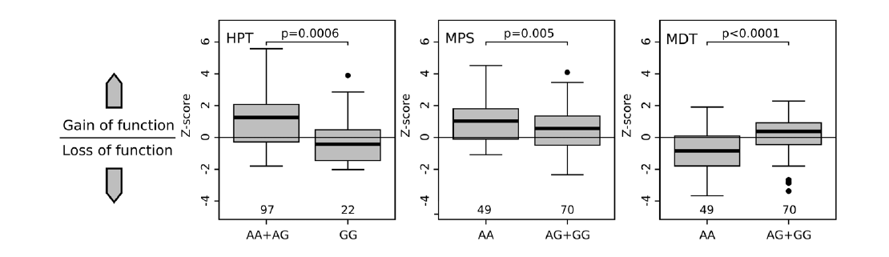
QST Profiles & TRPV1 Polymorphisims Neuropathic Patients
Binder et al PLoS ONE 2011; 6: e17387
Notes:
Figure 4. Associations of TRPV1 1911 A.G with HPT, MPS and MDT in cluster 1. Z-scores of heat pain threshold (HPT), mechanical pain
Transient receptor potential channels are important mediators of thermal and mechanical stimuli and play an important role in
neuropathic pain. The contribution of hereditary variants in the genes of transient receptor potential channels to neuropathic pain is
unknown. We investigated the frequency of transient receptor potential ankyrin 1, transient receptor potential melastin 8 and
transient receptor potential vanilloid 1 single nucleotide polymorphisms and their impact on somatosensory abnormalities in
neuropathic pain patients. Within the German Research Network on Neuropathic Pain (Deutscher Forscbungsverbund
Neuropathischer Schmerz) 371 neuropathic pain patients were phenotypically characterized using standardized quantitative
sensory testing. Pyrosequencing was employed to determine a total of eleven single nucleotide polymorphisms in transient
receptor potential channel genes of the neuropathic pain patients and a cohort of 253 German healthy volunteers. Associations of
quantitative sensory testing parameters and single nucleotide polymorphisms between and within groups and subgroups, based
on sensory phenotypes, were analyzed. Single nucleotide polymorphisms frequencies did not differ between both the cohorts.
However, in neuropathic pain patients transient receptor potential ankyrin 1 710G.A (rs920829, E179K) was associated with the
presence of paradoxical heat sensation (p = 0.03), and transient receptor potential vanilloid 1 1911A.G (rs8065080, I585V) with cold
hypoalgesia (p=0.0035). Two main subgroups characterized by preserved (1) and impaired (2) sensory function were identified. In
subgroup 1 transient receptor potential vanilloid 1 1911A.G led to significantly less heat hyperalgesia, pinprick hyperalgesia and
mechanical hypaesthesia (p= 0.006, p =0.005 and p,0.001) and transient receptor potential vanilloid 1 1103C.G (rs222747, M315I)
to cold hypaesthesia (p= 0.002), but there was absence of associations in subgroup 2. In this study we found no evidence that
genetic variants of transient receptor potential channels are involved in the expression of neuropathic pain, but transient receptor
potential channel polymorphisms contributed significantly to the somatosensory abnormalities of neuropathic pain patients.
sensitivity (MPS) and mechanical detection threshold (MDT) stratified to TRPV1 1911G.A. HPT: Homozygous variant GG carriers exhibited
significantly lower, i.e. normal, Z-scores than carriers of the heterozygote or wild type genotype, which tended to show heat hyperalgesia. MPS:
Presence of at least one G-variant allele resulted in a decreased Z-score indicating less pinprick hyperalgesia. MDT: Presence of at least one G-variant
allele was associated with less mechanical hypaesthesia to non-painful mechanical stimuli resulting in higher Z-scores. Z-scores are given as median
with quartiles and ranges, p-values were calculated with t-test and corrected for multiple testing by permutation testing.
doi:10.1371/journal.pone.0017387.g004
TRP Channel Polymorphisms in Neuropathic Pain
PLoS ONE | www.plosone.org 5

Slide 17
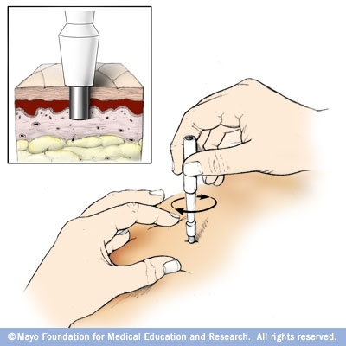
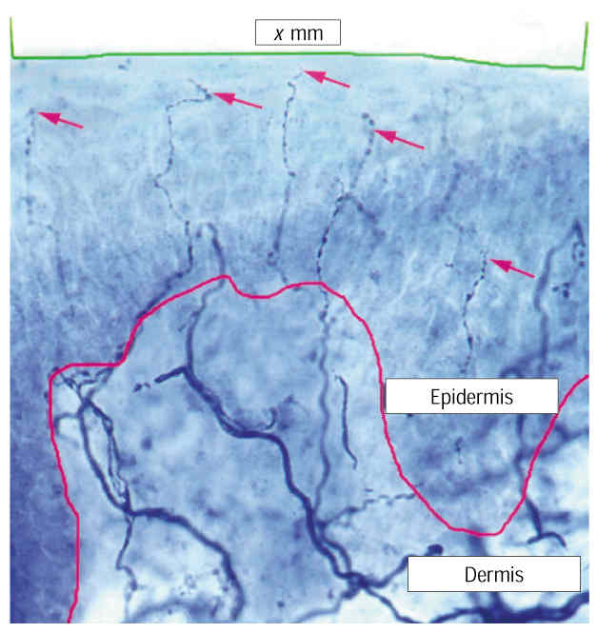
Is there a lesion or disease of the somatosensory system?
  Clinical history and examination
  Imaging
  Electrophysiological studies
  Quantitative sensory testing
  Skin biopsy (3-4mm punch)
    Minor outpatient procedure
    Intraepidemal nerve fibre density measurement
McArthur JC et al Arch. Neurol. 1998;55:1513-20
Notes:
Editors: Warrell, David A.; Cox, Timothy M.; Firth, John D.; Benz, Edward J.
Title: Oxford Textbook of Medicine, 4th Edition
Copyright ©2003 Oxford University Press
> Table of Contents > Volume 3 > 24 - Neurology > 24.2 - Electrophysiology of the central and peripheral nervous systems > Studies of the peripheral neuromuscular system > Nerve conduction studies
Nerve conduction studies
Motor and sensory nerve conduction studies of peripheral nerves are performed by recording the propagated responses evoked by supramaximal electrical nerve stimulation. The responses reflect the summation of action potentials from individual sensory nerve fibres (the compound sensory action potential, CSAP) or motor units (the compound motor action potential, CMAP), and their amplitudes represent a semiquantitative measure of the number of activated myelinated fibres. The CSAP amplitude is an
P.3.919
expression of activity in large fibres with diameters greater than 7 µm, whereas small fibres in the nerve contribute only slightly to the response. The CMAP amplitude is a reflection of the number of α-motor neurones. A reduction of the CSAP or the CMAP amplitudes is an indicator of fibre loss. However, the CMAP amplitude is also influenced by the size of the motor-unit response. During chronic axonal loss, collateral spouting causes an increase of the MUP, which partially or completely may compensate for the fibre loss. Since reinnervation does not have the same effect on sensory nerves, the CMAP is a less sensitive measure for determining the degree of fibre loss in chronic axonal lesions than the amplitude of the CSAP. Conduction studies are supplemented with EMG to ascertain whether motor fibres are affected by the pathological process.
Method
Investigations of motor and sensory fibres are carried out separately.
Motor conduction studies
The nerve is stimulated by an electrical pulse of 0.1- to 0.2-ms duration applied to the nerve at well-defined sites, with the cathode (depolarizing electrode) being placed over the nerve distal to the anode if a longitudinal electrode placement is used. It is essential that the stimulation pulse is supramaximal, defined as being 10 to 20 per cent above the stimulus strength that elicits a maximal CMAP. This stimulation strength requires that the output of the stimulator provides a stimulus at least four times higher than threshold when surface electrodes are used, and ensures that all fibres in the nerve remain activated even though the stimulation electrode may move slightly. The CMAP is recorded from the muscle, preferably using surface electrodes or a subcutaneous needle electrode to ensure that activity from all the muscle fibres in the muscle can be ‘seen’ by the recording electrode. Usually a belly-tendon montage is used, with the reference electrode being placed over a remote site. Recording of the CMAP with a concentric electrode is usually discouraged since the amplitude is highly dependent on how close the electrode is in relation to the active muscle fibres. However, a concentric needle electrode is useful in very atrophic muscles, as it allows a sharp deflection from the baseline to be measured. The response is amplified at a frequency band between 10 (or 20) Hz and 10 kHz.
Measurements
The parameters include latencies, conduction velocities, amplitudes, areas, durations, and shapes of the CMAPs (Fig. 12). The latency is measured to the first deflection from the baseline, which is negative when the CMAP is recorded from the endplate zone. Motor nerve conduction velocities (MNCV) between two sites of stimulation are calculated by dividing the distance between stimulation sites by the difference in latencies (Fig. 12).
Fig. 12 Motor and sensory conduction studies of a normal ulnar nerve from a patient with diffuse complaints from the arm. Above: compound sensory action potentials, evoked by electrical stimulation at digit V (DV), were recorded via needle electrodes at the wrist (WR), below the elbow (DE), and above the elbow (PE). The latencies were measured to the first positive peak (arrows) and the sensory nerve conduction velocities (SNCV), indicated above the traces, were calculated as indicated in the Method section. Below: compound muscle action potentials, evoked by stimulation at the wrist (WR), below the elbow (DE), and above the elbow (PE) were recorded via a surface electrode over the abductor digiti minimi muscle (ADM). The latencies were measured to the first deflection from the baseline (arrows). DML (distal motor latency) and MNCV (motor nerve conduction velocities), indicated above the traces were obtained as described in the Method section.
P.3.920
Distance between stimulation sites (mm)Difference between distal and proximal latencies (ms) = MNCV (m/s)
An MNCV is not calculated for the most distal site of stimulation since the latency includes conduction along terminal motor-axon branches and the neuromuscular transmission delay. In this instance, the delay is designated the distal motor latency (DML) (Fig. 12).
The CMAP amplitude (in mV) is measured either at the negative phase or peak-to-peak. The negative phase is usually preferred since it is less subject to influence by the positioning of the reference electrode. The area and duration of the negative phase are useful in evaluating temporal dispersion or conduction block.
Sensory conduction studies
In contrast to the CMAP, the compound sensory action potential (in µV) is recorded directly from active nerve fibres, and it is therefore only about 1/500th to 1/1000th of the CMAP amplitude. The response may be recorded through surface electrodes placed on the skin above the nerve or through needle electrodes placed close to the nerve. Surface electrodes are easy to apply but have a lower sensitivity than needle electrodes. In some normal, elderly people a CSAP from the lower limbs may, therefore, not be recorded through surface electrodes that have a resolution of about 1 µV, whereas near-nerve needle electrodes allow the recording of responses with an amplitude as low as 0.1 µV. In addition, the use of needle electrodes allow simultaneous recording from several sites along the nerve, which are usually not possible using surface electrodes (Fig. 12).
Sensory responses may be recorded antidromically (proximal stimulation, distal recording) or orthodromically (distal stimulation, proximal recording). The recording and reference electrodes may be placed longitudinally in relation to the nerve (bipolar recording), or the reference electrode may be placed transversely at a remote site (unipolar recording). The recording arrangements have advantages and disadvantages: the main advantage of bipolar recording being a smaller stimulus artefact; and the main disadvantage that the potential recorded by the reference electrode influences the CSAP shape and amplitude. Due to the low amplitude of the CSAP, electronic averaging is usually required to obtain a clear response that is suitably free of noise.
Measurements
The parameters include latencies, conduction velocities, amplitudes, and shapes of the CSAPs. The latency is measured to the first positive phase of the CSAP. This indicates conduction along the largest fibres in the nerve. Since the conduction path between the sites of stimulation and recording does not include synaptic transmission, a distal sensory nerve conduction velocity (SNCV) may be calculated (Fig. 12):
Distance between stimulation and recording sites (mm)Latency (ms) = Distal SNCV (m/s)
When the orthodromically conducted CSAPs are recorded at several sites along the nerve, the SNCV is calculated using a similar procedure as that used to calculate the MNCV:
Distance between proximal and distal recording sites (mm)Differernce between proximal and distal latencies (ms) = SNCV (m/s)
In some laboratories, the latency of the CSAP is measured to the first negative phase. This is to be discouraged, since this part of the response is a summation of both large and small fibres. A change in summation due to temporal dispersion therefore precludes measurements to the same group of fibres.
The amplitude of the CSAP (in µV) is measured peak-to-peak. The shape is usually bi- or triphasic. In both axonal and demyelinating neuropathies the shape may become dispersed, and when recorded with a needle electrode, the shape may become polyphasic. Due to temporal dispersion, the conduction distance has a marked influence on the shape of the CSAP. At long conduction distances a polyphasic shape may be normal.
Clinical correlations
The motor and sensory nerve conduction velocities (MNCV, SNCV) are measures of conduction of the largest motor and sensory fibres in the nerve. These limitations should be considered when the results of the studies are interpreted as, for example, a small-fibre neuropathy may escape detection. Similarly, if just a single large motor fibre is preserved, the motor conduction velocity may remain normal, indicating that the conduction velocity cannot be used in isolation to establish the presence of a neuropathy.
Focal nerve lesions
The number of patients referred to the clinical neurophysiology laboratory with possible focal nerve lesions due to compression or entrapment at root level, or along the course of the nerve, far outweighs that for other neuromuscular disorders. In entrapment and focal compression neuropathy, the main pathological abnormalities comprise demyelination at the site of the lesion, which is complicated by axonal loss in advanced lesions. Accordingly, the electrophysiological findings display a disproportionate slowing of conduction at the site of the compression, and also, in some cases, a loss of fibres as demonstrated by reduced amplitudes of the CMAP and the CSAP. This is illustrated in Fig. 13 from a patient with ulnar nerve entrapment at the elbow; the MNCV and SNCV across the elbow were markedly reduced compared to the conduction velocities distal to the elbow, consistent with a focal demyelinating lesion. The CSAP amplitudes were, in addition, markedly diminished, thus indicating axonal loss (Fig. 13(b)), and the slight reduction in SNCV distal to the elbow is commensurate with a loss of large fast-conducting fibres. The apparent sparing of the CMAP
P.3.921
amplitude is due to collateral reinnervation masking the motor fibre loss revealed by EMG examination (see above). The slight MNCV reduction distal to the elbow is due to the fibre loss (Fig. 13(a)). Similar methods are used to study focal nerve lesions in patients with compression of the peroneal nerve at the fibular head and in patients with Saturday night palsy (compression of the radial nerve in the spiral groove).
Fig. 13 Conduction studies in a patient with clinical signs of an ulnar nerve lesion. Both (a) motor and (b) sensory conduction showed a marked reduction of conduction velocities across the elbow (57 per cent and 41 per cent reduced between distal to the ulnar sulcus (DS) and proximal to the sulcus (PS), respectively). In addition, there was motor and sensory axonal loss, as indicated by the reduction in amplitudes of the CMAP and the CSAPs. The mild–moderate slowing of conduction distal to the elbow was probably due to a loss of large fibres.
In patients with carpal tunnel syndrome, the distal motor latency of the CMAP to the abductor pollicis brevis muscle, evoked by stimulation at the wrist, is prolonged, indicating a slowing of conduction beneath the flexor retinaculum. However, because it is difficult to stimulate motor fibres distal to the entrapment, differential attenuation of the MNCV is therefore not assessed. To ensure that the median nerve is selectively affected, the latency to the non-affected ulnar nerve should be normal. The SNCV, by contrast, may be tested both distal to and across the carpal tunnel, and is disproportionately reduced along this segment of the nerve compared with that distal to it. Variations on the study paradigm have been devised to increase the sensitivity of the electrophysiological studies.
On the other hand, it is usually not possible to directly study conduction across the compressed nerve segment in patients with very proximal lesions located at spinal roots or the brachial plexus across a cervical rib or band. In these situations, the anatomical distribution of EMG signs of chronic partial denervation is important in the differential diagnosis. For example, EMG findings in patients with apparent involvement of the ulnar nerve due to a C8 lesion or a thoracic outlet syndrome include abnormalities in non-ulnar nerve innervated muscles (for instance, the abductor pollicis brevis and the extensor digitorum communis muscles). This distribution of motor axon loss, and the absence of focal MNCV changes at the elbow (Fig. 14(a)), show that a single nerve lesion is not the cause of the clinical deficit, but it does not distinguish between a radicular and a brachial plexus lesion. By contrast, sensory conduction studies in root lesions usually remain normal, provided that the lesion is located proximal to the dorsal root ganglion, whereas the CSAP from digit V in the thoracic outlet syndrome is diminished due to sensory fibre loss at the level of the brachial plexus (Fig. 14(b)).
Fig. 14 Conduction studies in a patient with clinical signs of an ulnar nerve lesion that was clinically localized at the brachial plexus or the spinal roots, as indicated by the extent of sensory complaints along the medial forearm and upper arm. Both (a) motor and (b) sensory conduction showed normal conduction velocities distal to and across the elbow. However, the amplitudes of the CMAPs and the CSAPs were markedly decreased, indicating diffuse axonal loss. The loss of sensory fibres is inconsistent with a root lesion and indicates entrapment at the brachial plexus.
Generalized nerve lesions (peripheral neuropathy)
The electrophysiological study in patients with suspected polyneuropathy should document that pathological abnormalities are widely distributed. It is therefore a prerequisite that several motor and sensory nerves in the upper and lower limbs are investigated. However, the study should be individually tailored to delineate the distribution of changes, and the strategy should reflect the symptoms and clinical findings and hence address the question of the differential diagnosis. For example, it may be necessary to investigate certain nerves bilaterally if the symptoms are asymmetrical. This would allow the investigation to show whether the patient may have a mononeuropathy, a multiple mononeuropathy, or a polyneuropathy with asymmetrical features.
Axonal polyneuropathy
The underlying pathology in most patients with peripheral neuropathy is axonal loss in a symmetrical distribution, primarily located at distal nerve segments and more pronounced in the legs than in the arms. The electrophysiological characteristics in these patients are due to a loss of nerve fibres, that is associated with EMG signs of chronic partial denervation and conduction studies that show diminished amplitudes of evoked CMAPs and CSAPs. The remaining fibres in the nerve may conduct normally, and the MNCV and the SNCV in these patients may therefore be normal or show a reduction consistent with a large-fibre loss (Fig. 15). In some patients, the pathological changes may primarily be present at the distal nerve segments, thus studies of these segments will also be required (Fig. 15).
Fig. 15 Motor and sensory conduction studies of the peroneal nerve in a patient with diabetic neuropathy. The findings in this patient were consistent with axonal loss, primarily present in the very distal segment of the nerve. Top panel: orthodromic compound sensory action potentials (CSAPs), evoked at the deep peroneal nerve in the first dorsal interstice (ToeI), were recorded at the ankle (ankle) and the fibular head (CF). The amplitudes were more than 95 per cent diminished. The SNCVs were moderately diminished due to large-fibre loss. Middle panel: CSAP of the superficial peroneal nerve evoked at the superior retinaculum (RetSup) at the ankle and recorded at the CF. The amplitude was slightly diminished, and the SNCV was normal. Lower panel: compound muscle action potentials (CMAPs) of the deep peroneal nerve, evoked at the ankle and the fibular head, were recorded at the extensor digitorum brevis muscle (EDB). The distal motor latency (DML) was prolonged and the MNCV was reduced due to fibre loss.
Only motor or sensory fibres are involved in the rarer types of neuropathy, and demonstration of such a distribution may have important implications in the differential diagnosis. A sensory neuronopathy in a 47-year-old woman with profound sensory ataxia is illustrated in Fig. 16. The motor nerve conduction studies and the EMG were normal, but the sensory conduction studies were profoundly abnormal, and the sural nerve biopsy showed a 95 per cent loss of myelinated fibres (Fig. 16(a) and Fig. 16(b)). The SNCV was at the lower normal range, consistent with the slightly diminished diameter of the largest remaining fibres being around 10 µm (Fig. 16(b) and Fig. 16(c)). These findings were consistent with an autoimmune sensory neuronopathy.
Fig. 16 Morphometric and electrophysiological studies of the sural nerve in a 47-year-old woman with sensory neuronopathy. (a) Transverse semithin sections of the sural nerve showed a generalized severe fibre loss without evidence of degeneration or regeneration. (b) A total of 328 myelinated fibres were counted in the whole nerve. The fibre-diameter distribution showed a loss of both small and large fibres with a maximal diameter of 10 to 11 µm. (c) Conduction studies in the sural nerve showed a pronounced reduction of the CSAP amplitude and a dispersed shape. The SNCV was at the lower normal limit, consistent with the diameters of the largest fibres at morphometry. (Histological studies by courtesy of H. Schmalbruch, University of Copenhagen.)
Demyelinating neuropathy
Primary demyelination usually has a hereditary, inflammatory, or autoimmune basis. Although demyelinating neuropathy is rare compared to axonal neuropathy, it has become increasingly important to be able to diagnose acquired demyelinating neuropathy with a high degree of certainty since acute or chronic inflammatory demyelinating neuropathy may respond to immunomodulatory therapy. The primary electrophysiological sign of demyelination is a markedly reduced conduction velocity that is beyond the diminution caused by large-fibre loss. In hereditary motor and sensory neuropathy, type I and III, the MNCV and the SNCV are markedly diminished to less than 50 per cent of the lower limit of normal throughout the nerves, consistent with primary demyelination. In these conditions the amplitudes of the CMAPs and the CSAPs are, however, also markedly reduced and nerve biopsy confirms a marked loss of myelinated nerve fibres. Pure demyelination without axonal loss does not occur in these hereditary conditions and is extremely rare in acquired demyelinating neuropathy. The distinguishing features in acquired demyelinating neuropathy include widespread demyelination, often in a multifocal pattern, as indicated by focal temporal dispersion or conduction block or both of CMAPs
P.3.922
and CSAPs. Criteria have been established to assist in the diagnosis of these demyelinating neuropathies (Table 3).
Table 3 Criteria for the classification of acquired demyelinating polyneuropathies
Nerve conduction parameter
Albers and Kelly, 1989
Ho et al., 1997
Copenhagen values
Upper limbs
Lower limbs
Distal motor latency
>115% of UNL (amp. nl.)
>110% of UNL (amp. nl.)
4.5 ms
6.4 ms
>125% of UNL (amp. <nl.)
>120% of UNL (amp. <nl.)
5.4 ms
7.7 ms
Motor conduction
<90% of LNL (amp. nl.)
<95% of LNL (amp. >50% of LNL)
45 m/s
35 m/s
velocity
<80% of LNL (amp. <nl.)
<85% of LNL (amp. <50% of LNL)
38 m/s
30 m/s
Focal conduction
Temporal dispersion (>10–15%
Temporal dispersion
changes
increased duration). Proximal/
distal amplitude ratio, <0.7
F-wave latency
>125% of UNL
>120% of UNL
LNL, lower normal 95 per cent confidence limit; UNL, upper normal 96 per cent confidence limit; amp., amplitude of CMAP; nl., normal.
A weakness or sensory loss does not result solely from a diminished conduction velocity, but also as a consequence of nerve fibre loss or a block of conduction between the CNS and the target muscle. Conduction block is a partial or complete inability of fibres to propagate action potentials along a segment of the nerve, and is demonstrated by recording a larger motor or sensory response more distal to than proximal to the site of the block (Fig. 17(a)). This reduction in amplitude should be greater than that associated with a temporal dispersion of the conducting fibres. Therefore to demonstrate a block of motor fibres, the CMAP should show a reduction of at least 50 per cent (Fig. 17(a)). Conduction block may occur in acquired acute or chronic inflammatory demyelinating neuropathy and in some cases of monoclonal gammopathy. It does not occur in hereditary demyelinating neuropathy and probably not in gammopathy with IgM anti-MAG antibodies. However, demyelination due to compression may also cause a conduction block, and in demyelinating neuropathy a conduction block must therefore be demonstrated outside the usual sites of entrapment or compression. The pathophysiological changes in inflammatory demyelinating diseases usually show a multifocal pattern, with some nerves showing pronounced changes while other nerves or nerve segments have normal conduction.
Fig. 17 Motor conduction studies of the median and ulnar nerves of a 29-year-old woman with electrophysiological signs of demyelinating neuropathy and clinical signs of relapsing chronic inflammatory demyelinating neuropathy. Clinical examination showed marked weakness of the thenar and forearm median innervated muscles. The force in ulnar innervated muscles was normal. Left panel: CMAP recorded from the abductor pollicis brevis muscle (APB). Stimulation at the wrist (WR) and elbow (EL) elicited normal CMAPs and the DML and MNCV along the forearm were normal. Stimulation at the axilla (AX) resulted in a markedly reduced CMAP amplitude and a reduced MNCV between the elbow and axilla, consistent with a partial conduction block. Right panel: stimulation of the ulnar nerve at the wrist and axilla evoked CMAPs at the abductor digiti minimi (ADM) of normal amplitudes, DML and MNCV, indicating that motor fibres were not affected.
Apparent conduction block may be found in acute neuropathies due to vasculitis. However, conduction along the nerve segment distal to a focal lesion may continue for several days before Wallerian degeneration takes place, and repeated studies should therefore be carried out to exclude this possibility.
Motor disorders (motor neurone disease and motor neuropathy)
Conduction studies in motor neurone disease are normal at early stages of the disease, but at late stages the CMAP amplitudes are reduced. The distal motor latencies of weak and wasted muscles are often prolonged, and the MNCV slightly to moderately reduced due to a loss of large α-motor axons. In ALS, sensory conduction studies are usually normal, though the CSAP amplitudes may be slightly diminished. Therefore, conduction studies are mainly of use in the diagnosis of ALS in that they are normal in the face of widespread neurogenic changes at EMG. However, patients with X-linked bulbospinal muscular atrophy (Kennedy's syndrome) are characterized by a marked reduction of CSAP amplitudes, while the EMG examination shows abnormalities characteristic of motor neurone disease (fasciculations, widespread denervation, markedly enlarged and prolonged MUPs, and discrete high-amplitude recruitment at maximal effort).
Asymmetrical or focal weakness, atrophy, fasciculations (see Fig. 7), without or with only slight sensory symptoms, due to multifocal motor neuropathy may be mistaken for the early stages of spinal forms of motor neurone disease. The course is, however, prolonged over several years, and there is no involvement of bulbar muscles and no signs of corticospinal involvement. The electrophysiological features in these patients are distinct, with conduction block of motor fibres indicating focal demyelination. Usually there is also EMG evidence of chronic partial denervation, indicating fibre loss. The sensory conduction studies through affected nerve segments are normal. These patients frequently have high titres of anti-GM1 antibodies, and often respond clinically and electrophysiologically to intravenous infusions of immunoglobulin. Patients with chronic inflammatory demyelinating neuropathy may have mainly motor symptoms, with only minimal sensory deficits. Motor conduction studies in chronic inflammatory demyelinating neuropathy show signs of mixed demyelination, including conduction block, and fibre loss; sensory conduction studies are abnormal, with small CSAP amplitudes and often reduced SNCV. This is an important distinction, since patients with chronic inflammatory demyelinating neuropathy may respond to treatment with corticosteroids and other immune-modulating strategies that have no effect on multifocal motor neuropathy.
Andrew S.C. Rice MB BS MD FRCA FFPMRCA
Professor of Pain Research
Department of Anaesthetics, Pain Medicine and Intensive Care
Imperial College London
Chelsea & Westminster Hospital Campus
369 Fulham Road,
London SW10 9NH,
United Kingdom
Tel: +44 (0) 20 8746 8816
Fax: +44 (0)20 8237 5109
email a.rice@imperial.ac.uk
Sensory conduction in the median, ulnar, and radial nerves can be measured by applying stimuli through ring electrodes upon a finger (Fig. 2.19) and then recording the sensory nerve action potential through cutaneous electrodes applied over the trunk of the nerve (orthodromic conduction). For other nerves, such as the sural, the nerve trunk is stimulated and sensory nerve action potentials recorded from surface electrodes (antidromic or orthodromic conduction). The sensory nerve action potential (SNAP) is so small that averaging techniques are required following multiple stimuli, and occasionally needle recording electrodes inserted close to the nerve are required (Kimura 1983; Liveson and Ma 1992; Binnie et al. 1995).
View Figure
Fig. 2.19. Diagrammatic representation of the technique of measuring the sensory nerve action potential (SNAP) in the median nerve (at points R₁, R₂, R₃) after orthodromic stimulation of the finger(s) (reproduced from Bradley 1974).
Sensory nerve action potential amplitudes generally range from 5 to 50 µV, depending upon the particular nerve being studied, and drop in amplitude, or absence of the potential, occurs in axonal degenerative, demyelinating, or compressive neuropathies. Thus a diminished SNAP cannot in itself distinguish between these types of neuropathy. Sensory nerve action potentials reflect the integrity of the distal axonal branch of the dorsal root ganglion sensory neurons. They remain normal in disease such as spondylitic radiculopathy affecting the spinal nerve roots containing the proximal axonal branches because the dorsal root ganglia cell bodies lie outside the intervertebral foramina (Aminoff et al. 1985). The only exception to this can occur in the lower lumbar and sacral nerve roots, in which the dorsal root ganglia can lie within the intervertebral foramina, and loss of sensory nerve action potentials may occur with spinal disease as well as with peripheral nerve disease. Radiculopathy may be confirmed by the finding of denervation within limb and paraspinal muscles innervated by the same segment. Sensory nerve conduction latencies and velocities can be measured but generally find little usefulness in diagnostic clinical practice. Routine techniques for measuring possible conduction block in sensory nerves have not been established.
Andrew S.C. Rice MB BS MD FRCA FFPMRCA
Professor of Pain Research
Department of Anaesthetics, Pain Medicine and Intensive Care
Imperial College London
Chelsea & Westminster Hospital Campus
369 Fulham Road,
London SW10 9NH,
United Kingdom
Tel: +44 (0) 20 8746 8816
Fax: +44 (0)20 8237 5109
email a.rice@imperial.ac.uk

Slide 18
Diagnosis & Assessment of Neuropathic Pain
Investigation of underlying disease.
Is there a lesion or disease of the somatosensory system?
Is the pain neuropathic?
How severe is the pain?
What is the impact of the pain?

Slide 19
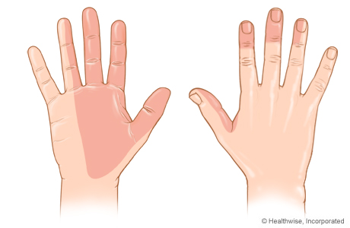
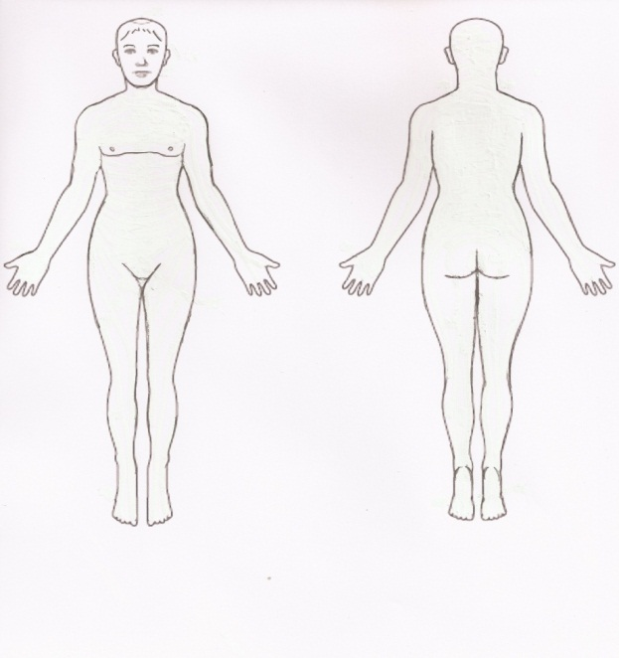
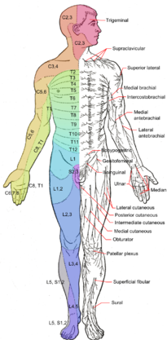
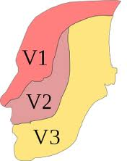
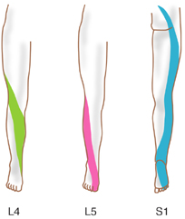
Is The Pain Neuropathic?
Body chart to determine whether pain is “neuro-anatomically plausible”:
  Within dermatome innervation
  Within peripheral nerve innervation
  “Glove & sock” distribution
  Hemi-corporeal

Slide 20
Is The Pain Neuropathic?
Body chart
Questionnaires for pain characteristics

Slide 21
Douleur Neuropathique 4 Questions (DN4)
Bouhassira et al Pain 2005;114:29–36
7 symptom questions
3 clinical examination questions
Specificity 83%
Sensitivity 90%
Score > 4/10 = POPNO*
7 symptom questions can be used alone as self administration form
Multiple validations in several languages
* Pain of Predominantly Neuropathic Origin
Notes:
Sesnitivity – abilty to detect true +
Specfcfity abilty to dtect treu -ve

Slide 22
Diagnosis & Assessment of Neuropathic Pain
Investigation of underlying disease.
Is there a lesion or disease of the somatosensory system?
Is the pain neuropathic?
How severe is the pain?
What is the impact of the pain?

Slide 23
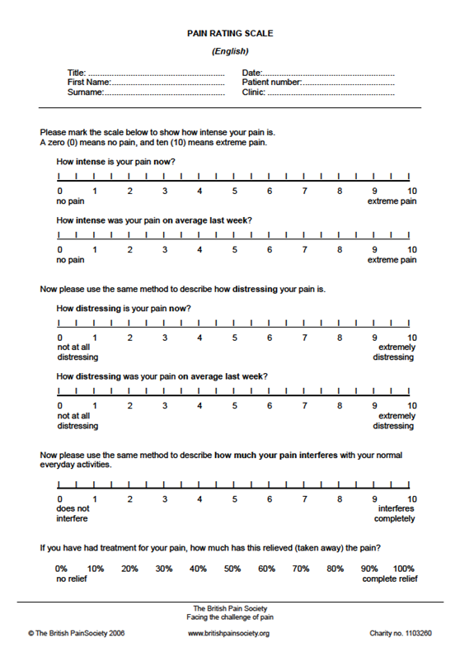
How severe is the pain?
Conventional analogue, Likert or categorical scales are adequate for routine clinical use
Separate measurement for:
  Spontaneous pain - continuous
  Spontaneous pain – paroxysmal (also event diary)
  Evoked pain - various modalities
Can also be used for:
  Pain relief
  Other symptoms e.g. paraesthiesae

Slide 24
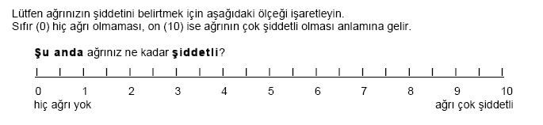
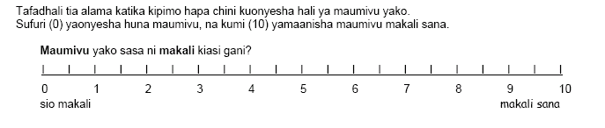
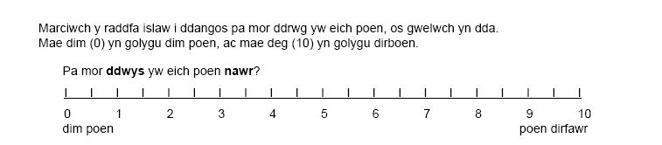
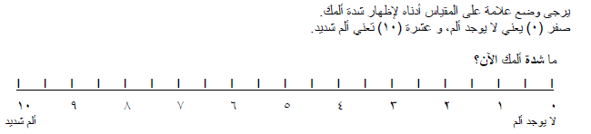
British Pain Society www.britishpainsociety.org
Notes:
Turkish, swahili, greek, welsh

Slide 25
Diagnosis & Assessment of Neuropathic Pain
Investigation of underlying disease.
Is there a lesion or disease of the somatosensory system?
Is the pain neuropathic?
How severe is the pain?
What is the impact of the pain?

Slide 26
Co-morbidity associated with peripheral neuropathic pain
Difficulty sleeping
60
Lack of energy
55
Drowsiness
39
Concentration difficulties
36
Depression
33
Anxiety
27
Poor appetite
18
0
10
20
30
40
50
60
70
% patients with moderate to very severe discomfort due to symptoms (n=126)
1. Meyer-Rosberg K et al. Eur J Pain 2001; 5: 379–389.
Notes:
Key message
Patients with peripheral neuropathic pain experience significant co-morbid symptoms
Other information
This study investigated pain intensity, employment status and quality of life in a survey of 126 patients with neuropathic pain from 2 Swedish Multidisciplinary Pain Centres¹
Patients were asked to what extent they were bothered by 25 pain-related symptoms and/or side-effects of treatment during the past week (rated as 1 = no discomfort to 7 = very severe discomfort)¹
The slide shows the proportions of patients who scored 4 (moderate) to 7 (very severe) discomfort. Data on 7 of the 10 most frequently reported symptoms are shown on the slide¹
Difficulty sleeping was most bothersome and was moderate to very severe in 60% of patients¹
Moderate to very severe discomfort due to anxiety was reported by 27% (1 in 4 patients) and depression by 33% (1 in 3 patients)¹
Reference:
Meyer-Rosberg K, Kvarnström A, Kinnman E et al. Peripheral neuropathic pain – a multidimensional burden for patients. Eur J Pain 2001; 5(4): 379–389.

Slide 27
What is the impact of the pain?
Domains:
  Sleep interference
  Anxiety
  Depression
  Quality of life and health impact
  Impact on daily living/function

Slide 28
Diagnosis & Assessment of Neuropathic Pain
Investigation of underlying disease.
Is there a lesion or disease of the somatosensory system?
Is the pain neuropathic?
How severe is the pain?
What is the impact of the pain?

Slide 29
TREATMENT OF NEUROPATHIC PAIN
;r
Primary therapy for underlying neuropathy and disease
Drug therapy for alleviation of pain:
  Evidence to support use of:
    Tricyclic antidepressants & duloxetine
    Gabapentinoids & other “anticonvulsants”
    Opioids
    Topical local anaesthetics
    Topical capsaicin 0.075% & 8%
Other therapies
  Spinal cord stimulation?
  Surgery for trigeminal neuralgia?
Treatment of co-morbidity
  Cognitive Behavioural Therapy- Pain Management Programme

Slide 30
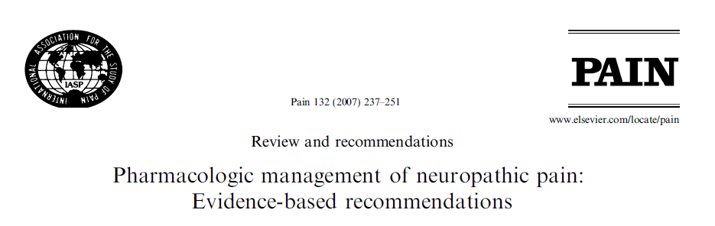
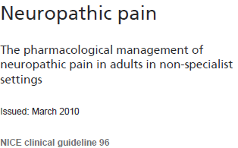
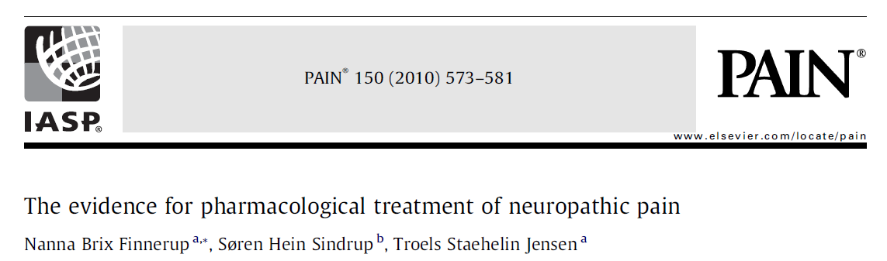

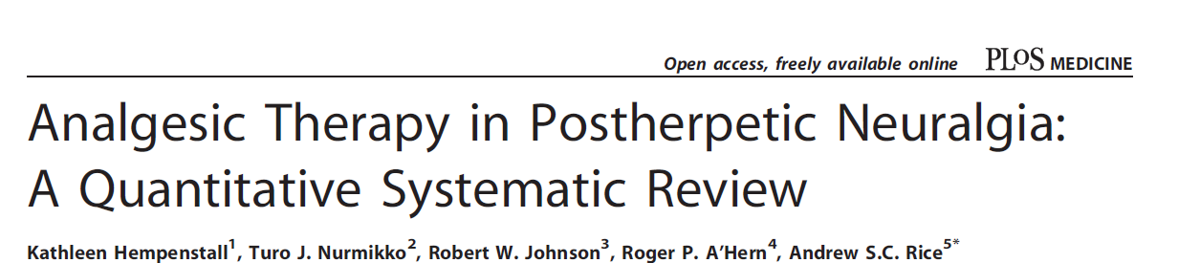

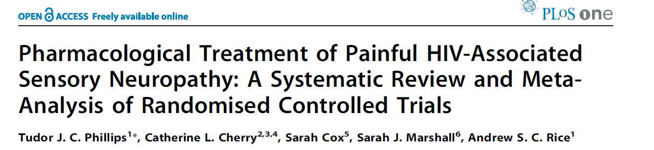
PHARMACOLOGICAL TREATMENT

Slide 31
Meta-analysis of RCTs in Peripheral Neuropathic Pain
Finnerup et al Pain 2010:150:573-851
.
Slide Courtesy of Nanna Finnerup, Aarhus
Notes:
31

Slide 32
Algorithm for Peripheral Neuropathic Pain Treatment
Peripheral NeuP
PHN or Focal Neuropathy?
Lidocaine 5%
Capsaicin 8%
Replace or Combine
TCA contraindication?
Gabapentin/Pregabalin
TCA
TCA contraindication?
Gabapentin/Pregabalin
TCA
Opioids
Breakthrough pain: tramadol prn

Slide 33


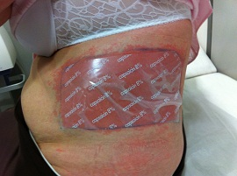
Topical Therapies
Lidoderm patch (5% lidocaine)
  Modified release local anaesthetic
  12 hours on/ 12 hours off
  Up to 3 patches at a time
  Can cut patches to size
Capsaicin 8%
  Single application 30-60 minutes
  TRPV-1 mediated desensitisation of nociceptors
  Relief for up to 3 months
  Can be repeated

Slide 34
Tricyclic Antidepressants
Amitriptyline or nortriptyline
  Starting dose 25 mg nocte (10 mg in elderly)
  increase by 25 mg weekly, to max. 150 mg.
Common side-effects
  Sedation, xerostomia, blurred vision, weight gain, urinary retention, cardiac dysrythmia, orthostatic hypotension, constipation
Caution
  Glaucoma, prostatic hypertrophy
  Driving

Slide 35
Gabapentin & Pregabalin
Gabapentin
  Starting dose 100 mg tds (300 mg/day)
  Increase gradually to max. 3600 mg/day
Pregabalin
  Starting dose 75 mg bd
  Increase gradually to max. 600 mg/day
Common side-effects
  Sedation, dizziness, GI disturbances, peripheral oedema
Caution
  Renal impairment

Slide 36
Clinical Heterogeneity of Neuropathic Pain – Symptoms & Signs
SYMPTOM PROFILES
SENSORY SIGN (QST) PROFILES
Maier et al Pain 2010;150:439
Baron et al Lancet Neurol.2012;11:999 - 1005
Notes:
Also Backonja & stacey 64 % mechaical 38% thermal hypersesnitivuty

Slide 37
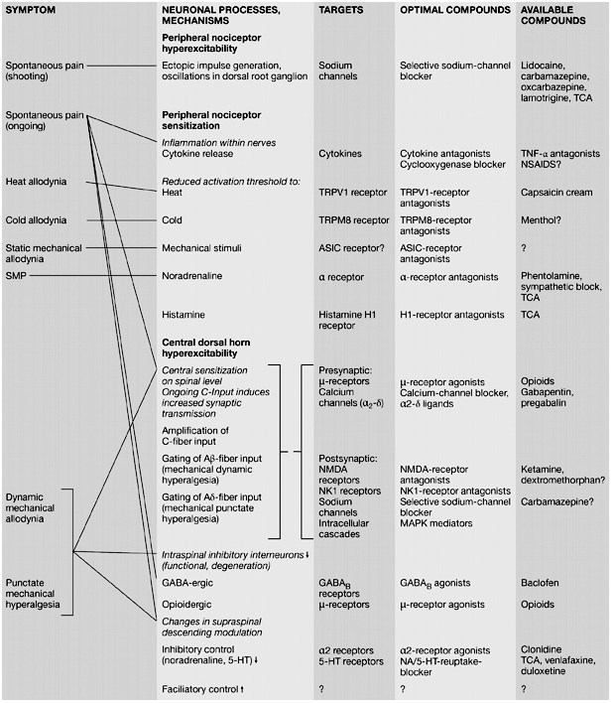
Predicting Pain Mechanisms and Treatment Responses at The Individual Patient Level
Baron Nat Clin Pract Neurol 2006;2: 95–105

Slide 38
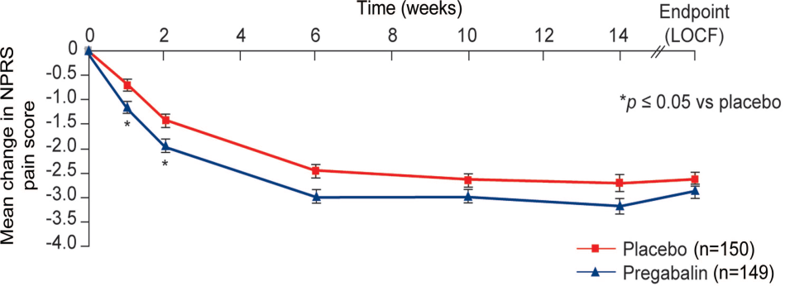
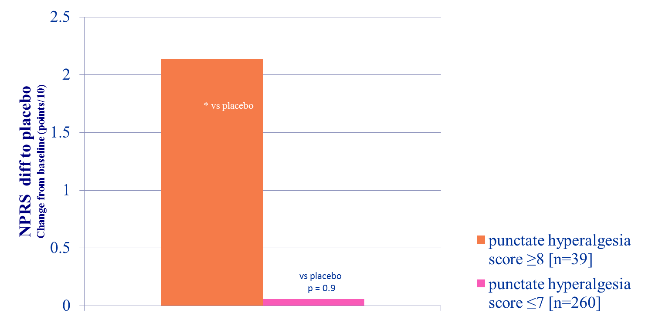
Efficacy Of Pregabalin In HIV Neuropathy Patient Subset With Pin Prick Hyperalgesia
Adapted from: Simpson et al Neurology 2010;74:413
Notes:
Do not sate if differcne was due to a lesser oplacebo response or greate pregablin - effciacy only give diff to placebo !
Numeric Pain Rating
Scale
Mean dose 385.7(160.3) mg/d.
Static mechanical allodynia was evoked by applying the plastic
base of a von Frey hair in the area of maximum pain for 10
seconds with sufficient pressure to indent the skin. Dynamic
mechanical allodynia was evoked by gently stroking the area of
maximum pain with a foam brush. Punctate hyperalgesia was
evoked by pinprick over the area of maximum pain with a supplied
safety pin. Temporal summation was evoked by repeatedly
tapping the area of maximum pain with a 300 g (6.65) Von Frey
hair at a rate of approximately 2 Hz (2 taps per second) for 60
seconds. Cold allodynia was evoked by applying a standardized
Figure 2 Study design and dosing schedule
Neurology 74 February 2, 2010 415
cool (15°C 2°C) metal rod. Cold hyperalgesia was evoked by
applying a cold (4°C) metal rod. Patients were asked to rate the
pain produced by the applied stimuli on an 11-point NRS. All
assessments were performed once at baseline and at endpoint.

Slide 39
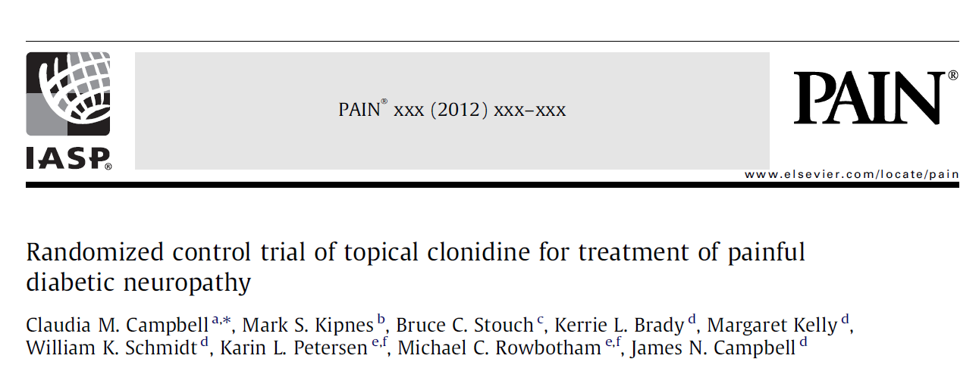
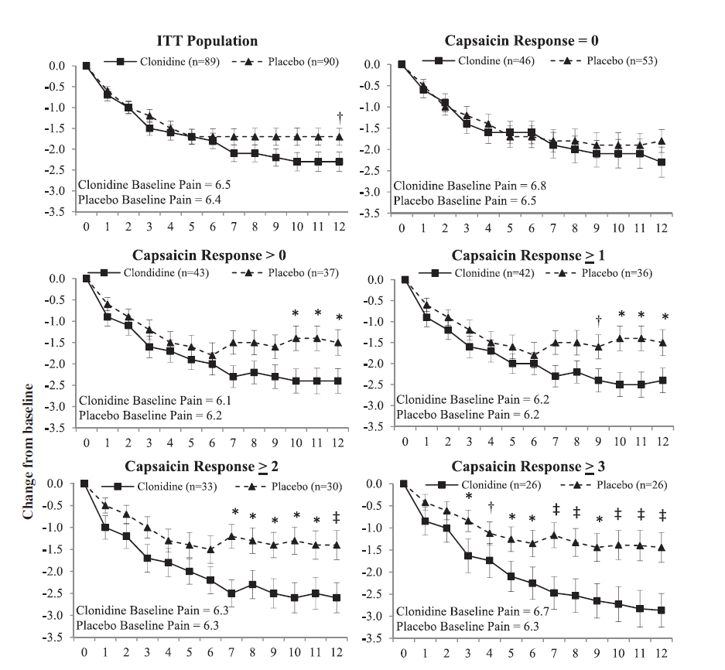

Slide 40

Opioids should not be used as first line pain therapy
Data supports short term efficacy, but lacking for sustained efficacy
Decision to start long term opioid therapy carefully considered by pain specialist, GP & patient. Informed consent required
Trial of opioid therapy with evaluation of analgesic efficacy & adverse effects
Modified release opioids should be used, not injectable opioids
Agreed goal of therapy: Complete relief of pain is rarely achieved with opioids. The goal of therapy should be to reduce symptoms sufficiently to support improvement in physical, social and emotional functioning.
Arrangements for long-term monitoring and follow-up must be in place

Slide 41
Opioids for Persistent Pain- Good Practice 2010
Side Effects
Constipation
Nausea & vomiting
Somnolence
Pruritis
Dizziness
Tolerance to side effects usually occurs within a few days
Pruritis and constipation tend to persist.
Troublesome side effects should be actively managed by appropriate pharmacological measures.
Respiratory Depression
Respiratory depression is can occur with opioids in acute pain, but only likely in problem persistent pain after major changes in dose, formulation or route of administration.
Accidental overdose is probably the commonest cause of respiratory depression, esp. with concomitant sedatives use.
Endocrine and Immune Effects
Uncertainty about long term effects on endocrine and immune function.

Slide 42
Opioids for Persistent Pain- Good Practice 2010
Signs of Opioid Toxicity
Mioisis
Sedation
Bradypnea and cyanosis
Myoclonic jerks
Snoring
Agitation
Confusion
Vivid dreams, nightmares or hallucinations
In severe cases: Hypotension, Coma & Convulsions
Signs of Opioid Withdrawal
Sweating
Mydriasis
Piloerection
Yawning
Abdominal cramps/vomiting/diarrhoea
Bone and muscle pain
Increase in usual pain
Restlessness
Anxiety
Rhinorrhoea
Lacrimation
Tremor

Slide 43
Opioids for Persistent Pain- Good Practice 2010
Dose Escalation
Can be a sign of problem drug use, but may also result from:
  Disease progression
  Additional new painful condition
  Opioid tolerance
  Opioid-induced hyperalgesia
Signs of Problem Opioid Use
Early prescription seeking
Lost medication/prescription claims
Intoxication
Frequent missed appointments
Misuse of other scheduled drugs
Concerns about problem drug use prompts referral to specialised pain & addiction services.
Opioid therapy for substance misuse patients should be closely monitored by specialists in
pain and/or addiction services.

Slide 44

Interventional Treatments For Neuropathic Pain
Caveats
Evidence base very limited, compared to pharmacological therapy, in terms of quantity and methodological quality (RCT)
Placebo control very rare
Studies of compare technical aspects of intervention, rather than documenting effectiveness
Potential for severe adverse effects
Neuroablation
Neurostimulation
Surgical procedures
Beecher HK.
Surgery as placebo.
A quantitative study of bias.
JAMA 1961; 176:1102-1107

Slide 45
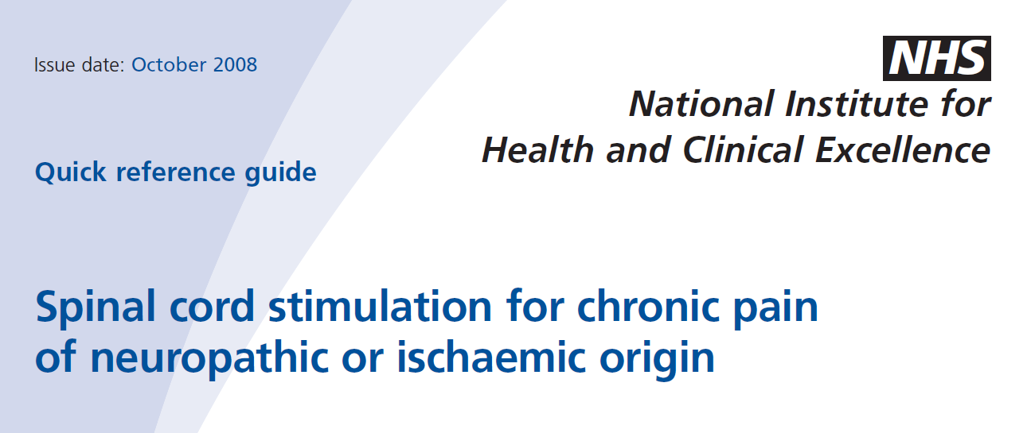
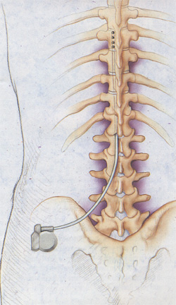
Spinal Cord Stimulation
SCS recommended for neuropathic pain if:
  Pain > 50/100 for at least 6 months despite appropriate conventional medical management
  Successful trial of stimulation
  ….but non-placebo controlled evidence in FBSS and CRPS1 only

Slide 46
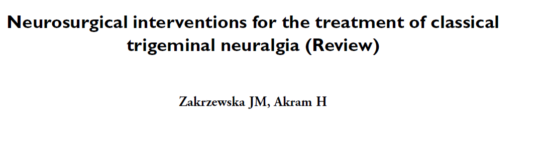
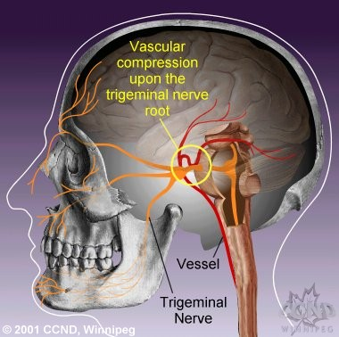
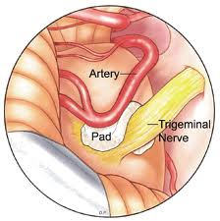

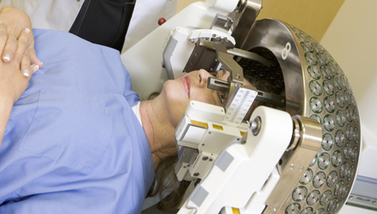

Surgery for Trigeminal Neuralgia
Vascular Decompression
There is very low quality evidence for the efficacy of most neurosurgical procedures for trigeminal neuralgia because of the poor quality of the trials.
All procedures produced variable pain relief, but many resulted in sensory side effects.
Gamma Knife

Slide 47
NEUROPATHIC PAIN
Definition, epidemiology, clinical presentation & pathophysiology
Clinical management: diagnosis and treatment
Clinical demonstration
Projects – a.rice@imperial.ac.uk:
  Laboratory
  Clinical

