Slide 1

Monitoring anaesthesia
Dr Helen Laycock
Academic Clinical Fellow / Anaesthetic Registrar (ST6)
Chelsea and Westminster Hospital / Imperial College London

Slide 2
Overview
Overview of anaesthesia
Awareness
Physiological monitoring
Neuronal monitoring

Slide 3
General Anaesthesia
“Lack of response and recall to a noxious stimulus”
Triad of Anaesthesia _{(Davy 1999)}
Hypnosis
Analgesia
Relaxation

Slide 4
Anaesthesia
Balance between unconscious and side effects

Slide 5
Awareness
Insufficient anaesthesia = Awareness
“ability to perceive and process sensory information and being aware of ones environment”
Explicit
  Spontaneous / prompted recall of intraoperative events with or without pain
Implicit
  no conscious recollection but evidence of intraoperative memory processing at a subconsious level

Slide 6
Maintaining General Anaesthesia
Inhalational agents
  Halogenated hydrocarbon structure
  Minimum Alveolar Concentration (MAC₅₀)
  “concentration which would prevent 50% young healthy men to show a reflex response to skin incusion”
Intravenous agents
  Total intravenous anaesthesia
  Target controlled infusion to give desired effective blood concentration

Slide 7
Maintaining General Anaesthesia
Spontaneous Ventilation
  Patient initiates breathing
  Patient is not paralysed
Mechanical Ventilation
  Ventilator initiates patient breathing
  Patient is paralysed with a neuromuscular blocking agent
  No skeletal muscle movement

Slide 8
Awareness
Overall incidence 0.1-0.2%
  Emergency caesarean section 0.4%
  Cardiac surgery 1.5%
Risk factors
  Equipment
  Pharmacology
  Patient Physiology
Consequences include PTSD, behavioural change, psychological distress, insomnia.

Slide 9
General Principle
Monitoring depth of general anaesthesia is complicated.
All methods have disadvantages
There is no “gold standard” and no recommended technique

Slide 10
Ideal monitor of depth of anaesthesia
Reduces risk of awareness
Independent of anaesthetic agent used
No hysteresis
Good sensitivity and specificity
Predictive of “light” anaesthesia
Proportionate to stimuli
Minimal response time
Easy to use
Inexpensive

Slide 11
Physiological measures
Respiratory and skeletal muscle activity
  Useful in spontaneous ventilation
  Repiratory rate and depth
  Movement to surgical stimulus
PRST
  Systolic arterial pressure, heart rate, sweating, tear formation
  Scoring system based on sympathetic stimulation

Slide 12
Respiratory Sinus Arrhythmia
Respiration changes the RR interval on ECG
More direct measure of respiration which reflects brainstem function
Requires intact autonomic nervous and myocardial conduction system
Restricted by drugs / pathophysiology

Slide 13
Isolated forearm technique
Arterial tourniquet prior to paralysis
Forearm NOT paralysed
Agree signals for awareness
During anaesthesia ask for responses
Movement suggests possible awareness
Problems
  Compiance
  Interference if move arm
  20mins get ischaemic paralysis of arm!

Slide 14
Oesophageal contractility
Measure amplitude and frequency of smooth muscle in lower oesophagus
Activity reduces with increased anaesthetic depth
High false positive and false negative results

Slide 15
Neuronal Activity
Brain is the target organ for anaesthetic agents
Logical changes in neurophysiological parameter could indicate depth of anaesthesia
Predominantly based on EEG recordings

Slide 16
EEG
Recording of electrical potentials arising from dendritic fields in cerebral cortex
16 electrodes on scalp
Potential around 50 μV
Complex, large quantity information
Burst supression during general anaesthesia
Influenced by anaesthetic agent and pathophysiology

Slide 17
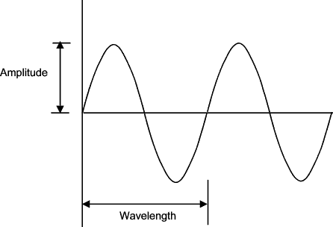
Physics of a waveform
Complex waveforms can be simplified into component sine waves

Slide 18
Cerebral Function Monitor
Simplify EEG
1950’s – anaesthetic agents changed the electrical “power” of EEG
Two electrodes (one on each paretal lobe)
Measure voltage as function of amplitude and frequency
Graph
  Height of baseline from x axis is activity of EEG
  Width of trace is variability

Slide 19
Compressed Spectral Array
Separate EEG into discrete time periods
Modified with Fourier transformation into sine wave components
Calculates power of different wave frequencies
Plots power vs frequency graph
Superimposes each time period to provide a 3D display as peaks and troughs
General anaesthesia power shifts to lower frequencies
Problems – interindividual and agent variability, pathophysiology affects results

Slide 20
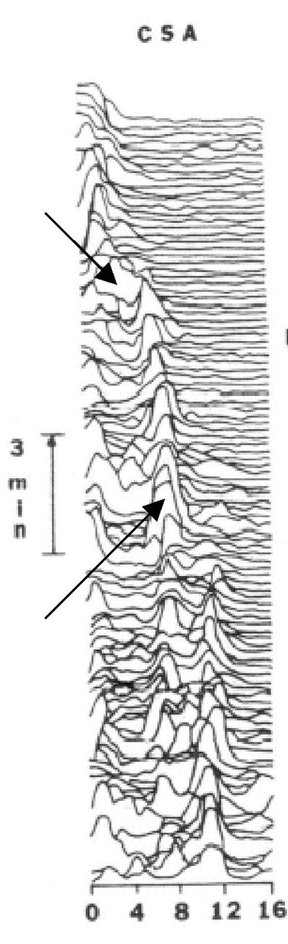
CSA spectra

Slide 21
Further adaptation of CSA
Spectral edge
  frequency above which there is only 5% of total EEG power
  upper edgde of spectrum
Median Frequency
  Measure of central tendency of power

Slide 22
Bispectral Index
Mathematically quantifying relationship between two EEG frequencies
Frontal electrodes
Creates a linear dimensionless scale from 0-100
0= cortical silence
100= normal cortical activity

Slide 23
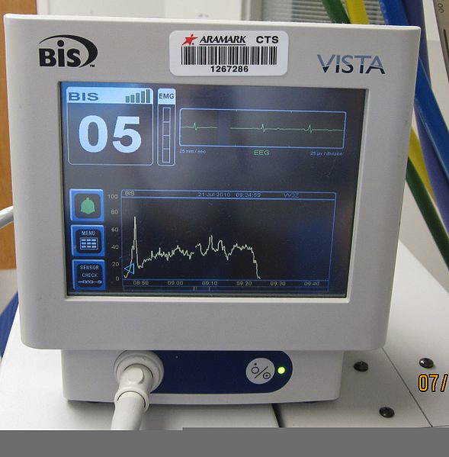
BIS monitor

Slide 24
Bispectral Index
Value | Clinical State
85-100 | Awake, aware, capable of memory processing and explicit recall
60-85 | Increasing sedation and impairment of memory processing, rousable in response to stimulus
40-60 | Surgical anaesthesia – decreased probability of post operative recall, Auditory processing and reflex movement still occurs
0-40 | Increasing frequency of burst suppression

Slide 25
Bispectral analysis
Advantages
  Rapid response time
  Accurate for anaesthetic agents
  Dose response relationship
Disadvantages
  No specific value for loss of consciousness
  Studies fail to address surgical stimulus!
  Some agents increase EEG activity

Slide 26
Entropy
Entropy is disorder within a system
Irregularity decreases with increasing levels of anaesthesia
Forehead sensors
Two numbers generated
  Response entropy includes EMG activity
  State entropy excludes EMG activity

Slide 27
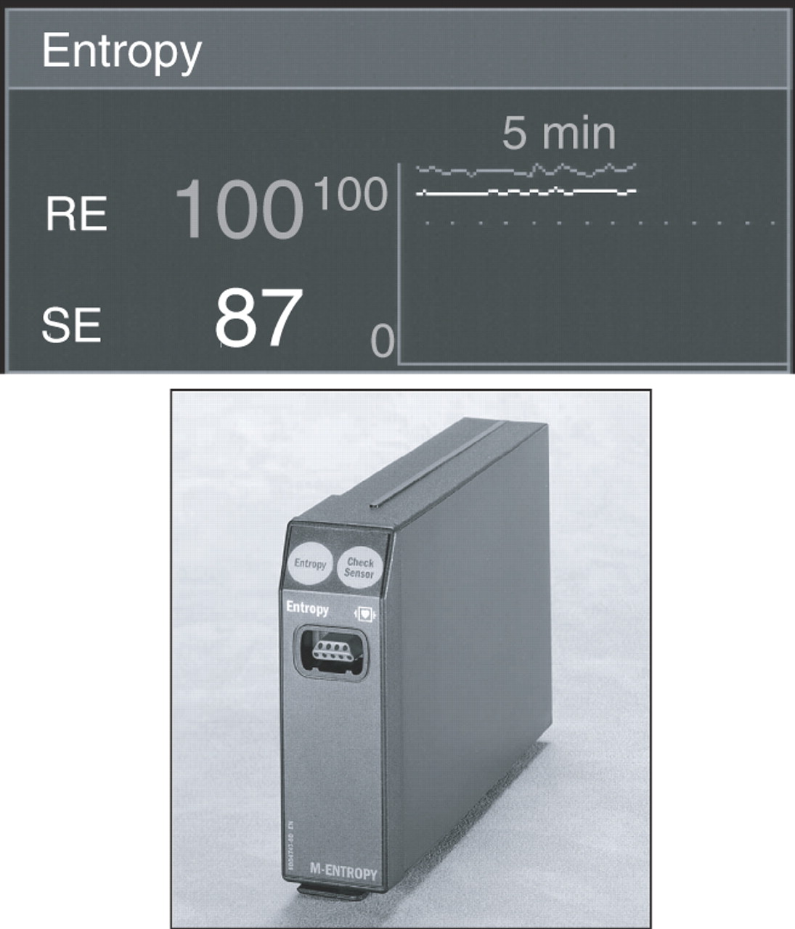

View of the M-Entropy module and the partial screen of the S5-Monitor (GE Healthcare, Helsinki, Finland).
Bruhn J et al. Br. J. Anaesth. 2006;97:85-94
© The Board of Management and Trustees of the British Journal of Anaesthesia 2006. All rights reserved. For Permissions, please e-mail: journals.permissions@oxfordjournals.org

Slide 28
Evoked potentials
Monitor EEG signal when a stimulus is applied
Electrode over area which primarily recieves that sensory modality
3 types
  Visual
  Somatosensory
  Auditory

Slide 29
Auditory Evoked Potnetials
Most effectived as last to disappear
Repeated 6-10Hz clicks
Activates pathway from cochlear to cortex
Record EEG after each click
EEG’s superimposed, amplified and noise removed
Middle latency section 10-50ms
Amplitude and latency decrease with depth of anaesthesia

Slide 30
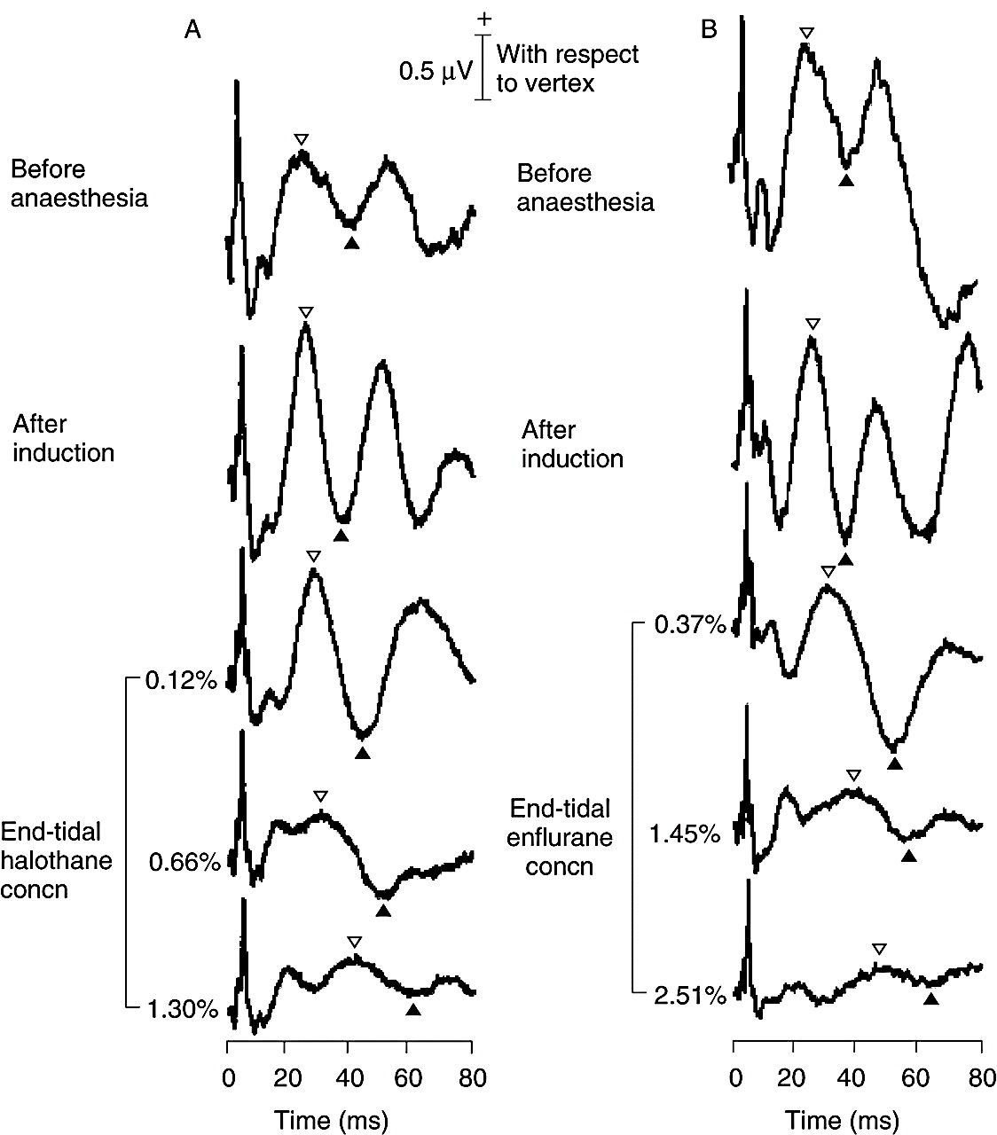
Auditory Evoked Potentials

Slide 31
Summary
Awareness important issue in anaesthesia
Difficult to measure
All tools have disadvantages
No gold standard – opportunity for development

Slide 32
References
Monitoring depth of Anaesthesia by EEG. Whyte SD, Booker PD, CEPD Reviews, BJA, 2003: 3(4); 106-110
Basic Physics and Measurement in Anaesthesia, 5th Edition. Davis PD, Kenny GNC, p289-293

