Slide 1
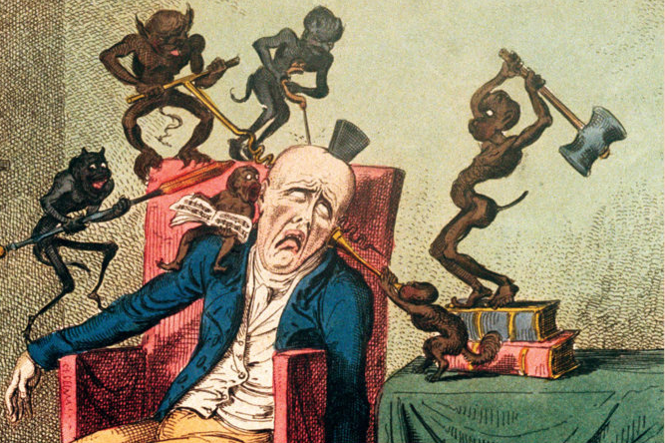
Headaches
Anna P Andreou
anna.andreou@headache-research.com
a.andreou@imperial.ac.uk
George Cruikshank
(1792–1878)

Slide 2
International Classification of Headache Disorders (ICHD)
International Headache Society, 2nd edition , 2004
 | IHS code | Classification
Primary headaches | 1. | Migraine
 | 2. | Tension-type headache
 | 3. | Cluster headache and other trigeminal autonomic cephalalgias
 | 4. | Other primary headaches
Secondary headaches | 5. | Headache attributed to head and/or neck trauma
 | 6. | Headache attributed to cranial or cervical vascular disorder
 | 7. | Headache attributed to non-vascular intracranial disorder
 | 8. | Headache attributed to a substance or its withdrawal
 | 9. | Headache attributed to infection
 | 10. | Headache attributed to disorder of homoeostasis
 | 11. | Headache or facial pain attributed to disorder of cranium, neck, eyes, ears, nose, sinuses, teeth, mouth or other facial or cranial structures
 | 12. | Headache attributed to psychiatric disorder
Central neuralgias, central and primary facial pains, other headaches | 13. | Cranial neuralgias and central causes of facial pain
 | 14. | Other headache, cranial neuralgia, central or primary facial pain

Slide 3
Preview....
Migraine classification & prevalence
Migraine: The disorder-The attack
Genetics of Migraine
Pathophysiology
Treatment

Slide 4
Classification of migraine
IHS code | Migraine Type
1.1 | Migraine without aura
1.2 | Migraine with aura 1.2.1 | Typical aura with migraine headache
 | 1.2.2 | Typical aura with non-migraine headache
 | 1.2.3 | Typical aura without headache
 | 1.2.4 | Familial hemiplegic migraine (FHM)
 | 1.2.5 | Sporadic hemiplegic migraine
 | 1.2.6 | Basilar-type migraine
1.3 | Childhood periodic syndromes that are commonly precursors of migraine 1.3.1 Cyclical vomiting
 | 1.3.2 | Abdominal migraine
 | 1.3.3 | Benign paroxysmal vertigo of childhood
1.4 | Retinal migraine
1.5 | Complications of migraine 1.5.1 | Chronic migraine
 | 1.5.2 | Status migrainous
 | 1.5.3 | Persistent aura without infarction
 | 1.5.4 | Migrainous infarction
 | 1.5.5 | Migraine-triggered seizure
1.6 | Probable migraine 1.6.1 | Probable migraine without aura
 | 1.6.2 | Probable migraine with aura
 | 1.6.3 | Probable chronic migraine

Slide 5
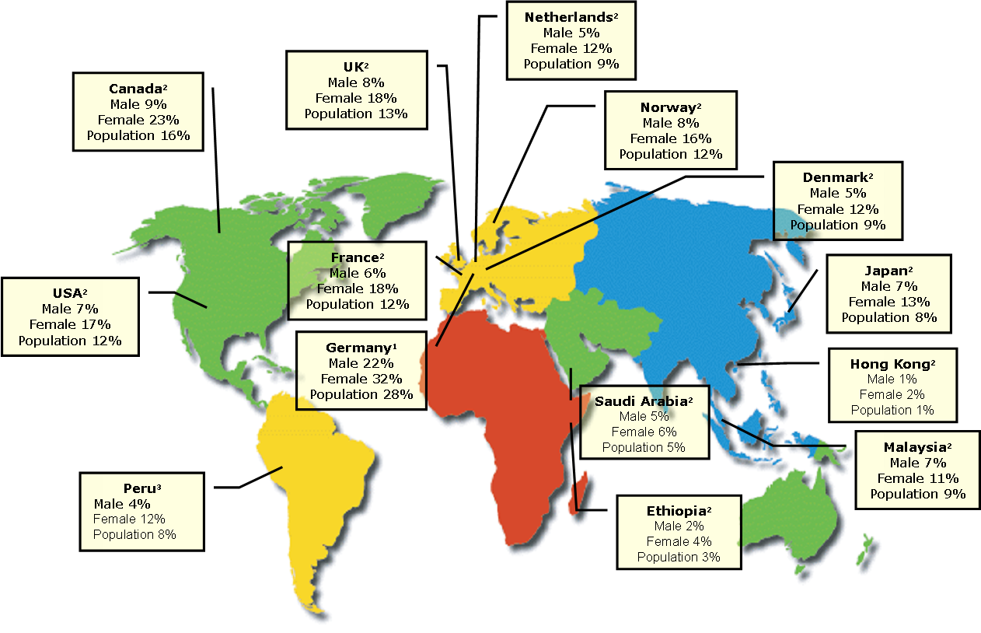
Epidemiology of Migraine
1 lifetime prevalence
2 one-year prevalence
3 not available period for
prevalence
Adapted from (Peres, 2005)

Slide 6
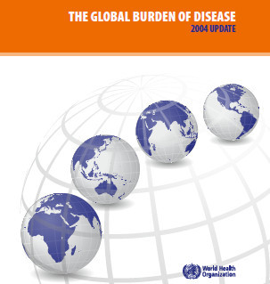

THE GLOBAL BURDEN OF DISEASE
2004 UPDATE
Prevalence in millions of the five most prevalent conditions of the world, by WHO, 2004
Iron-deficiency anaemia | 1159.3
Migraine | 324.1
Hearing loss | 318.25
Low vision | 272.4
Asthma | 234.9
Diabetes mellitus | 220.5
Prevalence and disability rank of neurological conditions of the world, by WHO, 2004
Condition: | Prevalence (millions) | Disability rank (0-1)
Migraine | 324.1 | 0.7-1.0
Unipolar depressive disorders | 151.2 | 0.36-0.5
Epilepsy | 40 | 0.7-1.0
Stroke | 30.7 | 0.24-0.36
Bipolar affective disorder | 29.5 | 0.36-0.5
Schizophrenia | 26.3 | 0.7-1.0
Alzheimer and other dementias | 24.2 | 0.5-0.7
Parkinson disease | 5.2 | 0.24-0.36

Slide 7
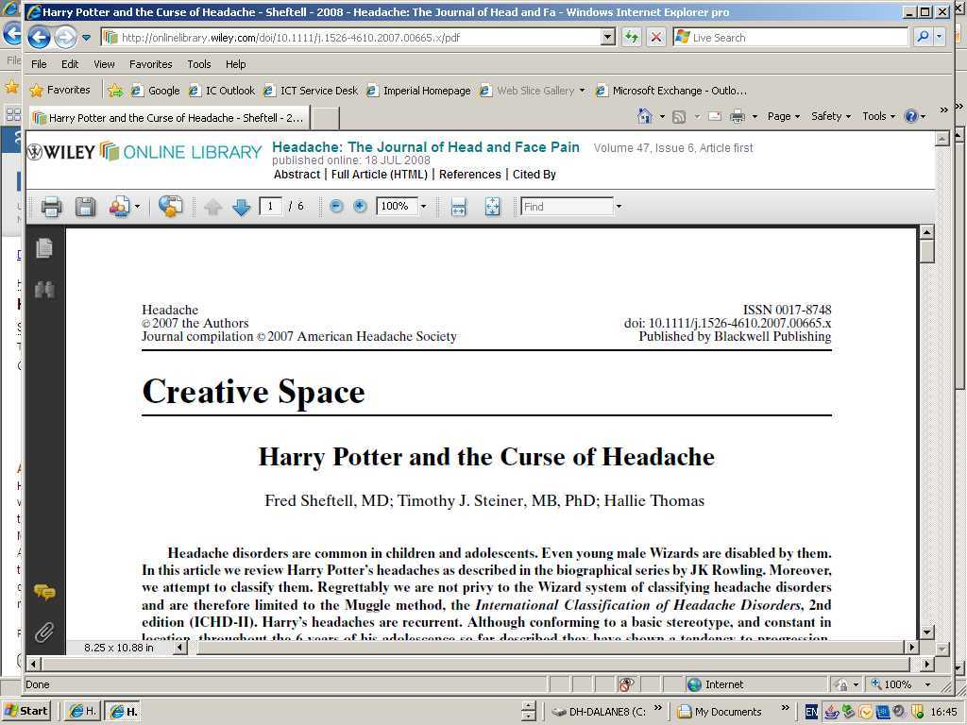
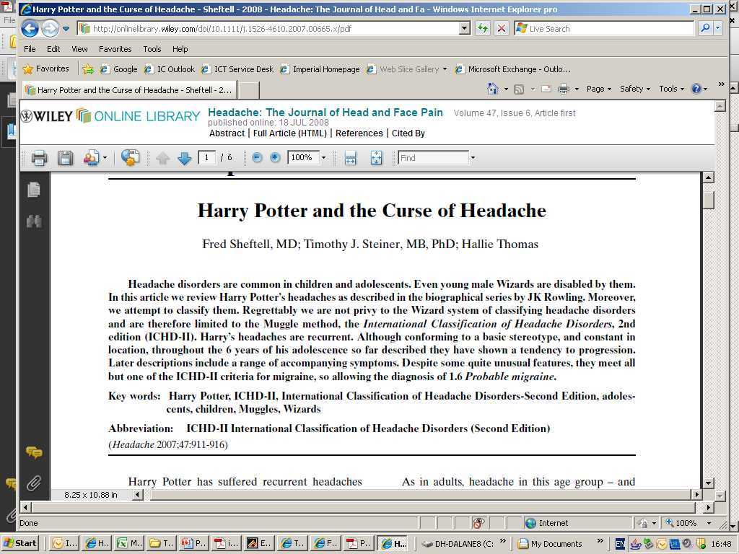

Epidemiology of Migraine in Children
Migraine occurs in 3-10% of
children < age of 12
Sex ratio 1:1
18% of 13-14 years old
“Then a pain pierced his head like he’d never
felt before, it was as though his scar was on fire –half blinded, he staggered backwards . . . The pain in Harry’s head was so bad he fell to his knees”. Rowling JK 2007. Harry Potter and the Philosopher's Stone

Slide 8
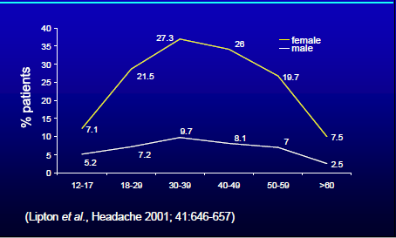
Age specific prevalence of Migraine

Slide 9
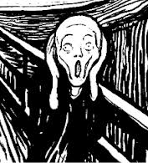
Migraine
The Attacks & the Disorder
Disorder
Repeated attacks
< 15 days/month: Episodic
≥ 15 days/month: Chronic
Family history
Triggers (biology)
Stress-relaxation
Hormonal (women)
Sleep: missing/excess
Missing meals
Chemical (alcohol/
nitroglycerin/CGRP)
Sensory: light, smells

Slide 10
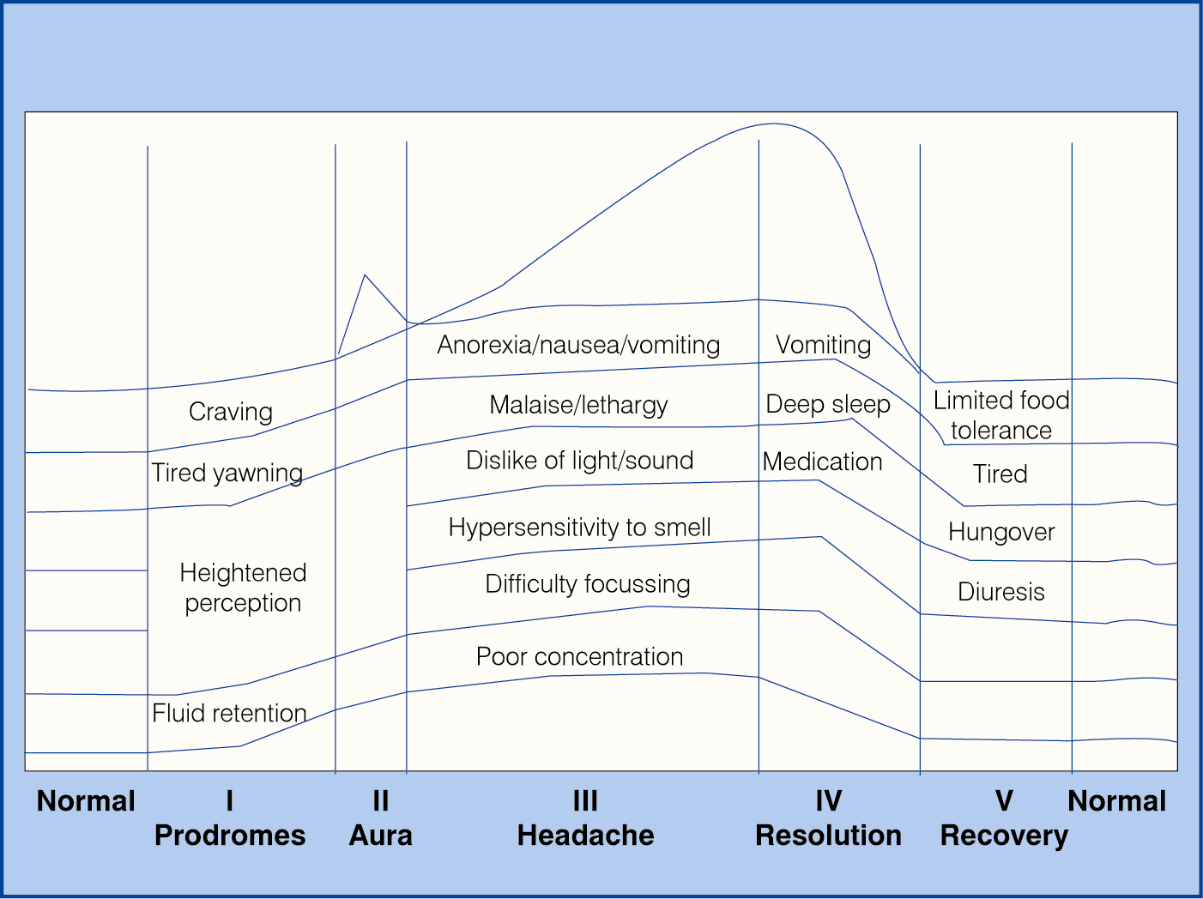
Clinical picture of a migraine attack
Headache
Premonitory

Slide 11
Migraine
The Attacks & the Disorder
Attacks
Premonitory Symptoms
Head Pain
Unilateral
Throbbing
Movement worsen
Nausea
Sensory sensitivity
Photophobia
Phonophobia
Osmophobia
Aura

Slide 12
Migraine – a multisymptom complex of the brain
HEADACHE
allodynia
photophobia
fatigue
phonophobia
speech
difficulties
MIGRAINE
aura
nausea/
vertigo
vomiting
yawning
osmophobia
poor concentration

Slide 13
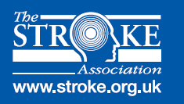
Migraine & CVS risk in women
Meta-analysis studies
Higher risk for stroke: ♀, migraine with aura,
< 45 yrs, smoke & OC
Migraine with aura
Migraine without aura
Migraine
Odds ratio
Stroke CVS disease MI
Schurks et al, 2009

Slide 14
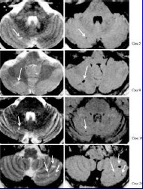
White matter lesions of migraine
CAMERA I & CAMERA II study
~ 20% of migraine patients
Small deep white matter
lesions
Not associated with
reduced mental ability
True etiology is unknown;
ischemic?
(Kruit et al., 2005)

Slide 15
Genetics of Migraine –
Familial Hemiplegic Migraine
FHM 1 (locus 19p13): CACNA1A calcium channel gene
calcium flux at the presynaptic terminal (Ophoff et al., Cell, 2003).
FHM 2 (locus 1q23): ATP1A2 gene of Na⁺/K⁺ ATPase
re-uptake of potassium and glutamate into glial cells (De Fusco
et al.,Nat Gen, 2003).
FHM 3 (locus 2q24): SCN1A gene of neuronal Na⁺ channels
high-frequency discharges (Dichgans et al., Lancet, 2005).

Slide 16
Genetics of Migraine –
Familial Hemiplegic Migraine
Is migraine a disorder of persistent neuronal
hyperexcitability?
Lack of habituation
glutamate in plasma and CSF

Slide 17
Genetics of Migraine - GWAS
Plasma glutamate carboxypaptidase gene (PGCP)
Astrocyte elevated gene 1 (MTDH)
TRESK potassium channel
TRPM8 cold receptor
LRP1 (apolipoprotein E receptor)

Slide 18
Migraine Pathophysiology
Largely Unknown
Potential involvement of:
The trigeminovascular system
Higher brain centers (thalamus, cortex)
Descending Brainstem & Pons Nuclei
Hypothalamus

Slide 19
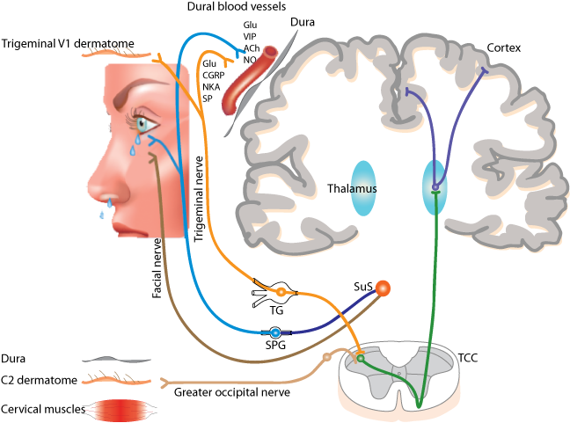

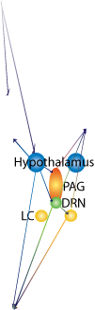

Neuronal pathways involved in migraine pathophysiology –
Trigeminovascular pathway

Slide 20
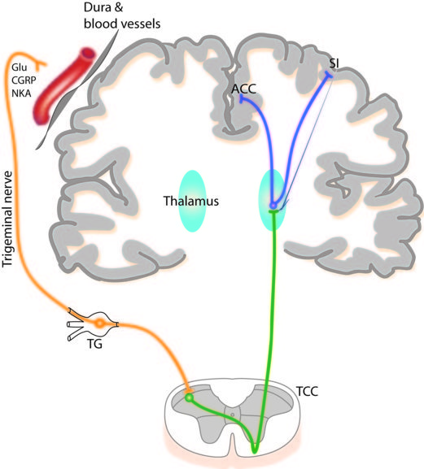
Thalamus and Cortex
Brain imagining studies
(spontaneous & GTN-induced migraine attacks):
Thalamus
Somatosensory cortex
Anterior cingulate cortex
[contralateral to pain]
Cortex
Thalamus

Slide 21
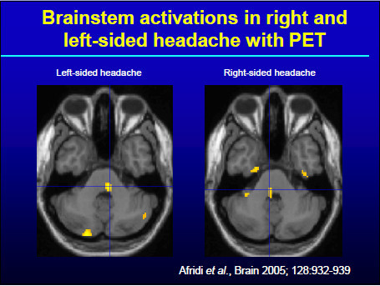
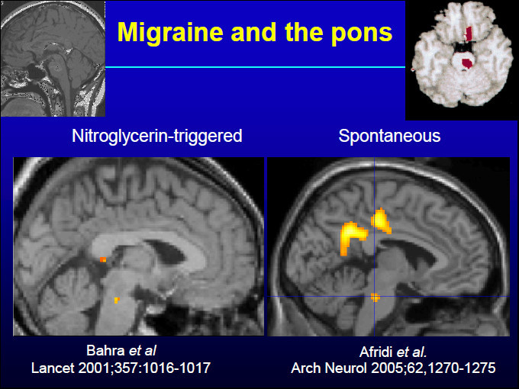
Brainstem, Medulla and Pons
Left side headache
Right side headache
Ipsilateral to Pain
Candidate nuclei:
Periaqueductal gray
Locus coeruleus
Dorsal raphe nucleus
Nucleus raphe magnus)
Afridi et al.,
Brain 2005;128:932-9
GTN-triggered
Spontaneous
Bahra et al.,
Lancet 2001;357:1016-17
Afridi et al.,
Arch Neurol 2005;62:1270-75

Slide 22
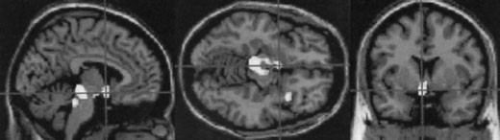
Hypothalamus
In premonitory phase (yawning, food craving, thirst, emotional)
Localization: anterior than TACs
Correlation with migraine triggers? (lack of sleep, hormonal changes in women, missing meal…)
(Denuelle et al., 2007)

Slide 23
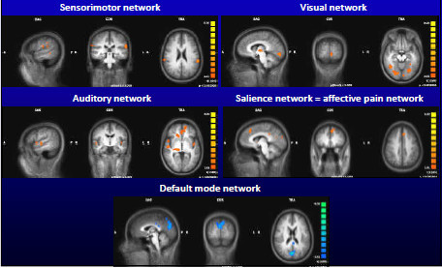
Outside migraine attacks migraineurs have increased network activity and decreased default mode connectivity
Sprenger T, AHS meeting,
Los Angeles 2010

Slide 24
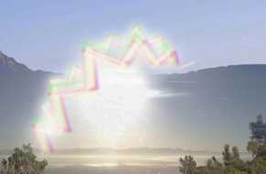
Migraine Aura
20-30% of migraine attacks
Reversible neurological symptoms (15-60 min)
visual symptoms (flickering lights, spots or lines, or complete scotoma)
sensory symptoms (pins and needles, numbness)
dysphasic speech disturbances
Headache usually (~ 80%) follows
Aura without headache is not uncommon

Slide 25
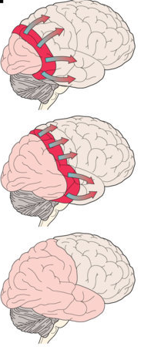
Pathophysiology of aura: Cortical spreading depression (CSD)
Self-propagating wave of neuronal depolarization
& glial activation
2-3 mm/min across the cerebral cortex
It does not crosses the cerebral hemisphere
Triggers: K⁺ , glutamate, ischemia, brain injury,
epileptic activity

Slide 26

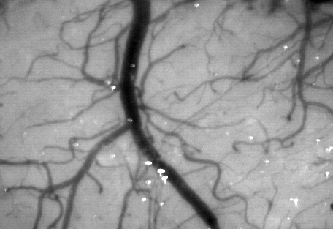
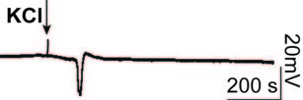

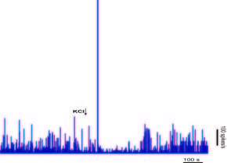
Cortical spreading depression
Laser Doppler: Cerebral blood flow measurements
Electrophysiology– Ag/AgCl recordings:
Field potential/ DC-shift
Electrophysiology– Single unit recordings:
Spikes/s
KCl

Slide 27
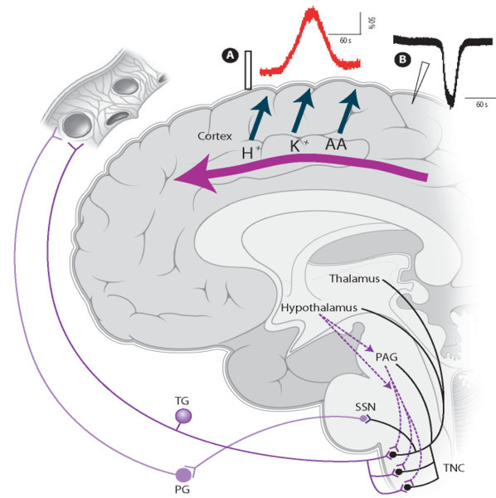
Does CSD initiates migraine?
Bolay et al., Nat Med 2002

Slide 28
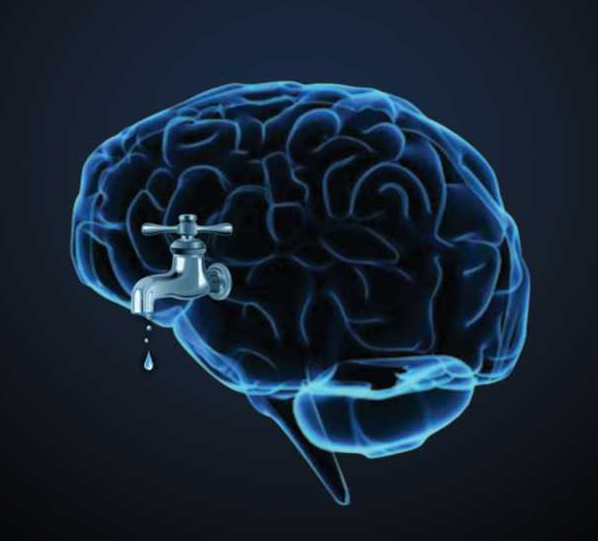
BUT... Does the brain really leak?
No evidence of a sterile inflammation response (plasma protein extravasation) in migraine patients

Slide 29
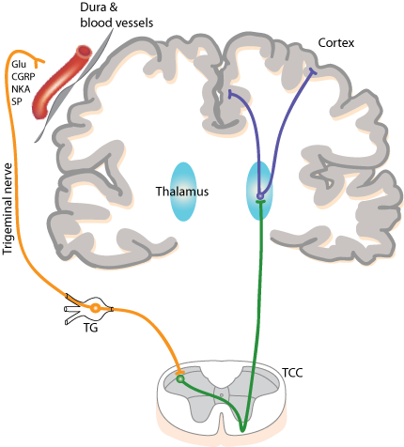
CSD can induce sensitization of the cotricothalamic loop, independent to trigeminal activation, leading to a “false perception of pain”
CSD

Slide 30
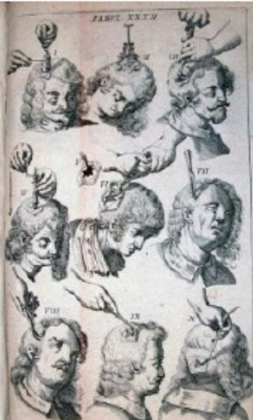
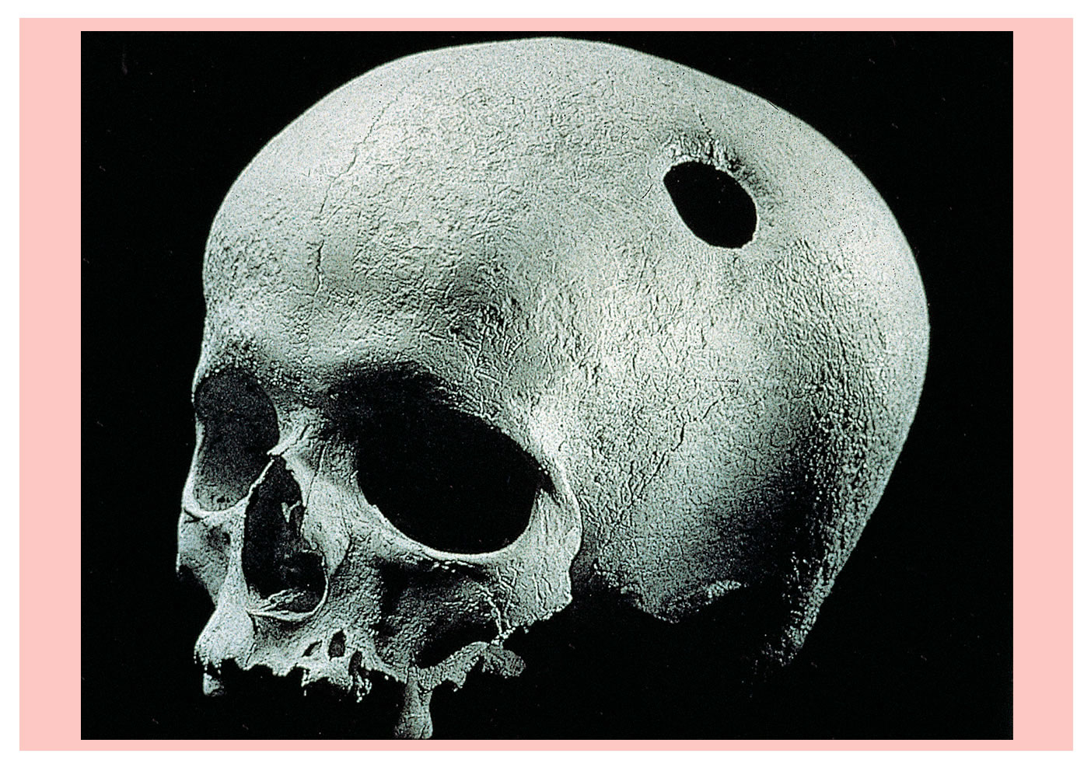
Treatment options for Migraine

Slide 31
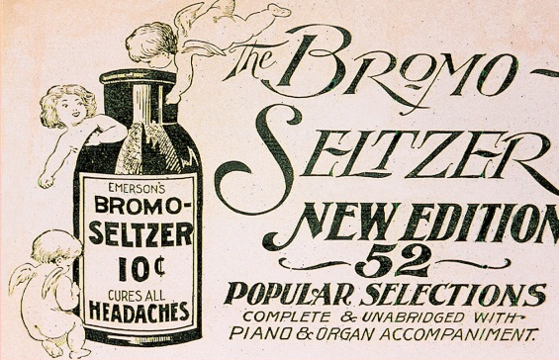
Treatment options for Migraine
Acute Treatment
Triptans*
Dihydroergotamine (5-HT_{1D} agonists)
NSAIDs*
Combination analgesics*
Neuroleptics/anti-emetics
Ketamine may be efficient in the treatment of
prolonged aura
sTranscranial Magnetic Stimulation
* MOH

Slide 32
Triptans
~ 40-55% efficacy (x migraine aura)
Early treatment is more effective
5-HT_{1B/D} agonists (Sumatriptan, Rizatriptan, Naratriptan, Zolmitriptan, Eletriptan, Almotriptan, Frovatriptan, Avitriptan)
Differences to consider:
route of administration
dose-dependent efficacy
adverse-effects profiles
onset of relieving effects
sustained pain-free duration

Slide 33
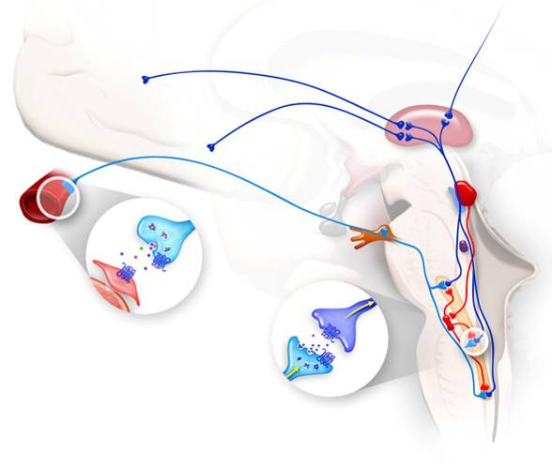
Where do triptans act?
Peripheral actions
Central actions
Thalamic 5-HT_{1B/D}
(inhibit 3rd order neurons action potentials)
Decreased 5-HT
synthetic rate in
descending
modulatory
pathways (DRN)
5-HT_{1B/D} in PAG,
NRM, PH
(activation of
descending
pain-modulating
pathways)
Vascular 5-HT_{1B} (vasoconstricotrs*)
Trigeminal fibers 5-HT_{1D} (inhibit glutamate and CGRP release)
* CVS risk
Pre-synaptic 5-HT_{1D} in the TCC (inhibit CGRP and glutamate release)
Post-synaptic 5-HT_{1B/D} receptors (inhibit action potentials)

Slide 34
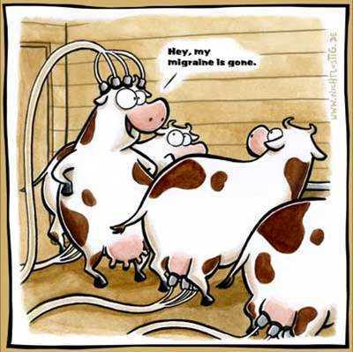
Treatment options for Migraine
Preventive Treatment
Pharmacological treatment
β-blockers (eg propranolol)
serotonin antagonists (eg pizotifen),
GABA modulators (eg valproate)
Glutamate modulators (eg topiramate, lamotrigine)
Calcium channel blockers (eg flunarizine)
Neuromodulation
Occipital nerve stimulation (~ 40-50% efficacy)
rTranscranial Magnetic Stimulation

Slide 35
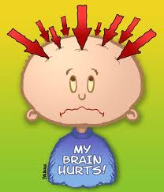
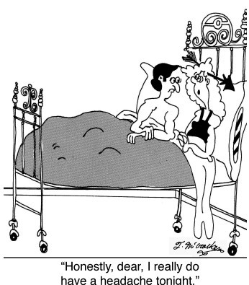
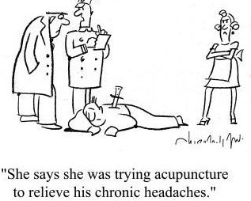
Do you have a headache?

