Slide 1
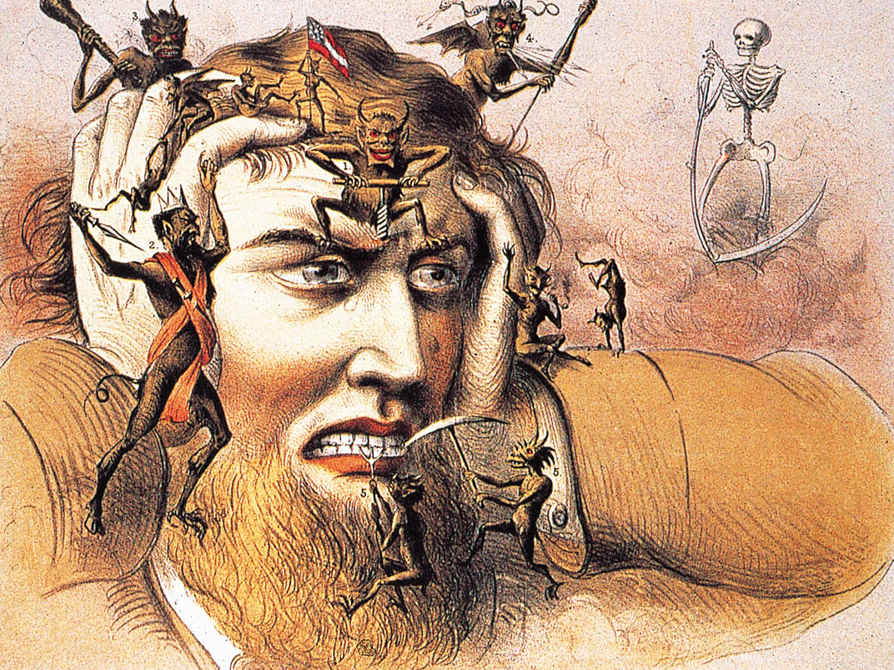
Headaches
Anna P Andreou
anna.andreou@headache-research.com
a.andreou@imperial.ac.uk

Slide 2
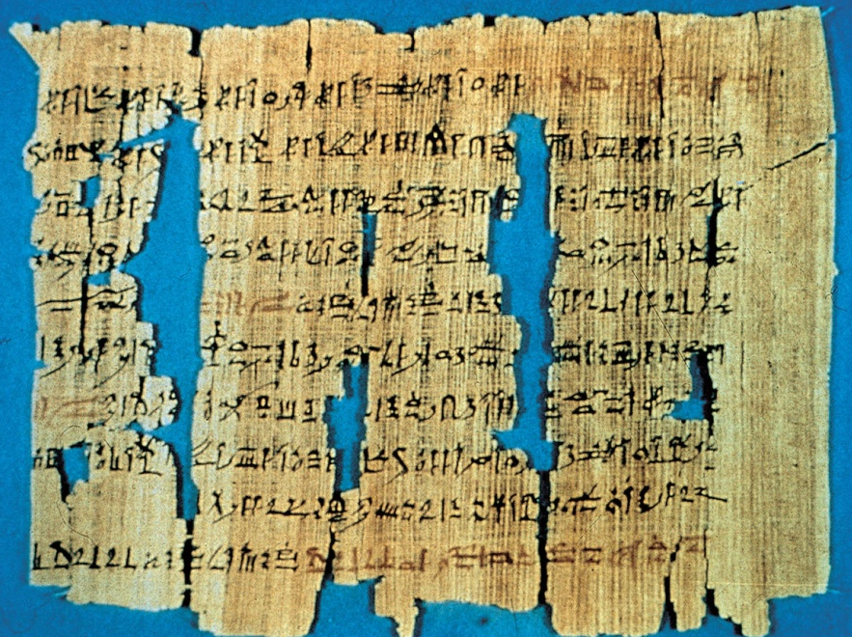
Headache is not a modern disease
British Museum

Slide 3
Headache Disorders
All headaches | Africa | Americas | Eastern Mediterranean | Europe | South-East Asia | Western Pacific
 | 21.6 % | 46.5% | 78.8% | 56.1% | 63.9% | 52.8%

Slide 4
Preview....
What is a headache?
Headaches Classification
Secondary Headaches
Red Flags
Medication Overuse Headaches
Primary Headaches
Tension Type Headache
Trigeminal autonomic cephalalgias

Slide 5
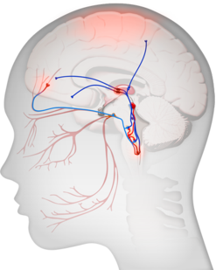
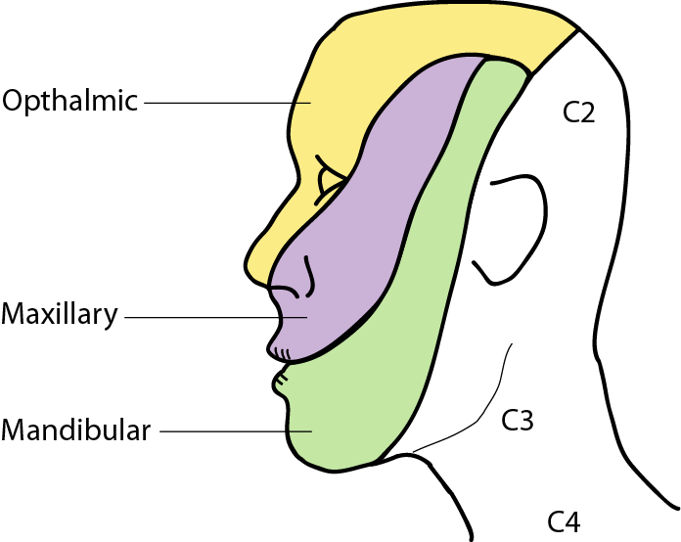
Headache
A headache or cephalgia is pain anywhere in
the region of the head or neck
Where is the pain felt?
Trigeminal
ganglion

Slide 6
Headaches Classification
International Headache Society Classification (IHSD)
2nd Edition (2004)
Primary headaches
2. Secondary headaches
3. Cranial neuralgias, facial pain and other
headaches
http://ihs-classification.org/en

Slide 7
International Classification of Headache Disorders (ICHD)
International Headache Society, 2nd edition , 2004
 | IHS code | Classification
Primary headaches | 1. | Migraine
 | 2. | Tension-type headache
 | 3. | Cluster headache and other trigeminal autonomic cephalalgias
 | 4. | Other primary headaches
Secondary headaches | 5. | Headache attributed to head and/or neck trauma
 | 6. | Headache attributed to cranial or cervical vascular disorder
 | 7. | Headache attributed to non-vascular intracranial disorder
 | 8. | Headache attributed to a substance or its withdrawal
 | 9. | Headache attributed to infection
 | 10. | Headache attributed to disorder of homoeostasis
 | 11. | Headache or facial pain attributed to disorder of cranium, neck, eyes, ears, nose, sinuses, teeth, mouth or other facial or cranial structures
 | 12. | Headache attributed to psychiatric disorder
Central neuralgias, central and primary facial pains, other headaches | 13. | Cranial neuralgias and central causes of facial pain
 | 14. | Other headache, cranial neuralgia, central or primary facial pain

Slide 8
How to approach a patient with a headache …
Distinguish primary from secondary headache
disorders
Accurate history, physical examination,
neurological examination if

Slide 9
Secondary Headaches
Occur as a consequence of an underlying
condition (e.g. Trauma, Structural lesion, Vascular disorder, Infection)
Can be life threatening
Complete neurologic examination
Usually treatable- treat underlying condition

Slide 10
Secondary Headaches
International Headache Society, 2nd edition , 2004
Headache attributed to head and/or neck trauma
e.g. head injury, traumatic intracranial haematoma (epidural/subdural), whiplash
injury, craniotomy
Headache attributed to cranial or cervical vascular
disorder
e.g. ischeamic stroke, intracerebral/subarachnoid haemorradge,
vascular malformation, cerebral venous thrombosis
Headache attributed to non-vascular intracranial disorder
e.g. intracranial hypertension, post-dural puncture, intracranial neoplasm, epileptic
seizures
Headache attributed to a substance or its withdrawal

Slide 11
Secondary Headaches
International Headache Society, 2nd edition , 2004
Headache attributed to infection
e.g. intracranial infection-meningitis, systemic infection, HIV/AIDS
Headache attributed to disorder of homoeostasis
e.g. hypoxia/hypercapnia, arterial hypertension, hypothyroidism, fasting
Headache or facial pain attributed to disorder of
cranium, neck, eyes, ears, nose, sinuses, teeth,
mouth or other facial or cranial structures
e.g. cervicogenic headaches
Headache attributed to psychiatric disorder
e.g. somatisation/phychotc disorders

Slide 12
Headache attributed to a substance or its withdrawal
Acute substance exposure induced headache:
NO-donors
Alcohol
PDE inhibitors
Monosodium glutamate*
Histamine
CGRP
Cocaine
Cannabis
Medication Overuse Headache:
Ergotamine
Triptans
Analgesics (NSDAIS, paracetamol)
Opioids
Substance withdrawal
Caffeine
Opioids
Oestrogen

Slide 13
Primary Headaches
The headache itself is the primary problem, with no identifiable underlying cause → DISORDER
Most common type (~ 90%)
Episodic (Usually recurrent)
Normal neurologic exam
Treatment should be provided for the headache

Slide 14
Primary Headaches
Tension-type headache
Migraine
Cluster headache and other trigeminal autonomic cephalalgias
Other primary headaches
e.g. stabbing headache, cough headache, orgasmic headache, thunderclap
headache

Slide 15
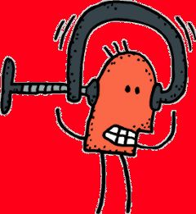
Tension Type Headache (TTH)
Very common (~60-80%; Women : Men 3:1)
Pain characteristics:
Bilateral tightness/pressure
Mild to moderate
Not aggravated by movement
Duration: 30 min to several days
No nausea, photophobia and phonophobia
3% of the population has chronic TTH ( ≥ 15 days, 6 months)

Slide 16
Pathophysiology of TTH
Unknown
Absence of excessive muscle contraction and
muscle ischemia
Episodic TTH: possible peripheral sensitization
Chronic TTH: possible central

Slide 17
Treatment options for TTH
Acute Treatment
Analgesics (aspirin, paracetamol), NSAIDs, triptans
* MOH
Preventive Treatment
Amitriptyline (tricyclic anti-depressant)

Slide 18
Trigeminal Autonomic Cephalalgias (TACs)
Cluster Headache
Paroxysmal Hemicrania*
Short-lasting Unilateral Neuralgiform Headache Attacks with comjuctival injection and Tearing (SUNCT)
* complete relief by indomethacin

Slide 19
Trigeminal Autonomic Cephalalgias
Duration (min)
4 15 30 180
SUNCT
Paroxysmal Hemicrania
Cluster Headache
Frequency (attacks/day)
0.5 - 8 > 5 3 - 200
Cluster
Headache
Paroxysmal
Hemicrania
SUNCT

Slide 20
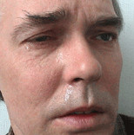
Cluster Headache (CH)
0.5-1% prevalence (Women:Men 1:4.3)
Pain characteristics:
Excruciating orbital/supraorbital/temporal pain
Unilateral, stabbing-like
Duration: 15 min to 3h
At least one ipsilateral autonomic feature (conjunctival lacrimation, nasal congestion and/or rhinorrhea, eyelid edema, forehead and facial sweating)
Remission period

Slide 21
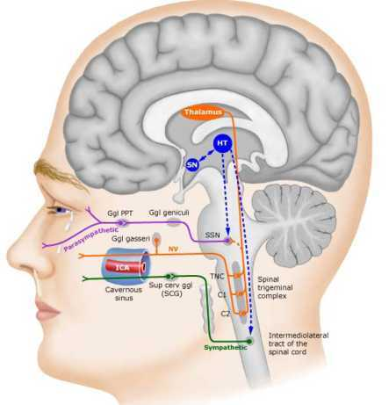
TACs Pathophysiology- Hypothalamic mulfunction?
Hypothalamic activation
Effective DBS in posterior hypothalamus
May A. Lancet 2005; 366:847

Slide 22
Treatment options for Cluster Headache
Acute Treatment
100% Oxygen inhalation
Sumatriptan injection or nasal spray (5-HT_{1B/D} agonist)
Preventive Treatment
Verapamil (L-type calcium channel blocker)
Ergot alkaloids
Lithium salt (Li⁺)

Slide 23
Treatment options for Cluster Headache
Surgical treatment?
Medically intractable cases (10-20%)
Deep Brain Stimulation (DBS)
Multi-center uncontrolled studies
Intended site of stimulation: Posterior hypothalamus
> 60% efficacy
Safe
Need for large, randomized, controlled, and double-blinded trials
Occipital Nerve Stimulation
Uncontrolled studies
Good efficacy
Less invasive than DBS

Slide 24
International Classification of Headache Disorders (ICHD)
International Headache Society, 2nd edition , 2004
 | IHS code | Classification
Primary headaches | 1. | Migraine
 | 2. | Tension-type headache
 | 3. | Cluster headache and other trigeminal autonomic cephalalgias
 | 4. | Other primary headaches
Secondary headaches | 5. | Headache attributed to head and/or neck trauma
 | 6. | Headache attributed to cranial or cervical vascular disorder
 | 7. | Headache attributed to non-vascular intracranial disorder
 | 8. | Headache attributed to a substance or its withdrawal
 | 9. | Headache attributed to infection
 | 10. | Headache attributed to disorder of homoeostasis
 | 11. | Headache or facial pain attributed to disorder of cranium, neck, eyes, ears, nose, sinuses, teeth, mouth or other facial or cranial structures
 | 12. | Headache attributed to psychiatric disorder
Central neuralgias, central and primary facial pains, other headaches | 13. | Cranial neuralgias and central causes of facial pain
 | 14. | Other headache, cranial neuralgia, central or primary facial pain

Slide 25
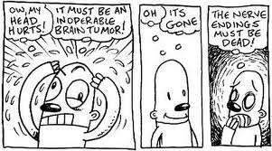
What a headache…

