Slide 1
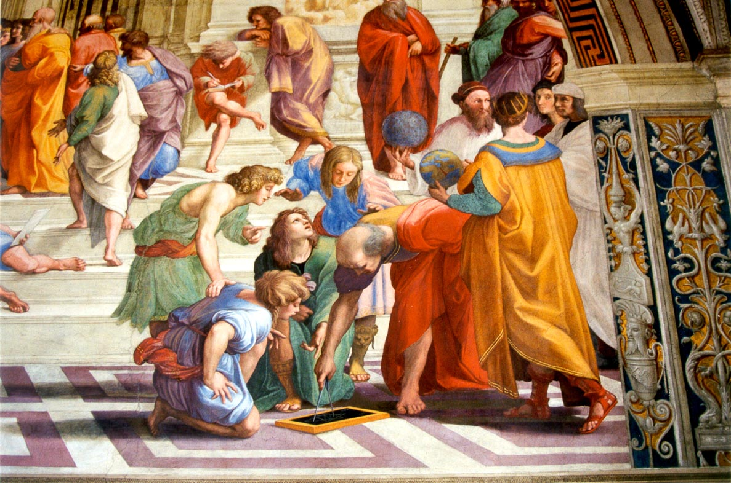

Slide 2
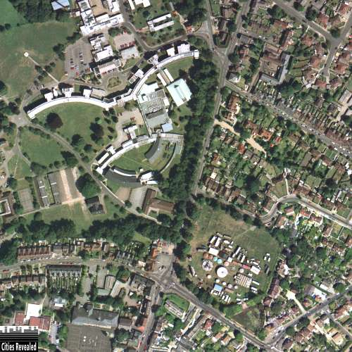
Innate Inflammation II
Gaseous Mediators
Dr Nandor Marczin
Imperial College London
Royal Brompton Harefield NHS Trust

Slide 3
Objectives
To review established and emerging gaseous mediator systems
NOS-NO-sGC-cGMP axis
HO-CO-cGMP
Endogenous H2S
To explore novel diagnostic aspects of these mediators
To discuss potential therapeutic applications

Slide 4
NO as mediator

Slide 5
The Nobel Prize in Physiology or Medicine 1998: A New Principle
Nitric Oxide, NO,
is a short-lived, endogenously produced gas that acts as a signalling molecule in the body.
Signal transmission by a gas, produced by one cell, which penetrates membranes and regulates the function of other cells is an entirely new principle for signalling in the human organism.

Slide 6
The Nobel Prize in Physiology or Medicine 1998

Slide 7
The Nobel Prize in Physiology or Medicine 1998: Furchgott’s sandwich

Slide 8
The Nobel Prize in Physiology or Medicine 1998: Murad: cGMP

Slide 9
The Nobel Prize in Physiology or Medicine 1998: Ignarro's NO

Slide 10
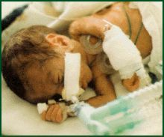
The Nobel Prize 1998: NO has many Clinical Applications

Slide 11
BH
4
L-arginine
EC
++
III. NOS
Ca
NO
1. Endothelium-dependent
vasodilators (Flow, Ach, Bk)
2. Nitrovasodilators (GTN,SNP)
3. Cytokines (LPS, IL-1, TNF)
NO
GTP
II. NOS
SM
sGC
cGMP

Slide 12
Hemodynamic influence of NO inhibition by LNMMA in man
Change [%]
Se NO MABP SVR PVR MPAP CO SV
Stamler et al, Circulation. 1994; 89(5):2035-40

Slide 13
HOMEOSTATIC FUNCTIONS OF NO IN THE LUNG
Cellular origin
Endothelial
Epithelial
Neurons
Macrophages
Mast cells
Leukocytes
NO
Vasodilatation
Ventilation-perfusion
matching
Permeability
Leukocyte, platelet
adhesion
Immunity
Antimicrobial
T cell responses
Type I (nNOS)
Type II (iNOS)
Type III (eNOS)

Slide 14
NO as inflammatory target

Slide 15
BH
4
L-arginine
EC
++
III. NOS
Ca
NO
_
O2-
IL-1, TNF
NO
_
+
H2O2
GTP
II. NOS
SM
sGC
cGMP

Slide 16
Interactions between ROS and RNS
PMN
EC
SM
}
HOOH, OH⁻
OO⁻
NO.
cGMP
biological response
Oxidant signalling
Protein oxidation
DNA damage
lipid peroxidation
LOO⁻
ONOO⁻
LOONO
PRO-OXIDANT ANTIOXIDANT

Slide 17
Basal + Physiological signal
Receptor, FMD
SM
sGC
cGMP
Ca++
NOS1
NOS3
NO.
Direct, acute, transient,
vasodilator response
minutes
NO.
Immunological signal
LPS, TNF,IL-1, IFN
Indirect, sustained
Response (apoptosis,
survial, growth)
hours
Protein-S-NO
mitochondria
NOS2
mRNA
Protein
O2⁻
OONO⁻
Oxidative
Stress
TOXICITY
Nitrosative
Stress

Slide 18
Consequences of NO dysfunction
Inappropriate vasomotor tone
Vasoconstriction
Vasoparalysis
Altered coagulation
Increased platelet adhesion, thrombus formation
Ventilation-perfusion mismatch
Arterial hypoxia
Inappropriate immune response
Organ dysfunction

Slide 19
NO as diagnostic tool
Endothelium dependent vascular tone
Exhaled nitric oxide

Slide 20
Clinical assessment of endothelial function: bedside translation of basic science

Slide 21
Clinical assessment of endothelial function: bedside translation of basic science
Ach: NO dependent receptorial mechanism
Adenosine: NO independent flow mediated receptorial
Reactive hyperemia: flow mediated non receptorial
Coronary bed; brachial artery

Slide 22
Flow mediated dilation

Slide 23
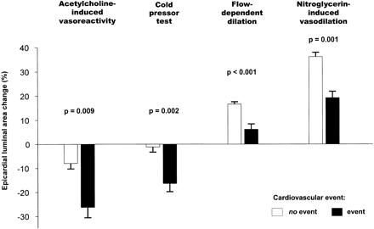
Clinical implications: Endothelial function and cardiovascular outcomes
.
Notes:
Coronary vasoreactivity was evalauted in 147 patients with documented coronary heart disease (CHD) or risk factors for CHD; flow-dependent dilation, assessed with intracoronary papaverine or adenosine (upper panel), and flow-independent vasodilation, induced by nitroglycerin (lower panel), were divided into tertiles (percent arterial dilation). During a median follow-up of 6.7 years, impaired vascular reactivity was associated with a signficantly higher cardiovascular event rate (cardiovascular death, unstable angina, myocardial infarction, revascularization, stroke, peripheral artery revascularization); the incidence of events was highest in those with the smallest percent of dilation. Data from Schachinger, V, Britten, MB, Zeiher, AM, Circulation 2000; 101:1899.
From patients.uptodate.com (retreived 2007-01-24).

Slide 24
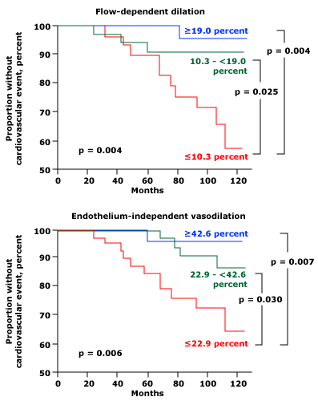
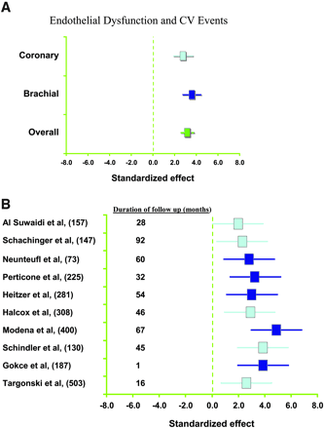
Clinical implications: Endothelial function and cardiovascular outcomes
.
Notes:
Coronary vasoreactivity was evalauted in 147 patients with documented coronary heart disease (CHD) or risk factors for CHD; flow-dependent dilation, assessed with intracoronary papaverine or adenosine (upper panel), and flow-independent vasodilation, induced by nitroglycerin (lower panel), were divided into tertiles (percent arterial dilation). During a median follow-up of 6.7 years, impaired vascular reactivity was associated with a signficantly higher cardiovascular event rate (cardiovascular death, unstable angina, myocardial infarction, revascularization, stroke, peripheral artery revascularization); the incidence of events was highest in those with the smallest percent of dilation. Data from Schachinger, V, Britten, MB, Zeiher, AM, Circulation 2000; 101:1899.
From patients.uptodate.com (retreived 2007-01-24).

Slide 25
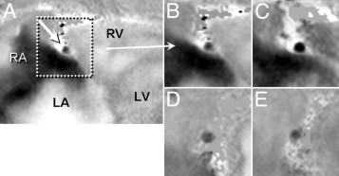

Slide 26
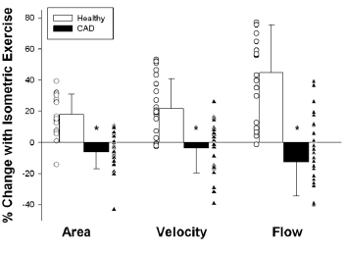

Slide 28
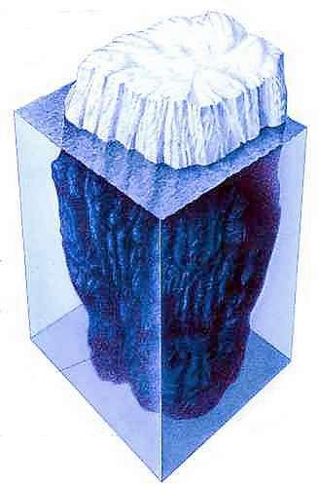
Theory of exhaled NO
Diffusibility
Solubility of NO (gas–liquid interfaces)
consumption by autooxidation, oxygen species, proteins, and haemoglobin
synthesis rate
“NO levels in the gas phase...reflect in an accurate and qualitative manner the dynamics of NO production and consumption in the lung”. Dweik et al. J. Clin. Invest.101: 660, 1998

Slide 29
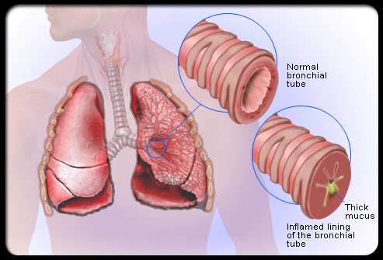
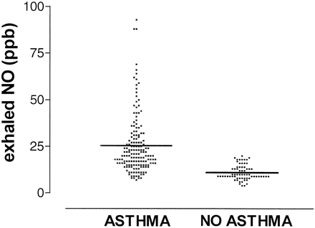
Exhaled NO in asthma

Slide 30
Effect of iNOS inhibitor on exhaled NO in asthma (Barnes)
NORMAL SUBJECTS
ASTHMA
35
35
30
30
25
25
PLACEBO
20
20
Exhaled NO (ppb)
15
15
10
PLACEBO
10
SD3651
5
5
SD3651
0
0
0
2
4
6
8
12
24
48
72
0
2
4
6
8
12
24
48
72
Hours
Hours

Slide 31
Exhaled NO for airway inflammation
Timeline
1991: NO in exhaled breath
1993: FENO increased in asthmatics
2003: FDA approval
2005: Respiratory society guidelines and revisions
2006: Reimbursement in Europe
To date: 1200 articles, towards clinical use
Achievements
Correct asthma diagnosis
Insights into steroid effectiveness
Prediction of steroid response
Steroid dose-titration that reduces cost and improves patient outcome
Notification of loss of asthma control
Prediction of asthma relapse
Rapid identification of non-compliance to anti-inflammatory therapy

Slide 32
Diagnostic progress: state of art

Slide 33
Inflammatory Diseases (same?)

Slide 34
eNO in ARDS
Brett &Evans Am J Respir Crit Care Med.
1998 Mar;157(3 Pt 1):993-7

Slide 35
THE NITRIC OXIDE/CYCLIC GMP PATHWAY IN LUNG Tx
NO levels measured at the surface of the transplanted lung plummeted upon reperfusion
NO levels moderately increased by topical application of SOD
Augmenting the NO pathway at the level of cGMP improves graft function and survival
DJ Pinsky, PNAS 91:12086-12090, 1994

Slide 36
NO consumption in Human LTx
Pre- Post- 24 hrs post
Reperfusion transplant

Slide 37
Endogenous NO consumption in ALI
NO is consumed in oxidative stress reactions in cellular models
NO is consumed in animal models of LTX
Endogenous NO is less in human Acute Lung Injury
Surely we need to supplement more NO!!??

Slide 38
NO as therapeutic

Slide 39
Marczin NANDOR
Marczin NANDOR

Slide 40
iNO: the master “reperfusion anaesthetic”
PVR, PAP, RV failure
Improved hemodynamics
PMN responses
(adhesion molecule expression,
Free radical release)
iNO
Capillary filtration
↓ Pulmonary oedema
Cytokine expression
Activation of NF-kB)
↓ Immune response to allograft
allograft preservation
Ventilation/perfusion
Matching, ↓ shunt
Improved gas exchange

Slide 41
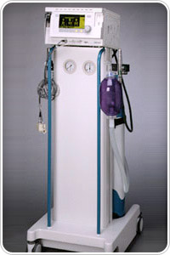
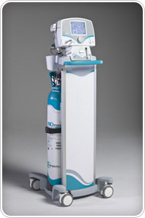

Slide 42
Placebo controlled, randomised single centre
84 patients. inhaled NO 20 ppm, 10 min after reperfusion
Tightly controlled study protocol and weaning from iNO and mechanical ventilation
No influence of physiological variables and outcome

Slide 43
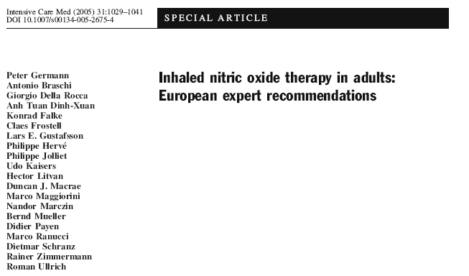
iNO therapy is effective and recommended for LVAD insertion

Slide 44
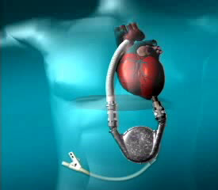
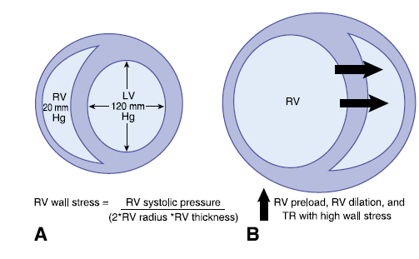
RV failure after LVAD insertion (5-39%)

Slide 45
RV OVERLOAD

Slide 46
BiVAD support

Slide 47
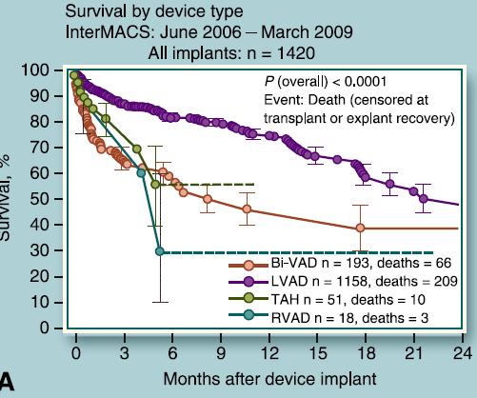
Impact of RVAD on survival

Slide 48
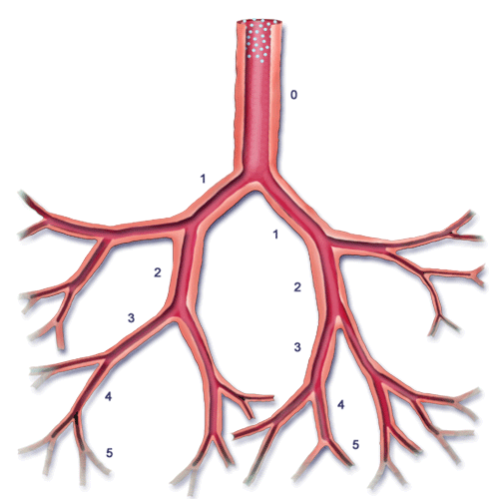
RV failure after LVAD insertion (5-39%)

Slide 49
Vasoactive drugs at ICU admission following Jarvik 2000 insertion Anesth Analg. 2003 Oct;97(4):964-71
Patient 1 | Nitric oxide, fenoldopam, PGE₁, milrinone
Patient 2 | Nitric oxide, PGE₁, fenoldopam, milrinone, dopamine
Patient 3 | Nitric oxide, PGE₁, fenoldopam, milrinone, epinephrine, norepinephrine
Patient 4 | Nitric oxide, fenoldopam
Patient 5 | Nitric oxide, fenoldopam, milrinone
Patient 6 | Nitric oxide, PGE₁, fenoldopam, milrinone, dobutamine, epinephrine, norepinephrine
Patient 7 | Nitric oxide, PGE₁, fenoldopam, milrinone, epinephrine
Patient 8 | Nitric oxide, PGE₁, fenoldopam, milrinone, dobutamine, epinephrine, nitroglycerin
Patient 9 | Nitric oxide, fenoldopam, milrinone, epinephrine
Patient 10 | Nitric oxide, fenoldopam, milrinone, dopamine

Slide 50
Use of iNO After LVAD Placement:
Results of a Prospective, Randomized, Double-Blind,
Multicenter, Placebo-Controlled Trial
Circulation. 2009;120:S845
Study-Defined Right Ventricular Dysfunction Criteria

Slide 51
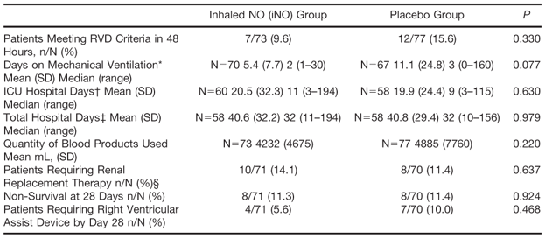
Use of iNO After LVAD Placement:
Secondary Efficacy Outcomes, Intent-to-Treat Population

Slide 52
Use of iNO After LVAD Placement:
iNO reduced the incidence of RVD,
reduced time on mechanical ventilation,
was safe and well tolerated.
Results are clinically meaningful considering the cross-over design.
The use of iNO after LVAD placement may improve outcomes and reduce ventilation time

Slide 53
Cardiac Surgery Inflammation
Monitoring
Diagnosis
Optimisation
Therapy
Pathogenesis
Mechanisms
Molecular
Targets
Biomarkers
eNO NO iNO

Slide 54
Rethink the “failures” and further potential

Slide 55
Possibilities for “extended” iNO therapy
iNO
1. Antioxidants (NAC, SOD)
x
O2⁻
4. PGI
NO
3. sGC
sensitisers
GTP
2. PDE Inhibitors
ATP
sGC
AC
cGMP
GMP
cAMP
PDE

Slide 56
The HO-CO-cGMP axis

Slide 57
Heme oxygenase-CO pathway

Slide 58
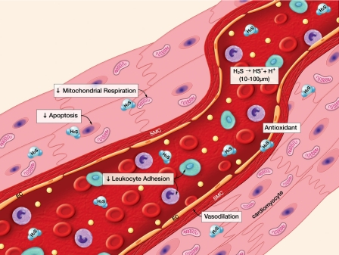
H2S: “all the benefits of NO but without toxicity???

Slide 59
Anaesthetist = “ Gas man”

Slide 60
Anaesthetist = “ New Gas man”

