Slide 1






Epigenetics and inflammation
Ian Adcock
National Heart and Lung Institute,
Imperial College London

Slide 2
Summary
Why epigenetics?
What is epigenetics?
Epigenetic changes in airways disease
  Acetylation, methylation and enzyme activity
The environment and epigenetic changes
  Effects on airways disease susceptibility and severity

Slide 3
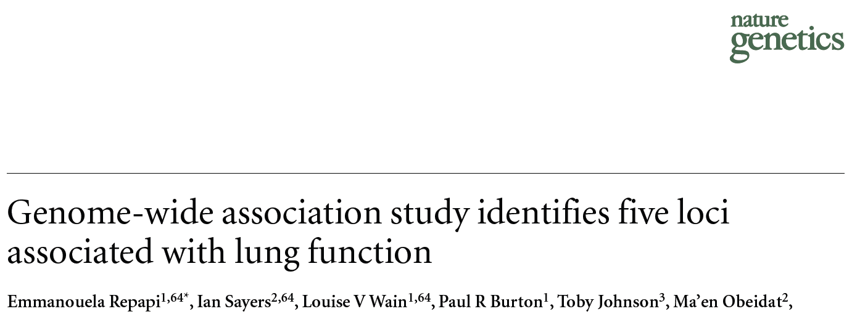
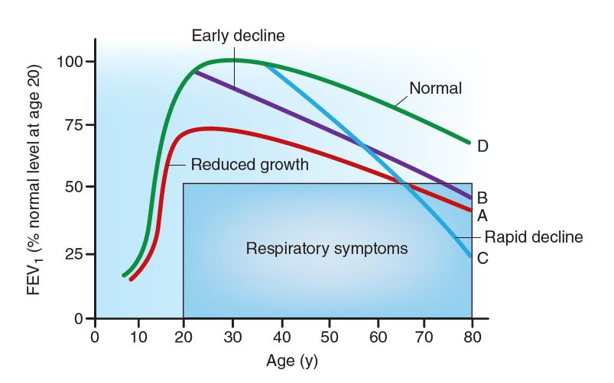

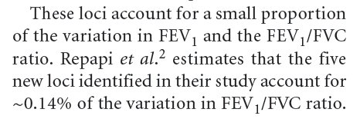
Genetics versus epigenetics
GWAS identified hundreds of genetic variants associated with complex human diseases and traits
  provided valuable insights into their genetic architecture.
Most variants identified so far
  confer relatively small increments in risk
  explain only a small proportion of familial clustering
Therefore, how can the remaining, 'missing' heritability be explained.
  Minor/rare allele frequency with large effect
  Structural variation incl. CNV, microsatellite repeats etc

Slide 4

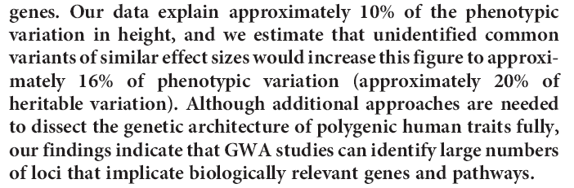

Slide 5
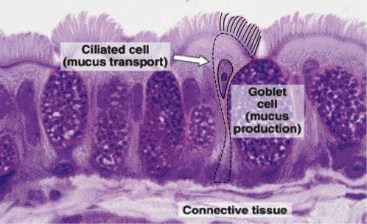
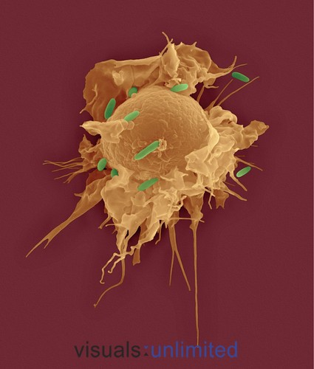
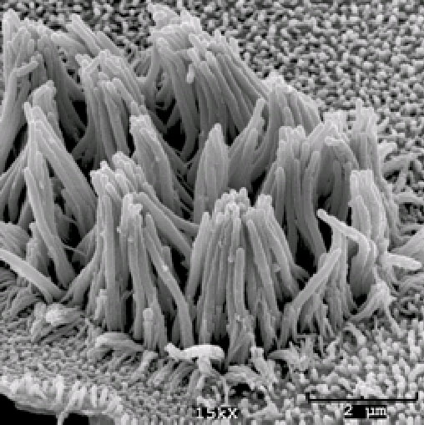
Same DNA different phenotype: the role of epigenetics?

Slide 6
DNA packaging
4m on DNA needs to be packaged into the nucleus.
DNA (146bp) wrapped around histone octomer to form nucleosome.
Nucleosome packaged in turn to produce 30nm fibres.
Net result is that each DNA molecule has been packaged into a mitotic chromosome that is 50,000x shorter than its extended length.

Slide 7
Epigenetics
epigenetics is the study of heritable changes in gene expression or cellular phenotype caused by mechanisms other than changes in the underlying DNA sequence
  epi- (Greek: επί- over, above, outer) -genetics.
It refers to functionally relevant modifications to the genome that do not involve a change in the nucleotide sequence.

Slide 8
Epigenetic marks
Cytosine DNA methylation
other modifications also occur
associated with gene repression
Covalent histone modifications
acetylation
methylation
phosphorylation
ubiquitination, and others
Histone variants
Nucleosome remodelling engines
Non-coding RNAs
effects on DNA methylation
Cross-talk between DNA methylation and histone modifications
Gene activation
Gene activation/repression
“Histone Code/Language” hypothesis
Modifications of the histones act as marks that can be read by other proteins to control the expression or replication of chromosomal regions. The coding in the histones may be heritable.
Regulates gene expression leading to effects on cell growth, proliferation and apoptosis
Controls when and where gene expressed

Slide 9
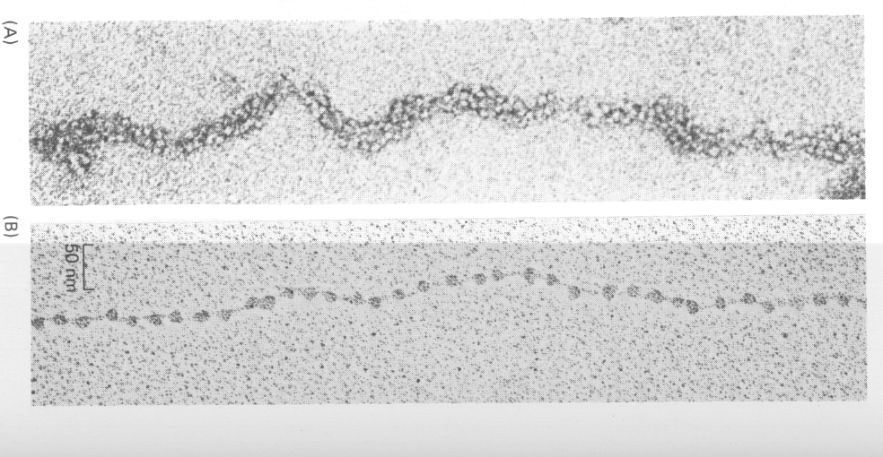
Histone Acetylation
Histone Deacetylation
(Gene silencing)
(transcriptional activation)
Histone Acetyltransferase
Histone Deacetylase
HDAC 1 - 11
sirtuins 1-7
P300/CBP, PCAF,
TAFs, SRC-1, ACTR, TIP60

Slide 10
Histone (Protein) deacetylases (HDACs)
inhibitor
Class I
HDAC1
HDAC2
HDAC3
HDAC8
Trichostatin A
SAHA
MS275
Valproic acid
etc…
(Rpd3 homolog)
Class II
HDAC4
HDAC5
HDAC6
HDAC7
HDAC9
HDAC10
(Hda1 homolog)
Class IV
HDAC11
Class III
)
SIRT1
SIRT2
SIRT3
SIRT4
SIRT5
SIRT6
SIRT7
Splitomycin
Suramine
NAD
(Sir2 homolog)
Notes:
Human HDACs are classified into three classes on the basis of their similarity to yeast HDACs.
Class I and II HDACs are classical HDACs and can be inhibited by trichostatin A and also enhanced by theophylline.
The third class is new class of HDAC and homologous to the silent information regulator 2 (Sir2) protein family which contains NAD-dependent deacetylases.
Class III HDACs are inhibited by Splitomycine and Suramin and enhanced by Quinolone or resveratolol, which compund is focused in Louise’s group.

Slide 11
Regulation of H3 methylation by methylases and demethylases
Green – activation
Red - repression

Slide 12
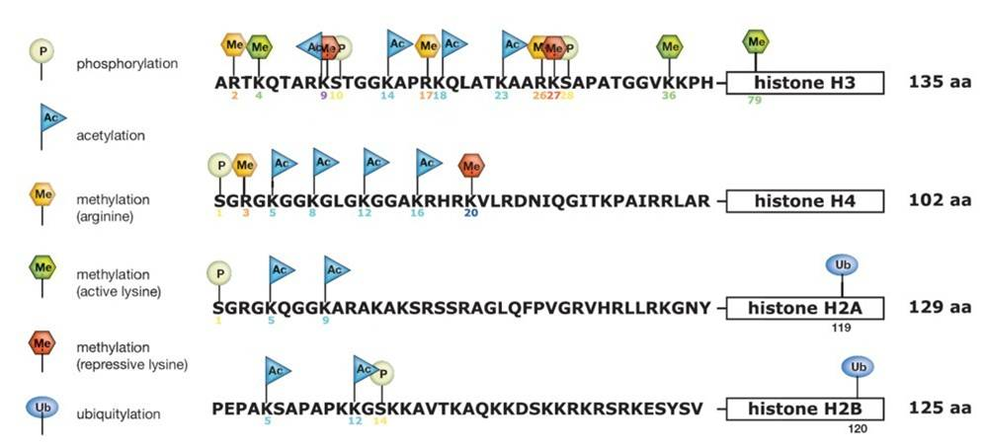
Histone tails are post-translationally modified: key role in epigenetic regulation of transcription

Slide 13

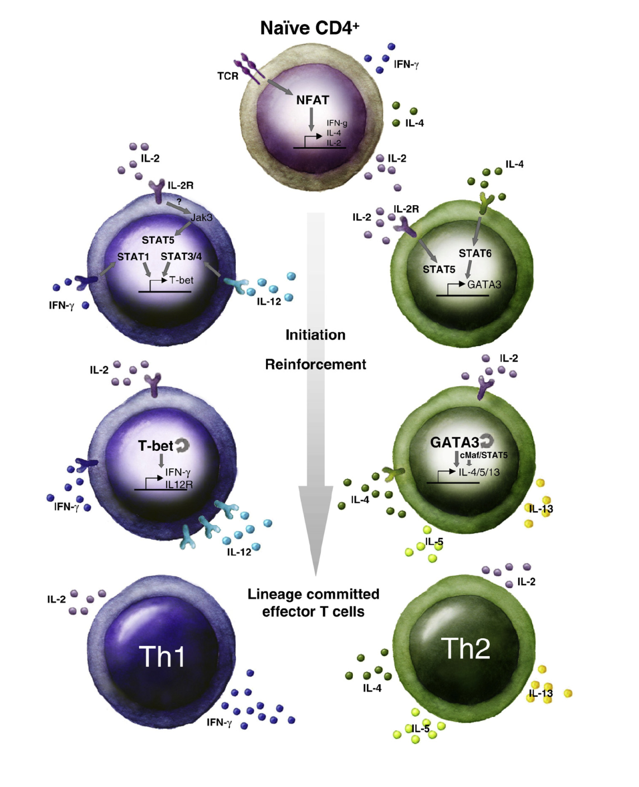
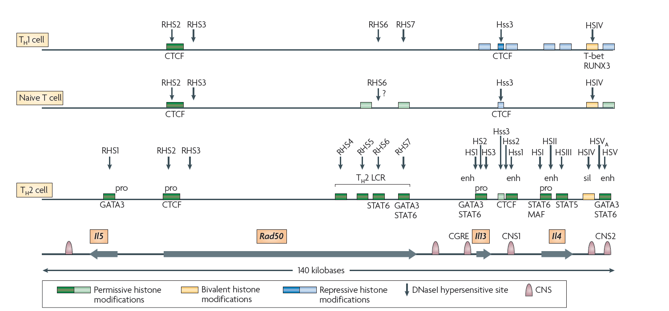
Wilson CB, et al., Nat Rev Immunol. 2009
Wilson CB, et al., Nat Rev Immunol. 2009

Slide 14


Slide 15
Evidence for a role of HDACs in inflammation: inhibitor and expression studies

Slide 16
Selective recruitment of NF-κB to the TGFβ1 promoter
ATG
κB1
(-2103/-2097)
κB2
(-2042/-2033)
κB3
(-790/-781)
TGFβ1 promoter
7.5
100
100
5.0
Fold Induction of
75
IP DNA
75
*
% maximal
50
*
% maximal response
50
25
2.5
25
0
0
+ + IL-1β (10ng/ml)
+ + IL-1β (10ng/ml)
0.0
- + AS602868 (10ng/ml)
- + AS602868 (10μM)
CBP ChIP (κB3 site)
−
AcH4 ChIP (κB3 site)
IL-1β (10ng/ml)
+
+
AS602868 (10μM)
−
−
+
Lee K-Y et al., JI 2006
A549 cells

Slide 17
HDAC inhibition enhances MMP-9 expression:
Inhibition of an inhibitor = activation
*
*
10.0
An imbalance between HAT and HDAC expression/activity can modulate inflammatory gene expression
7.5
MMP-9
5.0
2.5
0.0
0 100 0 0.1 1.0
TSA (nM)
PMA (50nM)
U937 and A549 cells
Satoshi Yamamura
Notes:
Finally, I examined selectivity of these two inhibitors.
TSA preferentially upregulate GM-CSF though TSA increased MMP9 and IL-8.
On the other hand, Suramine enhanced MMP9 and IL-8 but not enhance GM-CSF mRNA.
Class III HDAC is more specific to IL-8, MMP9

Slide 18
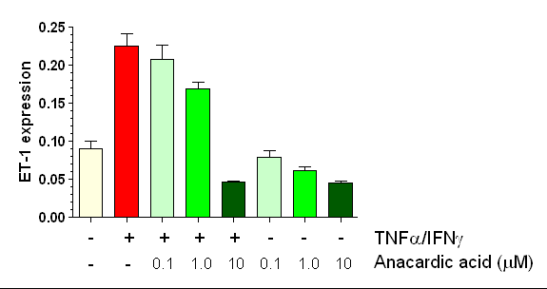
HAT inhibition reduces NF-κB-mediated ET-1 expression in primary lung endothelial cells
Wort et al., JBC 2009

Slide 19
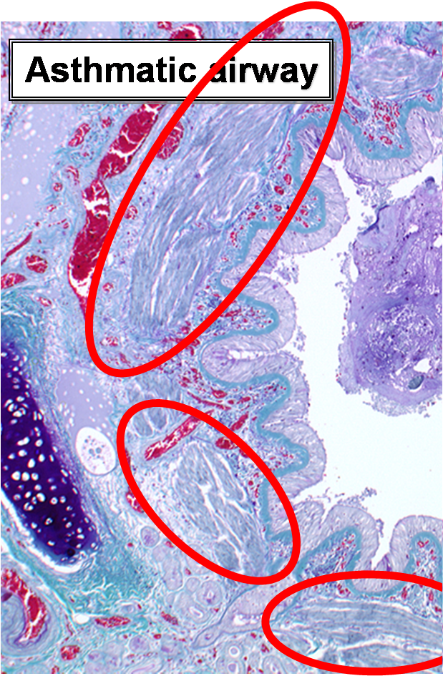
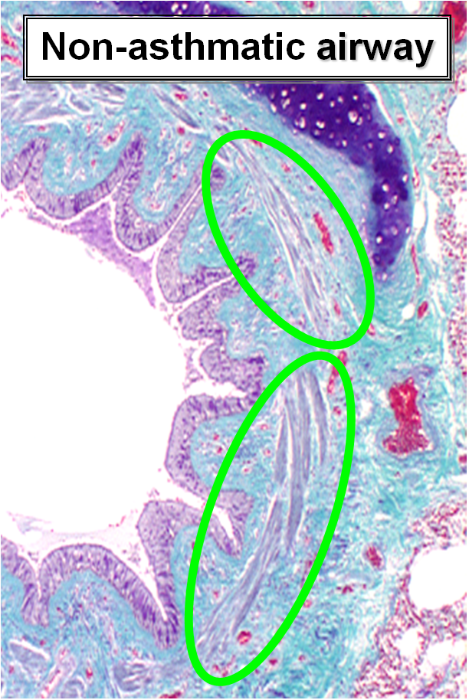
Proliferation of Airway Smooth Muscle (ASM) in asthma.
INCREASED ASM PROLIFERATION
Growth factors (e.g. FCS),
Pro-inflammatory cytokines (e.g. IL-1β, TGF-β, TNF-α)
(Adapted from Hirst et al, 2006)

Slide 20
ASM cells from severe asthmatics demonstrate increased proliferation

Slide 21
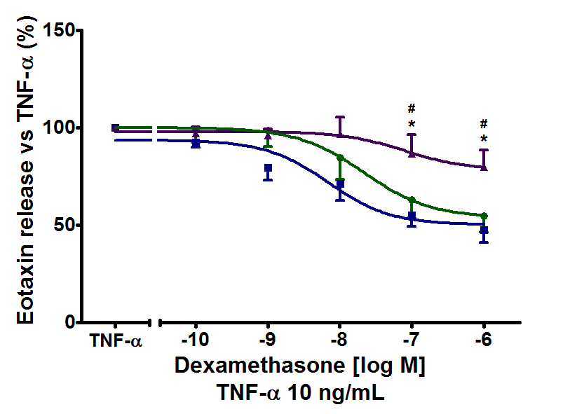
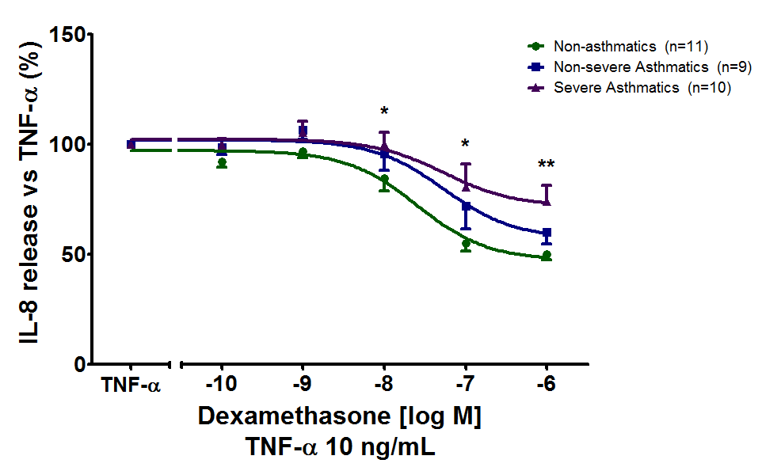
Impaired steroid responsiveness of ASM cells in severe asthma
Similar steroid resistance in cells from patients with COPD
? Differences in ASM (and HEP) cell function due to changes in intracellular signalling and/or epigenetics
Po-Jui Chang

Slide 22
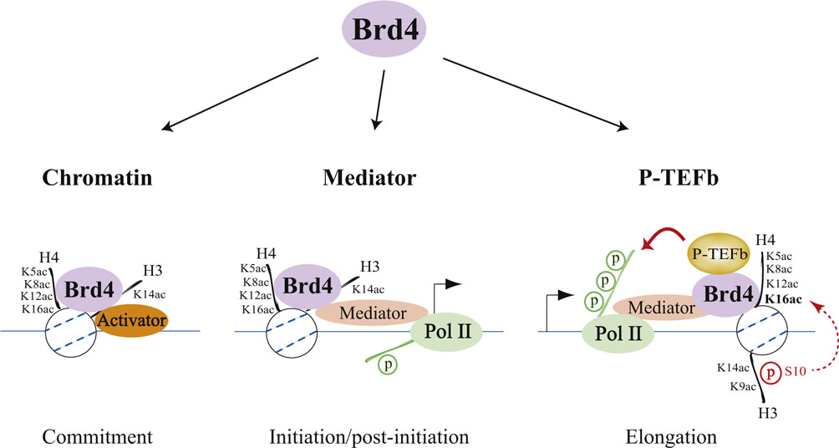
Gene induction requires association of H3 and H4 acetylation with Brd4
Figure 2. Acetylation of histone H3 and H4 lysine residues modulates Brd4 association with chromatin and the recruitment of Mediator and P-TEFb
Three steps for bromodomain-containing protein 4 (Brd4)-regulated chromatin targeting and transcriptional regulation are highlighted. The first step (left) represents a commitment to target gene transcription illustrated by cooperative binding between Brd4 and a transcriptional activator with acetylated chromatin through Brd4-activator interaction, activator-DNA contact, and Brd4 association, via its tandem bromodomains, with acetylated lysine 5 (K5ac), acetylated lysine 8 (K8ac), acetylated lysine 12 (K12ac), and acetylated lysine 16 (K16ac) of histone H4, and/or acetylated lysine 14 (K14ac) of histone H3. The second step (center) is Brd4-mediated recruitment of the initiation cofactor Mediator to the promoter region, which often leads to phosphorylation of the RNA polymerase II (Pol II) carboxyl-terminal domain (CTD) at Ser5 during initiation and post-initiation events. The third step (right) is Brd4-facilitated recruitment of the elongation cofactor P-TEFb (positive transcription elongation factor b) to paused Pol II that results in Ser2 phosphorylation of the CTD, thereby allowing Pol II to resume elongation. The inducible recruitment of Brd4 to an acetylated nucleosome located downstream of the transcription start site (indicated by an arrow) appears to depend on crosstalk between acetylated lysine 9 (K9ac) and phosphorylated serine 10 (S10) of H3 with H4K16ac [38].

Slide 23
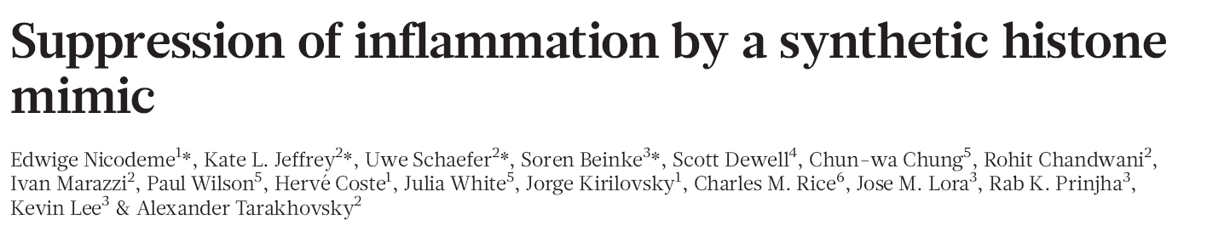
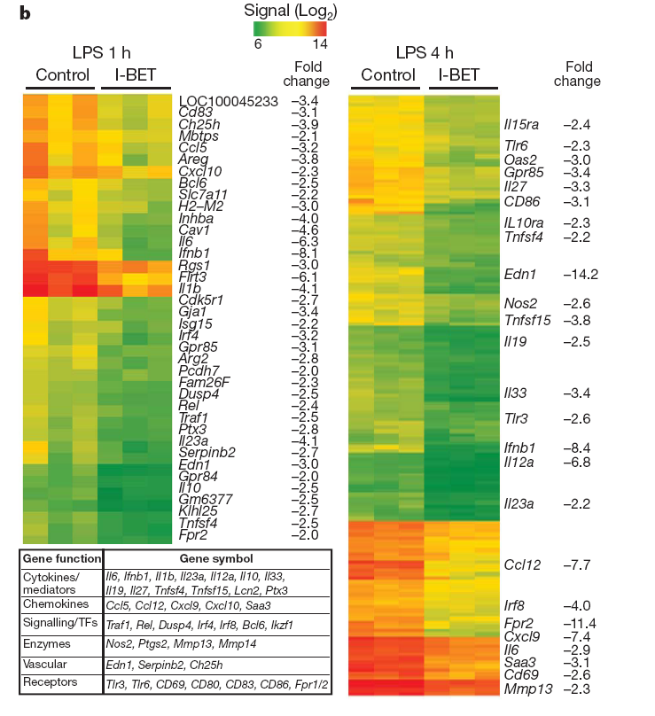
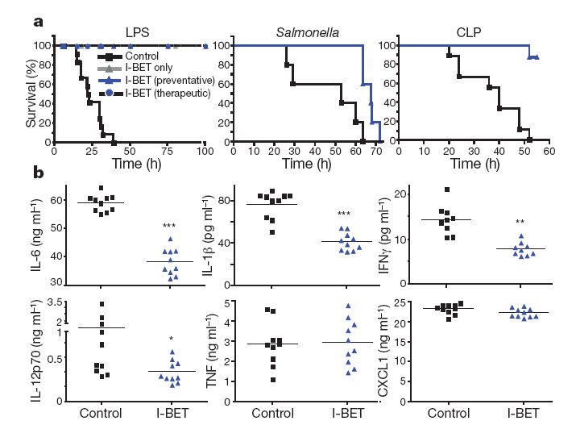
Bromodomain mimics suppress inflammation

Slide 24
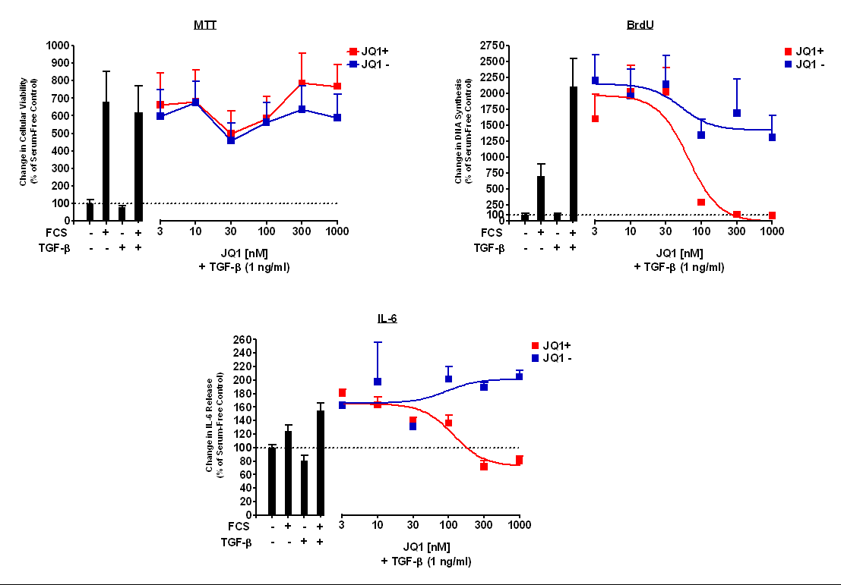
JQ1 does not affect ASM viability: TGF-β (1 ng/ml) @ 48 h

Slide 25
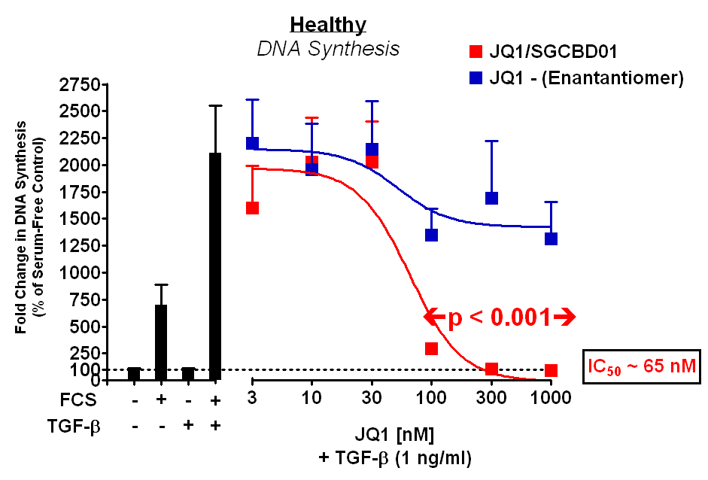
JQ1+ suppresses TGFβ+FCS-induced ASM cell proliferation
Healthy Patients (n = 9)

Slide 26
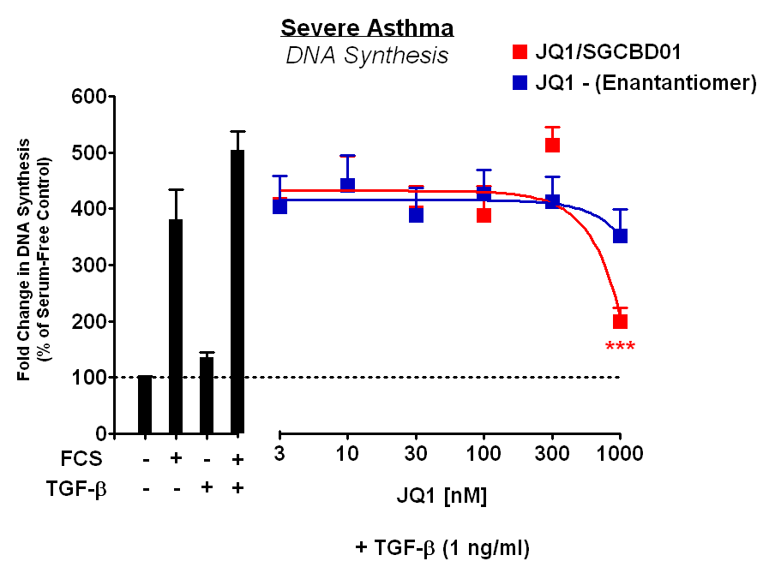
JQ1+ suppresses TGFβ+FCS-induced ASM cell proliferation
Severe Asthma (n = 3)
Similar data for IL-6 release

Slide 27
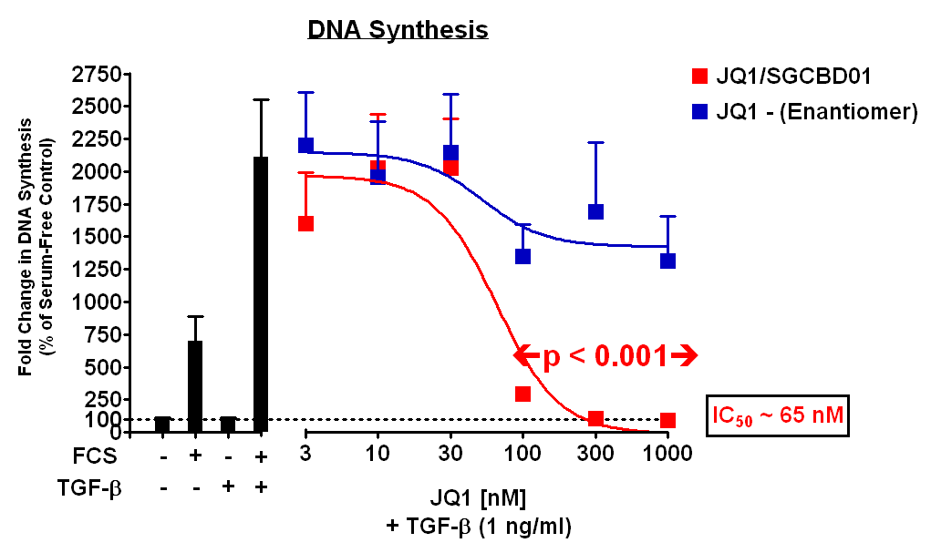
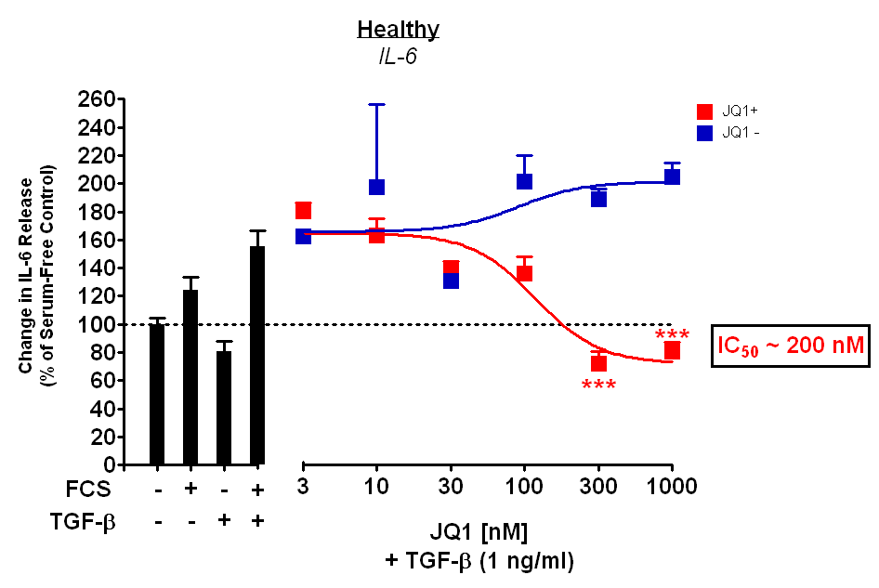
JQ1 suppresses TGFβ+FCS-induced IL-6 expression in human ASM cells
Healthy Patients (n = 9)
Mark Perry, Fan Chung

Slide 28
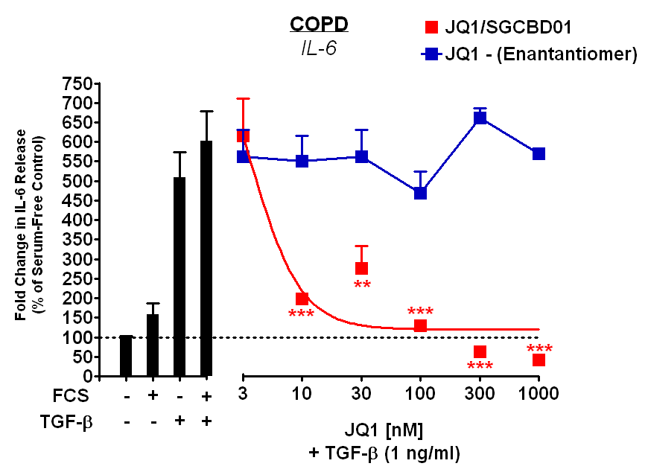
JQ1 suppresses TGFβ+FCS-induced IL-6 expression in human ASM cells
Suggests differences in Brd4 activation/function in severe asthma and COPD – output dependent
? Role of Brd2, 3 etc – studies ongoing
COPD (n = 4)
Mark Perry, Fan Chung

Slide 29
Abnormal expression of HDACs in airways disease

Slide 30
HAT and HDAC activity in asthmatic biopsies
HAT activity
HDAC activity
7500
**
150
protein)
#
**
5000
#
100
**
HAT activity (dpm)
HDAC activity
(dpm/mg
2500
50
0
0
N
As
-ICS
As
+ICS
N
As
-ICS
As
+ICS
125
100
r² = 0.7803
1
75
p< 0.0001
FEV
50
0
100
200
300
HDAC activity (dpm)

Slide 31
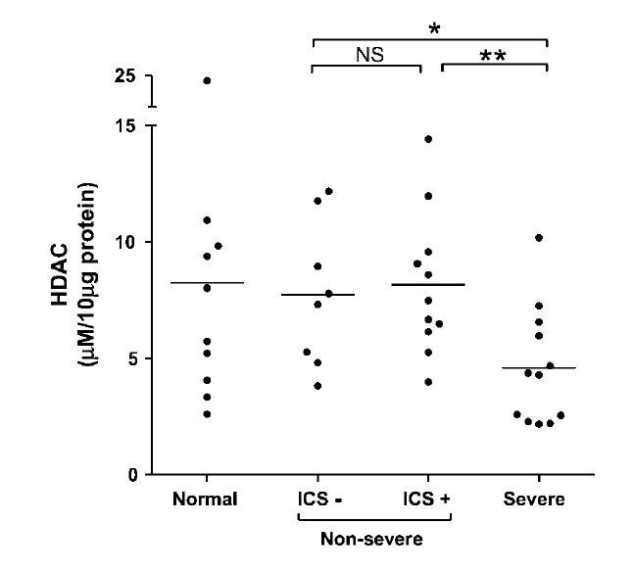
Reduced HDAC expression in BAL macrophages in SD asthma
Hew, Bhavsar et al., AJRCCM 2006

Slide 32
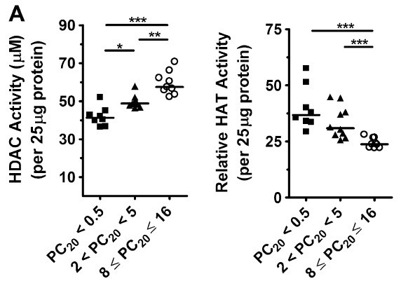
Increased HAT and reduced activity in asthmatic children
Su et al., JACI 2009

Slide 33

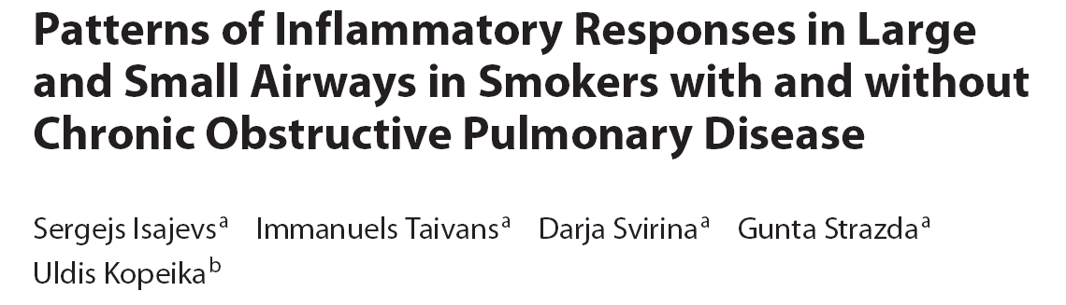

HDAC2 expression decreases according to disease severity
HDAC2
Histone 1
NS
S1
NS
S4
S0
S0
S4
S2
3
NS
##
*
2
##
HDAC2 expression
(vs.histone 1)
**
##
1
**
↓ HDAC2 greater in small airways cw large airways
0
non-
smoker
0
1
2
4
GOLD stage

Slide 34
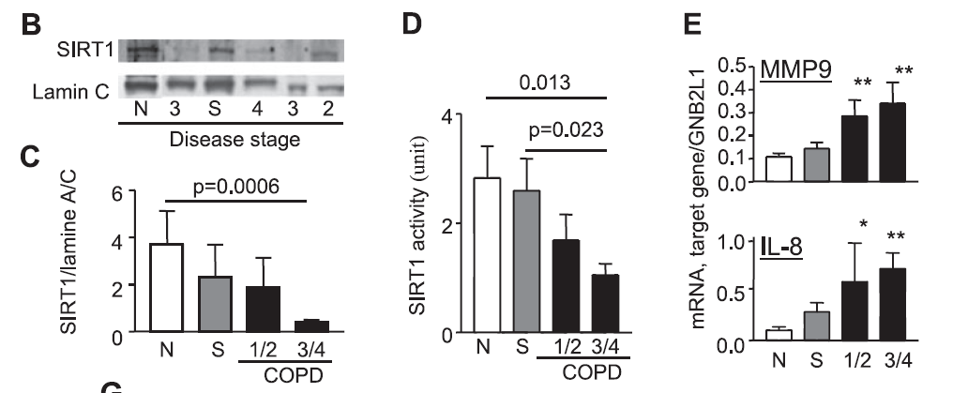
SIRT1 expression is reduced in COPD
Nakamaru et al., FASEB J 2009

Slide 35
What are the functional consequences of altered HDAC expression?

Slide 36
Increased IL-8 expression in COPD lung is associated with acetylation of the native promoter
Trend analysis p=0.004
Trend analysis p=0.009
1.0
***
3
***
**
**
2
IL-8 mRNA
0.5
IL-8 promoter acetylation (x10⁻³M)
1
0.0
0
Non
smoker
0
1
2
4

Slide 37
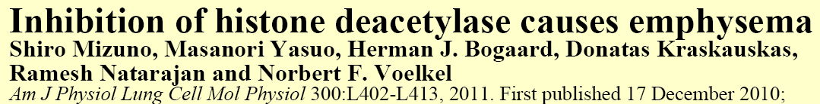
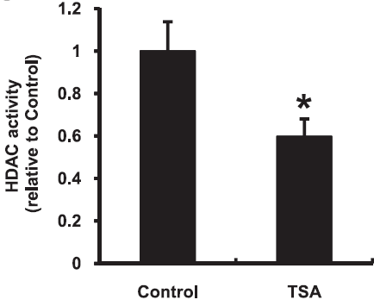
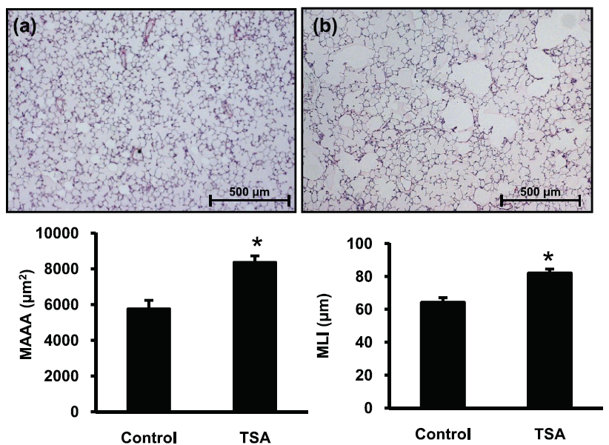
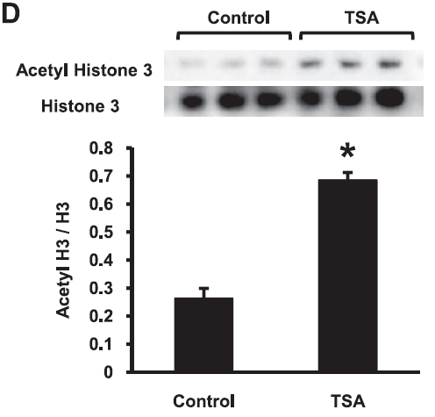
6 weeks

Slide 38
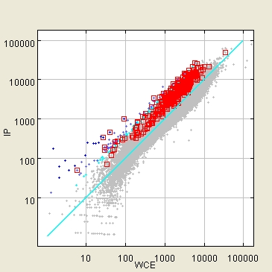
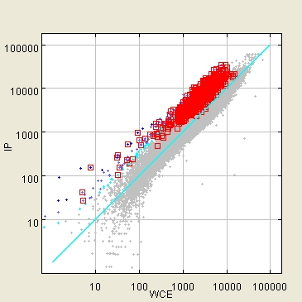
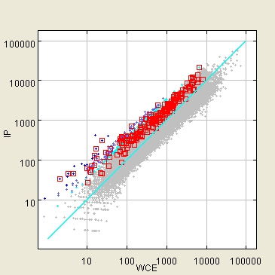
HDAC2 knockdown attenuates steroid sensitivity
A549 cells
sc
HDAC2 RNAi
**
100
C
IL-1β
FP+IL-1β
652 1122 388
% of control
50
0
AcH4 ChIP-on-chip
-14
-14
-10
-10
Dex (log, M)
Ito et al, 2006
Kan-Yung Lee

Slide 39
Cigarette smoke reduces HDAC activity in macrophages
Y146 - activity
Y253 - expression

Slide 40

HDAC2 overexpression restores dex sensitivity in COPD BAL macrophages
5.0
non-smoker
COPD
GM-CSF (ng/ml)
2.5
NT
Em
H2
NT
Em
H2
*
*
*
0
Non-smoker
smoker
COPD
Control
HDAC1 overexpression
LPS (1ng/ml)
HDAC2 overexpression
LPS + Dex (10⁻⁶M)
Ito et al., JEM 2006

Slide 41
Low dose theophylline enhances dexamethasone function under conditions of oxidative stress
3000
+TSA
2000
#
GM-CSF (pg/ml)
**
1000
**
0
IL-1β + H₂O₂
-
+
+
+
+
+
-
-
10⁻⁵
-
10⁻⁵
-
Theophylline
-
-
-
10⁻¹⁰
10⁻¹⁰
10⁻⁶
Dexamethasone
Cosio et al., PNAS 2004

Slide 42
Theophyline restores steroid responsiveness in smoking models: therapeutic dosing
To et al., AJRCCM 2011

Slide 43
Smoking asthma – lung function (PEF)
28 days treatment
Spears et al., ERJ 2009

Slide 44
FP/Theo improves sputum neutrophilia and lung function
PaulFord/Andrew Durham

Slide 45
Effect of FP+LDT on HDAC activity
PBMCs
PaulFord/Andrew Durham

Slide 46
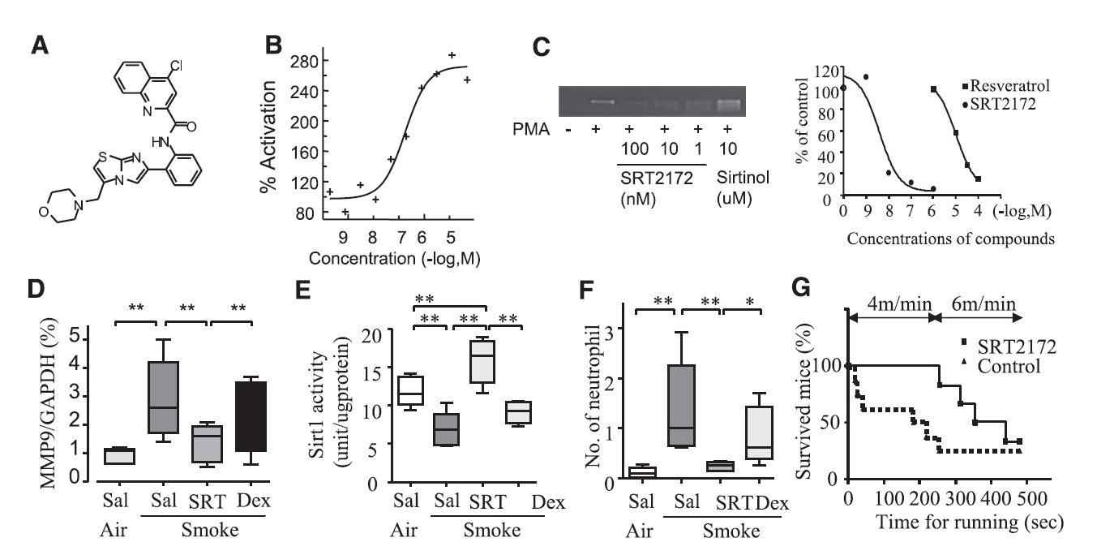
SIRT1 activation reverses smoke-induced inflammation and MMP-9 expression
SRT2172
Nakamaru et al., FASEB J 2009

Slide 47
Epigenetic writers/erasers in airways disease
ROS, Inflammation
Nrf2 Ac
HDAC2/Sirt 1
HDACs
Inflammation
(HDAC specific)
Emphysema
HDACi/MTi
Lung Cancer
Cell Proliferation
(HDAC specific)
Steroid sensitivity
(HDAC specific)

Slide 48
Epigenetics and the environment

Slide 49
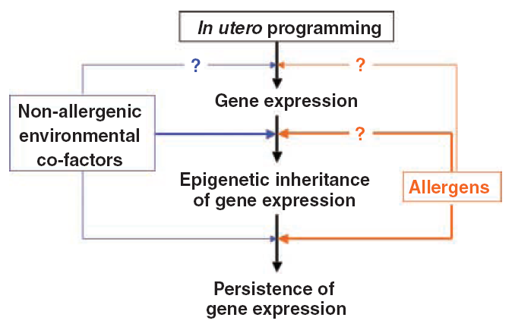
From in utero programming to epigenetic inheritance in allergic asthma
Bousquet J et al., Allergy 2004

Slide 50
Summary
Changes in cell function involves:
  Co-ordinated PTM of histones and DNA
Epigenetic changes occur through life in response to environmental, physiological and pathological signals.
Epigenetic changes are more frequent than genetic changes.
    - reversible – drug targets, cross-talk
Epigenetic effects are involved in asthma severity and probably in susceptibility.
Animal models of asthma –role for methylation
Lung disease – COPD, asthma (severe), CF, Fibrosis, pulmonary hypertension, lung cancer
    Steroids/theophylline are epigenetic modifying agents
    More specific agents being developed

Slide 51
The future for epigenetics
Research area – currently few direct clinical effects
    Cancer therapy – non-selective drugs
Great potential
    Understanding disease pathogenesis
    Specific treatments
      Inflammation, cancer
    Add-on therapies e.g. enhance steroid actions
    Stem cells

Slide 52
Questions?

Slide 53
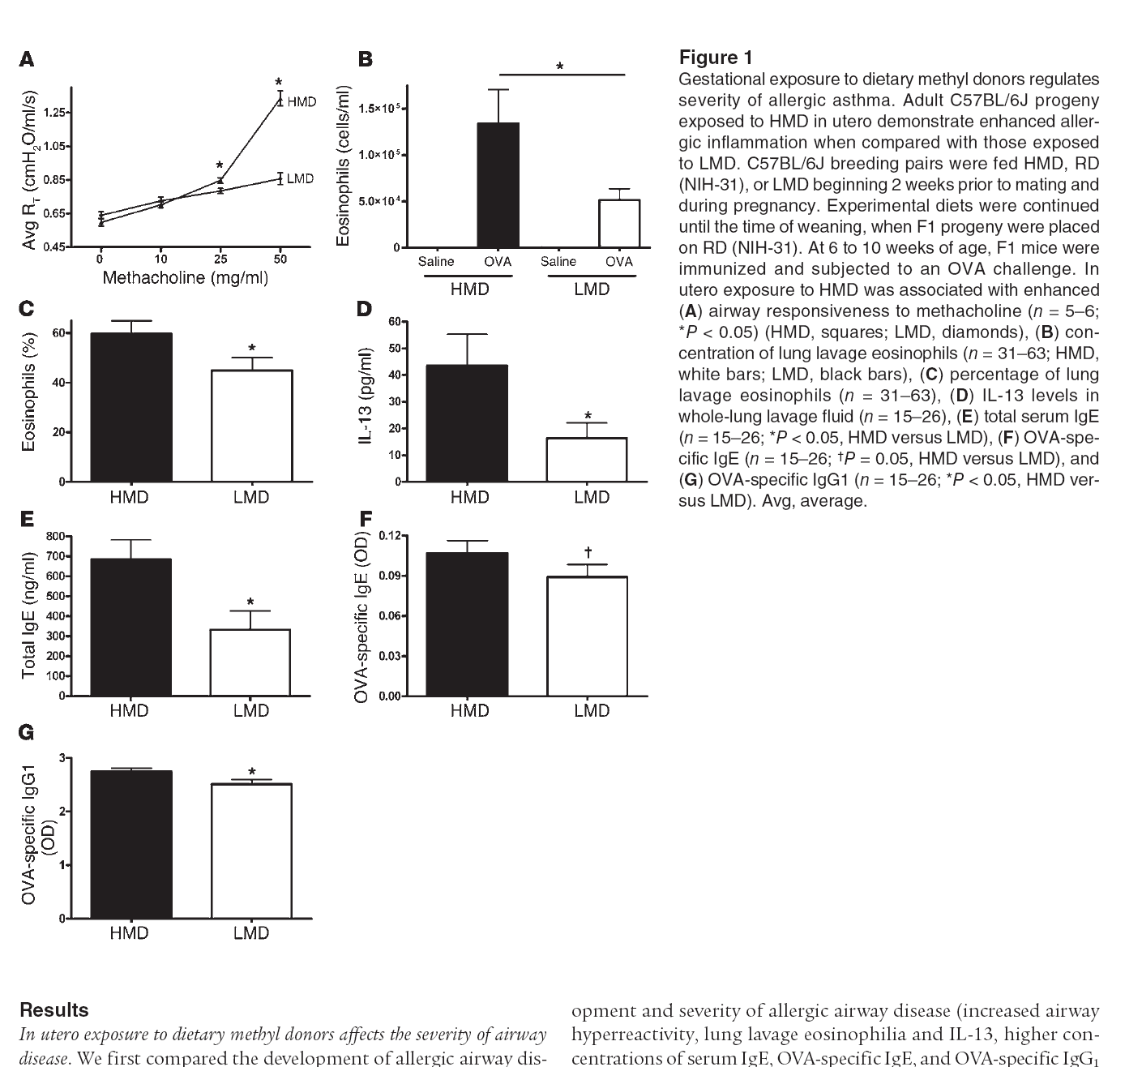
Gestational exposure to methyl donors increases BHR intensity and inflammation in mice
Hollingsworth et al., JCI 2008

Slide 54
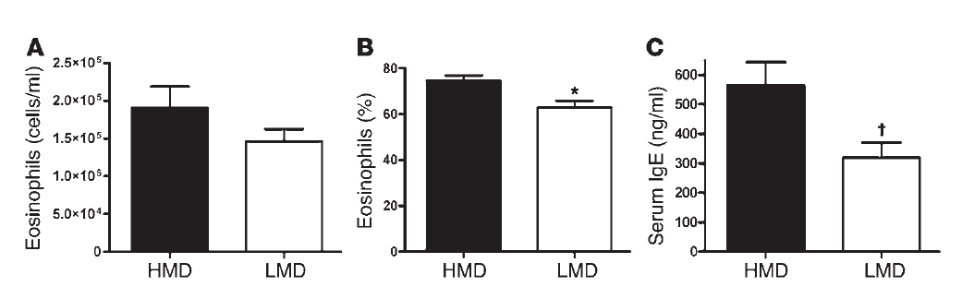
Transgenerational effect of methyl donor supplementation in murine allergic ‘asthma’
Post Ova-immunisation and challenge
Male F1 progeny
F2 generation maintained on regular diet
Hollingsworth et al., JCI 2008

Slide 55
Maternal smoking and asthma
Early Asthma Risk Factor Study (USA)
  4082 schoolchildren
Maternal grand mother smoked, maternal no
  Asthma OR = 1.8 (1.0-3.3)
Maternal grand mother smoked, maternal yes
  Asthma OR = 2.6 (1.6-4.5)
Maternal smoking in pregnancy
  Affects respiratory function
  Delays immune development – important for asthma
  Increases airway collagen deposition in primates
Yu-Fen et al., Chest 2005; Sekhon HS et al., AJRCMB 2002;
Stick SM et al., Lancet 1996; Macaubus et al., Lancet 2003

Slide 56


Global methylation
AluYb8 methylation significantly different in smoke exposed children
Gene-specific methylation (GoldenGate/pyrosequencing)
AXL
PTPRO
KLK11
TGFβ3

Slide 57
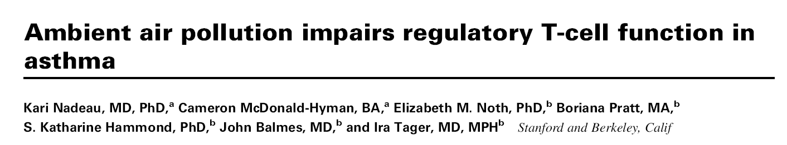
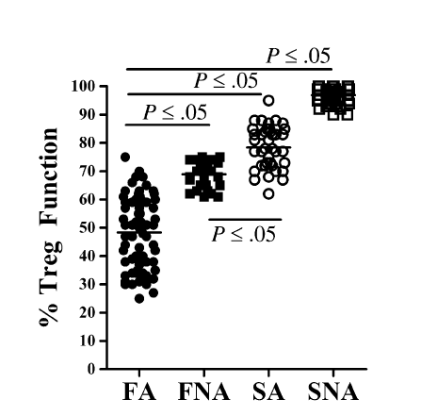
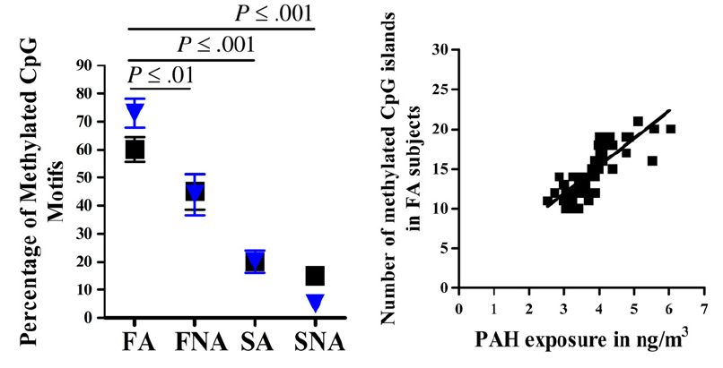

F - Fresno high pollution,
S - Stanford low pollution
FA - Fresno Asthma
FNA - Fresno Non Asthmatic
SA - Stanford Asthma
SNA - Stanford Non Asthma

Slide 58
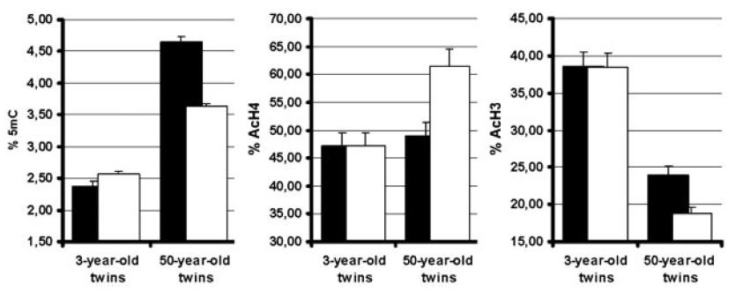
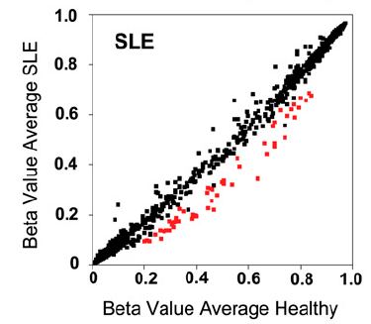
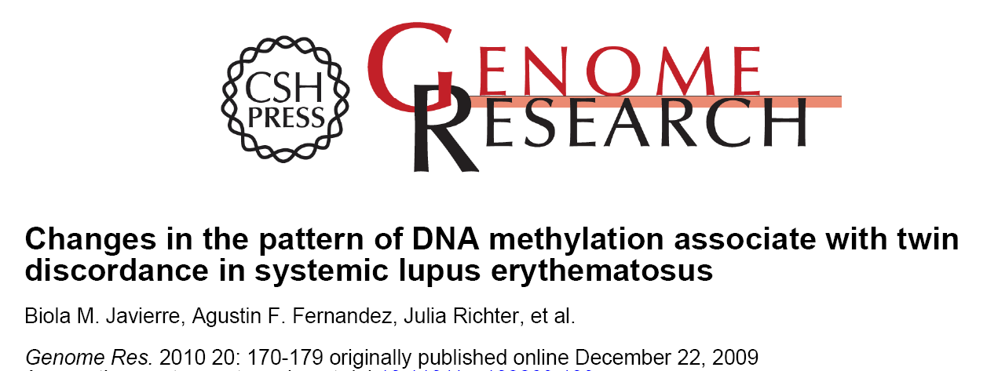
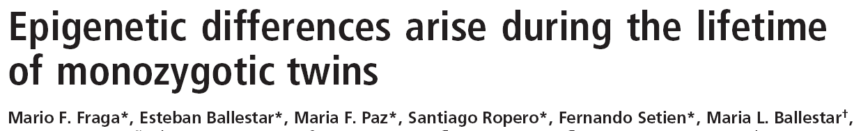

Changes in DNA methylation patterns in twins

Slide 59
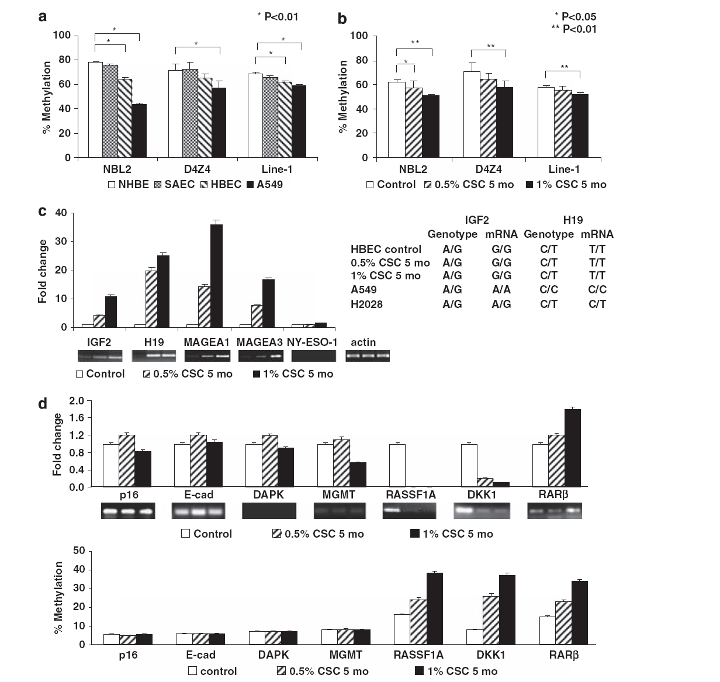
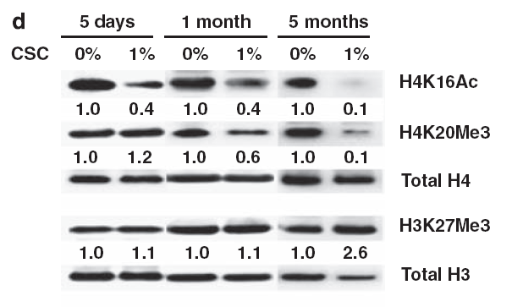
Chronic CS enhances epigenetic changes in airway epithelial cells
global hypomethylation
gene specific hypermethylation
Liu F et al., Oncogene 2010

Slide 60

CSC mediated dose- and time-dependent diminution of H4K16Ac and H4K20Me3, while increasing relative levels of H3K27Me3
Coincided with decreased DNMT1 and increased DNMT3b expression.
Time-dependent hypomethylation of D4Z4, NBL2, and LINE-1 repetitive DNA sequences;
  up-regulation of H19, IGF2, MAGE-A1, and MAGE-A3;
  activation of Wnt signaling; and
Hypermethylation of TSG such as RASSF1A and RAR-β
a CSC gene expression signature was also identified in these cells.
Progressive genomic hypomethylation and loco-regional DNA hypermethylation induced by CSC coincided with a dramatic increase in soft-agar clonogenicity.
Collectively, these data indicate that cigarette smoke induces ‘cancer-associated’ epigenomic alterations in cultured respiratory epithelia.

