Slide 1
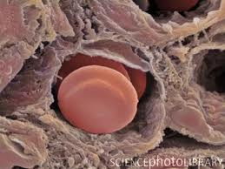
The endothelium and inflammation
Kieran O’Dea PhD
Critical Care Research Group
APMIC Section

Slide 2
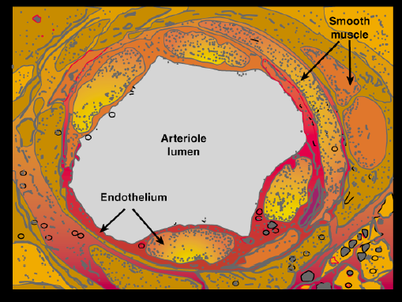
Endothelium as a structure
Single cell layer on luminal surface all blood vessels.
Dimensions
  0.3 -2.0 µm thick
  Area: 4000-7000 m²
  Cells: ~1 x 10¹³
Interface between blood and surrounding tissues.

Slide 3
Functions of the endothelium
‘Resting’
Regulation of vascular and tissue homeostasis
Facilitation and coordination of local inflammation
‘Activated’

Slide 4
Endothelium basal functions

Slide 5
Homeostatic functions of the endothelium
Vascular tone
  Vasodilation
  Vasoconstriction
Permeability
  Passive: small to large molecules
  Active: large molecules
Haemostasis
  Anti-thrombotic
  ↓ platelet aggregation
Leukocyte interaction
  Non-adhesive
  Non-activating
Redirect flow
Maintain fluid/colloid balance
Maintain flow
Anti-inflammatory

Slide 6
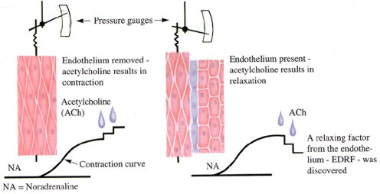
The obligatory role of endothelial cells in the relaxation of arterial smooth muscle by acetylcholine.
Furchgott RF and Zawadzki JV. Nature 288, 373 – 376. 1980
Acetycholine +
Muscle
=
Contract
Muscle + endothelium
=
Relax
Notes:
The obligatory role of endothelial cells in the relaxation of arterial smooth muscle by acetylcholine
Robert F. Furchgott & John V. Zawadzki
Department of Pharmacology, State University of New York Downstate Medical Center, Brooklyn, New York 11203
Despite its very potent vasodilating action in vivo, acetylcholine (ACh) does not always produce relaxation of isolated preparations of blood vessels in vitro. For example, in the helical strip of the rabbit descending thoracic aorta, the only reported response to ACh has been graded contractions, occurring at concentrations above 0.1 µM and mediated by muscarinic receptors1,2. Recently, we observed that in a ring preparation from the rabbit thoracic aorta, ACh produced marked relaxation at concentrations lower than those required to produce contraction3,4 (confirming an earlier report by Jelliffe5). In investigating this apparent discrepancy, we discovered that the loss of retaxation by ACh in the case of the strip was the result of unintentional rubbing of its intimai surface against foreign surfaces during its preparation. If care was taken to avoid rubbing of the intimai surface during preparation, the tissue, whether ring, transverse strip or helical strip, always exhibited relaxation to ACh, and the possibility was considered that rubbing of the intimai surface had removed endothelial cells4. We demonstrate here that relaxation of isolated preparations of rabbit thoracic aorta and other blood vessels by ACh requires the presence of endothelial cells, and that ACh, acting on muscarinic receptors of these cells, stimulates release of a substance(s) that causes relaxation of the vascular smooth muscle. We propose that this may be one of the principal mechanisms for ACh-induced vasodilation in vitio. Preliminary reports on some aspects of the work have been reported elsewhere

Slide 7
Endothelial nitric oxide mediated vasodilation
Shear stress
PI3-Kinase
+
eNOS
Nitric oxide
Calmodulin
Ca²+
Endothelial cell
Guanylate
cyclase
Protein
Kinase
G
Myosin light chain inactivation
GTP
↓Ca²⁺
cGMP
Smooth muscle cell
RELAX
Notes:
Nitric oxide: primary regulator of vasodilation under normal conditions
Endothelial nitric oxide synthase (eNOS)
Shear stress, acetylcholine, ADP, bradykinin.
Guanylate cyclase activation
Myosin light chain phosphatase activation
Cytosolic calcium decrease
Relaxation of myosin contractile apparatus
Other vasodilators:
Prostacyclin (PGI₂),
Endothelium-Derived Hyperpolarizing Factor (EDHF)
Vasoconstrictors:
Endothelin, PAF, TXA₂

Slide 8
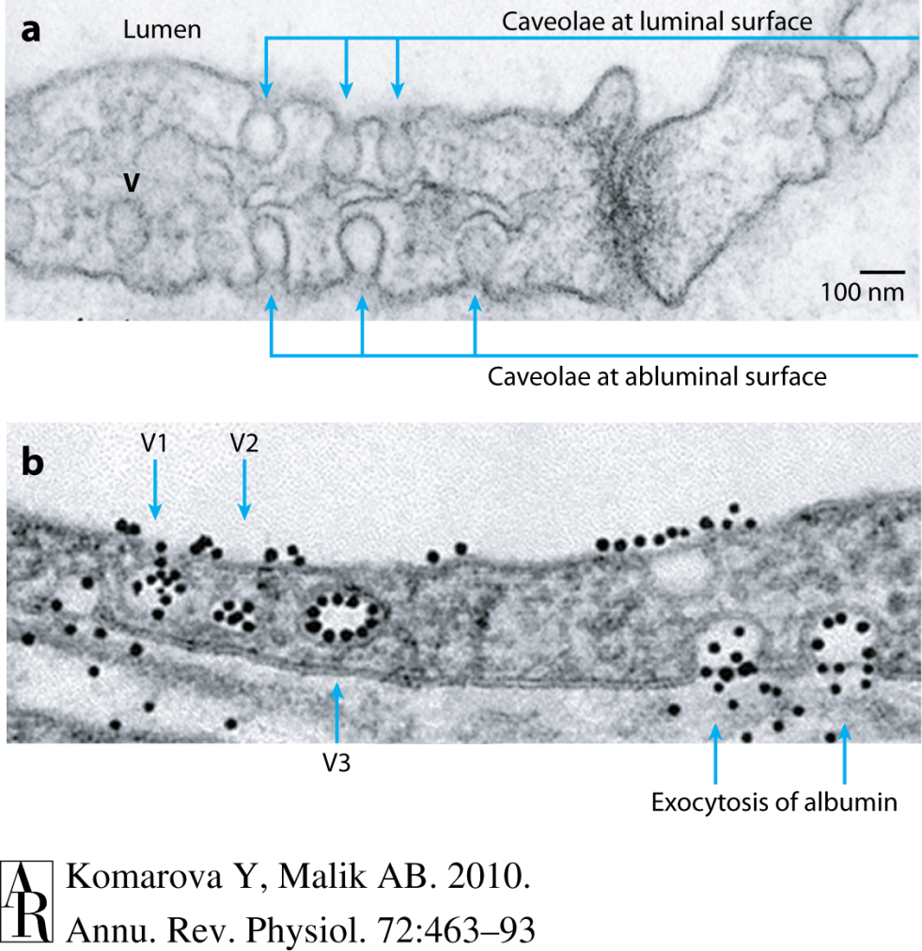
Transport of fluid and solutes in the capillaries
Blood
Blood
Tissue
Tissue
Active (transcytosis)
Transcellular movement of large molecules
Endocytotic uptake by caveolae
Exocytosis on the abluminal side
Passive (diffusion)
Paracellular movement of ions and water
Intercellular clefts:
  Tight junctions (apical)
  Adherens junctions (basal)

Slide 9
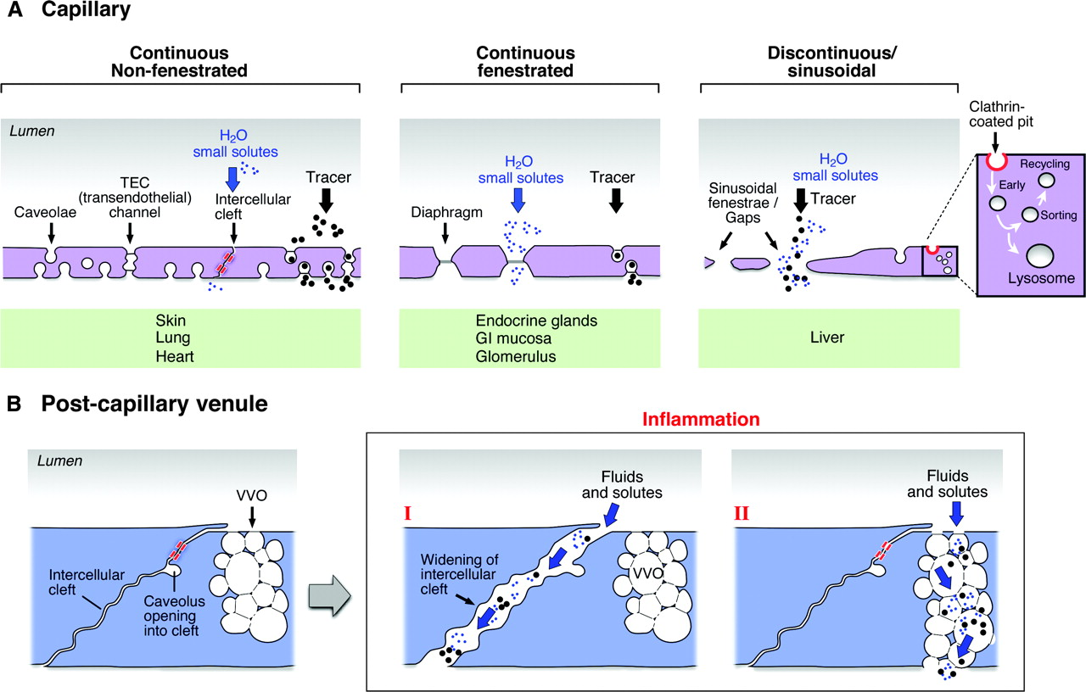
3 types of capillary endothelial barrier
Continuous
Lung
Heart
Skin
Brain
Fenestrated
Endocrine glands
GI mucosa
Glomerulus
Discontinous
Liver
Spleen
Bone marrow
Fenestrae: Large transcellular pores (70nm) with non-membranous diaphragm
Sinusoidal gaps: Large gaps/circular pores (110-200nm), no diaphragm

Slide 10
The endothelium is an anti-coagulant surface
Tissue
factor
+ VIIa
Tissue factor
pathway inhibitor
Endothelial
protein C receptor
X
Protein C
Anti-
thrombotic
Tissue factor-
VIIa/Xa
Thrombomodulin
+ Thrombin
V
Activated
Protein C
Va
Prothrombin
Plasminogen
Thrombin
Tissue Plasminogen
Activator
Pro-
fibrinolytic
Fibrinogen
Fibrin
Plasmin
ATPases/ADPases
Nitric oxide
Prostacyclin
Platelet
de-aggregating
Platelets
Notes:
Tissue factor pathway inhibitors (TFPIs) block the actions of the factor VIIa-tissue factor (TF) complex.
Thrombomodulin (TM) binds thrombin (Factor IIa) which then converts protein C (PC) to activated-PC (APC). APC inhibits coagulation cofactors Va and VIIIa.
Endothelial protein C receptor (EPRC) facilitates the thrombin-PC interaction.
Heparan sulphate proteoglycans enable bound anti-thrombin III to inhibit thrombin.
Tissue plasminogen activators (T-PA) convert plasminogen to plasmin to promote fibrinolysis
ATPases and ADPases convert platelet ATP to AMP, blocking physical interaction with collagen HOW?
NO and prostacyclin inhibit platelet binding.

Slide 11
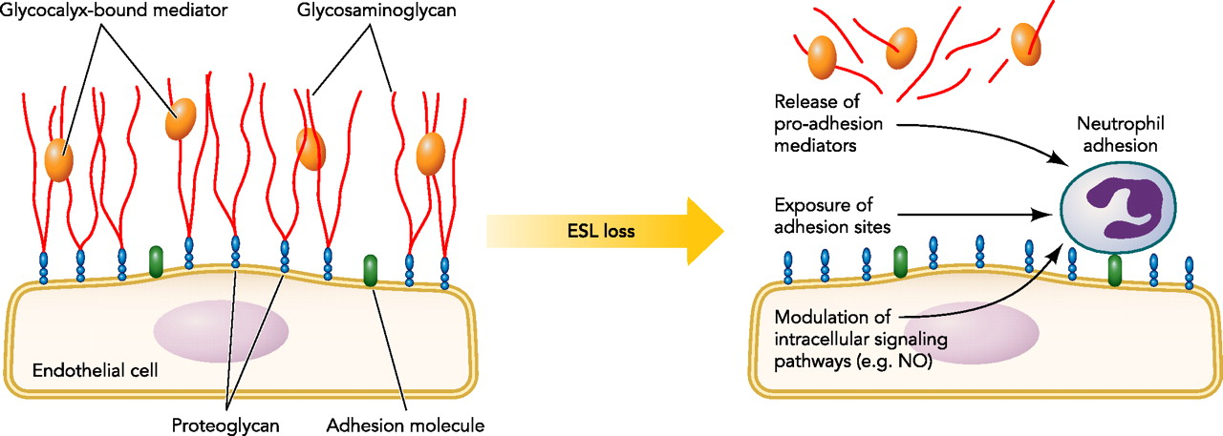
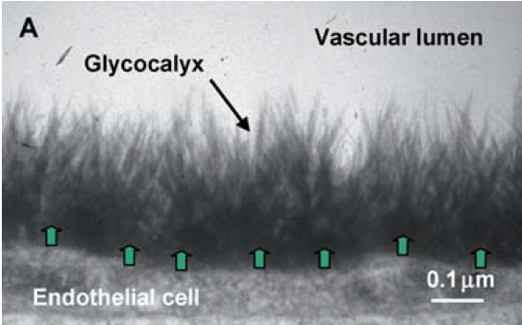
The endothelial surface layer (ESL)
Bound plasma proteins
and solutes
Endothelial
surface layer
Glycosaminoglycan
Glycocalyx
Proteoglycan core
Endothelial cell
Schmidt E P et al. Physiology 2011;26:334-347
The ESL is thick
0.5-2.0μM
0.1 μM: typical protein size

Slide 12
Functions of the ESL
Dampens physical stress on cells
Mechano-transduction of shear stress
Regulates fluid exchange
Anti-coagulant e.g. binds anti-thrombin III
Physical barrier regulating leukocyte contact

Slide 13
The endothelium in inflammation

Slide 14
Endothelial functions in the inflammatory reaction
Requirements
Responses
Increase local blood flow
Plasma exudation
Leukocyte
infiltration
Vasodilation
Permeability
Adhesion+
activation

Slide 15
Endothelial activation: Type I
Rapid response: independent of new gene expression
Histamine, soluble complement fragments (C3a, C5a)
G-protein coupled receptor (GPCR) signalling
Vasodilation Prostacyclin and NO
Permeability Opening of cell junctions
Adhesion + activation
P-selectin + platelet activating factor
Notes:
Vasodilation: COX-1 mediated prostacyclin release and eNOS mediated NO production (synergistic interaction).
Permeability: opening of tight junctions especially in post-capillary venules
Adhesion: exocytosis of Weibel Palade bodies with exposure of P-selectin on cell membrane. Release of von Willebrand factor increase platelet adhesiveness.
Activating surface: synthesis of PAF and presentation on membrane.

Slide 16
Type I activation
↑ Inositol trisphosphate via phospholipase C activation
Ligand: Histamine, C5a
Diacyl
glycerol
Phoshatidylinositol
bisphosphate
GPCR receptor
RHO
RHO-GEF
α
β
γ
Myosin light chain phosphorylation and activation
α
RHO
PLCβ
RHO-dependent
kinase
InsP₃
P
Tight & adherens
junction
MLC
phosphatase
MLC
phosphatase
Ca²⁺
Ca²⁺
Myosin light chain
↑ Arachadonic acid production via phospholipase A
activation
_{C}PLA₂
ER
MLC
P
Actin
Ca²⁺
Phosphatidylcholine
Calmodulin
+
MLCK
Weibel pallade
bodies
Arachadonic acid
COX1
Arginine
+
Lysoposphatidyl
choline
Prostacyclin
synthase
eNOS
Fusion
PAF
acetylase
PAF
Prostacyclin
NO
P-selectin

Slide 17
Endothelial activation: Type II
Delayed response: dependent on new gene expression
Pro-inflammatory cytokines: TNF-α, Il-1β
Activation of transcription factors: NF-κB and activating protein 1 (AP1)
Vasodilation: Prostacyclin (COX-2)
Permeability: Opening of cell junctions
Adhesion + activation: E-selectin + chemokines (IL-8, MCP-1)
Notes:
Vasodilation: COX-1 mediated prostacyclin release and eNOS mediated NO production (synergistic interaction).
Permeability: opening of tight junctions especially in post-capillary venules
Adhesion: exocytosis of Weibel Palade bodies with exposure of P-selectin on cell membrane. Release of von Willebrand factor increase platelet adhesiveness.
Activating surface: synthesis of PAF and presentation on membrane.

Slide 18
Type II versus Type I activation
Duration:
  Type I minutes; Type II evolves over hours/days
  Type I self-limiting; Type II continuous (in presence of stimulus)
Vasodilation and permeability:
  COX-2 expression in Type II results in greater prostaglandin production
  Actin reorganisation in type II results in sustained vascular leak and local fibrin deposition
Leukocyte infiltration:
  IL-8: more effective neutrophil infiltration
  Later expression of MCP-1, VCAM-1 and ICAM-1 produces transition to monocyte infiltration

Slide 19
The leukocyte-endothelial interaction

Slide 20
Leukocyte adherence to the activated endothelium
Leukocyte
Capture
Rolling + Activation
Arrest
Crawling
Migration
Selectin ligand
Selectin
Endothelium
Active Integrin
L-selectin,
PSGL-1
Integrin
Integrin ligand
β1 and β2 integrins
c
Chemokine receptor
CD11a/CD18
CD11b/CD18
VLA-4 (α4β7)
Chemokine
c
c
E & P selectins
PAF
IL8, MCP1
ICAM-1
VCAM-1
ICAM-2
PECAM-1
JAMs
PSGL-1
Notes:
A

Slide 21
How do leukocytes bypass the glycocalyx?
Enzyme digestion?
Neutrophil/monocyte or endothelial derived?

Slide 22
Dysfunction of the endothelium in systemic inflammation

Slide 23
Systemic infection or injury
→
Generalised endothelial activation
Fluid leak
Vasodilation
Coagulation
Hypoperfusion
Ischaemia
AMPLIFICATION:
Endothelial injury
Leukocyte recruitment

Slide 24
Leukocyte amplification of endothelial inflammation
Endothelial dysfunction
Prolonged type II activation (TNF, IL-1)
Enhanced coagulation
  Monocyte tissue factor
  Thrombin activation of Type I & II responses
Local release of proteases, reactive oxygen species and reactive nitrogen species
Consequences of endothelial apoptosis/injury
Loss of vascular integrity
Coagulation: tissue factor release and platelet adhesion

Slide 25
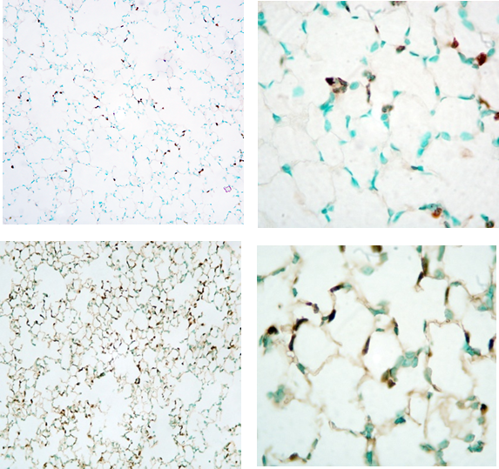
The clinical ‘2 hit’ concept of organ injury
Sequential insults produce inflammation that exceeds the sum of individual insults
  1st insult: trauma/surgery
  2nd insult: transfusion/infection
First insult ‘primes’ the response to the second insult.
Lungs
Normal
Experimental 2-hit models
1st hit → activation of endothelium and sequestration of primed leukocytes in capillaries
2nd hit → localised release of leukocyte inflammatory mediator → endothelial injury
Subclinical
inflammation

Slide 26

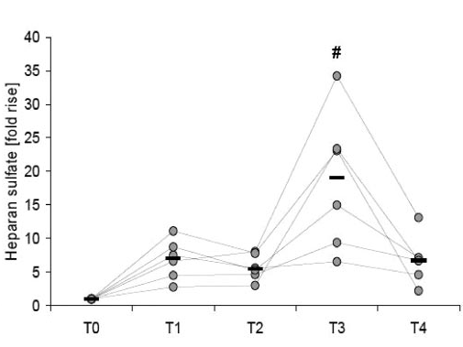
Plasma heparan sulphate
glycosaminoglycan
Baseline
Reperfusion of heart and lungs

Slide 27
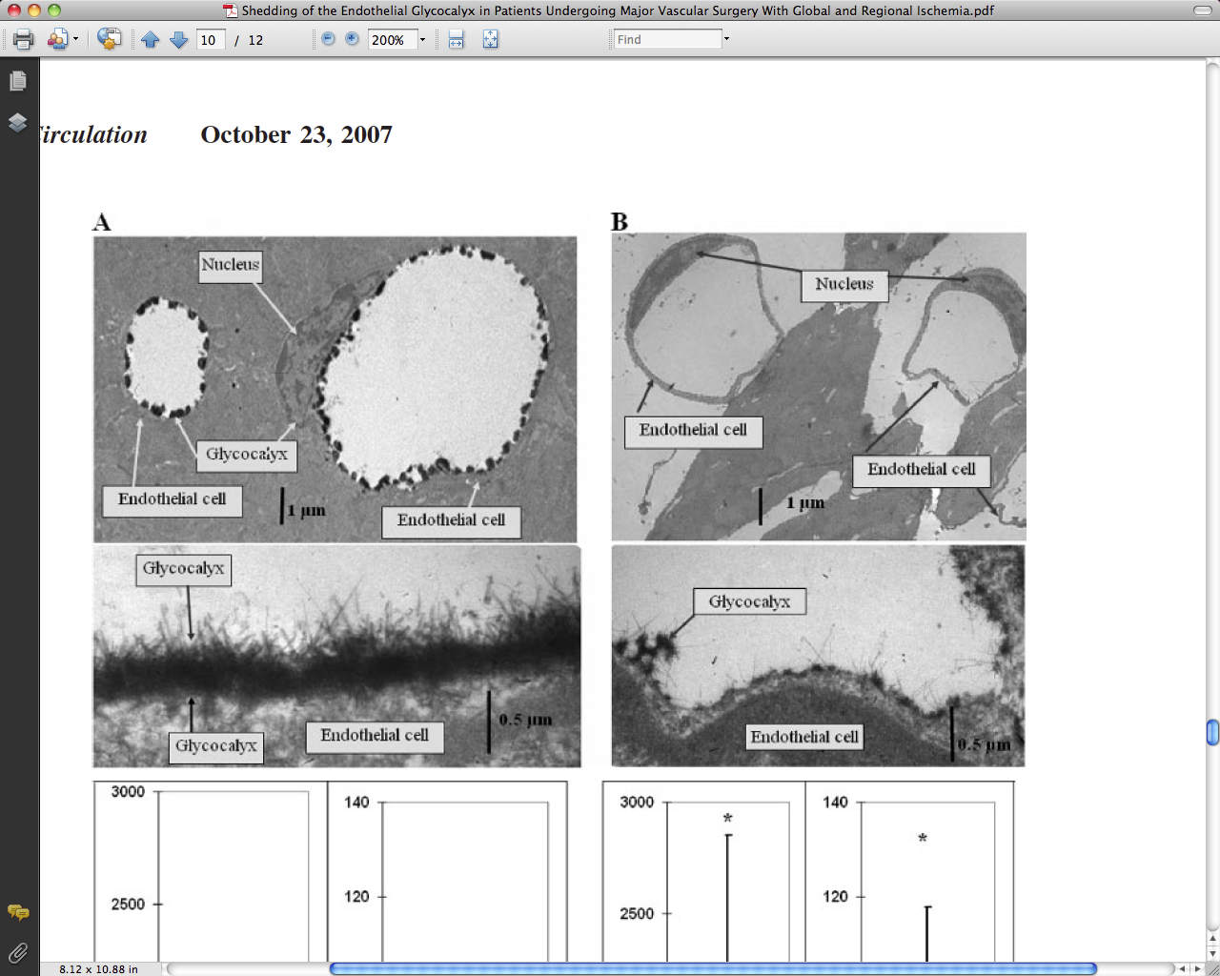
Shedding of ESL following cardiac ischaemia
  15 minutes of blood-free perfusion
  20 minutes of warm stopped-flow ischemia
Dysregulation of endothelial functions by glycocalyx degradation
↓ Mechano-transduction
↓ Osmotic barrier function
Pro-coagulant surface
Leukocyte adhesion
Notes:
GAGs syndecan and heparan sulphate release into coronary venous effluent

Slide 28
Summary
The endothelium and its surface glycocalyx layer performs essential homeostatic functions
The endothelial coordinates the inflammatory response
Systemic inflammation produces a generalised, and sometimes excessive activation of the endothelium, leading to organ dysfunction.
Restoring the normal endothelial response is a therapeutic goal in the treatment of acute systemic inflammation.

Slide 30
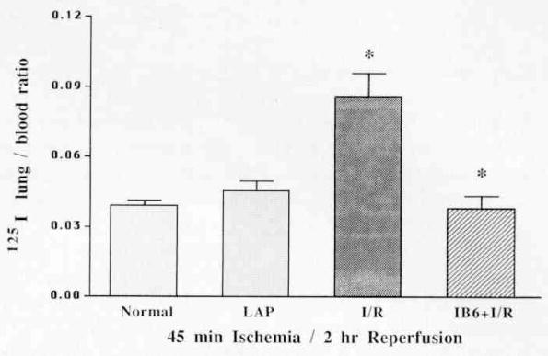
Attenuating the 2nd hit
CD11b blockade prevents lung injury despite neutrophil priming (and sequestration) after gut ischemia/reperfusion
Lung oedema
J Trauma 1995 !:23-28

Slide 31
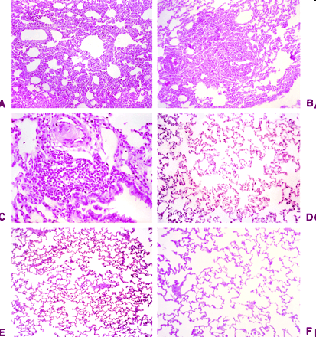
Blocking neutrophil/monocyte adherence could restore normal endothelial function
Model of prolonged sterile peritonitis in rabbits
Anti-CD18 i.v. treatment reduced leukopaenia
Neutrophil infiltration in the lungs and oxygen radical production reduced
Reduced mortality (40%) and improved lung function (↑pO₂)
Inhibition of CD11-CD18 Complex Prevents Acute Lung Injury and Reduces Mortality after Peritonitis in Rabbits
Gardinali et al. Am. J. Respir. Crit. Care Med., Volume 161, 2000, 1022-1029

Slide 32
Endothelial ‘activation’ vs. ‘dysfunction’
Endothelial activation under inflammatory conditions represents an adaptive phenotypic response to the local and systemic environment.
Endothelial dysfunction arises from activation, which is excessive or inappropriate in space and time.
The aims of endothelial therapies should not be to shutdown but to restore the adaptive phenotype.

Slide 33
Natural restoration of homeostasis (how it should work and therefore how it goes wrong = pathophys: intervention

Slide 35
Type II activation
IL-1
TNF
TIRAP
MyD88
IRAK4
TRADD
IRAK1
RIP1
TRAF2
TRAF6
IκB
AP1
p50
p65
AP1
NF-κB
E-selectin
ICAM-1
VCAM-1
Chemokines
COX-2
Arachadonic acid
COX2
Heparan
sulphate
proteoglycan
E-selectin
VCAM1
PGI₂
(prostacyclin)
C
Chemokine
ICAM1

Slide 36
Same mediator, opposite effects
Permeability
Oedema in
lung
Oedema in
muscle and mesenteric venules
10⁻¹²
10⁻¹¹
10⁻¹⁰
10⁻⁹
10⁻⁸
10⁻⁷
Endothelial NO concentration [log M]
Kuebler WM et al. Cell Physiol Biochem. 2010;26(1):29-40.

Slide 37
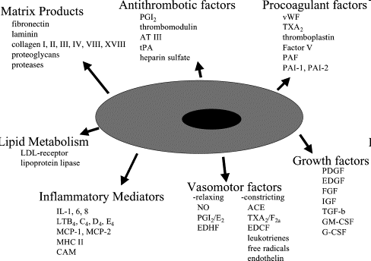
The endothelium has multiple physiological and immune functions
Sumpio BE et al. Int J Biochem Cell Biol. 2002 Dec;34(12):1508-12

Slide 38
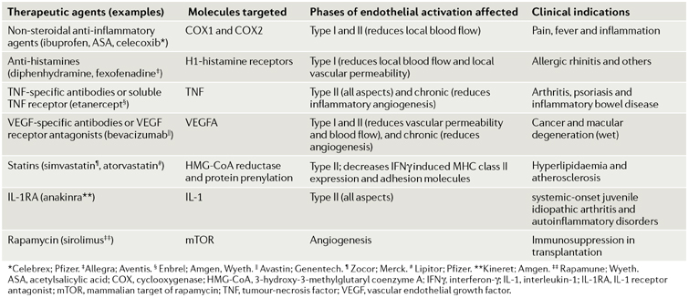
Endothelial-targeted actions of selected agents that reduce inflammation
Pober SJ and Sessa WC. Nature Reviews Immunology 7, 803-815 (October 2007)
Notes:
Went a bit flat
Make text and a message e.g. there are instances where targetting a single pathway may reset the system if other measures are in place to maintain this new steady state.
Make point that a lot of these treatments aim to targer local endothelial acitvation , whereas not global treatments availbale for SIRS and reversal of organ injury

Slide 39
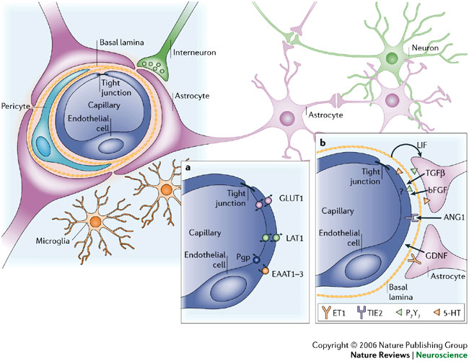
Endothelial transmission of inflammation between closed compartments
Notes:
To translate permeability changes into the local ans sytemic inflammatory contexts>
Local inflammation: swelling….cardinal signs of inflammation
For understanding organ function the role of heterogeneity is essential
Lung brain
How is this translated with such barriers
Lung=protected from sytemic cytokines: but there is a selective permeability
Brain=transmission of signal across, with the barrier in tact.

Slide 40
The endothelium as an organ
Multi- functional: regulating homeostasis of blood and underlying tissue.
Biosynthetic repertoire
  Matrix products, growth factors, procoagulant and antithrombotic factors, vasomotor factors, lipid metabolism, inflammatory mediators
Heterogeneous: functionally adapted to its location.
Adaptable: senses and responds rapidly to changes in its microenvironment.

