Slide 1
Anaesthesia and the cardiovascular system
Dafydd Lloyd MRCP, FRCA.
Academic Anaesthetics. G3.21.
dafydd@imperial.ac.uk

Slide 2
Miller’s Anesthesia 6th edition.
Total page count: 3203
Temperature monitoring: 28 pages.
Depth of Anaesthesia: 38 pages.
Respiratory monitoring: 44 pages.
Cardiovascular monitoring: ?

Slide 3
Miller’s Anesthesia 6th edition.
Total page count: 3203
Temperature monitoring: 28 pages.
Depth of Anaesthesia: 38 pages.
Respiratory monitoring: 44 pages.
Cardiovascular monitoring: 150 pages.

Slide 4
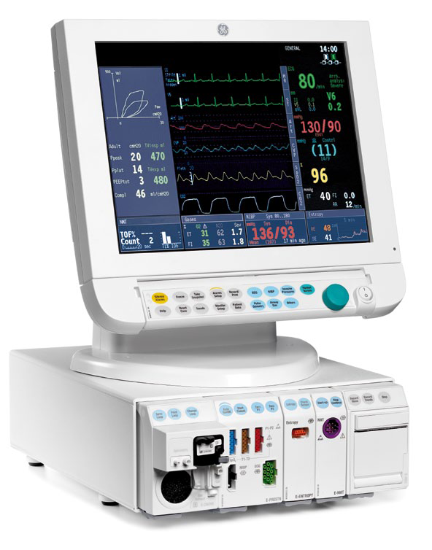
Datex Anaesthetic monitor:

Slide 6
Types of Anaesthesia:
General: Inhalational.
Intravenous: Opioid.
Non – opioid.
Regional: Local nerve blocks.
Central Neuroaxial.

Slide 7
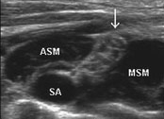
Supraclavicular Brachial Plexus:
ASM: Anterior Scalene.
MSM: Median Scalene.
SA: Subclavian Artery.
: Brachal Plexus.
NYSORA.

Slide 8
Cardiovascular System:
“Relating to the heart and blood vessels”
OED.
Systemic circulation: Cerebral.
Pulmonary.

Slide 9
Classical terminology:
Inotropy.
Chronotropy.
Lusitropy.
Dromotropy.

Slide 10
Classical terminology:
Inotropy : Force of contraction.
Chronotropy: Rate of contraction.
Lusitropy: Rate of relaxation.
Dromotropy: Rate of conduction.

Slide 11
Inhalational anaesthetics:

Slide 12
Inhalational anaesthetics:

Slide 13
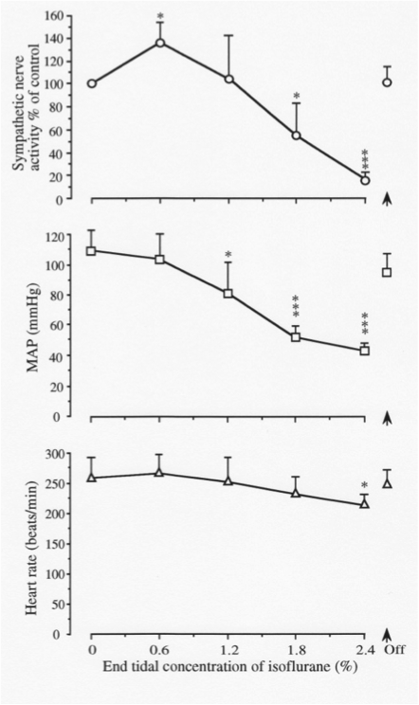
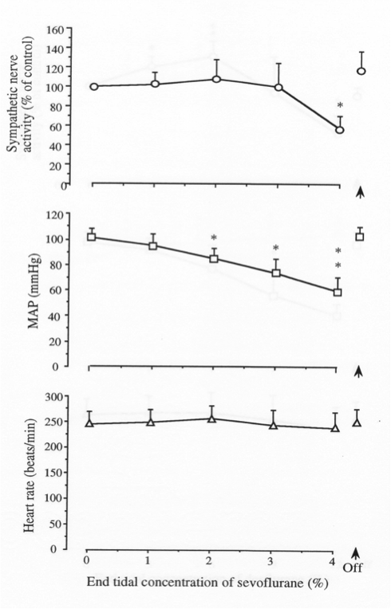
All volatiles reduce BP:
Isoflurane
Sevoflurane
Desflurane

Slide 14
Reduced Cardiac Output:
Initial increased sympathetic activity.
Reduce contractile function – 40%.
Negative Chronotropy.
Abnormal, blunted responses to change.

Slide 15
All reduce BP:
Isoflurane
Sevoflurane
Desflurane

Slide 16
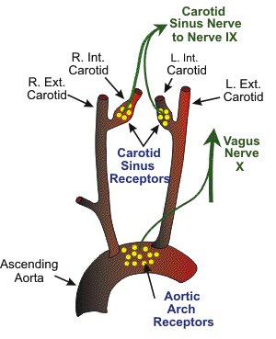
Baroreceptor reflex depressed:
Cardiovascular physiology concepts.

Slide 17
Altered LV relaxation:
Prolonged isovolumetric relaxation.
Altered coronary flow.
Reduced LV filling rate and volume.

Slide 18
Other effects:
RV: reduced contractility.
LA: reduced contractile function.
reduced filling.
Reduced SA node activity.
Conduction system: rate affected.

Slide 19
Effects at the Myocyte:

Slide 20
In the myocyte:
Reduce contractile function.
To varying degrees: H > I > D > S.
Ischaemic > non-ischaemic myocardium.
Failing > non-failing myocardium.

Slide 21
Volatiles alter calcium handling:
Ventricular myocyte Action Potential:
Ca²⁺ in.

Slide 22
Alter calcium transients:
Alter Ca²⁺ channel structure (L + T type)
Ca²⁺ influx.
Reduced Calcium induced Calcium release:
Leaky SR.
Reduced ‘Calcium sparks’
S/E exacerbated or reduced by Ca availability.

Slide 23
Effects can be clinically beneficial:
“Improve loading conditions”.
Reduce infarct size (experimental).
Ischaemic preconditioning.

Slide 24
Opioids and Benzodiazepines:
Haemodynamically stable.
Preserve homeostatic reflex mechanisms.
Effective dose is patient dependent.
Generally very stable.

Slide 25
Propofol:
Used for induction and maintenance.
Causes hypotension: up to 40%.
Myocardial depression.
Vasodilation.
HR stable: Resets baroreceptor reflex.

Slide 26
Ketamine:
Stimulates the CVS.
Increases BP, HR and Cardiac Output.
Increases Myocardial work and O₂ demand.
Central mechanism.

Slide 27
Neuroaxial anaesthesia:
Sympathetic blockade:
- Vasodilation below block.
- Hypotension: Preload.
Cardiac output.
Profound in hypovolaemia.

Slide 28
Neuroaxial blockade:
Bradycardia (T1-4).
Sympathetic blockade.
Reduced myocardial work and O₂ demand.
Reduced bleeding and DVT.

Slide 29
Cerebral perfusion:
Autoregulation: impaired by drugs.
Affected by: Blood pressure.
pCO₂.
pO₂.
Laryngoscopy.
Coughing.

Slide 30
Clinical considerations:
35 yr female.
Fit and well.
Elective laparoscopic Cholecystectomy.

Slide 31
What could you use?
75 year old male.
Severe ischaemic heart disease.
Elective Coronary Bypass Graft x 4.

Slide 32
What are the options?
50 year male.
Severe bilateral pneumonia.
Exhausted.
Sats 85% on 100% O₂, HR 120 bpm.
BP 80/50.

Slide 33
How could you…….
12 year old child.
Elective tonsillectomy.
“Doesn’t want a needle, very precious”.

Slide 34
What would work?
Road Traffic Accident.
Trapped in the vehicle.
Major lower limb bone + soft tissue injury.
In agony.

Slide 35
Last one.
65 year female.
Hypertensive.
PONV, “Terrible, you will help me Dr….”
Previous DVT, not on warfarin.
Elective total knee replacement.

Slide 36
In summary:
Complex, variable cardiovascular effects:
Direct Myocardial.
Direct arterio-venous.
Altered autonomic function.
Overall negatively - Inotropic.
- Chronotropic.
- Lusitropic.
- Dromotropic.

Slide 37
Anaesthesia and the cardiovascular system.
Dafydd Lloyd. MRCP, FRCA.
Academic Anaesthetics.
dafydd@imperial.ac.uk

