Slide 1

BSc Surgery & Anaesthesia:
Phase I oncology trials
Dr Sarah Blagden
s.blagden@imperial.ac.uk
31 October 2012

Slide 2

Talk outline
Introduction
The cost of drug development
What is a Phase I trial?
The differences between healthy volunteer and oncology phase I
Trial designs and their limitations
Safety, efficacy and ethics of oncology Phase I trials

Slide 3
Introduction
Around 12.7 million new cancer cases were diagnosed worldwide in 2008
Worldwide around 7.6 million deaths from cancer occurred in 2008
Estimated that people in UK have a 1:3 risk of developing cancer at some time during their life
Currently, average 10 year cancer survival in UK is 46.2% (CRUK 2007)

Slide 4
The Impact of chemotherapy
In some like prostate, breast and colorectal cancers, survival has significantly increased over time (by 12%, 6% and 6% every 5 years respectively)
For others, like oesophageal and ovarian cancer there has been little improvement in survival in recent years
New treatments are drastically required

Slide 5
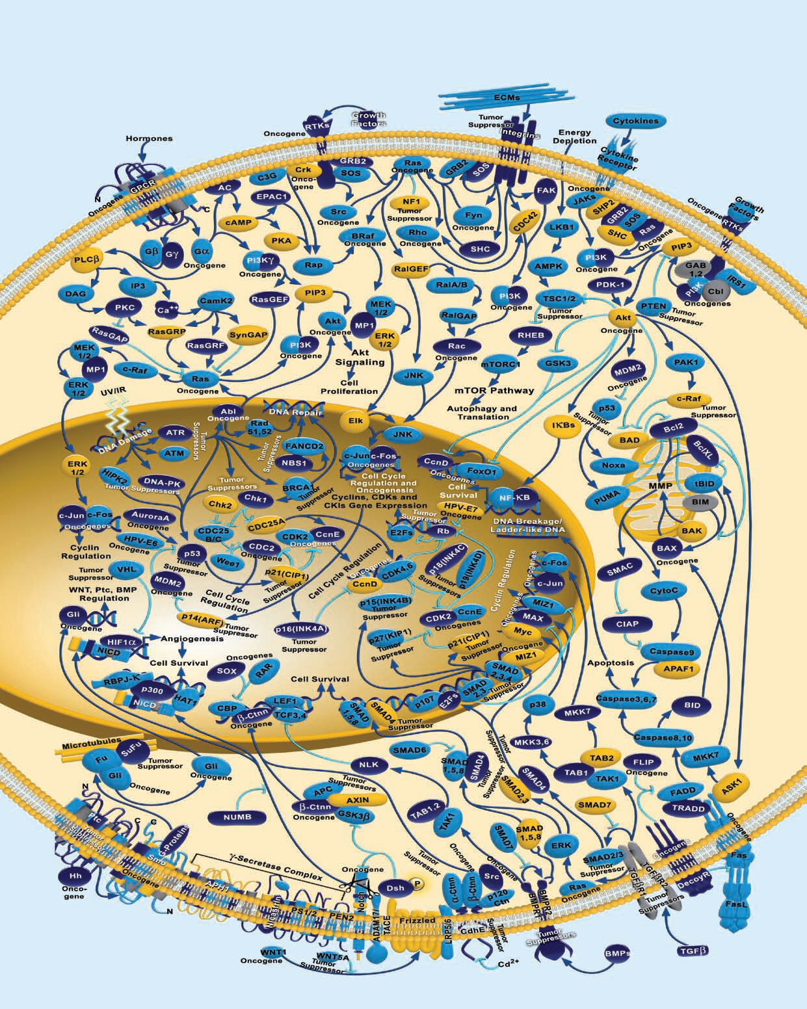
We are now in an era of targeted oncology

Slide 6
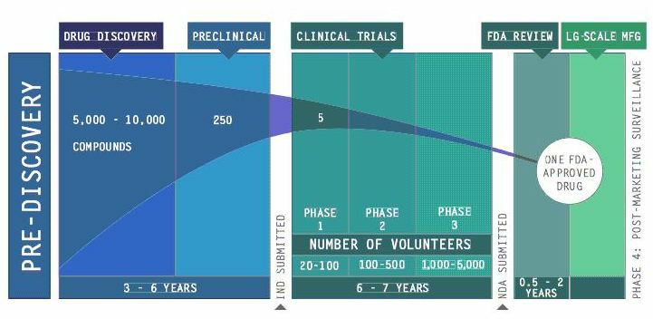
But each drug has to pass through extensive (and expensive) stages of drug development first!

Slide 7
The cost of developing one new cancer drug is approximately $1bn (£700m)
Phase III trial
(1000+ pats)
UK/FDA marketing approval
Phase II trial
(100 pats)
Phase I trial
(20-30 pats)
Preclinical Testing (lab and animal)
Discovery
(2-10 years)
0
2
4
6
8
10
12
14
16

Slide 8

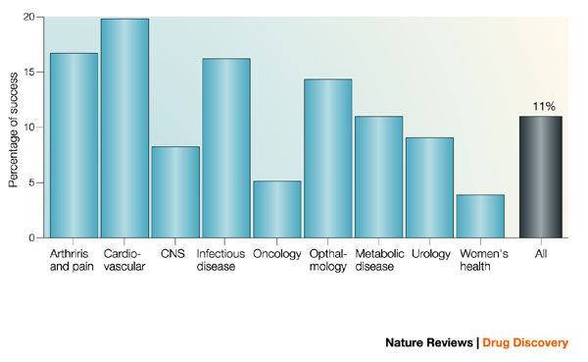
Only 5% cancer drugs entering clinical trials obtain marketing approval
(Kola et al, 2004)

Slide 9
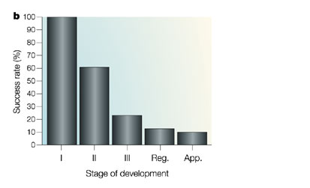
Success rate by % of phase 1 drugs that progress to development
Most expensive is stage of highest attrition i.e. phase II to III
It is vital for any drug company to develop a drug that is likely to active and whose activity can be clearly demonstrated.

Slide 10
Phase III trial
(1000+ pats)
UK/FDA marketing approval
Phase II trial
(100 pats)
Phase I trial
(20-30 pats)
Discovery
(2-10 years)
Preclinical Testing (lab and animal)
0
2
4
6
8
10
12
14
16

Slide 11
Phase I trials lie on the interface between pre-clinical and clinical development
There are 2 main types
  Healthy volunteer Phase I
  Disease-specific Phase I
- Characterise an agent’s toxicity profile
-Determine suitable dose and schedule to take to Phase II testing
- Characterise an agent’s toxicity profile
-Determine suitable dose and schedule to take to Phase II testing
- Determine disease response

Slide 12
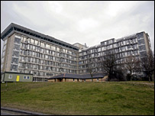
Healthy volunteer studies
Young volunteers
Paid to take part
Not usually cancer drugs
Risky, none the less
"I felt my head swelling up like an elephant's -I thought my eyeballs were going to pop out."
TGN1412

Slide 13
TGN-1412, a humanised monoclonal antibody against CD28.
Designed for use in CLL and rheumatoid arthritis
CD28 in expressed on T cells
Acted as a “super-agonist” activating T cells
Clinical trial at Northwick Park in 2006
8 volunteers each paid £2,000 to take part
2 had placebo and 6 had subclinical doses of active drug
6 admitted to hospital, 4 developed multi-organ failure

Slide 14
Outcome of Northwick park “scandal”
Patients had undergone cytokine release syndrome or “cytokine storm” – angioedema, swelling of skin and face
Complete depletion of white cells
The protocol had been approved by MHRA and drug given as directed
All volunteers recovered, though one has cancer
Seeking compensation of £5m each

Slide 15
Learning points from “Tegenero”
TGN1412 study problem | Detail | Learning Point
Interpretation of preclinical (primate) studies | Low-level cytokine release in primate studies should have promoted with more caution | Minor but potentially important effects in preclinical studies should raise caution in crossing the species barrier
Use of human in vitro studies | Insufficient in-vitro human studies were performed | In vitro studies on human material as close as possible to the target tissue can be important.
Choice of starting dose | Subtle difference between primate and human target ligand may explain marked difference in potency – the calculation of an initial dose based on a fraction of predicted ‘no adverse effect level’ proved dangerously wrong | Prediction of risk and dose range from animal studies may prove unreliable: extra caution with wider margins of safety are required with ‘potentially risky modes of action’
Dosing interval between subjects | No ‘proper interval’ allowing for the observation of possible side effects was left between the dosing of one subject and the next | In fisrt-in-man studies, investigators should expect the unexpected
Preparation for adverse events | Preparation for possible adverse events (cytokine storm) was inadequate – investigators did not expect it, recognize it or treat early. | Where there is a known theoretical risk, investigators should plan for its potential occurrence
Taken from paper by: H. Attarwala, J Young Pharm. 2010

Slide 16
Recap: Healthy volunteer studies
Young volunteers
Paid to take part
Not usually cancer drugs
Risky, none the less

Slide 17

Oncology Phase I studies
Patients have advanced cancer and have exhausted all standard treatment options
Patients are not paid to participate
Generally, studies are open to patients with all types of cancer (called “first in human” or “first in man trials”)
Not ever (or very rarely) placebo controlled studies

Slide 18
Standard Phase I design
Enrol successive cohorts of 3 to 6 patients at increasing doses with the idea of determining dose limiting toxicity (DLT) and maximum tolerated dose (MTD) then backing down in dose until reach a dose suitable for Phase II.

Slide 19
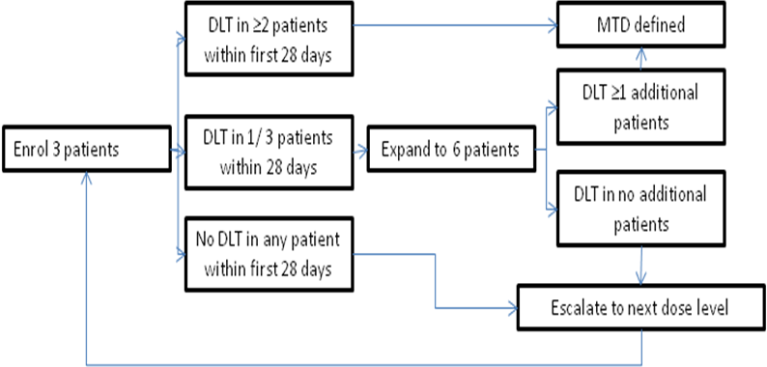
Standard 3 by 3 trial design

Slide 20
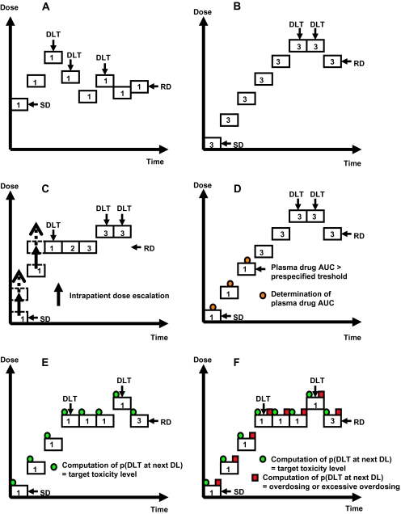
Other trial designs:
Up and down
Accelerated titration
Continual reassessment
Pharmacologically guided dose escalation
Modified continual reassessment method.
Escalation with overdose control.
See Le Tourneau et al, JNCI 2009

Slide 21
Limitations to these trial designs
When looking at a combination of agents
When assessing a targeted therapy in the correct target population / in the non-target population
  Adaptive designs
  Rapid Pharmacokinetics (PK)
  Pharmacodynamic (PD) readouts
      Circulating tumour cells
      Repeat tumour biopsies (feasibility / heterogeneity)
      Hair follicles
      Circulating DNA
      PET imaging / DCE MRI

Slide 22
Dose limiting toxicity
No standard definition (see paper by Le Tourneau et al, EJC, 2011)
A DLT is defined as one or more of the following events occurring through to the last scheduled day of Cycle 1:
• ≥Grade 3 non-hematological toxicity (excluding nausea/vomiting/diarrhoea that responds to standard medical treatment)
• ≥ Grade 3 nausea/vomiting/diarrhea that occurs despite standard medical treatment
• Grade 4 neutropaenia lasting > 7 days
• Febrile neutropaenia
• Grade 4 thrombocytopaenia
• Inability to begin next cycle of treatment (at full dose) within 14 days of the scheduled dosing due to unresolved toxicity
• Either isolated or recurrent Grade 2 (i.e, cardiac, renal, neurologic) toxicity that is judged by the Investigator and Medical Monitor to be a DLT.

Slide 23
Maximum Tolerated dose (MTD)
In a standard 3+3 design, the MTD is defined as the highest dose level for which fewer than 2 out of 6 (or < 33%) subjects experience DLT. If 2 or more subjects in a cohort of up to 6 subjects (or ≥ 33%) experience a DLT, then the MTD has been exceeded and one of the two following procedures should be followed:
• Evaluate the next lower dose level by enrolling a total of 6 subjects OR
• Evaluate a dose between the level exceeding the MTD and the next lower dose level by enrolling up to 6 subjects.

Slide 24
Challenges of Oncology Phase I trials
Dose 4 - TOXIC
Dose 3
Dose 2
Dose 1
There is usually no intra-patient dose escalation, therefore a patient cannot increase the dose level once they have started. A patient recruited at a low dose level may not receive a therapeutic dose level

Slide 25
Challenges of Oncology Phase I trials
Dose 4 – TOXIC – maximum tolerated dose
Dose 3 – expanded (3 more patients) – Recommended phase II dose (RP2D)
Dose 2
Dose 1
A patient recruited at a high dose level may experience toxicity

Slide 26
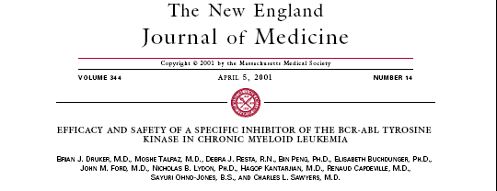
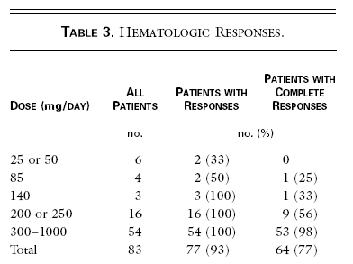
Challenges of Oncology Phase I trials
There is no guarantee of efficacy, even in those receiving a therapeutic dose level

Slide 27
Just how effective are oncology phase I trials?
Roberts et al,( JAMA, 2004) reviewed 213 published phase I trials (6474 patients) between 1991-2002
Divided into 3 time periods:
  Period 1: 1991-1994
  Period 2: 1995 –1998
  Period 3: 1999-2002
Overall 56% were male
89% PS 0 or 1
Most commonly patients with lung, colorectal cancer, kidney, breast and prostate
243 objective responses = 3.8%
Response rates declined over time: 6.2% (1), 2.6% (2), 2.5% (3)
Non-industry sponsors and non-USA trials had higher RR
Intra-patient (instead of inter-patient) dose escalation schedules were better (5.3% vs 3.2%)

Slide 29
Why are treatments less effective than before?
Chance of responding to treatment has decreased (overall benefit ratio has improved!)
  More independent radiology review
  More lines of prior treatment
  Unequal responses between trials
  Methods of assessing response unsuitable for newer agents (?look at progression rates rather than RR)

Slide 30
Just how effective are oncology phase I trials?
Horstmann et al (NEJM, 2005) performed similar analysis of 460 trials
Included stable disease
Found overall RR 10.6%
Additional 34.1% had stable disease or “less than PR” = 44.7% derived a benefit from treatment

Slide 31
How safe are oncology Phase I trials?
Roberts et al, JAMA, 2004 noted 137 deaths (2.1%), decreasing over the 3 time periods: 3% (1), 2.2% (2), 1% (3)
1991-1994 >10x riskier than 1999-2002)
  Why? Less cytotoxics
  Better supportive care (GCSF, anti-emetics)
  Stricter regulatory supervision and entry criteria
  ?publication bias
26% classified as treatment related (PE, febrile neutropenia)
Deaths less common in industry sponsored studies
Targeted agents less deaths than cytotoxics (0.19% vs 0.8%), 1/4th overall
Clinical signs of toxicity decreased over time 4.2% (1), 3.9% (2), 3.1% (3)
Hostmann reported treatment-related deaths of 0.49%

Slide 32
As these studies are potentially unsafe and potentially ineffective or toxic, are they ethical in cancer patients?
“No” :
The principle aim of phase I studies is to address safety and tolerability and patients are unlikely to obtain benefit
Patients may misunderstand this (24% do according to Jansen et al, 2011)
Patients are vulnerable (Annas et al (1992), Degos et al (2000), Lipsett et al (1982))

Slide 33
As these studies are potentially unsafe and potentially ineffective or toxic, are they ethical in cancer patients?
“Yes” :
It is patronising to assume patients do not understand the purpose of phase I
Demographically speaking, patients are not “vulnerable” (Seidenfeld, 2008)

Slide 34
The pros and cons of entering oncology phase I trial
Pros
Get a drug that may work and won’t be approved for another 15 years
Get access to a drug that might never be approved for their (rare) cancer
Treatment is free
Treatment continues for as long as it works
Continue to give “hope” to patients who don’t want to give up
Get close support of Phase I team during treatment
Advance cancer research
Cons
Get a drug either at too low or too high a dose with unexpected toxicities (may be fatal)
Get a drug that doesn’t work at all or doesn’t work for their cancer type
Fixed and inflexible treatment schedule
Have to “donate” blood, hair follicles, tumour specimens etc – v.invasive!
No time to spend with family/friends – perpetuates denial

Slide 35
Getting approval to run a trial
ICH-GCP training (guidelines approved since 1986)
Protocol, patient info sheet etc registered on European Database (Eudract number)
Protocol reviewed by MHRA
Protocol reviewed by External Ethics Committee
Protocol reviewed and approved by hospital R&D committee
Site inspected by trial monitors
Deviations reported to trial sponsors or MHRA
MHRA can do random inspections
Registration revoked if unsafe

Slide 36
Summary – Oncology Phase I studies
Costly to develop
At the interface between preclinical and clinical trials
Oncology phase I fundamentally differ from healthy volunteer studies
Trial designs developed around cytotoxics
Studies are safer, more efficacious and better regulated than ever before
They are still ethically controversial
What will the future be??

Slide 37
