Slide 1
BSc in Surgery & Anaesthesia
Cancer metastasis mechanisms
16 October 2012
Dr Manuela Mura

Slide 2
Definition of cancer metastasis
Primary tumour: is a tumour that is at the original site where
first arose.
Secondary tumour: is a tumour formed by cell escaping the
primary tumour to neighbouring or distant site. Cells of
secondary tumour share molecular/morphological
characteristic with cells in the primary tumour.
Metastatic cancer: is a cancer that has spread from the
original site it first formed (primary tumour) to a neighbouring or distant organ (secondary tumour).

Slide 3
Why metastases are so dangerous?
Cell that undergo metastasis are a subpopulation of cells that acquire a
highly motile phenotype
They have stem cell-like characteristic (self renewal)- Still controversial!
Are resistant to chemotherapy

Slide 4
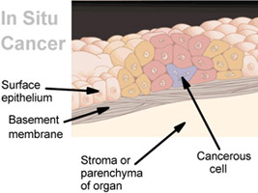
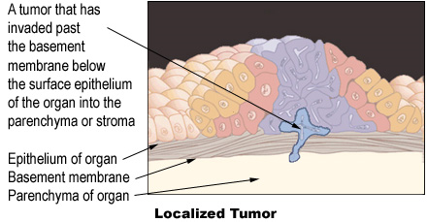
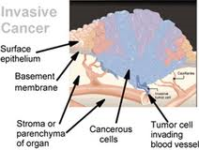
Steps in cancer progression
www.cancer.gov
US National Institute of Health

Slide 5
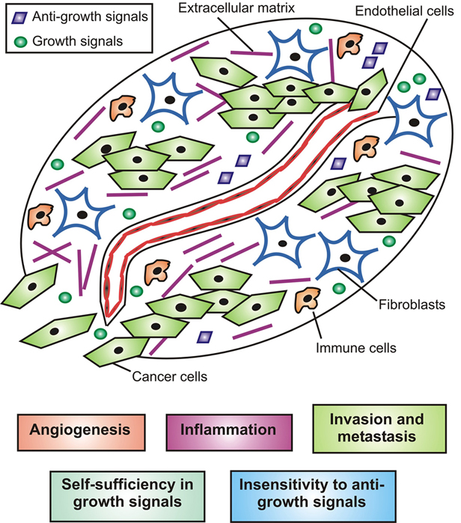
Tumour micro-environment
Macrophages
Fibroblasts
T cells
Newly formed vessels
Cytokines
Growth factors
Extra cellular matrix (ECM)
Nyberg P, Frontiers in Bioscience 2008

Slide 6
Characteristic of metastatic cancer cell
Motility
Anchorage independent growth
Local invasion
Intravasation
Extravasation
Ability to survive and multiply in an environment different than
the original

Slide 7
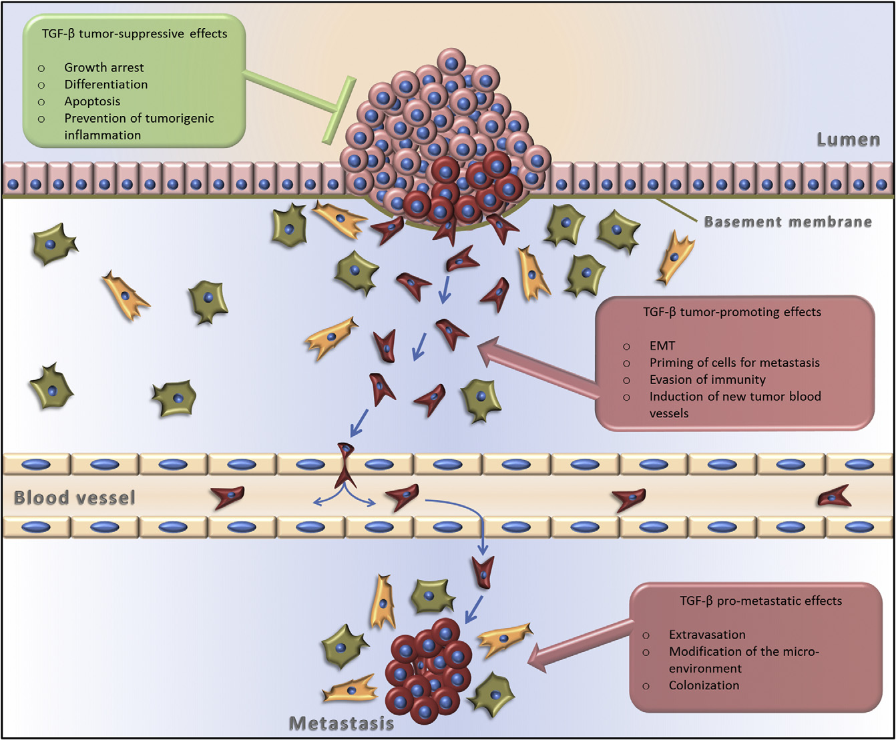
Local invasion
Intravasation
Extravasation
Heldin et al FEBS Lets

Slide 8
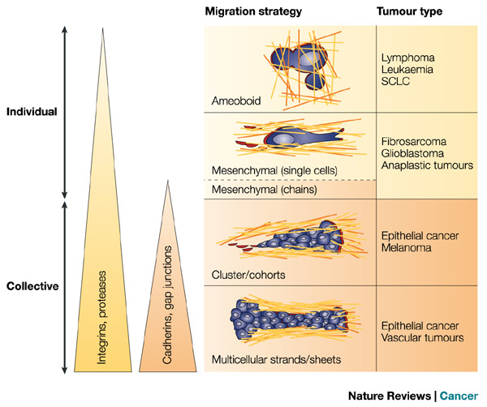
Type of cell movement
Peter Friedl & Katarina Wolf, Nature Review Cancer 2003

Slide 9
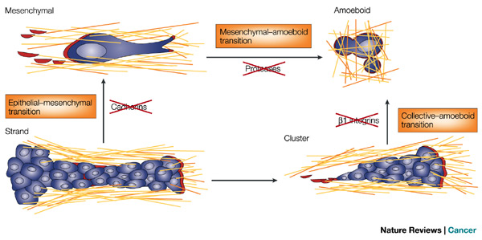
Transition from one type of movement to another can occur depending on the surrounding environment
Peter Friedl & Katarina Wolf, Nature Review Cancer 2003
Dense interstitium: mesenchymal
Sparse Interstitium: amoeboid

Slide 10
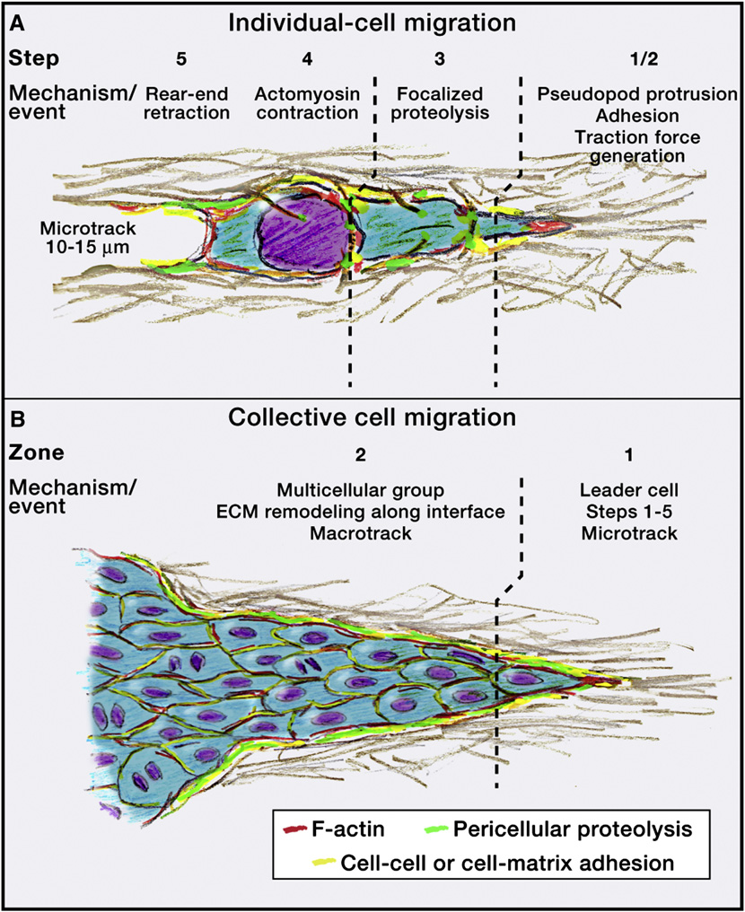
Individual and collective migration
Friedl and Alexander Cell 2011

Slide 11
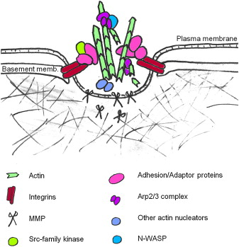
Pseudopodia/Invadopodia
Actin polymerisation
Focal adhesion complexes
Metallo-protease (MMP)
Chris D. Madsen , Erik Sahai Developmental Cell 2010

Slide 12
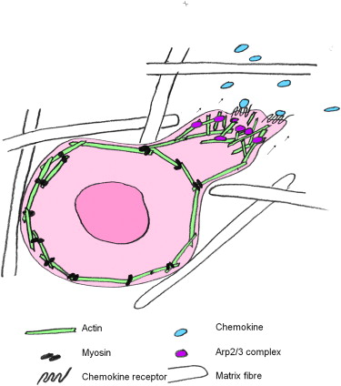
Amoeboid migration
Cortical contraction:
generates hydrostatic pressure to push the leading protrusion forward
squeezes the cell through small gaps without the need for matrix proteolysis
Chris D. Madsen , Erik Sahai Developmental Cell 2010

Slide 13
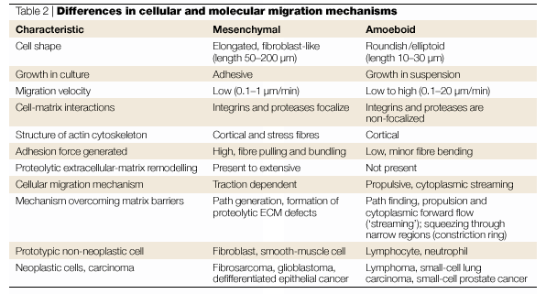
Characteristic of mesenchymal and amoeboid migration
Peter Friedl & Katarina Wolf, Nature Review Cancer 2003

Slide 14
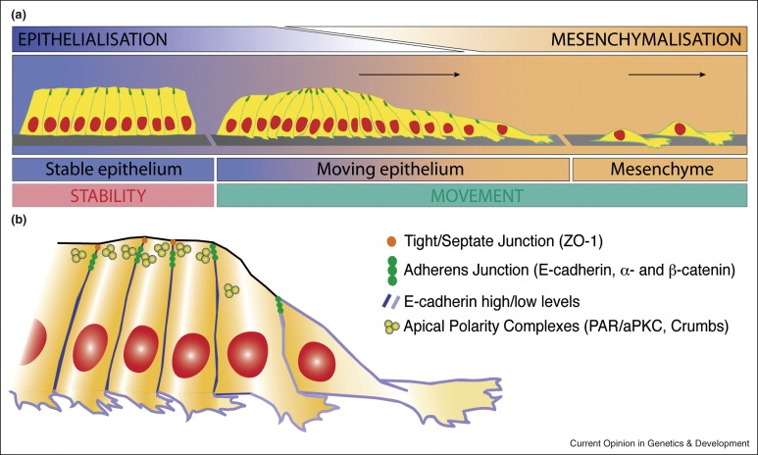
Epithelial to mesenchymal transition (EMT)
Revenu and Gilmour, Current Opinion in Genetics and Development 2009
Cells lose the cobblestone regular pattern
Acquire a spindle-like scattered phenotype
Become highly motile

Slide 15
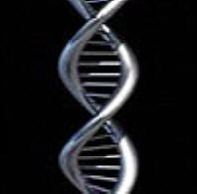
Molecular events occurring in EMT
TGF-β / FGF
Activates Snail/twist
E-cadherin/ β-catenin complex disorganised
N-cadherin expression
Snail
Translocates into the nucleus
Repress epithelial-related gene expression such as E-cadherin
E-cadherin expression
E-box promoter suppressor
twist
Dr Normala Abd Latip

Slide 16
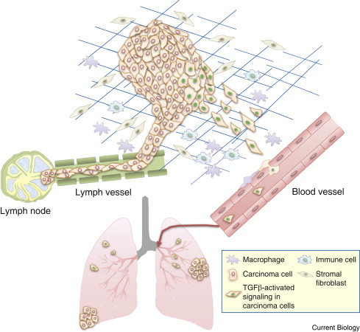
Intravasation/Extravasation
Tumour cells enter blood
or lymphatic vessels
Tumour cells can station
in regional lymph-nodes
before spreading at distant site
through the lymphatic system
JP Thiery Current Biology 2009

Slide 17
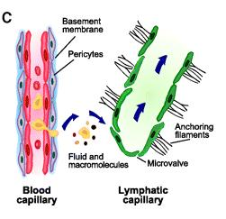
Characteristics of blood and lymphatic capillaries
Lymphatic capillaries are highly
permeable
Blood capillaries have a “thicker
Wall” due to the presence of
Basement membrane and pericytes.
Sinusoid capillaries (liver)
have open pores and lack this
organised structure and have high
permeability
C Norrmén et al Circulation 2011

Slide 18
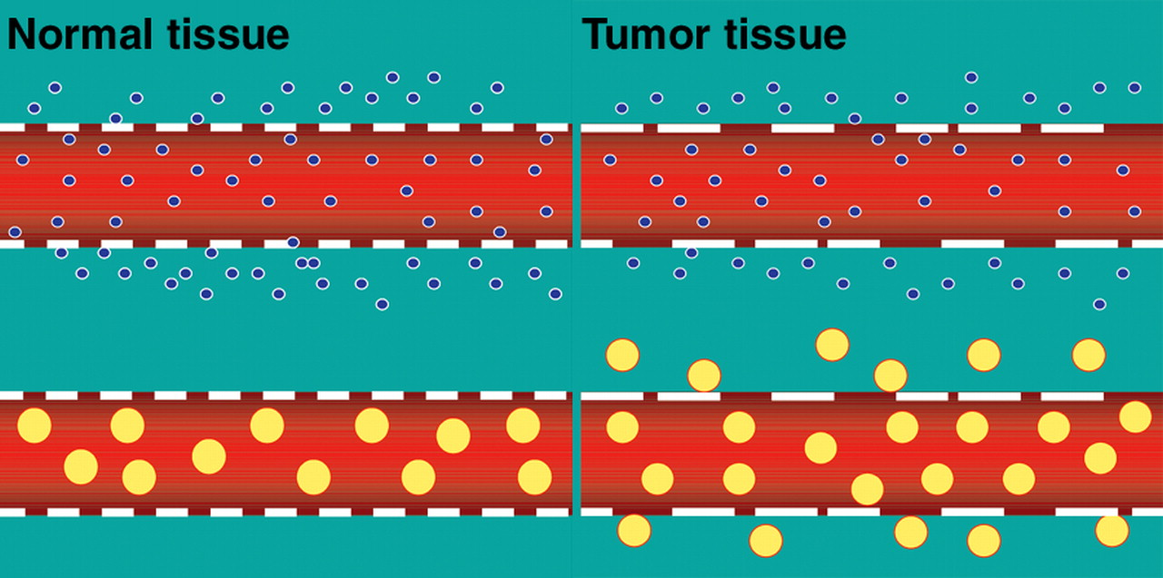
Tumour blood capillaries
van Vliet M et al. Radiographics 2005
Discontinuous
Lack pericytes
High permeable

Slide 19
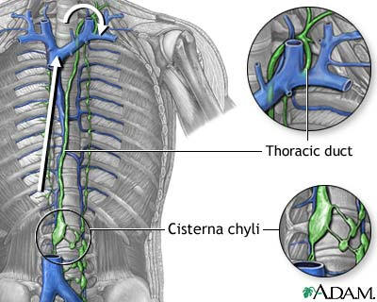
Circulating tumour cells (CTC)
Tumour cells circulate through the lymphatic and haematic vasculature
Tumour cells circulating in the lymphatic vasculature will enter the blood stream
Through the lymphatic thoracic duct into the left branch of sub-clavian vein

Slide 20
Disseminated tumour cells (DTC)
Disseminated tumour cells (DTC) are tumour cells that leave the blood stream and enter the stroma of a distant tissue
It is estimated that only 0.01% of CTC become DTC
The ability of a DTC to survive in an environment completely different from the original site depend in part on how “welcoming” is the receiving tissue (theory of seed and soil)
Anatomical characteristics: highly vascularised organs (liver) are more likely to form metastasis
Biochemical characteristic: presence of growth factor or pH can influence the secondary tumour growth

Slide 21
Principal site of metastasis
Cancer type | Primary site | Principal site of metastasis
Breast adenocarcinoma | Breast | Bone, lung, liver and brain
Small cell carcinoma | Lung | Brain, liver and bone
Malignant melanoma | Skin | Lung, brain and liver
Prostatic adenocarcinoma | Prostate | Bone
Testicular carcinoma | Testis | Liver
Colorectal adenocarcinoma | Colon/rectum | Liver and lung
Neuroblastoma | Mediastinum, abdomen | Liver
Mathot and Stenninger Cancer Science 2012

Slide 22
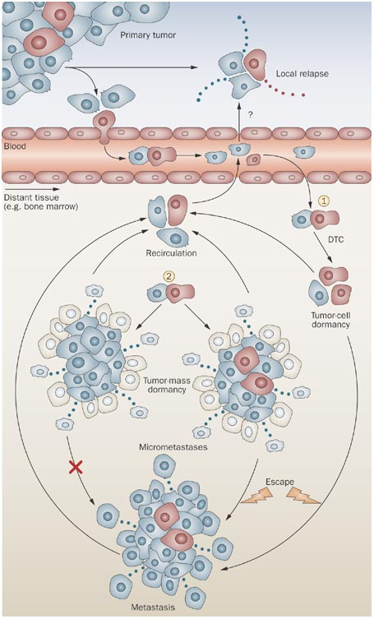
Tumour cell and dormancy and relapse
Some tumour cells in the primary tumour,
micro-metastasis or in distant metastasis
exit the cell cycle and became dormant
This cells are most likely to be
chemotherapy resistant and have self
renewal characteristic
Dormant tumour cells have the ability
to induce relapse once awakened
Pantel K et al. (2009)

Slide 23
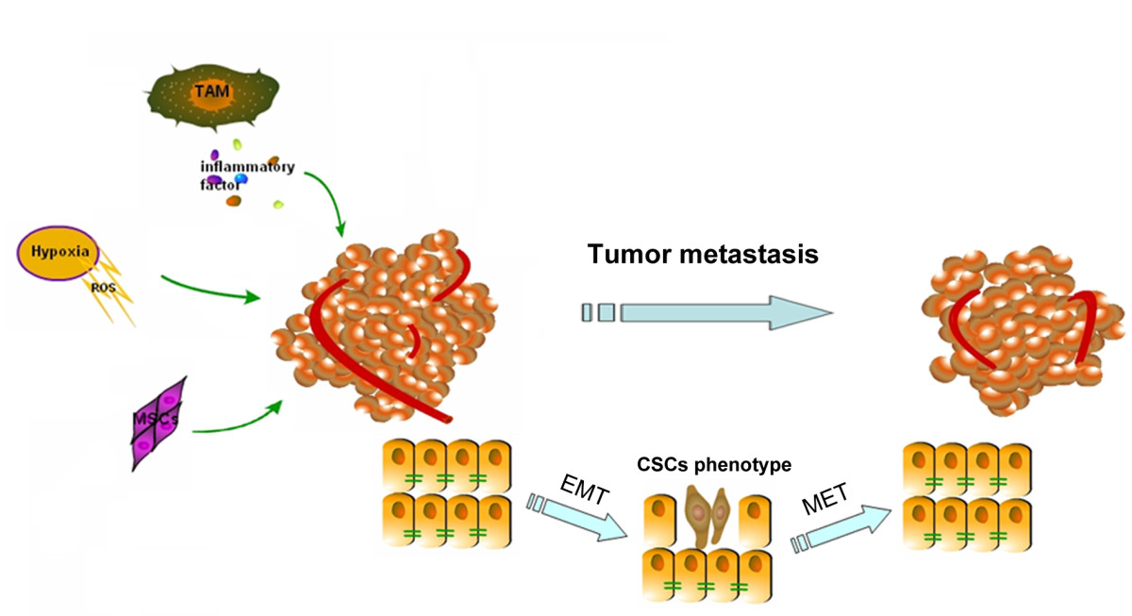
Mesenchymal to epithelial transition (MET)
Tumour cell re-acquire epithelial characteristic
basal-apical polarity
Tight junction

Slide 24
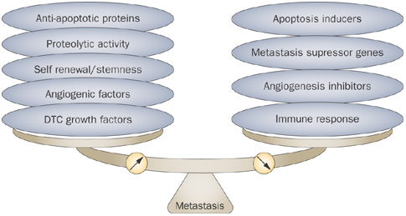
Factors that can influence the formation of metastasis
Pantel K et al. (2009)

Slide 25
Summary
Motility
Mesenchymal (EMT)
Collective
amoeboid
Anchorage independent growth
Local invasion
dormancy/relapse
Intravasation
Haematic/lymphatic vessel
Extravasation
Ability to survive and multiply in an environment different than
the original
Seed and soil
Dormancy relapse

Slide 26
Contact: manuela.mura1@imperial.ac.uk

