Slide 1
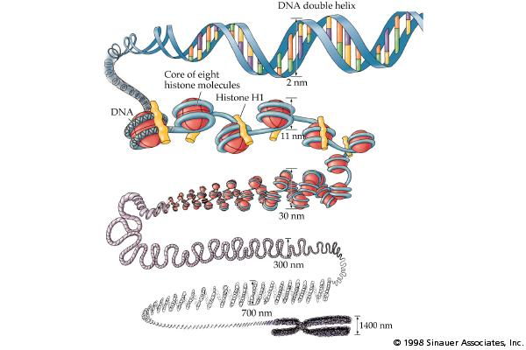
Cancer Epigenomics
Bob Brown: b.brown@imperial.ac.uk
Notes:
1

Slide 2

Same genotype, different phenotype
Same genome, different expression pattern

Slide 3
Same genotype, different phenotype
Same genome, different epigenome

Slide 4
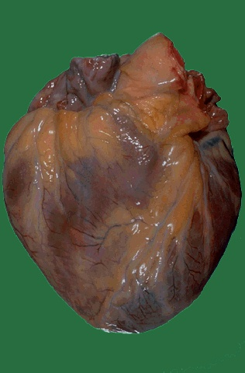

Same genotype, different phenotype
Same genome, different epigenome

Slide 5
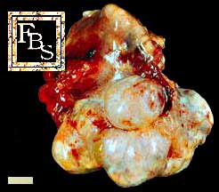
Same genotype, different phenotype
Ovarian Cancer: Similar genome, very different epigenome and chromosome instability

Slide 6
Many important genes are epigenetically silenced in malignant cells
Cell cycle: Rb, p16^{INK4a}, p15^{INK4a}, p14^{ARF}
Signal transduction: RASSF1, APC
Apoptosis: DAPK, Caspase 8
DNA repair: MLH1, MGMT, BRCA1
Senescence: TERT, TERC
Invasion/metastasis: TIMP-3, E-cadherin
APC = adenomatous polyposis coli
DAPK = death-associated protein kinase
MGMT = O-6-methylguanine-DNA methyltransferase
1. Jones & Baylin. Cell 2007;128:683–92
2. Teodoridis JM, et al. Drug Resistance Updates 2004;7:267–78
Notes:
6

Slide 7
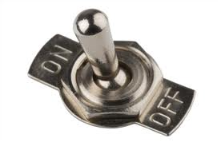







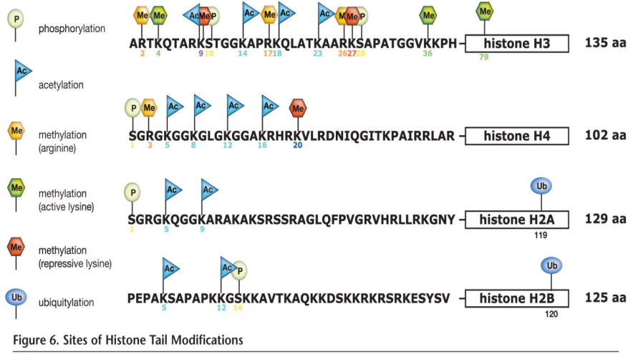
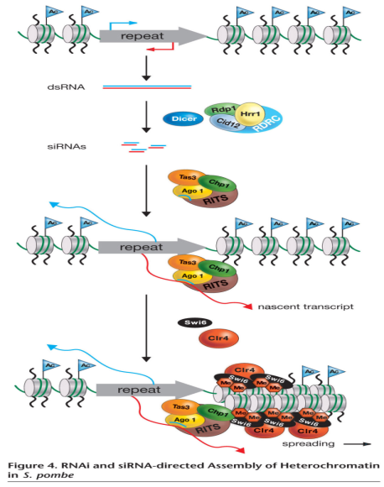
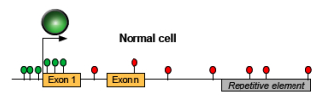

Epigenetics: Levels of control
DNA Methylation
On/Off switch
Histone modifications
Packaging
miRNA regulation
Fine tuning dimmer switch

Slide 8


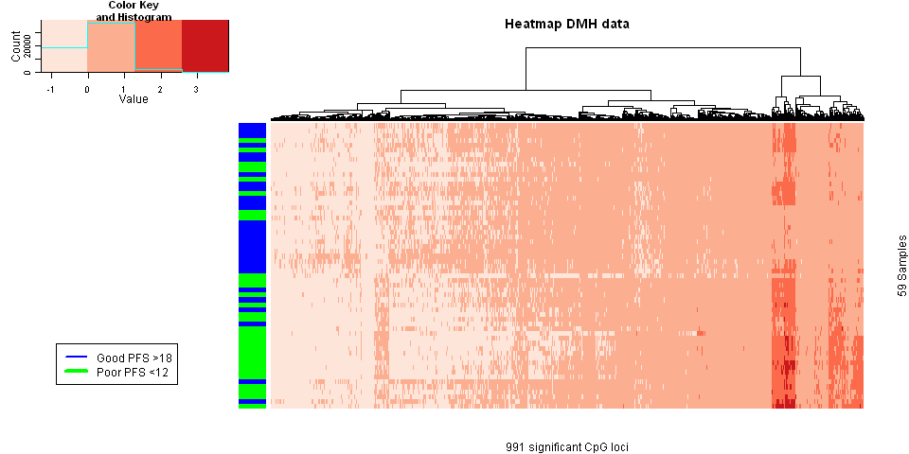
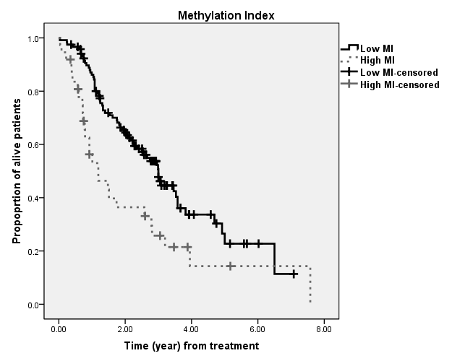
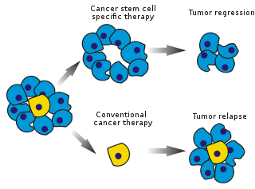
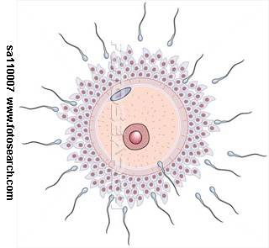
Epigenetics can impacts at multiple points on the Patient Cancer Journey
Carcinogenesis
Treatment
Epigenetic therapies
Epigenetic Variation
Prenatal exposures
Environmental factors
e.g smoking
Risk + Etiology
Pharmaco-Epigenomics
Prognostic and predictive biomarkers
Drug resistance
Drug development

Slide 9
Key translational areas for epigenetics
Cancer Biomarkers
  Cancer risk
  Cancer diagnosis
  Cancer prognosis
  Personalised medicine
New anti-cancer drugs
  DNA demethylation agents
  Histone deacetylases
  Histone methylation/demethylation
New biological targets
  Tumour stem cells
Notes:
9

Slide 10
Epigenetics
“A hereditable change in gene expression not involving a change in DNA sequence”
DNA methylation: addition of methyl groups to CpG dinucletides in DNA

Slide 11
(cytosine-5) DNA methylation
NH
2
NH
2
CH
3
N
D
n
m
t
N
O
N
O
N
occurs predominantly at CpG dinucleotides
is catalyzed by DNA methyltransferases (DNMTs)
can be pharmacologically reversed (DNMT inhibitors)
source of cancer biomarkers

Slide 12
Sodium Bisulfite Modification
Unmethylated DNA
Methylated DNA
me
me
ACGTCTCGAC
TGCAGAGCTG
ACGTCTCGAC
TGCAGAGCTG
me
me
Sodium Bisulfite
me
me
AUGTUTUGAU
ACGTUTCGAU
TGCAGAGCTG
TGUAGAGUTU
PCR
me
me
AUGTUTUGAU
ACGTUTCGAU
T-A-C-A-A-A-A-C-T-A
T-G-C-A-A-A-G-C-T-A
TGUAGAGUTG
TGCAGAGCTG

Slide 13
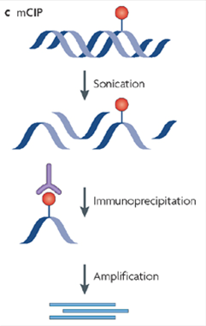
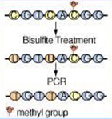
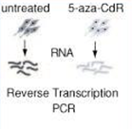
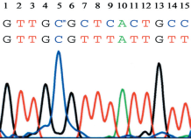
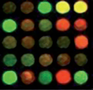
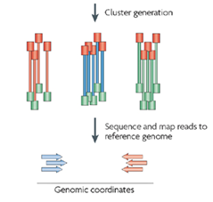

Current methods for high-throughput DNA methylation analysis
DNA purification
Detection of DNA methylation
RNA purification
Genome-wide approaches
Candidate genes:
Bisulphite sequencing
MSP
Pyrosequencing
Methylight
DMH
MeDIP
Illumina BeadChips
Demethylating drug
CH₃
CH₃
α-5mC
CH₃
Notes:
13

Slide 14
DNA methylation
Gene transcription
EXON1
EXON2
EXON3
CpG island
CpG non-island
Generally unmethylated in normal cells
De-methylated state allows gene transcription
Methylation of CpG islands associated with gene silencing:
  Imprinted genes
  X-chromosome inactivation
Generally methylated in normal cells
Methylation associated with gene transcription
Methylation helps prevent mutations and genomic instability
Methylation helps prevent recombination and activation of transposable elements

Slide 15
DNA methylation silences genes in cancer including tumour-suppressor genes
Normal tissue
Gene ON
Many hundreds of CpG Islands become aberrantly methylated in all types of cancer cells
Tumour
Gene OFF

Slide 16
DNA methylation silences genes in cancer: role of DNMT
Normal tissue
Permissive: (Gene ON)
DNMT1 and 3b genetic inactivation in colon tumour cells¹
Tumour
Repressive: (Gene OFF)
DNMT = DNA methyltransferase
1. Rhee, et al. Nature 2002;416:552–6

Slide 17
DNA Methylation and Cancer
Normal tissue
Permissive state
DNMT and HDAC inhibitor (Cameron et al 1999)
Tumour
Gene OFF

Slide 18
Epigenetics
“A hereditable change in gene expression not involving a change in DNA sequence”
DNA methylation: addition of methyl groups to CpG dinucletides in DNA
Histone modification and chromatin remodelling e.g. acetylation of lysine in histones

Slide 19
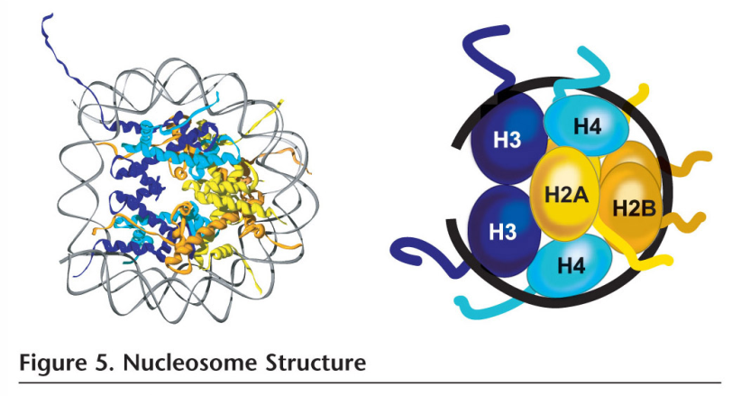

Histones and posttranslational modifications
Epigenetics, Allis, Jenuwein, Reinberg, Caparros, 2009

Slide 20
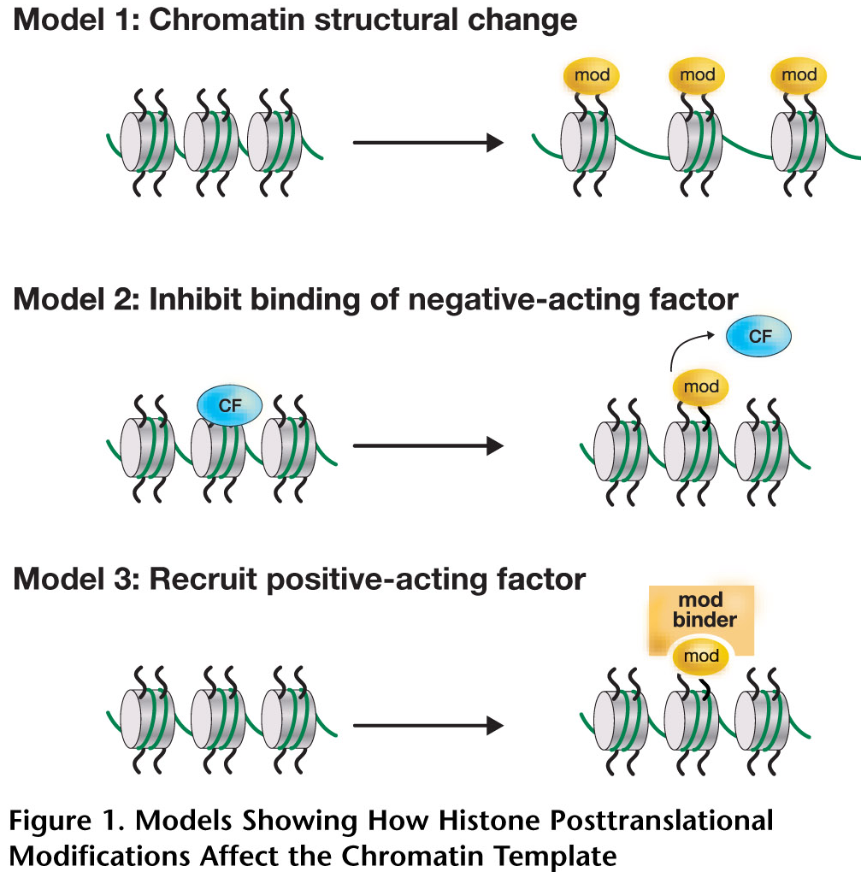
Histone modifications affect chromatin template
- Prevention of crucial contacts
necessary for higher order structure
Disruption of effector protein binding
Altered binding surface attracts certain effector proteins and complexes
Epigenetics, Allis, Jenuwein, Reinberg, Caparros, 2009

Slide 21
HDAC
Acetyl
Acetyl
MBD protein
Me
Me
Me
DNA
Histone
Histone

Slide 22
Acetyl
HDAC
MBD protein
Me
Me
Me
DNA
Histone
Histone

Slide 23
HMT
+
Me
Me
Me
MBD protein
Me
Me
Me
DNA
Histone
Histone

Slide 24
HMT
Me
Me
Me
MBD protein
Me
Me
Me
DNA

Slide 25
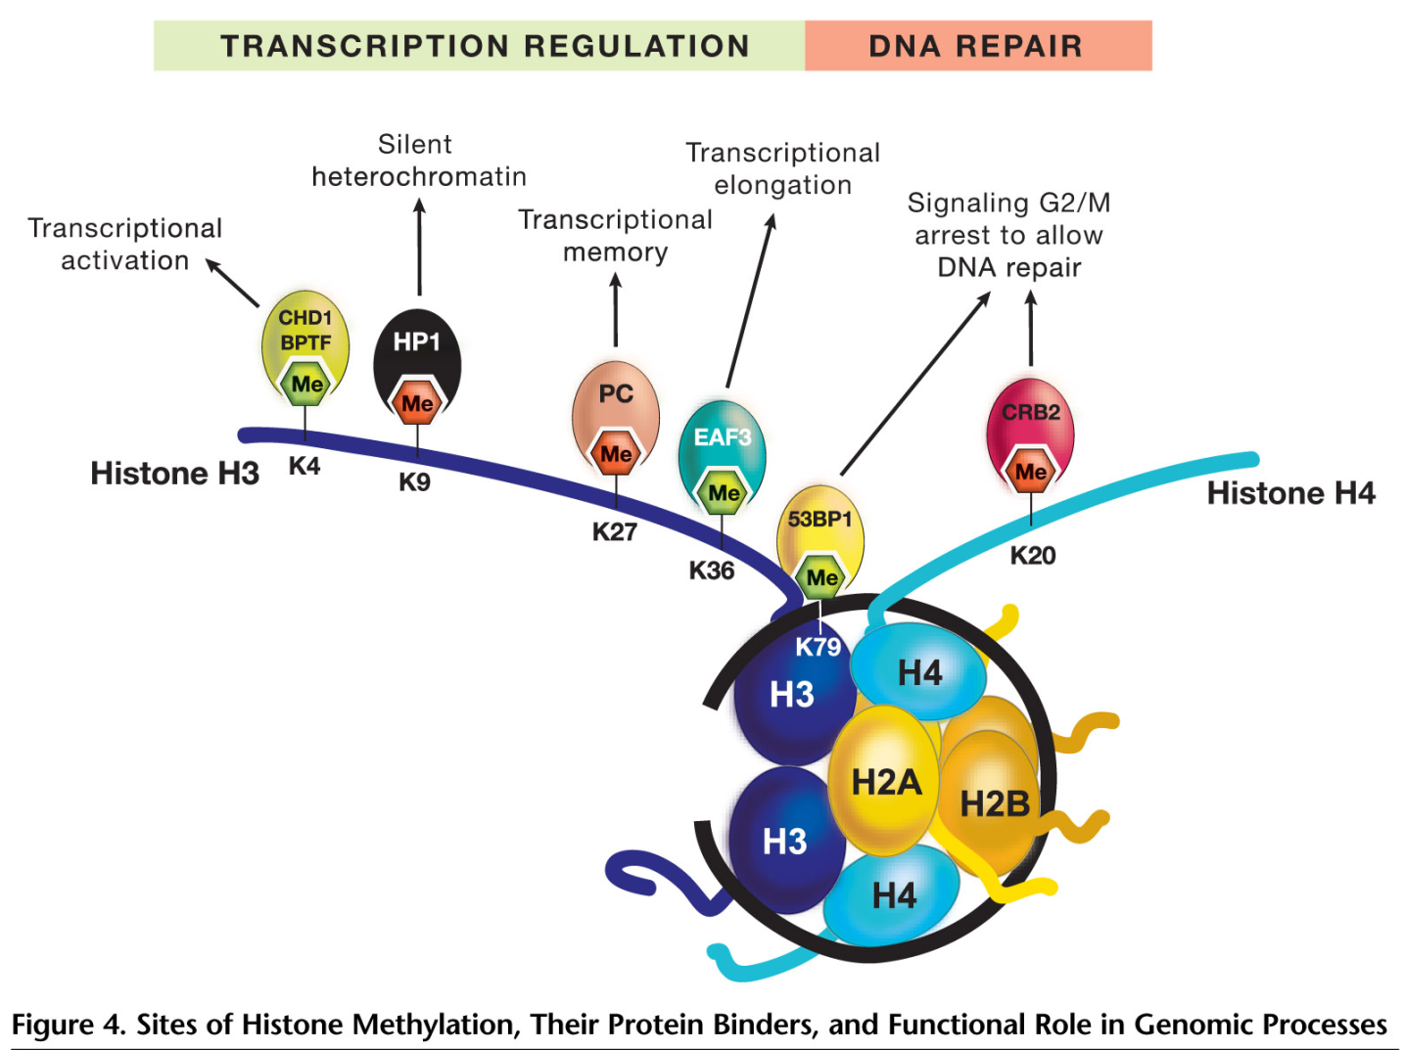
Histone methylation and protein binders
Epigenetics, Allis, Jenuwein, Reinberg, Caparros, 2009

Slide 26
Epigenetics
“A hereditable change in gene expression not involving a change in DNA sequence”
DNA methylation
  addition of methyl groups (CH₃) to cytosines in DNA
Histone modification and chromatin remodelling
  acetylation and methylation of lysine in histones
microRNA (miRNA)
  short pieces of single-stranded RNA that do not encode for proteins but control the expression of genes

Slide 27

RNAi and RNA directed gene silencing (S. pombe)
RNAi :
Acts as a host defence mechanism
Leads to transcriptional gene Silencing (TSG)
Epigenetics, Allis, Jenuwein, Reinberg, Caparros, 2009

Slide 28
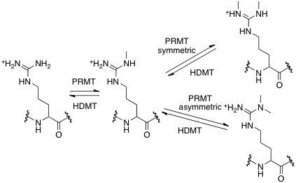
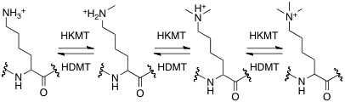
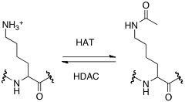

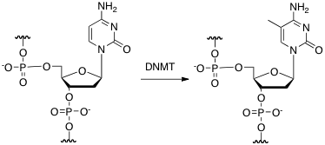
Epigenetic modification as drug targets
Ub
K
Su
K
Me
R
Me
K
S / T
Ac
P
K
C
Me
Future Med Chem. 2012 Mar;4(4):425-46.
Current limitations and future opportunities for epigenetic therapies.
Cherblanc F, Chapman-Rothe N, Brown R, Fuchter M.

Slide 29
Epigenetic Therapies
DNA Methyltransferase (DNMT) Inhibitors
  Azacytidine: approved in the EU for the treatment of patients with higher-risk MDS, CMML and AML
  Decitabine: approved in the USA for the treatment of patients with all FAB classifications of MDS
Histone Deacetylase (HDAC) Inhibitors
  Vorinostat (SAHA) and Romidepsin (FK228): approval in US for treatment of advanced cutaneous T-cell lymphoma
Challenges
  Off-target effects
  Lack of gene specificity
  Uncertain mechanism of action in responsive tumours
  Delivery
Graham, et al. Eur J Cancer. 2009 45(7):1129-36.

Slide 30
Better Epigenetic Therapies?
More specific, less toxic epigenetic anti-cancer therapies
Rational approaches to combination studies of epigenetic therapies: optimise schedule and maximise efficacy
Stratifying patient populations: prognostic or predictive epigenetic biomarkers
Targeting tumour cell subpopulations: drug resistant and stem (sustaining) cell population

Slide 31
Cancer epigenetics: from mechanism to therapy. Cell. 2012 Jul 6;150(1):12-27.
Dawson MA, Kouzarides T.
Abstract
The epigenetic regulation of DNA-templated processes has been intensely studied over the last 15 years. DNA methylation, histone modification, nucleosome remodeling, and RNA-mediated targeting regulate many biological processes that are fundamental to the genesis of cancer. Here, we present the basic principles behind these epigenetic pathways and highlight the evidence suggesting that their misregulation can culminate in cancer. This information, along with the promising clinical and preclinical results seen with epigenetic drugs against chromatin regulators, signifies that it is time to embrace the central role of epigenetics in cancer.
Notes:
Already covered cancer stem cells in other tissues….so lets focus on Ovarian cancer
What evidence is in the literature?
Very recently, 3 papers have appeared that utilise CD133 as a marker of stem cells in ovarian cancer.
The first, Zhang et al

Slide 32
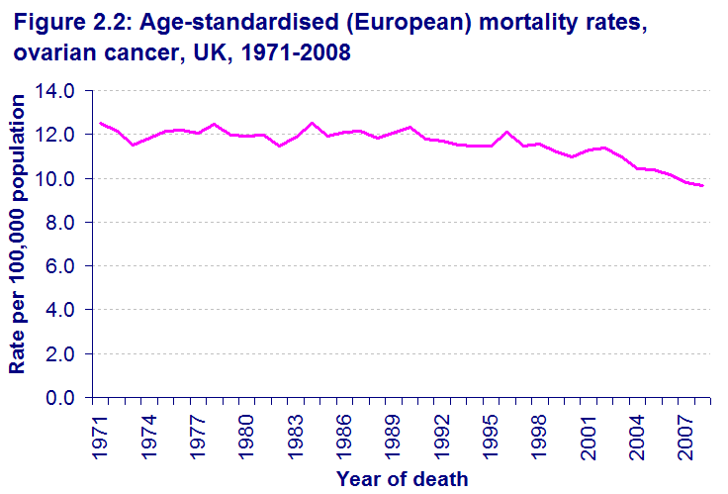
Progress in the management of ovarian cancer: evolution over 40 years
Key advances in chemo-therapy
First
reports
of
bevacizumab
First use of oral PARPi
Positive evidence
for weekly paclitaxel
in first line
First
use
of
cisplatin
First
use
of
carboplatin
First
use
of
paclitaxel
1970
1980
1990
2000
2010
High Grade Serous
Low Grade Serous
Endometroid
Mucinous
Clear Cell
32

Slide 33
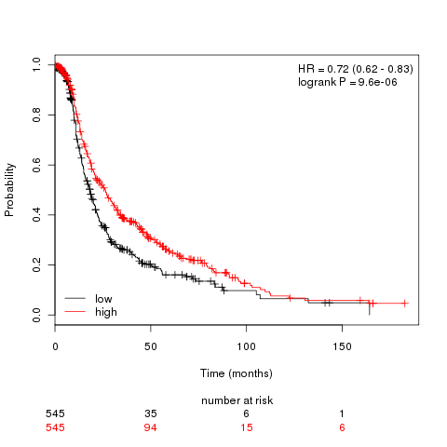
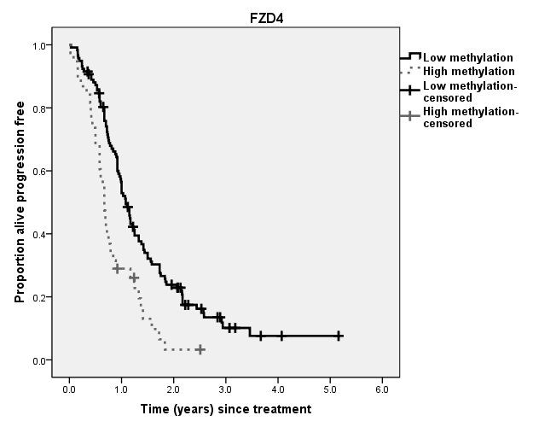
Systematic CpG Islands methylation profiling in ovarian cancer and association with clinical outcome (progression-free survival)
In silico identification of genomic regions
(e.g. CpG islands)
Evaluation of univariate association of methylation with clinical outcome in “test” tumour cohorts
Evaluation of univariate association in independent validation cohort
Multivariate model building with multiple loci and clinical features
Validation in independent study cohort (TCGA)
Integrated genomic analyses of ovarian carcinoma. Nature 2011;474:609-615.
FZD4: methylation
FZD4: expression
p=2.50x10⁻⁴
HR: 2.05 (1.38, 3.05)
Dai et al 2011 Clin. Cancer Res. 17, 5052-62
Time (year) since treatment

Slide 34
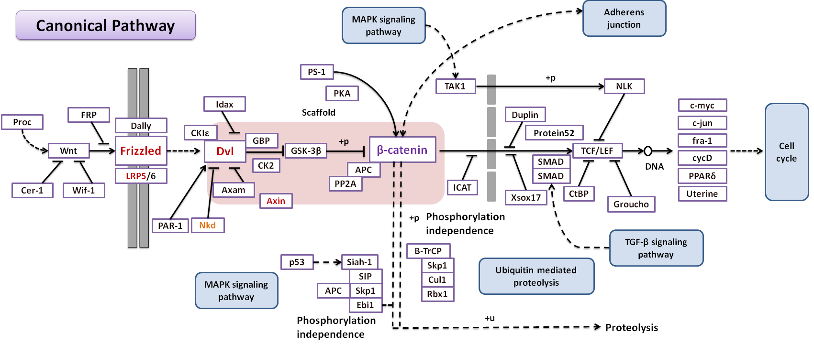
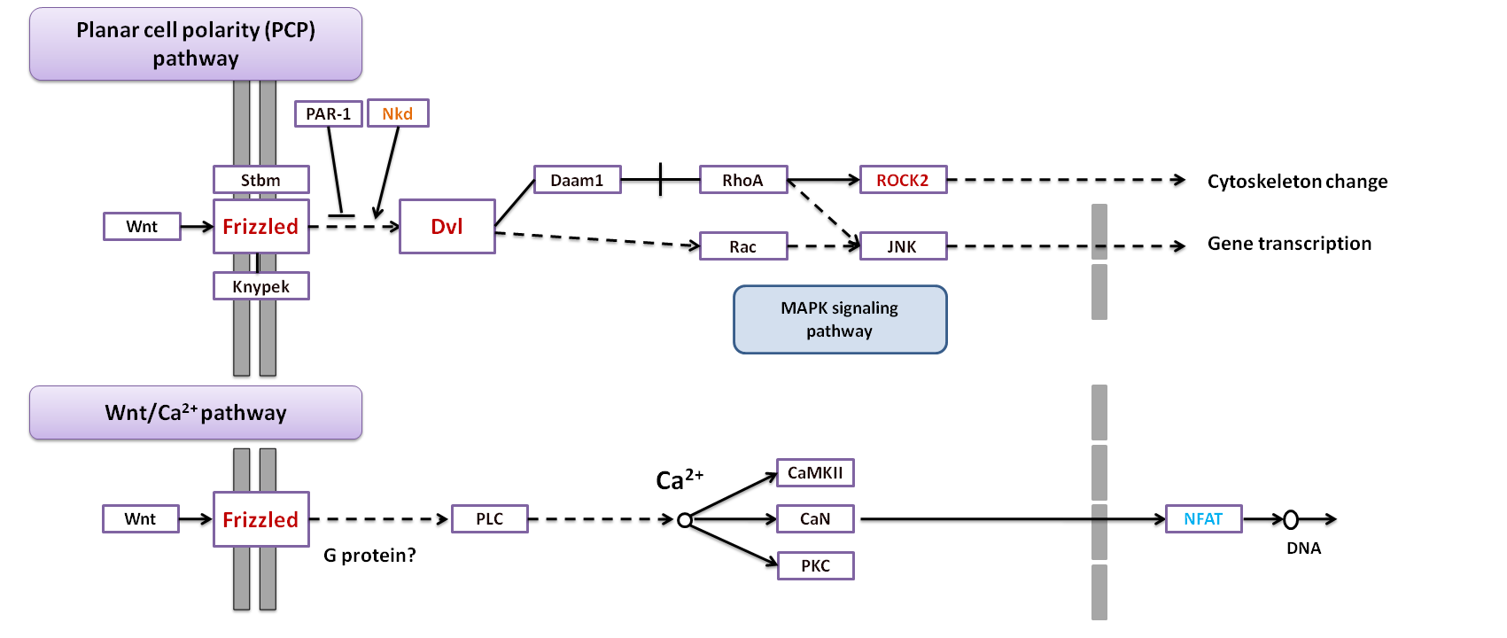
Wnt Pathways
Red: SGCTG cohort & TCGA cohort
Blue: SGCTG cohort only
Orange: Absent in TCGA cohort

Slide 35
Bob Brown
Epigenetics Unit
IRDB, 4th Floor
Hammersmith Hospital Campus
b.brown@imperial.ac.uk
Notes:
Already covered cancer stem cells in other tissues….so lets focus on Ovarian cancer
What evidence is in the literature?
Very recently, 3 papers have appeared that utilise CD133 as a marker of stem cells in ovarian cancer.
The first, Zhang et al

