Slide 1
Carcinogenesis
Dr Ana P Costa-Pereira
Imperial College London
Faculty of Medicine, Department of Surgery & Cancer
Molecular Oncology Section
London, UK
a.costa-pereira@imperial.ac.uk

Slide 2
Aims
• Become more insightful about cancer as a disease of cell biology
• To demonstrate how a normal cell can become a cancer cell
• Provide the basis to understand mechanisms of carcinogenesis

Slide 3
Learning Outcomes
By the end of this lecture you will be able to:
• Understand how important it is for cells to
‘communicate properly with each other’
• Give examples of different carcinogens and
enumerate cancers in which they are known to play
key roles
• Understand basic principles of cancer formation
and progression

Slide 4
Today’s Menu
• Complexity of living beings and of its building
blocks – the cell
• DNA replication, the cell cycle and apoptosis
• The origins of cancer
• Carcinogenesis

Slide 5
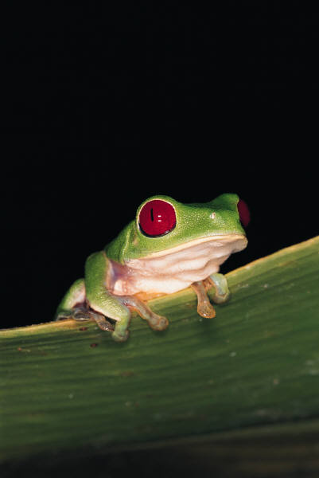
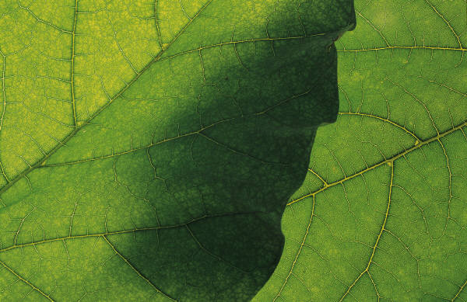
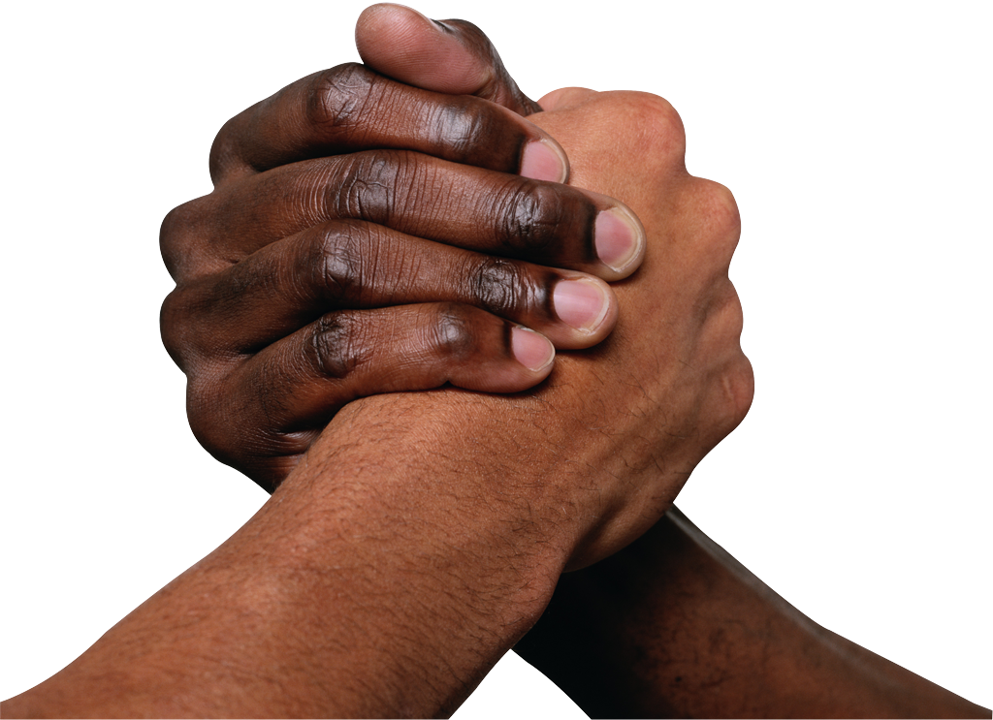
Unity of Design & Beauty…
Notes:
All of these pictures show what we admire in biological systems: beauty, control, form, unity of design…

Slide 6
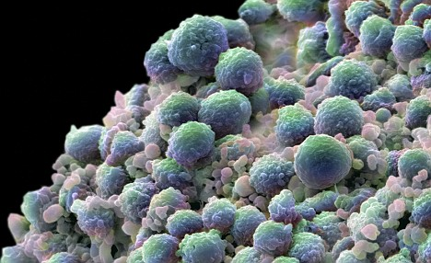
… versus Chaos!
And, yet, so much about normal biology has been
learnt from studying cancer cells!
Notes:
Cells divide without cues, they don’t die, they are selfish and do not respect their neighbours…
They don’t talk…

Slide 7
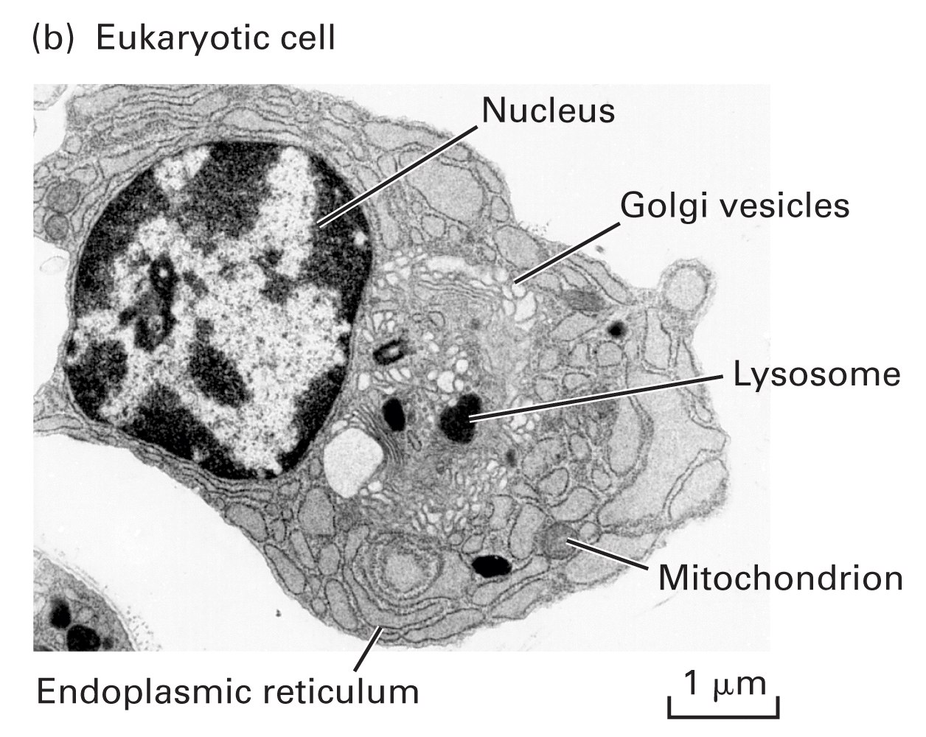
Introduction
• The body = 80 trillion (80,000,000,000,000) cells!
• The cell = ~20 thousand (20,000) proteins!
• The nucleus = 3 metres of tightly packed DNA!
Problem!
* Every day 30,000,000 die…
* 30,000,000 are generated by mitosis…
* 30,000,000 x 3 m DNA need to be copied…
Lodish et al. (2004). Molecular Cell Biology, 5th ed, W.H. Freeman & Co., NY, USA.

Slide 8
Cell ‘Multiplication’
This is where it can all go horribly wrong…
• complex systems, with various tissues, need
to follow precise genetic instructions for the
growth, maturation and maintenance of the cells
Key Cellular Events:
• Error-free DNA replication
• Cell cycle control
• Cell normal physiology
• Induction of apoptosis at key moments

Slide 9
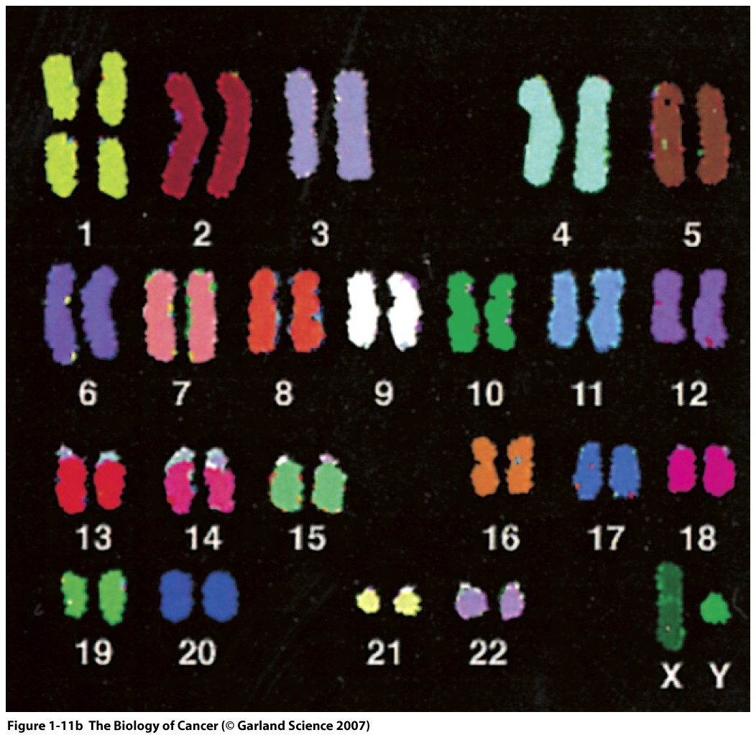
The Cells
• Each cell is a building block, a single entity,
surrounded by a lipid bi-layer
• Boundaries separate them from other cells
• Eukaryotes have a membrane
that isolates the DNA in the nucleus
Weinberg (2007). The Biology of Cancer, 1st ed. Garland Science, New York, USA
Notes:
The DNA is covered in proteins and these assemble in chromosomes (22+2)

Slide 10
Cells are autonomous entities…
• Cells can perform many different functions
almost as if they were a mini-ecosystem
* this is good and bad…
The good:
• Cells that can survive in several cellular contexts can adapt and
serve specific functions in the body and are free to move
The bad:
• Potential overgrowth which can ultimately lead to cancer

Slide 11
…yet they must leave in a community
• Cells do not exist in a vacuum: they are
surrounded by other cells and by extracellular
fluids
• They scan the environment for cues (divide,
stay still, apoptose/die)
• They send messages to other cells

Slide 12
The society of proteins
Proteins
do…
Die
Integrate
… not
“live” alone!
Talk
Feed
Sense
Divide

Slide 13
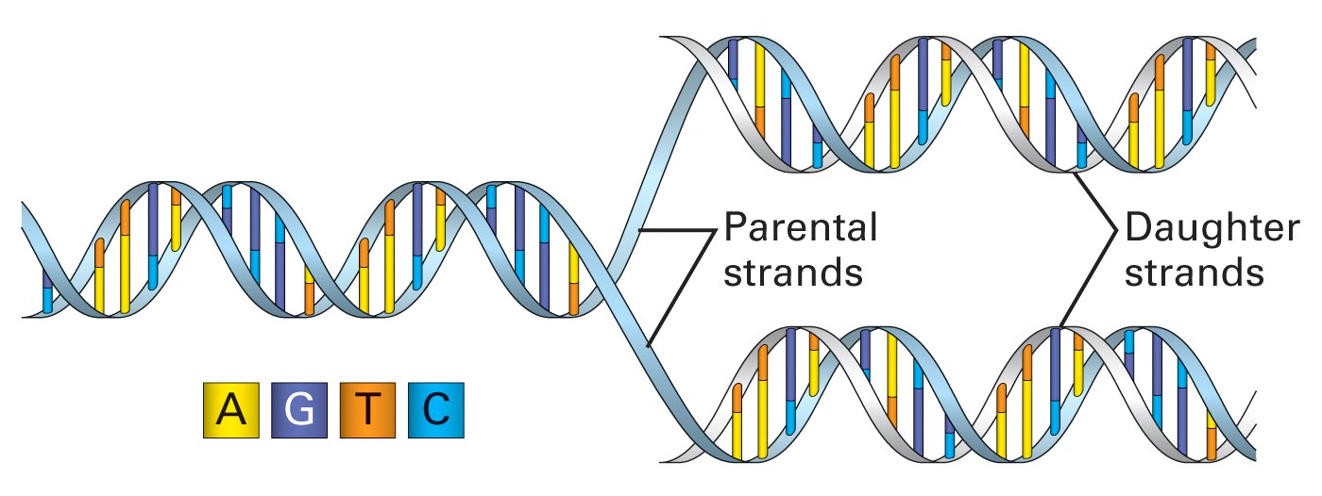
A cell is born…
• Each cell has the potential to give rise to
two daughter cells – mitosis
• The cell cycle requires the replication of
DNA
Lodish et al. (2004). Molecular Cell Biology, 5th ed, W.H. Freeman & Co., NY, USA.

Slide 14
Ingredients for a cell cycle
• Parental cell must grow and ensure that it
has enough ‘goodies’ (DNA, RNA, proteins,
organelles, membranes, salts, fluids…) to divide
between the daughter cells
• Cell must be able to coordinate the cell cycle
* several checks must be in place
* cycles of phosphorylation/dephosphorylation
are very important - cyclins

Slide 15
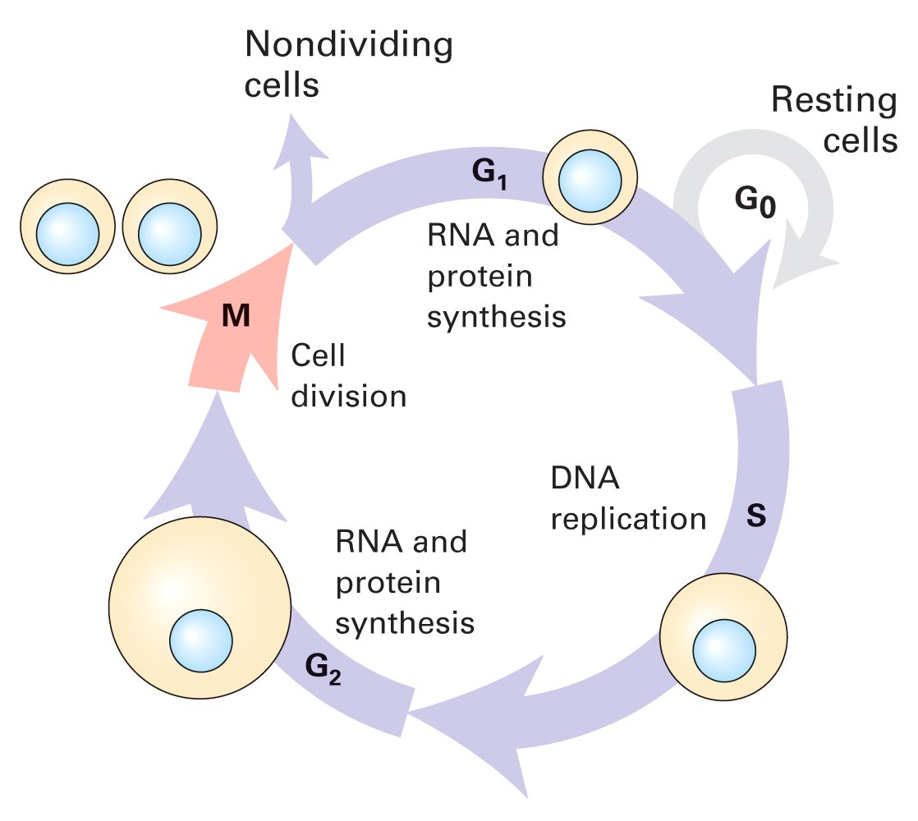
The Cell Cycle
Lodish et al. (2004). Molecular Cell Biology, 5th ed, W.H. Freeman & Co., NY, USA.
Notes:
M phase 1-2 hours
S phase sevral hours (3 billion pairs of nucleotides over 23 chr)
G1 and G2 cell synthesises many of its building blocks
G1 enzymes needed to duplicate the genome + other ingredients for DC
G2 mitosis preparation; check that DNA repn has been successfully achieved
M pahse segregagtes newly synth chromosomesinto appropriate portions of the enlarged cells

Slide 16
Mutations Can Arise from Replication
• Many errors can occur during the transcription
of 3 metres of DNA, which will accumulate
• Can lead to silent mutations or harmful (small
or large) mutations:
* deletion * base substitution missense (new aa)
* insertion * base substitution nonsense (STOP)
* translocation * frameshift (different sequence sub.)
* amplification
Notes:
Minute changes can lead to dramatic changes in sequnce affecting the meaning of a gene totally
Contributes to oevolution

Slide 17
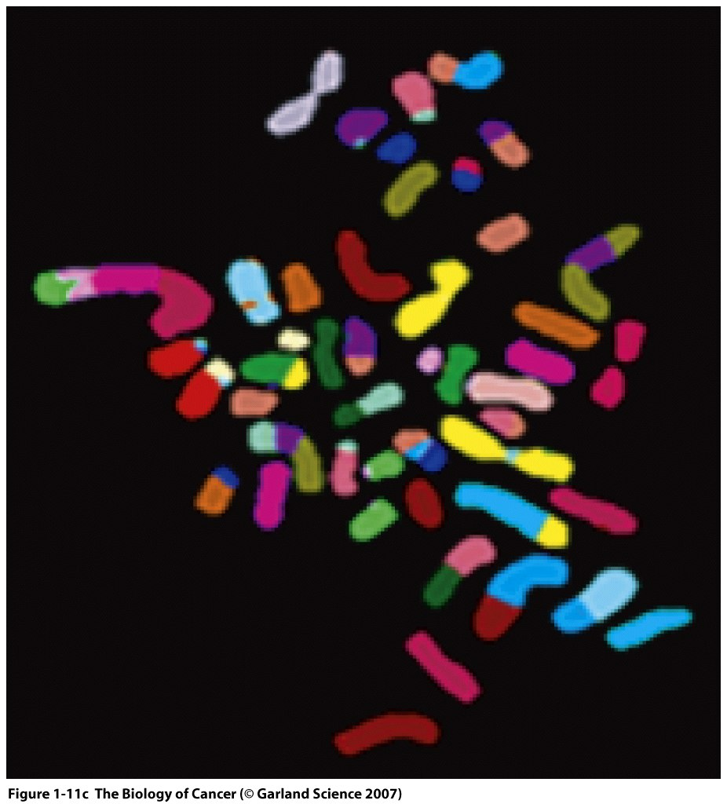
Normal Cell vs. Cancer Cell
Weinberg (2007). The Biology of Cancer, 1st ed.
Garland Science, New York, USA

Slide 18
Cells also have a life…
• Different cells have different functions
• Different cellular functions require a different
set of proteins to execute it
• DNA has all the information necessary to
make any given protein – the “cellular soldiers”
• Different kinds of proteins – different families

Slide 19
What do cancer cells do?!?
• They multiply uncontrollably – they focus their
energy on their own proliferation and no longer
focus on forming a functional tissue or organ
• They don’t differentiate as they should – often
lose organ- or tissue-specific characteristics
• They do not die when apoptosis is triggered
Notes:
Nucleus size! 1/5 of cell
Tumour cells have a nucleus almost as large as the cell itself!!!
Lots more DNA; lots more of mitosis

Slide 20
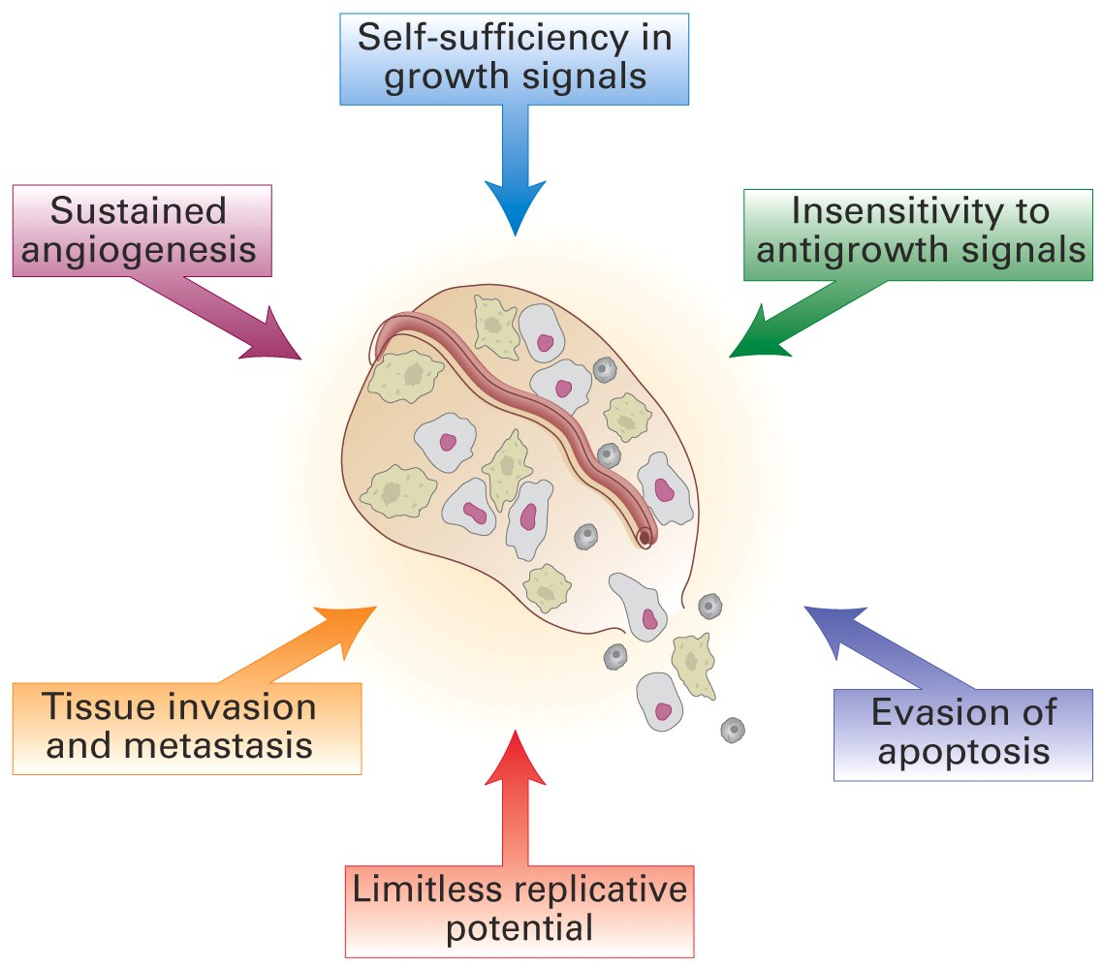
Lodish et al. (2004). Molecular Cell Biology, 5th ed, W.H. Freeman & Co., NY, USA.

Slide 21
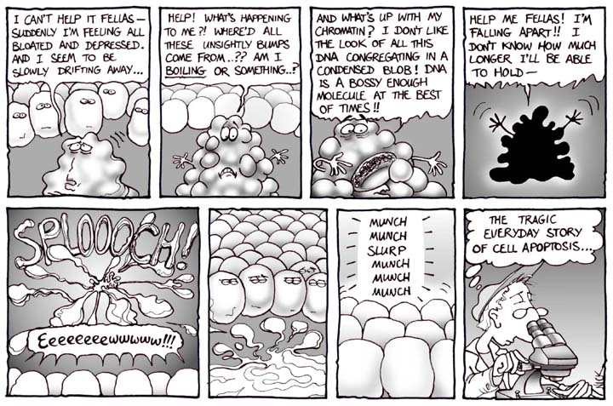
But all cells must eventually die…
• Billions of cells die every day
• Highly controlled process that involves:
• caspases
• DNA cleavage
•membrane blebbing
•
http://www.nearingzero.net/

Slide 22
What pushes cancer cells
to adopt such
rogue behaviour?!?

Slide 23
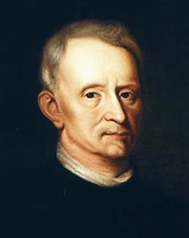
Cancer throughout the ages
• Hippocrates used the word cancer to
describe metastatic breast cancer (400 BC)
• Robert Hooke coined our building blocks
“cells” in 1665
• Rudolf Virchow established that “omnis cellula
a cellula”

Slide 24
But if all cells arise from one cell…
• Ultimately all cells must derive from one cell:
the zygote… even tumour cells (RV)
• But from which cells do cancers arise from?
• Colon cancer will be used to exemplify and
explain carcinogenesis

Slide 25
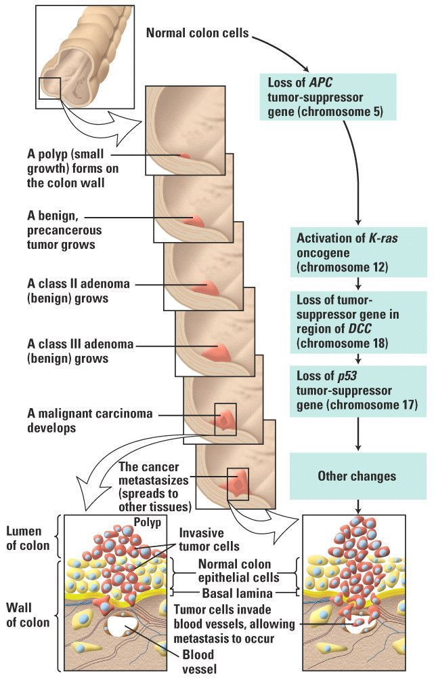
Carcinomas
do not respect
boundaries and
quickly start invading
other tissues
Lodish et al. (2004). Molecular Cell Biology, 5th ed, W.H. Freeman & Co., NY, USA.
Notes:
Epithelial cells that line the colon wall continuously die and are disposed of as in normal skin
Cell division occurs in the cripts to compensate for this (undifferentiated cells are continuously diving here)
They move up and start absorbing nutrients and water and start secreting a mucous layer that protects the gut lining
They replace the predecessors once they have differentiated
This process can go wrong and tickned patches of epithelial cells (polyps/adenomas) arise
The more undifferentiated the greater the potentiaal for disaster
The real cancer arise from the secreting cells thus adenocarcinoma

Slide 26
Where do cancer cells come from?!?
• Do they arise from normal cells in an adjacent
tissue(s)?
• Are they introduced in the body by infection?
Transplants to the rescue…
* most are rejected except between twins or
closely, genetically, related people – tumours
must thus arise from normal tissues… How?!?

Slide 27
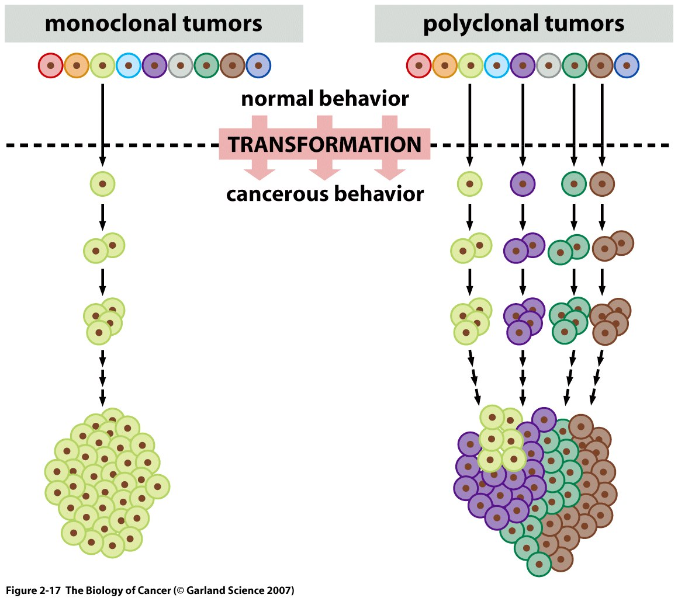
The origins of tumour cells
Weinberg (2007). The Biology of Cancer, 1st ed. Garland Science, New York, USA
Notes:
2 ways cancer cells can arise
Four normal cells independently become transformed and the progeny of each contribute to the tumour mass
A single cell undergoes transformation and becomes the ancestor of all cells in the tumour (can be more than 100 billion in a large tumour)
Most cancers likely to be monoclonal in origin

Slide 28
So what are tumours?
• Most are believed to be monoclonal
• Picture is more complex and some tumours
may be polyclonal, depending on how
many cells have initially crossed the threshold
between normality and malignancy

Slide 29
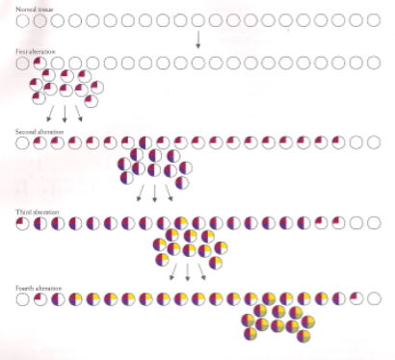
A cell clone can sustain successive multiple alterations
Varmus & Weinberg (1993). Genes and the Biology of Cancer, 1st ed, W.H. Freeman & Co., NY, USA.

Slide 30
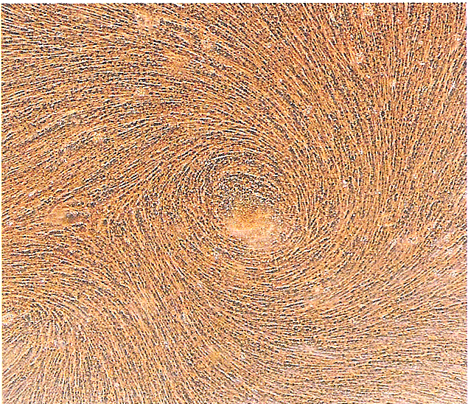
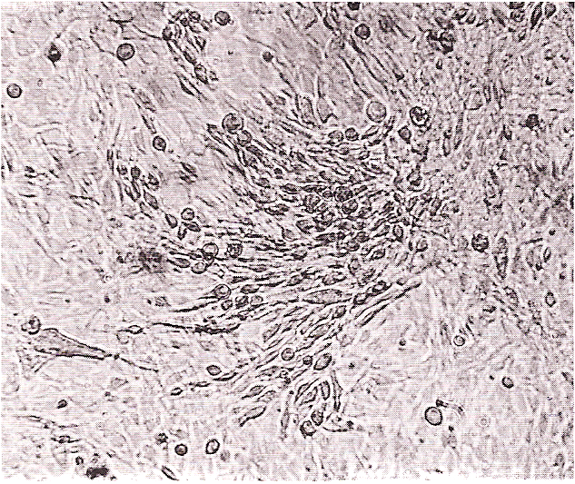
Normal and Cancer Cells in Culture
* Loss of contact inhibition
* Disorganization
* Anchorage-independent
* Less dependent on growth factors
* Immortal!
Varmus & Weinberg (1993). Genes and the Biology of Cancer, 1st ed, W.H. Freeman & Co., NY, USA.

Slide 31
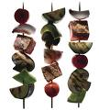
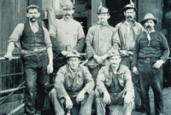
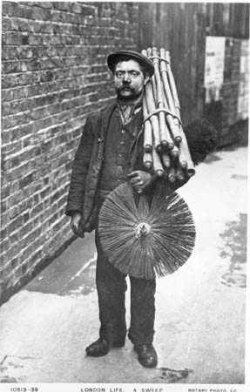
Clues to What May Cause Cancer
Smoking
lung cancer/oral cancer, etc
Pitchblende miners
lung cancer
Infections?
Chronic Inflammation?
Sun bathing/Sun beads
skin cancer
X-Rays
≠ cancers
Chimney sweepers
scrotal cancer

Slide 32
Is it an inherited disease?
• Darwin – theory of evolution
• Mendel – rules of inheritance
• Environmental factors
By analysing factors such as diet, habits, life-style,
occupation, sex, age, ethnic origin and geography
scientists gained clues into the origins of cancer

Slide 33
Cancer Incidence
• Cancer varies tremendously around the globe
Men
* Liver cancer: Mozambique > 70x > Norway
* Skin cancer: Queensland > 200x > Bombay
* Lung cancer: UK > 35x > Nigeria
Women
* Uterus cancer: California > 30x > Japan
* Breast cancer: Connecticut > 15x > Uganda
* Ovarian Cancer: Denmark > 6x > Japan

Slide 34
What causes such variation?!?
• Diet
• Tobacco
• Infection
• Sexual and reproductive behaviour

Slide 35
Viruses can cause cancer
• Peyton Rous showed in 1910 that a filtrate from
chicken sarcomas could induce new sarcomas
in healthy chicken – virus
• Efforts to identify bacteria or viruses that
caused cancer failed and theory fell in disrepute
• In 1966, however, he got the Nobel Prize for it!

Slide 36
Peyton Rous
Weinberg (2007). The Biology of Cancer, 1st ed. Garland Science, New York, USA

Slide 37
Viruses and Cancer
• Rous sarcoma virus
• Polyoma
• Simian virus 40 (SV 40)
These showed that cancer could be traced
to a single initiating cause (a virus particle)
But how?!? How can a virus induce
cancer in such a complex environment?

Slide 38
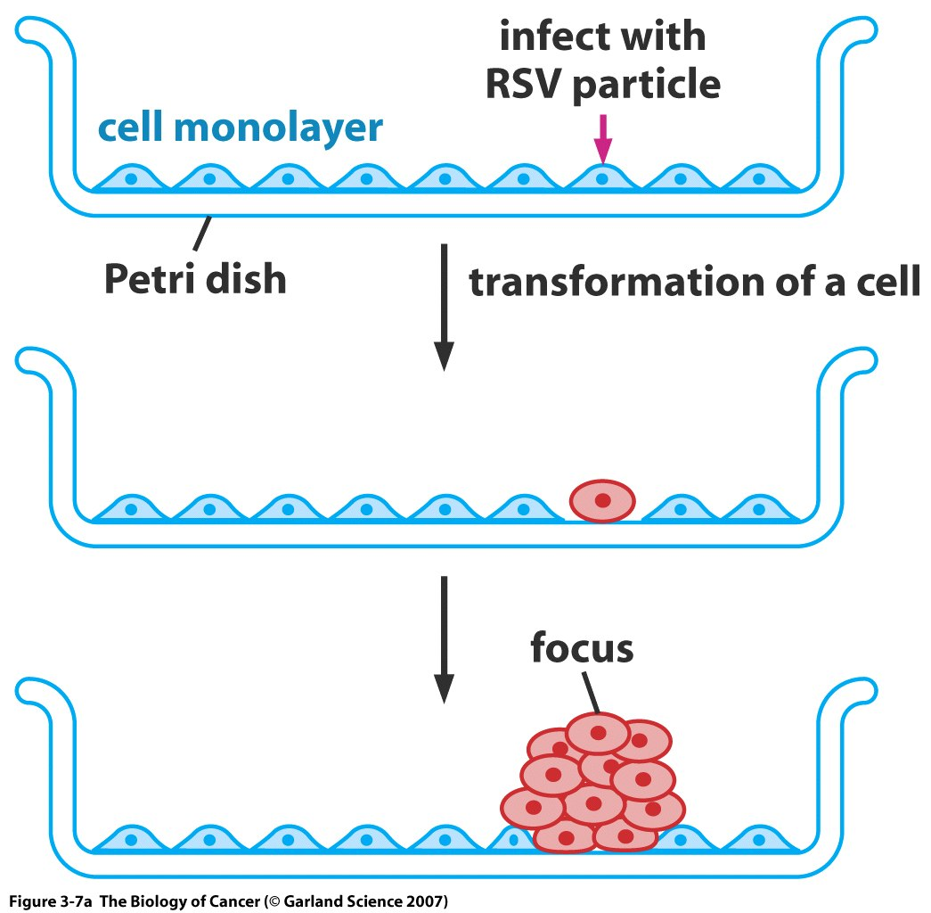
Transformation of Cells in Culture
Weinberg (2007). The Biology of Cancer, 1st ed. Garland Science, New York, USA
Notes:
Study the interaction of cancer-causing viruses with a normal cell in culture
If tumours are masses of cells, then the question is reduced to how a virus provokes a mass of cells to grow abnormally
Viruses kill the host cell – not tumour viruses…
Continue to grow fast and the traits are passed to subsequent generations: how?!?

Slide 39
Radiation and Cancer
• Repeated exposure to X-Rays correlated with
subsequent cancer onset – e.g. Marie Curie
• Skin, leukaemias and bone cancers – not
explained by local irritation (inflammation)
• Herman Muller noticed > mutant off-spring in
flies subjected to X-Rays (later seen with chem.)
Thus radiation can affect cells by damaging their DNA (mutations)

Slide 40
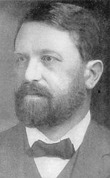
Normal Cell vs. Cancer Cell
Theodor Boveri, 1914
Weinberg (2007). The Biology of Cancer, 1st ed.
Garland Science, New York, USA

Slide 41
Chemical Carcinogenesis
• Coal tar induced skin cancer in rabbits
when applied on their hears (1918)
• DNA known to be the genetic material by
late 1940s
• Carcinogens likely to damage DNA
• Carcinogens often found bound to DNA…

Slide 42
Mutagenicity Test
• Some chemical are potent inducers of cancer,
others are weak inducers.
• Bruce Ames (1975) developed a reliable,
cheap and easy test to measure mutagenicity
• The test used Salmonella typhimurium and
a target gene that controlled His metabolism
Notes:
100 million bugs per plate
1/1,000,000
But bugs cant metalolise chem compounds as humans…

Slide 43
• Chemical mutagenesis = 2-step process
• Cells alter the inert pro-mutagen chemically
• Resultant mutagen can now interact with DNA
≠ chemical structure ➔ ≠ information content
• Potent carcinogens were shown to be potent
mutagens!

Slide 44
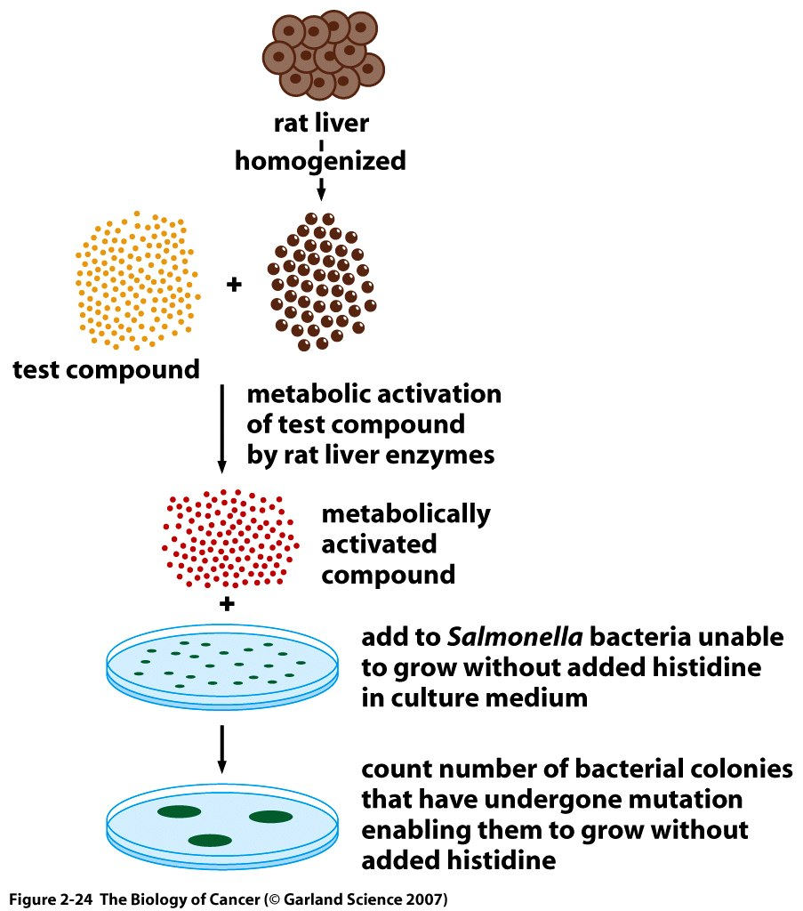
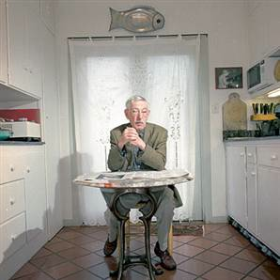
Ames’ Test
Weinberg (2007). The Biology of Cancer, 1st ed. Garland Science, New York, USA

Slide 45
Conclusion
• Cancer is a disease of cell biology
• Cancer is highly complex and it arises due
to errors in our DNA – these can be inherited
or induced by environmental factors
• Mutagens must target specific molecules

Slide 46
Bibliography
• Weinberg (2007). The Biology of Cancer,
1st ed. Garland Science, New York, USA
• Lodish et al. (2004). Molecular Cell Biology,
5th ed, W.H. Freeman & Co., NY, USA
• Varmus & Weinberg (1993). Genes and the
Biology of Cancer, 1st ed, W.H. Freeman & Co.,
NY, USA

Slide 47
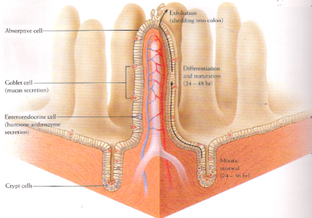
Colon Carcinogenesis
Carcinomas do not respect boundaries and
quickly start invading other tissues
Varmus & Weinberg (1993). Genes and the Biology of Cancer, 1st ed, W.H. Freeman & Co., NY, USA.
Notes:
Epithelial cells that line the colon wall continuously die and are disposed of as in normal skin
Cell division occurs in the cripts to compensate for this (undifferentiated cells are continuously diving here)
They move up and start absorbing nutrients and water and start secreting a mucous layer that protects the gut lining
They replace the predecessors once they have differentiated
This process can go wrong and tickned patches of epithelial cells (polyps/adenomas) arise
The more undifferentiated the greater the potentiaal for disaster
The real cancer arise from the secreting cells thus adenocarcinoma

