Slide 1
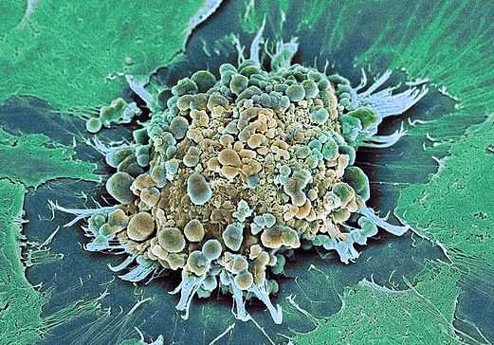
Pathways to apoptosis
Euan Stronach
Molecular Therapy Lab
Imperial College London
e.stronach@imperial.ac.uk

Slide 2
Objectives
What is it?
Why does it happen?
When does it happen?
How does it happen?

Slide 3
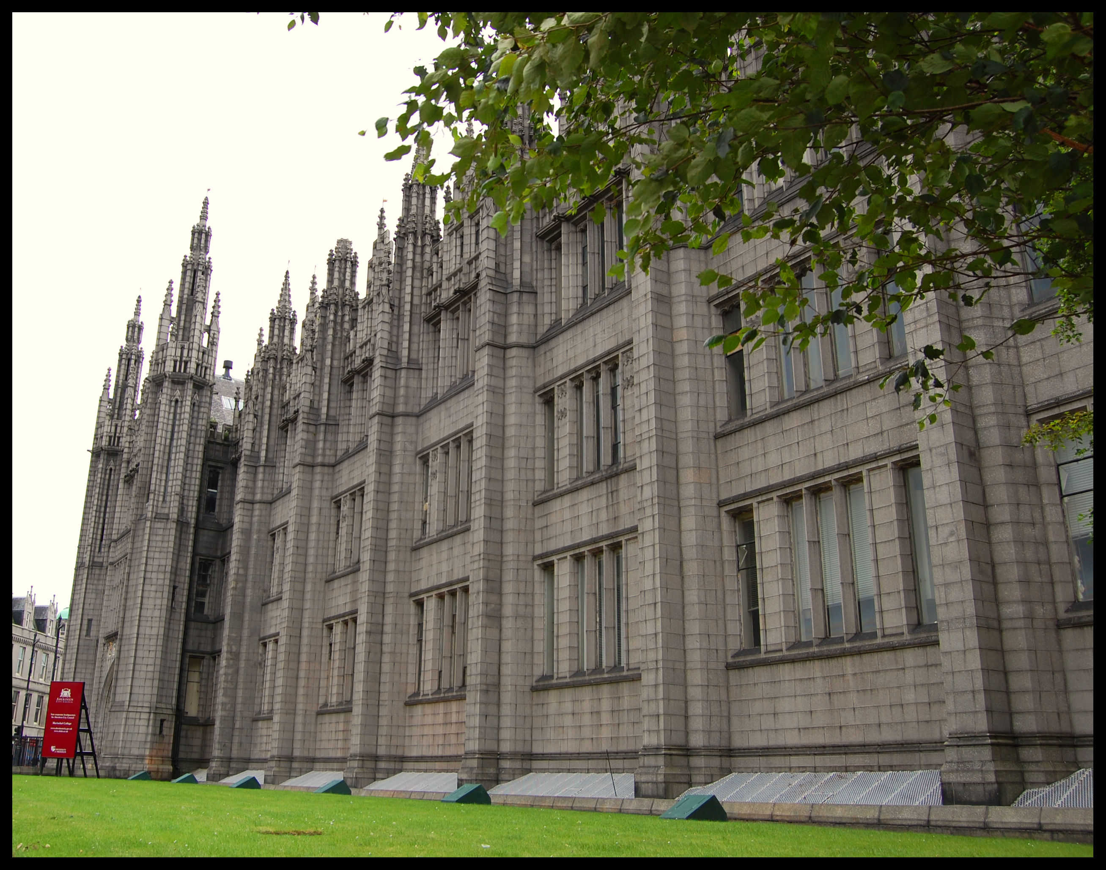
Apoptosis
Apo: off/away from
Ptosis: to fall
Term coined by Wylie, Kerr and Currie, University of Aberdeen (1972)
Growth rate of tumour far less than predicted from growth rate of tumour cells
Observed high level of cell death
Balance between death and survival determines tumour growth rate
NB 60 billion new cells are made a day… same number must die to maintain homeostasis

Slide 4
Apoptosis
Programmed cell death/Cell suicide
Cell is dismantled from within
WHY???

Slide 5
What is apoptosis?
Organised cellular demolition……

Slide 6
Why apoptose?
Purpose:
If cell state is such that removal is prudent….
“better dead than broken”
What happens if we keep broken cells?
……Cancer
Apoptosis minimises damage and disruption to neighbouring cells

Slide 7
Apoptosis: features from the outside
Cell rounds up and detaches from neighbours
Plasma membrane blebbing/pinching off
Clearance of debris by phagocytes

Slide 8
What are the advantages over necrosis?
Necrosis
Apoptosis
Membranes rupture
Cell contents released to EC space
Damages neighbouring cells
Release of ‘alarmins’ (danger activated molecular patterns [DAMPs])
Triggers inflammatory response
Macrophage/neutrophil infiltration
Membranes remain intact
Cell contents remain contained
Non-inflammatory phagocytic clearance

Slide 9
Why have necrosis at all?
Immune response is costly to the cell and can induce further cell death
WHY?
To alert immune system to danger.
Types of event causing necrosis: pathogens, burns, cuts etc ie events associated with infection

Slide 10
Apoptosis: features from the outside

Slide 11
Apoptosis: key morphological features
Cell rounds up and detaches from neighbours/extracellular matrix
Plasma membrane blebbing/pinching off
But what’s going on inside?

Slide 12
Apoptosis: features from the inside
Nuclear condensation
DNA fragmentation
Golgi and ER condense and fragment
Mitochondrial network fragmentation
Mitochondrial outer membrane permiabilisation
Shutdown of transcription and translation
Protein cleavage
So how does all that happen??

Slide 13
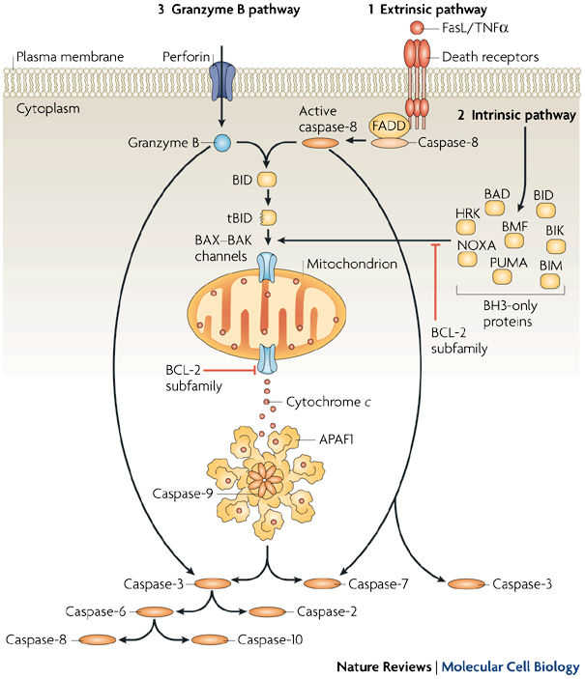
How does it all happen? Initiation….
Caspases are king
Present in normal cells as inactive precursors
Once activated caspases are potent proteases with multiple substrates (>400)
Initiator caspase
Effector caspases

Slide 14
How does it all happen? Initiation….
Apoptosome
Initiator caspase
Effector caspases

Slide 15
How does it all happen? Initiation….
Granzyme B (protease) delivered by T cells/NK (natural killer) cells. ie assassination.

Slide 16
Apoptosis: key features
Membrane blebbing
Detachment from neighbours/extracellular matrix
Nuclear condensation
DNA fragmentation
Shutdown of transcription and translation
Golgi and ER condense and fragment
Mitochondrial network fragmentation
Mitochondrial outer membrane permiabilisation
Phagocytosis
How does caspase activation cause all that??

Slide 17
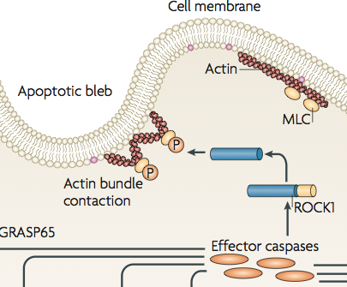
Cytoskeletal breakdown/membrane blebbing
Active caspases cleave components of the cell cyctoskeleton
actin, myosin, spectrin, tubulin, nuclear lamins
Leads to loss of cell structure and ‘rounding up’ of cells
Caspase cleavage of cell-cell and cell-matrix proteins (eg Focal adhesion kinase [FAK]) and beta-catenin) causes detatchment
Membrane blebbing involves ROCK1
Activated by C-terminal caspase dependent cleavage
Constitutively active ROCK1 kinase
Myosin phosphorylation and actin bundle contraction
Contraction increases cytosolic pressure
Blebs form at ‘weak spots’ in plasma membrane

Slide 18
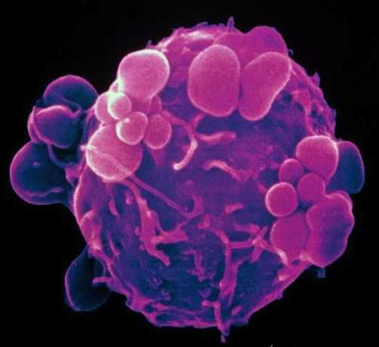
Membrane blebbing

Slide 19
Mitochondrial membrane permiabilisation
BAX/BAK for pores in the external leaflet of mitochondria
Mitochondrial intermembrane space leaks contents to cytosol
Mitochondrial networks fragment and collapse
Cytochrome c release complexes with caspase 9 and APAF1 to form the apoptosome
Cascade of caspase activation
Destruction of mitochondrial electron transport chain

Slide 20
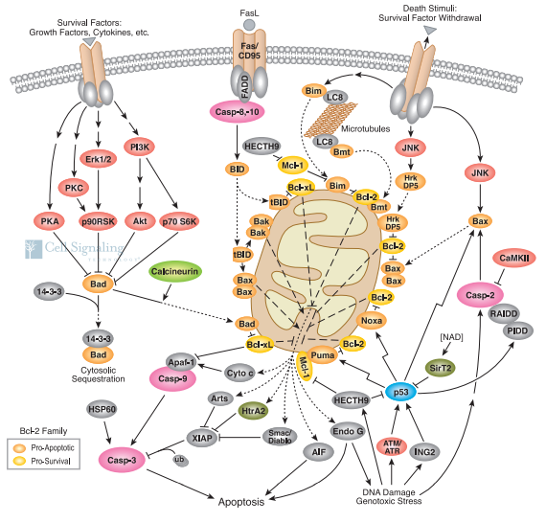

Slide 21
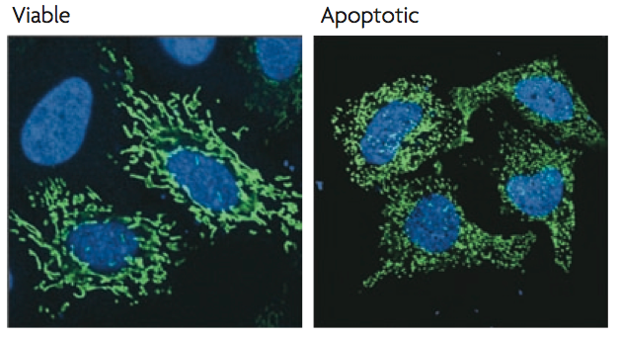
Destruction of mitochondrial networks
Blue- nuclei, Green- mitochondria

Slide 22
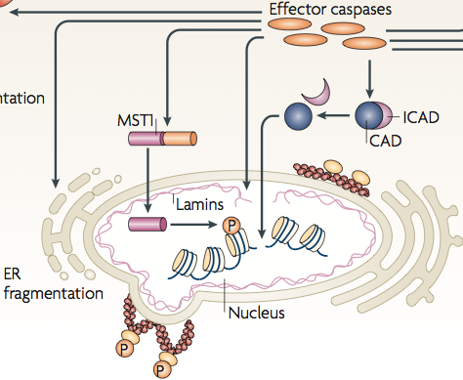
Nuclear condensation/DNA fragmentation
Nucleus is surrounded by proteinaceous lamina
Nuclear lamin proteins are cleaved by apoptosis activated caspases
ROCK1 mediated actin/myosin contraction rips nuclear envelope apart
Caspase cleavage of MST1 targets nuclear transloaction and subsequent chromatin condensation
CAD (caspase activated DNase) is normally kept inactive by binding with iCAD.
Caspase mediated cleavage of iCAD releases active CAD
Causes inter-nucleosomal DNA cleavage
Fragmented DNA is less immunogenic

Slide 23
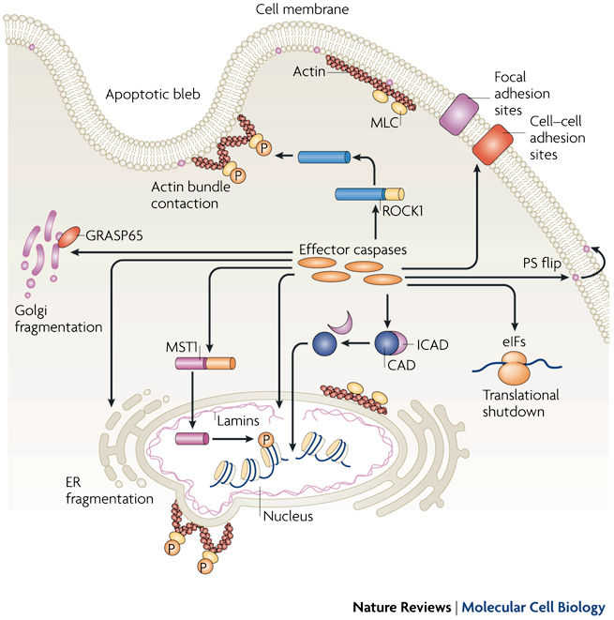
Shutting down the cell
Chromatin condensation silences transcription
Caspase cleavage of eukaryotic initiation factors [eIFs] shuts down protein translation
Why? Prevents interference from new activity. Prevents viral replication.
ER and golgi networks are broken down by further caspase mediated cleavage events
Direct or via caspase mediated GRASP65 activation

Slide 24
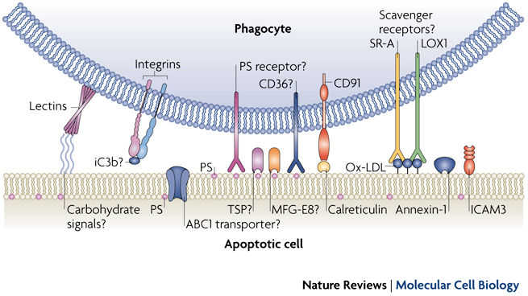
Clearing up the mess: phagocytosis
Following cellular shutdown the cell is broken into smaller pieces: apoptotic bodies
“Bite sized chunks”: easier for phagocytes to manage
Plasma membrane changes signal to phagocytes to engulf apoptotic bodies. Currently poorly understood.
Flipping of phopsphatidyl serine (PS) from inner to outer leaflet of plasma membrane is key
Release of lipophosphatidyl choline

Slide 25
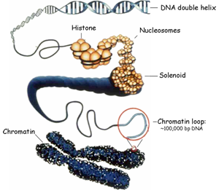
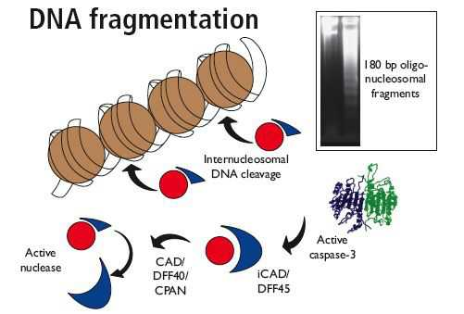
Aside: how do we detect apoptosis in the lab?
DNA fragmentation

Slide 26
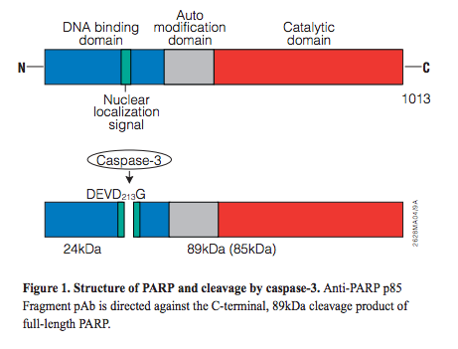
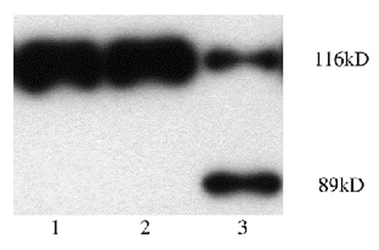
Aside: how do we detect apoptosis in the lab?
PARP cleavage
PARP (poly ADP-ribose polymerase):
Role in DNA repair/chromatin structure
Cleaved from full length to 89/23kDa by caspase 3 during apoptosis
Detect by western blot
DEVD: D- aspartic acid, E- glutamic acid, V-valine

Slide 27
Aside: how do we detect apoptosis in the lab?
Annexin V
Remember that phosphatidylserine (PS) flips from the inner to the outer membrane leaflet
Remember that plasma membrane remains in tact
Co-stain cells with Annexin V [binds PS] and propidium iodide (PI) [binds DNA]
AnnexinV -/PI - = healthy
AnnevinV +/PI - = apoptotic
AnnexinV +/PI + = necrotic

Slide 28
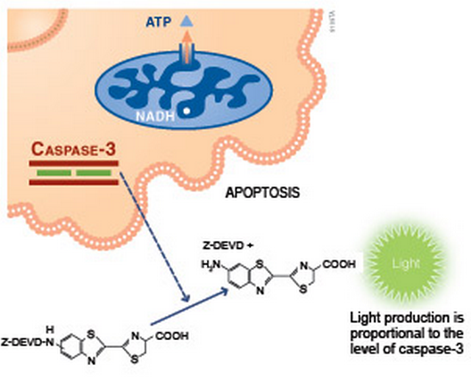
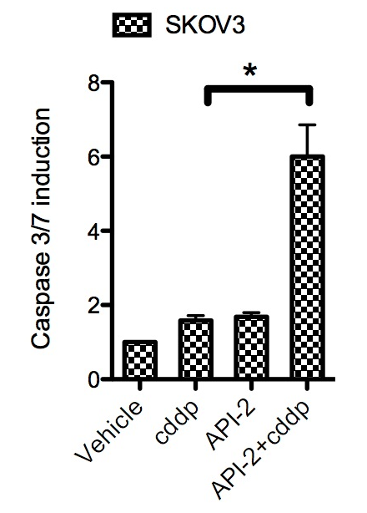
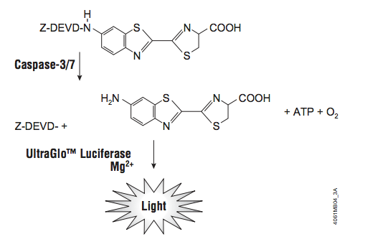
Aside: how do we detect apoptosis in the lab?
Caspase 3/7 activation
Detection of executioner caspase activation itself
DEVD: D- aspartic acid, E- glutamic acid, V-valine

Slide 29
What induces apoptosis?
??
DNA Damage

Slide 30
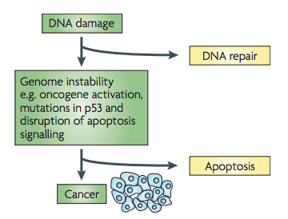
DNA damage response

Slide 31
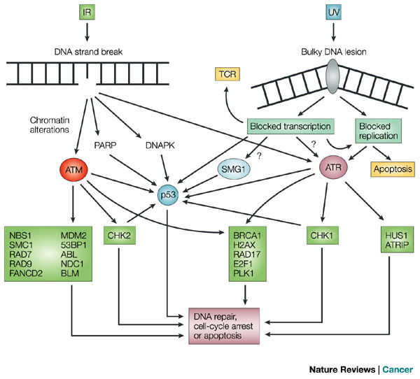
DNA damage response: p53, the guardian of the genome

Slide 32
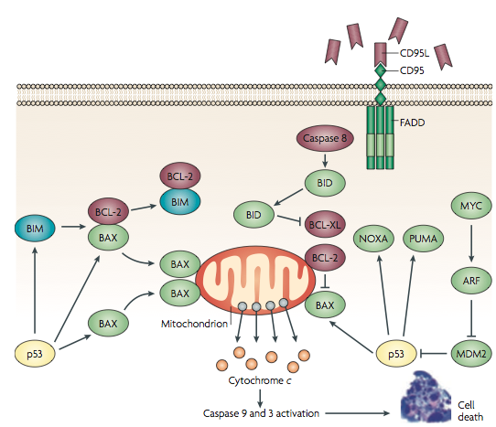
DNA damage response: p53, the guardian of the genome

Slide 33
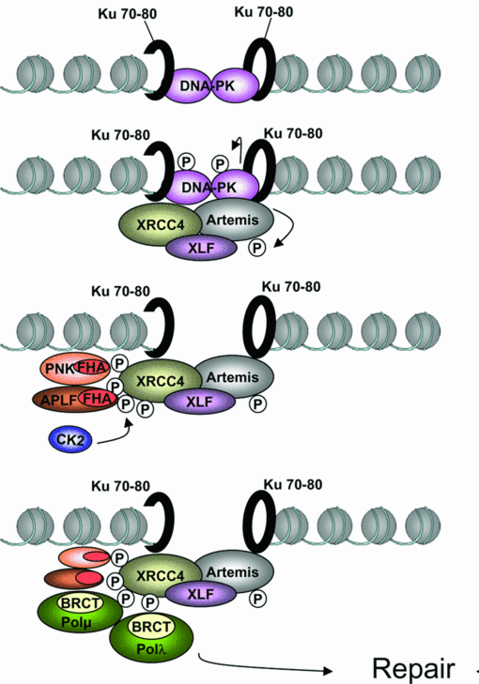
DNA damage response: DNA-PK and non-homologous end joining
How does the cell stop itself from apoptosing while repair proceeds?

Slide 34
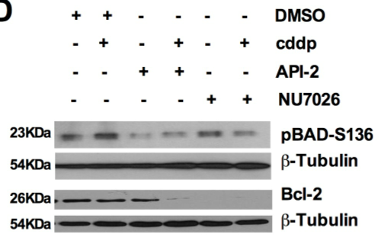
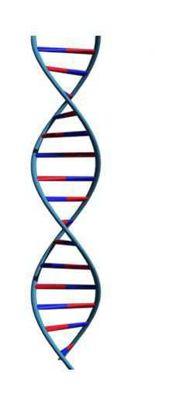
AKT promotes survival via BAD phosphorylation and Bcl2 stabilisation
Cisplatin
SURVIVAL
DNA-PK
Bad
pBAD
AKT
pAKT-S473
pAKT-S473
Bcl2

Slide 35
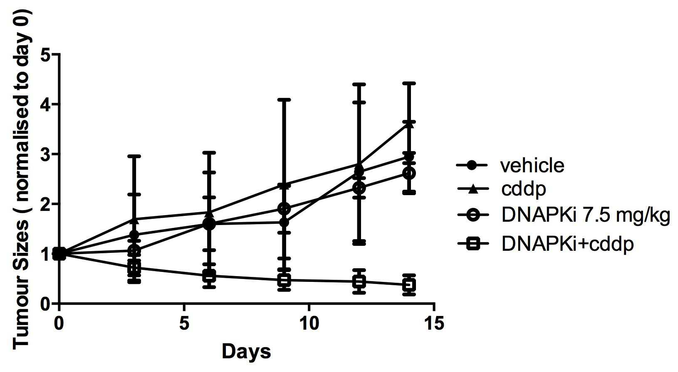
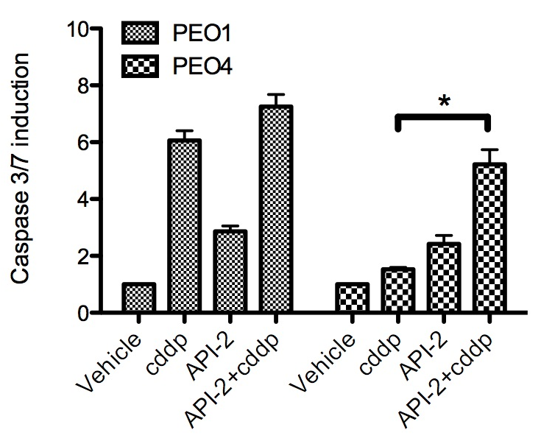
How is this knowledge useful?
What happens when it goes all goes wrong?

Slide 36
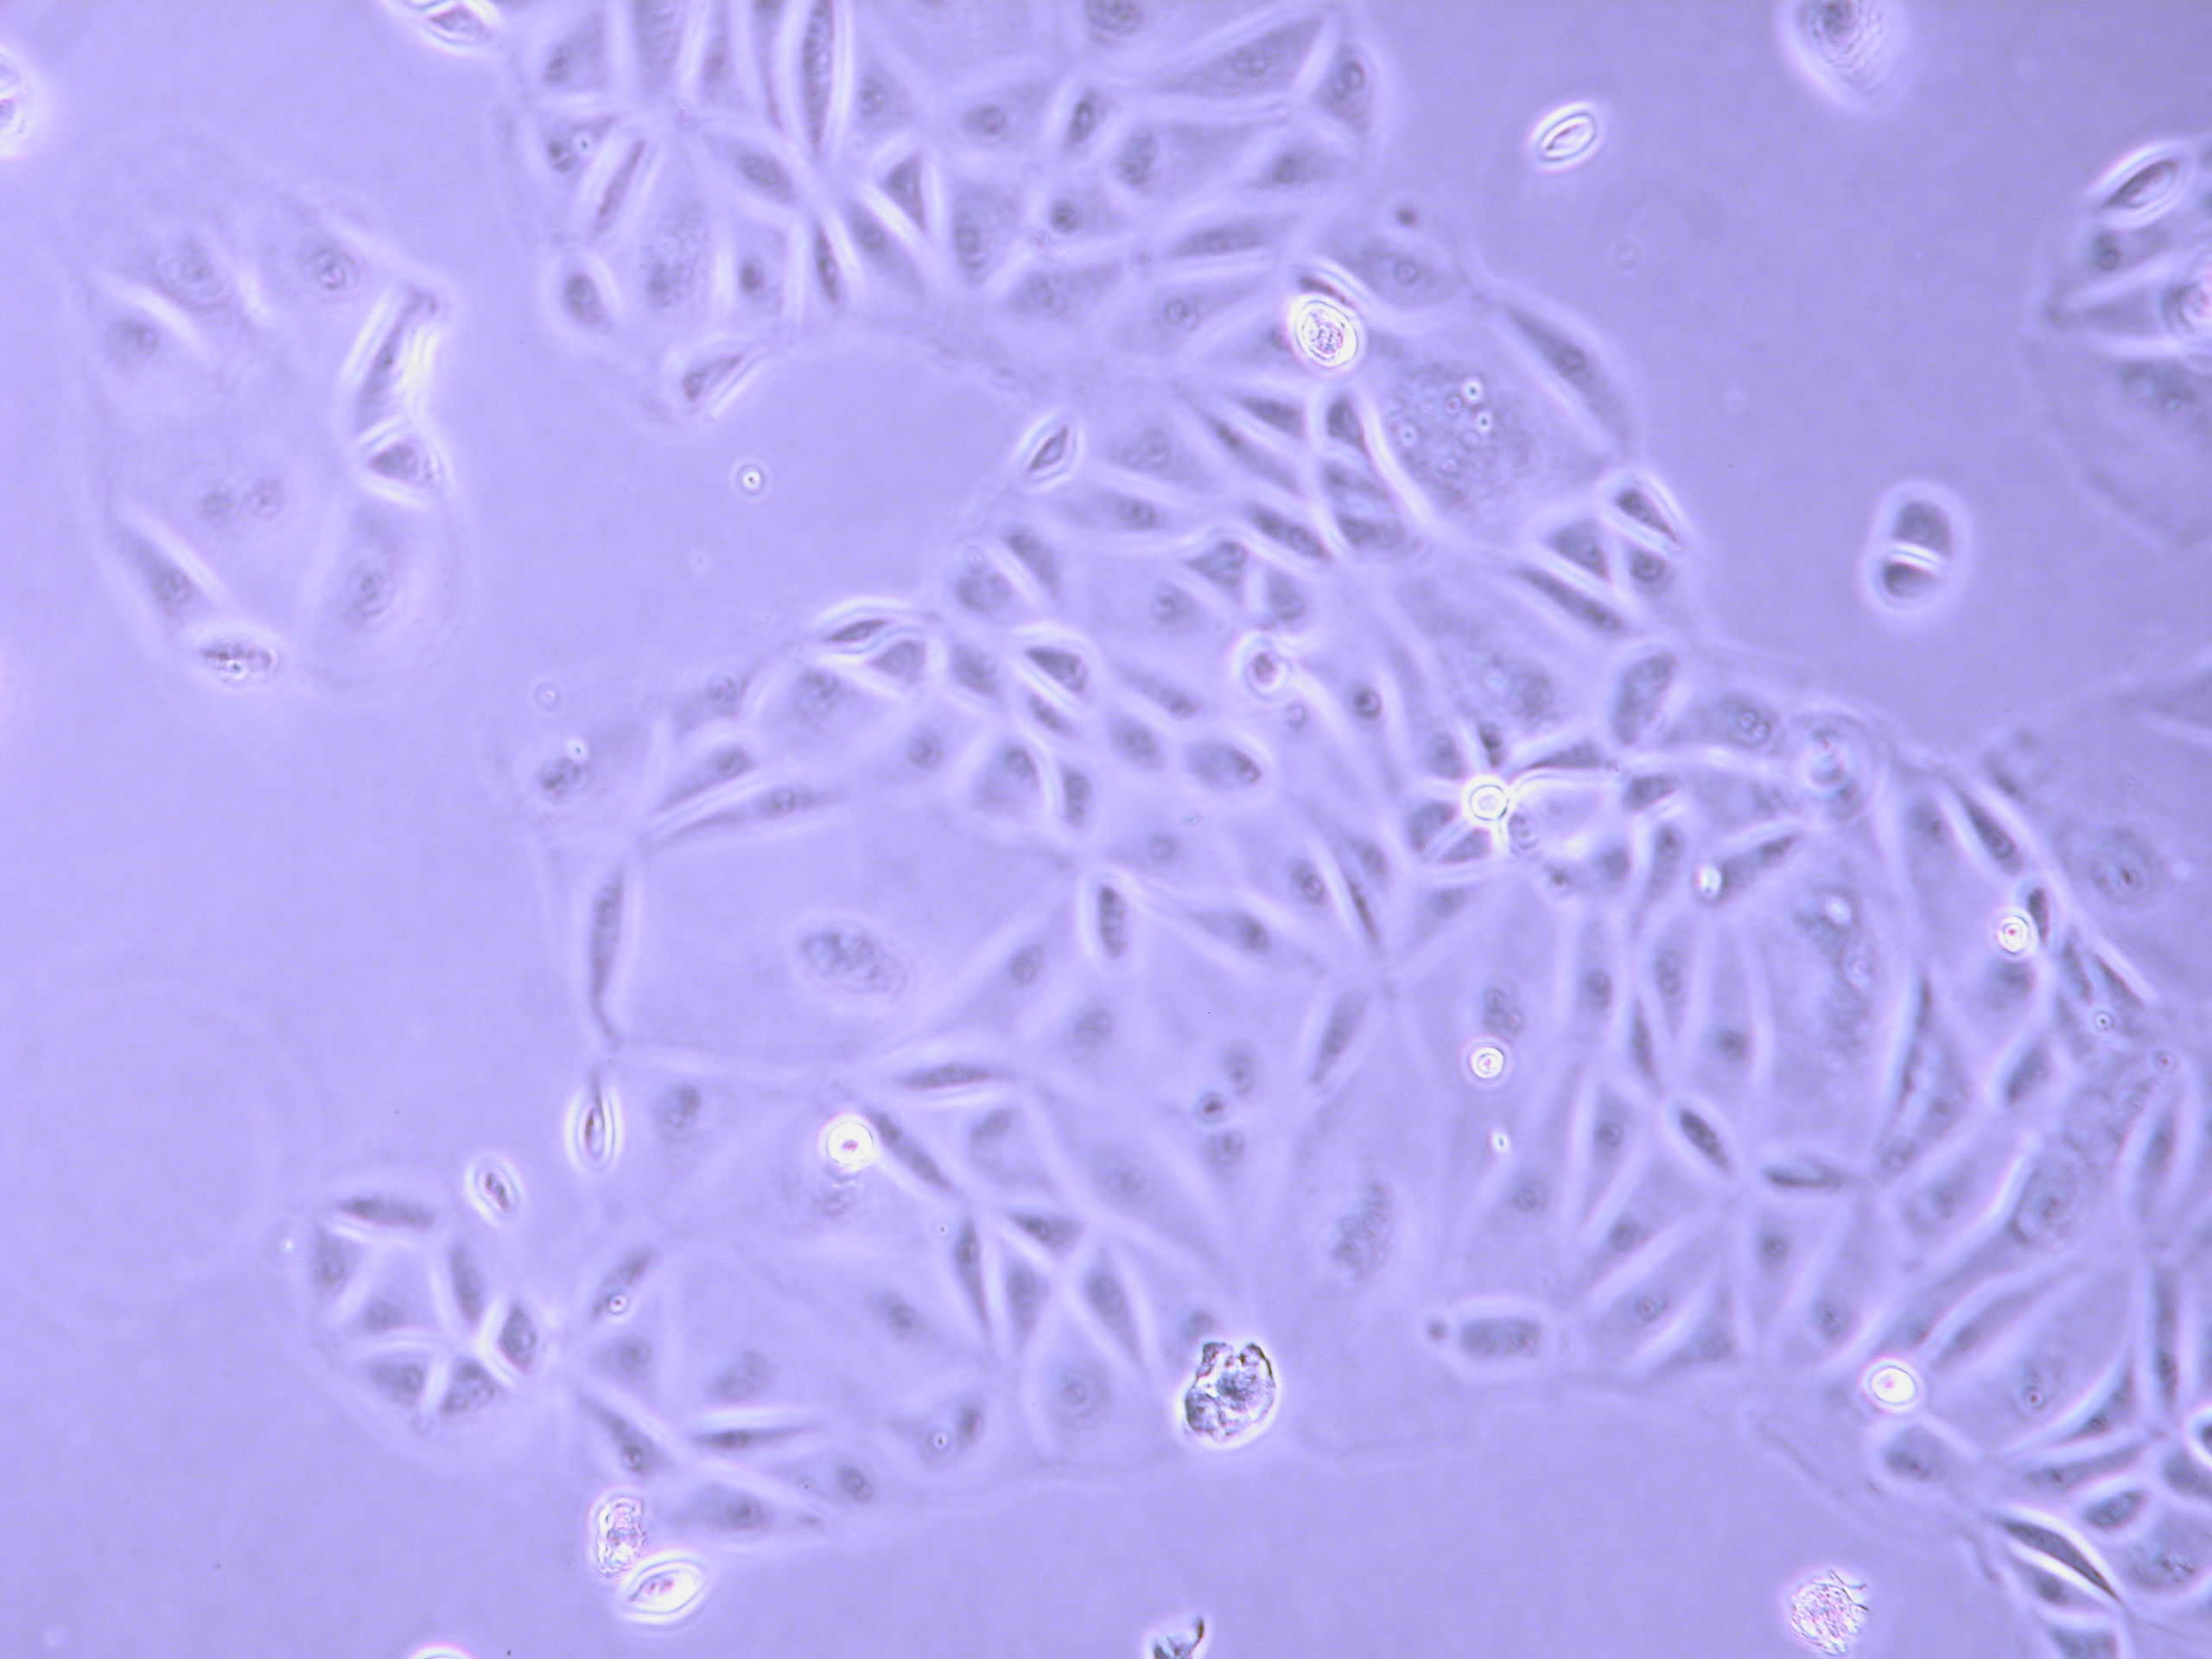
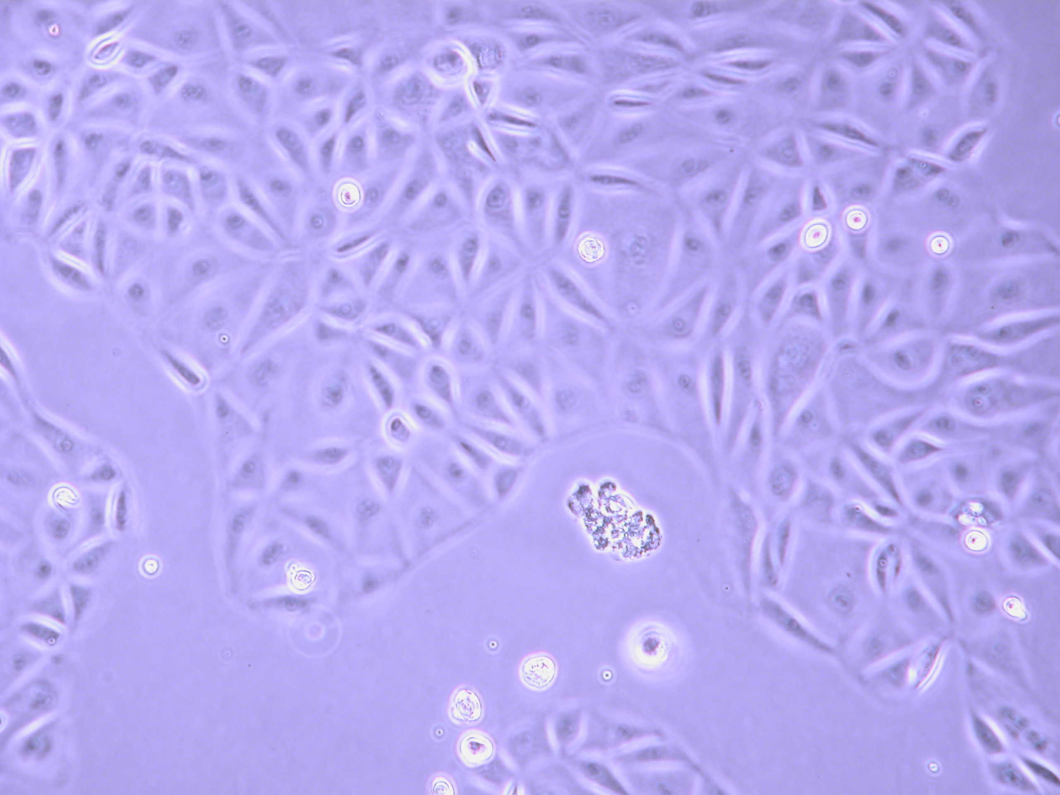
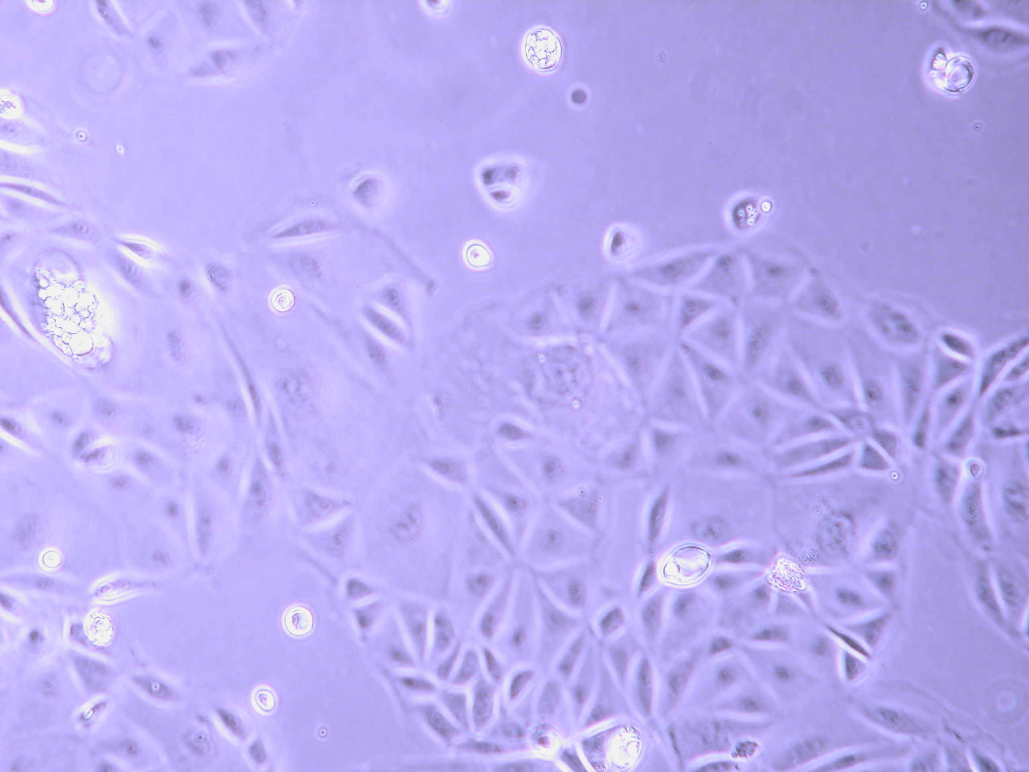
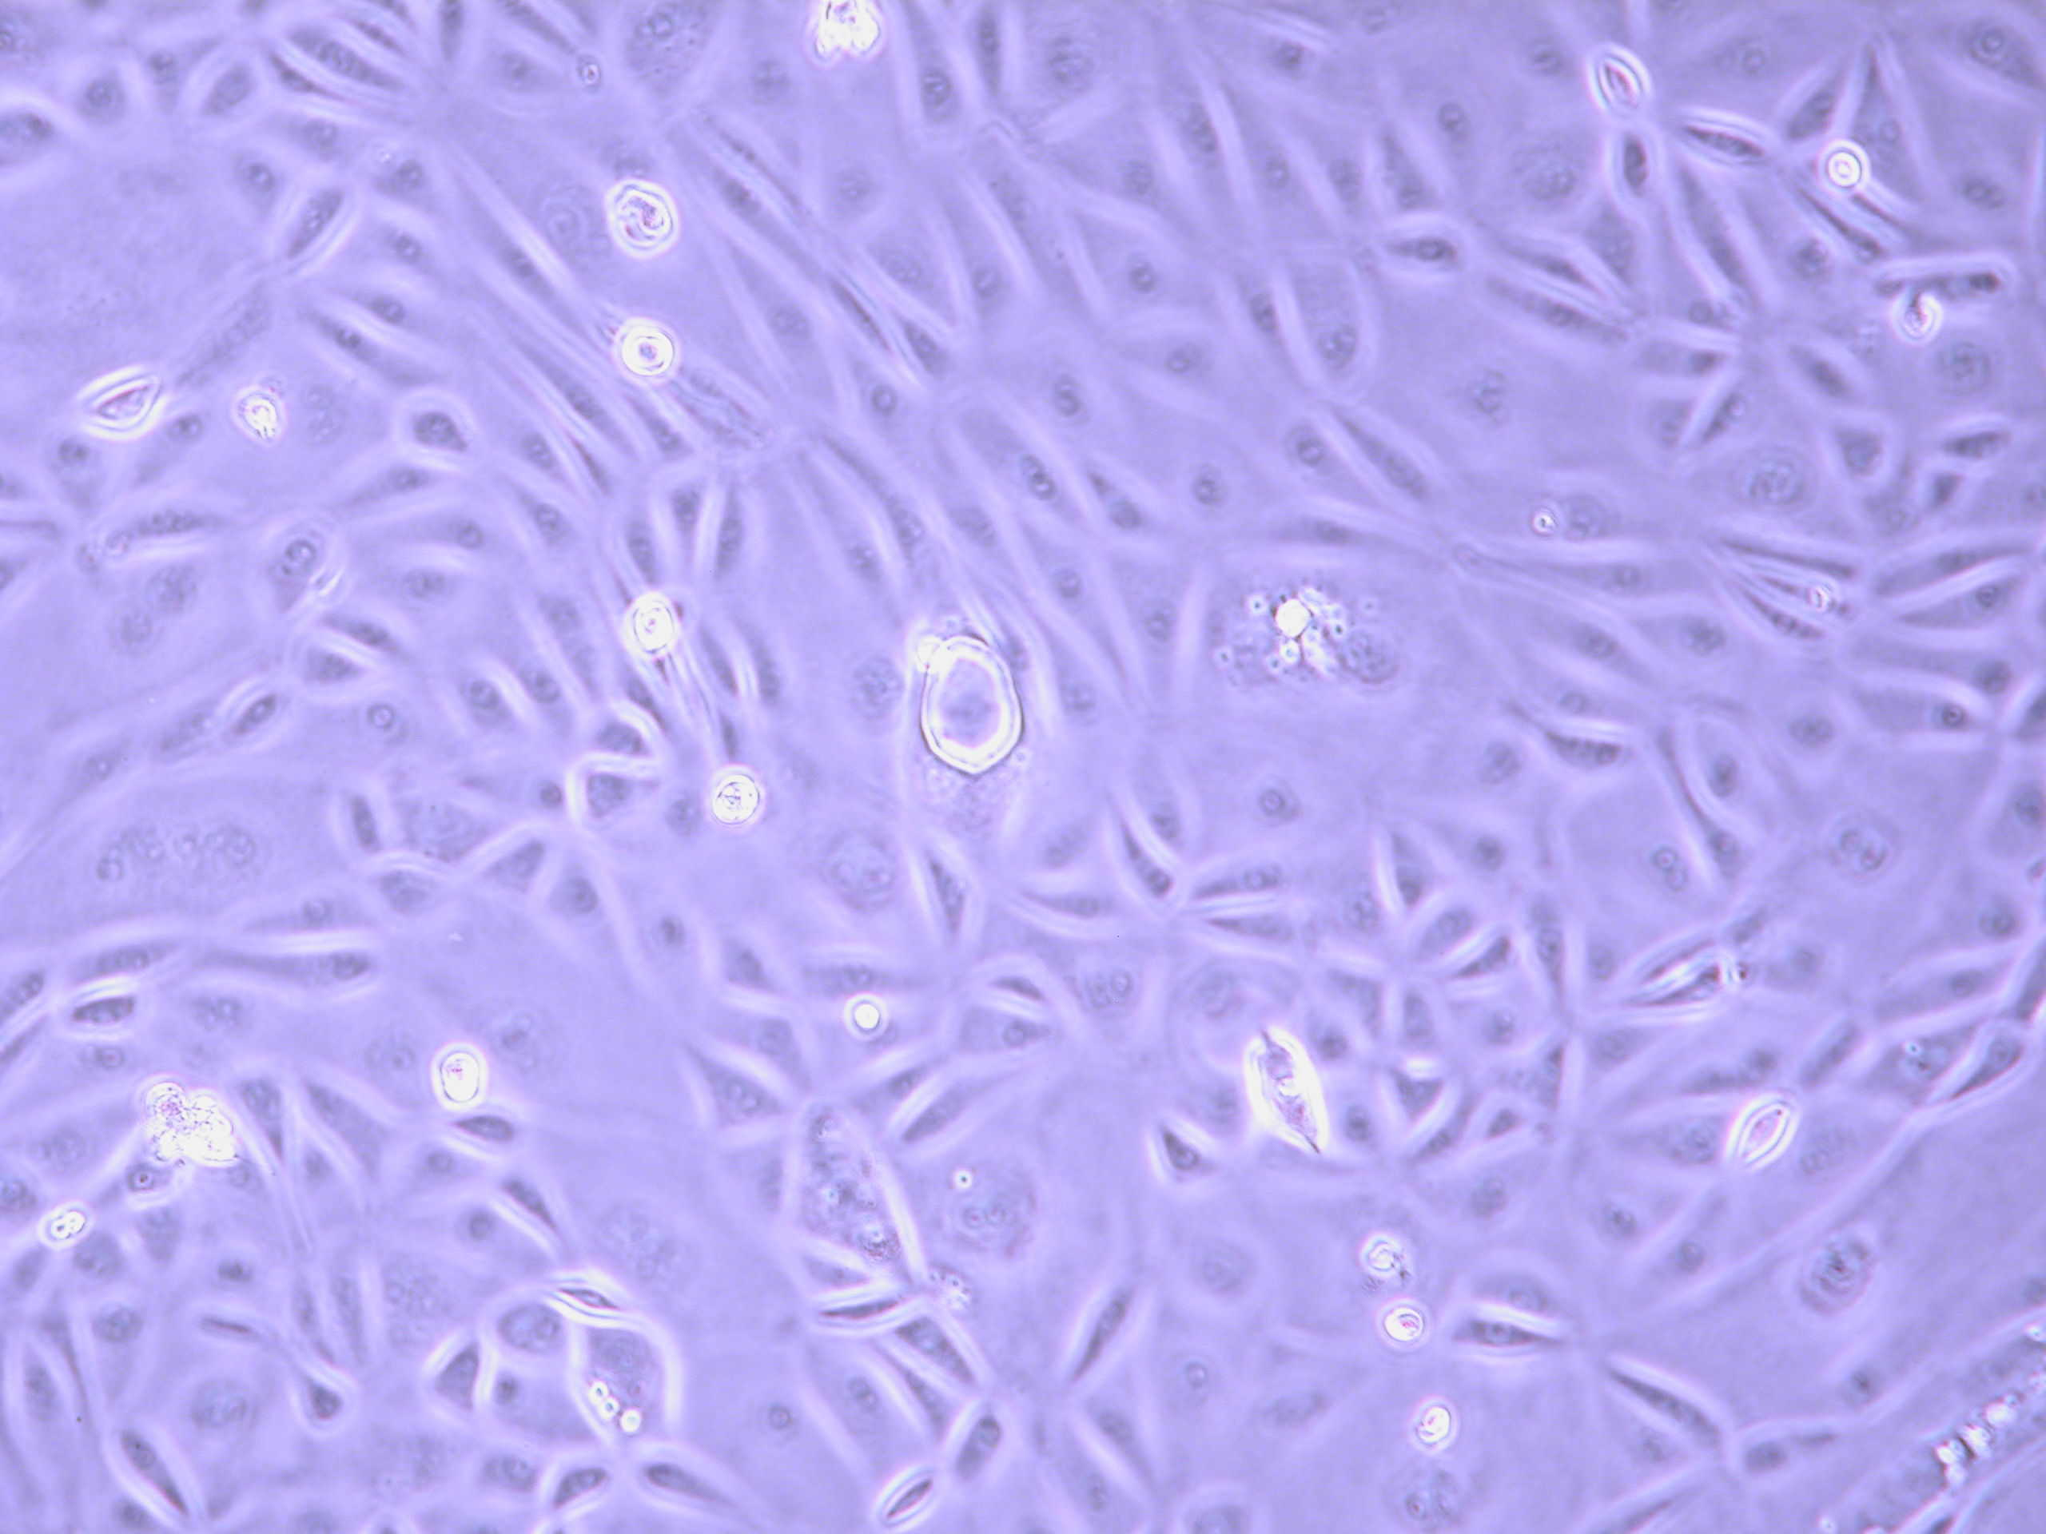
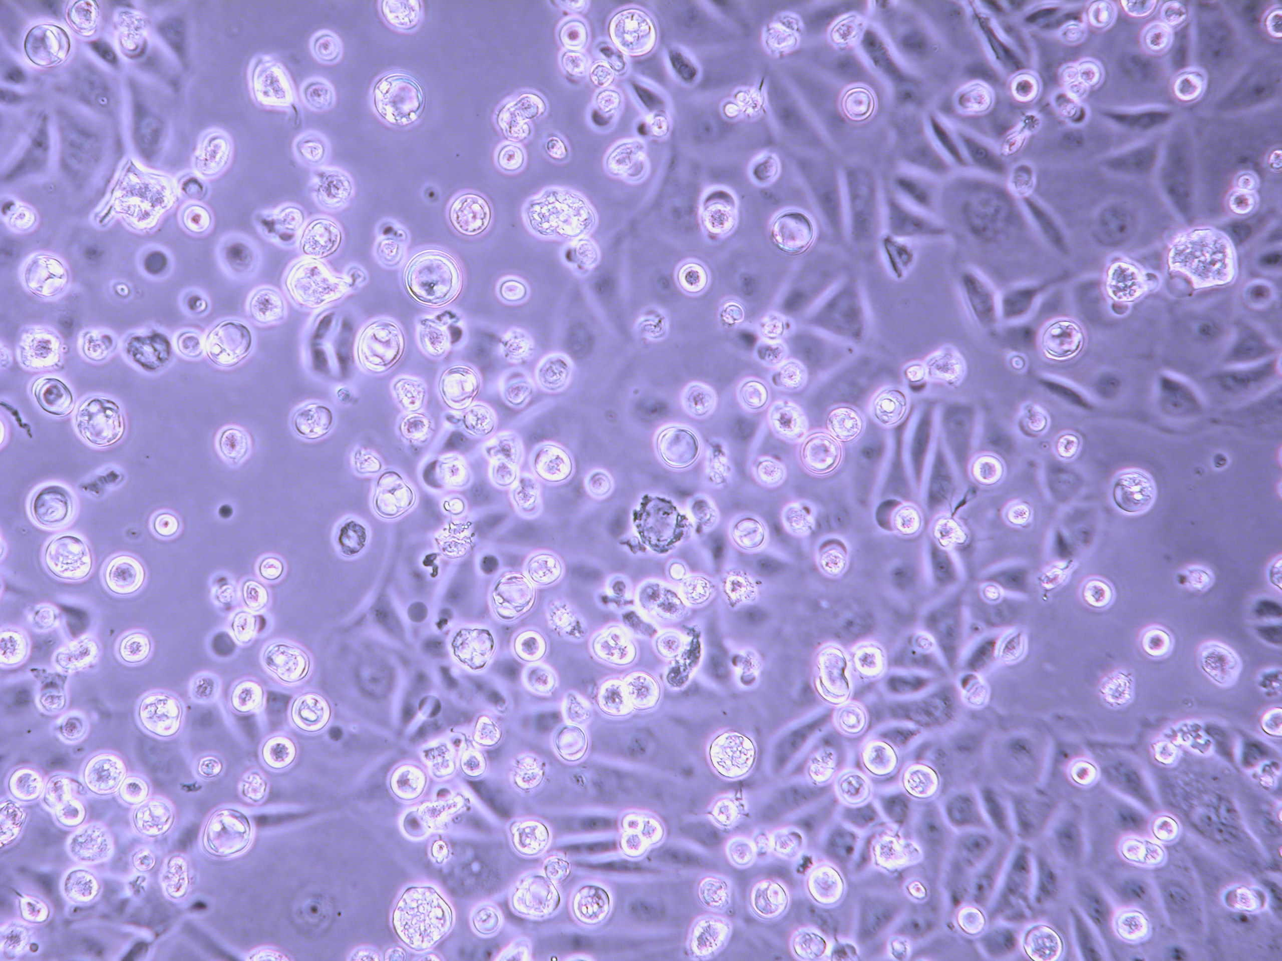
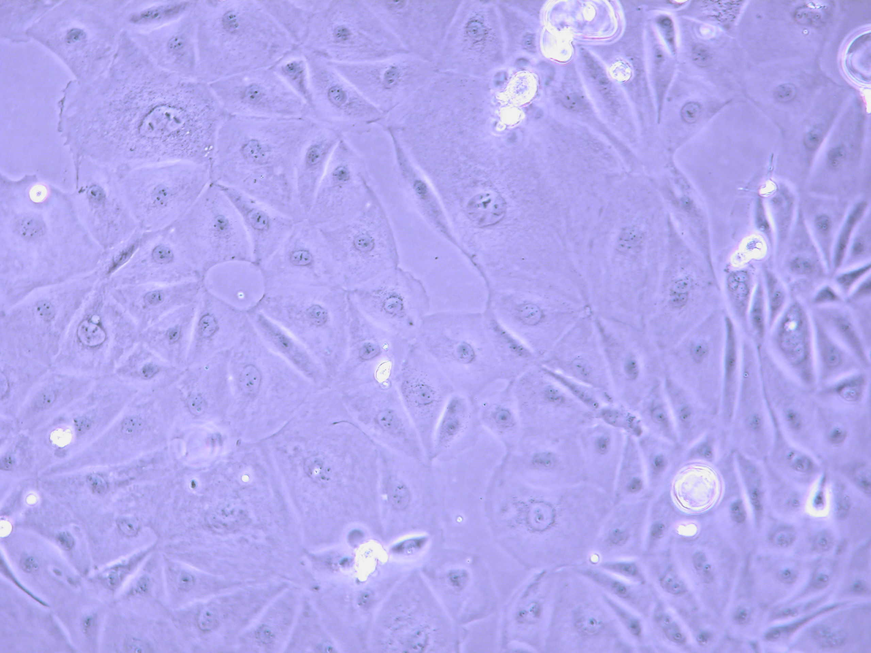
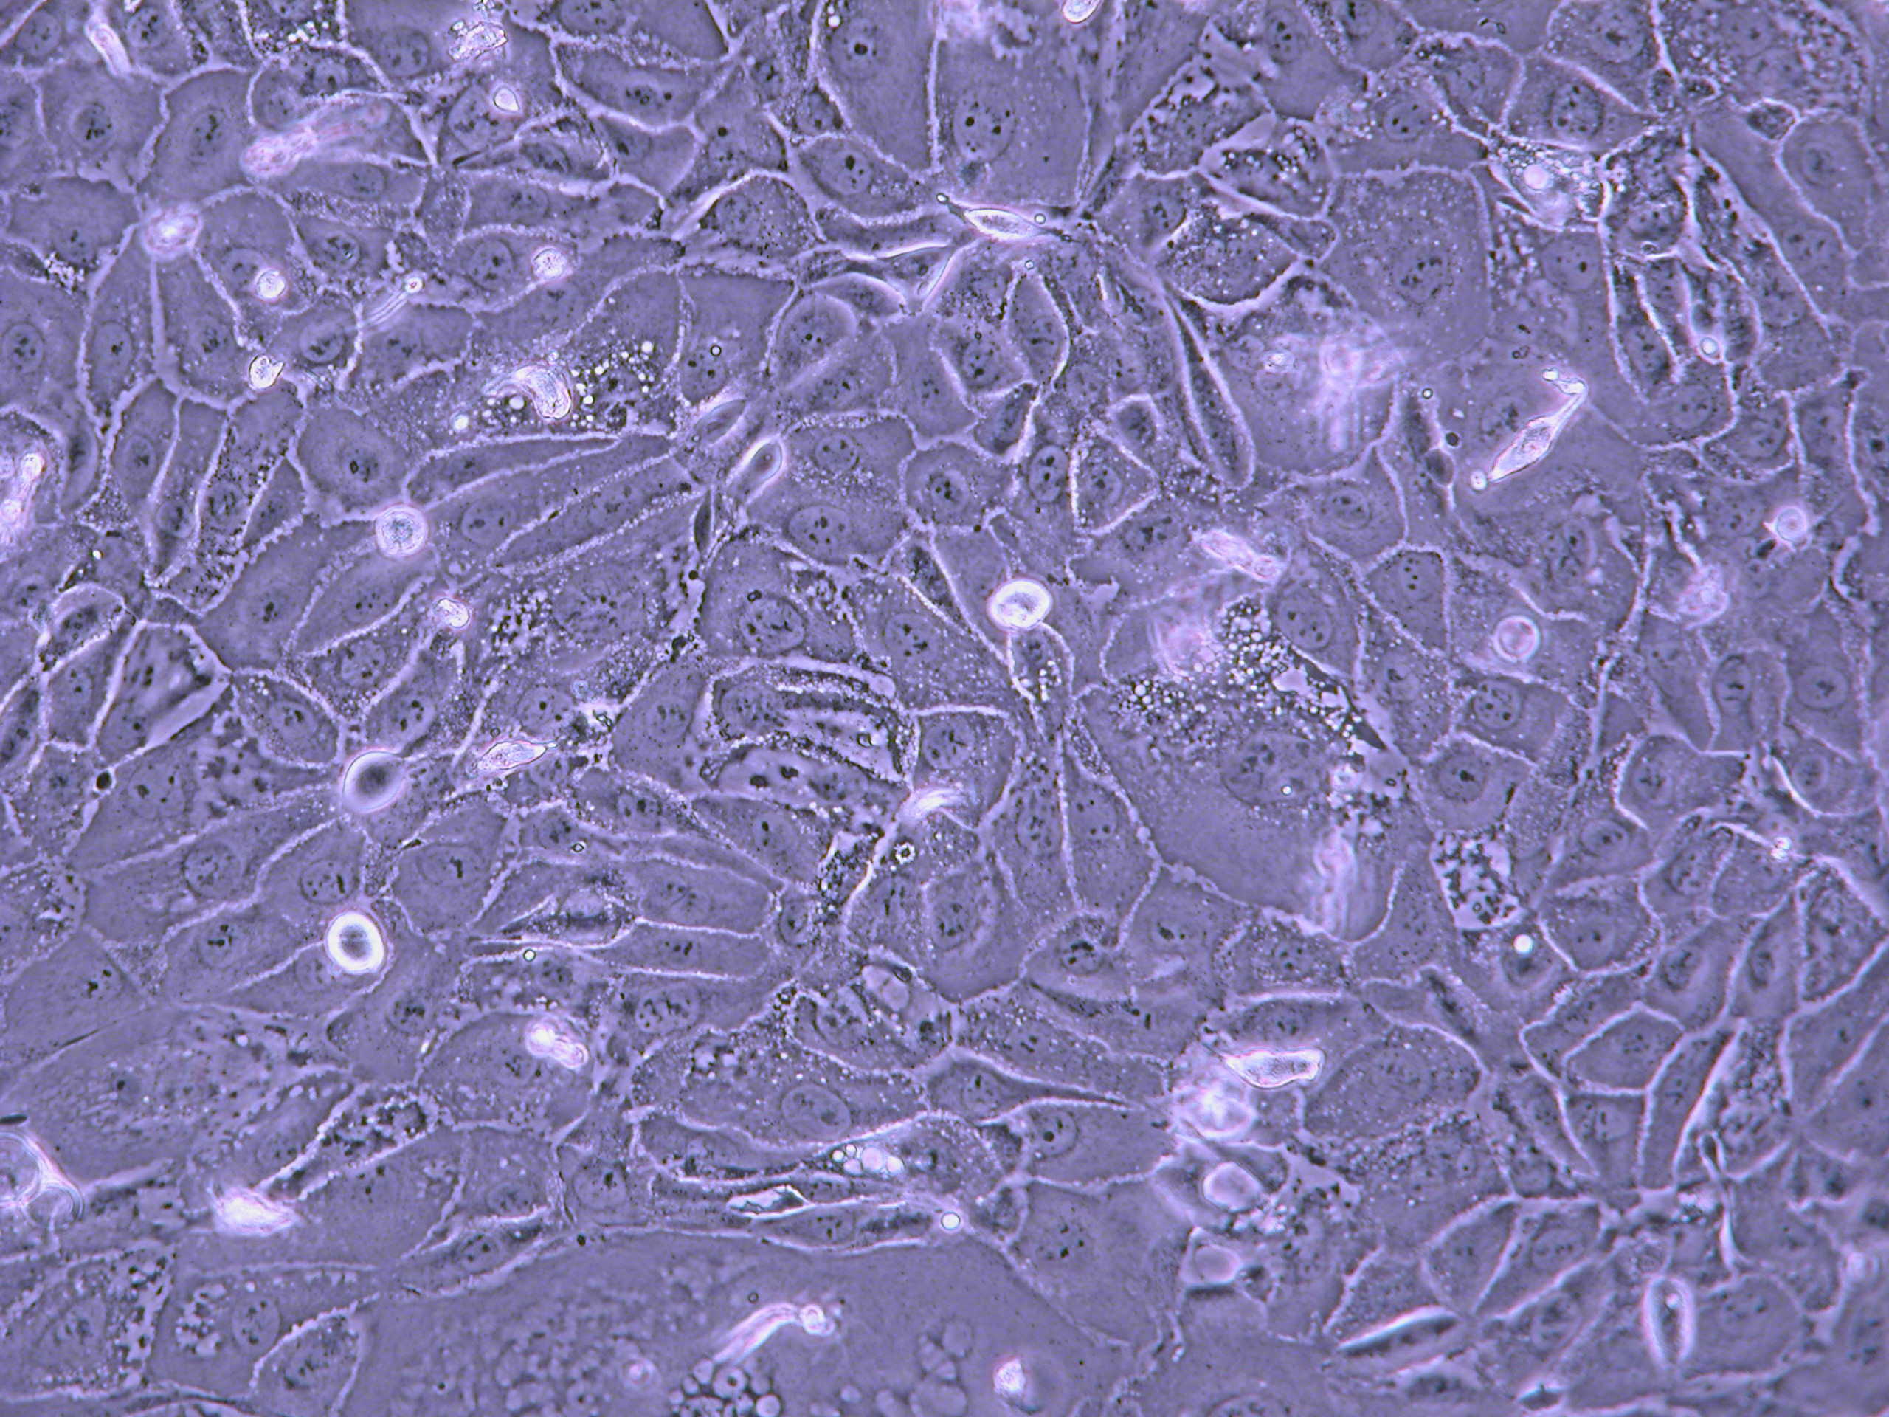
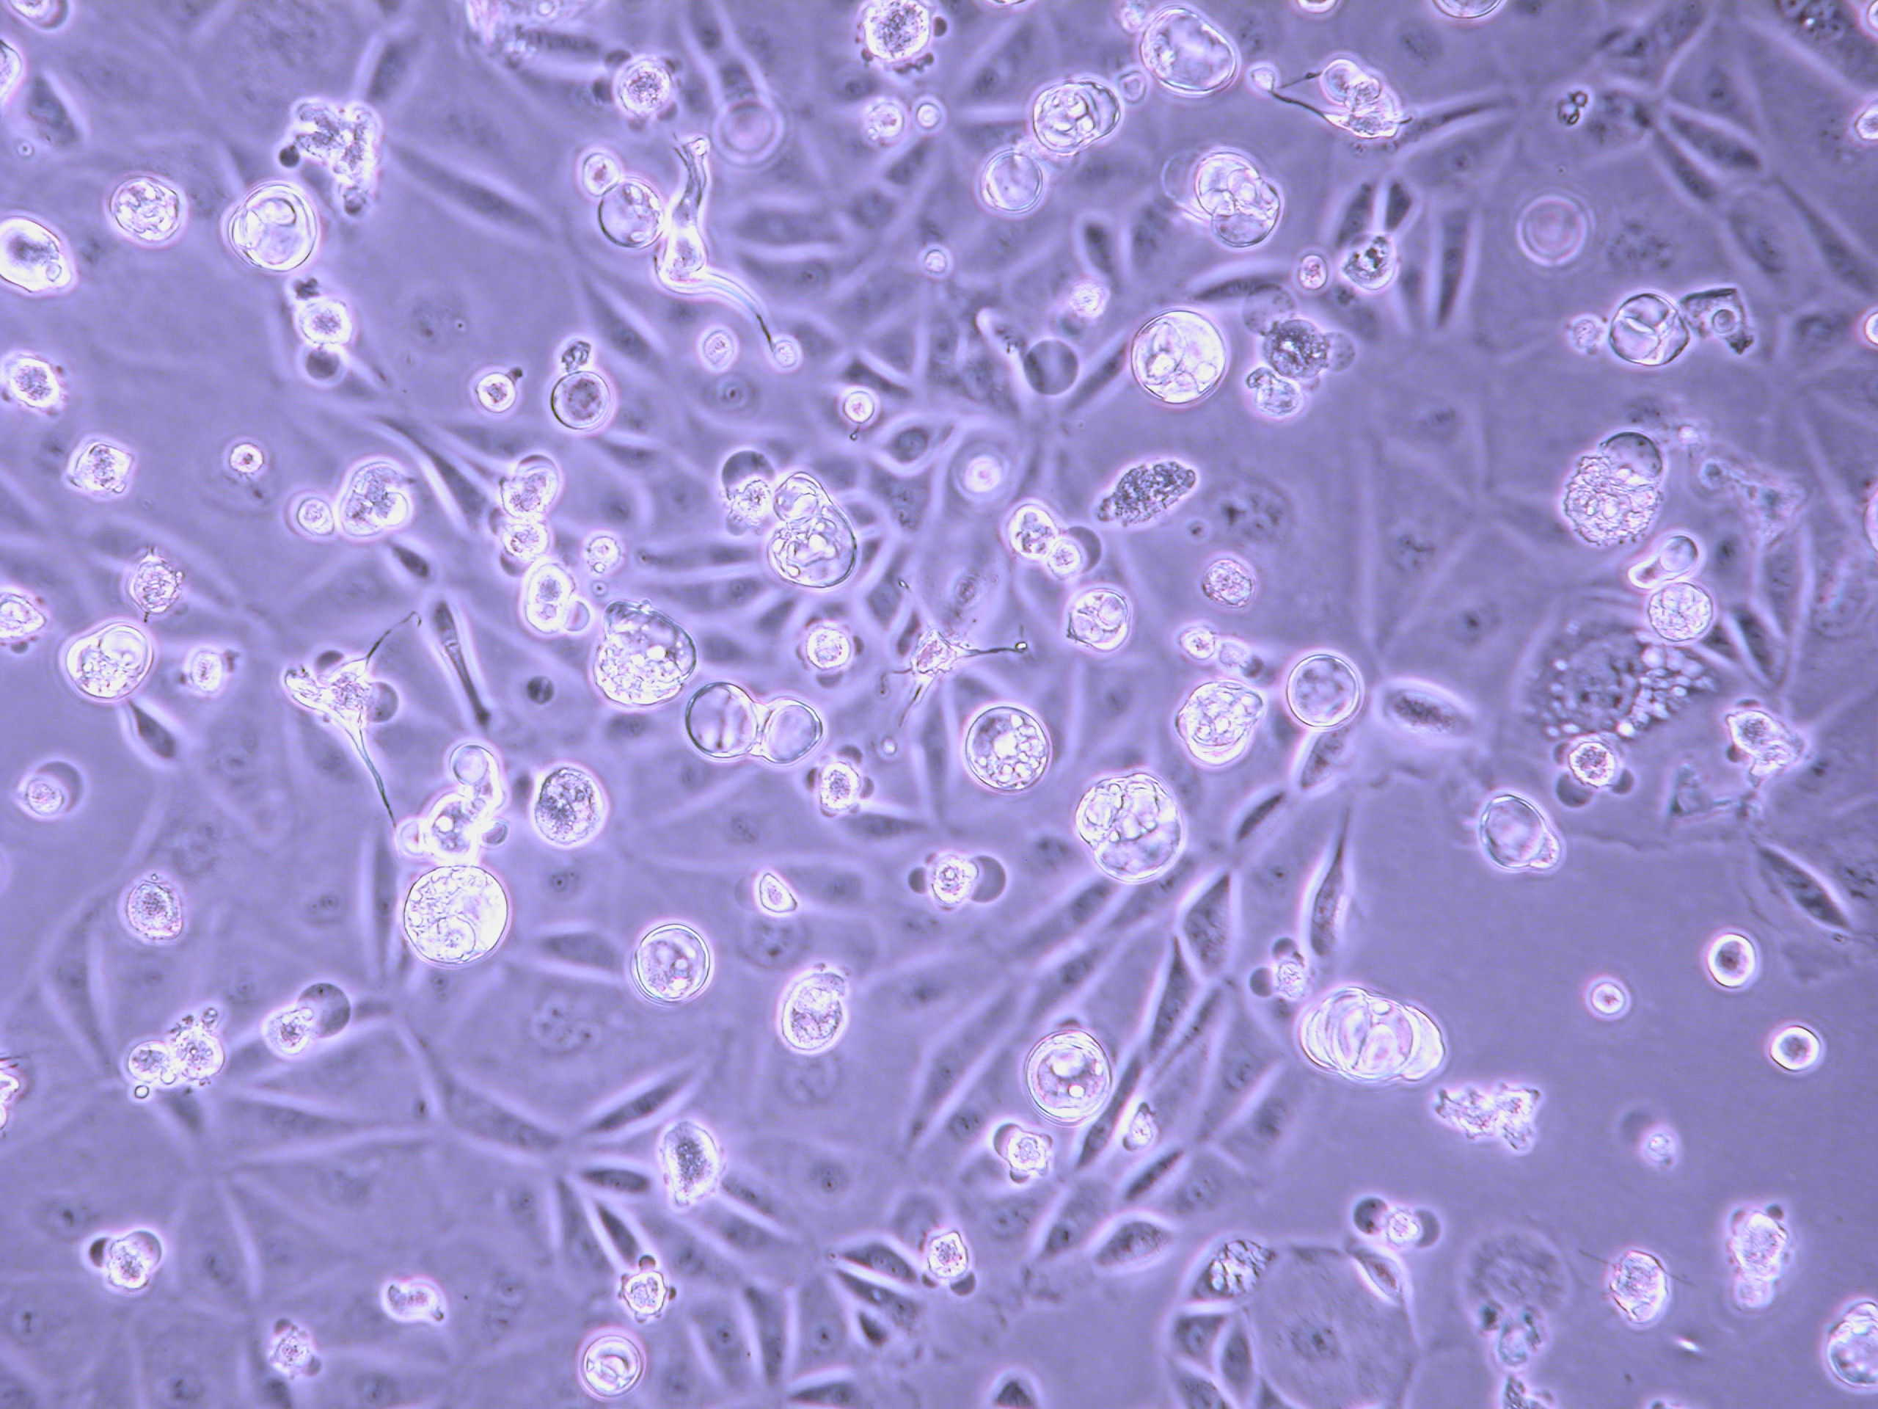
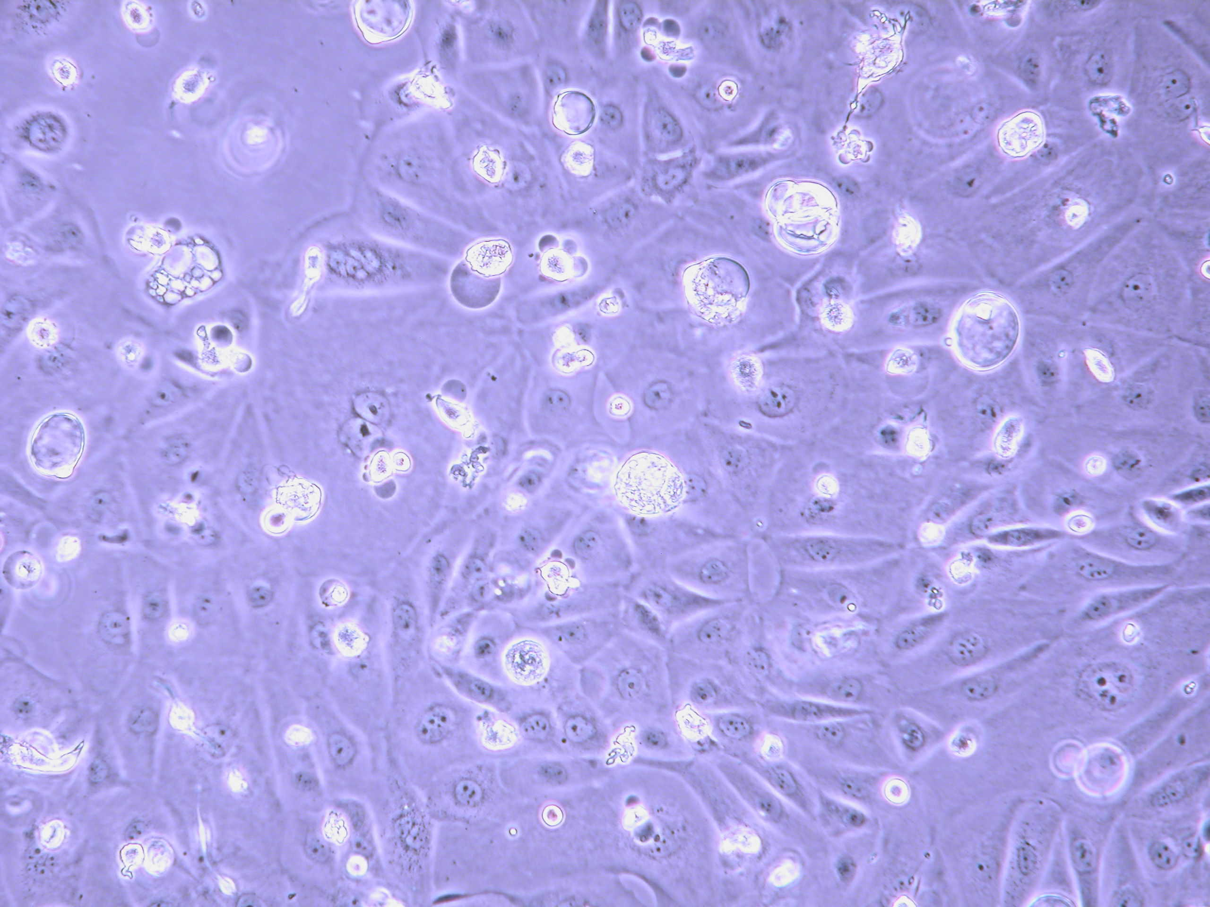
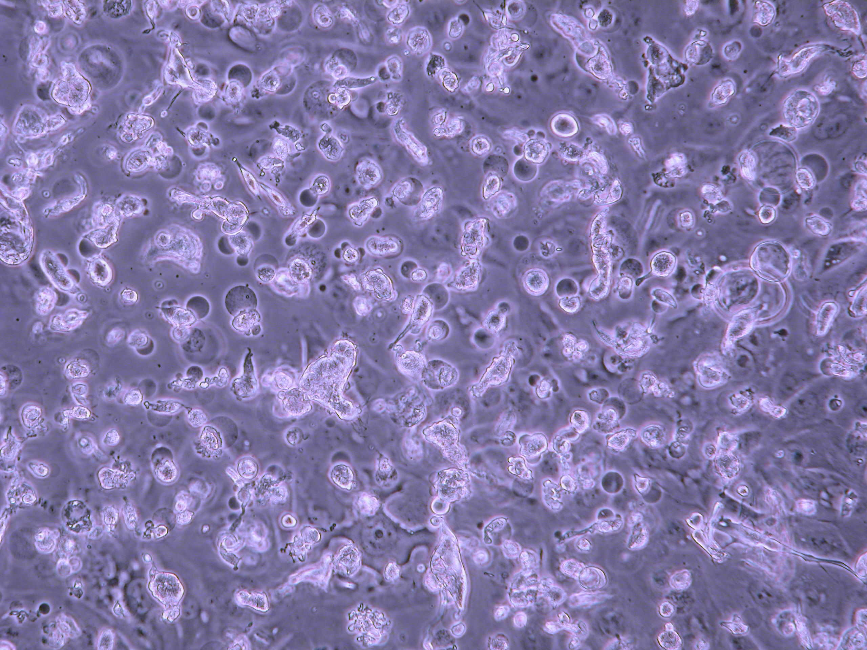
Pathways to apoptosis: AKT inhibition reverses chemoresistace
PEA1
Platinum based
chemotherapy:
resistant relapse
Cisplatin
Cisplatin + AKT inhibitor
2hrs
4hrs
2hrs
24hrs
4hrs
72hrs
8hrs
8hrs
24hrs
72hrs
PEA2

Slide 37
Death: apoptosis is not the only option….
Necrosis
Necroptosis
Anoikis

Slide 38
Necrosis
Greek nekros, “corpse”
Caused by external factors
‘Accidental’ and ‘passive’ cell death
Usually detrimental to organism, unlike apoptosis
Unregulated/uncontrollable
Associated with inflammation

Slide 39
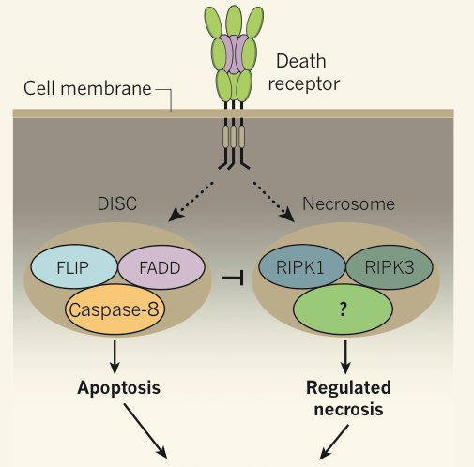
Necroptosis
Shares features of apoptosis and necrosis
‘Regulated necrosis’ or ‘programmed necrosis’
Participates in pathogenesis of ischemic injury, neuro-degeneration and viral infection
Initiated via death receptor activation (eg TNF receptor 1/2, FAS, TRAILR1/2)
Ie same receptors as the extrinsic apoptosis pathway
Choice between apoptosis and necrosis modulated by protein modificaiton (ubiquitination) and caspase 8 activity
Necrosome forms consisting of receptor interacting proteins, RIP1/3
Active disintegration of mitochondria, lysosomes and cell membrane
Cell death

Slide 40
Anoikis: detatchment induced apoptosis
Anoikis- greek for homeless
Apoptosis caused by loss of cell anchorage
Distinct from loss of anchorage occurring during classical apoptosis
Key feature of metastatic cancer is resistance to anoikis
Key feature of vertebrate development
Involved in formation of structural cavities eg prostate/mammary gland
Adhesion is maintained through integrins
Not simple anchors- induce intracellular signaling via FAK /ILK
Decreases p53, decreases BAX, decreases p21
Ie anti-apoptotic, pro-growth state
Loss of attachment induces apoptotic signaling and cell death
Unsurprisingly key regulators of anoikis are frequently dysregulated in cancer
Cancer therapy targets

Slide 41
Summary
Programmed cell death
“better dead than broken”
Minimises inflammatory response
Externally:
Cell rounds up and detaches from neighbours
Plasma membrane blebbing/pinching off
Internally
Protein cleavage: “death by a thousand cuts”
Nuclear condensation
DNA fragmentation
Golgi and ER condense and fragment
Mitochondrial network fragmentation
Mitochondrial outer membrane permiabilisation
Shutdown of transcription and translation
Clearance of debris by phagocytes
Other methods of cell death exist

Slide 42
Does this make more sense now…?

