Slide 1



Novel tracers in PET imaging
Dr L Kenny

Slide 2
Why do we need imaging biomarkers?
Novel agents may not cause decrease in tumour volume as per RECIST criteria
Survival benefit can occur without objective response
Clinical trials – optimal biological dose
may not relate to MTD
Early prediction of pharmacological resistance

Slide 3
Wester, Clin Can Res 2007

Slide 4
Examples of Molecular Imaging Probes in Development

Slide 5
Stages to new probe development
Proliferation
Angiogenesis
Apoptosis
Microdosing studies

Slide 6
Novel Probe Development
Is the new probe specific to the target of interest?
Can it be radiolabelled?
Suitable molecule for lead compound? (e.g. enzyme, receptor ligand, peptide, or antibody) with relevant affinity and suitability?
Can it be produced with high purity and stability?

Slide 7
Novel Probe Development
          Lead Compound Identified
          Radiolabelled
          Xenograft model - microPET
          Toxicology and Mutagenic studies in Rats
          Human Radiation Dosimetry + Biodistribution
          Human Disease Model – Correlation with tissue
Dynamic PET with full quantitation

Slide 8
Radioisotopes for PET research
Positron Emitter | Half-life (t_{½} of product) in min
¹¹C | 20.4
¹⁸F | 109.8
¹⁵O | 2.03

Slide 9
Data Interpretation
Visual
Quantitative to calculate the SUV – uptake at a particular timepoint corrected for dose injected and body weight or surface area
SUV(bw)= tissue concentration(MBq/g)
injected dose (MBq)/body weight (g)
Above methods assume that dephosphorylation is negligible

Slide 10
Data Interpretation
For more detailed analysis: need an input function generated from a large vessel on the images/ or from arterial sampling
Data led models – spectral analysis, patlak analysis
Fixed models – compartmental analysis

Slide 11
Proliferation
Thymidine analogues
[11C]thymidine
3’-deoxy-3’-[18F]fluorothymidine (FLT)
2’-deoxy-2’-[18F]fluoro-D-arabinofuranosyl-thymine (FMAU)

Slide 12
Pyrimidine Nucleoside Analogues Used in PET
O
O
Me
Me
NH
NH
11
N
O
N
O
HO
O
HO
O
OH
18
F
2[
11
C]Thymidine
[
18
F]FLT
O
O
O
11
Me
76
124
NH
Br
I
NH
NH
N
O
N
O
N
HO
O
O
HO
O
HO
O
OH
F
OH
OH
[
11
C]
FMAU
[
76
Br]
BrdU
[
124
I]
IUdR

Slide 13
[¹⁸F]fluorothymidine – a substrate for TK1 and ENT1
O
O
Me
Me
NH
NH
N
O
Thymidine
kinase
²⁻ O₃PO
N
O
HO
O
O
Deoxynucleotidase
¹⁸F
¹⁸F

Slide 14
Compartmental Analysis
K
K
k
1
k
1
3
3
18
18
18
18
18
[
18
[
F]FLT
F]FLT
[
[
F]FLT
F]FLT
[
[
F]FLT
F]FLT
-
-
P
P
k
k
k
2
k
2
4
vascular
4
vascular
free
free
metabolic
metabolic
compartment
compartment
space
space
compartment
compartment
K
K
‘
‘
1
1
18
18
18
18
F]FLT
[
F]FLT
[
[
F]FLT
[
F]FLT
glu
glu
glu
glu
‘
k
‘
k
2
vascular
2
vascular
free
free
compartment
compartment
space
space

Slide 15
[18F]FLT-PET (Kenny et al, Cancer Research 2005)
Proposed marker of proliferation, related to thymidine kinase 1 (TK1) activity
Scanned 15 patients with stage II-IV breast cancer for 95 min
29 tumor regions
Arterial sampling for PK and metabolite analysis
Kinetic analysis to quantify retention (FRT and Ki), delivery, and uptake
[18F]FLT correlated with Ki67 (r=0.92 for Ki and FRT, 0.79 for SUV)

Slide 17
[18F]FLT and proliferation in breast cancer - Results
Metabolised into a single metabolite by glucuronidation
71.5 ± 1.5% as parent compound at 90mins
Uptake, retention, delivery higher in tumor than normal tissue (p<0.0001 for all parameters)
Kinetic analysis showed irreversible trapping in tumor but not normal tissue
Wide intratumor and interpatient variation in uptake of [18F]FLT
Correlates with Ki-67:r=0.92 (p<0.0001) for Ki, FRT, 0.79 for SUV, ns = 0.28 for K1

Slide 18
FLT Metabolism and Modelling
Patlak
Spectral

Slide 19
Defining objective criteria for response assessment
Test-retest reproducibility of FLT
Ki: SD=15% ICC=0.99 r=0.97
SUV: SD=10% ICC=0.97 r=0.99
Kenny et al. Eur J Nucl Med Mol Imaging 2007
Notes:
As mentioned in earlier sessions there tends to be a problem with reproducibility and large enough patient numbers to make any useful judgments on the relevance of PD changes. The way we’ve approached this problem is to run a reproducibility study either within a trial or before the trial and use the coefficient of repeatability to set the prospective objective response.

Slide 20
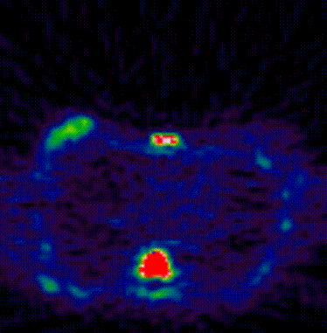
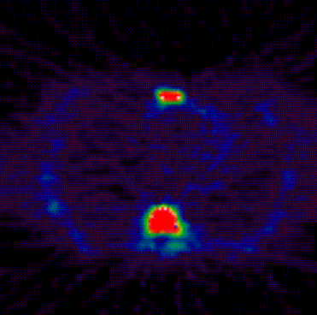

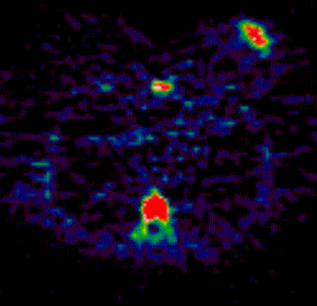
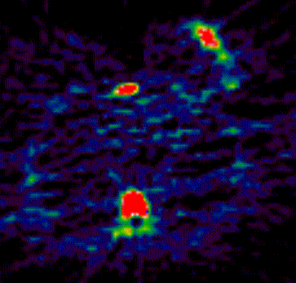
Comparison of [18]FLT-PET response and non-response
[¹⁸F]FLT uptake
A. Patient 1 Baseline
B. Patient 1 Day 8 Post FEC
100%
tumour
vertebra
0%
C. Patient 8 Baseline
D. Patient 8 Day 8 Post FEC
tumour
tumour

Slide 21
[18F]FLT-PET
Able to detect significant changes in 11/17 lesions by Ki and 12/17 by SUV
All patients who had a clinical response had an FLT-PET response
Heterogeneity of response between different lesions in the same patient
Now being assessed in other tumors – e.g. NSCLC and gefitinib – d7 FLT predicts for clinical response: positive and negative values of 0.92 (Sohn et al, Clin Canc Res Nov 2008)

Slide 22
FLT-Pharmacodynamic studies
The enzyme thymidylate synthase is an important therapeutic target
Proposed mechanism of the active metabolite FdUMP of capecitabine is inhibition of TS
Hypothesized that early inhibition of TS would increase extracellular thymidine and hence [18F]FLT uptake
Could be used to determine early resistance

Slide 23
thymidine
FLT
Cell membrane
ENT1
[¹⁸F]FLT
TMP
TK1
DNA
thymidine
TMP
TTP
Salvage pathway
dUMP TMP TTP DNA
De novo pathway
TS
Capecitabine and 5-FU

Slide 24
[18F]FLT as a PD marker (Kenny et al Clinical Cancer Res Nov 1, 2009.)
[18F]FLT and H2[15O] (for blood flow) scans at baseline, then repeat scans at the maximum bioavailability timepoint for capecitabine
Significant increases in [18F]FLT uptake which were independent of blood flow
Non-responders failed to show a significant change
No significant change in normal tissue

Slide 25
Capecitabine
Blood flow
Vd (H2O)
K1 FLT
PS product
SUV
IRF
Ki

Slide 26
Results
Possible to see significant changes in FLT uptake (p=0.004 IRF60, p=0.002 Ki and SUV)
No significant change in patients with PD
Heterogeneity of FLT-PET response
Independent of blood flow
No significant change in normal tissue supporting tumor-specific action of capecitabine

Slide 27
Angiogenesis: Background
Angiogenesis is essential for tumour growth
Advances in our understanding of the molecular biology
Treatment options
Crucial need for quantification in vivo

Slide 28
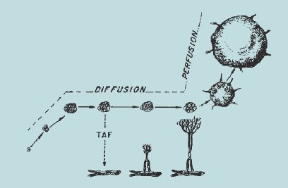
Folkman, 1971

Slide 29
Integrins
Heterodimeric transmembrane proteins
Extracellular ligand receptors
Crucial for stability of microenvironment, cell movement and differentiation
18α and 8β genes
24 αβ combinations at protein level

Slide 30
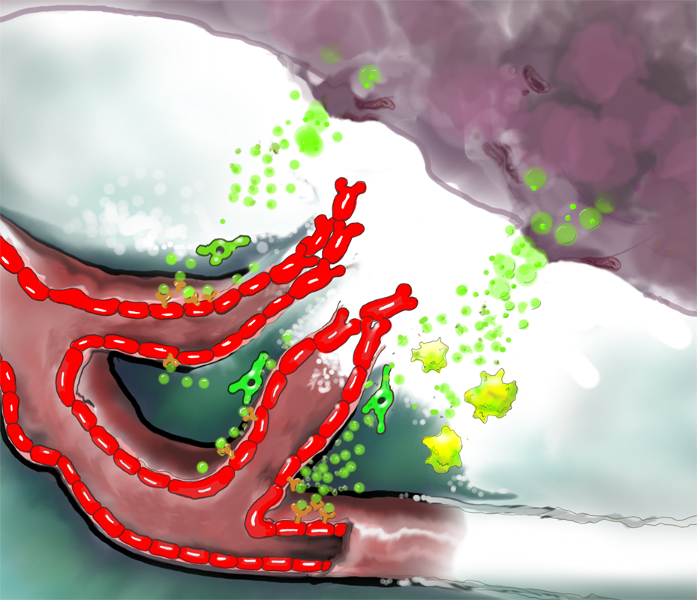
New angiogenesis imaging agents: integrin α_{v}β₃ receptor probes
αvβ3/5
Tumor
A receptor for ECM proteins with exposed arginine-glycine-aspartic acid (RGD), e.g. fibronectin
Over-expressed on activated but not quiescent endothelial cells (during angiogenesis)
Present on some tumor cells
New blood vessels
Stromal cells

Slide 31
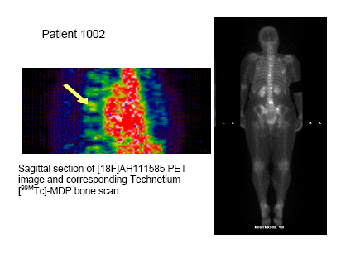
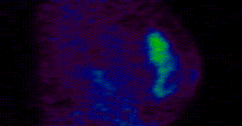
Breast tumour with bone metastases
Primary tumor
Bone metastases
Sagittal view of left breast grade 2 invasive ductal carcinoma imaged with [18F]AH-111585 PET

Slide 32
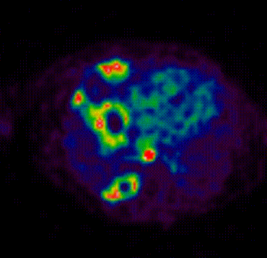
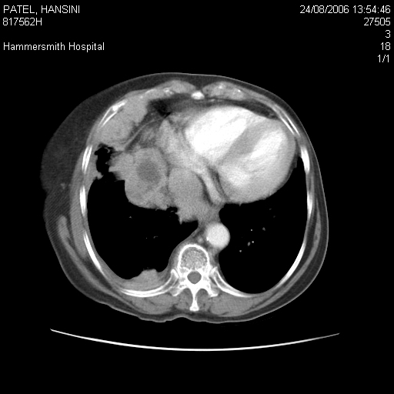
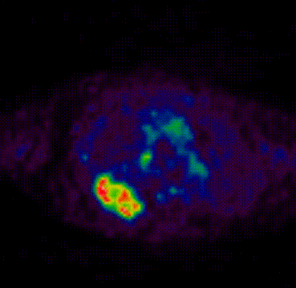
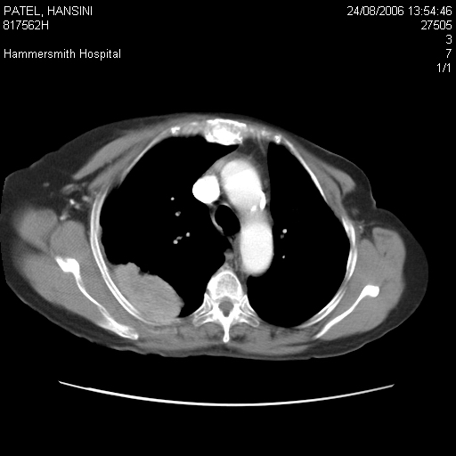
Pleural and lymph node metastases
Necrotic lymph node
Posterior necrotic mass
Right pleural
metastasis

Slide 33
Results
Efficacy:
  Good visualization of tumors in breast, pleura, lymph node, lung
  Hepatic metastases demonstrate low level of tracer uptake compared with surrounding normal liver
Safety:
  No any adverse event and serious adverse event was found in this group

Slide 34
Blood flow
Quantified using [15O]Water
Very short half-life
Independent prognostic feature in LABC (Dunnwald JCO 2008)
Varies with subtype in LABC (Specht CCR, 2010)

Slide 35
PET Water Images in Breast cancer
coronal
transverse

Slide 36
Apoptosis
Annexin V – detects asymmetric phosphatidylserine distribution,nonspecific, poorly distributed
Isatin analogues
Caspase 3/7 selective labelled with [18F]
Preclinical validation in RIF-1 sarcoma and lung cancer
Increases 2 fold in lymphoma xenografts 24 hrs post-treatment

Slide 37
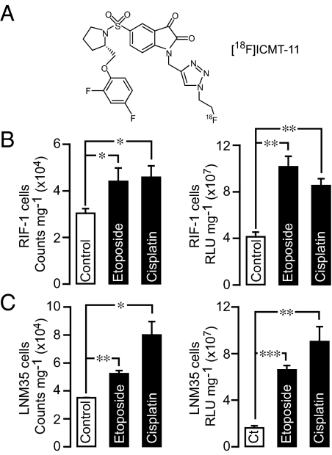
Nguyen PNAS , Sept 2009
ICMT-11 binding caspase 3 activity

Slide 38
Carcinoids
Standard imaging with SPECT
New somatostatin receptor analogues
[68]GA-DOTA-NOC – peptide binds to somatostatin receptors 2,3,5
Increased specificity

Slide 39
PET and Therapeutics

Slide 40
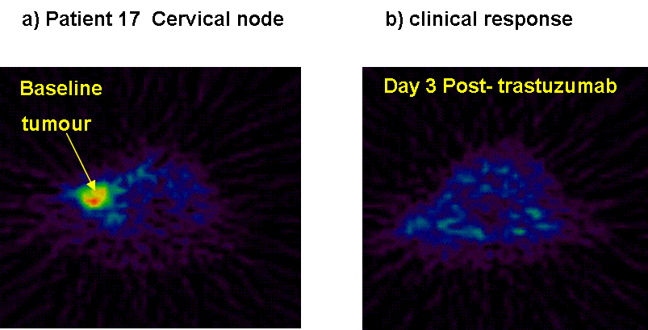
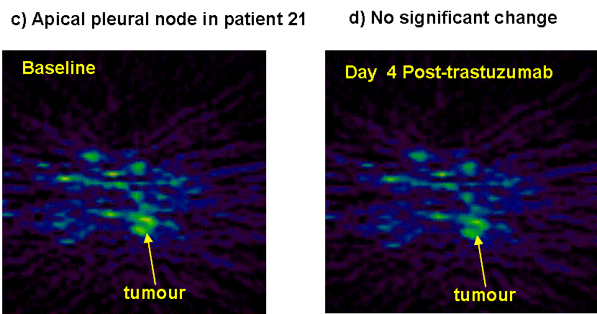
Using of generic radiotracers for PD imaging: [¹¹C]choline
Her2
EGFR
MAPKinase
CHOKinase
proliferation
Kenny et al Clin Canc Res 2010
Notes:
Provocative use of choline PET

Slide 41
PET microdose studies
10-15 years to take a drug to market
$1bn dollars
Clinical trials are becoming even more expensive
Many compounds fail phase 1 due to safety or poor pharmacokinetics

Slide 42
PET microdose studies
Administer subpharmacological dose of compound = nanmolar concentrations
Study pharmacokinetics using dynamic imaging

Slide 43
