Slide 1
Non-IgE mediated allergic reactions
21 Jan 2013
Stephen Till
Clinical Senior Lecturer/Consultant Physician in Allergy
King’s College London/Guy’s & St Thomas’ NHS Foundation Trust

Slide 2
Learning Objectives
To recognise that some patients complaining of ‘allergies’ have disease that is not IgE-mediated
To be able to describe some of the clinical features that differentiate IgE and non-IgE mediated 'allergies'
To be able to recall the features of some non-IgE reactions occurring commonly in clinical practice
To be able to describe in simple terms some examples of mechanisms of non-IgE mediated ‘allergic' reactions

Slide 3
IgE Mediated Allergy
Time from exposure to symptoms is usually rapid (minutes)
Small amounts of allergen > large reactions
Recurs with re-exposure
IgE can demonstrated by SPT or RAST
IgE Mediated Food Allergy
Non-IgE but Immunological hypersensitivity
Skin (urticaria, angioedema, eczema)
GI (vomiting, cramps, diarrhoea)
Resp (wheeze, stridor, nasal Sx)
CVS (hypotension, collapse)
Food induced enteropathy (coeliac disease)
Allergic eosinophilic gastroenteritis
Contact dermatitis
Idiosyncratic
May look like IgE Mediated Food Allergy but isn’t (examples)
e.g. Irritable bowel syndrome, Chronic fatigue syndrome
Non Immunological Food Intolerance
Chronic urticaria/angioedema (may be autoimmune, cholinergic, genetic, idiopathic etc)
Idiopathic anaphylaxis
Toxic effect: e.g. sulphites, drugs, schromboid reaction
Pharmacological (caffeine, nitrites)
Metabolic (lactase deficiency > milk intolerance)

Slide 4
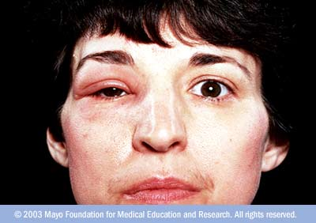
RN – Allergy Clinic referral from GP
50 yrs ♀ Professional musician
Episodic facial swelling for 3 months
PC

Slide 5
HPC cont/d
Starts early morning while still in bed
Associated with itch and erythema
Lasts between 2 and 3 days
Only ever R side of face
Onset coincided with anniversary of mother’s death
Dyspepsia for 4-6 weeks
PMH
Gastritis 2004
Globus hystericus 1998
Hayfever
Childhood asthma
Other Q?

Slide 6
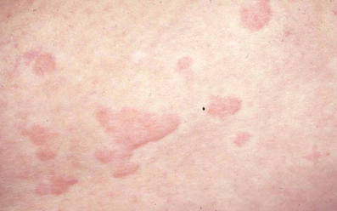
Angioedema
Lifetime incidence: 10-15% of population
Painless, well defined areas of oedema
Due to vascular permeability
Usually face, lips, mouth (but also any part of body)
In severe cases: LARYNX > Obstruction >
Can involve bowel > abdominal pain
Natural history variable
Can be associated with:
urticaria

Slide 7
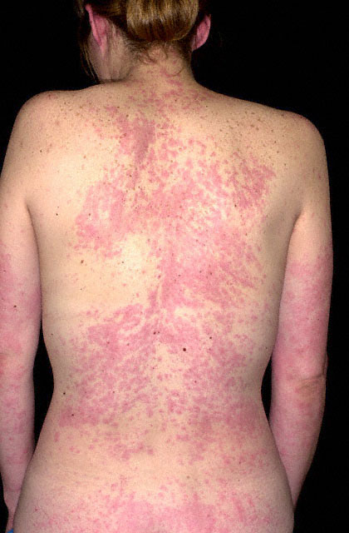
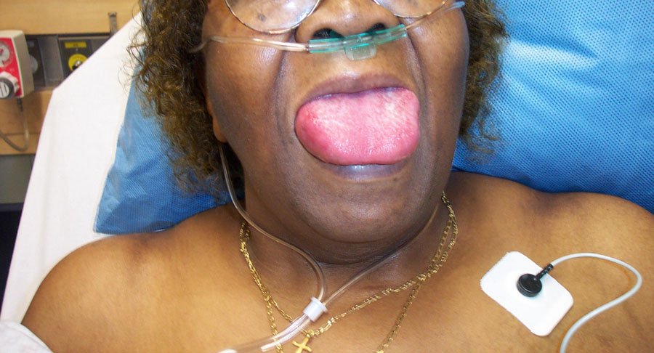
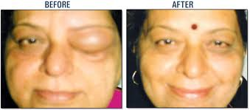
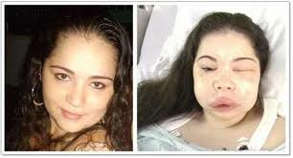
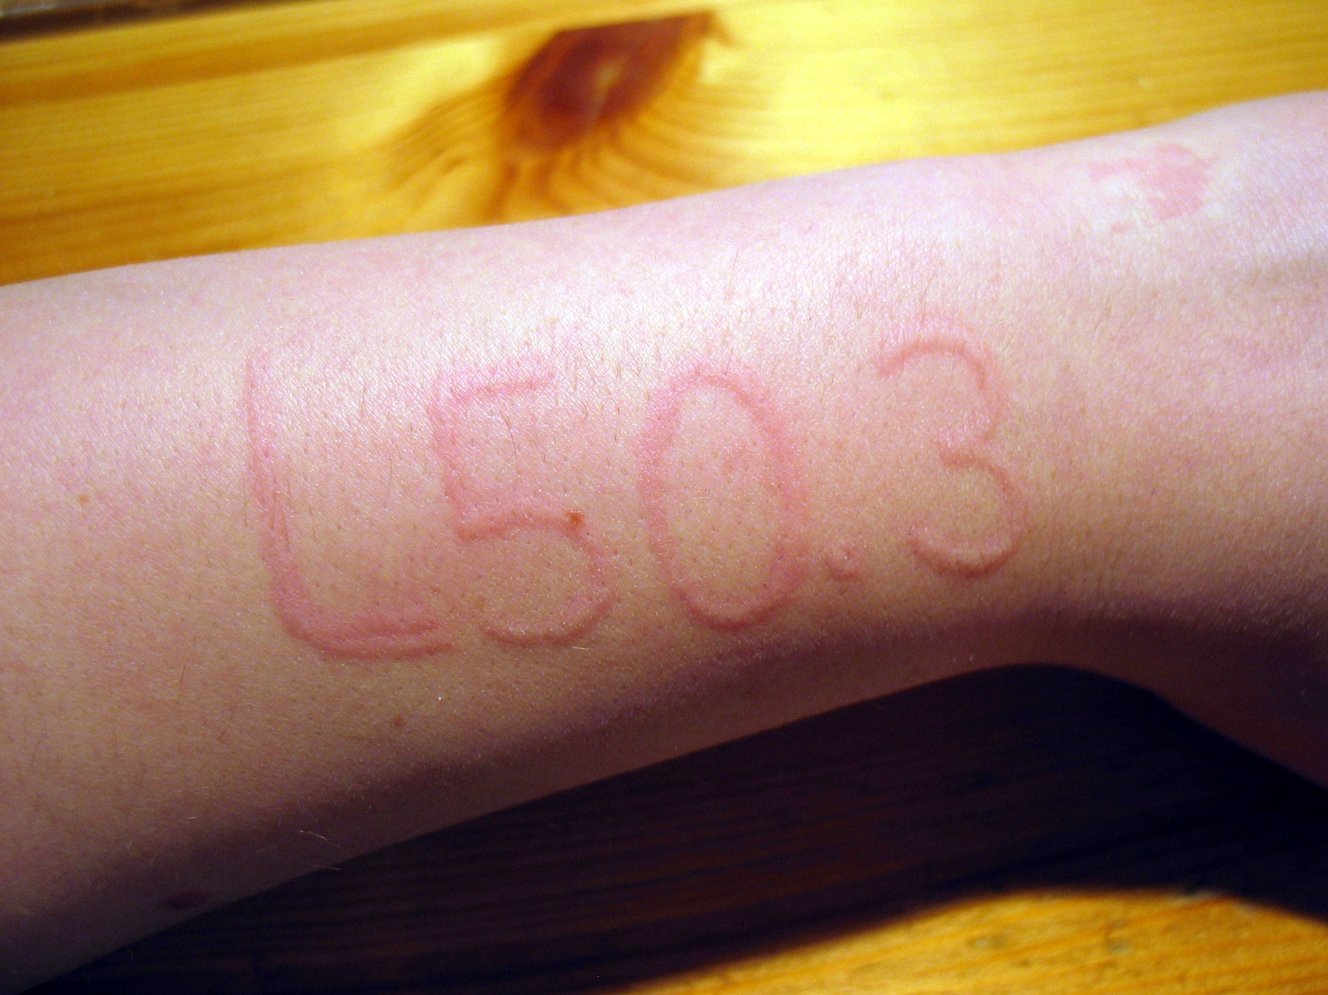
Urticaria
Angioedema
Superficial
Deep

Slide 8
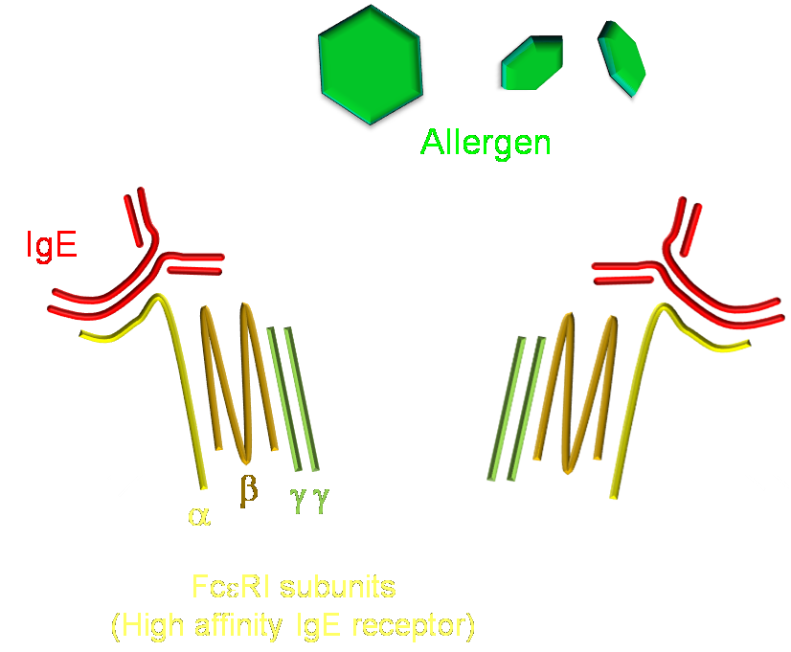
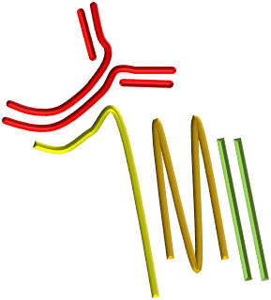
Activation of Mast Cells by Allergen
PLCγ
PLA₂
DAG
InsP₃
ARACHIDONIC ACID
CYTOKINE GENE EXPRESSION
PKC
Ca²⁺
LTC₄, PGD₂
DEGRANULATION

Slide 9
Activation of Mast Cells by anti-FcεR1 auto-antibody
PLCγ
PLA₂
DAG
InsP₃
« Autoimmune urticaria »
ARACHIDONIC ACID
CYTOKINE GENE EXPRESSION
PKC
Ca²⁺
LTC₄, PGD₂
DEGRANULATION

Slide 10
Allergen-Independent Mast Cell Activation
SCF (stem cell factor)
Microbial components e.g. LPS
c-kit (RTK)
Toll like receptor 4
mast cell proliferation
Enhances degranulation
FcεR1
Intrinsic mast cell releasing activity
Opioids
Muscle relaxants
Radiocontrast media
Auto-antibodies

Slide 11
Allergen-Independent Mast Cell Activation
SCF (stem cell factor)
Microbial components e.g. LPS
c-kit (RTK)
D816V point mutation
Toll like receptor 4
mast cell proliferation
Enhances degranulation
FcεR1
Intrinsic mast cell releasing activity
Opioids
Muscle relaxants
Radiocontrast media
Auto-antibodies

Slide 12
Microbial components e.g. LPS
c-kit (RTK)
D816V point mutation
Acute urticaria
(classically during URTI, Strep throat)
Systemic Mastocytosis
Possibly also Idiopathic anaphylaxis
Chronic urticaria/angioedema
“allergic reactions”
Opioids
Muscle relaxants
Radiocontrast media
Auto-antibodies

Slide 13
No urticaria
Hereditary
IgE-mediated
Foods (nuts, fruits, seafood)
Bee/wasp stings
C1 esterase inhibitor deficiency
Acquired
Auto-Abs to C1-Est inh
Consumption (lymphoma)
No urticaria
ANGIOEDEMA
Drugs (>90 of A&E cases)
Autoimmune
ACE inhibitors
NSAID
or
Idiopathic
? stress
? trauma
? Helicobacter pylori infection

Slide 14
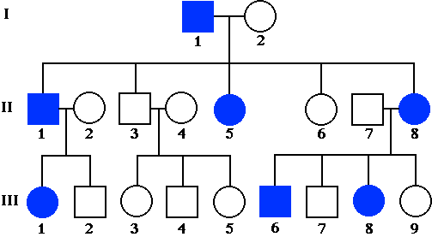
Hereditary Angioedema

Slide 15
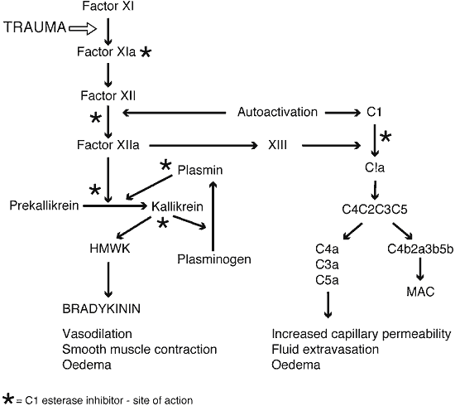
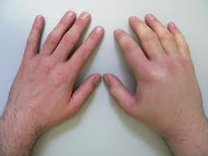
Hereditary Angioedema
(congenital C1-esterase inhibitor deficiency)

Slide 16
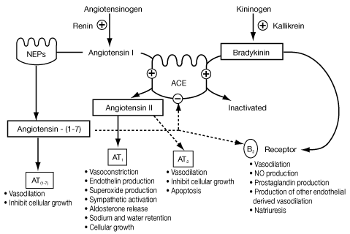
Kinin system: blood proteins that plays a role in inflammation, blood pressure control, coagulation and pain
C1-esterase
Inhibitor
inhibits
Kallikrein
ACE inhibitors
e.g. ramipril

Slide 17
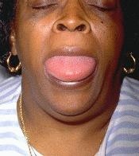
Lingual angioedema in a patient taking enalapril for 2 years
Alternative drug?

Slide 18
Urticaria
Angioedema
Possibly idiopathic urticaria and angioedema but consider ACE-I
Likely ACE-I
‘Ordinary’ urticaria
(? Allergic, autoimmune, infection, idiopathic)
Dermographism
(physical urticaria)
Hereditary angioedema
Superficial
Deep

Slide 19
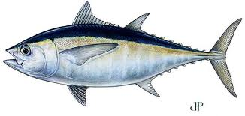
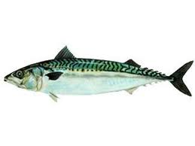
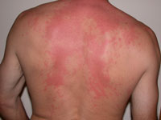
Toxic effect: schromboid reaction
Poorly preserved oily fish (e.g. tuna)
Bacterial decarboxylation of histidine
Histamine content may be increased > 100-fold
(fish tastes funny)
Tachycardia, erythematous flush w/o urtication

Slide 20
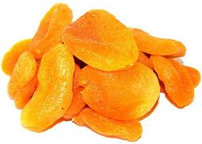
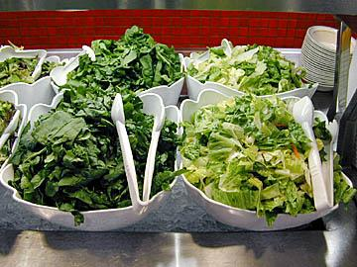
Sensitivity to Sulphites (1)
Anti-oxidant used as preservative
Sensitivity affects 1:100
5% of asthmatics react
Uncommon in non-atopic non-asthmatics

Slide 21
Sensitivity to Sulphites (2)
Clinical feaures
Bronchospasm - “wine sensitive asthma”
Flushing/feeling of temperature change
Vomiting
Difficulty swallowing
Dizziness
Contact dermatitis

Slide 22
Sensitivity to Sulphites (3)
Mechanism?
? Non-IgE dependent mast cell degranulation
? Sulphur dioxide produced in stomach > inhaled > bronchospasm

Slide 23
Learning Objectives
To recognise that some patients complaining of ‘allergies’ have disease that is not IgE-mediated
To be able to describe some of the clinical features that differentiate IgE and non-IgE mediated 'allergies'
To be able to recall the features of some non-IgE reactions occurring commonly in clinical practice
To be able to describe in simple terms some examples of mechanisms of non-IgE mediated ‘allergic' reactions

