Slide 1
Neonatal immunology
Fiona Culley
f.culley@imperial.ac.uk

Slide 2
Learning Outcomes
You should have an understanding of –
Current hypotheses regarding the association of neonatal experiences with long term respiratory health
The importance of respiratory infections in early life
The mechanisms underlying failure of vaccination in neonates
How B cell, T cell and antigen presenting cell responses differ in neonates

Slide 3
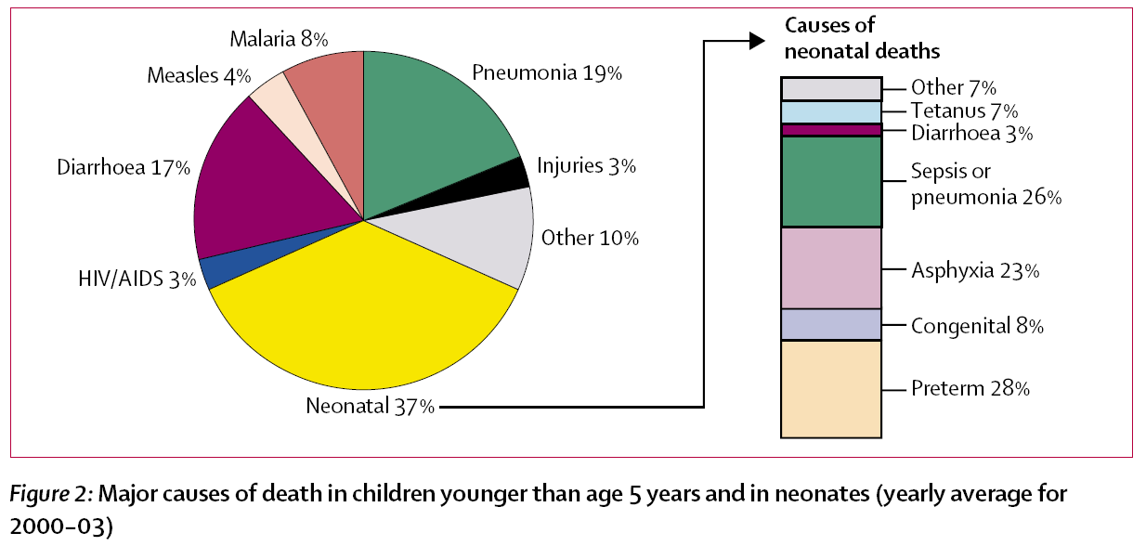
The Influence of Early Life on Respiratory Health: 1. Infections
Infectious disease is the major cause in deaths in under 5s
Malnutrition is a major underlying contributor to these deaths.
Bryce et al. WHO estimates of the causes of death in children, The Lancet (2005) 365: 1147–52

Slide 4
Major Pathogens in Young Children
Measles Virus
Respiratory Syncytial Virus (RSV)
Bortetella pertussis
Streptococcus pneumoniae
Haemophilus influenzae b (Hib)
Rotavirus
Salmonella
Malaria
HIV
Black et al Where and why are 10 million children dying every year?
Lancet 2003; 361: 2226–34

Slide 5
Respiratory Illnesses per Person per Year
7
6
5
4
3
2
1
0
Females
Males
Mean annual incidence
<1
1–2
3–4
5–9
10–14
15–19
20–24
25–29
30–39
40–49
50–59
>60
Age group (yr)
Monto AS, Ullman BM. JAMA. 1974;227:164
(data from Tecumseh, Michigan, 1965–1971)

Slide 6
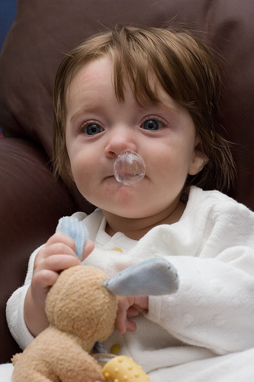
Common colds
Respiratory Infections mostly lead to common colds (URTI)
Pre-school children get 6-10 colds per year - Adults 2-5
Colds cause 17% of GP consultations
Annual expenditure on cold remedies: about $2 billion per year in the USA
The main agents of respiratory infection have many strains/subtypes
Mostly viral 75%, bacterial 25%

Slide 7
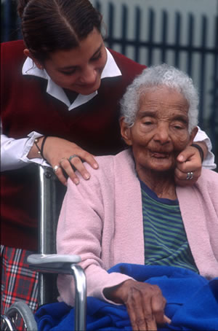
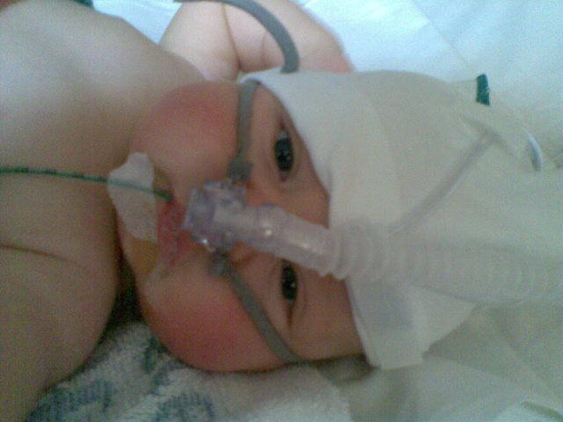
Clinical importance of RSV
The Old
Increasing importance
Aging population
Often fatal
The young
All get RSV by 2 yrs old
Highest risk 1-6 months
Largest single cause of hospitalisation in infancy
Leads to bronchiolitis

Slide 8
Age incidence of bronchiolitis
80
70
60
50
40
Number of cases
30
20
10
0
0
4
8
12
16
20
24
Age (months)
Data from Parrott et al Am J Epidemiol 1973; 98:289

Slide 9
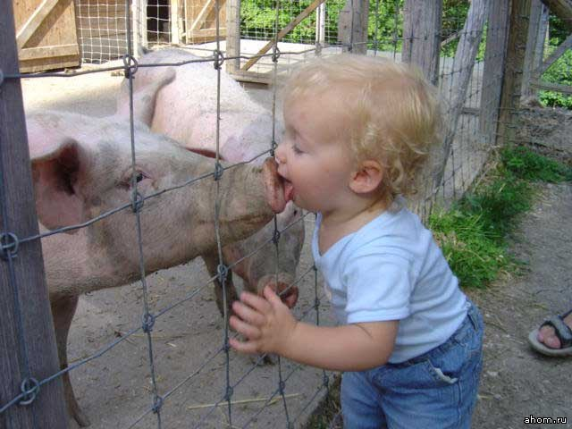
Respiratory Infections
Children get more respiratory viral infections
Disease often more severe (eg. bronchiolitis)
They also act as vectors of disease
Understanding neonatal immunology may help us to understand why children are more susceptible to infection
Notes:
One of the first precautions re-

Slide 10
Wheezing and asthma after RSV hospitalisation
% of group
Bronchiolitis
No bronchiolitis
Sigurs N et al. Pediatr 1995; 95:500-05., Sigurs N, et al. Am J Respir Crit Care Med 2000;161:1501-07. Sigurs N, et al. Am J Respir Crit Care Med 2005;171:137-41.

Slide 11
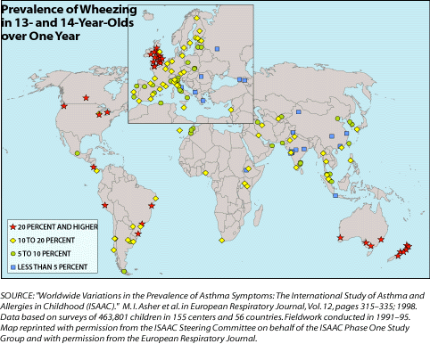
2. The modern environment
Asthma was rare in 1900, but now it has grown into an epidemic: more than 150 million are affected around the world. Every year it kills 180,000 worldwide.

Slide 12
Epidemiology: The hygiene hypothesis
Children from large families or raised on farms are at reduced risk of developing:
  Hay fever
  Eczema
  Allergen sensitisation
  Immunological mechanisms?

Slide 13
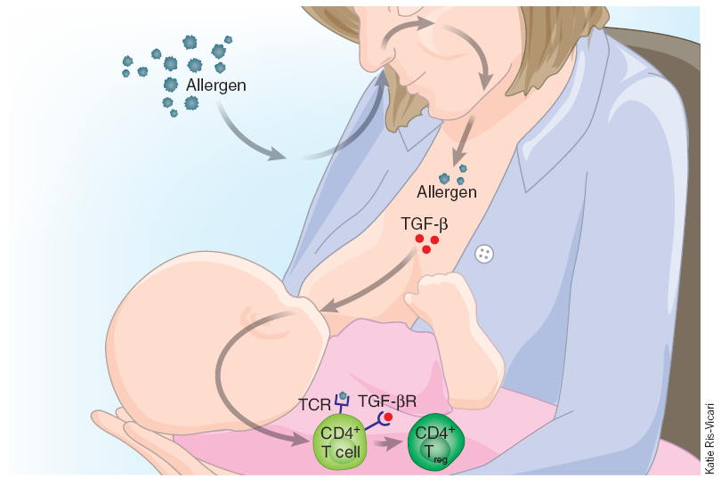
3. Tolerogenic Effects of Breast Milk
Breast feeding is believed to protect against allergy and wheeze. Mouse studies have demonstrated that regulatory T cells are induced after ingestion of allergen and TGFβ in breast milk, rendering offspring tolerant to the allergen.
Friedman and Zeiger, J Allergy Clin Immunol 2005;115:1238-48;Verhasselt et al Nature Medicine (2008) 14 (2): 170

Slide 14
4. Microflora
Differences in microflora are associated with different diseases eg allergy and inflammatory bowel disease (most studies are on gut flora).
There is growing evidence that microflora can influence development of disease.
Microbiota can be sufficient to transfer disease eg
Tbet-/- RAG2-/- (TRUC) mice transfer colitis to co-housed wild type mice.

Slide 15
Active interaction between host microbiota and immune response
The host innate immune response influences the bacteria...
eg Myd88 − / − mice or Nod1 − / − mice exhibit dramatic changes of the composition of gut microbiota.
The bacteria influence the host...
eg Some can promote Tregs.
A symbiosis factor (PSA, polysaccharide A) of B. fragilis signals through TLR2 directly on Foxp3+ regulatory T cells to promote immunologic tolerance. B. fragilis lacking PSA is unable to restrain T helper 17 cell responses and is defective in niche-specific mucosal colonization.
PSA is a “symbiont-associated molecular patterns (SAMPs)”
Round et al Science May 2011

Slide 16
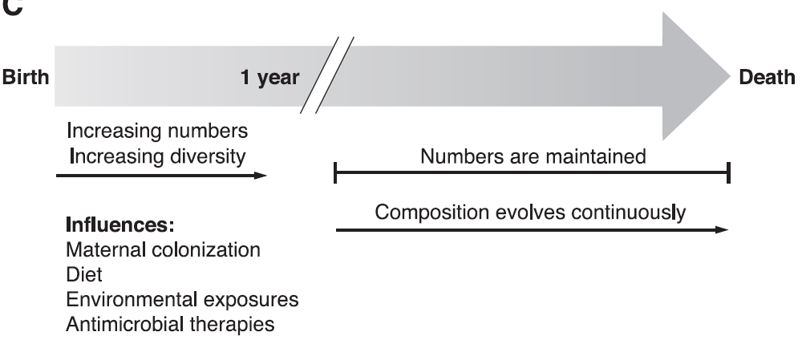
Acquisition of the microbiota
Microbiome is acquired from the mother during birth and from random environmental encounters. Stabilises at about 1 year old.
This may be influenced by delivery route, breast feeding, diet, antibiotics and cleanliness of the environment (controversial).
According to Hill and Artis, bacteria in the gut undergo two main phases of colonisation – during breast feeding and upon weaning. In mice the immune response to colonisation of the gut peaks within a week of birth and stabilises over the first year of life.
Sekirov et al Physiol Rev 2010

Slide 17
Microbiome of the Lung
Bronchial tree is not sterile but contains a mean of 2,000 bacterial genomes per cm² surface
A rich microbial environment in infancy protects against asthma.
Caesarian section, early life antibiotic use are associated with asthma.
The microbiome is altered in COPD and asthma (Hilty, Mowat, Cookson 2010).
Neonates colonized in the hypopharyngeal region with S. pneumoniae, H. influenzae, or M. catarrhalis, or with a combination of these organisms, are at increased risk for recurrent wheeze and asthma early in life. (Bisgaard et al NEJM, 2007).
Differences in the composition of the gut flora between infants who will and infants who will not develop allergy are demonstrable before the development of any clinical manifestations of atopy. (Björkstén B et al , JACI, 2001)
Taken together this suggests that bacterial colonisation of the airways may influence respiratory health.
Notes:
(Penders et al Eur Respir J, 2011. Vael, C., et al., BMC Pulm Med, 2008; Renz-Polster, H., et al. Clin Exp Allergy, 2005. Penders, J., et al., J Allergy Clin Immunol, 2010.)

Slide 18
5. Neonatal Vaccination
Many commonly used vaccines are ineffective if administered during infancy - they do not protect and generate weak, short-lived or inappropriate immune responses.
Currently only three vaccines given at birth:
oral polio vaccine, hepatitis B virus vaccine
and bacille Calmette-Guerin (BCG)

Slide 19
Maternal Antibodies
Window of susceptibility
1600
400
100
<100
Reciprocal antibody titre
1 2 3 4 5 6 7 8 9 10 11 12 >12
Age (months)
Data from Richardson et al Infect Immunol 1978; 20:660
Notes:
Why high at 1-2 months?

Slide 20
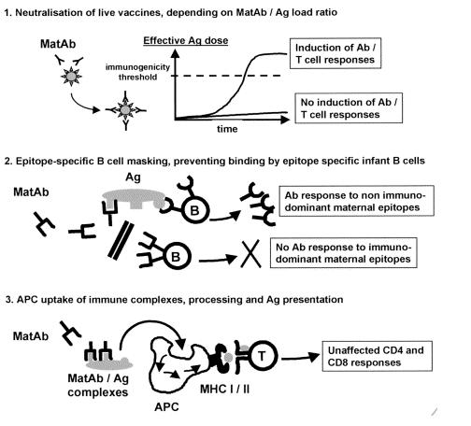
Neonatal Vaccination: Influence of maternal antibodies on induction of vaccine responses
Siegrist CA Vaccine (2001) 19 : 3331-46
Notes:
Antigen is rapidly cleared
Important epitopes are masked and cannot be taken up by appropriate antigen R bearing B cells
(3) Ag up take via Fc receptors can still allow for presentation to T cells, which may at least mean some memory T cells are induced, even if the B cell memory isn’t

Slide 21
Neonatal Vaccination: MEASLES
Despite the availability of a vaccine, measles still ranks as one of the leading causes of childhood mortality worldwide.
42 million cases of measles annually.
1 million annual fatalities from measles and its complications.
Infants become susceptible to infection as soon as maternal measles antibodies have disappeared (from 6mths)
Vaccine is usually administered at 12-15 mths old.

Slide 22
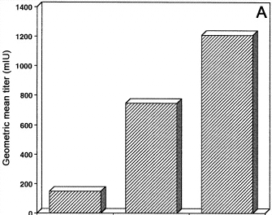
Neutralizing antibody responses of infants after measles immunization in the absence of maternal Ab
6 mths 9 mths 12 mths
Age at Immunisation
Gans et al, JAMA. 1998;280:527-532

Slide 23
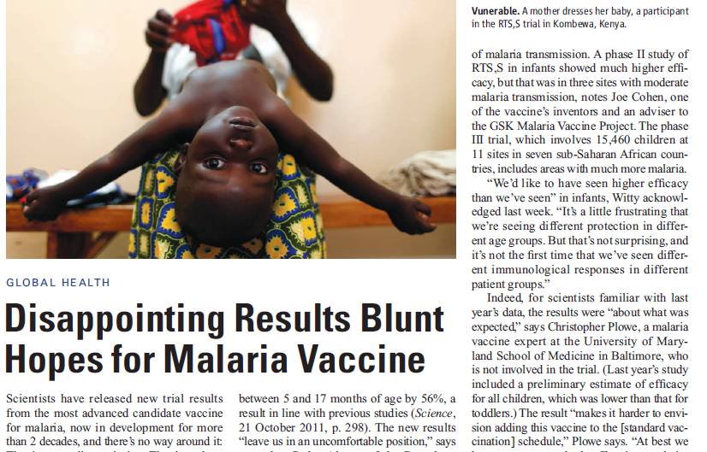
“Possible explanations include the younger babies’ less-developed immune systems, interference from maternal antibodies that babies carry in their first months of life, and interactions with other vaccines administered at the same time.”
Science Nov 2012

Slide 24
The Neonatal Respiratory Tract
Respiratory infections are the major cause of infant mortality and hospitalisation.
Long-term respiratory health may be strongly influenced by neonatal experiences:
- Breast feeding, microflora, exposure to environmental factors and microbial components may be important for preventing allergy and asthma.
- Some infections (RSV) may predispose to the development of asthma.
Notes:
The lung undergoes much of its maturation post partum

Slide 25
Why study neonatal immunology?
To understand how the immune system develops
To understand why the young are more susceptible to infection and the development of allergy.
To understand how external influences can shape our developing immune system.
To manipulate the immune system to promote protection against infectious disease (vaccination) and allergy.

Slide 26
Studying Neonatal Immunology
Murine Models
One week old pups are considered to be similar to new born humans in terms of their immunological maturity. Neonate <7d old.
Human Studies
Ethically difficult to get hold of blood or tissues from newborns. Many studies carried out on cord blood.
Neonate <28d old.

Slide 27
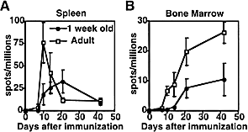
Neonatal B-cell response is delayed and deficient
Antibody secreting cell frequency in the spleen and bone marrow following immunisation of 1 week old mice with TT and Al (OH)₂

Slide 28
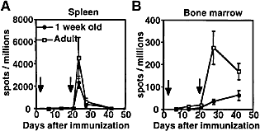
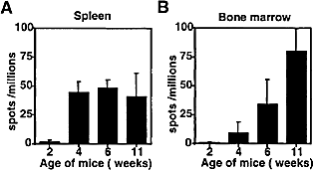
Mice immunised as neonates respond poorly to boosting
Boosting Antibody secreting cells
Secondary immunization fails to correct limitation of bone marrow antibody secreting cells in early life.
Total IgG secreting cells
Neonates lack B-cell follicles in the spleen and bone marrow
Pihlgren et al, European Journal of Immunology 2001. 31: 939

Slide 29
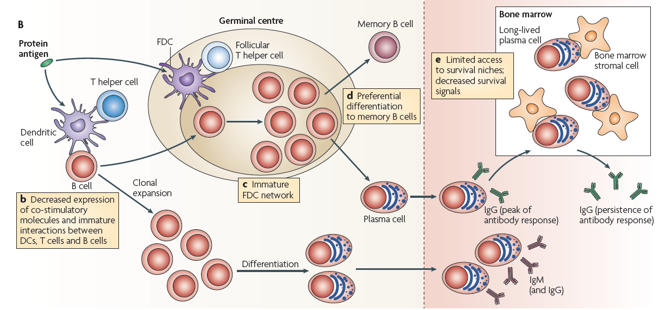
Early-life Limitations of B-cell responses
Siegrist and Aspinall, Nature Reviews Immunology, 2009
Notes:
Some ‘defects’ are B cell intrinsic

Slide 30
Summary: Neonatal Antibody Response
Delayed and weaker IgG response
Poor affinity maturation
Rapid decline of Ab production
Preferential memory cell production, but short lived
Lower responses to polysaccharides
Maternal antibody may interfere

Slide 31
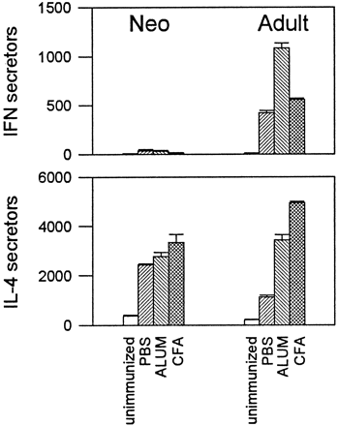
Mouse: Spleen T-cell responses are Th2 - biased in neonates
ELISPOT analysis in spleens following immunization with Ag in adjuvants.
Mice were immunized with KLH in PBS, CFA, or ALUM.
Adkins B et al, J. Immunol. (2000) 164:2347.

Slide 32
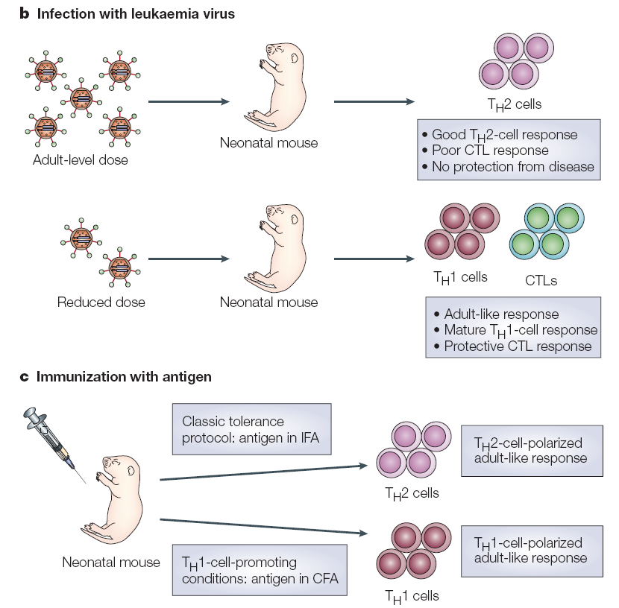
Under certain circumstances neonates can produce adult-like responses
Dose
Adjuvant
BCG vaccination works in newborns
Adkins et al Nature Reviews Immunology (2004) VOLUME 4: 553

Slide 33
Is ‘defect’ at the level of the T-cell or its environment?
Environment:
Neonatal T-cells are able to resolve P. carinii infection when transferred into adults, whereas neonates are not, suggesting the neonatal environment is preventing T-cell function (Qureshi and Garvy, 2001).
T-cells:
T-cells are still Th1 deficient when transferred into adults (Adkins et al . 2002).
The IFNγ promoter is differentially methylated, suggesting different gene regulation in neonatal T-cells (White et al, 2002)

Slide 34
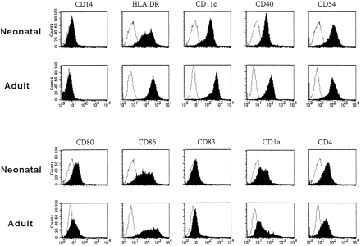
Human Neonatal Cord Blood-derived Dendritic Cells are deficient in Co-receptor expression
Goriely et al The Journal of Immunology, 2001, 166: 2141-2146.

Slide 35
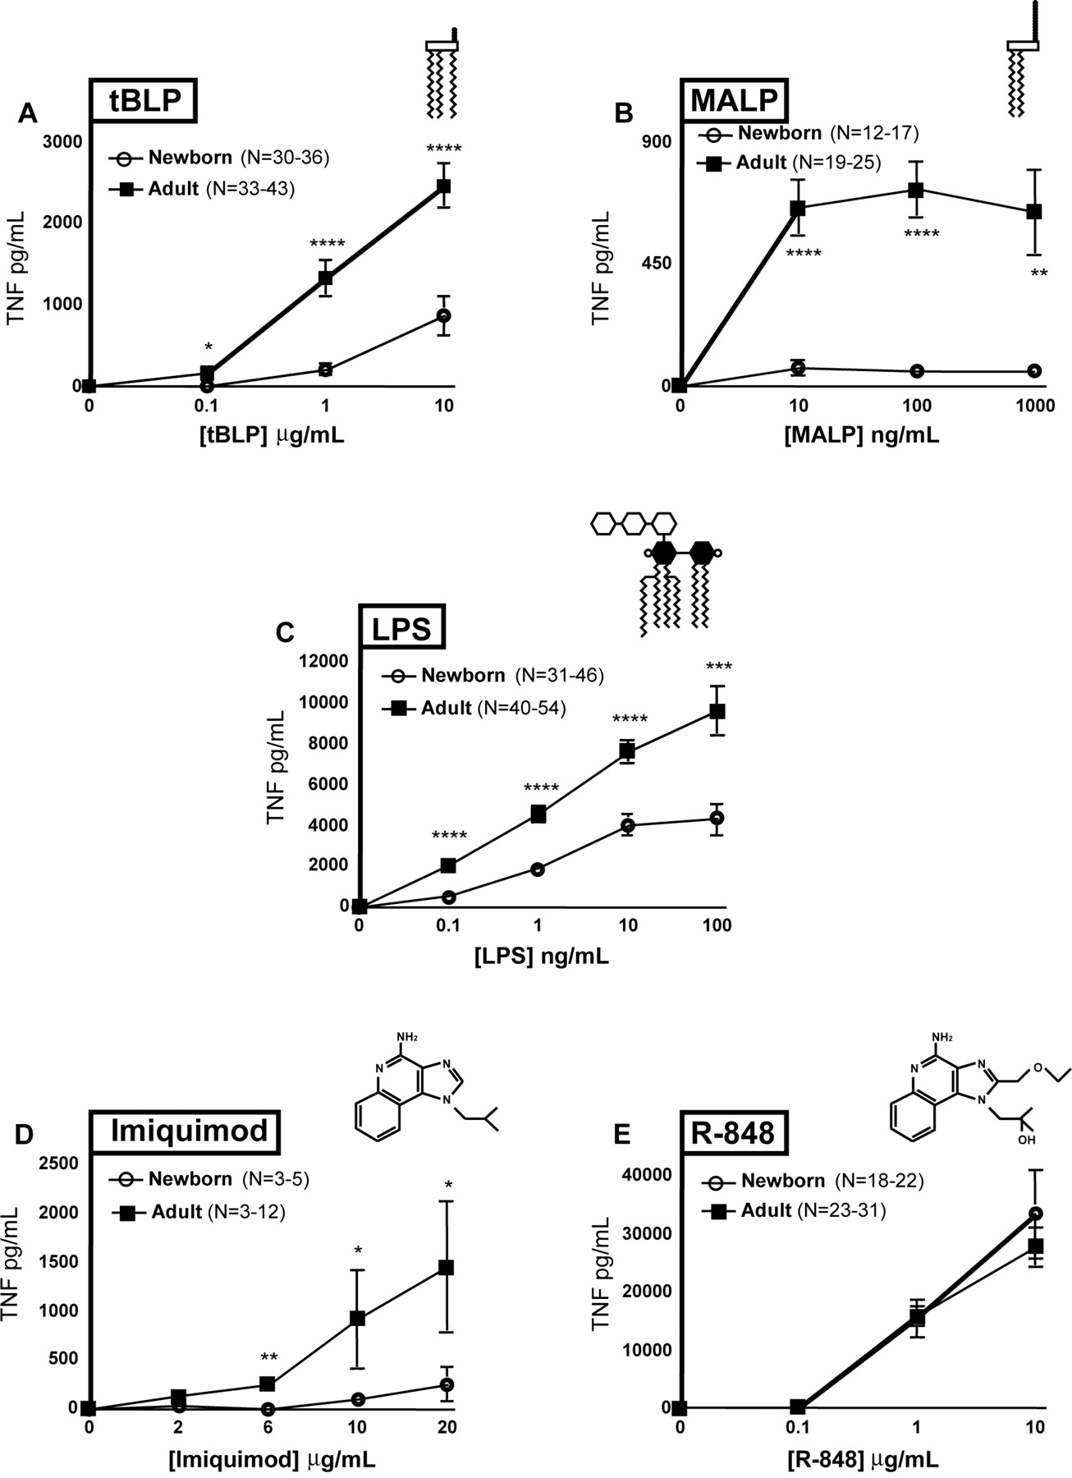
Toll like Receptors
TLR1/2
TLR2/6
TNF responses in neonates are less than adults
Human neonatal cord blood monocytes
TLR 4
TLR7
TLR7/8
From Levy et al JI 04

Slide 36
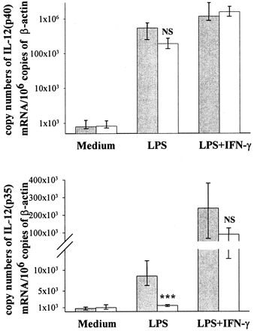
Neonatal DCs are deficient in IL-12 p35 production in response to LPS, CD40 ligation, or poly(I:C)
Goriely ey al The Journal of Immunology, 2001, 166: 2141-2146.

Slide 37
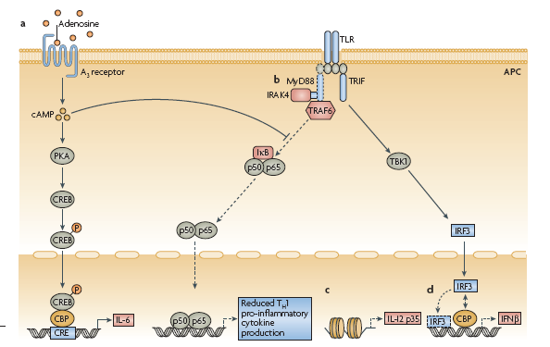
Differences in Neonatal APC
Chromatin
Levy. Nature Reviews Immunology VOLUME 7 | MAY 2007 | 379
Notes:
Figure 3 | Mechanisms for distinct function of human neonatal monocytes and antigen-presenting cells.
a | High concentrations of adenosine, an endogenous immunomodulatory purine metabolite, in neonatal blood plasma
act through adenosine A3 receptors on neonatal mononuclear cells to induce high (~20-fold greater than adult levels)
intracellular concentrations of cyclic AMP (cAMP). cAMP is a secondary messenger that, through both protein kinase A
(PKA)-dependent and PKA–independent pathways, can inhibit Toll-like receptor 2 (TLR2)-mediated tumour-necrosis factor
(TNF) production while preserving production of interleukin-6 (IL-6). b | Neonatal monocytes have diminished expression of
myeloid differentiation primary-response gene 88 (MyD88), a key adaptor molecule for TLR-mediated signalling. c | Failure
of nucleosome remodelling of the Il12p35 gene promoter contributes to diminished TLR-mediated IL-12 p35 production
by neonatal dendritic cells (DCs), an example of distinct regulation of neonatal cytokine production at the chromatin level.
d | Lipopolysaccharide (LPS)-induced association of interferon (IFN)-regulatory factor 3 (IRF3) with cAMP-responsiveelement-
binding protein (CREB)-binding protein (CBP) and IRF3 binding of DNA are reduced in human neonatal
monocyte-derived DCs, resulting in impaired expression of IFNβ. AP1, activator protein 1; NF-κB, nuclear factor-κB;
TBK1, TANK-binding kinase 1; TRAF, TNFR-associated factor; TRIF, TIR-domain-containing adaptor protein inducing IFNβ.

Slide 38
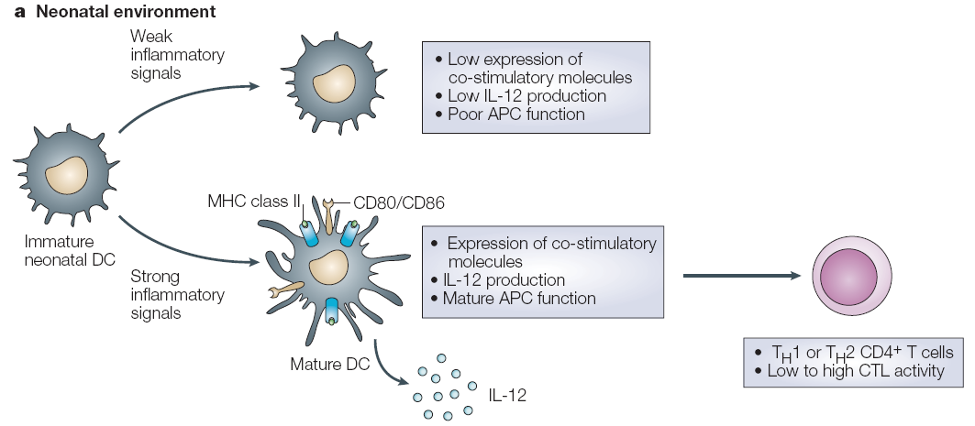
Neonatal Dendritic Cells
Low numbers
Poor responses to TLR ligands
Adkins et al Nature Reviews Immunology (2004) VOLUME 4: 553

Slide 39
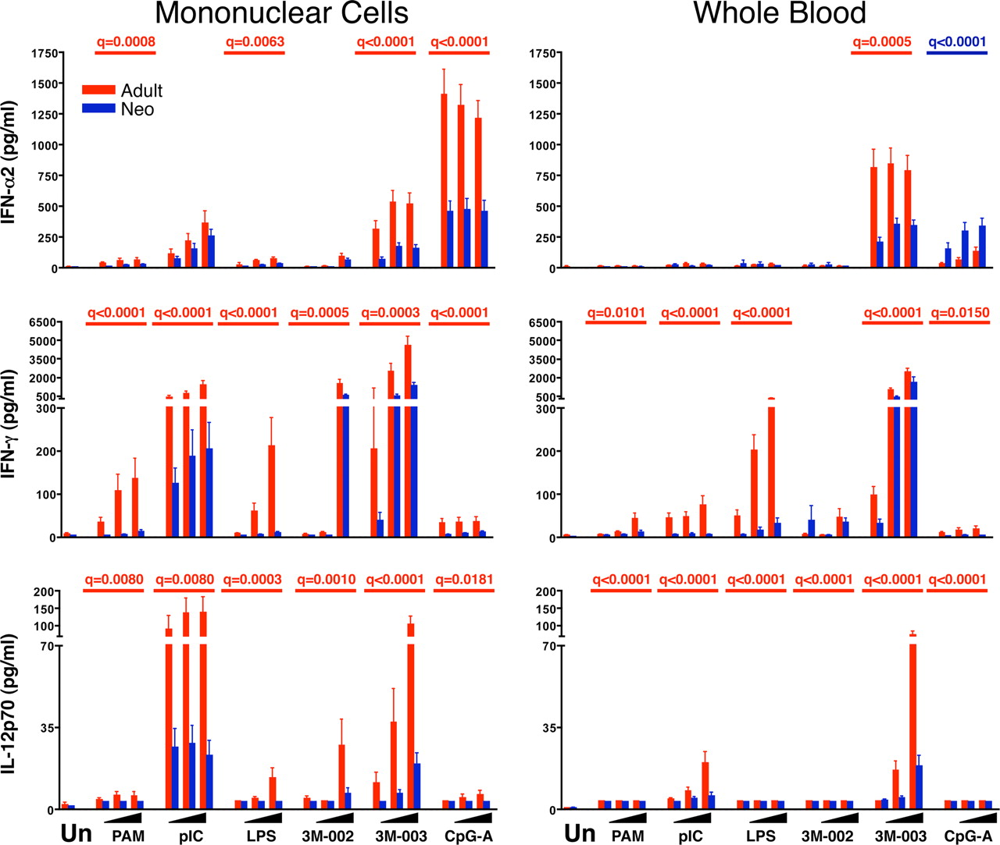
Neonate blood cells– lower IL-12, IFNα and IFNγ responses to TLRs…
Kollmann et al J Immunol. (2009) 183(11):7150-60.

Slide 40
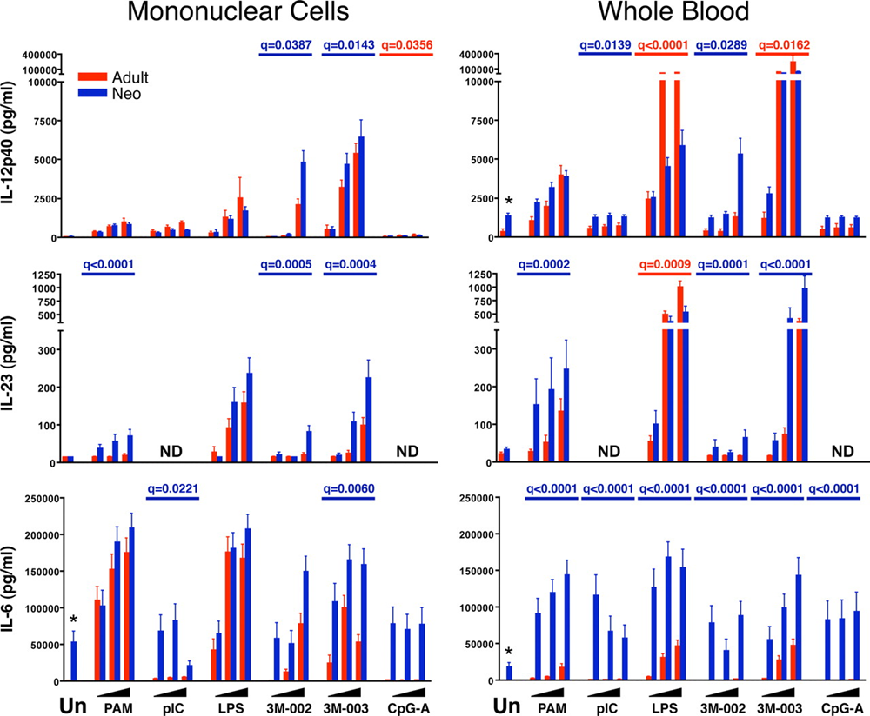
…but higher Th17 promoting cytokines (IL-23, IL-6)
Good for protection against extracellular pathogens?

Slide 41
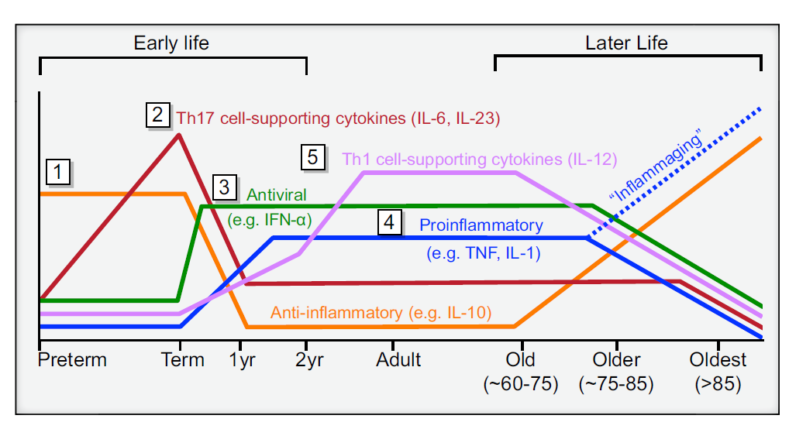
Age dependent changes in TLR-induced immune regulatory function
Kollmann et al Immunity 37:771 (2012)

Slide 42
Why are neonates different?
The fetus is an allograft onto the mother and is at risk of rejection, so there is a strong T helper 2 (T_{H}2) and Treg cell bias to fetal immune responses, a tendency also initially manifest in the newborn.
Advantages -
At birth the neonate leaves a sterile environment and moves to a microbe rich one. Neonates must establish tolerance to environmental antigens, including microflora. Avoids over-exuberant and potentially harmful reactions.
Inflammatory responses can be inherently dangerous to postnatally developing tissues, such as the lungs.
Adkins et al (2004) Nature Reviews Immunology 4: 553
Levy (2007) Nature Reviews Immunology 7, 379-390
Notes:
So neonates must balance this with the need to protect against infections

Slide 43
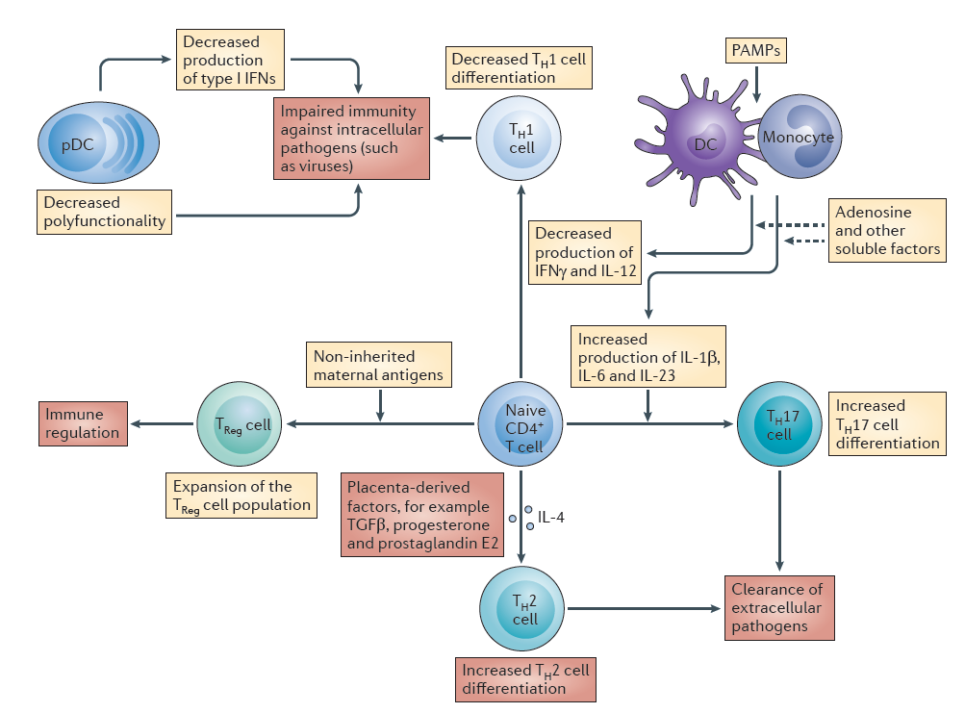
Prendergast et al Nature Reviews Immunology (2012) 12: 636-648

Slide 44
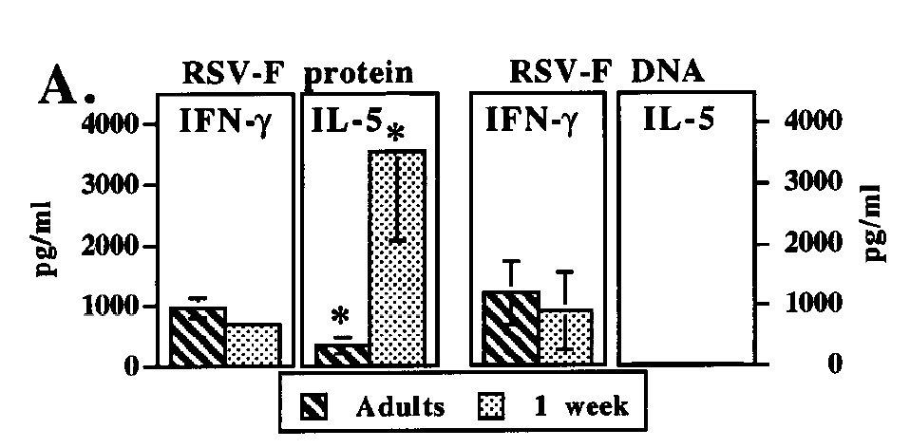
New Vaccine Strategies
The ideal vaccine would be a single dose given at birth, preferably avoiding injections and providing immediate and long-lasting protection against multiple diseases.
(Wood and Siegrist, Curr Op Infect. Dis 2011, 24:190.)
The challenge is to develop novel vaccine strategies that overcome maternal antibody and weak neonatal responses. Novel adjuvants (not alum) may be the key.
DNA Vaccination

Slide 45
Alternative vaccine strategies
Vaccinate mothers to provide protective immunity during infancy
Create ‘herd immunity’ by vaccinating population at large

Slide 46
Summary 1
The neonatal period is important -
Increased susceptibility to infection
Acquisition of tolerance to environmental Ag
Acquisition of microbiome
Long term influence of environment/ infections on development of asthma/allergy (hygiene hypothesis)

Slide 47
Summary 2
Neonatal immune system –
Vaccination often ineffective in neonates
Ab responses delayed, weaker, low affinity, poor memory
T cells – Th2/Treg biased
APC – Low IL-12, lower responses to TLRs

Slide 48
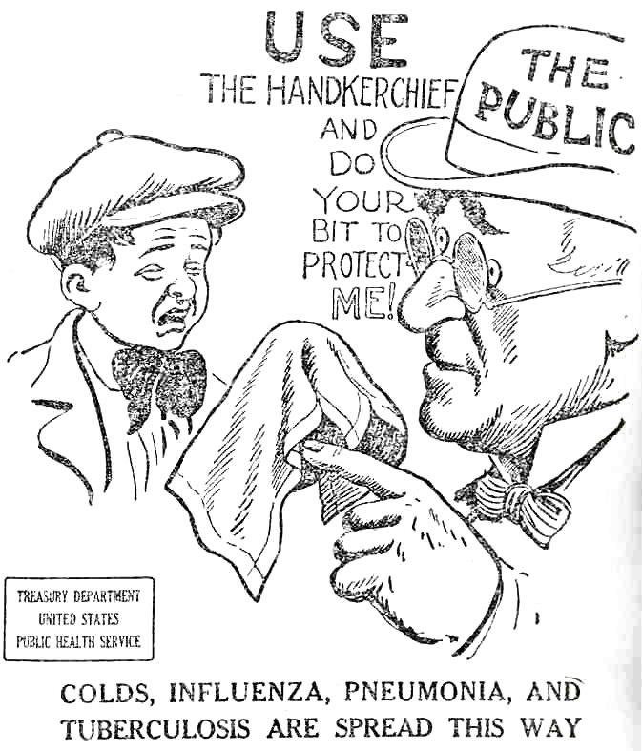
USA 1918 advertising campaign

