Slide 1
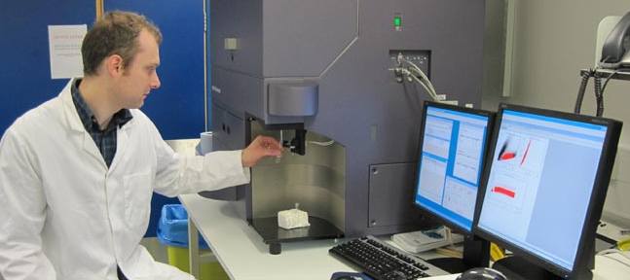
Flow cytometry 14/1/2013
Nazanin.farhadi09@ic.ac.uk

Slide 2
Learning objectives
By the end of this lecture you will be able to:
Describe the principles of flow cytometry
Evaluate and critically analyse flow cytometric data
List at least 3 applications of flow cytometry
Understand the different methods used to stain cells
prior to flow cytometric analysis

Slide 3
What is flow cytometry?
Flow cytometry is the measurement of specific characteristics of cells whilst they are in suspension.
Principles: Cells flow in single file past lasers where they scatter light and emit fluorescence.
Cell size, granularity and fluorescence can be measured.
These parameters are collected, converted to digital values and stored on a computer.
Allows sorting of cells.

Slide 4
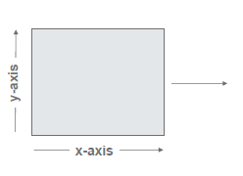
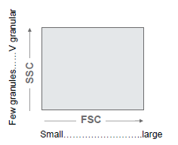
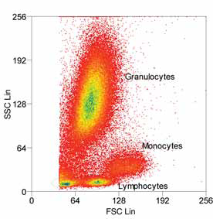
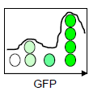
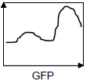
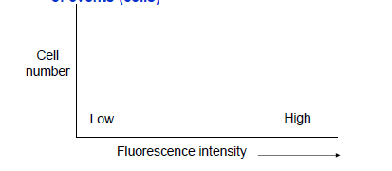
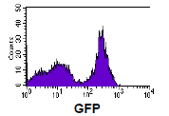
Flow cytometry measures:
Relative size: Forward scatter (FSC)
Relative granularity: Side scatter (SSC)
Relative fluorescence intensity (eg. GFP)

Slide 5
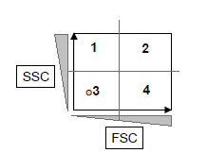
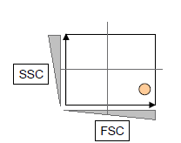
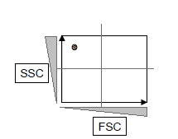
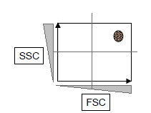
SSC
SSC
Laser
FSC
Laser
FSC
Samples
Samples
Small, not granular
Large, not granular
SSC
SSC
Laser
FSC
Laser
FSC
Samples
Samples
Small, granular
Large, granular

Slide 6
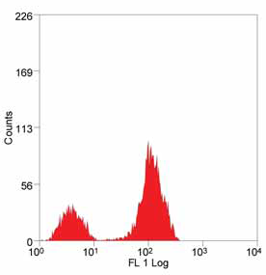
Measurement of Fluorescence
Flow cytometry allows measurement of fluorescence when cells:
are expressing a fluorescent protein e.g. Green Fluorescent Protein (GFP)
have a fluorescent dye inside them e.g. CFSE
have a fluorochrome labelled antibody bound to them (allow detection of specific markers e.g. CD4)
Detectors
Filters
Laser
FSC
Samples

Slide 7
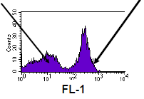
Labelling cells with Abs
Use fluorochrome conjugated Antibodies to detect specific cell surface or intracellular proteins
Fluorochromes are dyes that can be bound to antibodies (FITC, PE, APC)
Each fluorochrome gets excited by the laser and then emits light that passes through the specific filter and is detected as a specific wavelength.
Y
Y
fluorochrome
Y
Y
Y
Y
Y
Y
Antibody
Y
Low
Bright
Surface protein

Slide 8
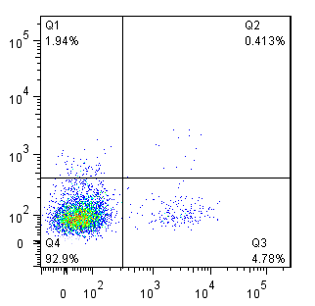
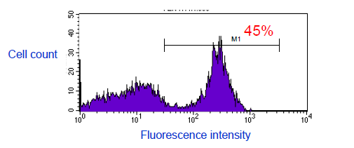
Data presentation and analysis
Data can be presented as Dot-plots or histograms
Population can be gated for % and statistical analysis
Must use negative controls ( Isotype control) to be able to know where your negative population is and also if there is any non-specific binding by your Ab
IL-13
IL-4

Slide 9
Staining Th2 cells (example)
Th2 cells are CD4+ cells that produce IL-4 and/or IL-13.
Flow cytometry can be used to detect this cells in disease conditions (asthma)
Cells are incubated with the Ab specific for CD4, this Ab is conjugated to a fluorochrome (in this case APC) then cells are permeabalised (creating holes in the cells membrane) and stained with Abs specific for IL-4 conjugated to FITC and IL-13 conjugated to PE.
Cells are then run on the machine and data collected.
Y
Y
Y
Y
Y
Y
Y
CD4+
Y
Y
Y

Slide 10
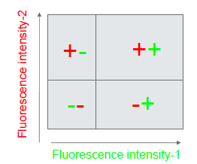
Data interpretation
Isotype control
CD4 cells
Y
Y
Y
CD4⁺
Y
APC
APC
CD4⁺IL-13⁺ IL-4⁻
Y
Y
CD4⁺IL-4⁺IL-13⁺
Y
Y
Y
Y
Y
Y
IL-13-PE
Y
Y
CD4⁺IL-4⁺IL-13⁻
Y
Y
Y
Y
Y
Y
CD4⁺IL-4⁻IL-13⁻
IL-4-FITC

Slide 11
References
http://static.uk-plc.net/library/abd/uploads/Flow-Cytometry.pdf
The above reference contains a reading list.

