Slide 1
Diagnosis of sleep disorders
Dr Martin Glasser
Clinical Research Fellow
National Heart and Lung Institute

Slide 2
Introduction
What parameters are we interested in?
Can we measure them?
Should we measure them?
How do we measure them?

Slide 3
What Parameters are we interested in?
Oxygenation
Carbon dioxide concentration
Respiratory effort
Airflow
Snoring
Movement
Brain activity
Eye movements

Slide 4
Can we measure them?
Yes

Slide 5
Should we measure them?
Invasive / non-invasive?
Where can the test be done?
Who can set it up?
Who can interpret it?
What does it cost?
Do we need to know?

Slide 6
How do we measure them?
Single channel monitoring
  pulse oximetry
Multiple channel monitoring
  TOSCA
  respiratory polygraphy
  full nocturnal polysomnography (NPSG)

Slide 7
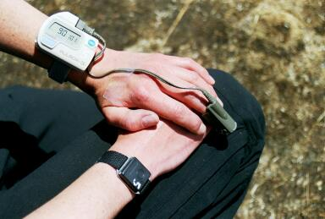
Pulse oximetry
Two halves
  Red and infrared light source
  Photodetector
Spectra of light absorbed varies with haemoglobin oxygen saturation
Infra red-spectroscopy allows calculation of oxygen saturation

Slide 8
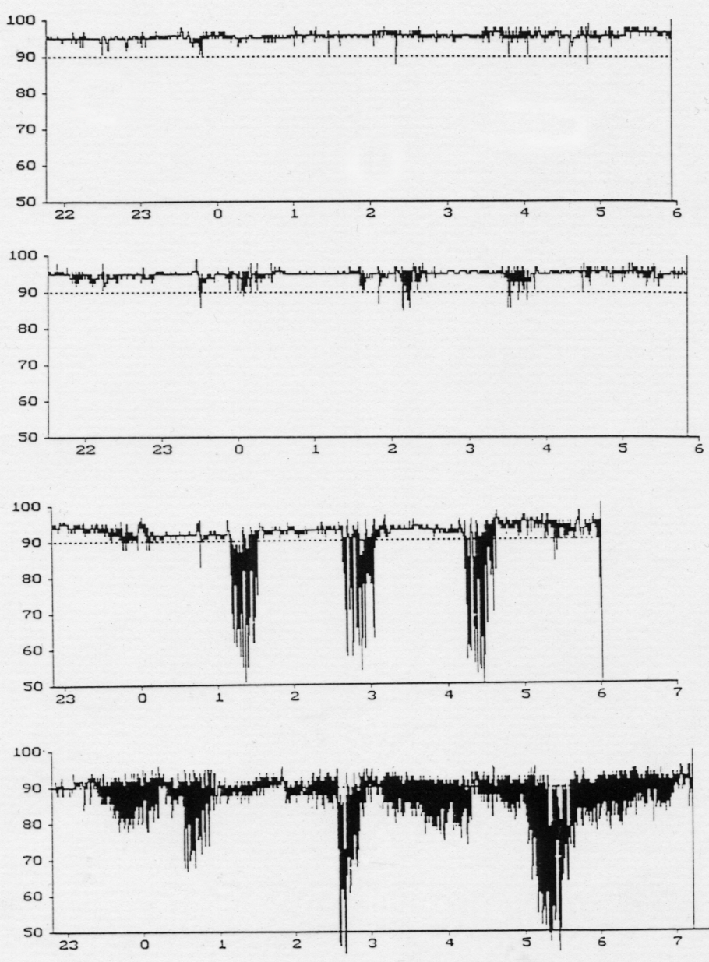
Pulse oximetry
Normal Person
Increasing weight
Patient with severe obstructive sleep apnea

Slide 9
Pulse oximetry
Advantages
  Easy to use
  Patient can set up
  Suitable for use at home
  One channel gives information about two parameters (HR and SaO²)
Disadvantages
  Limited information
  Unable to differentiate between obstructive apnoea and central apnoeas
  Unable to assess hypoventialtion

Slide 10
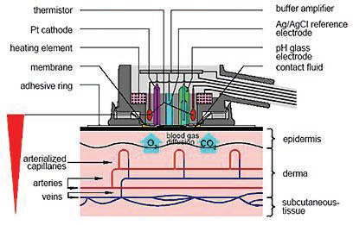
Transcutaneous measurement of CO²

Slide 11
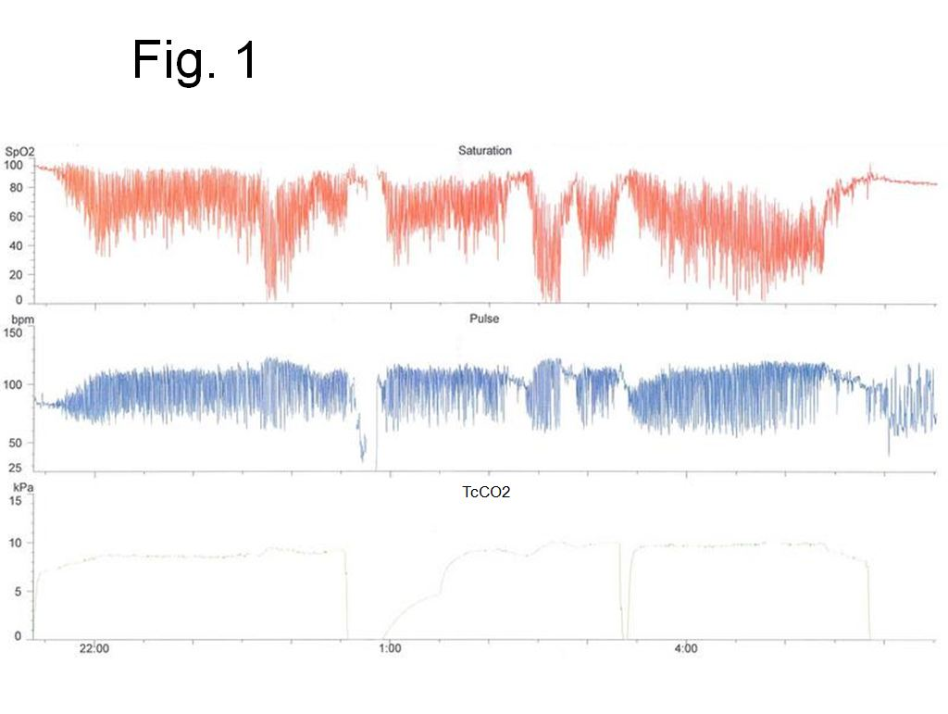

Slide 12
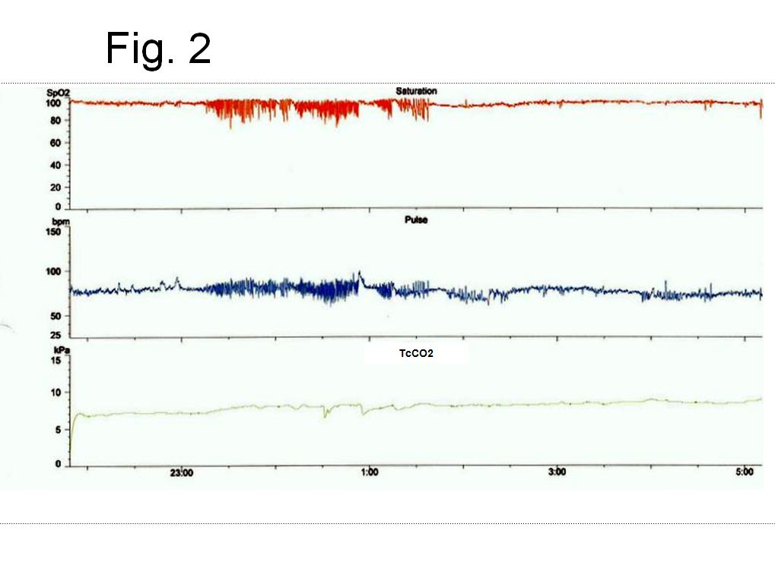
Transcutaneous measurement of CO²

Slide 13
Transcutaneous measurement of CO²
Advantages
  Non-invasive
  Allows diagnosis and follow-up of respiratory insufficiency
Disadvantages
  Need specialist equipment
  Must be done in hospital

Slide 14
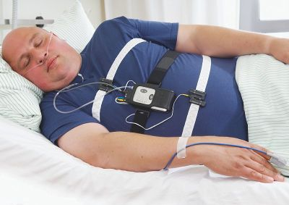
Respiratory polygraphy
Oximetry
Measurement of airflow (pressure or thermistor)
Respiratory effort bands

Slide 15
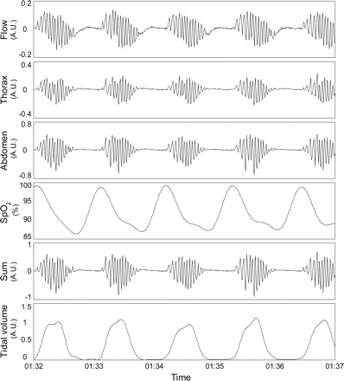
Respiratory polygraphy

Slide 16
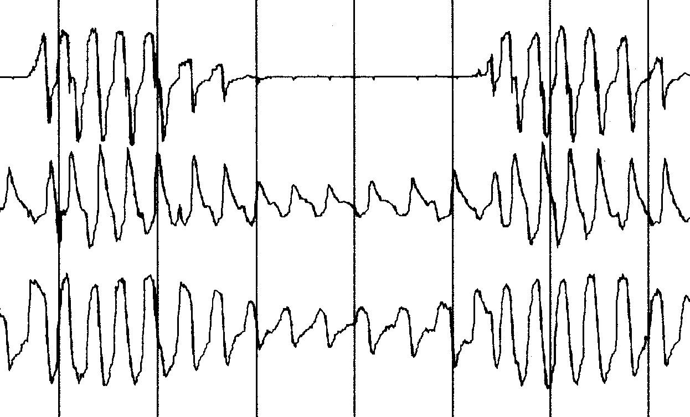
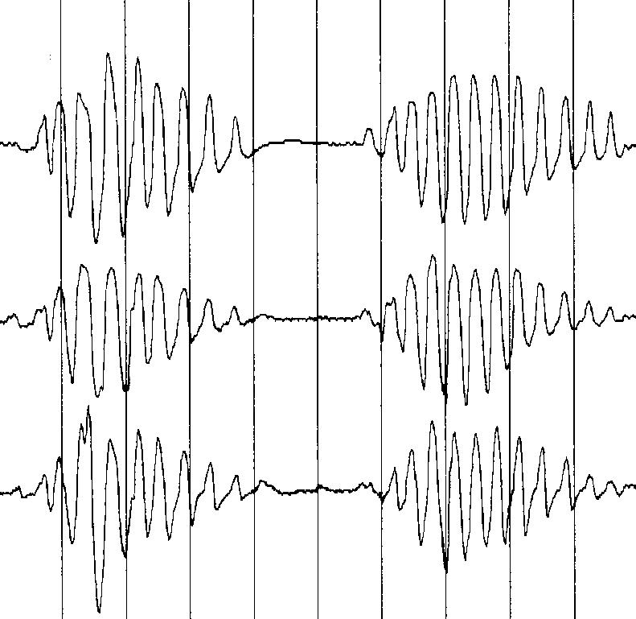
Obstructive Apnoea
Central Apnoea
Airflow
Thoracic
Effort
Abdominal
Effort

Slide 17
Respiratory polygraphy
Advantages
  Non-invasive
  Can be done at patient’s home
  With some instruction from technician can be set up by patient
Disadvantages
  Patient needs to collect from / drop off at hospital
  Requires specialist equipment
  More expensive than oximetry alone
  Cannot diagnose non-respiratory sleep disorders

Slide 18
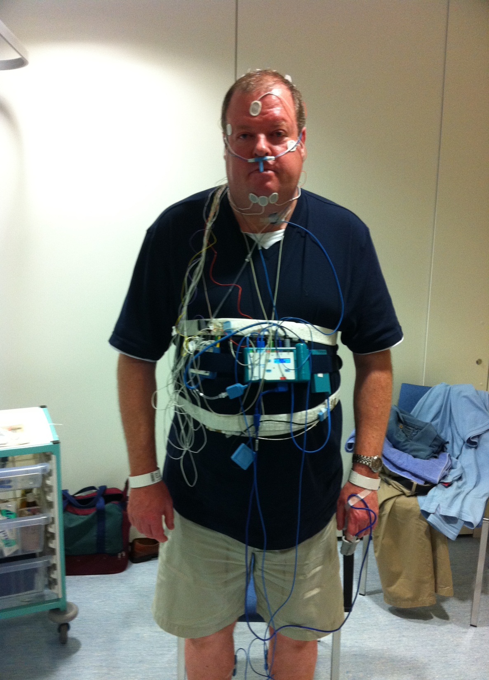
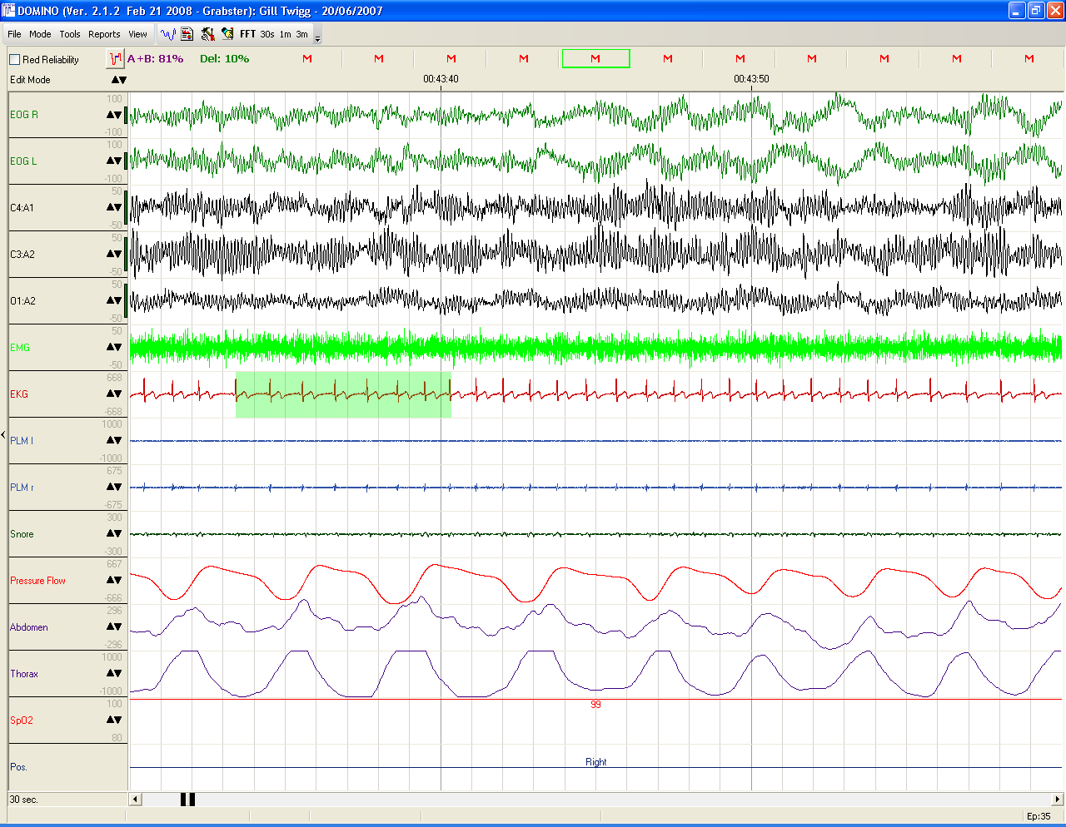
‘Full sleep study’
Polysomnography

Slide 19
Polysomnography
Advantages
  Maximal information acquired
  Can diagnose other sleep disorders (e.g. narcolepsy, periodic limb movements, parasomnias)
  No need for further diagnostic studies
Disadvantages
  Non-invasive, but very intrusive
  Patient may not be able to sleep
  Requires specialist equipment
  Must be done in hospital
  Requires specialist interpretation
  Expensive

Slide 20
Summary
We can measure multiple physiological parameters in sleep
The more we measure the more we can detect
The more we measure the more expensive it is and the worse it is for the patient
We must balance these factors when deciding what sleep study to use

