Slide 1
Pharmacology Module 3 L6- Alzheimer’s disease Nicotinic & NMDA receptors
Dr Sohag Saleh

Slide 2
Learning objectives
Summarise the reasons why the cholinergic system is implicated in the pathogenesis of Alzheimer’s disease (AD)
Review the anti-cholinesterase drugs licensed for the treatment of AD
Outline the molecular mechanism of memantine action
Discuss the need for further drug development in the treatment of AD and outline new strategies

Slide 3
Lecture structure
Current drugs
Anti-cholinesterases
Memantine
Clinical trials
Recent failures
γ-secretase inhibitors
β-amyloid antibodies
Promising future?
Tau aggregation
Other
Biomarkers

Slide 4
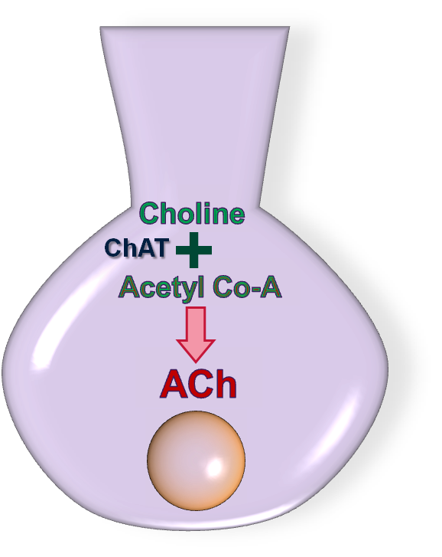
Cholinergic theory of Alzheimer’s
Scopolamine
Cholinergic blockade
Scopolamine (hysocine) produced cognitive deficits in monkeys and non- demented elderly humans
Deficits in ChAT enzymes
Brains of AD patients exhibited significant loss of ChAT enzymes
Down-regulation of cholinergic neurons
Atrophy of basal forebrain neurones in animals & human (75% loss in nucleus basalis of Meynert)
Down-regulation of ACh receptors
Reversal by anticholinesterase drugs
Physostigmine & tacrine improved symptoms in animals and humans
Muscarinic receptor
Nucleus basalis of Meynert

Slide 5
Anti-cholinesterase drugs
Donepezil
Reversible cholinesterase inhibitor.
Long plasma half-life
Treatment costs ~ £800-1200 per year
Rivastigmine
Inhibits both AChE and BChE in a pseudo-reversible manner
An 8 hour half-life
Reformulated as transdermal patch
Treatment costs ~ £900 per year
Galantamine
Reversible cholinesterase inhibitor with modest activity
The elimination half-life of galantamine is about 7-8 hours
Has additional properties as an α7 nAChR agonist
Treatment costs £900-1100 per year
Plasma conc
5
24
Time (h)

Slide 6
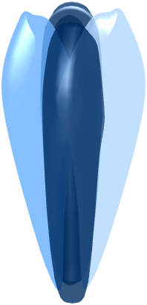
Memantine: mechanism
M
Glu
Glu
A use-dependent non-competitive NMDA receptor blocker with low channel affinity.
Preferentially blocks excessive NMDA activity possibly by an action on extra-synaptic currents
Plasma half-life ~ 70 hours
Not metabolised by liver cytP450 enzymes
Treatment costs ~ £900 per year

Slide 7
Clinical trials
DON-Nordic (Winblad B et al, 2001)
52-week, double-blind, parallel-group, placebo-controlled, randomized study
286 participants with mild to moderate possible or probable AD, 67% completion rate
AD2000 (Courtney C et al, 2004)
565 patients assessed over a 2 year period
Given either 5/10 mg Donepezil or placebo
Donepezil is not cost effective, with benefits below minimally relevant thresholds
High number of dropouts (20% remained), complex design, 5 &10mg not reported separately
DON vs RIV (Bullock R et al 2005)
104 week, randomized, double-blind, parallel group
998 participants with mild to moderate probable Alzheimer's disease, 58% completion rate
Although both drugs performed similarly on cognition and behaviour, rivastigmine may provide greater benefit in activities of daily living and global functioning.
DOMINO-AD (Howard R et al, 2012)
295 patients assessed over 52-weeks
continued treatment with donepezil was associated with cognitive benefits that exceeded the minimum clinically important difference.

Slide 8
Lecture structure
Current drugs
Anti-cholinesterases
Donepezil: 1st line
Rivastigmine: patches
Galantamine: α7 agonist
Memantine
Moderate-severe AD
Use-dependent block
Clinical trials
DON-Nordic
AD2000
DOMINO-AD
Recent failures
γ-secretase inhibitors
β-amyloid antibodies
Promising future?
Tau aggregation
Other
Biomarkers

Slide 9
Recent failures
sAPPα
p3
γ-secretase inhibitors
Tarenflurbil
γ-secretase modulator that binds to the amyloid precursor protein (APP) molecule
Phase 3 study conducted in 1800 patients over 18 months showed no efficacy
Semagacestat
A small molecule γ-secretase inhibitor
Phase III (IDENTITY1 & 2) trials were halted during an interim analysis when it was found that symptoms significantly worsened
β-amyloid antibodies
Bapineuzumab
Humanised monoclonal antibody
No clinical benefit & increased incidence of side-effects
Solanezumab
Humanised monoclonal antibody
Failed to meet primary end-points in Phase III EXPEDITION trials
γ-secretase
α-secretase
APP
sAPPβ
Aβ₄₀₋₄₂
γ-secretase
β-secretase

Slide 10
Lecture structure
Current drugs
Anti-cholinesterases
Donepezil: 1st line
Rivastigmine: patches
Galantamine: α7 agonist
Memantine
Moderate-severe AD
Use-dependent block
Clinical trials
DON-Nordic
AD2000
DOMINO-AD
Recent failures
γ-secretase inhibitors
Tarenflurbil
Semagacestat
β-amyloid antibodies
Bapineuzumab
Solanezumab
Promising future?
Tau aggregation
Other
Biomarkers

Slide 11
Tau aggregation
Tau protein
Tau protein
A protein that modulates the stability of microtubules
Hyperphosphorylated tau aggregates resulting microtubule instability
Tau pathology correlates better with AD symptoms than Aβ
May act downstream of Aβ
May be a natural product of aging
Methylene blue
Also known as methylthioninium chloride
Licensed for the treatment of methaemoglobinaemia
Phase II data reported a significant slowing of cognitive decline in mild to moderate AD
Recently entered phase III trials
β
α
β
β
β
β
α
α
α
β
α
β
β
β
α
β
α
β
α
β
α
α
α
α
β
β
β
α
α
β
β
β
α
α
α
α
β
β
α
β
β
α
α
β
β
α
β
β
α
α
β
α
α
β
α
α
β
α
β
α
β
β
β
α
α
β
α
α
β
α
β
β
β
α
α
β
α
α
β
α
β
α
β
β
α
β
α
α
β
α
β
α
β
α
β
β
β
α
α
α
β
α
β
α
β
β
α
α
β
α
β
β
α
α
β
α
β
α
β
β
α
β
α
α
β
α
β
α
β
α
β
β
α
α
α
β
β
α
β
α
β
α
β
β
α
α
β
α
β
β
α
α
β
β
α
α
Microtubule
P
P
β
α
β
β
β
β
α
α
α
β
α
β
β
β
α
β
α
β
α
β
α
α
α
α
P
β
β
β
α
α
β
β
β
α
α
α
α
β
β
α
β
β
α
α
β
β
α
β
β
α
α
β
α
α
β
α
α
β
α
β
α
β
β
β
α
α
β
α
α
β
α
β
P
α
β
β
α
β
α
α
β
α
β
α
β
β
P
α
β
α
α
β
α
β
α
β
α
β
β
β
α
α
α
β
α
β
α
β
β
α
α
β
α
β
β
α
α
β
α
β
α
β
β
α
β
α
α
β
α
β
α
β
α
β
β
α
α
α
β
β
α
β
α
β
α
β
β
α
α
β
α
β
P
β
α
P
α
β
β
α
α
P
Hyperphosphorylated Tau

Slide 12
Future prospects
3
BACE inhibitors
LY-2886721 & MK-8931 are in phase II-III clinical trials
Gantenerumab
A novel fully human anti-Aβ antibody with strong binding capacity
Gammagard
Immunoglobulin that acts as an antibody against Aβ
Currently approved for the prophylaxis of hepatitis/ measles
Florbetapir
PET imaging biomarker that allows pre-symptomatic diagnosis
2
sAPPβ
Aβ₄₀₋₄₂
1
γ-secretase
β-secretase

Slide 13
Lecture structure
Current drugs
Anti-cholinesterases
Donepezil: 1st line
Rivastigmine: patches
Galantamine: α7 agonist
Memantine
Moderate-severe AD
Use-dependent block
Clinical trials
DON-Nordic
AD2000
DOMINO-AD
Recent failures
γ-secretase inhibitors
Tarenflurbil
Semagacestat
β-amyloid antibodies
Bapineuzumab
Solanezumab
Promising future?
Tau aggregation
Methylene blue
Other
BACE inhibitors
Gantenerumab
Gammagard
Biomarkers
Florbetapir

Slide 14
Learning Objectives: Revisited
Summarise the reasons why the cholinergic system is implicated in the pathogenesis of Alzheimer’s disease (AD)
Depletions in cholinergic pathways and key enzymes
Anti-cholinergic induced memory loss
Benefits of anti-cholinesterase drugs
Review the anti-cholinesterase drugs licensed for the treatment of AD
Donepezil is the drug of choice, has a long duration and may be effective in moderate-severe AD
Rivastigmine also inhibits BChE, is available in patch formulation and maybe more effective than donepezil
Galantamine is a weak AChE inhibitor but has additional nAChR agonist properties

Slide 15
Learning Objectives: Revisited
Outline the molecular mechanism of memantine action
Has low affinity for the NMDA receptor and fast on-off kinetics.
Preferentially inhibits NMDA receptors during high activity
Discuss the need for further drug development in the treatment of AD and outline new strategies
No disease modifying properties
Recent high profile clinical failures
New targets: tau, BACE, better diagnostic tools

