Slide 1
Pharmacology Module 3 L1- Amino Acid Neurotransmitters
Dr Sohag Saleh

Slide 2
Learning objectives
Describe the physiological roles of glutamate and how it is generated and metabolised
Categorise the types of glutamate receptors and differentiate between them
Outline the physiological roles of GABA & Glycine and explain how they are generated and metabolised
Examine the functional properties of the GABA receptors and distinguish between them
Review the major drug classes associated with these transmitters and summarise their clinical uses

Slide 3
Lecture Structure
Glutamate
Synthesis & Metabolism
Receptors
Pharmacology
GABA
Synthesis & Metabolism
Receptors
Pharmacology
Glycine
Synthesis & Metabolism
Receptors
Pharmacology

Slide 4
Glutamate: Synthesis & Metabolism
NEURONE
Synthesis
Glutamate (Glu) can be generated from Glutamine (Gln) by the action of the glutaminase (in mitochondria)
Can also be generated by transamination of Alanine or Aspartate
Glu is stored in synaptic vesicles and released following Ca²⁺ influx
Metabolism
Glu is primarily taken up by GLT-1 & GLAST transporter proteins located on adjacent glial cells
Some neurones also express EAAC1, which recycles Glu directly
The Glu is converted into Gln within the glia and taken back up into neurones to complete the ‘Glu-Gln cycle’
GLIAL CELL
Gln
Gln
Glu
Glu
Asp
Glu
Glu

Slide 5
Glutamate: Ionotropic Receptors
NMDA-R
Kainate-R
Form tetrameric complexes with a central pore
Each subunit consists of a transmembrane domain, a ligand binding domain and an extracellular N-terminal domain
NMDA
GluN1-3
Under voltage-dependent Mg²⁺ block
Requires simultaneous binding of Glu & Gly for activation
Slow activation-deactivation kinetics (ms) and weak desensitisation
Permeable to Ca²⁺ ions
AMPA
GluA1-4
Fast activation-deactivation & strong desensitisation
Less permeable to Ca²⁺
Kainate
GluK1-5
N1
K1-5
N1
N2/3
AMPA-R
K1-5
K1-5
N2/3
A1-4
K1-5
A1-4
A1-4
A1-4
Ligand binding domain
Transmembrane domain

Slide 6
NMDA-R: Pharmacotherapy
NMDA-R
NMDA-R mediated Ca²⁺ overload is thought to contribute to cell death in a number of neurological disorders including: Alzheimer’s disease; Huntington disease; Parkinson’s disease (PD); Stroke & Multiple sclerosis
Pharmacology
Ketamine
Non-competitive open channel blocker
Licensed for the induction and maintenance of anaesthesia.
May also be useful as an analgesic and in the treatment of major depressive disorder (see Matthews et al, 2012)
Drug of abuse
Memantine
Non-competitive open channel blocker
Low affinity with fast on-off kinetics
Preferentially blocks excessive activity
Used to treat moderate to severe Alzheimer’s
In clinical trials for dementia in PD patients (Aarsland et al, 2009)
N1
N1
K
N2/3
N2/3
Ca²⁺
Open channel pore blocker
K
Matthews et al (2012) Drugs 72(10), 1313-33
Aarsland et al (2009) Lancet Neurol 8(7), 613-8

Slide 7
AMPA & Kainate receptors
AMPA-R
Kainate-R
Over activation of AMPA and Kainate receptors can also be targeted to reduce glutamate induced neurotoxicity:
Antagonists are neuroprotective and reduce ischaemia-induced white matter injury
DRUGS
Topiramate
Inhibits both AMPA & kainate receptors
Licensed as an adjunct for epileptic seizures & prophylaxis of migraine
(In trials)
Talampanel & Perampanel
Highly selective non-competitive AMPA antagonists
Investigated for the treatment of partial seizures (EXPLORE trial, 2011); Amyotrophic Lateral Sclerosis; Malignant gliomas
Tezampanel
More selective for the kainate receptor and being investigated for the treatment of migraine
A1-4
K1-5
A1-4
A1-4
K1-5
K1-5
A1-4
K1-5
Na⁺
T

Slide 8
Glutamate: Metabotropic receptors
7-TM GPCRs that modulate NMDAR, opioid receptors & cannabinoid receptors
Have a ‘Venus Fly Trap’ (VFT) domain that is composed of two lobes, with the glutamate binding site located between the two lobes
Are able to form heterodimers
Grouped into three classes based on sequence homology & signal transduction
Mostly located presynaptically and play an important role in long-term depression (LTD)
Group I (mGlu1 & mGlu5)
G_{q}- linked to PI-PLC pathway
mGlu5 antagonists reverse mental retardation (see Dolen & Bear, 2008)
Group II (mGlu2 & mGlu3)
G_{i}-linked to inhibition of adenylyl cyclase
Positive modulators are being investigated for schizophrenia (see Fell et al, 2012)
Group III (mGlu4, mGlu6, mGlu7 & mGlu8)
G_{i}-linked to inhibition of adenylyl cyclase
mGlu4 positive modulators are being investigated for the treatment of Parkinson’s
VFT domain
PLC
AC
G_{q}
G_{i}
Dolen & Bear (2008) J Physiol 586(6), 1503-8
Fell et al (2012) Neuropharmacology 62(3), 1473-83

Slide 9
Summary slide
Glutamate
Synthesis & Metabolism
Excitatory neurotransmitter
Generated from GLN (by glutaminase) or from ASP (by transamination)
Primarily taken up by GLT-1 & GLAST transporter proteins
Receptors
NMDA, AMPA & Kainate
Metabotropic receptors
Pharmacology
Memantine: AD
Ketamine: Anaesthesia
Topiramate: Epilepsy
GABA
Synthesis & Metabolism
Receptors
Pharmacology
Glycine
Synthesis & Metabolism
Receptors
Pharmacology

Slide 10
GABA: Synthesis & Metabolism
Synthesis
GABA is generated from Glutamate (Glu) by the action of the glutamic acid decarboxylase enzyme (GAD)
GAD comprises two major isoforms with two different molecular weights (65kDa & 67kDa)
Although GAD65 is the major isoform in the brain the majority is inactive
Metabolism
The majority of GABA is taken up by GABA transporters (GAT) in presynaptical terminals and repackaged
The GABA transaminase (GABA-T) enzyme is found in glial cells and catabolises GABA to Glu
Glu
Glu
GABA-T
GAD₆₇
GAD₆₅
GABA
GABA
GABA
GABA

Slide 11
GABA_{A} Receptors
GABA_{A}
GABA_{C}
IONOTROPIC RECEPTORS
Belongs to cys-loop family and form pentameric complexes with a central pore
Each subunit consists of an extracellular ligand-binding domain and transmembrane domain with 4 transmembrane α-helices
GABA_{A}
Chloride permeable ion channel
Are assemblies of the following subunits: α1-6, β1-4, γ1-4, δ, ε, π, and θ
Composed of 5 subunits (usually 2α,2β1,1γ)
Contain 2 GABA binding sites and a benzodiazepine-site
GABA_{C} (GABA_{A}-Rho)
Chloride permeable ion channel composed entirely of ρ-subunits
Expressed exclusively in the retina
β
ρ
α
α
ρ
ρ
γ
β
ρ
ρ

Slide 12
GABA_{A} Receptors: Pharmacotherapy
GABA_{A}
GABA_{A} RECEPTORS
Allosterically modulated by:
Benzodiazepines e.g. Diazepam
The α_{1, 2, 3, & 5,} β & γ₂ are important is BDZ binding
BDZs are used in the treatment of seizures, anxiety, insomnia, alcohol withdrawal, muscle spasms.
The α₁ subunit mediates the sedative effect whereas α₂ & ₃ mediate the anxiolytic effects
Barbiturates e.g. Phenobarbital
Can stimulate channel opening independent of GABA binding (>50μM). Used to treat epilepsy (phenobarbital) and as an anaesthetic (thiopental)
Steroids:
Progesterone derivatives also able to open channels directly (>50μM). Ganaxolone is in trials for epilepsy
Anaesthetics: e.g. Propofol, etomidate
Action thought to involve the β₃ subunit
β
α
α
γ
β

Slide 13
GABA_{B} Receptors
GABA_{B}R1
GABA_{B}R2
GABA_{B} RECEPTORS
7-TM GPCRs that modulate ion channel activity
Two isoforms exist (GABA_{B}R1 & R2) and can only form functional receptors as dimers
Pre-synaptic GABA_{B} receptors reduce multi-vesicular release of glutamate
Post-synaptic GABA_{B} receptors reduce neuronal excitability by enhancing K⁺ channel activity and reducing Ca²⁺ channel activity through Gβγ subunits.
They are also linked to the inhibition of adenylyl cyclase through G_{i} proteins
DRUGS
Baclofen: Agonist that acts a s a skeletal muscle relaxant and is used in the treatment of severe chronic spasticity:
Numerous positive modulators in development: anxiety, depression and addiction (see Tyacke et al, 2010)
AC
G_{i}
Gβγ
VGCC
VGKC
Tyacke et al (2010) Adv Pharmacology 58, 373-96

Slide 14
Summary slide
Glutamate
Synthesis & Metabolism
Excitatory neurotransmitter
Generated from GLN (by glutaminase) or from ASP (by transamination)
Primarily taken up by GLT-1 & GLAST transporter proteins
Receptors
NMDA, AMPA & Kainate
Metabotropic receptors
Pharmacology
Memantine: AD
Ketamine: Anaesthesia
Topiramate: Epilepsy
GABA
Synthesis & Metabolism
Synthesised from GLU by GAD
Taken up by GAT or metabolised by GABA transaminase
Receptors
GABA_{A}= ligand-gated Cl⁻ channels
GABA_{B}= 7-TM GPCRs, only function as oligomers
Pharmacology
Barbiturates: Epilepsy
Benzodiazepines: anxiety, depression
Baclofen: spasticity
Glycine
Synthesis & Metabolism
Receptors
Pharmacology

Slide 15
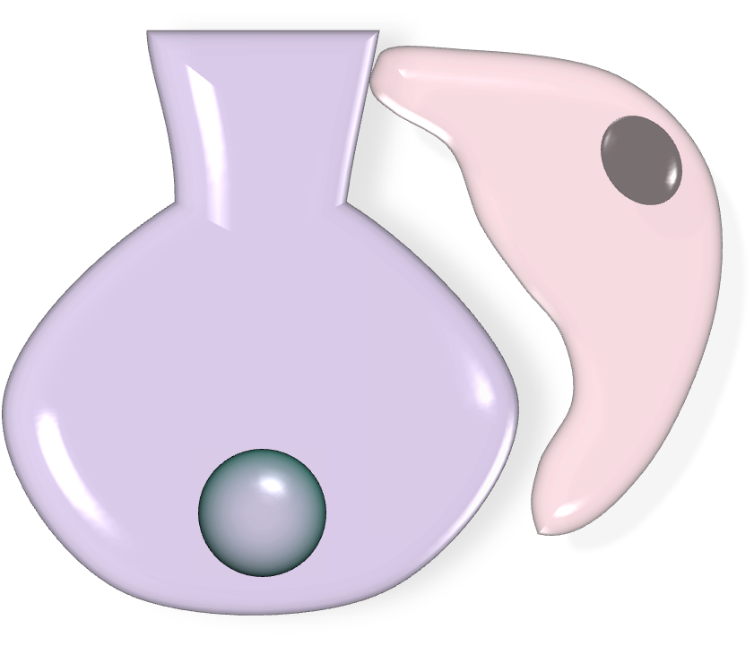
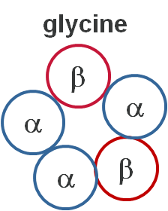
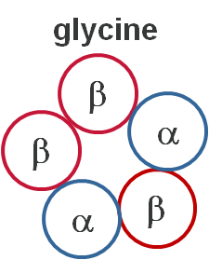
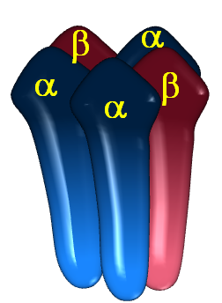
Glycine: Briefly
GlyT1
GlyT2
Found in the spinal cord and brainstem (reflex responses, processing of sensory signals and pain sensation)
GLYT2 transporter is predominant in presynaptic terminals of glycinergic neurons. GLYT1 is in glial cells
Also catabolised by the glycine decarboxylase system
Cys-loop ligand-gated ion channel
Cl⁻ permeable pore causing membrane hyperpolarisation
Four α-subunits (α1-α4) and one β-subunit have been identified
Inherited mutations to human GlyR genes give rise to hyperekplexia
The GLYT1 inhibitor RG1678 is in clinical trials for the treatment of schizophrenia (see Alberati et al, 2012)
Alberati et al (2012) Neuropharmacology 62(2), 1152-61

Slide 16
Summary slide
Glutamate
Synthesis & Metabolism
Excitatory neurotransmitter
Generated from GLN (by glutaminase) or from ASP (by transamination)
Primarily taken up by GLT-1 & GLAST transporter proteins
Receptors
NMDA, AMPA & Kainate
Metabotropic receptors
Pharmacology
Memantine: AD
Ketamine: Anaesthesia
Topiramate: Epilepsy
GABA
Synthesis & Metabolism
Synthesised from GLU by GAD
Taken up by GAT or metabolised by GABA transaminase
Receptors
GABA_{A}= ligand-gated Cl⁻ channels
GABA_{B}= 7-TM GPCRs, only function as oligomers
Pharmacology
Barbiturates: Epilepsy
Benzodiazepines: anxiety, depression
Baclofen: spasticity
Glycine
Synthesis & Metabolism
Reuptaken into neurones and neuroglia by GlyT proteins
Catabolised by the glycine decarboxylase system
Receptors
Cys-loop ligand-gated chloride channels
Pharmacology
No selective ligands

Slide 17
Learning Objectives: Revisited
Describe the physiological roles of glutamate and how it is generated and metabolised
Glutamate is the main excitatory neurotransmitter
Two main synthesis pathways:
From glutamine utilising glutaminase in mitochondria
From α-ketoglutarate utilising another amino acid and transaminase
Two main metabolism pathways:
Taken up into glial cells by GLT-1 and GLAST;
Taken up into nerve terminals by EAAC1
Categorise the types of glutamate receptors and differentiate between them
Ionotropic receptors
NMDA: Require both Glu & Glycine binding, under Mg²⁺ block
AMPA: Activated by 2 Glu molecules, Undergo rapid desensitisation
Kainate: tetramers with presynaptic and post-synaptic locations
Metabotropic receptors
G-protein coupled receptors with a venus fly-trap motif

Slide 18
Learning Objectives: Revisited
Outline the physiological roles of GABA & Glycine and explain how they are generated and metabolised
GABA is the major inhibitory neurotransmitter in the CNS
GABA is synthesised from glutamate by the enzyme GAD; catabolised by the enzyme GABA transaminase or reuptaken by the GAT-1 transporter
Glycine is reuptaken by glycine transporters (GlyT1 & T2) and can be broken down by the glycine decarboxylase system
Examine the functional properties of the GABA receptors and distinguish between them
GABA_{A} ionotropic receptors are Cl⁻ permeable pentameric cys-loop receptors
GABA_{B} receptors are 7-transmembrane G-protein linked receptors that can only form functional receptors as dimers. They are linked to G_{i} proteins

Slide 19
Learning Objectives: Revisited
Review the major drug classes associated with these transmitters and summarise their clinical uses
Glutamate: NMDA antagonists used for anaesthesia (Ketamine), Alzheimer’s (Memantine). AMPA & kainate antagonist (Topiramate) use for epilepsy, numerous others in clinical trails (Perampanel)
GABA_{A}: Enhancers used as anti-convulsants, hypnotics, anxiolytics, anaesthetics
GABA_{B}: Agonist (baclofen) used as a skeletal muscle relaxant

