Slide 1
Autonomic control of blood vessels
Dr Chris John

Slide 2
Outline
The autonomic nervous system
Co-transmission
Evidence for co-transmission
Functional significance
Vasoconstriction (sympathetic)
Noradrenaline
Other co-transmitters – ATP / NPY
Vasodilation (parasympathetic and NANC)
Acetylcholine, non-adrenergic non-cholinergic (NANC) nerves, peptidergic and nitrergic nerves

Slide 3
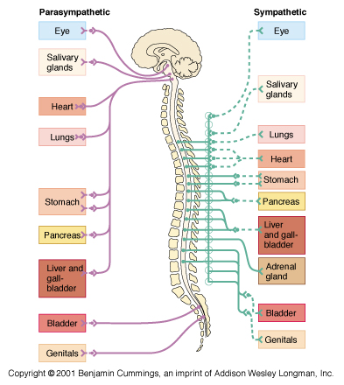
ANS divisions
Sympathetic division
Thoracolumbar division
Preganglionic cell bodies at T1-L2
Parasympathetic division
Craniosacral division
Preganglionic cell bodies
Dual innervation – many organs receive opposing inputs from both divisions

Slide 4
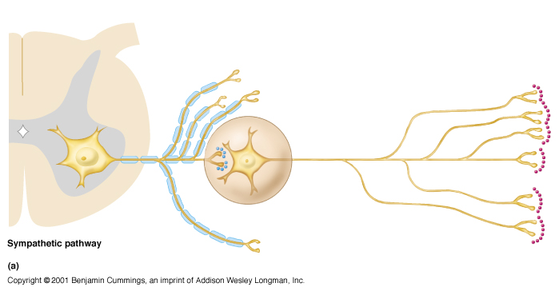
Sympathetic neurotransmitters
Acetylcholine at pre-postganglionic synapse
Noradrenaline at postganglionic axon terminal on effector organ

Slide 5
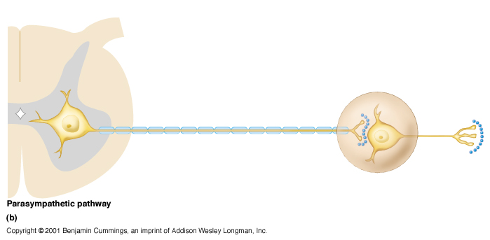
Parasympathetic neurotransmitters
ACh at pre-postganglionic synapse
ACh at postganglionic axon terminal on effector organ

Slide 6
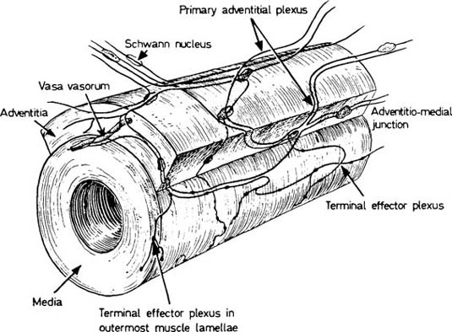
Autonomic innervation of the vasculature
Sympathetic nerves accompany arteries
and veins. Ramify in the adventitia.
Un-myelinated. Schwann cells.
Varicosities (small enlargements along
the nerve fibres) are the site of
neurotransmitter release.
Noradrenaline vasoconstriction
α1-adrenoceptors
Parasympathetic fibres rarely innervate blood vessels
salivary glands, gastrointestinal glands, genital erectile tissue
Acetylcholine vasodilation
muscarinic receptors
NANC vasodilator fibres play some role in some circulations

Slide 7
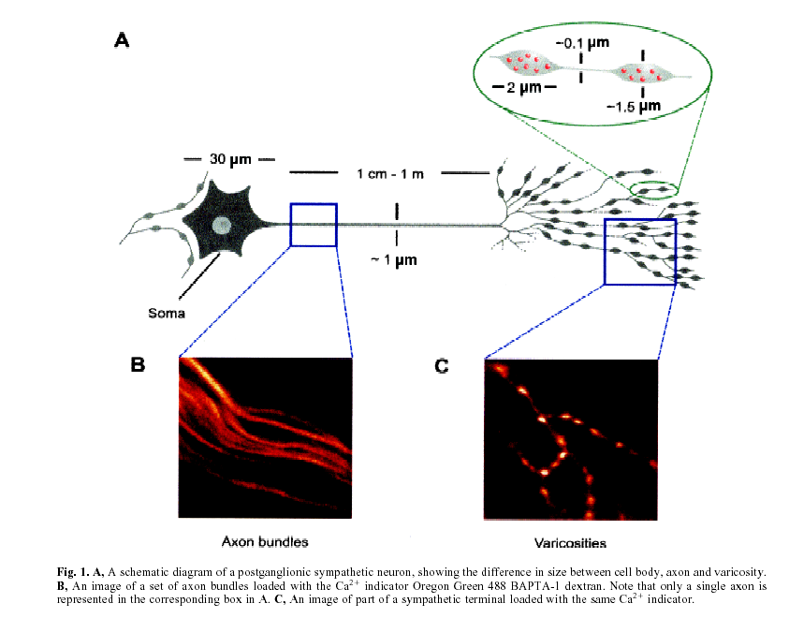
Postganglionic sympathetic fibres
Jackson & Cunnane Neurochem Res 2001; 26: 875-889.

Slide 8
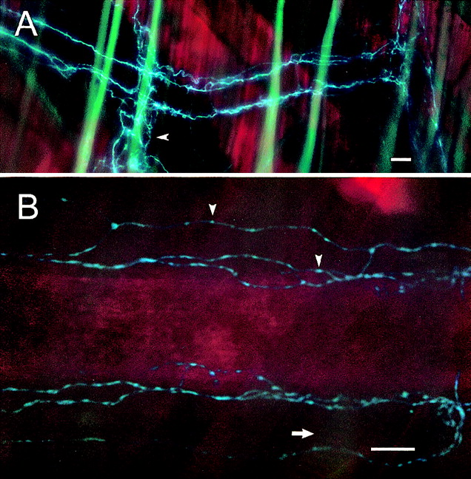
Sympathetic innervation of the vasculature
Perivascular sympathetic nerves in rat cremasteric arterioles.
A) low magnification of a second order arteriole (scale bar = 10 µm).
B) A higher magnification view catacholamine-containing varicosities (arrowheads) are visible (scale bar = 10 µm)
Intravital microscopy – stained for
gylcoxylic acid
Hungerford et al., FASEB Journal. 2000;14:197-207

Slide 9
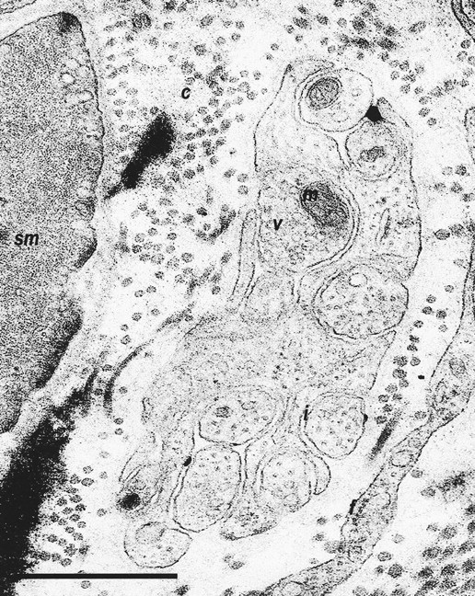
Sympathetic neuroeffector junctions 1
An axon bundle in a renal arcuate artery containing a varicosity (v) (with a mitochondrion, m) and intervaricosities (i) approaching a vascular smooth muscle cell (sm) but without the formation of a close neuromuscular junction. Collagen fibers (c) and a fibroblast (f) are also evident. Calibration bar=1 µm.
Parkington et al., Hypertension. 2004;43:643

Slide 10
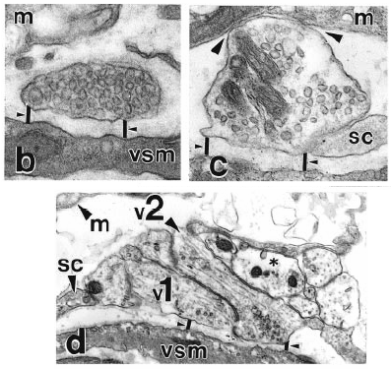
Sympathetic neuroeffector junctions 2
Close associations of sympathetic varicosities with vascular smooth muscle cells in rat iris arterioles. Vascular smooth muscle (VSM) (sc, Schwann cell), (m, melanocyte).
1μm
Sandow & Hill J Anat 1999; 195:257-270

Slide 11
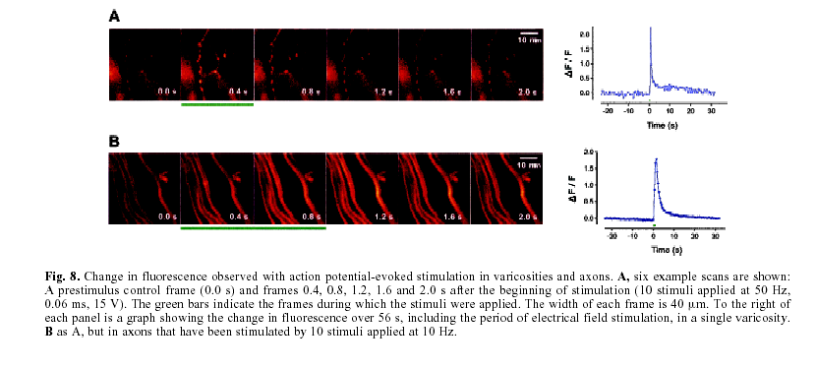
Activation of sympathetic neurones
A rise in intracellular Ca²⁺ causes neuronal release of transmitter
Jackson & Cunnane Neurochem Res 2001; 26: 875-889.

Slide 12
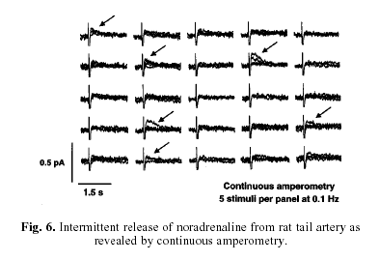
Release of noradrenaline is intermittent during nerve stimulation
Jackson & Cunnane Neurochem Res 2001; 26: 875-889.

Slide 13
Cotransmission
Co-existence of neurotransmitters is a widespread phenomenon in the autonomic nervous system, including in the vasculature.
Responses to autonomic nerve stimulation typically consists of several phases with distinctive time courses, possibly mediated by different transmitters.
Cotransmission also permits a variety of interactions and effects on the target cell

Slide 14
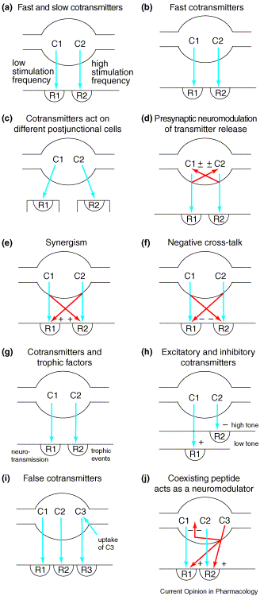
Cotransmission
Different
firing
patterns
GABA/
ATP
Spinal
cord
Symp
NPY
Heart
Ach/VIP
saliva
ATP/
adenosine
ATP/
Ach or NA
Symp
5HT
GABA /
glycine
Current Opinion in Pharmacology 2004, 4:47–52

Slide 15
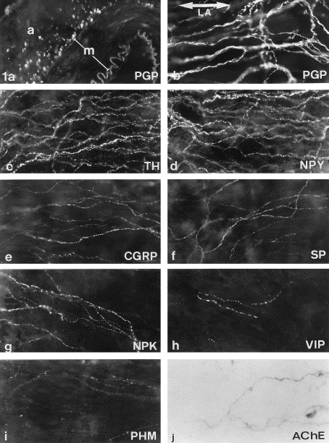
Examples of cotransmitters
Human middle meningeal artery immunostained for: (a-b)PGP 9.5 (neuronal marker) (c) Tyrosine Hydroxylase (d) Neuropeptide Y (e) Calcitonin Gene Related Peptide (f) Substance P (g) Neuropeptide K (h) Vasoactive Intestinal Peptide (i) Peptide Histidine Methionine (a = adventitia; m = media, magnification ×250).
Edvinsson et al., Peptides1998;19:1213-25

Slide 16
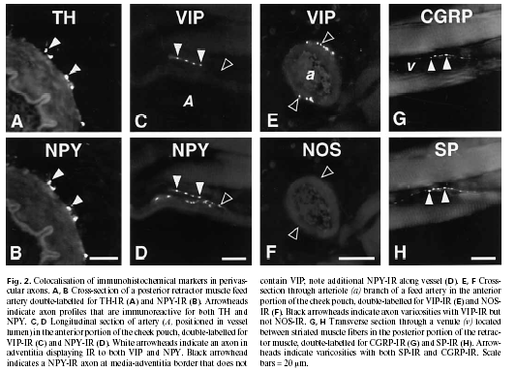
Other examples of cotransmission
Edvinsson et al., Peptides1998;19:1213-25

Slide 17
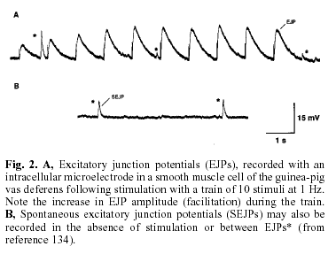
Excitatory junction potentials (EJP)
When loose seal electrodes are inserted into arteries to record potentials from smooth muscle cells during neural activation small depolarizations (EJP) can be seen. These are thought to be mainly due to release of ATP
Jackson & Cunnane Neurochem Res 2001; 26: 875-889.

Slide 18
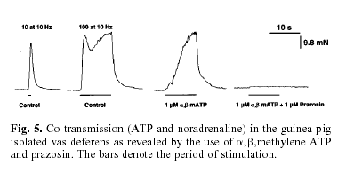
Noradrenaline and adenosine trisphosphate act as cotransmitters
Jackson & Cunnane Neurochem Res 2001; 26: 875-889.

Slide 19
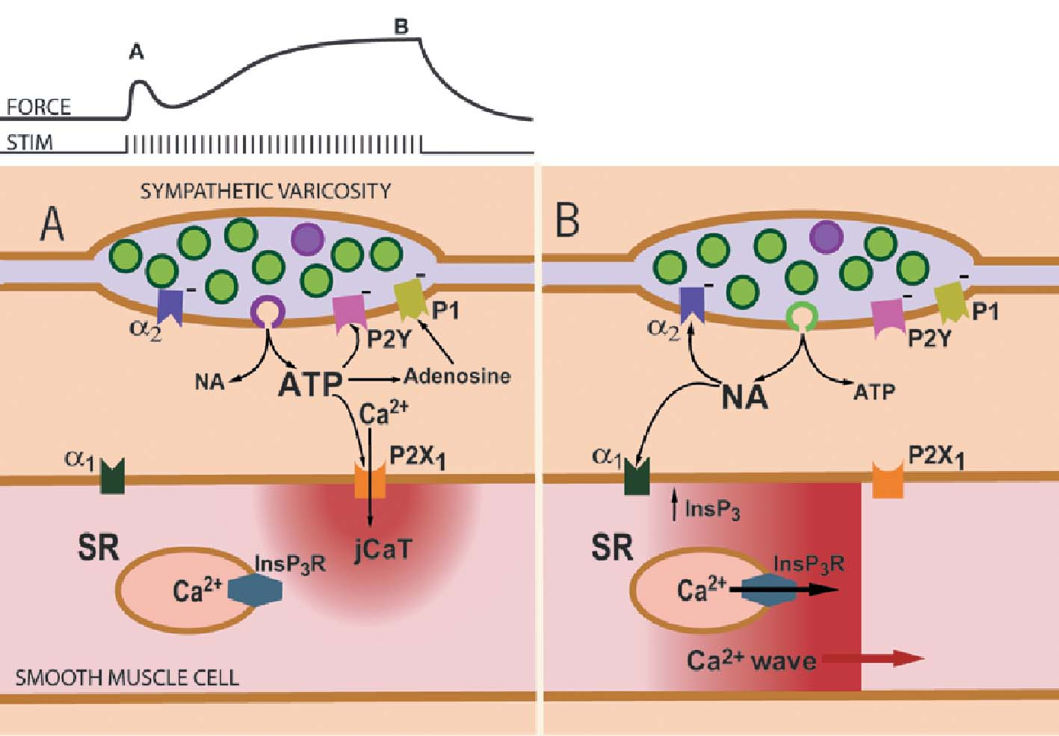
Noradrenergic and purinergic cotransmission
ATP released from SNS acts on P_{2x} receptors to cause excitatory junction potentials due to cation influx. NA acts more slowly via α₁-adrenoceptors to cause a more sustained response
Notes:
Sympathetic motor neurons are good examples of the new principle of ‘ multiplicity of neurotransmitters’ (see Stjarne, 1999), by which the old ‘ ergic’ classification of neurons (Dale’s Principle) has been rendered obsolete. At the varicosities present along the terminals of these nerves (Fig. 1) not one, but multiple neurotransmitters are ‘co-released’: noradrenaline (NA), ATP, and NPY. In small arteries and vas deferens, it is likely that NA and ATP are not always released in parallel. Details of co-transmitter release are sketchy at best, but Stjarne (2001) has advanced the provocative hypothesis that NA and ATP are present in two types of small synaptic vesicles; a ‘ big’ quantum type containing a relatively much larger amount of ATP compared to NA than the other, ‘small’ quantum type. It is certainly true, in small arteries, that the effects of ATP predominate at lower frequencies of nerve activity, while NA predominates at higher frequencies. After release, ATP binds primarily to ionotropic (ion-channel) purinergic receptors (probably homomeric P2X1) on smooth muscle cells, activating inward current, including entry of Ca2+, and produces the excitatory junction potential (EJP) (see Ralevic & Burnstock, 2003 for review of purinergic signalling). On mouse mesenteric arteries at least, other purinergic receptors of the metabotropic type, such as P2Y6, may also be present (Vial & Evans, 2002), but these will be activated only by pyrimidine nucleotides (released from endothelial cells or platelets). On smooth muscle, NA binds mainly to a1-adrenoceptors and activates the well-known signaling cascade involving production of 1,4,5-InsP3, activation of receptor activated channels (ROCs), activation of protein kinase C and other events (see Wier & Morgan, 2003, for review). These events culminate in increases in intracellular [Ca2+], activation of Ca-calmodulin dependent myosin light-chain kinase (MLCK), as well as modulation of myosin light-chain phosphatase (MLCP) activity. As with all synapses, the spatio-temporal dynamics of transmitter action at sympathetic varicosities are influenced by diffusion, uptake and enzymatic degradation of transmitter, and receptor desensitization. Through pre-synaptic α2- adrenoceptors, NA inhibits its own release, as does ATP though presynaptic P1 (adenosine) and P2Y receptors. Observing sympathetic neuromuscular transmission
Classically, the release of ATP has been detected electrically, as excitatory junctional currents (EJCs) recorded with loose-patch electrodes. These electrodes are ~ 12 µm in diameter and thus may encompass several sympathetic varicosities. With this technique, it can also be difficult to distinguish small EJCs arising beneath the electrode from large EJCs arising one cell layer deeper in the wall (Bennett et al. 2001). Perhaps surprisingly for this relatively mature field, a new technique has emerged recently for observing purinergic sympathetic neuromuscular transmission, with temporal and spatial resolution sufficient to resolve events at single sympathetic varicosities. As so often since the early 1990s, the combination of fluorescent Ca2+ indicators with confocal microscopy has provided the new observations. Cunnane and his colleagues in Oxford (Brain et al. 2002) were investigating pre-synaptic Ca2+ signaling in mouse vas deferens and found, unexpectedly, their fluorescent Ca2+ indicator (dextranlinked, low affinity Oregon Green) also in a subset of smooth muscle cells. By whatever means the indicator might have gotten there, it revealed localized smooth muscle Ca2+ transients, adjacent to sympathetic varicosities, after nerve stimulation. The Ca2+ transients were termed ‘neuroeffector Ca2+ transients’ (NCTs). At about the same time, we (Lamont & Wier, 2002) were asking the question, ‘Does NA elicit propagating Ca2+ waves in SMC during neurogenic contractions of small arteries, just as it does (Zang et al. 2001) during bath-application of NA?’ Unexpectedly, we observed brief, spatially localized Ca2+ transients that occurred in the vicinity of nerve fibres, before the adrenergic Ca2+ waves began. These localized Ca2+ transients were completely resistant to blockade of a1-adrenoceptors, L-type Ca2+ channels or ryanodine receptors. They were abolished, however, by the purinergic receptor blocker suramin. Thus, they certainly represented Ca2+ that had entered the cell through post-junctional purinergic receptors (probably P2X1) activated by neurally released ATP. As a manifestation of the excitatory junction current (EJC) we termed them ‘junctional Ca2+ transients’ or ‘ jCaTs’. It seems clear that NCTs and jCaTs represent very similar phenomena but in vas deferens and arteries, respectively.
Opening the window
Synaptic physiologists can expect to use jCaTs to examine function of an individual sympathetic varicosity at an unprecedented level of detail. For example, the ability to monitor preand post-junctional activity for long periods at a single varicosity should provide the best estimates yet of the probability of transmitter release at a single varicosity. It may also provide new information on quantal content, by carefully observing amplitude distributions of jCaTs at single varicosities, and reveal differences amongst individual varicosities.
Students of smooth muscle contraction can also expect to benefit. Briefly, an initial transient component of the neurogenic contractions of small arteries appears to be activated by jCaTs (Fig. 1A), while a larger, maintained component of the contraction appears to be associated with asynchronous propagating Ca2+ waves (Fig. 1B), similar to those elicited by exogeneous α1- adrenoceptor agonists, such as phenylephrine (PE) (Lamont et al. 2003).
Clearly, bath-application of ATP (in particular), as typically done in the past, does not mimic the events involved in contractile activation by sympathetic nerves. Most importantly, the pattern of ‘tonic’ sympathetic nerve activity to small arteries consists of intermittent bursts of action potentials. Given the frequency dependence of ATP and NA release (and/or their effects) this should provide a spatio-temporal pattern of activation within the artery wall that is very markedly different than that achieved with simple bathapplication of NA or ATP. Furthermore, the sympathetic cotransmitters act synergistically. The most recent data indicate that: ‘All three co-transmitters contribute significantly to vascular responses and their contribution varies markedly with impulse numbers’ (Bradley et al. 2003). Optical indicators of sympathetic neuromuscular transmission, such as jCaTs and NCTs now provide another view into this complex picture.
References
Bennett MR, Farnell L, Gibson WG, Lin YQ & Blair DH (2001). Quantal and non-quantal current and potential fields around individual sympathetic varicosities on release of ATP. Biophys J 80, 1311-1328.
Bradley E, Law A, Bell D & Johnson C (2003). Effects of varying impulse number on cotransmitter contributions to sympathetic vasoconstriction in rat tail artery. Am J Physiol Heart Circ Physiol 284, H2007-H2014.
Brain KL, Jackson VM, Trout SJ & Cunnane TC (2002). Intermittent ATP release from nerve terminals elicits focal smooth muscle Ca2+ transients in mouse vas deferens. J Physiol 549, 849-862.
Lamont C, Vainorius E & Wier WG (2003) Purinergic and adrenergic Ca2+ transients during neurogenic contractions of rat mesenteric small arteries. J Physiol 549, 801-808.
Lamont C & Wier WG (2002). Evoked and spontaneous purinergic junctional Ca2+ transients in rat small arteries. Circ Res 91, 454-456.
Ralevic V & Burnstock G (2003). Involvement of purinergic signaling in cardiovascular diseases. Drug News Perspect 16, 133-140.
Stjarne L (1999). Catecholaminergic neurotransmission: flagship of all neurobiology. Acta Physiol Scand 166, 251-259.
Stjarne L (2001). Novel dual ‘small’ vesicle model of ATP- and noradrenaline-mediated sympathetic neuromuscular transmission. Autonomic Neuroscience: Basic and Clinical 87, 16-36.
Vial C & Evans RJ (2002). P2X1 Receptor-deficient mice establish the native P2X receptor and a P2Y6-like receptor in arteries. Mol Pharmacol 62, 1438-1445.
Wier WG & Morgan KG (2003). a1-Adrenergic signaling mechanisms in contraction of resistance arteries. Reviews of Physiol Biochem Pharmacol (Published On-Line, 20 July 2003). DOI: 10.1007/s10254-003-0019-8
Zang W-J, Balke CW & Wier WG (2001). Graded a1-adrenoceptor activation of arteries involves recruitment of smooth muscle cells to produce ‘all or none’ Ca2+ signals. Cell Calcium 29, 327-334.

Slide 20
NPY and noradrenaline
α-antagonist
α-antagonist
+
Y₁ antagonist
Newhouse & Hill Am J Physiol 273: H2119-H2127, 1997;

Slide 21
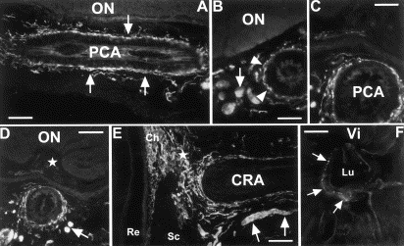
Nitrergic nerves
The PCA appears densely innervated with perivascular nNOS-containing nerve fibers (arrows). Some autofluorescence can be seen in the elastic lamella of the vessel. (B) Cross-section of the PCA at the same level as in Fig. 3(A) showing both nNOS-positive perivascular innervation (arrowheads) and thick nNOS-positive nerve bundles (arrow) which run parallel to the trajectory of the PCA. (C) Cross-section of the ON and the PCA – shortly before branching of the CRA – with nNOS-positive perivascular innervation. (D) Overview of Fig. 3(C) showing nNOS-reactive perivascular innervation and fascicular (arrows) nNOS-positive nerves. Central retinal vein (CRV) (star) without nitrergic innervation. ON: optic nerve. (E) Longitudinal section through the CRA at the level of the sclera (Sc) showing nNOS-positive reactivity. Note some nNOS-positive innervation in connection (star) with the dense nNOS-positive innervation of the choroid (Ch). Fascicular nNOS-positive bundle (arrows) run parallel to CRA. Re: Retina. (F) Cross section through the CRA at the ON head level showing delicate nNOS-positive varicosities (arrows) in a similar disposition as observed in Fig. 2D Vi: Vitreous. Lu: Lumen of CRA. Scale bar is 80μm in (A) and (B), 60μm in (C) 100μm in (D), 90μm in (E) and 50μm in (F).
Bergua et al., Experimental Eye Research 2003; 77: 367-374

Slide 22
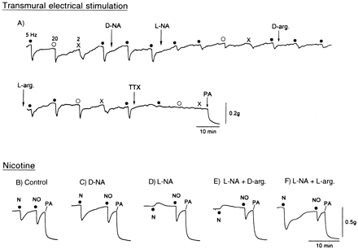
Nitrergic nerves -2
Monkey middle cerebral artery
Toda & Okamura Pharmacol Rev 55:271-324, 2003
Notes:
Typical tracings of the response of monkey middle cerebral arterial strips to transmural electrical stimulation (A) at frequencies of 2 (crosses), 5 (solid circles), and 20 (open circles) Hz, and nicotine (10-4 M, N) and nitric oxide (10-7 M, NO) (B–F). The right end of the top tracing continues to the left end of the middle tracing. Two strips from different monkeys, used for studies on the action of electrical stimulation and nicotine/NO, were partially contracted with prostaglandin F2 . A, neurogenic relaxation was not influenced by D-NA (10-6 M) but was diminished by L-NA (10-6 M); D-arginine (D-Arg, 10-3 M) did not affect but L-arginine (L-Arg, 10-3 M) completely restored the responses. Abolishment of the responses by TTX (3 x 10-7 M) supports the view that the induced relaxation is derived from nerve stimulation. PA represents 10-4 M papaverine, which produced the maximal relaxation. B–F, the relaxation induced by nicotine was not affected by D-NA (C) but was reversed to a slight contraction by L-NA (D); the L-NA-induced inhibition was not reversed by D-arginine (E) but by L-arginine (F). The relaxation induced by NO was not affected by either treatment. After the papaverine-induced relaxation was stabilized, the strip was repeatedly washed by drug-free media and was equilibrated for the next trial.

Slide 23
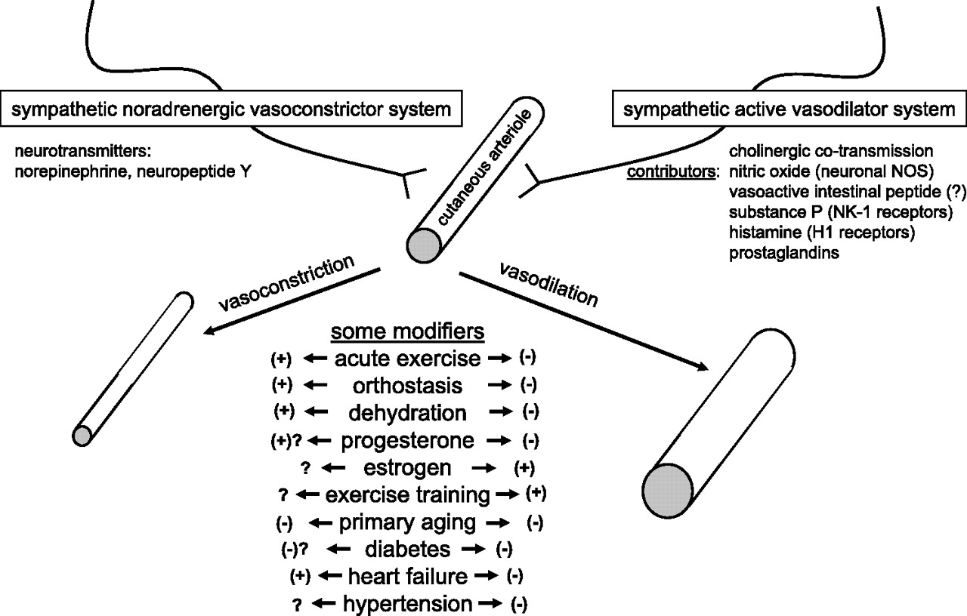
Major contributors to reflex neurogenic cutaneous vasoconstriction and vasodilation in humans, along with a summary of some potential modifiers of these processes.
Charkoudian N J Appl Physiol 2010;109:1221-1228
©2010 by American Physiological Society
Notes:
Major contributors to reflex neurogenic cutaneous vasoconstriction and vasodilation in humans, along with a summary of some potential modifiers of these processes. Many of these areas are incompletely understood, as indicated by “?”, and, therefore, are important topics for future research. NOS, nitric oxide synthase; NK-1, neurokinin-1.

Slide 24
Summary
Arteries and veins may be innervated by sympathetic, parasympathetic and non-adrenergic non cholinergic (NANC) fibres, although sympathetic fibres are generally dominant in most blood vessels.
Neurotransmitter release occurs from vesicles as a result of a rise in intracellular Ca²⁺. Release is intermittent and the relationship between the vesicle and the target cell shows variable specialization.
Many (most?) nerves contain more than one transmitter and co-transmission (either prejunctional or postjunctional) is an important aspect of neurovascular regulation.

Slide 25
Further reading
Toda N, Okamura T. The pharmacology of nitric oxide in the peripheral nervous system of blood vessels. Pharmacol Rev. 2003;55:271-324.
Burnstock G. Cotransmission. Curr Opin Pharmacol. 2004 Feb;4(1):47-52.
Burnstock G. Pathophysiology and therapeutic potential of purinergic signaling. Pharmacol Rev. 2006;58:58-86.
Pablo Huidobro-Toro J, Veronica Donoso M. Sympathetic co-transmission: the coordinated action of ATP and noradrenaline and their modulation by neuropeptide Y in human vascular neuroeffector junctions. Eur J Pharmacol. 2004;500:27-35.
Brain SD, Grant AD. Vascular actions of calcitonin gene-related peptide and adrenomedullin. Physiol Rev. 2004;84:903-34.

