Slide 1
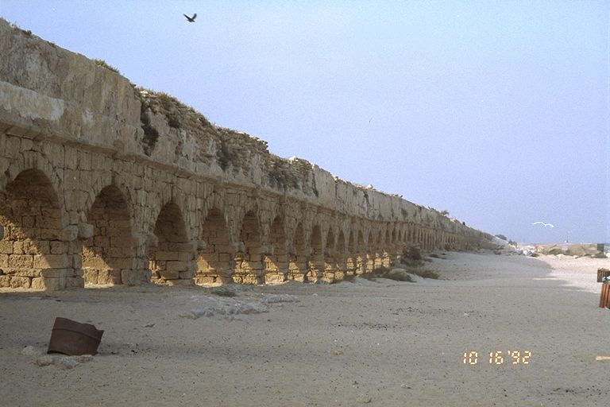
Natriuretic peptides: physiology & therapeutic potential
http://www.midwinter.com/~koreth/israel/aqueduct.jpg

Slide 2
The heart as an endocrine organ. Historical perspectives on natriuretic peptides
diuresis in Roman diving engineers in Caesarea (Flavius 94AD) and salvage divers elsewhere - ‘urinatores’
Secretory granules in atria (Kish 1956)
Atrial distension causes diuresis (Henry et al., 1956)
Atrial extract induces diuresis (De Bold 1981)
ANP sequenced ~1984 (various authors)

Slide 3
Natriuretic peptide family
5 members:
Atrial natriuretic peptide (ANP / CDD) α-ANP 23 aa peptide, β-ANP dimeric form of ANP.
Brain natriuretic peptide (BNP) 32 aa peptide
C-type natriuretic peptide (CNP) 22 aa (circulating) and 53 aa (tissue) peptides
Urodilatin (proANP 95-126)
Dendroaspsis natriuretic peptide (DNP) 38aa isolated from green mamba venom (present in plasma)

Slide 4
Synthesis of ANP
Scheme for ANP shown:
Essentially similar process for BNP & CNP except coded for by separate genes nearby on the same chromosome (mouse 1, human 2).

Slide 5
Distribution of natriuretic peptides
Dual labelling of Tupaia (tree shrew) atrium for ANP (small granules) and BNP (large granules/arrows) by EM immunocytochemistry. Forssmann et al., Histochem Cell Biol 1998; 110: 335 – 357.
Distribution of ANP (a-d, g) or urodilatin (e & f) by immuno-cytochemistry or in situ hybridization.

Slide 6
Comparison of natriuretic peptides
 | Atrial natriuretic peptide(ANP) | B-type natriuretic peptide (BNP) | C-type natriuretic peptide (CNP) | Urodilatin
Biologically active forms | ANP-28 | BNP-32 (humans) BNP-45 (rats) | CNP-22 CNP-53 | CDD/ ANP-95-126
Storage forms | proANP | BNP-32 (humans) BNP-45 (rats) | proCNP? | CDD/ANP-1-126 prohormone
Major tissue distribution | atrial myocytes | ventricular myocytes atrial myocytes | central nervous system vasculature | Renal tubule
cardiovascular effects | Vasodilatation natriuresis, diuresis, inhibition of renin, aldosterone, vasopressin and endothelin release | vasodilatation natriuresis, diuresis inhibition of renin, aldosterone, vasopressin and endothelin release | vasodilatation inhibition of proliferation of vascular smooth muscle cells inhibition of aldosterone, vasopressin and endothelin release | ?
Elimination | C-receptors Neutral endopeptidases | C-receptors Neutral endopeptidases | C-receptors Neutral endopeptidases

Slide 7
Release of NPs
ANP and BNP are released by the heart in response to atrial + ventricular (BNP) stretch (increased volume load)
CNP is released by endothelium in response to shear stress and cytokines

Slide 8
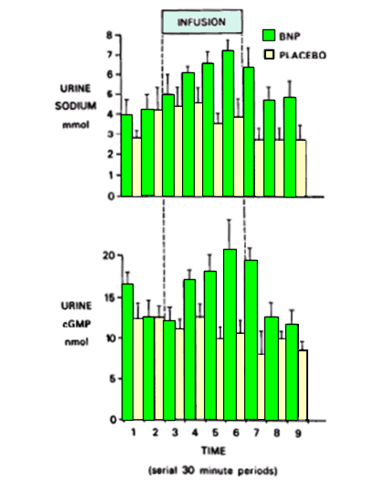
Effect of ANP & BNP
Increased natriuresis
Reduced BP (vasodilation)
Increased urinary cGMP
Holmes et al. J Clin Endo Metab 76 (1): 91. (1993)

Slide 9
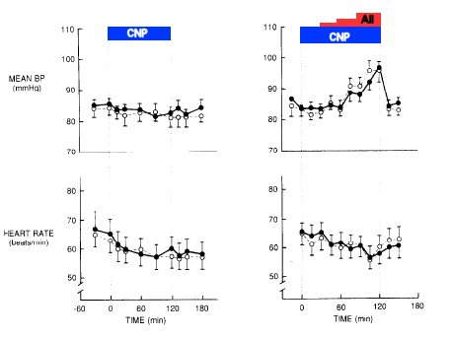
Effect of CNP
Little or no effect on natriuresis or BP
Does exert vasodilator effects in some circulations

Slide 10
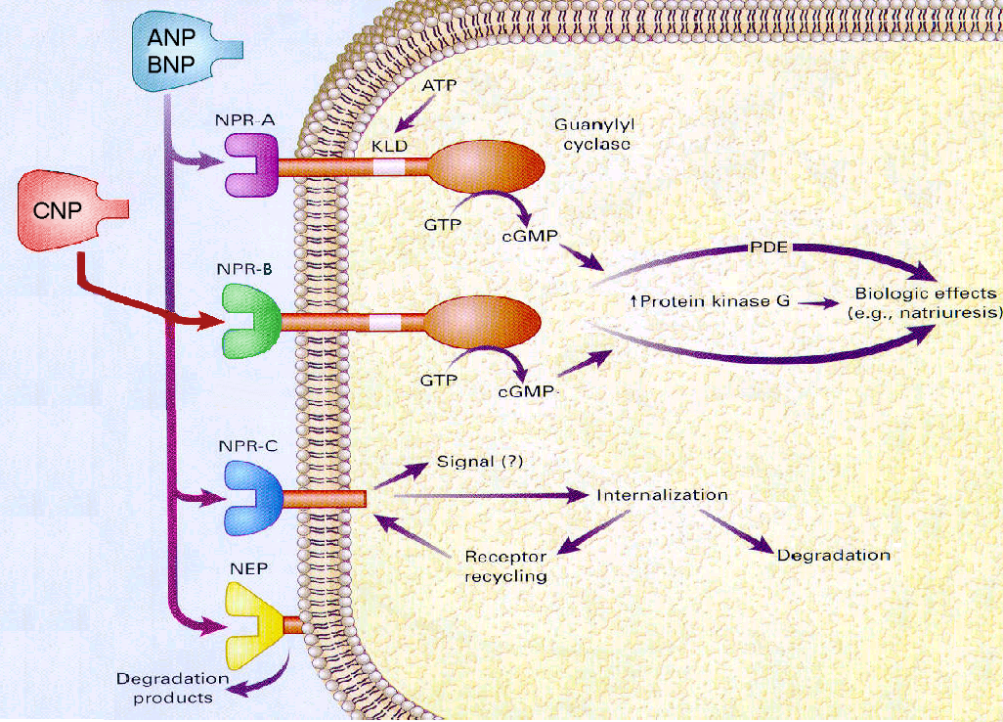
Natriuretic peptide receptors

Slide 11
Metabolism and clearance
Occurs via two routes:
Neutral endopeptidase (EC24.11) metabolises (CNP>ANP>BNP) – largely present in renal tubular and vascular smooth muscle
NPR-C (clearance receptor): NPR-C has lower affinity for BNP accounting for its longer half life than ANP
NEP inhibitors (e.g candoxatrilat) can increase levels of NP by inhibiting breakdown
NPR-C ligands (e.g. SC46542) can also increase levels of NP by inhibiting clearance

Slide 12
Neutral endopeptidase (NEP: EC24.11)
Present mainly in the brush-border membrane of renal tubules. Also present in lungs, intestine, adrenal, brain, heart and peripheral blood vessels.
Catalyses the breakdown of ANP, BNP & CNP
Also degrades other peptide hormones, such as adrenomedullin, urodilatin and bradykinin
Also converts pro-endothelin into endothelin and Ang I into Ang (1-7).

Slide 13
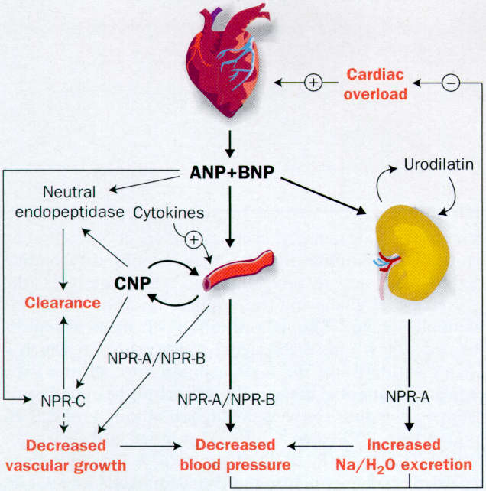
Physiology of natriuretic peptides

Slide 14
Elevated natriurietic peptides in disease
Condition | ANP | BNP
Essential hypertension | ⬆ | ⬆
Tachycardias | ⬆⬆ | ⬆
Heart failure | ⬆⬆⬆ | ⬆⬆⬆
Isolated diastolic dysfunction | ⬆⬆ | ⬆⬆
Mitral stenosis | ⬆⬆ | ⬆⬆
Aortic stenosis | ⬆ | ⬆⬆⬆
Dilated cardiomyopathy | ⬆⬆⬆ | ⬆⬆⬆⬆
Hypertrophic obstructive cardiomyopathy | ⬆⬆ | ⬆⬆⬆⬆
Myocardial infarction | ⬆ | ⬆⬆⬆
Renal failure / dialysis | ⬆⬆⬆ | ⬆⬆⬆
Responses to ANP/BNP are blunted in CHF – desensitisation?

Slide 15
Possible uses of plasma natriuretic peptides
Prediction of cardiovascular risk
Assessment of severity of congestive heart failure
Monitoring of therapy in congestive heart failure
Detection of LV diastolic dysfunction
Screening for mild heart failure
Evaluation of LV systolic dysfunction
Identification of LV hypertrophy in hypertension
Recognition of obstructive hypertrophic cardiomyopathy
Estimation of infarct size after myocardial infarction
Prognostic outcome after myocardial infarction

Slide 16
BNP or NT-proBNP
BNP is released as a pro-hormone and cleaved into BNPand NT-pro-BNP in equimolar amounts.
The in-vivo half life of BNP is ~20 min
Cf. NT-proBNP ~2 h
Commercial assays exist for both
The greater stability of NT-proBNP may offer advantages in terms of a biomarker, although comparative studies have not shown marked differences in predictive power (e.g. Masson et al., Clin Chem. 2006 Aug;52(8):1528-38; Vanderheyden et al., Clin Biochem. 2006 Jun;39(6):640-5.)

Slide 17
Therapeutics of manipulation of NP system
ANP and BNP infusion
Decrease
right-atrial and pulmonary-capillary pressure
renin and aldosterone concentration
Increase
urinary sodium and water excretion
Might a NEP inhibitor cause similar beneficial effects?

Slide 18
Therapeutic use of NEP inhibitors
In the deoxycorticosterone acetate-salt rat model (low-renin) hypertension, NEP inhibitor decreased blood pressure and increased urinary volume,
But in the spontaneously hypertensive rat (SHR), (normal renin) model NEP inhibitor do not affect BP.
Clinical experience in man (hypertension or heart failure) with neutral endopeptidase inhibitors alone (e.g. candoxatril) show adverse, absent, or small effect that are poorly sustained
Combination of NEP inhibition and ACE inhibition has been shown to be more effective on BP than either alone.

Slide 19
ACEI enhance the effect of NEPI
Change in mean arterial pressure (MAP) response in spontaneously
hypertensive rats infused intravenously with SQ 29,072 100 mg/kg
or vehicle (100 mg/kg) + 3 mg/kg/min of captopril. Seymour et al

Slide 20
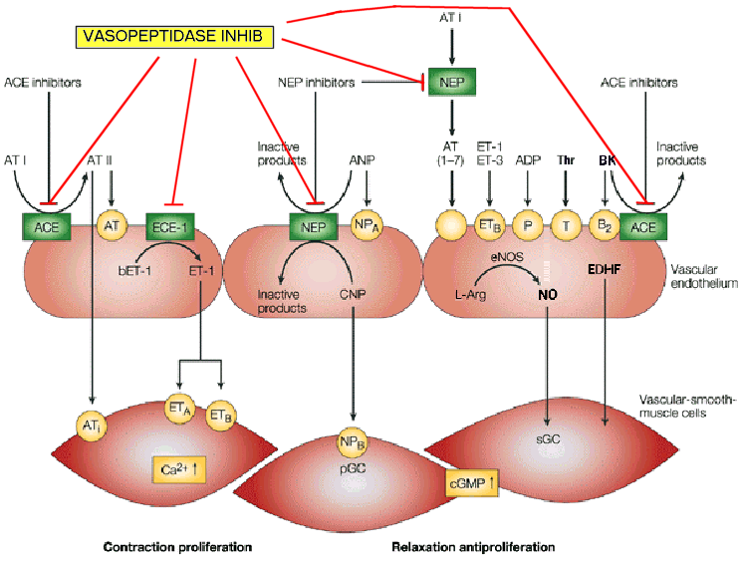
Vasopeptidase inhibitors

Slide 21
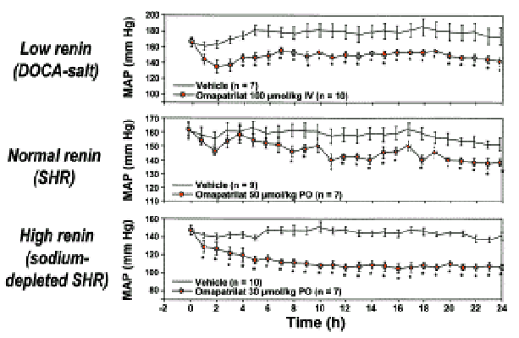
Effect of vasopeptidase inhibitor on BP in hypertensive rat models
Effect of omapatrilat on mean arterial pressure (MAP) in rat models of low, normal and high-renin hypertension. Trippodo et al.

Slide 22
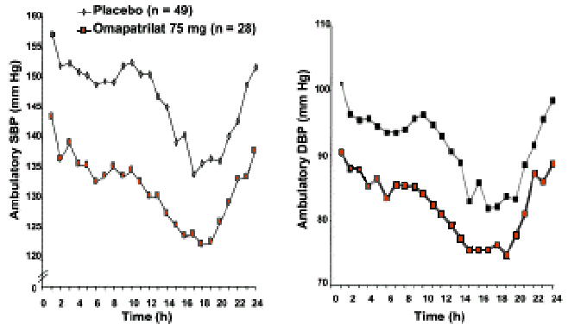
Effect of vasopeptidase inhibitor in man
Effect of omapatrilat 75 mg on mean 24-h ambulatory systolic blood pressure (SBP) and diastolic blood pressure (DBP) in patients with mild to moderate hypertension. Weber 1999

Slide 23
Vasopeptidase inhibitors – not worth it?
OVERTURE (Omapatrilat vs. Enalapril Randomised Trial of Utility of Reducing Events)
5770 NHYA II-IV CHF pts
1° endpoint: Hazard ratio 0.94 [0.86-1.03]
Angioedema (0.8% vs. 0.5%)
OCTAVE (Omapatrilat Cardiovascular Treatment Assessment vs. Enalapril)
25267 hypertensive pts
3mmHg difference in favour of omapatrilat
Angioedema (2.17% vs 0.68%; blacks 5.54% vs 1.62%)
No superiority, worse adverse effect profile. Not approved by FDA 2002.
Will endopeptidase/endothelin converting enzyme (NEP/ECE) or ACEI/NEP/ECE inhibitors fare better?

Slide 24
Novel endopeptidase inhibitor combinations
LCZ-696 – an angiotensin receptor blocker and neutral endopeptidase inhibitor (NEP) - -phase 2
CGS 26303 - an endothelin-converting enzyme and neutral endopeptidase inhibitor – animal studies
CGS 35601, a triple inhibitor of angiotensin converting enzyme, neutral endopeptidase and endothelin converting enzyme – animal studies

Slide 25
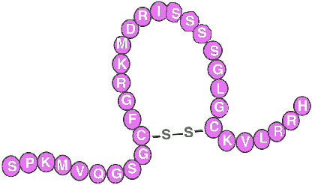
hBNP (Nesiritide)
Recombinant hBNP (32aa) iv was approved by FDA for use in acute decompensated CHF with dyspnoea at rest or minimal activity.
⬇ cardiac filling
⬆ cardiac index
⬆ diuresis/natriuresis

Slide 26
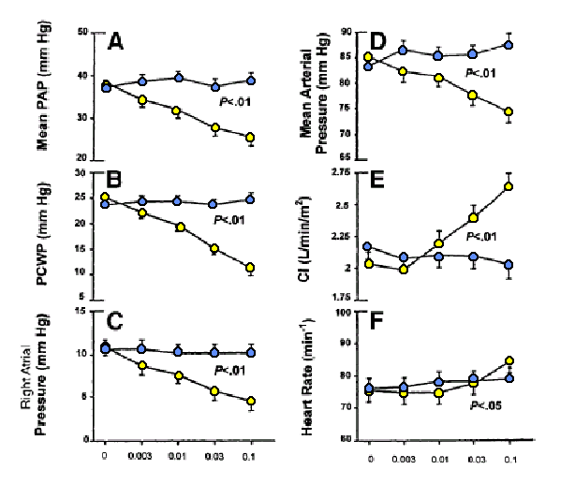
Nesiritide in patients with CHF
Marcus et al. Circulation 1996;94:3184–3189.

Slide 27
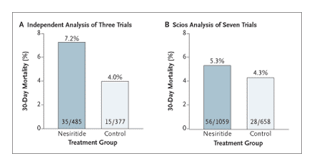
Nesiritide – a good thing?
Mortality at 30 Days among Patients Treated with Nesiritide vs.Controls in Randomized Trials.
(RR death with nesiritide vs. placebo = 1.81 (1.02 to 3.27; P=0.04) (Panel A) and 1.26 (0.80 to 2.00; P=0.33) in the analysis by Scios (Panel B)).
Topol EJ, NEJM 2005; 353:113-116.

Slide 28
Primary results and renal-function safety end point in ASCEND-HF, IV nesiritide in acute decompensated heart failure
End points | Placebo (%), n=3511 | Nesiritide (%), n=3496 | p
30-d death/HF hospitalization* | 10.1 | 9.4 | 0.31
30-d death | 4.0 | 3.6
30-d HF rehospitalization | 6.1 | 6.0
Dyspnea at 6 h* | 42.1 | 44.5 | 0.030
Moderately better | 28.7 | 29.5
Markedly better | 13.4 | 15.0
Dyspnea at 24 h* | 66.1 | 68.2 | 0.007
Moderately better | 38.6 | 37.8
Markedly better | 27.5 | 30.4
>25% decrease eGFR | 29.5 | 31.4 | 0.11
*Co–primary end points
eGFR=estimated glomerular filtration rate
1.Hernandez AF. American Heart Association 2010 Scientific Sessions; November 14, 2010; Chicago, IL. Late-Breaking Clinical Trials I.

Slide 29
Nesiritide in acute CHF
improves haemodynamic function, clinical status, dyspnoea and fatigue in acute CHF.
Major adverse effect seems to be hypotension
Safety concerns over renal function allayed by ASCEND-HF
But is it really any better than existing therapies?
Might hBNP be of value in chronic heart failure?¹
¹ Chen et al. Novel Protein Therapeutics for Systolic Heart Failure: Chronic Subcutaneous B-Type Natriuretic Peptide.
J Am Coll Cardiol. 2012 Oct 20. doi:pii: S0735-1097(12)04491-9. 10.1016/j.jacc.2012.07.056. [Epub ahead of print]

