Slide 1
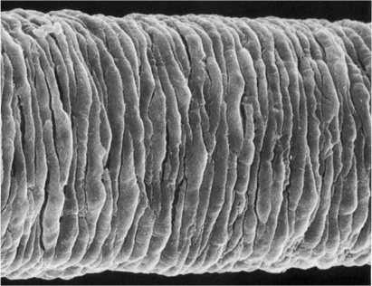
Excitation contraction coupling

Slide 2
Vasoconstriction
Blood vessel
constriction
shortening
VSMC

Slide 3
How do signals evoke contraction?
Electromechanical coupling
Predominantly driven by membrane depolarization
Pharmacomechanical coupling
Predominantly independent of membrane depolarization

Slide 4
Electromechanical coupling and intracellular Ca²⁺

Slide 5
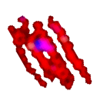
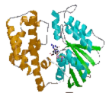
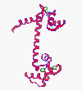
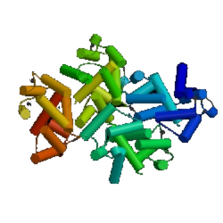
Calcium and contraction
G protein
Ca²⁺
Actin + Myosin
(relaxed)
Acto-myosin-P
(contracted)
CaM
Ca²⁺-CaM
MLCK- Ca²⁺-CaM
MLCK
Notes:
7

Slide 6
Electro- and pharmaco-mechanical coupling
Rat mesenteric small artery
Rabbit pulmonary artery
Mulvany et al., 1982
Droogmans et al., 1979
Tension
0
0
1
-10
Tension
2
-10
-20
-20
E_{m} (mV)
E_{m}
E_{m} (mV)
Wall tension (N/m)
-30
Force (g)
-30
1
-40
E_{m}
-40
-50
-50
-60
0
-60
0
0
1
3
10
0
0.03
0.1
0.3
1
3
10
NA (μM)
NA (μM)

Slide 7
Membrane potential in VSMC
Resting E_{m} of smooth muscle in arteries is between –60mV (unpressurized) and –45mV (pressurized)
Action potentials are generally not seen and depolarization rarely exceeds –20mV.
Vsmc in blood vessels are electrically coupled (λ ~2mm), by gap junctions. In at least some vessels endothelial and smooth muscle cells are also coupled by gap junctions.

Slide 8
Membrane potential in vsmc
[K⁺]
6mM
[Na⁺]
137mM
[Ca²⁺]
1.7mM
[Cl⁻]
134mM
+62mV
+150mV
-22mV
E_{rev} (Nernst)
-89mV
13mM
0.0001mM
164mM
58mM
vsmc cytoplasm
K⁺
Ca²⁺
Resting E_{m} = ~-60mV
Na-K-Cl
Na⁺
Na ⁺
K conductance is the major determinant of resting membrane potential in vascular smooth muscle cells

Slide 9
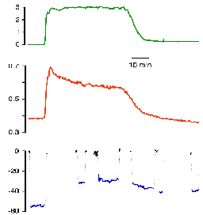
Role of Ca²⁺ channels in contraction
Rat mesenteric small artery
NA 5μM
0
1
Aml 1μM
Tension
E_{m} (mV)
Wall tension
[Ca²⁺]_{i}
-50
0
0
1
3
10
E_{m}
NA (μM)
Mulvany et al., 1982
Nilsson et al., 1998

Slide 10
Regulation of L-type calcium channels
Membrane potential
Vasoactive agents
G protein coupled receptors(e.g. α-adrenoceptors, AT₁ receptors, etc.)
Growth factors (e.g PDGF)
Vasodilators (e.g. NO)
pH
Drugs (Ca²⁺ antagonists)

Slide 11
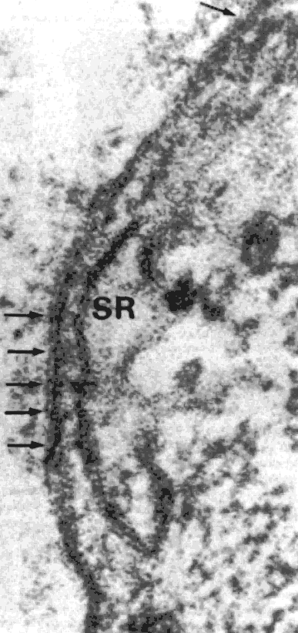
Calcium stores (sarcoplasmic reticulum)
SR = 1-7.5% of cell volume (phasic>tonic)
SR is closely associated with plasma membrane (figure)
SR Ca²⁺ is taken up by Ca-ATPase (SERCA2b & 3), which are regulated by phospholamban and blocked by thapsigargin and cyclopiazonic acid
Phospholamban is regulated by cAMP (and cGMP?) kinase
In SR Ca²⁺ is buffered by proteins (calreticulin and calcisequestrin), but [Ca²⁺] may be as high as 10-15mM
PM
SR

Slide 12
Release from Ca stores
Ryanodine receptors (RyR1, 2 & 3)
All three subtypes present in smooth muscle (cf RyR2 in cardiac muscle)
Activated by Ca²⁺ (>1μM); activated by caffeine, blocked by ryanodine
Role in vascular smooth muscle uncertain
IP₃ receptors
IP₃ generated by agonist stimulation of phospholipase C hydrolysing PIP₂
IP₃ sensitivity increased by [Ca²⁺]_{i} ~300nM (potential positive feedback)

Slide 13
Roles of Ca stores
Ryanodine receptors
Ca²⁺ induced calcium release?
Less well understood than IP3R may contribute to same processes – do they release from the same stores in smooth muscle?
IP₃ receptors
Agonist-induced release from store
Unitary Ca²⁺ events (Calcium sparks)
Calcium waves
Ion channel regulation
Transcriptional regulation

Slide 14
Ca²⁺ efflux
2H⁺
3Na⁺
Ca²⁺
Ca²⁺
ADP
ATP
PMCA (1b[& 4])
Major efflux route
Stimulated by cAMP-, cGMP- and CaM-kinase.
Blocked by lanthanum, vanadate
Na/Ca exchanger
- Electrogenic
Variable contribution (generally small) to Ca2+ extrusion in VSMC
blocked by Na removal or amiloride derivatives

Slide 15
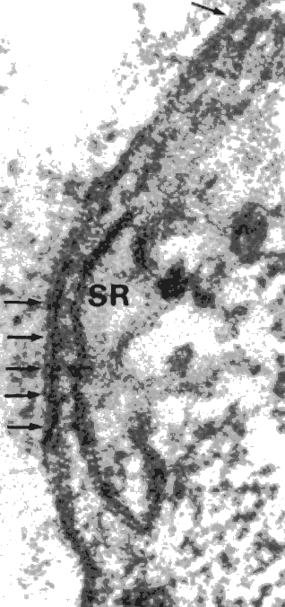
Calcium homeostasis in vascular smooth muscle cells
Ca²⁺
Ca²⁺
Na⁺
1
vsmc
2
3
SR
Ca²⁺
Mito
1. Calcium channels
2. Sarcoplasmic reticulum (intracellular stores)
3. Efflux pathways (pumps/exchangers)
4. Mitochondria?

Slide 16
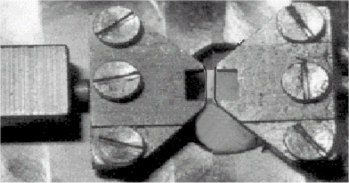
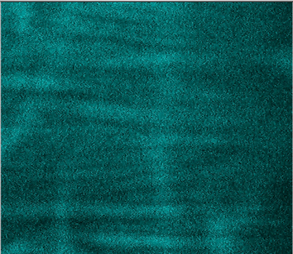
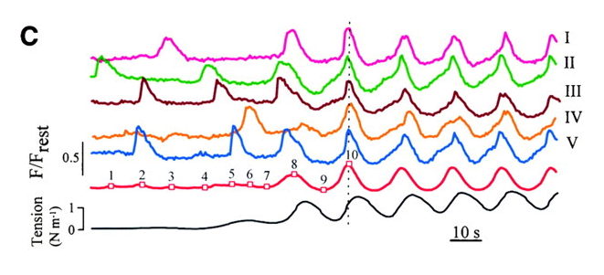
Ca waves in small arteries
At low [NA] individual VSMC show unsynchronised waves. Spontaneously, coordinated waves appear, at the same time as phasic changes in mean Ca²⁺ and tone
Peng, et al., 2001

Slide 18
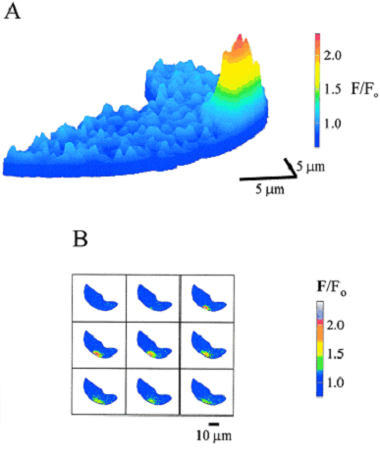
Ca²⁺ sparks
Ca²⁺ sparks
[Ca²⁺]_{i} is not homogenous in cells.
Localized elevations in [Ca²⁺]_{i} (Ca²⁺ sparks) may play an important role in regulating Ca²⁺-activated ion (e.g. K, Cl) channel activity and hence tone.
As in myocardial cells, ion channels and intracellular stores may exist as spatially associated functional units in smooth muscle.
Gollasch et al.,Circ Res 1998;83:1104-1114

Slide 19
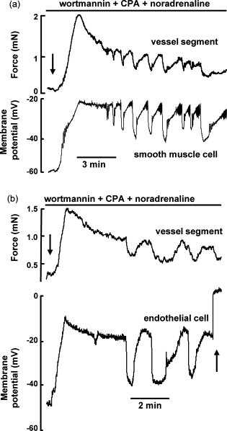
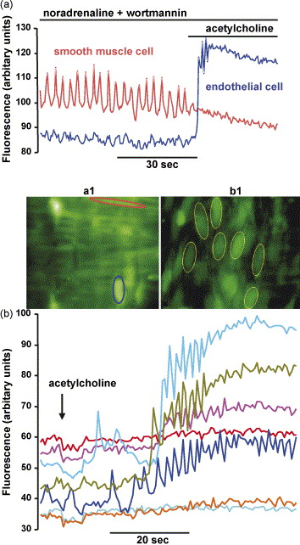
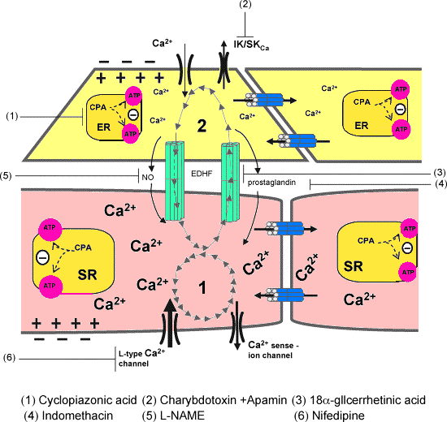
Vasomotion involves endothelial and smooth muscle cell coupling through gap junctions
In intact vessels excitation contraction coupling involves a complex interplay between endothelium, smooth muscle (coupled by gap junctions). These interactions are further modulated by neural, paracrine and endocrine factors
Rahman A, et al., Cell Calcium. 2007 Dec;42(6):536-47.

Slide 20
Pharmacomechanical coupling and Ca²⁺ sensitization

Slide 21
‘Calcium sensitization’
Isolated artery
force
NA
KCl
cAMP /
cGMP
[Ca²⁺]i
Force (or MLC₂₀-P)
K⁺
PE
[Ca²⁺]_{i}

Slide 22
‘Calcium sensitization’
‘Skinned’ artery (permeabilised with Staph α toxin)
pCa 4
PE
GTP
PE
GTPγS
GDP-β-S
GTP
PE

Slide 23
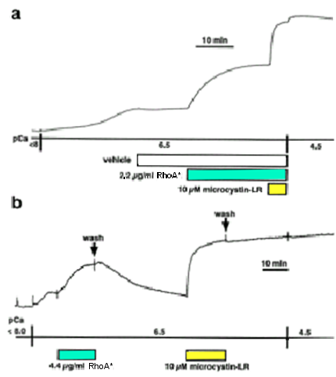
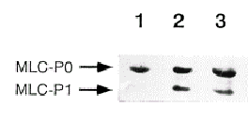
RhoA contributes to calcium sensitization
A catalytically active monomeric small G protein (CAT) can induce MLC₂₀ phosphorylation and Ca²⁺ sensitization in skinned portal
vein.
Vehicle RhoA* RhoA*
+
Wortmannin
Kureishi et al., JBC 1997; 27212257-12260

Slide 24
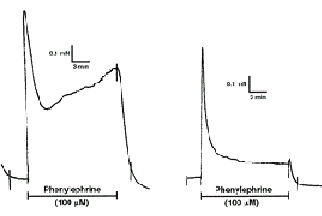
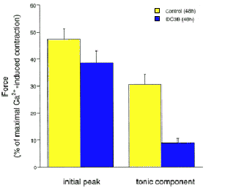
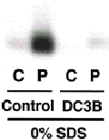
RhoA and calcium sensitization
DC3B - a chimeric toxin (clostridium botulinum exoenzyme C3 + diphtheria toxin) was used to ADP-ribosylation and inactivate rho A in rabbit portal vein
Control
DC3B
Control
RhoA inhibited
By DC3B
Phosphorylation of LC20
(c = control; p = phenylephrine)
Fujihara et al., Mol Cell Biol 1997

Slide 25
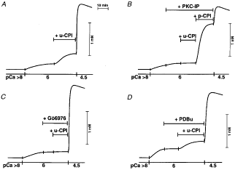
A protein-kinase C-potentiated myosin phosphatase inhibitor (CPI-17) also mediates PKC-induced sensitization
u-CPI = unphosphorylated CPI-17
p-CPI = phosphorylated CPI-17
Go6976 = PKC inhibitor
PKC-IP = PKC inhibitor peptide
Eto J Biol Chem. 2001 Aug 3;276(31):29072-8. Epub 2001 Jun 7.
Notes:
Figure 1. Different efficacies of phorbol ester PDBu on contractile Ca2+ sensitivity in -toxin-, -escin- or Triton X-100-permeabilized arterial smooth muscle. Strips of rabbit femoral artery were permeabilized with staphylococcal -toxin + A23187 (A), -escin + A23187 (B), or Triton X-100 (C) and then incubated in the relaxing solution (see Methods). They were placed in a submaximal pCa 6·7 (A), 6·3 (B) or 6 (C) solution until reaching a low steady-state level of force at 20 °C. Three micromolar PDBu was applied into the same pCa solution. After a steady-state level of force was reached, PDBu was washed out and a pCa 4·5 solution was added to verify maximum force levels in the preparations. D, summary of 4-6 independent experiments for each permeabilized preparation. The filled and hatched bars represent, respectively, relative force levels before and after addition of PDBu.
Figure 4. Unphosphorylated CPI-induced contractions of Triton X-100-demembranated strips at a given level of Ca2+ A, potentiation of contraction by 5 µM u-CPI at pCa 6. The u-CPI-induced contraction was inhibited by the presence of selective PKC inhibitor 30 µM PKC-IP (B) or 10 µM Gö6976 (C). These traces are representative of 4 similar experiments.

Slide 26
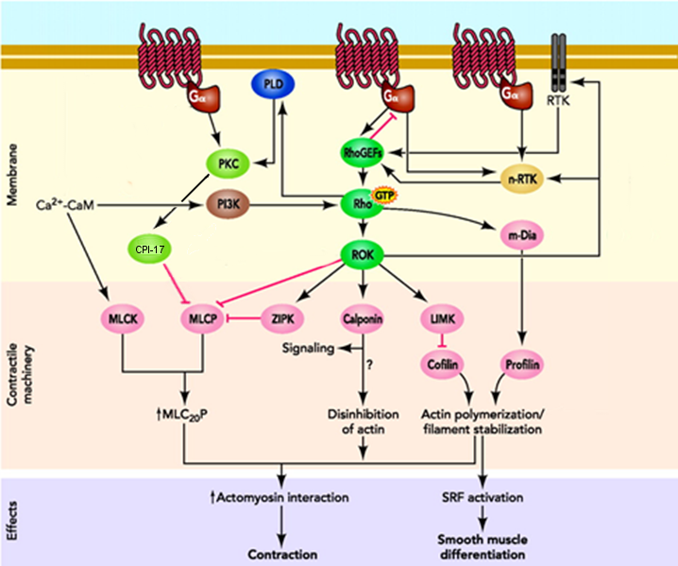
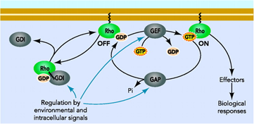
Pathways of calcium sensitization
Rho cycling

Slide 27
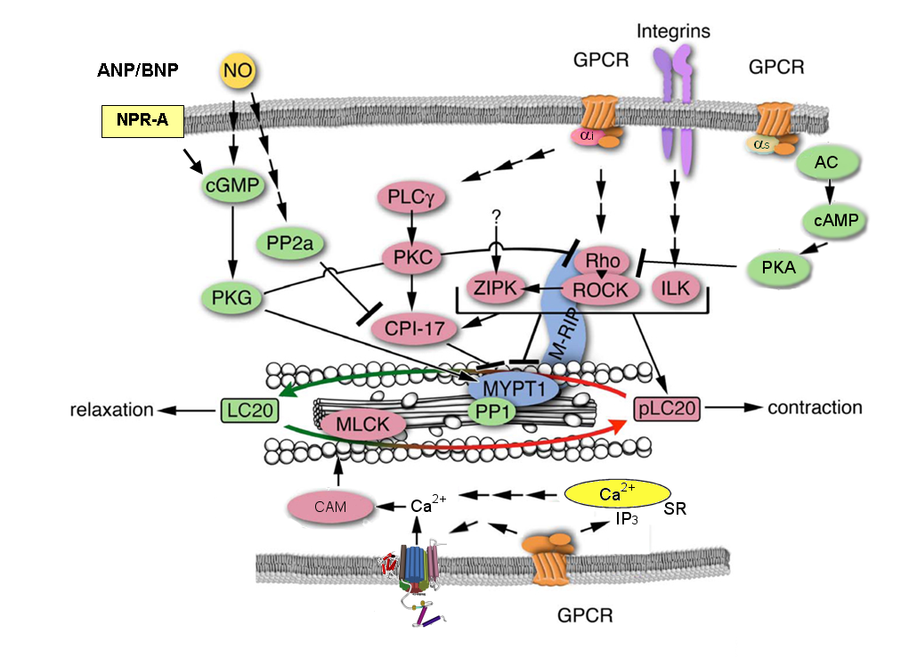
Summary of mechanisms of excitation contraction coupling
Modified from Kim et al., J Cell Mol Med. 2008 December; 12(6A): 2165–2180
Notes:
ANP = atrial natriuretic peptide, CPI-17 = protein-kinase C-potentiated myosin phosphatase inhibitor, ILK =- integrin-linked kinase, LC20 = myosin light chain, MLCK = myosin light chain kinase, M-RIP = myosine phsophatse rho interacting protein, MYPT1 = myosin phosphatase targeting protein 1, PKC = protein kinase C, PKG = protein kinase G, PLC = phospholipase C, PP1 = protein phosphatase 1, PP2a = protein phosphatse 2a, ROCK – rho-operated kinase, ZIPK = zipper interacting protein (ZIP) kinase

Slide 28
Summary
L-type calcium channels are the major influx pathway for Ca²⁺ in most blood vessels
Localized changes in [Ca²⁺]_{i} may be important in cell coordination, regulation of vascular tone via ion channel activity and possibly growth
A rise in [Ca²⁺]_{i} plays a key role in contraction, but other signalling pathways make an important contribution to force production in VSMC via calcium sensitization, principally via modulation of myosin phosphatase

Slide 29
Further Reading
Cheng H, Lederer WJ. Calcium sparks. Physiol Rev. 2008;88:1491-545.
Somlyo AP, Somlyo AV. Ca2+ sensitivity of smooth muscle and nonmuscle myosin II: modulated by G proteins, kinases, and myosin phosphatase. Physiol Rev. 2003 Oct;83(4):1325-58.
Nilsson H, Aalkjaer C. Vasomotion: mechanisms and physiological importance. Mol Interv. 2003 Mar;3(2):79-89, 51.
Puetz S, Lubomirov LT, Pfitzer G. Regulation of smooth muscle contraction by small GTPases. Physiology (Bethesda). 2009 Dec;24:342-56
Thorneloe KS, Nelson MT. Ion channels in smooth muscle: regulators of intracellular calcium and contractility. Can J Physiol Pharmacol. 2005 Mar;83(3):215-42.
Wellman GC, Nelson MT. Signaling between SR and plasmalemma in smooth muscle: sparks and the activation of Ca2+-sensitive ion channels. Cell Calcium. 2003 Sep;34(3):211-29

