Slide 1
Principles of PKPD - Preclinical models in toxicity testing / Drug development Dr Muireann Coen Biomolecular Medicine, Department of Surgery and Cancer, Imperial College London

Slide 2
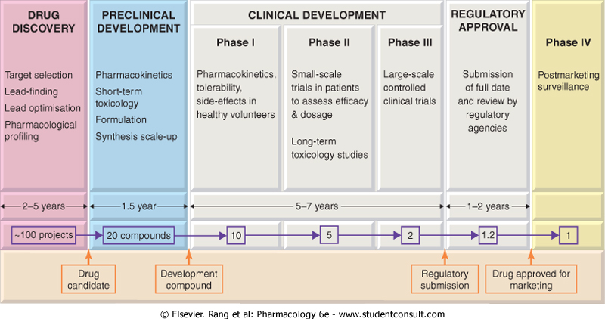
Stages of Development of a New Drug

Slide 3
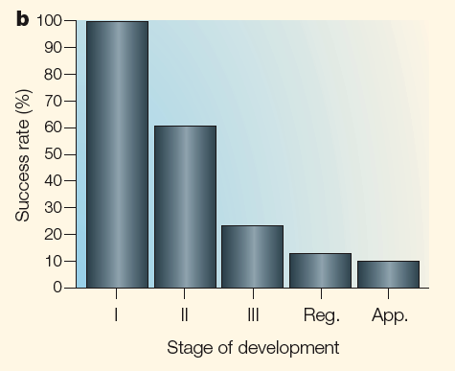
The Drug Discovery Pipeline
Discovery
Development
Pre-clinical
Increasingly High Drug Attrition Rates
Clinical
Kola and Landis, Nature Reviews Drug Discovery, 2004

Slide 4
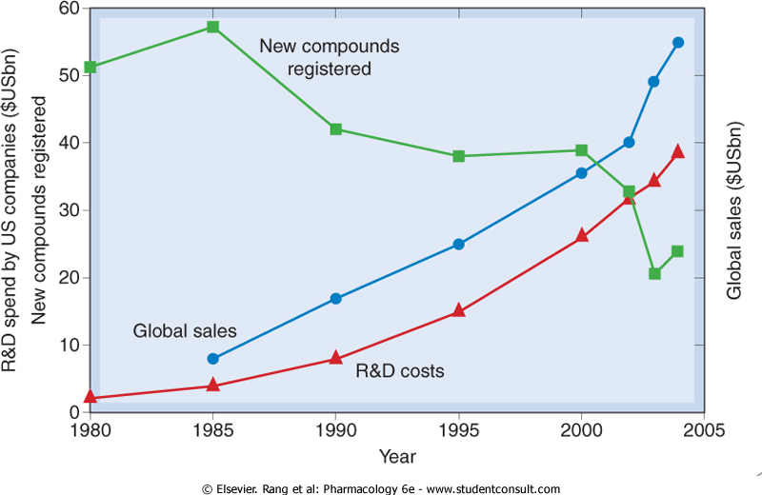
R&D Spend, Sales and New Drug Registration

Slide 5
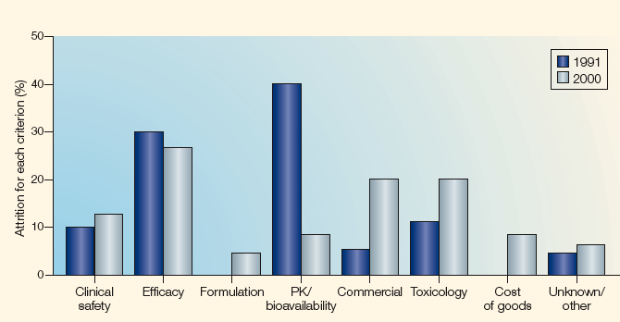
Reasons for Attrition
Efficacy and Toxicity/Clin Safety = Major Reasons
PK/bioavail change – can identify/remedy but also shift to later stages – fail for other reasons

Slide 6
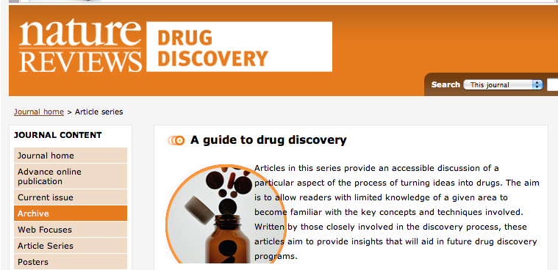
Recommended Reading
Nature Reviews, Drug Discovery: A guide to drug discovery – article archive on http://www.nature.com/nrd/series/drugdiscovery/index.html

Slide 7
The Pre-clinical Stage
Steps before a new compound can be tested in humans
Laboratory and animal studies to -
Scale up and optimise chemical synthesis
Choose formulation
Investigate formulation stability
Prove biological efficacy in animal models
Conduct safety studies (toxic threshold/genotoxicity?)
Evaluate drug metabolism (ADME)

Slide 8
Pre-formulation Tasks
Determination of the physico-chemical properties of a drug
Solubility
pK values
Partition coefficient
Chemical stability profile
Crystal form and polymorphism
Particle size, shape and surface area

Slide 9
Formulation
This is carried out after pre-formulation studies or sometimes concurrently
The route of administration has to be considered
The dose form has to be confirmed – tablet, intra-venous, skin patch, cream, buccal dose, suppository, etc
Formulations are tested for physical and chemical stability at higher temperatures
Often need to develop new analytical methodology
HPLC for quantifying degradation products is common

Slide 10
The Pre-clinical Phase - Biology
Pharmacology
Molecular mechanisms of action and targets
Mechanisms of drug resistance
Determinants of response
Intracellular pharmacodynamics
Molecular pharmacology (primary/secondary)

Slide 11
The Pre-clinical Phase - Biology
In vitro studies using isolated cell systems
Used for study of substrates/inhibitors and metabolism of drugs – cytotoxicity/efficacy/safety/genetic toxicity
Genetic toxicity eg Ames Test - A bacterial ‘reverse mutation’ mutagenicity assay that is designed to identify frame- shift and base-pair-substitution point mutations.
Metabolite-mediated toxicity: Glutathione binding assays or covalent binding (radiolabel)
Can guide in vivo study design

Slide 12
In vivo signal generation
in vitro assays often can not reliably predict safety margins, as there is no efficacy end point and pharmacokinetic parameters are not faithfully reproduced in vitro
In vivo studies using animal models
Proof of therapeutic principle
Animal pharmacokinetics and pharmacodynamics
Toxicology (single and repeat dose studies)
Starting dose and schedule for clinical trials

Slide 13
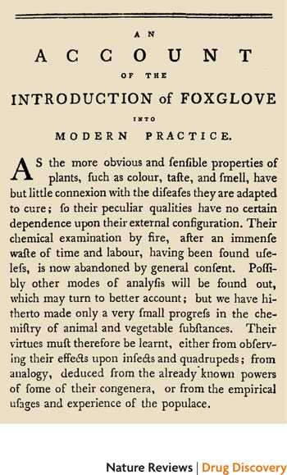
Early Record of need for In Vivo Animal Models for Toxicity Testing William Withering laments the lack of chemical methods available to study drugs and accepts that the second-best method is the study in whole animals and in humans. (Oxford Univ. Press, London, 1785). See: Cohen, Nature Reviews Drug Discovery, 2010, Epub

Slide 14
In Vitro Preclinical Model Systems
Sub-cellular fractions
Microsomal, S9
Tissue derived and recombinant
Liver, Kidney, intestine, lung etc
E Coli, yeast, insect cells etc
Whole cell systems
Hepatocytes etc.
Mammalian Cell lines

Slide 15
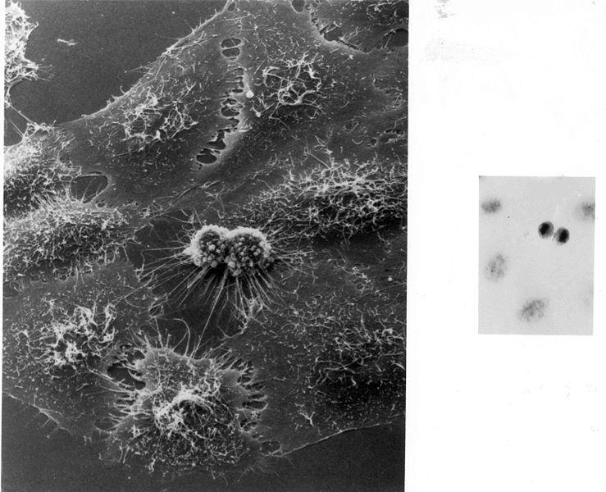
Cell Lines and Cell Culture
Primary Cells – explanted directly donor, short survival times (Hayflick limit), senescence
Secondary Cells – explanted, cultured and divide/grow for time (eg MRC5 cells – human lung fibroblasts)
Immortalized cell lines - can provide unlimited tissue amounts - transformed cells as growth properties altered (HeLa cells)
Cancer Cell Lines – rapid division

Slide 16
Limitations of In Vitro Models
Sub-cellular fractions need addn co-factors eg CYP/FMO – NADPH; NAT – AcetylCoA
In primary culture, use of special substrates (collagen, laminin, extracellular matrix preparations), growth factors and soluble media supplements, is complex
Difficulties in obtaining adequate tissue amounts - immortalized cell lines
lack of metabolism, differences in sensitivity of cell types, culture conditions and the context of the ultimate target tissue in vivo
Stability and/or viability major issues

Slide 17
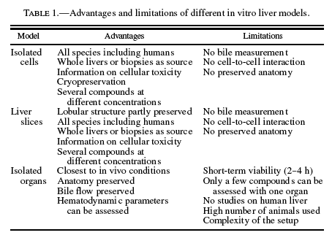

Slide 18
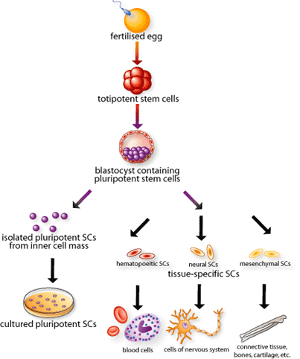
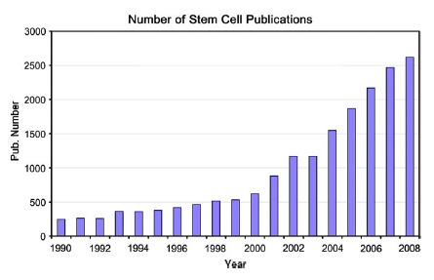
Stem Cells – Novel In Vitro Models
Much research - regenerative medicine
Delivered new assays to predict embryo-fetal developmental toxicity in vitro
mixtures of cells much more representative of tissues in vitro – can monitor alterations in homeostasis

Slide 19
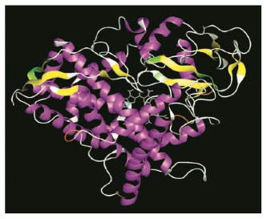
In Silico Models
Computer Based Approach – Data Modelling (eg Protein binding) & Molecular Modelling
Prediction – QSAR – multivariate modelling eg PLS
- Physicochemical properties (eg lipophilicity/H bonding)
- absorption, distribution, metabolism, excretion (ADME) and toxicity (T) ADMET
Van de Waterbeemd and Gifford, Nature Reviews, ADMET IN SILICO MODELLING: TOWARDS PREDICTION PARADISE?, 2003, 2, p192

Slide 20
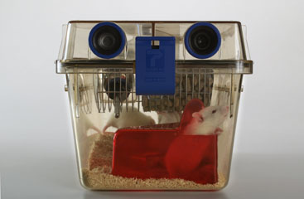
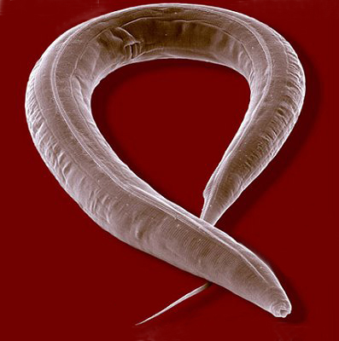
In Vivo Animal Models
one rodent and one non-rodent, have to be included in preclinical safety studies before human testing
Considerations: Species, Strain, Sex, Age, Diet, Housing, Dosage, Sample Collection, Termination, Time-points etc…
C elegans, fruit-flies and zebra fish – new models: faster, cheaper, more ethical

Slide 21
Genetic/Transgenic Models
Selective Breeding – animals with characteristics of a disease, eg genetically obese mice – responsible genes often not identified
Transgenic models – deliberate genetic manipulation of germ-line
Inactivate individual genes (knock-out)/introduce new genes (knock-in)/over-express
Phenotypic changes that can mimic human disease
E.g. Alzheimer’s Disease mouse model – over expresses mutated forms of amyloid precursor protein

Slide 22
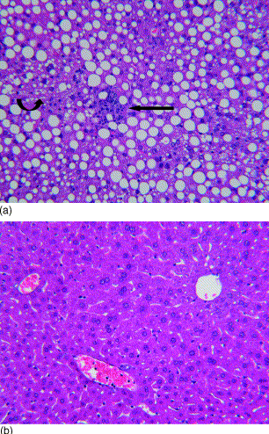
Metabolic/Diet-Induced Models of Disease
MCD
Methionine/choline deficient (MCD) diet –
histological steatohepatitis very similar to human non-alcoholic steatohepatitis (NASH) – although metabolic background different
CONTROL

Slide 23
The 3Rs - Replacement, Refinement and Reduction
a widely accepted ethical framework for conducting scientific experiments using animals humanely
Replacement: Established animal cell lines, Animal cells, tissues and organs collected from animals killed by a humane, nematodes etc.
Reduction: Improved experimental desdign and statistical analysis, modern imaging techniques, sharing data and resources
Refinement: improvements to scientific procedures and husbandry which minimise actual or potential pain, suffering, distress or lasting harm and/or improve animal welfare in situations where the use of animals is unavoidable.

Slide 24
Translatability from animal to man??
Huge species differences eg morphine is a strong emetic in dogs, it does not have this effect in rats, and to a much lesser extent in humans
Anatomical and physiological differences e.g. physical size
Nonhuman primates – ethical issues and high costs
APAP is a good example of a useful translatable model - an in vivo mouse model resembling human APAP toxicity – need more of these models

Slide 25
Translatability from animal to man??
Differences in age (young animals Vs variable aged human populations)
Genetic background homogeneous (animal) Vs heterogeneous (man)
Healthy Animal Vs Diseased Patient
Therapeutic Vs Toxic Dose – how does high drug concentrations used in in vitro/in vivo models relate to therapeutic doses?
Environmental Factors: Controlled Vs Variable – e.g. nutrition, concomitant therapies…
* Are these in vitro/in vivo/in silico models predictive of adverse drug reactions in human populations??

Slide 26
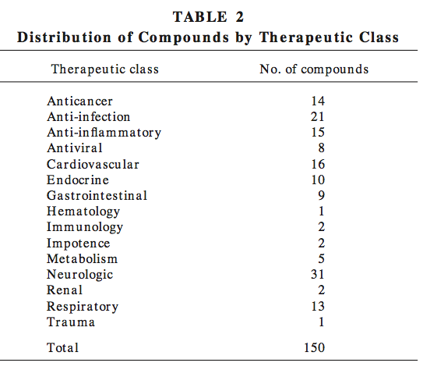
221 separate cases of compounds associated with significant human toxicity (HT) were recorded. A total of 150 compounds contributed to this series with multiple HTs being recorded in 47 cases.

Slide 27
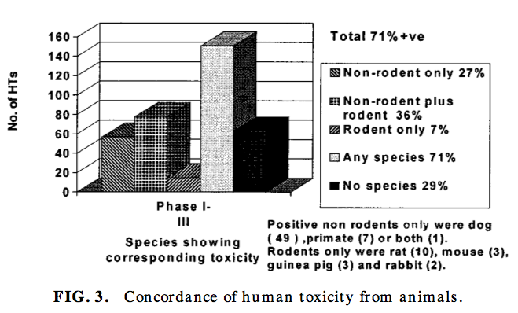
70% concordance in one or more preclinical animal model – target organ toxicity in both animal and human Remaining 30% - no relationship between human and animal

Slide 28
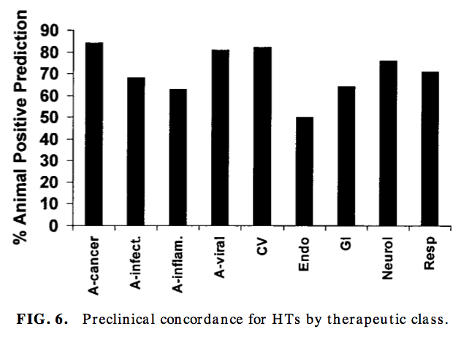
Best concordance for hematological, gastro- intestinal, and cardiovascular toxicities and the least for cutaneous toxicity
Dependence on therapeutic class
94% detected within one month in animals
Liver toxicity never reported after single dose in animals

Slide 29
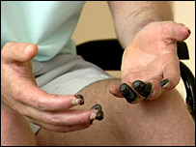
CD28 agonist TGN1412
Proposed Treatment for B-cell chronic lymphocytic leukemia and rheumatoid arthritis
A strong agonist for the CD28 receptor of T cells – ie induces a T-cell response
A monoclonal antibody, based on an antibody produced in a mouse.
“Humanised” - genetically engineered so that it will be immunologically accepted in humans, so the drug given to humans was not the same as the one used in animal testing.
Significant differences in the immune system between species

Slide 30
CD28 agonist TGN1412
TGN1412 caused serious damage (systemic organ failure) in six healthy volunteers in a first-in-human trial
Cytokine Storm: Feedback loop between cytokines and T-cells impaired – too many immune cells are activated
Administered at a ‘sub-clinical’ dose of 0.1 mg per kg; 500 times lower than the dose found safe in animals
Not fully understood what went wrong but criticism with lack of integration of results from pre-clinical studies
Toxicology tested in an animal species but pharmacological effects not detailed.
One problem was dosing six individuals with the drug within 20 mins, rather than at longer intervals

