Slide 1
Receptors BSc Pharmacology & Translational Medical Science, yr 2 MBBS, yr4
Marc-Emmanuel Dumas, PhD
Biomolecular Medicine, Dept Surgery and Cancer
Sir Alexander Fleming Building, room 360
South Kensington Campus
m.dumas@imperial.ac.uk

Slide 2
Learning objectives
Discuss the role of receptors and why they are good drug targets
Define 4 types of receptors and their mechanisms
Ligand-gated ion channels
G-protein coupled receptors
Kinase-linked receptors
Nuclear receptors
Describe how drugs interact with receptors

Slide 3
Outline
Biological role of receptors
Types of receptors
Ligand-gated ion channels
G-protein coupled receptors
Kinase-linked receptors
Nuclear receptors
Mechanism of action of drugs and receptors
agonism, antagonism

Slide 4
What are receptors? How do they work?
Communication between nerves and cells
Nerves in CNS send messages to target cells
Cells of one tissue send messages to other cells
Chemical messenger = neurotransmitter or hormone
Nerve
Signal
Messenger
Receptor
Nucleus
Cell

Slide 5
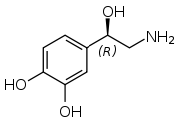
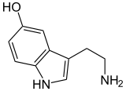
Typical neurotransmitters
Cover gap between nerve and cell
Structures vary
Ions
Lipids, purines, peptides
Monoamines, amino acids
Noradrenaline Serotonin Dopamine

Slide 6
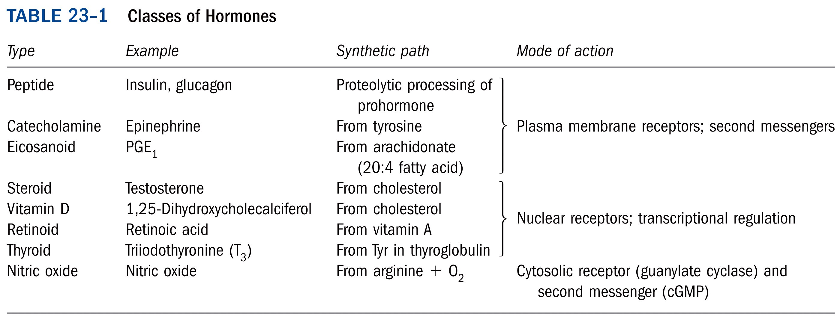
Hormones
Endocrine, paracrine, autocrine

Slide 7
Receptors
Nerve 1
Blood
supply
Nerve 2
Hormone
Neurotransmitters

Slide 8
Binding and action of messenger
Nerve
Nerve
Signal
Messenger
Receptor
Response
Nucleus
Cell
Cell
Resting State
Messenger
Induced fit
Messenger
Messenger
Cell
Receptor
Membrane
Receptor
Receptor
Cell
Cell
Cell
message
Message

Slide 9
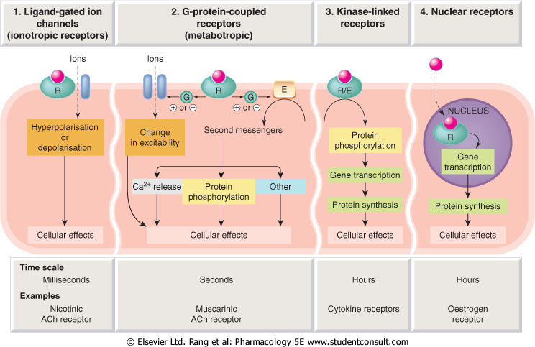
Type 1: ligand-gated ion channels

Slide 10
Ligand-gated ion channels
Ligand-gated ion channels = “ionotropic receptors”
Respond within milliseconds
Membrane proteins :
made of several subunits
structure similar to other ion channels
incorporating ligand-binding site = receptor
Examples:
nicotinic acetycholine receptor
GABA_{A} receptor
glutamate receptor

Slide 11
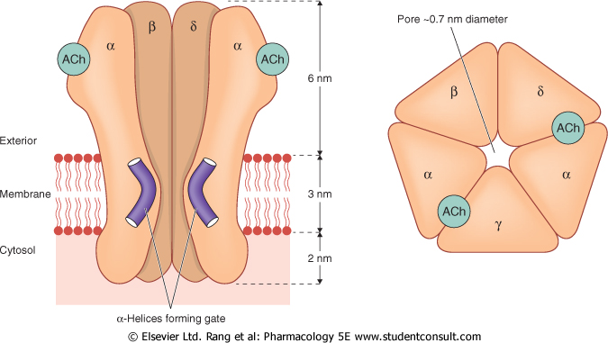
Typical ion channel: Acetylcholine nicotinic receptor

Slide 12
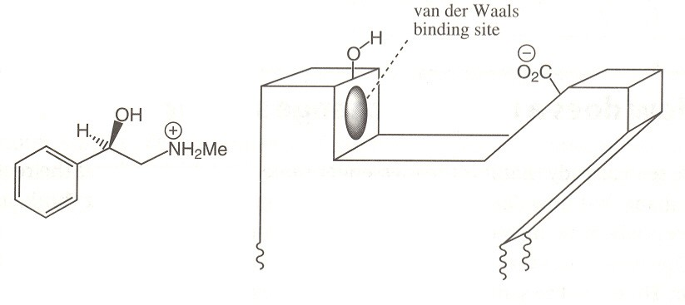
A hypothetical neurotransmitter and receptor:
What binding groups exist on the neurotransmitter?
On the binding site?

Slide 13
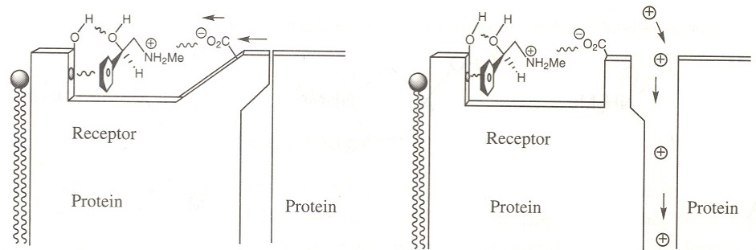
Lock-gate mechanism

Slide 14
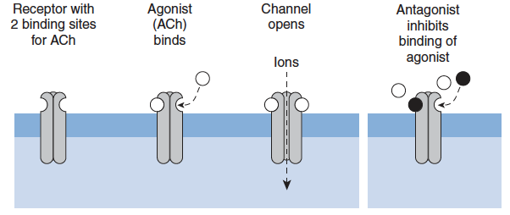
Ach nicotinic receptor

Slide 15
Type 2: G-protein coupled-receptors

Slide 16
Type 2: G-protein coupled-receptors

Slide 17
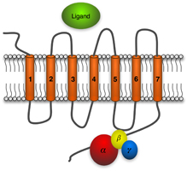
G-protein-coupled receptors
Receptors coupled to intracellular enzymatic effector systems = “metabotropic receptors”
Respond within seconds
transmembrane proteins :
Monomeric, but 7 transmembrane domains = “serpentine”, snake-like
Coupled to G proteins (guanine nucleotide-binding proteins)
Examples:
Muscarinic acetycholine receptor
Adrenoreceptors

Slide 18
G-proteins
Guanine nucleotide-binding proteins
Heterotrimeric complexes
α, β, γ subunits
Gα subunit act as molecular switch
guanosine triphosphate (GTP) = activated
guanosine diphosphate (GDP) = deactivated
Different types of subunits => different targets
“Second messengers”
Also small GTPases (not covered)

Slide 19
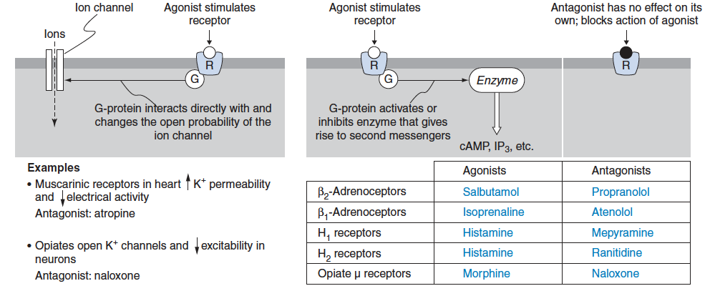
G-protein-coupled receptors

Slide 20
Membrane-bound enzyme activation via G-proteins

Slide 21
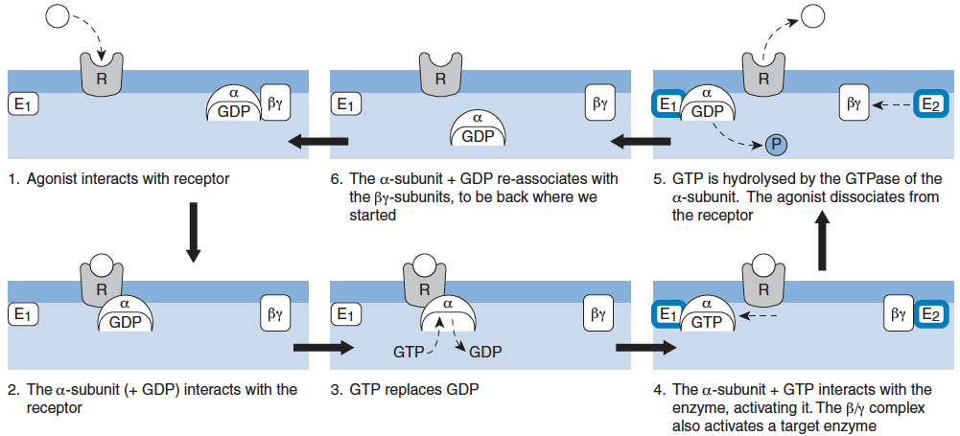
Mechanism of G-protein coupled receptor transduction

Slide 22
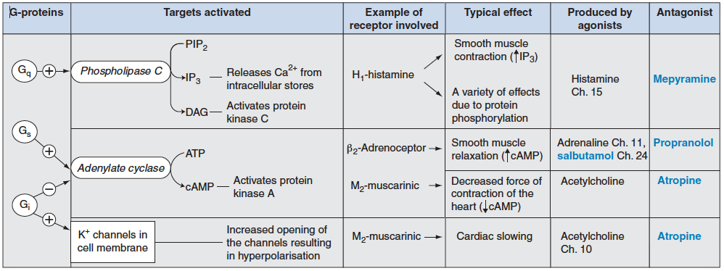
Examples of G-protein-coupled actions

Slide 23
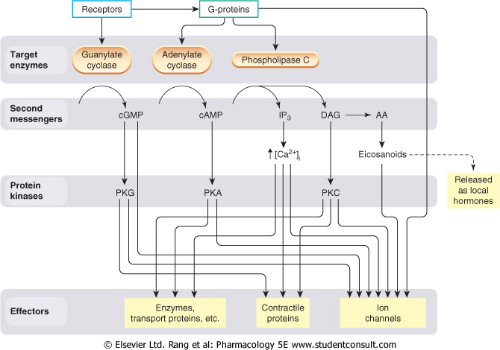
Diversity of G-protein coupled actions

Slide 24
Type 3: Kinase-linked receptors

Slide 25
Type 3: Kinase-linked receptors

Slide 26
Kinase-linked receptors
Receptors coupled to intracellular kinase
Respond within hours
Heterogeneous family of proteins :
Monomeric
Single transmembrane helix linking extracellular receptor domain to intracellular kinase domain
Examples:
Insulin receptor
Growth factor receptor
Cytokine receptors
etc…

Slide 27
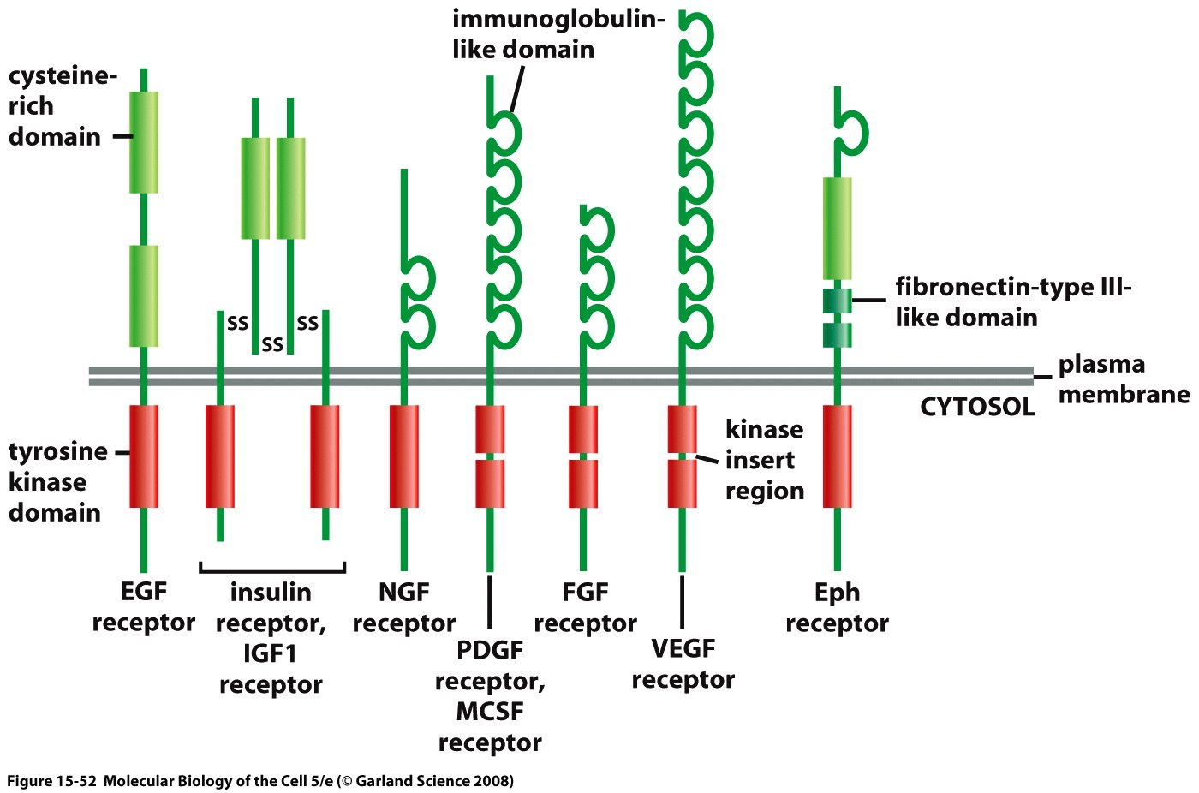
Different types of Receptor Tyrosine Kinases (RTKs)

Slide 28
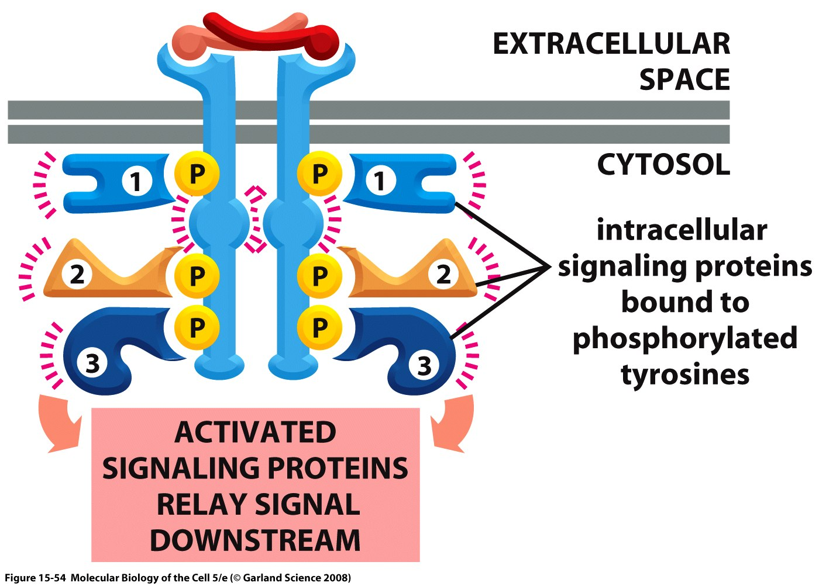
Mechanism of action

Slide 29
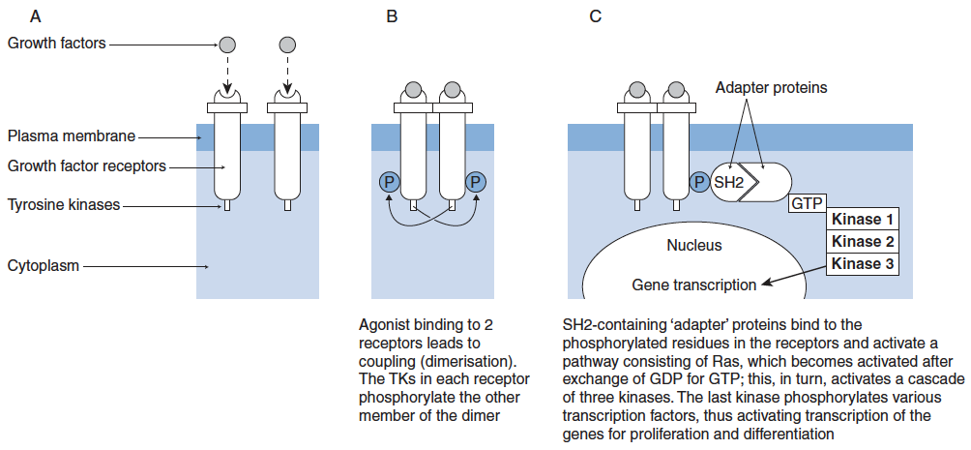
Typical tyrosine kinase cascade

Slide 30
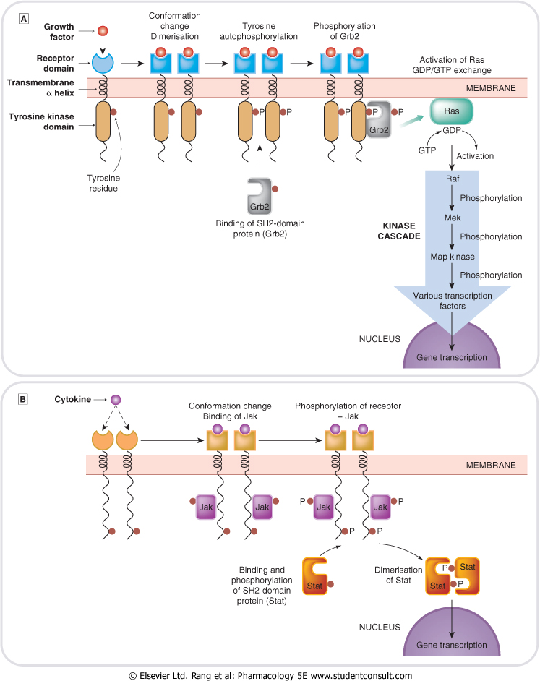
Growth factor cascade

Slide 31
Cytokine receptor cascade

Slide 32
Type 4: Nuclear Receptors

Slide 33
Type 4: Nuclear Receptors

Slide 34
Nuclear Receptors
Intracellular receptors affecting gene transcription
Respond within hours
Large family of proteins:
Monomeric
DNA binding domain “zinc fingers”
Examples:
Thyroid hormone receptor
Steroid receptors

Slide 35
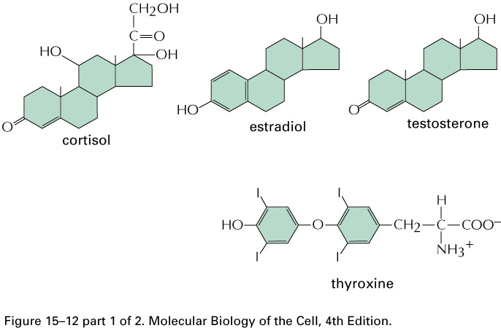
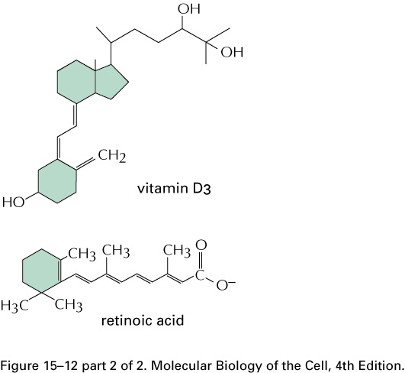
Examples of molecules binding nuclear receptors
Notes:
Some signaling molecules that bind to nuclear receptors. All of them are small and hydrophobic. In addition there are progesterone. The only lipophilic hormone that bind to cell surface receptors are the prostaglandins.

Slide 36
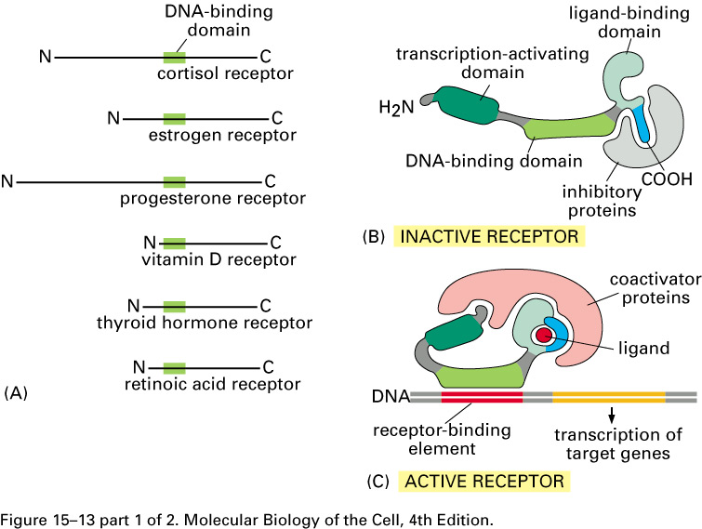
The Nuclear Receptor superfamily (1)
Notes:
The nuclear receptor superfamily

Slide 37
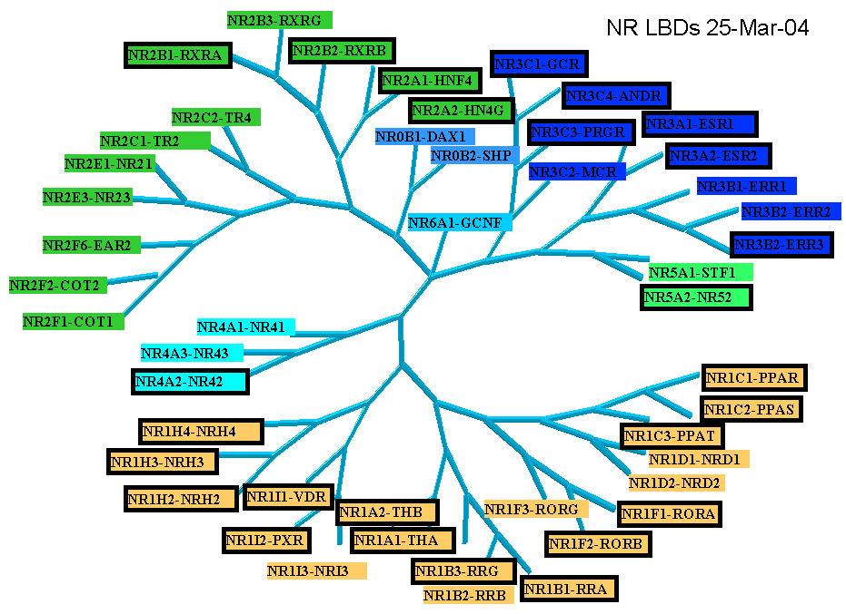
The Nuclear Receptor superfamily (2)

Slide 38
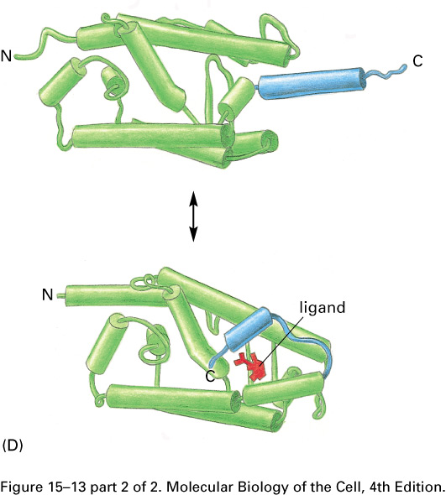
3D structure of Nuclear Receptors

Slide 39
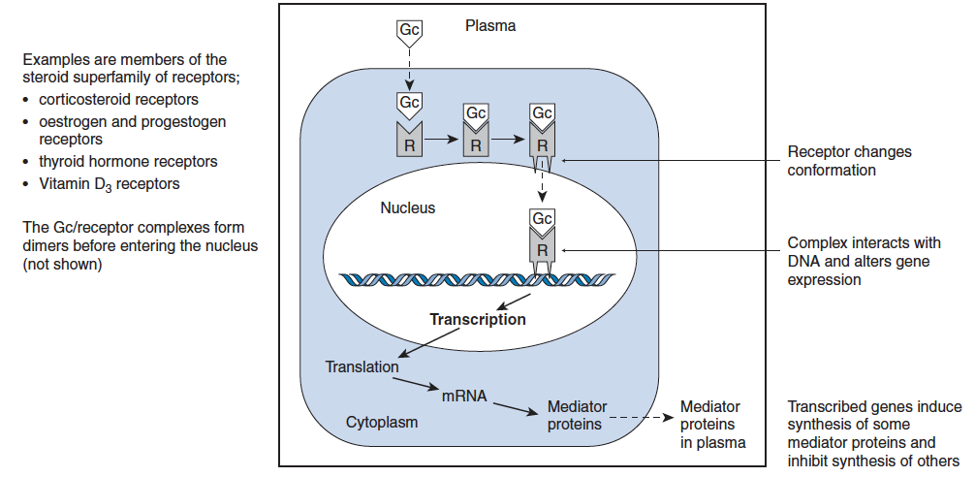
Generic Nuclear Receptor Mechanism

Slide 40
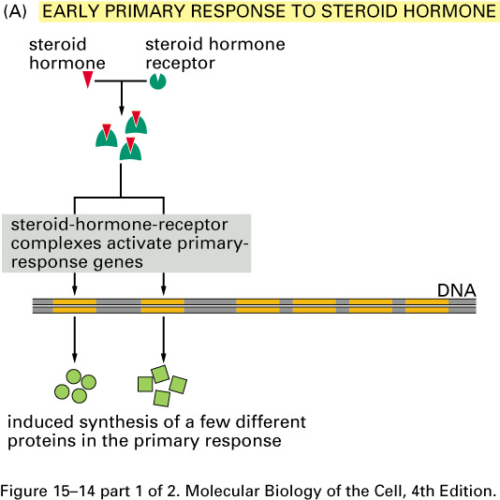
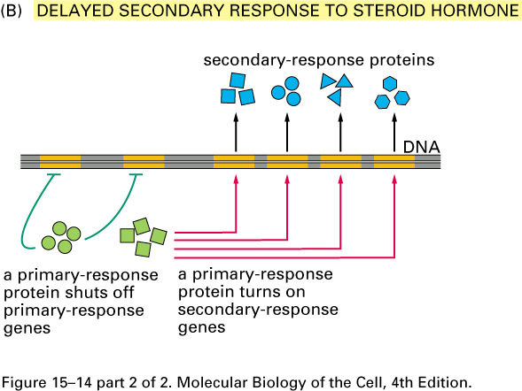
Two types of responses
Notes:
There are 2 types of responses induced by the activation of nuclear hormone receptor

Slide 41
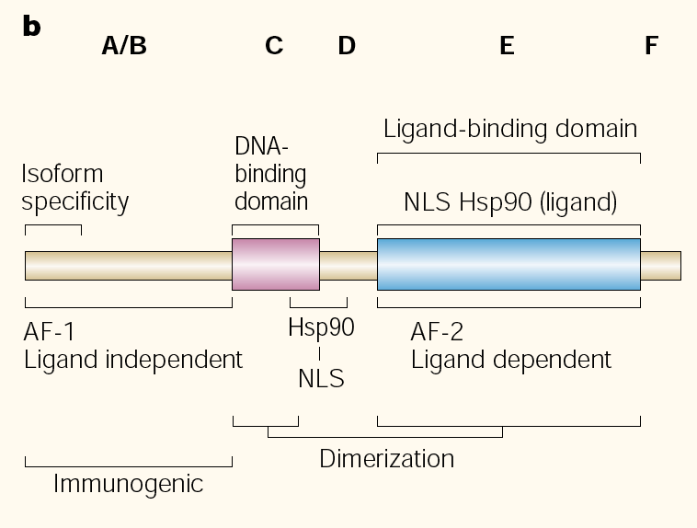
Steroid hormone receptors
The relative sizes of the human receptors indicated.
The numbers above the bars indicate the percentage homology of the consensus regions of the DNA- and ligand-binding domains

Slide 42
Mechanism of action SHR

Slide 43
Sub-family: RXR heterodimers
Prototypiske members:
RAR [retinoic acid receptor] vitamin A metabolite
VDR [vitamin D receptor]
TR [thyroid hormone receptor]
PPARγ [prostaglandine J2]
several “Orphan receptors” with unknown ligand
Characteristic feature of the RXR-heterodimers
Broader chemical variation of ligands
Not all ligands are endocrine hormones
ligand-independent activation mechanisms exist
bind DNA also in absence of ligand
bind often to “direct repeats”
bind as heterodimers
RXR
? R

Slide 44
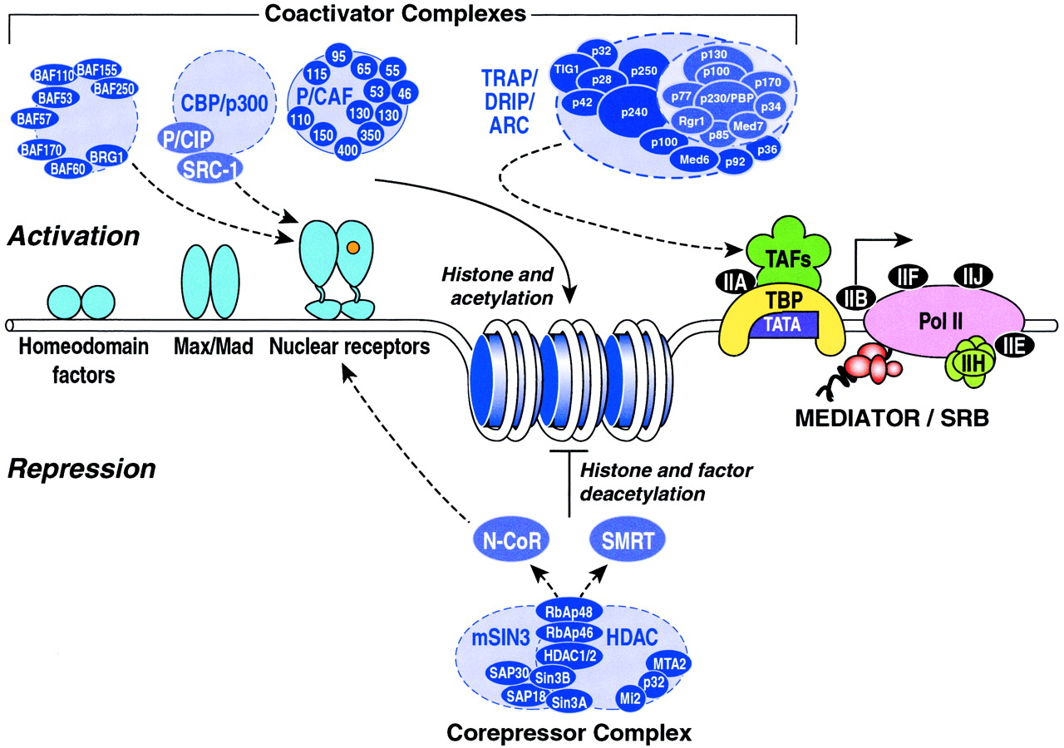
Several coactivators and corepressors

Slide 45
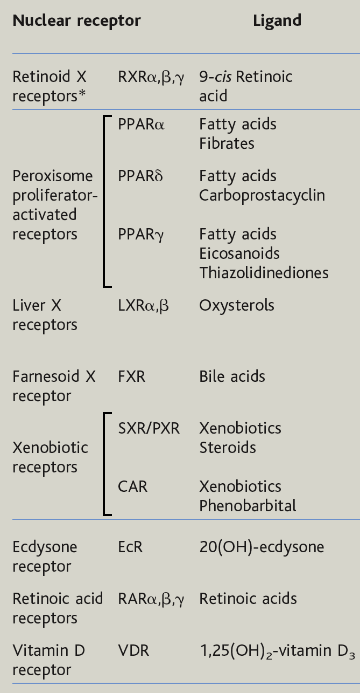
Bioactive lipids and their nuclear receptors

Slide 46
Receptors: synopsis

Slide 47
Synopsis

Slide 48
How drugs interact with receptors

Slide 49
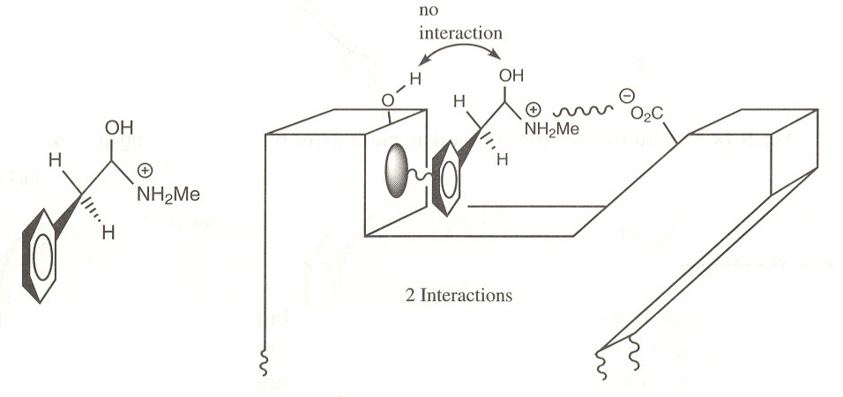
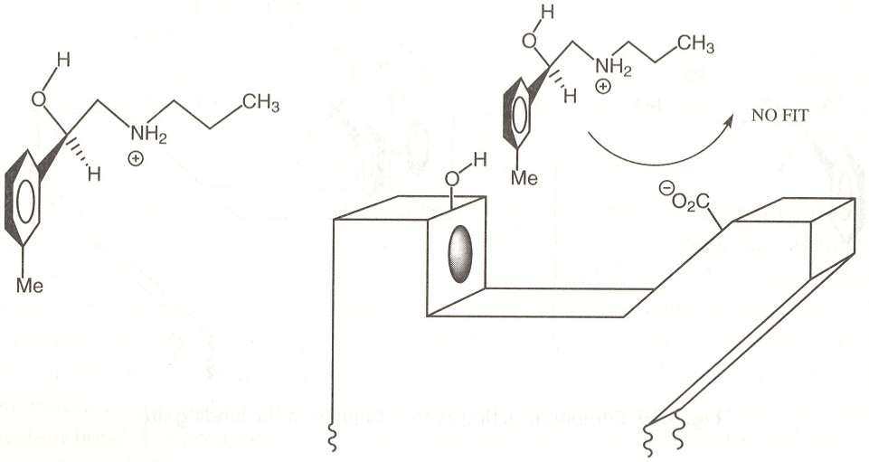
Agonists
Receptor binding site
Design of agonist:
Correct binding groups
Correctly positioned
Correct size

Slide 50
Enantiomers
Asymmetrical Synthesis

Slide 51
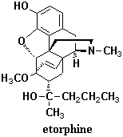
Pharmacophore

Slide 52
Antagonists

Slide 53
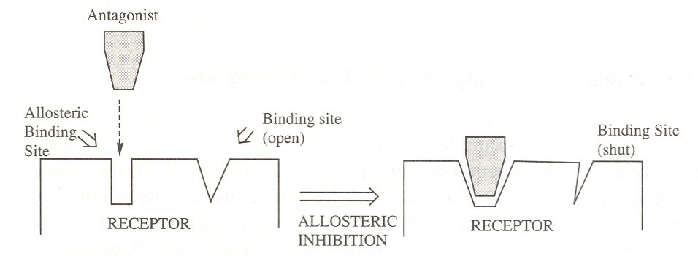
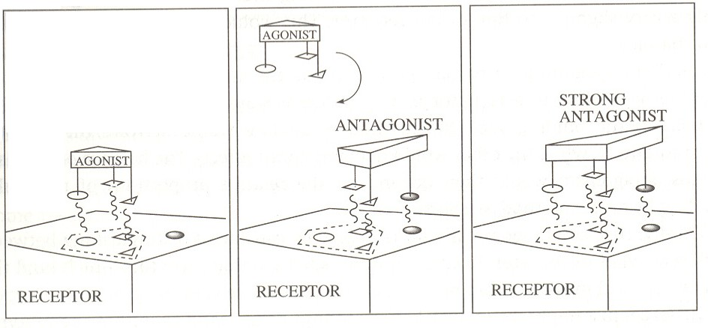
Other types of antagonists:
Allosteric antagonists
Antagonism by the umbrella effect

Slide 54
Partial agonists
Small conformational change
Multiple binding, same receptor
Multiple receptors

Slide 55
After binding…
What happens when a drug binds to the receptor and stays for a prolonged period of time?
Desensitization
Sensitization

Slide 56
1. Desensitization
Phosphorylation
Endocytosis
Reduction of receptors

Slide 57
2. Sensitization
Prolonged deactivation by antagonist leads to deficiency of messages sent to cell
Leads to tolerance and dependence

Slide 58
Conclusions
Receptors essential to extracellular communication
Regulation of cellular function
4 types of receptors
Good drug target

