Slide 1
Phase 2 polymorphisms
(+ drug activation, receptors)
BSc Pharmacology & Translational Medical Science, yr 2
Marc-Emmanuel Dumas, PhD
Biomolecular Medicine, Dept Surgery and Cancer
Sir Alexander Fleming Building, room 360
South Kensington Campus
m.dumas@imperial.ac.uk

Slide 2
Learning objectives
Evaluate and discuss the different sources of variability in drug metabolism
Recall the implication of polymorphisms on absorption, distribution and elimination of drugs
Define phase 1 and phase 2 metabolism
List reactions associated with phase 2 metabolism
Be aware of phase 2 polymorphisms
Be aware of polymorphisms in drug administration, distribution, excretion
Be aware of polymorphisms in receptors and target proteins
Illustrate the variety of phase 2 and other polymorphisms through few examples

Slide 3
Outline
… continued from Phase 1 polymorphism lecture
Phase 2 polymorphisms
  N-AcetylTransferases (NAT)
  Thiopurine S Methyltransferase (TPMT)
  Glutathione S Transferases (GST), UDP Glucuronosyl-Transferases (UGT)
Other polymorphisms
Other sources of variability

Slide 4
Phase 2 polymorphisms

Slide 5
Drug metabolism
Phase I
Oxidation
Reduction
Hydrolysis
Hydration
Dethioacetylation
Isomerization
Aim: introduce a new functional group
Cytochrome P450 enzymes in hepatocytes
Phase II
Glucuronidation
Sulphation
Methylation
Acetylation
Amino Acid Conjugation
Glutathione Conjugation
Fatty acid conjugation
Aim: to increase water solubility
Ususally in the cytosol

Slide 6
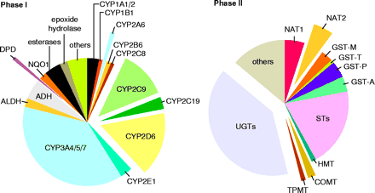
Drug Metabolizing Enzymes
Phase I: CYP and nonCYP involved with modification of functional groups (such as oxidation). See CYP P450 dominate over the others.
Phase II: Conjugative process for enhancing elimination of drug/metabolites out of the body. Note: UGT’s (UDP Glucoronyl transferases) are the most predominant phase II enzyme.
Notes:
As covered in a previous lecture on Drug Metabolism, the process has been broken down into the following 2 phases.
Phase I: CYP and nonCYP involved with modification of functional groups (such as oxidation). See CYP P450 dominate over the others.
Phase II: Conjugative process for enhancing elimination of drug/metabolites out of the body. Note: UGT’s Glucoronal transferases are the most predominant phase II enzyme.
In the next few slides, I’ll be reviewing the known drug metabolizing enzyme polymorphisms with significant phenotypic effects and discuss some of the latest discovery with the CYP 3A isoform.

Slide 7
Pharmacogenetics
Implications of polymorphisms
on Pharmacokinetics
Drug Absorption
Drug Distribution
Drug Elimination
Drug Metabolism
Drug Activation
Implications of polymorphisms
on Drug Effect
Receptors
Target Proteins

Slide 8
Polymorphism of phase II metabolism: conjugation I.
Paracetamol: conjugated with glucuronide (55-60%) and sulphate (35%), can be used for testing of polymorphism of phase II reactions
  UDPGT: uridinglucuronyltransferase
  PST: sulphotransferase, both under monogenic control, genetic deficiency is important in Parkinson’s disease, Gilbert syndrome, Crigler-Najjar syndrome

Slide 9
Acetaminophen
Glucuronidation 60%
Sulfation 30%
CYP 2E1
CYP 3A4
CYP 1A2
NAPQI
Toxic Metabolite
Non-toxic metabolites

Slide 10
Polymorphism of phase II metabolism: conjugation II.
Acetylation
  INH (isoniazid) is acetylated by N-acetyltransferase (NAT)
  Speed of acetylation is genetically determined: bimodal distribution, slow and fast acetylators
  Autosomal recessive inheritance
  The rate of slow acetylators increases with age
  Rate of slow acetylators is higher: Gilbert syndrome, rheumatoid arthritis, ischaemic heart disease
  N-substituted arylamines are less carcinogenic after acetylations

Slide 11
Pharmacogenetics of Acetylation
Weinshilboum NEJM 2003

Slide 12
N-acetyl-transferase-2
NAT-2
Inducers
Disulfuram
Prednisone
Inhibitors
Cimetidine
Ketoconazole
Substrates
Caffeine
Hydralazine
Isoniazid
Amrinone
Procainamide

Slide 13
NAT2 and Race/Ethnicity

Slide 14
Frequency of fast acetylators in different populations:
Population | Frequency %
Canadian Eskimos | 95-100
Polynesians | 93
Koreans, Japanese | 90
Germans | 43
Czechs & Slovakians | 40
Egyptians | 18
Hungarians | 43

Slide 15
Xenobiotics subject to polymorphic acetylation in man
Carcinogenic
Arylamines
benzidine
β-naphthylamine
4-aminobiphenyl
Hydrazines
isoniazid
hydralazine
phenylzine
acetylhydrazine
hydrazine
Arylamines
dapsone
procainamide
sulfamethazine
sulfapyridine
aminoglutethimide
Drugs metabolized to amines
sulfasalazine nitrazepam
clonazepam caffeine

Slide 16
Thiopurine S-methyltransferase (TPMT)
Drugs:
  6-mercaptopurine
  azathiopurine
Diseases:
  Acute lymphoblastic leukemia
  Inflammatory bowel disease
Toxicity:
  Fatal myelosuppression
  Hematopoietic toxicity

Slide 17
TPMT and 6-mercaptopurine

Slide 18
Pharmacogenetics of TPMT

Slide 19
TPMT Haplotypes and Activity

Slide 20
Genotype Specific TPMT Dosing

Slide 21
Other important pharmacogenetic polymorphisms I.
Glucose-6-phosphate dehydrogenase
  Most frequent pharmacogenetic enzymopathy
  Affects 100 million people worldwide
  130 enzym variants, only some are abnormal
    Antimalaria drugs (primaquine), antibiotics (sulfonamides, chloramphenicol, nitrofurantoine), other medicines (quinine, quinidine, phenylhydrazine, dapson) cause fatal haemolysis in some patients
    Favism: haemolysis after consumption of legumes, gooseberry, blackcurrant

Slide 22
Glucose-6-phosphate dehydrogenase activity
R-NH₂
CYP
MPO
PGH Synthase
R-NOH
ERYTHROCYTE
NADP+ or
GSSG(?)
O₂
HgbFe⁺²
NAD+
HMP Shunt
G-6-PD
Dependent
R-NOH
MetHgb
Reductase
NADPH
or GSH(?)
R-NO
HgbFe⁺³
NADH
GSH
Reactive
Oxygen
Splenic
Sequestration
Semi-mercaptal
SOD
Catalase
GSH Peroxidase
sulfinamide
Detoxification
Hemolytic
Anemia
R-NH₂

Slide 23
Other important pharmacogenetic polymorphisms II.
Alcohol dehydrogenase (ADH)
  Speed of ethanol ⇒ acetaldehyde reaction is increased
  Acetaldehyde dehydrogenase activity is unaffected, so acetaldehyde is not metabolised at a sufficient rate
  Acetaldehyde is accumulated causing flushing and tachycardia
  Frequency: 5-20% in caucasians, 90% among Chinese

Slide 24
Other important pharmacogenetic polymorphisms III.
Serum cholinesterase
  Activity of serum cholinesterase is reduced 1/100 in some people (1/25000)
  Atypical cholinesterase
  Administration of succinylcholine causes paralysis of breathing muscles

Slide 25
Atypical Plasma Cholinesterase
choline
succinylmonocholine
Hydrolysis by pseudocholinesterase
a rapid acting, rapid recovery muscle relaxant - 1951
usual paralysis lasted 2 to 6 min in patients
occasional pt exhibited paralysis lasting hrs
cause identified as an “atypical” plasma cholinesterase

Slide 26
Implication of polymorphisms on absorption, distribution and elimination of drugs

Slide 27
Pharmacogenetics
Implications of polymorphisms
on Pharmacokinetics
Drug Absorption
Drug Distribution
Drug Elimination
Drug Metabolism
Drug Activation
Implications of polymorphisms
on Drug Effect
Receptors
Target Proteins

Slide 28
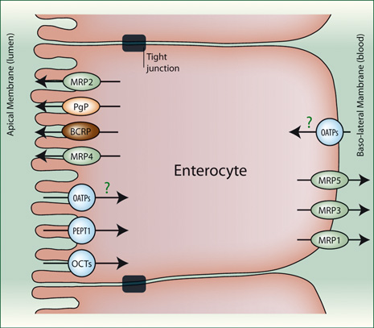
Transporters Mediate Absorption

Slide 29
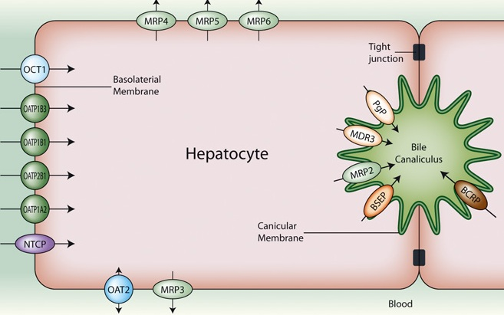
Transporters Mediate Bile Elimination

Slide 30
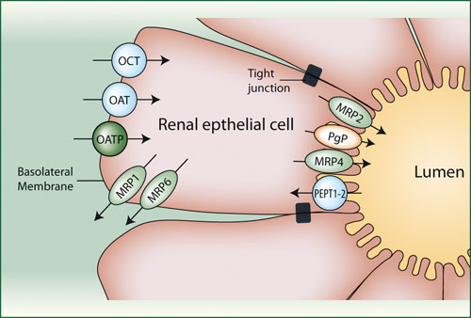
Transporters Mediate Renal Elimination

Slide 31
Different types of transporters
MRP: Multidrug-Resistance like Proteins
- ATP-binding cassette (ABC) transporters
- members include: MRP1, MRP2, MRP3, MRP4, MRP5, MRP6, permeability glycoprotein (PgP)
Organic anion transporters (OAT, for negative ions)
- Organic anion transporting polypeptides
Organic cation transporters (OCT, for positive ions)
Peptide transporters (PEPT)
All members of the solute carrier family (SLC)
Numerous polymorphisms.

Slide 32
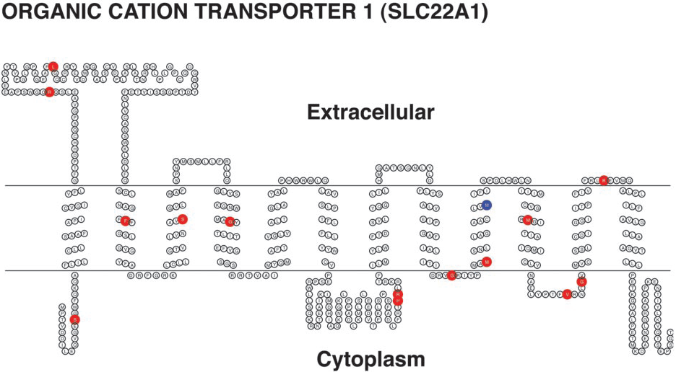
Genetic Variation in OCT1
Shu et al PNAS 2003

Slide 33
Pharmacogenetics
Implications of polymorphisms
on Pharmacokinetics
Drug Absorption
Drug Distribution
Drug Elimination
Drug Metabolism
Drug Activation
Implications of polymorphisms
on Drug Effect
Receptors
Target Proteins

Slide 34
Tamoxifen
SERM
Used for adjuvant therapy in ER/PR+ breast CA
Metabolite Endoxifen is 100x more effective than parent compound
CYP2D6 mediates activation of Tamoxifen to Endoxifen

Slide 35
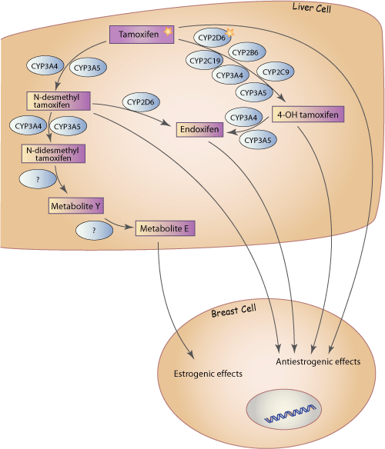
Tamoxifen
Importance of CYP2D6

Slide 36
Pharmacogenetics
Implications of polymorphisms
on Pharmacokinetics
Drug Absorption
Drug Metabolism
Drug Elimination
Drug Distribution
Drug Activation
Implications of polymorphisms
on Drug Effect
Receptors
Target Proteins

Slide 37
Beta Receptor and HTN/CHF
Beta blockers – well named
ADRB1 and ADRB2
In ADRB1, 2 common functional polymorphisms (Ser49Gly and Gly389Arg).
In HTN, pts treated with Metoprolol, Gly389:
  WT/WT: 10.4% drop in SBP
  WT/Variant: 2.8%
  Variant/Variant: 1.1%
  Similar differences found in HR and SBP at rest and with exercise
In CHF, WT patients need more medications/dosages
Liu J et al. Clin Pharmacol Ther 2003, 2006
Terra SJ, et al. Clin Pharmacol Ther 2006

Slide 38
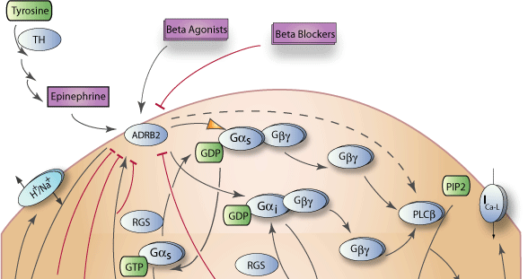
Beta Receptor and Acute Coronary Syndrome

Slide 39
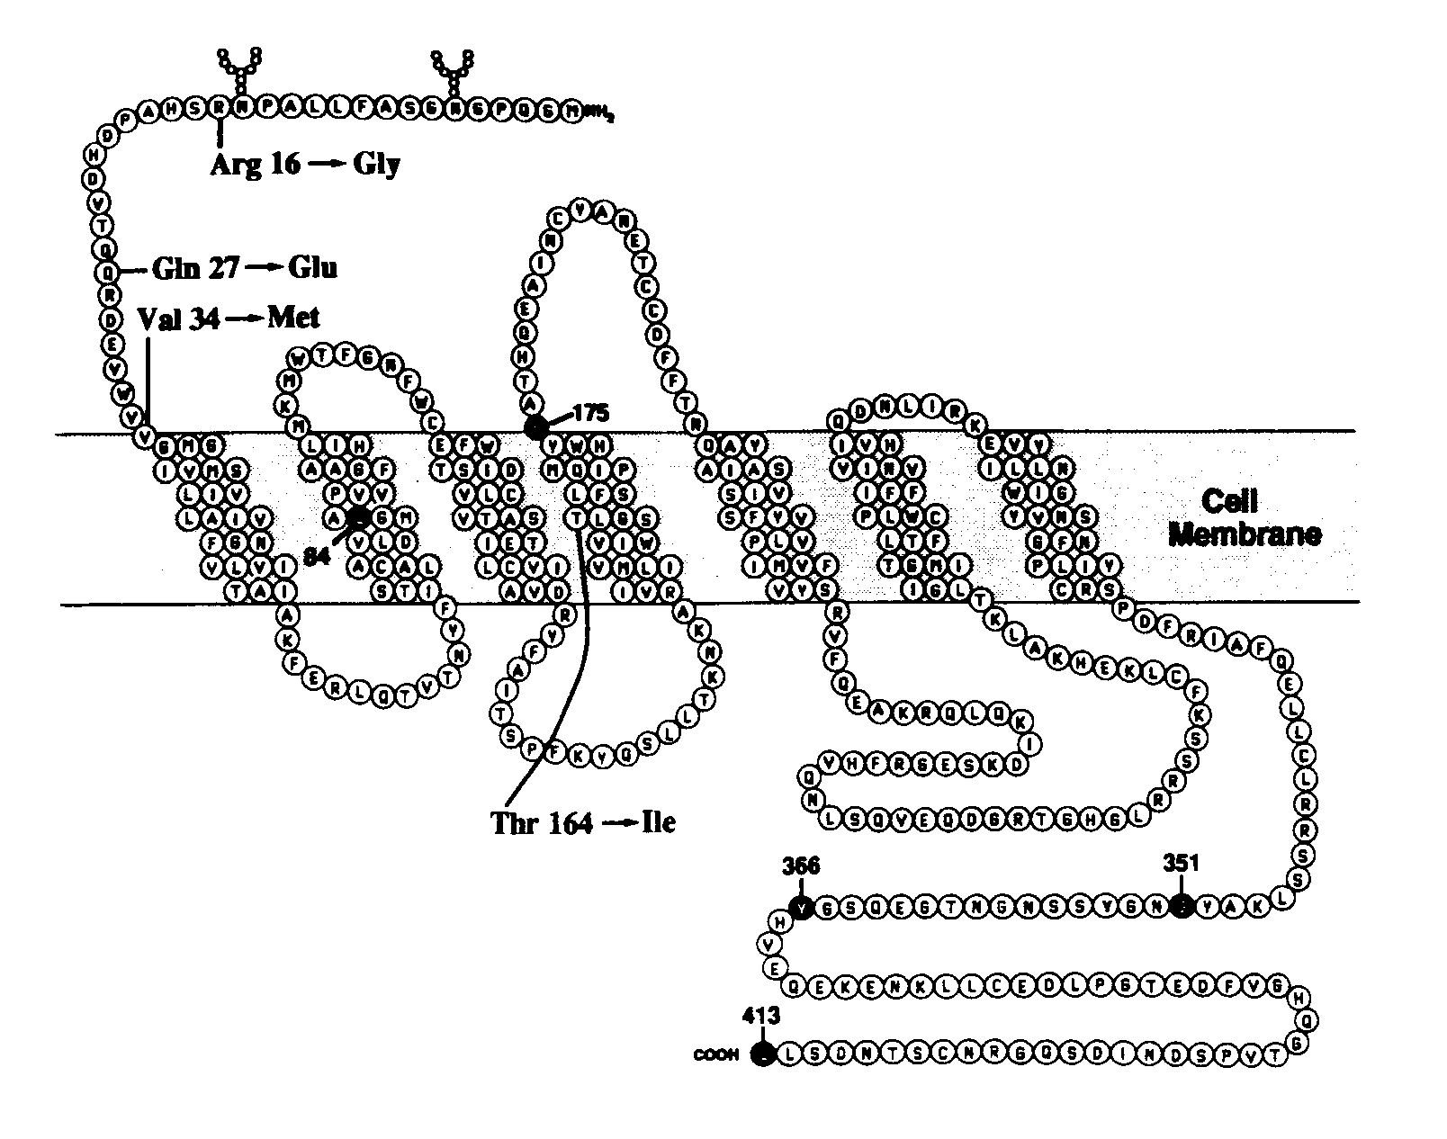
β₂-Adrenergic Receptor Polymorphisms
Reihsaus etal. Am J Respir Cell Mol Biol. 1993;8:334-339.
Notes:
This is a schematic amino acid diagram of the beta2-adrenergic receptor. The receptor is a member of the class of 7 transmembrane spanning receptors which couple to adenylate cyclase through a G-protein. Adenylate cyclase converts ATP to cAMP which acts as a second messenger to activate proteins such as protein kinase A. In airway smooth muscle this results in relaxation and bronchodilation of the airways. This pathway is important to controlling asthma.
Nine single nucleotide polymorphisms have been identified within the coding region of the gene, with only 4 resulting in amino acid changes. These occur at codons 16, 27, 34 and 164. Only the polymorphism at position 164 affects the binding region for the beta agonist. The portion outlined in light blue is the area that salmeterol binds to give it its long duration of action. Polymorphisms at codon 34 have not been shown to have any functional significance. The polymorphisms at position 16 and 27 have been associated with increased down-regulation of the receptor and a reduced clinical response.

Slide 40
Other sources of variability

Slide 41
Sources of Pharmacokinetic and Pharmacodynamic Variability
Drug Specific:
Dose & Schedule
Dosage form
Morphometric:
Body Size
Body Composition
Genetics:
Demographic:
Age
Race/Ethnicity
Sex
Variability
Environment:
Drug-drug interactions
Drug-CAM interactions
Drug-formulation interactions
Drug-food constituent interactions
Physiologic:
Disease
Hepatic Function
Renal Function

Slide 42
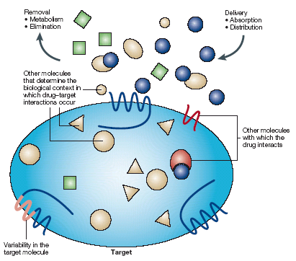
Sources of Drug Variability at the Target
Removal
Metabolism
Elimination
Delivery
Absorption
Distribution
Other molecules that determine the biological context in which drug-target interactions occur
Other Molecules with which the drug interacts
DM Roden et al: Nature Reviews, Drug Discovery, 1, 37-43, 2002

Slide 43
Gene-environment interactions: intraindividual variability I.
Diet: may alter hepatic cytochrome P 450 activity
  Smoked foods (polycyclic aromatic hydrocarbons) increase CYP1A activity (Kall & Clausen 1995)
  Cruciferous vegetables (brussels sprouts, cabbage, broccoli): alter activity of selected CYP isoenzymes
    Indole-containing vegetables (cabbage, cauliflower) upregulate CYP1A (Pantuck et al., 1989)
    Isothyocyanate-containing vegetables (watercress) inhibit CYP2E1 (Kim & Wilkinson 1996)
  Organosulfur compounds (garlic) inhibit CYP2E1 and induce CYP1A, CYP3A and phase II enzymes
  Grapefruit juice phytochemicals influence CYP3A activity
  Vitamins, spices

Slide 44
Gene-environment interactions: intraindividual variability II.
Drug-drug interactions:
  Enzyme inductors or inhibitors: rifamycins, anticonvulsants, macrolide antibiotics, azole antifungal drugs, nefazodone, certain SSRIs
Nutraceutical influences: herbs and dietary compounds
  St. John’s wort (Hypericum peforatum) CYP3A inductor
Aging: lower blood flow and liver volume decreases from the third decade, but the effect on enzymes is moderate
Disease
  Acute inflammation and infection affect drug metabolism
  Liver disease modifies blood flow and reduces enzyme activity

Slide 45
Pharmacoenvironment
Grapefruit juice-felodipine interaction
bergamottin inhibition of CYP3A4 in the small intestine

Slide 46
Drug levels
Dahan and Altman EJCN 2004

Slide 47
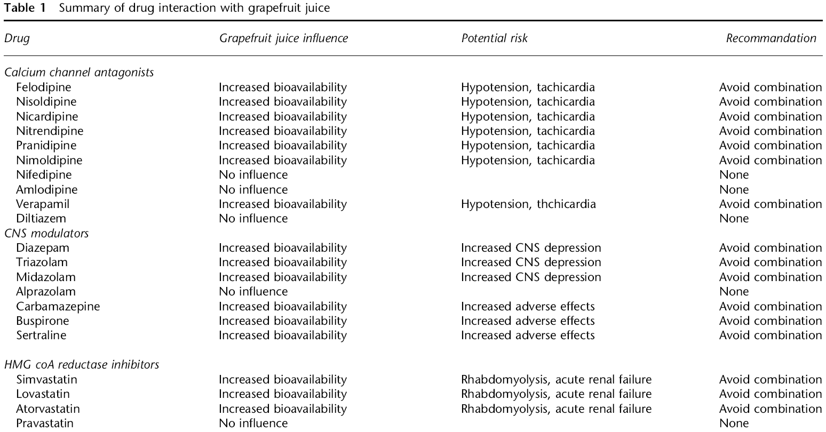
Grapefruit juice drug interactions
Dahan and Altman EJCN 2004

Slide 48
Conclusions
Phase 1 & 2 polymorphisms v. important in explaining drug metabolism variation
Other polymorphisms in transport
Certain drug metabolising enzyme activities are determined by environment
Inherent complexity
  multiple pathways for each drug
  direct and indirect consequences
Everybody is different

