Slide 1
Pharmacogenomics and pharmacometabonomics
BSc Pharmacology & Translational Medical Science
Marc-Emmanuel Dumas, PhD.
Biomolecular Medicine, Dept Surgery and Cancer
Sir Alexander Fleming Building, room 360
South Kensington Campus
m.dumas@imperial.ac.uk

Slide 2
Learning objectives
Define pharmacogenomics
Discuss the high-throughput methods available
Be aware of importance of genotype/phenotype associations
Be aware of pharmacometabonomics
Discuss pharmacogenomics and pharmacometabonomics in personalized healthcare

Slide 3
Lecture outline
Pharmacogenetics and pharmacogenomics
Methods available
  DNA microarrays
  Proteomics
  Metabonomics
Genotype/phenotype associations
Pharmacometabonomics
Personalized healthcare

Slide 4
Pharmacogenetics and pharmacogenomics

Slide 5
Definitions
PHARMACOGENETICS: “The study of genetically determined inter-individual differences in therapeutic response to drugs and susceptibility to adverse effects”
Restricted to one or few genes of interest
Mendelian segregation
PHARMACOGENOMICS: “Use of genome-based techniques in drug development”
Not restricted to one or few genes
Use of high-throughput technologies

Slide 6
Pharmacogenetics vs. Pharmacogenomics
PHARMACOGENETICS: Study of variability in drug response determined by single genes.
PHARMACOGENOMICS: Study of variability in drug response determined by multiple genes within the genome.

Slide 7
Pharmacogenetics and Pharmacogenomics

Slide 8
Genomics
GENOME: the entirety of an organism's hereditary information. includes both the genes and the non-coding sequences of the DNA (RNA in the case of retroviruses).
TRANSCRIPTOME: set of all RNA molecules, including mRNA, rRNA, tRNA, and other non-coding RNA produced in one or a population of cells.
PROTEOME: Entire set of proteins expressed by a genome, cell, tissue or organism.
METABOLOME: Complete set of small-molecule metabolites (such as metabolic intermediates, hormones and other signalling molecules, and secondary metabolites) to be found within a biological sample, such as a single organism.

Slide 9
Pharmacogenomics
Evans and Relling Nature 2004

Slide 10
Methods

Slide 11
How can we study 30,000 genes?
DNA microarrays
Multiplexed technology (measures made in parallel)
Evolution of classical Southern blots
Arrays of microscopic spots of DNA, attached to array surface
Hybridization of labelled cDNA or DNA on surface when sequences match
Possibility to detect SNP polymorphisms (genotyping), mRNA (transcriptomics), etc…

Slide 12
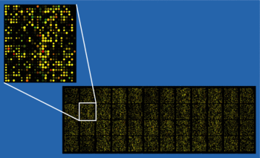
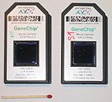
Microarray technology

Slide 13
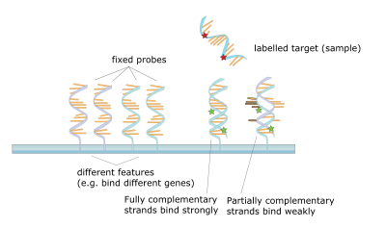
Principle of DNA arrays

Slide 14
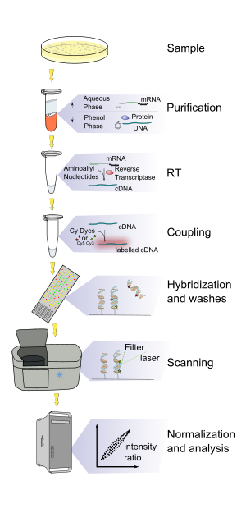
Microarray experiment
Extraction of samples, purification prior to amplification
Amplification usually made by polymerase chain reaction (PCR)
Hybridization
Detection of signal made by scanner and image analysis
Statistical analysis of data

Slide 15
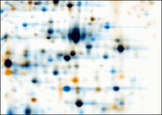
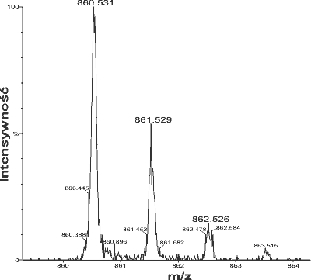
Proteomics

Slide 16
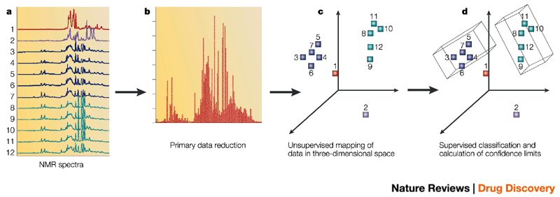
Metabolomics
Data import, preprocessing and databasing
Unsupervised analysis
Supervised analysis confidence intervals
Spectral acquisition
Nicholson JK, Connelly J, Lindon JC, Holmes E Nat Rev Drug Discov. 2002 Feb;1(2):153-61.

Slide 17
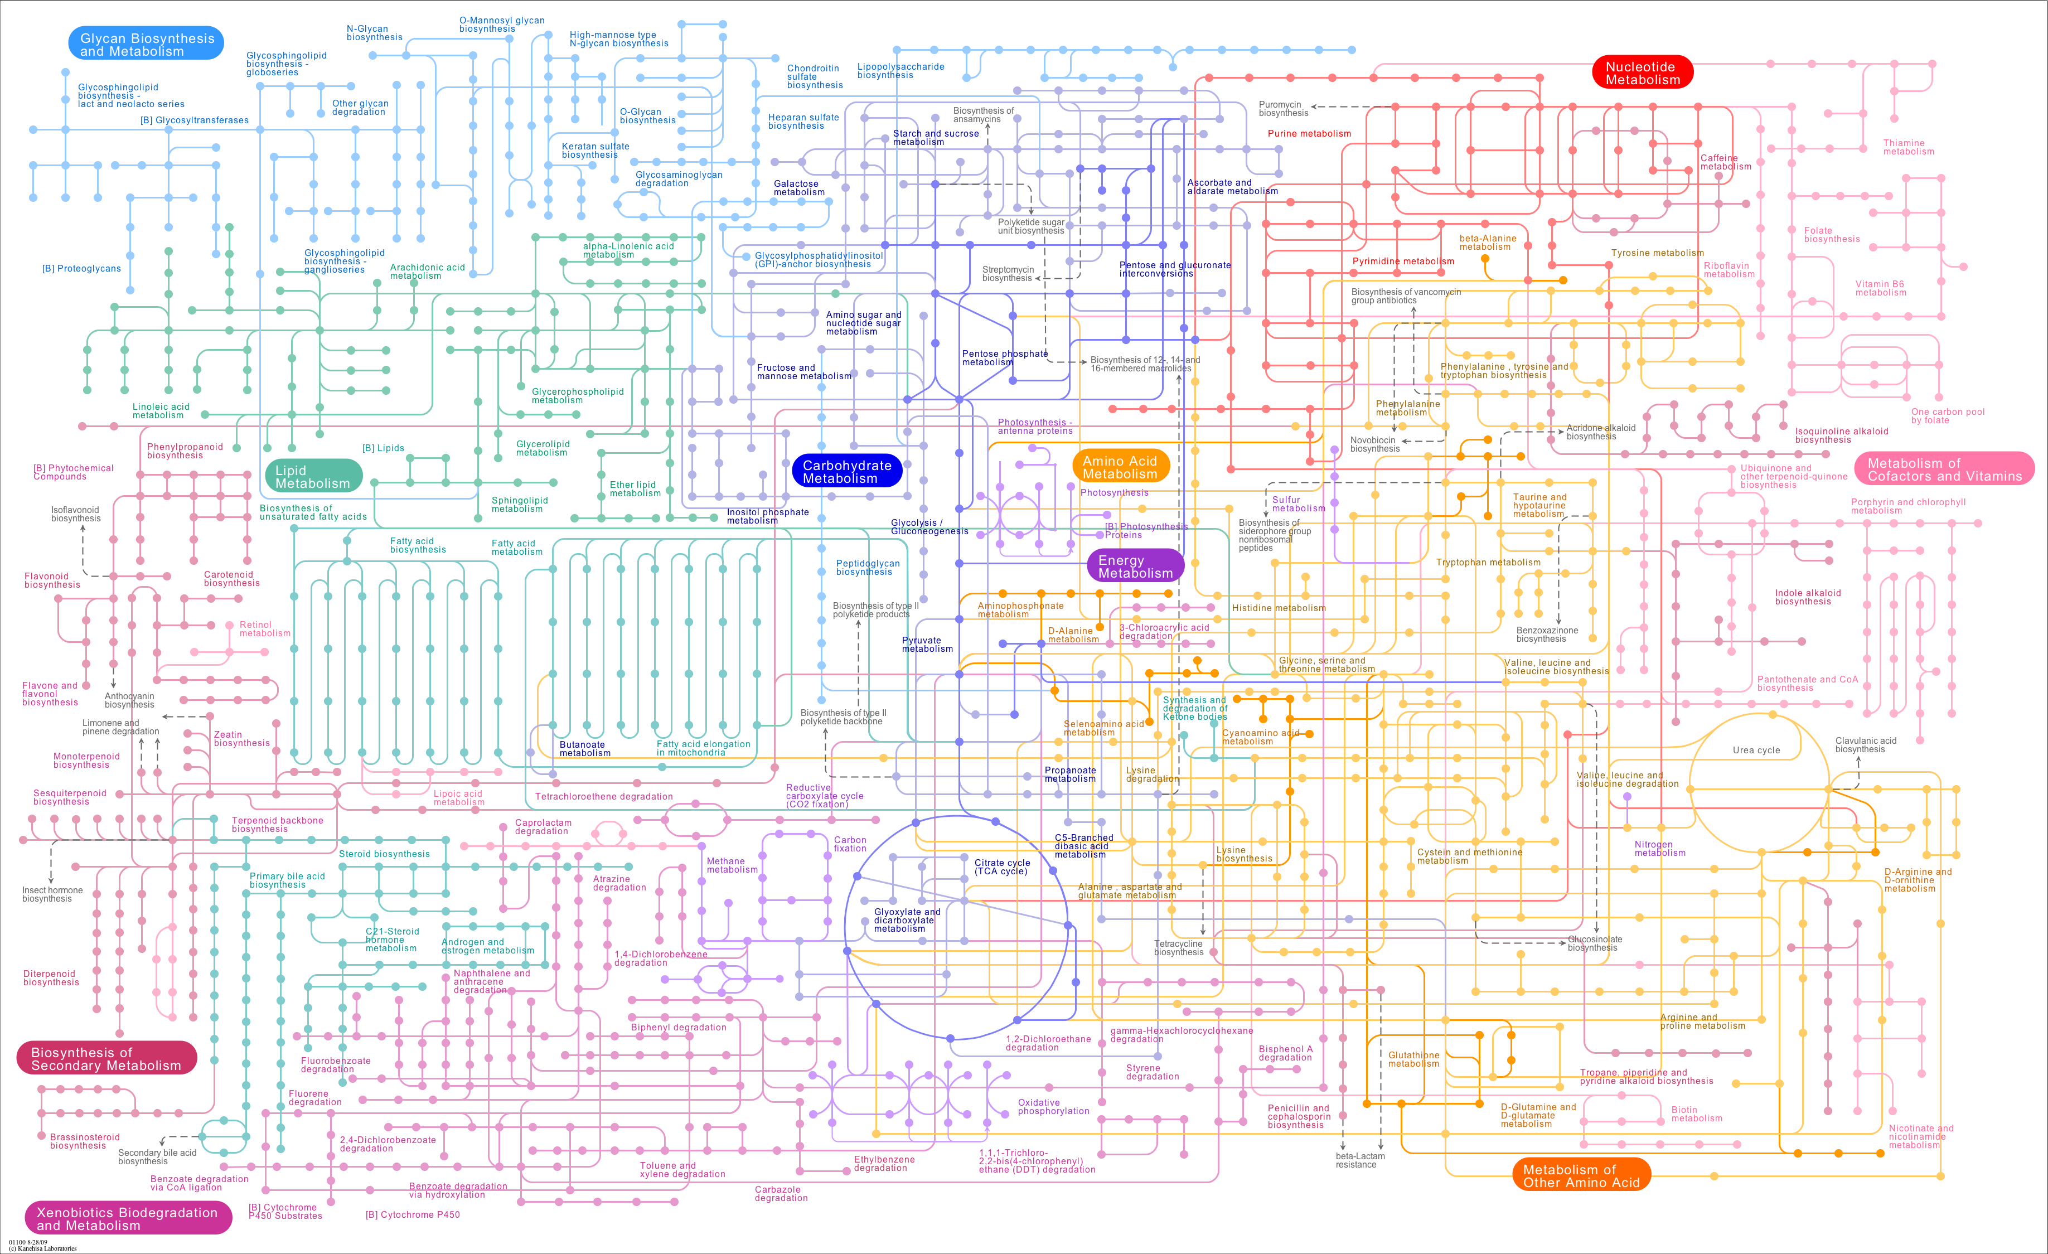

Metabolic pathways in one glance

Slide 18
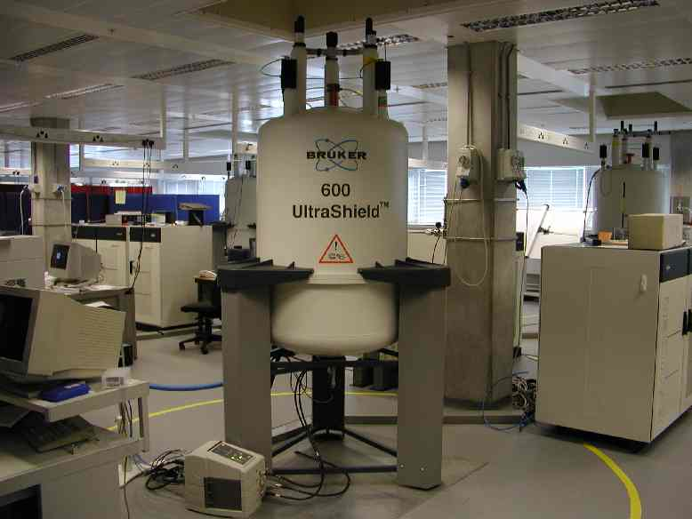
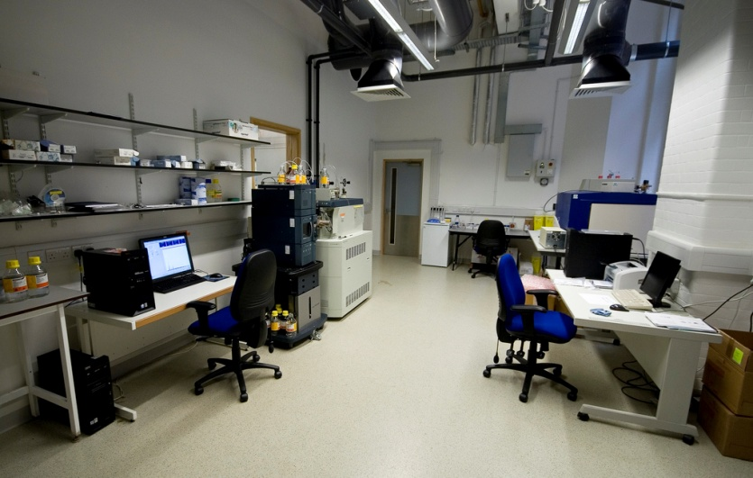
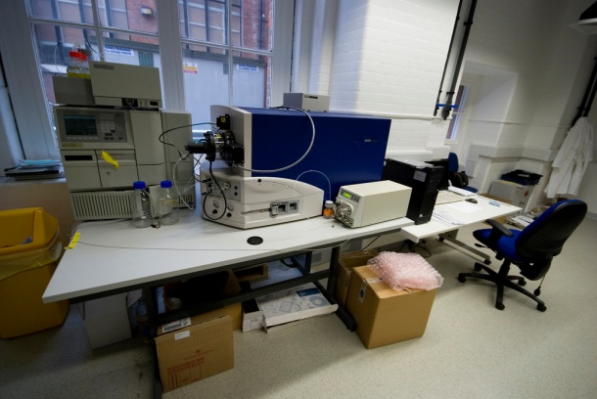
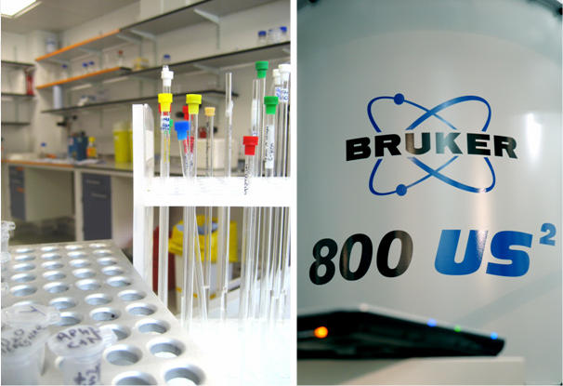
Metabolomic facility @ Imperial – NMR, GC-MS, UPLC-MS

Slide 19
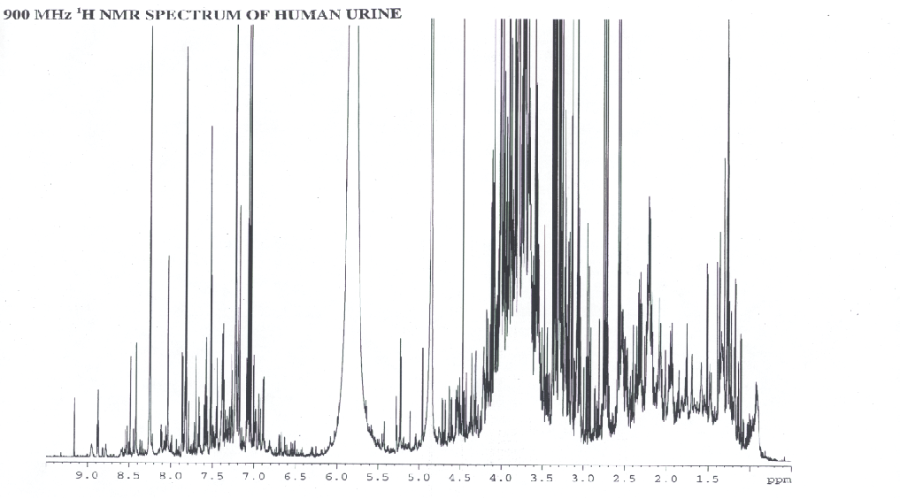
¹H NMR spectrum – a metabolic snapshot
SUGARS
METHYLS
AROMATICS
ACETYLS

Slide 20
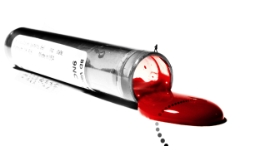
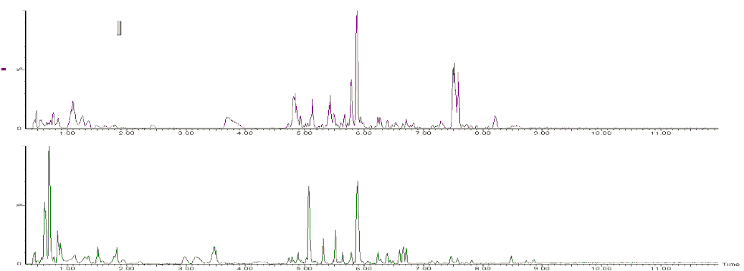
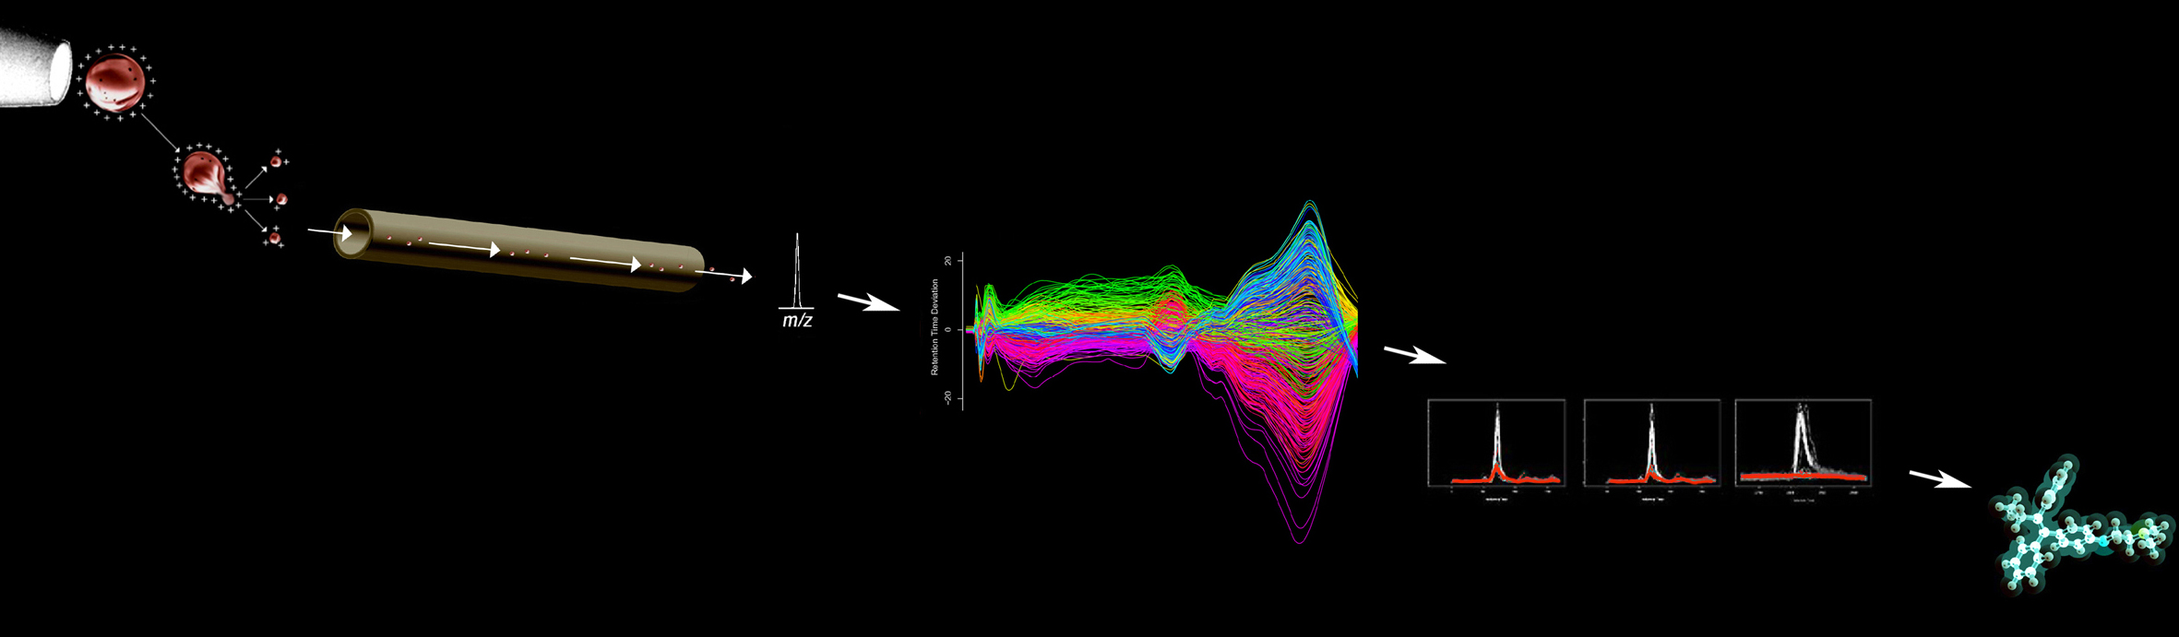
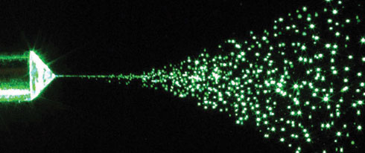
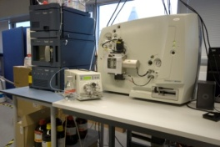
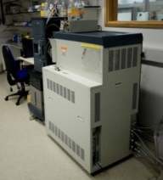
Liquid chromatography -MS Analysis
Reverse phase chromatography
Sample
preparation
urine
ESI+
ESI-
ESI+
UPLC-MS Analysis
Untargeted Profiling using
TOF or Q-TOF
ESI-
Hydrophilic interaction (HILIC)

Slide 21
  Genotype/phenotype association

Slide 22
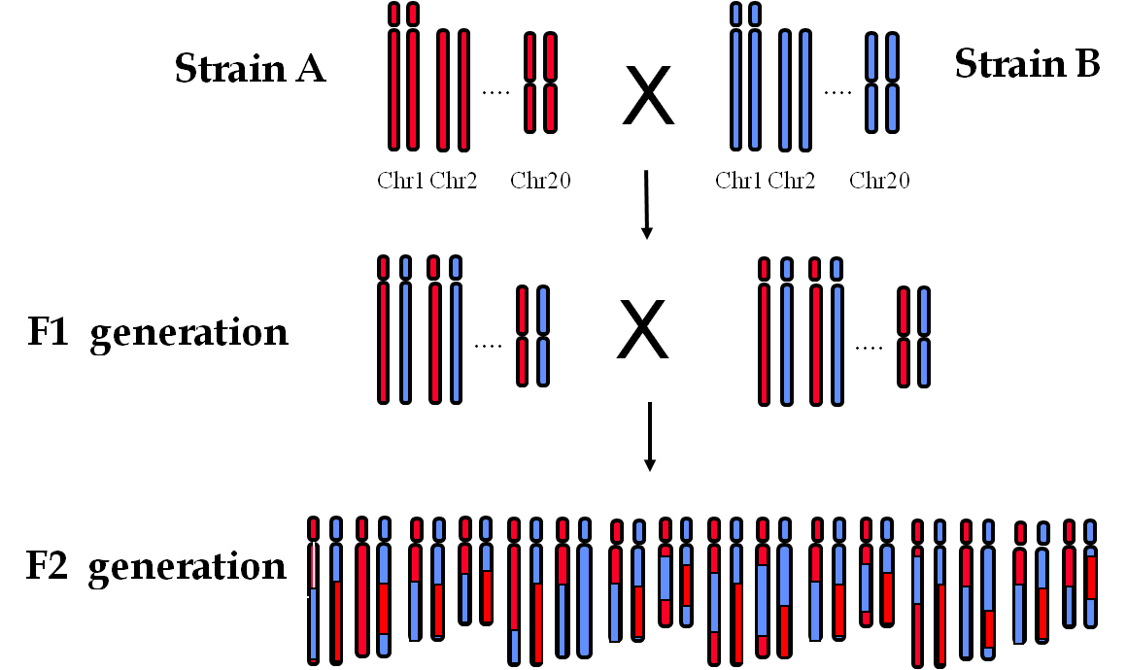
Experimental cross - genetic variation

Slide 23
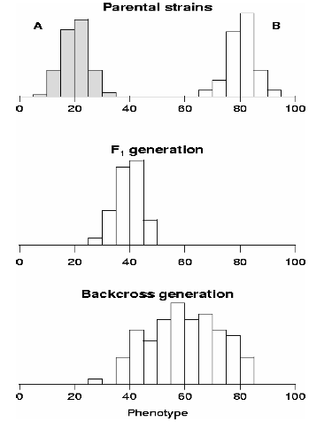
Phenotype variation

Slide 24
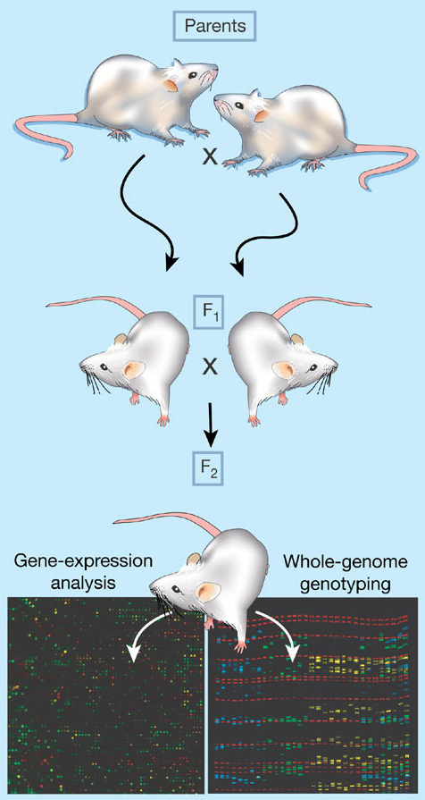
Genome mapping of transcriptomic data
Genetical genomics, eQTL
based (amongst others) on the paper from
Schadt et al., Nature 2003, 422, 297-302.
F2 cross:
start seeing segregation of alleles on chromosomes
Genotyping: SNP
Phenotyping: transcriptomics
eQTL: treating expression data like phenotypes to map Quantitative Trait Loci

Slide 25
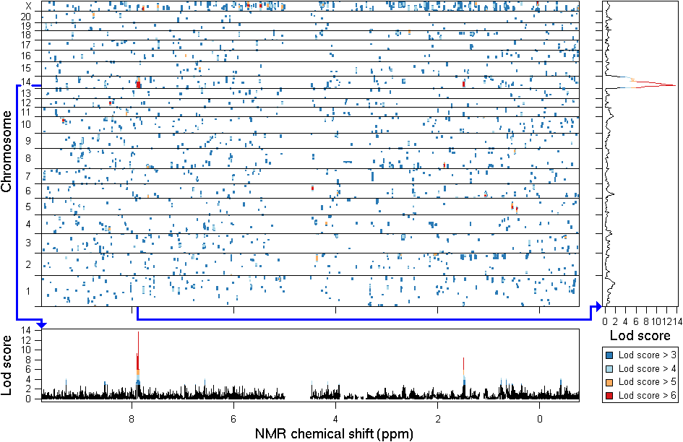
Metabotype Quantitative Trait Locus (mQTL)
a
GK x BN F2 cross:
BN = normoglycemic
GK = diabetic
Genotyping: microsatellites / SNP
Phenotyping:
plasma NMR
qtl mapping:
LOD score > 15
c
Genome dimension
b
Metabolome dimension
Dumas, Wilder et al., Nature Genetics 2007, 39, 666-672

Slide 26
Typical mQTL - metabolite association
Dumas, Wilder et al., Nature Genetics 2007, 39, 666-672
Notes:
26

Slide 27
Pharmaco-metabonomics

Slide 28
Pharmacometabonomics
PHARMACOGENOMICS: “Use of genome-based techniques in drug development”
PHARMACOMETABONOMICS: “Use of metabolome-based techniques in drug development”
Access to genetic and environmental variation in metabolism
Complementary to genetic studies
Focus on identification of responders and non-responders and early response

Slide 29
Pharmacometabonomics
All patients with same diagnosis
Responders and
Patients not Experiencing
Severe Toxicity
Non-Responders and
Patients Experiencing
Severe Toxicity

Slide 30
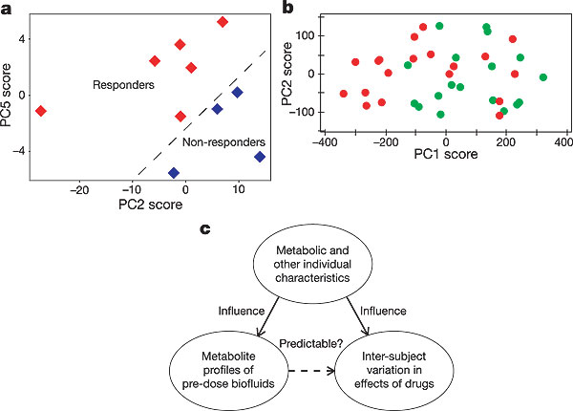
Pharmacometabonomics

Slide 31
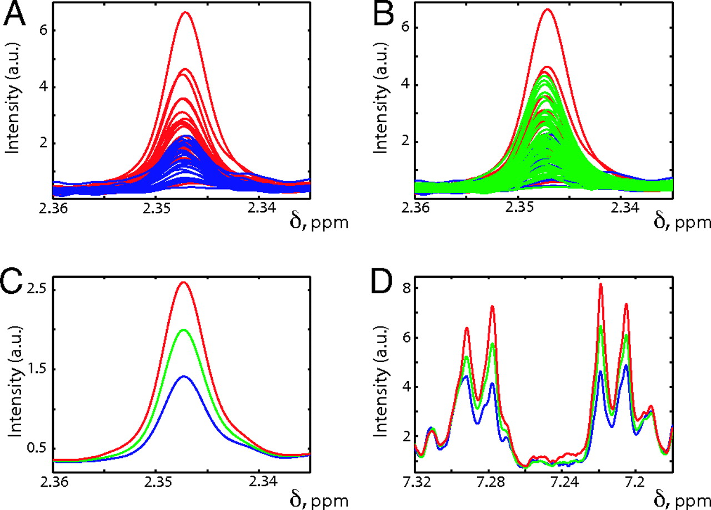
Post dose behaviour according to pre-dose spectra

Slide 32
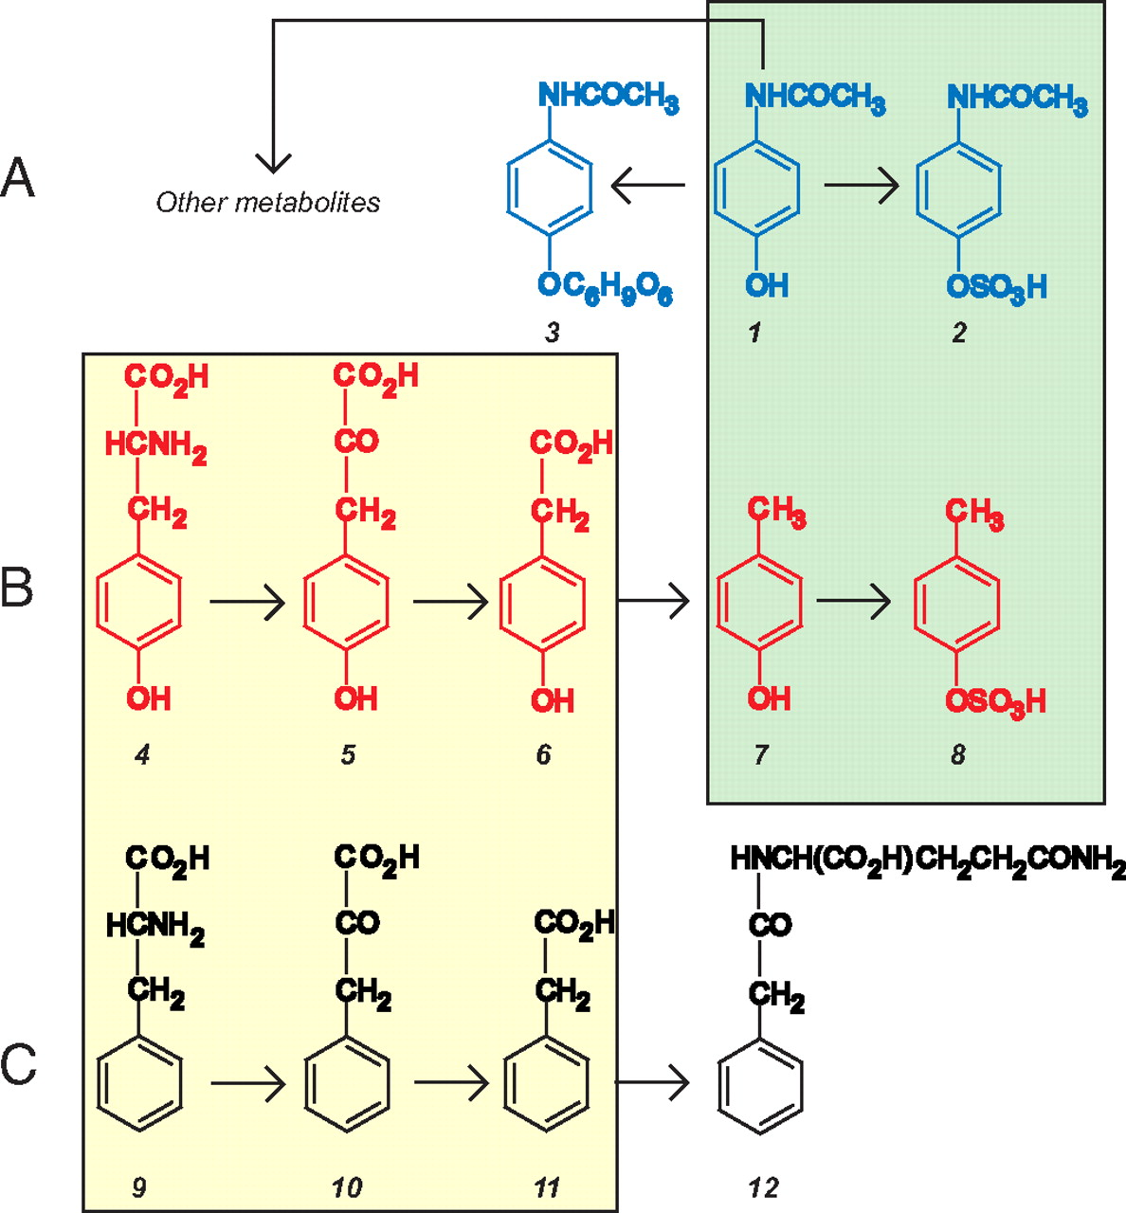
Indirect role of gut flora in paracetamol metabolism
Gut flora structural analogues compete for sulfonation of paracetamol
Gut flora metabolites

Slide 33
Personalized healthcare

Slide 34
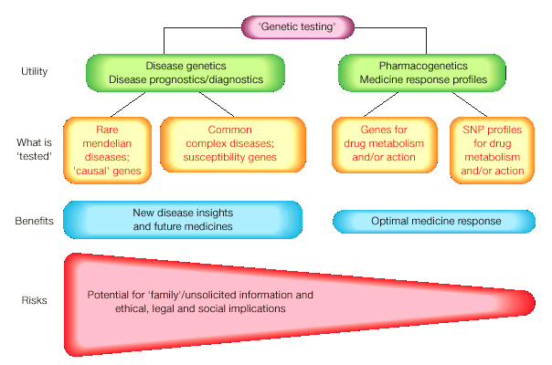
Risk assessment in pharmacogenomics

Slide 35
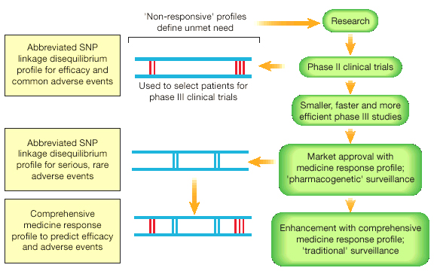
Pharmacogenomics in clinical trials

Slide 36
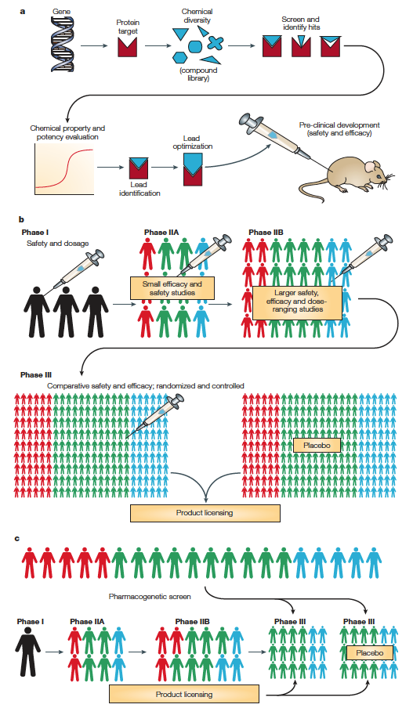
Pharmacogenomics in pharmaceutical pipeline
Identification of target proteins
Identification of ligands
Assessment of drugability
Tests in animals / cells
Clinical trials
Population studies

Slide 37
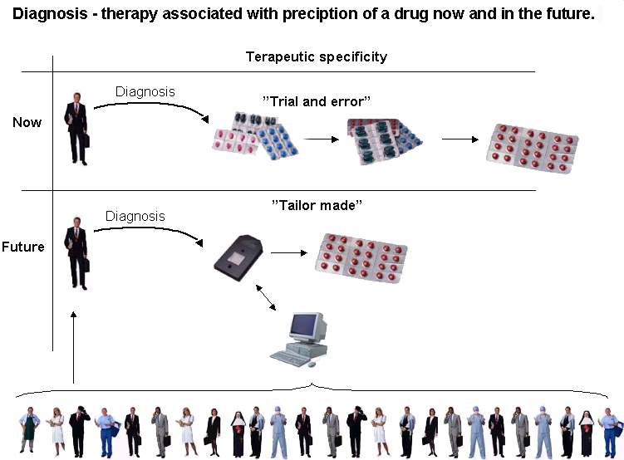
Pharmacogenomics prospect
Therapeutic specificity
Trial and Error
“Tailor-made”

Slide 38
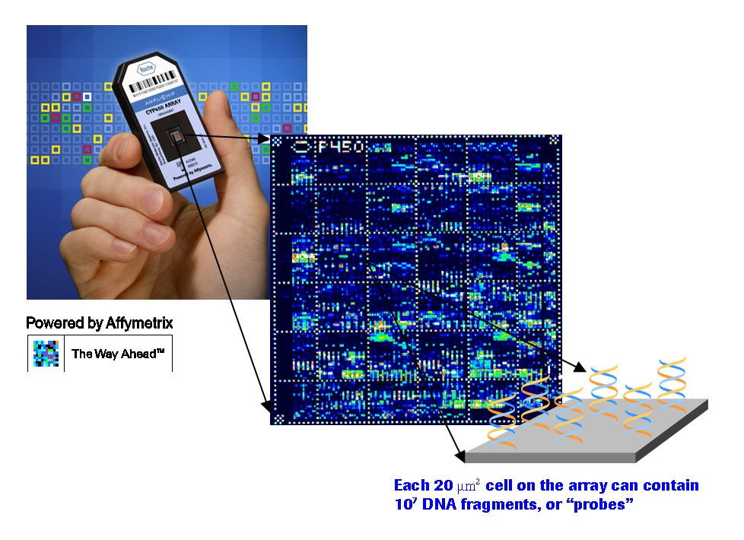
New Frontiers in Genetics
First Phase of the ‘HapMap’
(Haplotype Map, which maps common patterns of human genetic variation - ‘haplotypes’)
■ First diagnostic microarray chip approved by FDA in 2005
The Amplichip, made by Roche, analyzes variation in 2 genes involved in metabolism of 25% of prescription drugs (CYP450 genes)

Slide 39
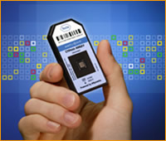
Pharmacogenomics:
Industry
First clinically available, FDA-approved genotype test in
2005 (Roche - Amplichip)
Chip for SNPs in all CYP450 genes, 2005 (GE)
Chip for p53 mutations expected mid-2006 (Roche)
Affymetrix/ParAllele DMET Chip - 1,300 SNPs covering 185 genes (enzymes and transporters) involved in drug
metabolism Spring, 2006

Slide 40
Pharmacogenomics - Industry
Biomarker/Genetic targets:
  Abbott
  Johnson & Johnson
  Roche (Swiss)
Pharmacogenomics for individualized Rx:
  Pfizer
  Bristol-Myers-Squibb
  Genentech
Molecular diagnostic kits/devices:
  Roche expected sales for 2005: $6.5 billion
expected sales by 2010: $12 billion

Slide 41
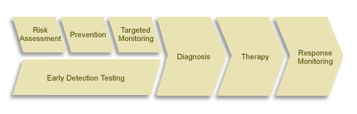
The Paradigm of Personalized Medicine
Better Diagnosis
More Effective Therapy
Earlier Intervention
More Efficient Drug Development

Slide 42
Conclusion
Pharmacogenomics integrates genomic information in drug discovery
Powerful tool for genetic information but wealth of data
Environmental variation in Pharmacometabonomics
Useful industrial applications
All approaches participate in personalized healthcare

