Slide 1
Principles of Pharmacogenetics
BSc Pharmacology & Translational Medical Science
Marc-Emmanuel Dumas, PhD
Biomolecular Medicine, Dept Surgery and Cancer
Sir Alexander Fleming Building, room 360
South Kensington Campus
m.dumas@imperial.ac.uk

Slide 2
Pharmacogenetics: Learning objectives
Define pharmacogenetics in historical context
Recall the molecular basis of genetic polymorphisms
Determine the genetic regulation model
Apply the Hardy-Weinberg Law
Illustrate with few examples

Slide 3
Outline
Context, definitions and history
The molecular genetic basis
Genetic Polymorphisms
Quantitative genetic analysis
Hardy-Weinberg Law
Few examples

Slide 4
Context, definitions and history

Slide 5
Pharmacogenetics
Relatively new field of study within the realm of pharmacology
Patients can respond differently to a given therapeutic agent even if they have the same illness
The same dose of a given drug in some patients causes very different plasma levels and different therapeutic responses that cannot be explained by weight, age or gender

Slide 6
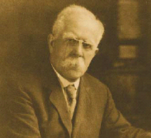
Sir Archibald E. Garrod 1858-1936
Coined the term “Chemical Individuality”
“Even against chemical poisons taken by mouth, or by other channels, there are some means of defense. Every active drug is a poison, when taken in large enough doses; and in some subjects a dose which is innocuous to the majority of people has toxic effects, whereas others show exceptional tolerance of the same drug. Some chemical poisons are destroyed in the tissues, provided that the dose given be not too large, and others are combined up with substances to hand, and so rendered innocuous and got rid of.”

Slide 7
History: From Genetics to Pharmacogenetics
Meyer Nature Reviews Genetics 2004

Slide 8
What is Pharmacogenetics?
All patients with same diagnosis
Responders and
Patients not Experiencing
Severe Toxicity
Non-Responders and
Patients Experiencing
Severe Toxicity

Slide 9
Definitions
PHARMACOGENETICS: “The study of genetically determined inter-individual differences in therapeutic response to drugs and susceptibility to adverse effects”
Restricted to one or few genes of interest
Mendelian segregation
PHARMACOGENOMICS: “Use of genome-based techniques in drug development”
Not restricted to one or few genes
Use of high-throughput technologies

Slide 10
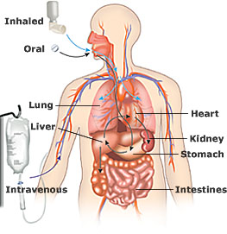
Drug transport, targeting, and metabolism

Slide 11
Genetic variation in drug response
The differences in the response to a given drug can be due to two major pharmacological factors that can vary with genetic influence:
Pharmacokinetics - “the study of what the body does to a drug”
  The process by which a drug is absorbed, distributed, metabolized, and eliminated by the body
  Genetically-based differences in the processes influencing bioavailability: absorption, distribution, metabolism, elimination
Pharmacodynamics: “the study of what a drug does to the body”
  How cells, organs or tissues respond to an equal stimulation
  Genetically-based differences in the targets at which the drug acts
  Receptors, enzymes, ion channels, etc

Slide 12
Pharmacology paradigm
Pharmacokinetics, PK
Pharmacodynamics, PD
Pharmacogenetics, PG

Slide 13
Consequences of polymorphisms
Drug metabolism
Drug Transport
Receptor sensitivity
Genetic variation
ADRs, toxicity
Therapeutic efficacy
Disease susceptibility

Slide 14
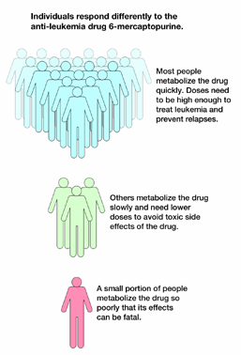
Pharmacogenetics – one example
Well known that the clinical response to a drug varies between individuals
1) In Europe ~10 % of population are deficient in cytochrome P450 enzymes responsible for metabolism of about 20 % of drugs on the market
⇒ Receive too high plasma concentrations at ordinary doses and increased susceptibility for adverse drug reactions
2) Ultra-rapid metabolisers (UMs) identified in 1992, where subjects have duplicated or multi-duplicated genes encoding drug metabolising enzymes
⇒ Too rapid drug metabolism occurs and the subjects get no response at ordinary dosage

Slide 15
The molecular genetic basis

Slide 16
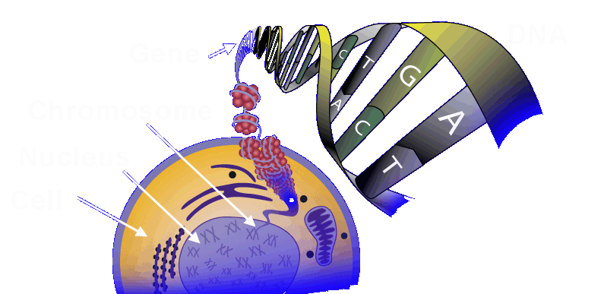
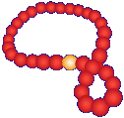
Basics: From DNA to proteins
Information in DNA
leads to the production
of proteins that do
the body’s work
Protein
Amino Acid
Notes:
Slide 16a:

Slide 17
Basics: From DNA to proteins
(35,000 genes in total)
GENE
(DNA)
intron
transcription
precursor
RNA
splicing
mRNA
translation
protein

Slide 18
Basics: Anatomy of a Gene
Coding Region
Promoter
Exons
Intron
DNA
Start
Transcription
RNA transcript
Processing
AAAAAAAAA
mRNA

Slide 19
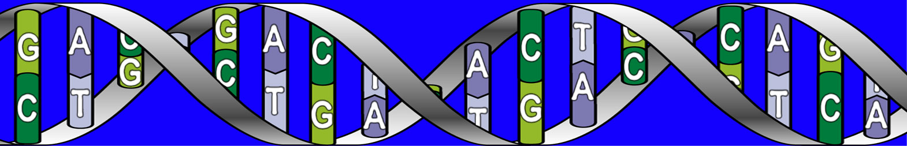
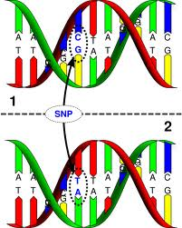
Basics: Genetic Variation
…G G T A A C T G…
Human Genome has 3 billion DNA base-pairs
Polymorphic
…G G C A A C T G...
Some people have a different
base at a given location:
This is a Single Nucleotide
Polymorphism or SNP

Slide 20
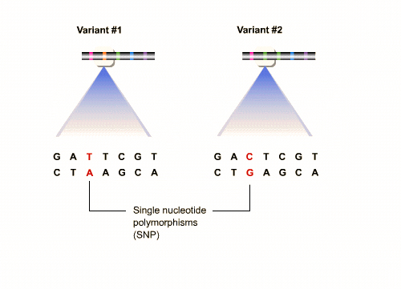
Consequences of polymorphisms

Slide 21
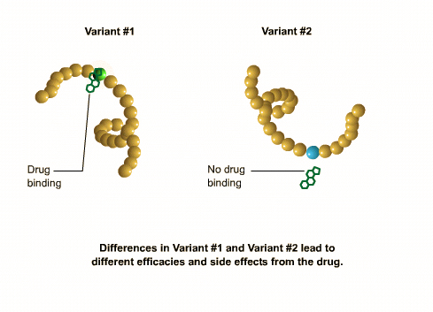
Consequences of Polymorphisms on Drug Activity

Slide 22
Genetic Polymorphisms

Slide 23
Polymorphisms (1): SNPs
Genetic variation occuring with a frequency of 1% or more in the population (otherwise, mutation)
SNP (single nucleotide polymorphism):
    most frequent type
    difference in a single base of the genomic sequence
    usually 1/1000 base along the 3 billion base pairs of the human genome
    The most common SNP is a change from cytosine to thymine (CT) on one strand of DNA, with a change from guanine to adenine (G A) on the other strand
    most do not influence the structure or function of proteins
SNP can occur
    In exons (may alter the structure of proteins and may lead to functional consequences)
    In introns (may influence splicing)
    In the regulatory regions (may influence expression of the gene)

Slide 24
Polymorphism (2): other types
  Insertion/deletion polymorphism: insertion or deletion of a few nucleotides
  Variable number tandem repeats: variation in the number of times a sequence of several hundred base pairs is repeated
  Simple tandem repeats (microsatellites): 2-4 nucleotides repeated a variable number of times

Slide 25
The quantitative genetic basis

Slide 26
Key Concepts and Terms
Genotype: gene structure encoding for the given characteristics
Phenotype: the manifestation of the genotype, which can be observed and can be influenced by other factors:
Other gene products
Environment
Acquired characteristics
Determinism of a trait, or phenotype can be:
Monogenic: due to allelic variation at a single gene
Polygenic: due to variations at two or more genes
Polymorphic: frequently occurring monogenic variants at a frequency >1%

Slide 27
How is this determined? (1)
Determination of genotype: PCR
Determination of phenotype:
  determination of metabolic rate (e.g. level of original drug/metabolite in urine)
  after administration of a given dose of the drug, pharmacokinetic parameters are measured (e.g. halflife, clearance, plasma levels)
Distribution of phenotypes in the population:
  Multimodal (usually bi- or trimodal) distribution
  indicates determination by a single gene
  having polymorphic variants
  Unimodal distribution indicates polygenic
  multifactorial inharitance, or monogenic
  inheritance but no polymorphism

Slide 28
How is this determined? (2)
The function is usually bi- or trimodal indicating two or three phenotypes
  Enhanced/extensive metaboliser:
    intensive metabolisation, resulting in low plasma concentration of the drug
    usually heteozygote or homozygote dominant
  Intermediate metaboliser
  Poor metaboliser or non-metaboliser:
    Slow or no metabolisation of the drug resulting in high plasma concentration for an extended time
    Usually homozygote recessive

Slide 29
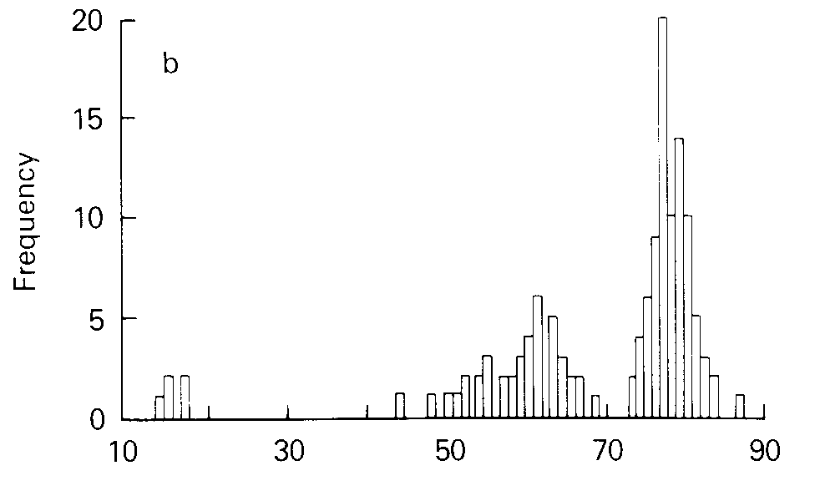
Polymorphic Distribution
From Pratt WB,Taylor P. Fig 7-5b

Slide 30
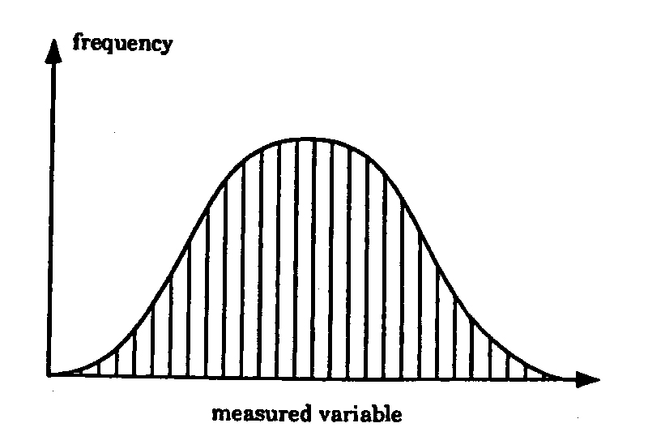
Polygenic control
Genetic control
CONTINUOUS/UNIMODAL DISTRIBUTION
Large differences between individuals at extremes of distribution
Several genes act together – not possible to recognise or discern the influences of single genes
⇒ Salicylate conjugation with glycine or glucuronic acid

Slide 31
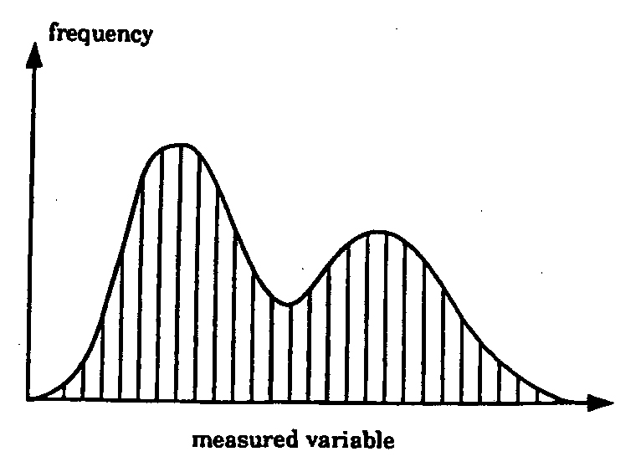
Monogenic control
Genetic control
DISCONTINUOUS/MULTIMODAL DISTRIBUTION
two phenotypes
Low incidence
Rare trait/inborn error
High incidence (>1%)
polymorphism
Rare trait
Succinylcholine – hydrolysis by plasma cholinesterase
Polymorphism
debrisoquine – oxidation by cytochrome P450 2D6

Slide 32
Hardy Weinberg Law

Slide 33
Hardy-Weinberg law (1)
Hardy-Weinberg law (or principle) states that both allele and genotype frequencies in a population remain constant—that is, they are in equilibrium—from generation to generation unless specific disturbing influences are introduced.
Phenotype = observed FAST or SLOW metabolizer
Genotype = genetic make-up: FF, SS, FS or SF
Allele = individual copy of the gene F, or S

Slide 34
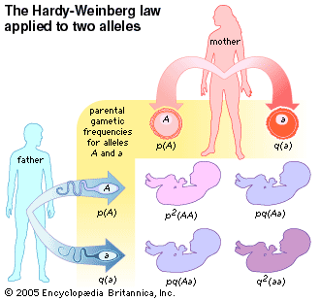
Hardy-Weinberg Law (2)
F
S
p(F)
q(S)
F
p(F)
p²(FF)
pq(FS)
S
q(S)
pq(SF)
q²(SS)
{ (p + q)² = p² + 2pq + q² = 1 }

Slide 35
Hardy-Weinberg Law (3)
p(F) = p = frequency of wild-type allele(s)
p(S) = q = frequency of variant allele(s)
Only 2 alleles in this case, sum of frequencies = 100%
So that p + q = 1
p² = frequency of wild-type genotype
q² = frequency of variant genotype
2pq = frequency of heterozygote genotype

Slide 36
Hardy-Weinberg Law (4)
Generalization of binomial expansion
2-allele case :
(p + q)² = p² + 2pq + q² = 1
3-allele case :
(p + q + r)² = p² + q² + r² + 2pq + 2pr + 2qr = 1
Etc…

Slide 37
Consequences of Hardy-Weinberg Law
Based on observation of phenotypic frequencies
Allows computing the following frequencies:
-allelic frequencies: p, q
-genotypic frequencies: p², q², 2pq
Or based on allele frequencies (p and q),
Allows computing genotype frequencies

Slide 38
Few examples

Slide 39
More Examples
Evans and Mcleod NEJM 2003

Slide 40
Even more Examples
Evans and Mcleod NEJM 2003

Slide 41
Conclusions: Pharmacogenetics
Rational framework for evaluation of genetic variation of
    Drug metabolising enzymes
    Drug transporters
    Receptors
    Ion channels
Which influences the risk of adverse drug reactions or therapeutic failure
Reduction of trial-and-error choice of medication and dose
Personalized treatment guidelines

Slide 42
Next pharmacogenetics lectures
Variability in drug metabolism (but not only)
  Phase 1 polymorphisms (+ drug absorption, distribution and elimination)
  Phase 2 polymorphisms (+ drug activation, receptors)
Modern methods
  pharmacogenomics,
  pharmacometabonomics
Tutorial on pharmacogenetics

