Slide 1
Enzymes as drug targets
BSc Pharmacology & Translational Medical Science, yr 2
MBBS, yr4
Marc-Emmanuel Dumas, PhD
Biomolecular Medicine, Dept Surgery and Cancer
Sir Alexander Fleming Building, room 360
South Kensington Campus
m.dumas@imperial.ac.uk

Slide 2
Learning objectives
Define what an enzyme is and their biological role
Define a catalyst
Be aware of mechanisms of action
Describe different types of inhibition
Use few examples to support ideas

Slide 3
Outline
Enzymes and their biological function
Active sites and catalysis mechanisms
Different types of Inhibition
  Competitive inhibition
  Irreversible inhibition
  Allosteric (reversible) inhibition
Examples

Slide 4
Enzymes and their biological function

Slide 5
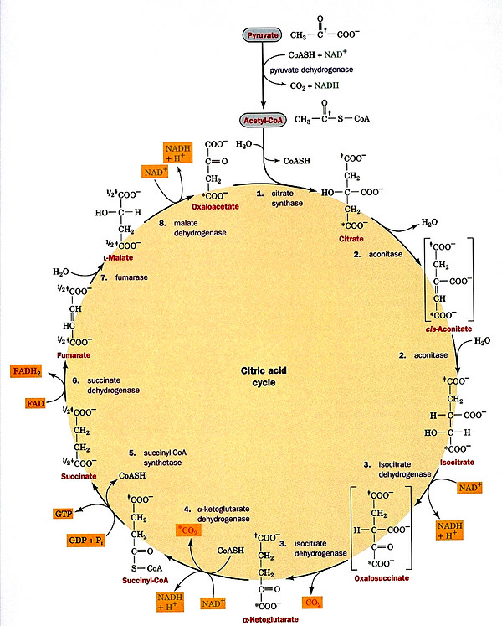
What is an enzyme?
Globular proteins acting as the body’s catalysts
Nomenclature:
  Root + ase
Classification
  Oxidoreductases
  Transferases
  Hydrolases
  Lyases
  Isomerases
  Ligases/synthetases

Slide 6
What is a catalyst?
Speed up time for reaction to reach equilibrium
Lowers activation energy
Energy
Energy
Transition state
New
transition
state
Act.
energy
Act.
energy
Starting
material
Starting
material
∆G
∆G
Product
Product
WITHOUT ENZYME
WITH ENZYME

Slide 7
Methods of catalysis
H
2
C
H
2
C
H
2
C
H
3
C
H
3
P
d
,
P
t
,
N
i
Provide a reaction surface/suitable environment
Bring reactants together
Position reactants correctly for reaction
Weaken bonds in the reactants
H
H
CH₂
CH₂
H
H
Surface
Metal

Slide 8
Enzymes as catalysts
Provide a reaction surface (the active site)
Provide a suitable environment (hydrophobic)
Bring reactants together
Position reactants correctly for reaction
Weaken bonds in the reactants
Provide acid / base catalysis
Provide nucleophiles

Slide 9
Active sites and catalysis mechanisms

Slide 10
The active site
Hydrophobic hollow or groove on the enzyme surface
Accepts reactants (substrates and coenzymes)
Contains amino acids which
  bind reactants (substrates and coenzymes)
  catalyze the reaction
Active site
Active site
ENZYME

Slide 11
Enzyme catalysis
S
P
S
P
E
E
E
E
E
E + S
ES
EP
E + P
Binding interactions:
  Ionic, H-bonding, van der Waals
  strong enough to hold the substrate sufficiently long for the reaction to occur
  weak enough to allow the product to depart
Drug design:
  designing molecules with stronger binding interactions results in enzyme inhibitors which block the active site

Slide 12
Enzymes as drug targets: examples
Increase [S]
  Decreased levels of GABA cause seizures
  GABA aminotransferase degrades GABA
  Inhibition of enzyme raise GABA levels
Decrease [P]
  Xanthine converts to uric acid with xanthine oxidase
  Excess uric acid leads to gout
  Inhibition of enzyme lowers production of uric acid

Slide 13
An example reaction:
Reduction of pyruvate to lactate
Homolactic fermentation
LDH = Lactate dehydrogenase (enzyme)
NADH = reducing agent & coenzyme
Pyruvic acid = substrate
O
H
O
H
C
O
LDH
C
O
N
A
D
H + H⁺
+
H
3
C
C
H
C
C
+
N
A
D
+
3
O
H
O
H
Pyruvic acid
Lactic acid

Slide 14
Binding of pyruvic acid in LDH
O
H-Bond
H
Ionic
bond
H₃N
Possible interactions
vdw-interactions
H-Bond
van der Waals
Ionic

Slide 15
Substrate binding: induced fit
Active site is nearly the correct shape for the substrate
Binding alters the shape of the enzyme (induced fit)
Binding will strain bonds in the substrate
Substrate
S
Induced fit

Slide 16
Induced fit
Active site alters shape to maximize intermolecular attractions
S
Phe
S
Phe
O
H
O
H
Ser
Ser
CO₂
Induced
fit
CO₂
Asp
Asp
Intermolecular bonds not optimum length for maximum bonding
Intermolecular bond lengths optimized
Susceptible bonds in substrate strained
Susceptible bonds in substrate more easily broken

Slide 17
Binding of pyruvic acid in LDH
O
H
O
O
H₃N
O

Slide 18
Binding of pyruvic acid in LDH
O
π bond
weakened
H
H₃N

Slide 19
Catalysis Mechanisms
Acid/base catalysis
Covalent catalysis: Nucleophilic residues
Non-ionized
Acts as a basic catalyst
(proton 'sink')
Ionized
Acts as an acid catalyst
(proton source)
L-Serine
L-Cysteine

Slide 20
Serine as a nucleophile

Slide 21
Different types of inhibition

Slide 22
Competitive (reversible) inhibitors
S
I
I
E
E
E
Inhibitor binds reversibly to the active site
No reaction takes place on the inhibitor
Inhibition depends on the strength of inhibitor binding and inhibitor concentration
Substrate is blocked from the active site
Increasing substrate concentration reverses inhibition
Inhibitor likely to be similar in structure to the substrate
Examples:
  Ethylene glycol or methanol poisoning
  Sulfonamide antibacterial agents (sulfa drugs)
fomepizole

Slide 23
Irreversible inhibition
X
Covalent Bond
X
OH
OH
O
Irreversible inhibition
Inhibitor binds irreversibly to the active site
Covalent bond formed between the drug and the enzyme
Substrate is blocked from the active site
Increasing substrate concentration does not reverse inhibition
Inhibitor likely to be similar in structure to the substrate
Examples:
  Aspirin
  Penicillins

Slide 24
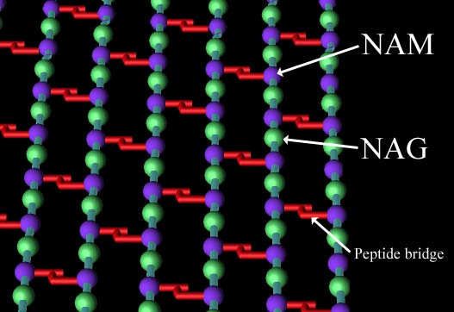
Penicillin
Penicillin: antibiotic binding bacterial transpeptidase (discovered by Sir Alexander Fleming)
Peptidoglycan cell wall: overlapping lattice of 2 sugars - N-acetyl glucosamine (NAG) and N-acetyl muramic acid (NAM) - that are crosslinked by peptide bridges

Slide 25
Mechanism of action of penicillin
NAM
NAG
NAM
NAG
NAM
L-Ala
NAM
L-Ala
NAM
L-Ala
NAM
NAG
NAG
D-Glu
D-Glu
D-Glu
L-Ala
L-Ala
NAM
L-Ala
NAM
NAM
NAG
NAG
L-Lys
L-Lys
L-Lys
D-Glu
D-Glu
D-Glu
D-Ala
L-Ala
D-Ala
L-Ala
L-Ala
L-Lys
L-Lys
L-Lys
D-Glu
D-Glu
D-Glu
D-Ala
D-Ala
D-Ala
L-Lys
L-Lys
L-Lys
Bond formation
inhibited by
penicillin
D-Ala
D-Ala
D-Ala

Slide 26
Bacterial cell wall synthesis
Cross linking

Slide 27
Bacterial cell wall synthesis
Normal Mechanism:
Mechanism inhibited by penicillin:

Slide 28
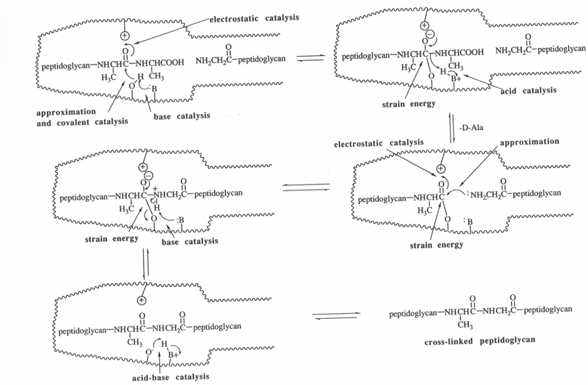
From The Organic Chemistry of Drug Design and Drug Action by Richard B. Silverman, Academic Press, 1992.

Slide 29
Alternative “umbrella” mechanism
D
-
A
l
a
-
D
-
A
l
a
Blocked
Acylation
H
O
O
Active Site
O
H
O
H

Slide 30
Allosteric inhibition (reversible)
Inhibitor binds reversibly to allosteric site
Induced fit alters the tertiary structure of the enzyme
Active site is distorted and is not recognized by the substrate
Increasing substrate concentration does not reverse inhibition
Inhibitor is not similar in structure to the substrate
Active site
Active site
unrecognizable
Induced
fit
ACTIVE SITE
Enzyme
ENZYME
(open)
(open)
Enzyme
Allosteric
site
ENZYME
Allosteric
inhibitor

Slide 31
Allosteric inhibition (reversible)
Biosynthetic pathway
S
P
P’
P’’
P’’’
Enzyme
(open)
ENZYME
Inhibition
Feedback control
Enzymes with allosteric sites often at start of biosynthetic pathways
Enzyme is controlled by the final product of the pathway
Final product binds to the allosteric site and switches off enzyme
Inhibitor may have a similar structure to the final product

Slide 32
Examples

Slide 33
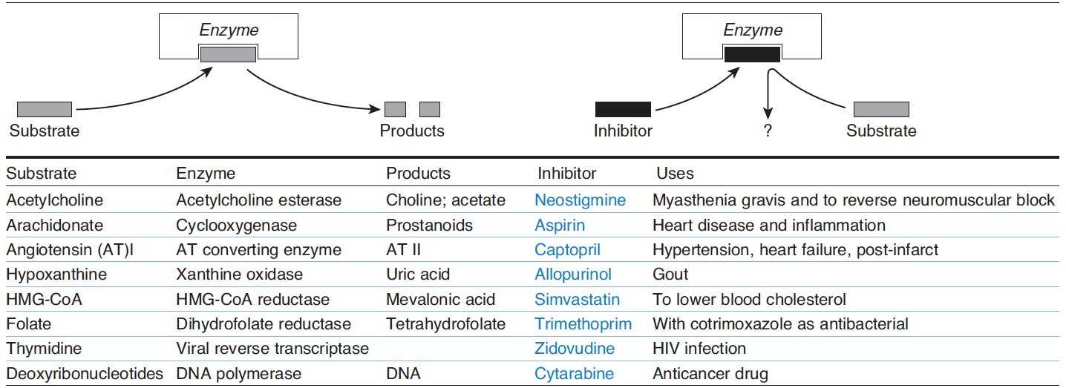
Drugs acting through alteration of enzyme reactions

Slide 34
Conclusions
Enzymes have key biological function
Catalysis mechanism in active site
Specificity of reaction
Different types of Inhibition
=> good targets for drugs

