Slide 1
Multivariate statistics in pharmacogenomics and metabonomics
BSc Pharmacology & Translational Medical Science
Marc-Emmanuel Dumas, PhD.
Biomolecular Medicine, Dept Surgery and Cancer
Sir Alexander Fleming Building, room 360
South Kensington Campus
m.dumas@imperial.ac.uk

Slide 2
Learning objectives
Be aware of the use of chemometrics in –omics data (metabonomics, transcriptomics, proteomics)
Use multivariate methods to analyse high-content data
Be aware of the characteristics of
n individuals << p variables
Use unsupervised and supervised methods
Be aware of model validation strategies

Slide 3
Plan
Data analysis in metabolic profiling
  Aims, issues & characteristics
Principal Components Analysis (PCA)
Model validation
Partial Least Squares (PLS) regression
  PLS-Discriminant Analysis
Orthogonal PLS

Slide 4
Plan
Data analysis in metabolic profiling
  Aims, issues & characteristics
Principal Components Analysis (PCA)
Model validation
Partial Least Squares (PLS) regression
  PLS-Discriminant Analysis
Orthogonal PLS

Slide 5
Aims of ‘omics’data analysis
Visualise differences, trends and relationships
  Between samples
  Between variables
Determine significance of difference between groups
Determine which variables cause the difference and how they influence it?
Construct predictive models
Definition of relationship to continuous variables
Enable pathway based interpretation

Slide 6
Multivariate data analysis - issues
Visualisation - Non-intuitive!
More variables than samples
Correlation between variables
Non-normality of distributions
Nonlinearity
Level of ‘noise’ - unexplainable variation
Size of data matrices
Missing data
Model validation
Not good for classical methods

Slide 7
Characteristics of Metabonomic data
More variables than samples
  Typically 10-100s of samples, 100-100000s of variables
Highly degree of correlation
  Analytic / structural + biological correlations
Unknown number and identity of metabolites
  Contrast to microarray data: no. & sequence known
Often time resolved
  multiple time points from same organism
Analytical error
  Eg. NMR Tox studies <20% biological variation
Multiple analytical methods
  NMR, LC/GC-MS
Emphasis on interpretation of models
  Not just predictive success

Slide 8
Plan
Data analysis in metabolic profiling
  Aims, issues & characteristics
Principal Components Analysis (PCA)
Model validation
Partial Least Squares (PLS) regression
  PLS-Discriminant Analysis
Other topics – lightning tour

Slide 9
PCA - Matrix Schematic Diagram
1
variables
K
t₁
t₂
t_{i}
1
2
T
3
“scores”
Summarises the variation
in the object direction
samples
X
N
Scores: t[1]/t[2]
p’₁
P’
p’₂
20
5
9
13
17
7
3
2
p’_{i}
11
12
t[2]
0
8
18
16
10
“loadings”
Summarises the variation
in the variable direction
1
14
6
19
15
20
-20
4
-60
-40
-20
0
20
40
60
t[1]

Slide 10
PCA – Step by step (1)
From data table to variable space
var. 3
One object in
variable space
 | Var 1 | Var 2 | Var 3
1
2
3 | a | b | c
4
…
N
c
var. 2
b
a
var. 1

Slide 11
PCA - Step by step (2)
var. 3
Many objects become a cloud of points in the multivariate space
var. 2
var. 1

Slide 12
Centring and scaling (1)
Centring – move centre of point swarm to the origin
var. 3
var. 3
mean
var. 2
var. 2
var. 1
var. 1

Slide 13
Centring & Scaling (2)
Scaling – put each variable on an equal footing
e.g. make standard deviations equal (not the only way)
var. 3
var. 3
var. 2
var. 2
var. 1
var. 1

Slide 14
PCA – Step by step (3) – 1st PC
var. 3
1st principal component follows largest variation in data
Score, t_{i1} = distance from projection of i’th point to origin
p₁ is like a new axis
  a latent variable
p₁
var. 2
t_{i1}
(i)
var. 1

Slide 15
PCA – Step by step (4) – 2nd PC
var. 3
2nd principal component follows largest variation which is perpendicular (orthogonal) to 1st component
Score, t_{i2} = distance from projection of i’th point on 2nd component to origin
p₂ is like a new axis
  a latent variable
p₁
p₂
var. 2
t_{i1}
t_{i2}
(i)
var. 1

Slide 16
PCA – Step by step (5) – Loadings
var. 2
Loading, p_{ij} = weight of original variable i in principal component j
Gives similarity in direction between the original variable and PC.
p_{ij} = cos θ_{i}
p₂₁
p₁
θ₂
θ₁
p₁₁
var. 1
∑_{i} p_{ij}² = 1

Slide 17
PCA – Step by step (6) – Example
If largest variation coincides with var. 1, then first principal component will be in direction of var. 1
var. 2
PC1 scores = values of var. 1
PC1 loadings, p₁ = (1, 0)
θ₂= 90º
PC₁
θ₁= 0º
var. 1

Slide 18
PCA – Step by step (7) – Residual
var. 2
Residual e_{ij} = perpendicular distance from point i to p_{j}
Residuals: variation not explained by PCs
Residuals = ‘Distance to Model’ = DmodX
p₁
(i)
e_{i1}
var. 1

Slide 19
PCA – Step by step (8) – 1 PC model
var. 2
Model after one PC:
X = t₁p₁’ + E₁
PC₁
θ₂
θ₁
(i)
e_{i}
var. 1
t_{i1}

Slide 20
PCA – Step by step (9) – 2 PC model
Plane
Model after 2 PCs:
X = t₁p₁’ + t₂p₂’+ E₂
2 PCs define a plane, 3 or more a hyperplane
Visualisation
Scores plot, t_{i} vs. t_{j} – point positions projected on plane
Loadings plot, p_{i} vs. p_{j} – weights of variables on each PC
Residuals or distance to model plot – distances of points to plane
PC 1
x
2
observation i
Projection
x
3
PC2
x
1
True position of data point
Position of projected point

Slide 21
Outliers
Strong outliers
  Found in scores plots
  Detection tool: Hotelling’s T²
Moderate outliers
  Found in residuals plots
  Detection tool: DmodX threshold

Slide 22
Strong Outliers
Q: Why are strong outliers found in scores plots?
PC2
PC1

Slide 23
Strong outlier detection – Hotellings T²
Hotelling's T² is a multivariate generalisation of Student's t-test
Ellipse of constant T² → confidence region
No strong outliers
Strong
outliers
Hotelling’s ellipse

Slide 24
Moderate Outliers
Moderate outliers detected on residuals (DmodX) plot
Distribution of residuals ~ Normal
F test specifies cut-off at e.g. 99% confidence

Slide 25
Moderate Outliers - detection tool DModX
No moderate outliers
Some moderate outliers
Critical distance is derived from the distribution of residuals

Slide 26
Example - Metabonomic Toxicology
Score Plot
Loading Plot
No influence
on the variation
in that direction

Slide 27
PCA - Summary
PCA models directions of greatest variation in data
PCA performs dimension reduction
Scores describe variation between objects. Strong outliers visible.
Loadings describe importance of variables.
Residuals describe unmodelled variation. Moderate outliers visible.

Slide 28
Plan
Data analysis in metabolic profiling
  Aims, issues & characteristics
Principal Components Analysis (PCA)
Model validation
Partial Least Squares (PLS) regression
  PLS-Discriminant Analysis
Orthogonal PLS

Slide 29
Model validation (1)
Can we trust conclusions based on the model?
  Statistical validation
  Biological validation
Statistical validation
  Goodness of fit to data
  Goodness of prediction for new data
  Errors on model parameters
Often ignored, but a vital stage of modelling process

Slide 30
Model validation (2) - train/test
Training set
Split the data
  Training set - build the model
  Test set - validate the model
Typically require >1/3 data in test set
All model parameters optimised on training set
  E.g. no. components, variables selected etc.
Goodness of fit statistic on test data indicates predictive quality of the model
Test set
1
2
3
4
5
6
7
8
1
2
3
4
5
6
7
8
Build model
Predict test set

Slide 31
Model validation (3) - Cross-validation
Rounds
Training set
General principle:
  Remove some data
  Build model on remaining data
  Predict removed data
  Repeat until all samples removed once
Compute predictions & residuals (e_{ik}) for each sample when left out
Calculate PRESS and Q² from all residuals
Can do this for X or Y
Test set
 | 1
 | 2
 | 3
 | 4
 | 5
 | 6
 | 7
 | 8
1
2
Samples
3
5
4
8
6
7
Build model
Predict test set
‘3-fold’ cross validatoin

Slide 32
Cross-validation - R² and Q²
R² & Q² plot from SIMCA-P software
R² rises with each component
Q² rises, then falls
Q: How many components do you think are appropriate here?
R²
Q²
Number of components

Slide 33
Model validation - summary
A statistically valid model:
  Has good fit to the data
  Is predictive of new data
Two widely accepted methods:
  Train / test
  Cross-validation
R² = variance explained (all data)
Q² = variance predicted (on a test set, usually by cross-validation)

Slide 34
Plan
Data analysis in metabolic profiling
  Aims, issues & characteristics
Principal Components Analysis (PCA)
Model validation
Partial Least Squares (PLS) regression
  PLS-Discriminant Analysis
Orthogonal PLS

Slide 35
Supervised methods
Unsupervised = algorithm does not know true answer/output (e.g. class) – e.g. PCA
Supervised = algorithm does know true answer
  Attempt to find rule which predicts output (e.g. class) for given input (e.g. metabolic profile)
Two cases
  Classification: output is class label
  Regression: output is continuous
Often denote input data as X and output as Y

Slide 36
Partial Least Squares (PLS)
Regression technique - relates X to Y
Projection technique (linear like PCA)
Often considered the ‘regression extension of PCA’
One of many multivariate regression techniques
  OLS, PCR, RR, RRR…
Good when
  More variables than samples
  Many highly correlated variables
  More than one Y variable
  Missing data
Common conditions in metabonomics!

Slide 37
PLS - Step by step (1)
X
Y
x3
y3
x2
y2
x1
y1
Initially, we have two sets of N (mean centred) data points in the X and Y spaces

Slide 38
PLS - Step by step (2)
X
Y
x3
y3
u1
t1
x2
y2
x1
y1
First PLS component: maximises covariance between X scores (t) and Y scores (u)
Good summary of X space (X variance)
Good representation of relationship between X & Y (X-Y correlation)

Slide 39
PLS - Step by step (3)
X
Y
x3
y3
u1
t1
x2
y2
x1
y1
Inner relation
u1
t1

Slide 40
PLS - Step by step (4)
X
Y
x3
y3
u1
t1
t2
x2
u2
y2
x1
y1
Subsequent components:
orthogonal (uncorrelated) to previous components and
continue to maximise the covariance between X & Y scores
  good description of X space & relationship between X & Y

Slide 41
PLS - Step by step (5)
X
Y
x3
y3
u1
t1
t2
x2
u2
y2
x1
y1
Inner relation
u2
t2

Slide 42
PLS-Discriminant Analysis (PLS-DA)
Classification method based on PLS
Y = ‘dummy matrix’ - defines class membership
Scores give information about class separation
Weights give information about variables responsible for separation

Slide 43
PLS-DA schematic
X
Y
‘Dummy’ matrix
1
1
0
0
1
1
0
0
1
1
0
0
2
0
1
0
2
PLS
0
1
0
2
0
1
0
3
0
0
1
3
0
0
1
3
0
0
1
PLS-DA models separation between classes
Q: Why can’t Y just be a single column of class numbers 1,2,3 etc?

Slide 44
PLS-DA - geometrical view
X space
Metabolic information
Y space
Class information
x2
y2
t
u
1
x1
0
y1
1
0
x3
u
Inner relation
t

Slide 45
PLS-DA Interpretation
PLS-DA ‘scores’
PLS-DA ‘loadings’
Scores
information about class separation
ANIT, Hydrazine → effect
Insulin → no effect
Loadings
information about variables responsible for class separation.
ANIT c.f. Controls: citrate ↓, bile acids ↑

Slide 46
PLS - Prediction
X
Must check new point is not an outlier in X, Y or t/u space
Y
y3
u1
x3
New sample
t1
x2
y2
x1
y1
Inner relation
u1
t1

Slide 47
PLS & PLS-DA - Summary
PLS – regression method
  models relationship between X & Y
PLS components maximise covariance between scores in X & Y spaces
PLS-DA – classification with PLS
  Y = dummy matrix, gives class info

Slide 48
Plan
Data analysis in metabolic profiling
  Aims, issues & characteristics
Principal Components Analysis (PCA)
Model validation
Partial Least Squares (PLS) regression
  PLS-Discriminant Analysis
Orthogonal PLS

Slide 49
Orthogonal PLS (O-PLS)
Divide variation in to correlated and orthogonal components
Same number of components & prediction ability as ordinary PLS, but…
Interpretation is improved
E.g. 6 component, 2 class PLS-DA model
  What variables important for separating classes?
  Interpret 6 sets of weights
1corr + 5orth O-PLS-DA model
  Interpret one set of weights
Trygg, J. and Wold, S. (2002) J. Chemometrics, 16, 119-128.

Slide 50
O-PLS – Matrix schematic
Predictor data
X
Y
O-PLS
Class
X_{corr}
X_{orth}
‘Structured noise’
T_{corr}
P_{corr}′
T_{orth}
P_{orth}′

Slide 51
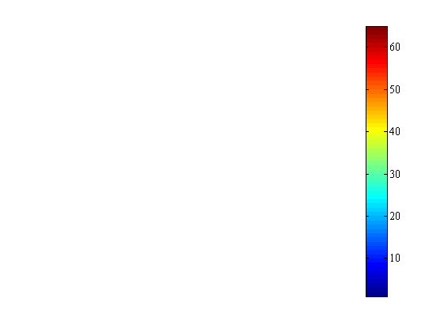
O-PLS – geometrical view
X space
High Y
p_{corr}
x3
p1
PCA
O-PLS
PLS
p1
Points colour-coded according to Y value
p2
p2
Y value
p_{orth}
x2
Low Y
x1

Slide 52
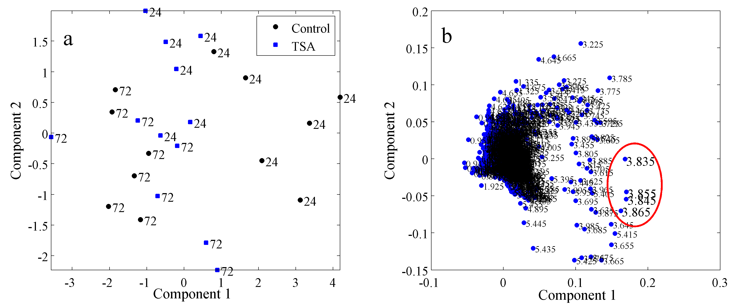
Comparing models - PCA
1-D ¹H NMR metabolic profiles of rat hepatocytes treated with trichostatin-A (TSA) & control.
Some separation visible in scores – mostly time related

Slide 53
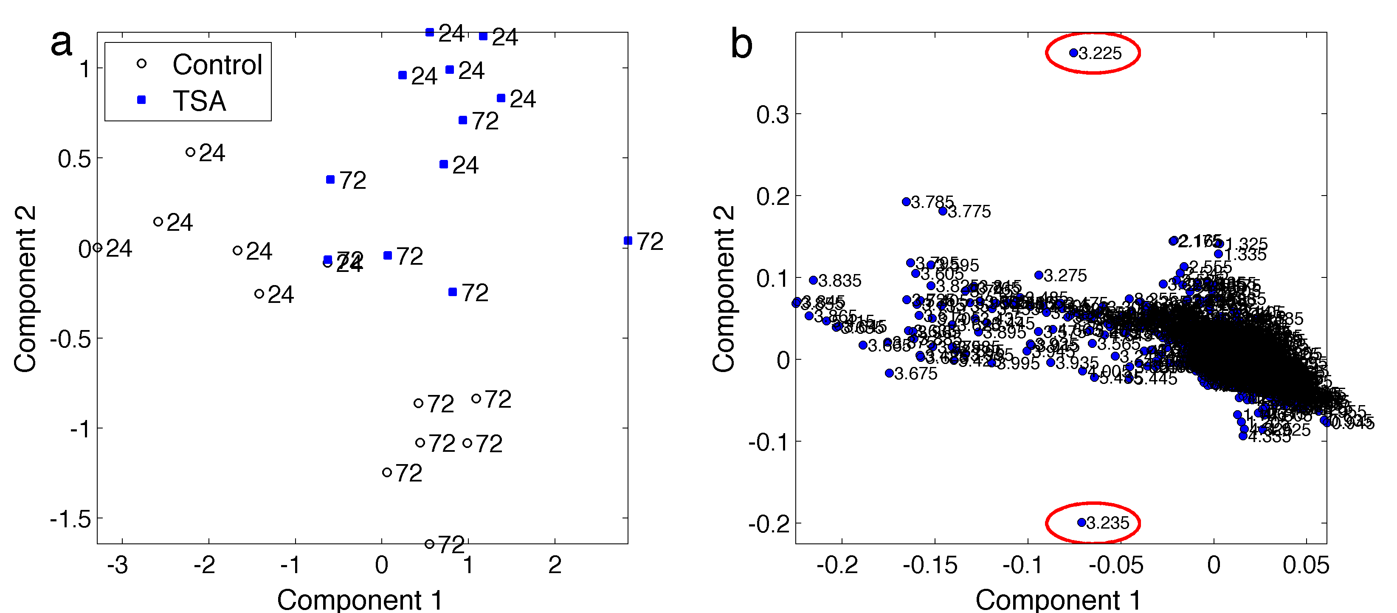
Comparing models – PLS-DA
Phospho-
choline
Glycerophospho-
choline
Scores – better separation
  But still some time related substructure
Loadings – two clear variables related to TSA treatment

Slide 54
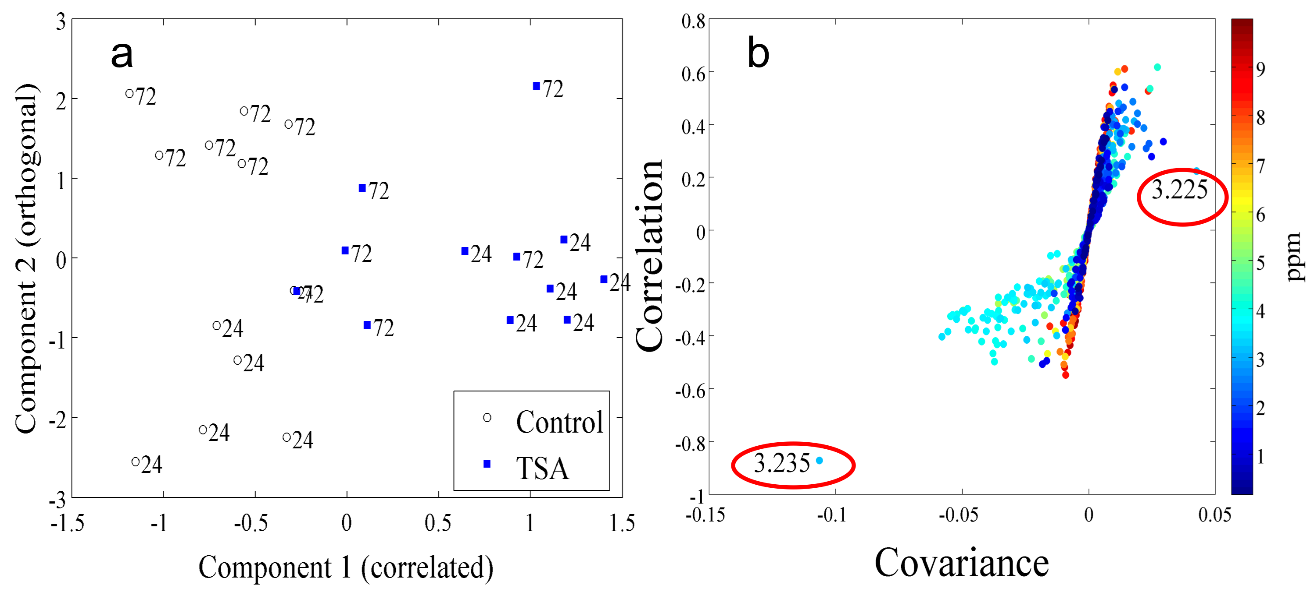
Comparing models – O-PLS-DA
Discrimination in ‘predictive’ component only
Interpretation using ‘S-plot’:
  Covariance: magnitude of change
  Correlation: ‘reliability’ of change

Slide 55
Comparing models
Nutrigenomics
2 mouse strains (genetics)
2 diets (high fat and low fat)
PCA shows total variation
PLS shows between-group variation, but scores plot influenced by diet (within-group)
O-PLS shows v efficient between-group variation (genetics), whereas diet is orthogonal
Fonville et al. (2010) J. Chemometrics, 24:636-649.

Slide 56
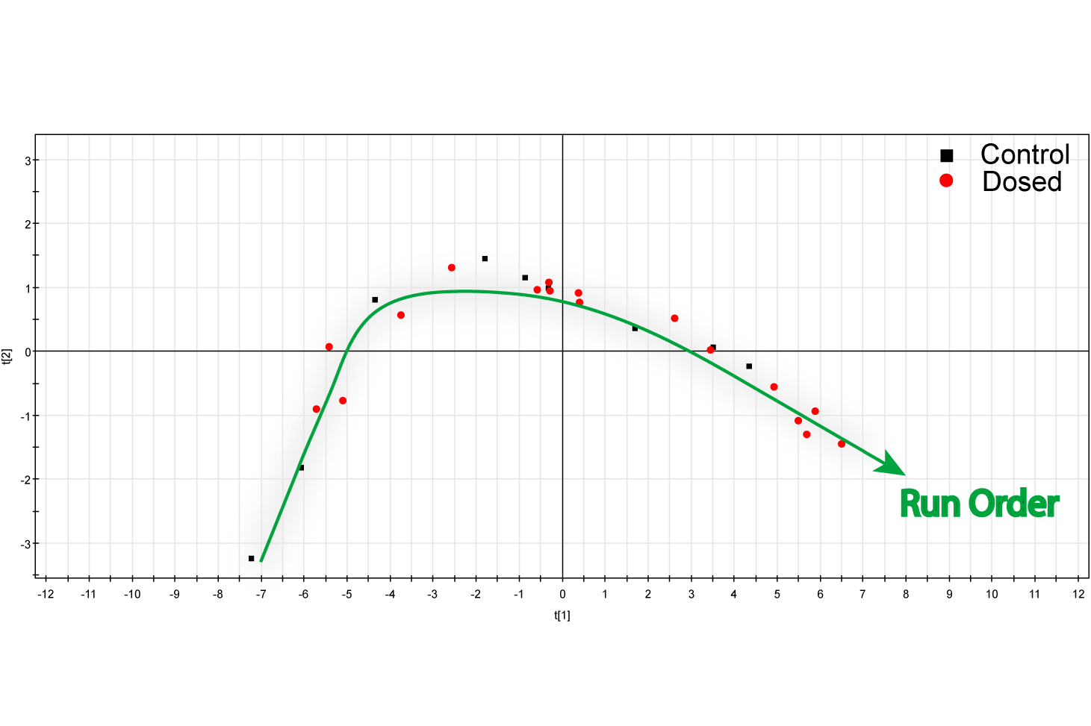
What about the orthogonal variation?
Rats dosed with paracetamol
Liver extracts profiled by NMR
PCA - strong trend with run order
Impossible to separate control & dosed classes
PCA

Slide 57
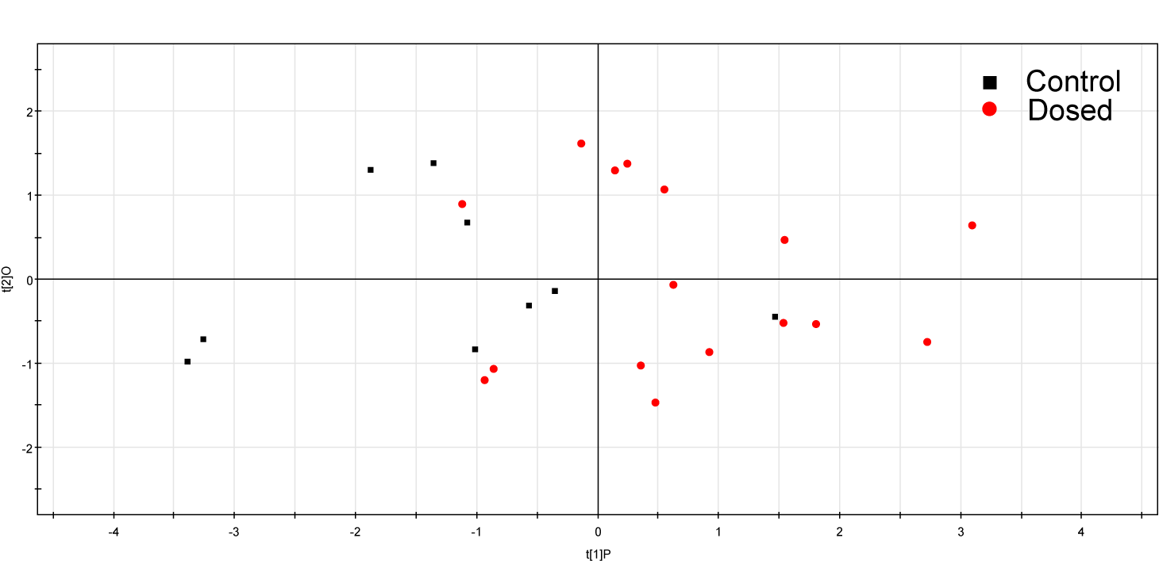
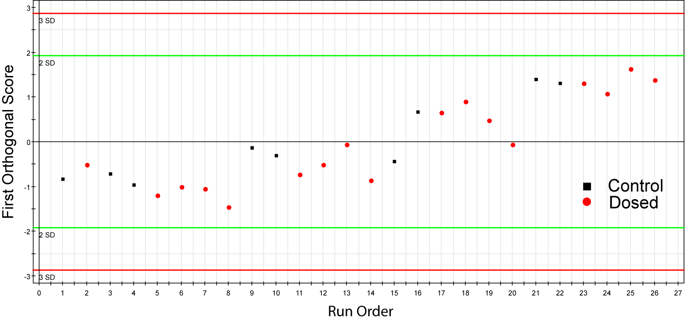
Examining the orthogonal variation
Separation now visible (though marginal)
Interpret loadings on correlated component
Orthogonal component shows trend with run order - removed
t_{orth}
t_{corr}
t_{orth}

Slide 58
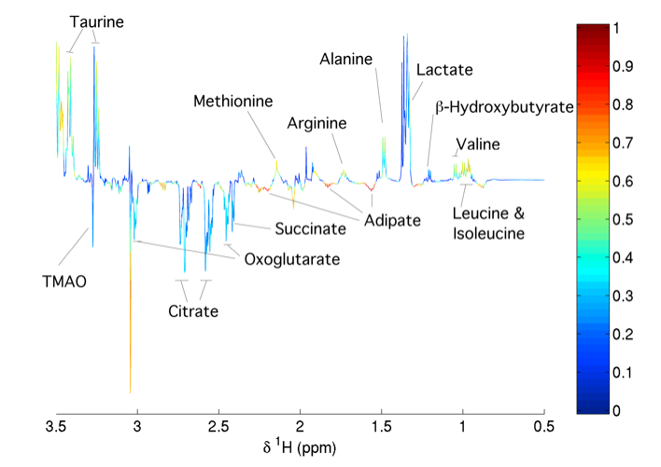
O-PLS-DA - interpretation
O-PLS coefficients plot
Direction → up / down in given class
Colour scale → correlation to Y variable (r²)

Slide 59
O-PLS - Summary
O-PLS splits variation into parts correlated & uncorrelated to response (Y)
Prediction quality identical to PLS
Interpretation improved - all ‘relevant’ information in few components
  E.g. 1 component when O-PLS-DA with 2 classes
O2-PLS (Trygg & Wold, (2003) J. Chemometrics, 17, 53)
  Further development of O-PLS
  Main difference: orthogonal components in Y

Slide 60
Brief history of chemometrics in omics
Fonville et al. (2010) J. Chemometrics, 24:636-649.

Slide 61
Use of multivariate methods
Fonville et al. (2010) J. Chemometrics, 24:636-649.

Slide 62
Overall Summary
Metabolic profiling data analysis
  Visualisation, group differences, interpretation
PCA
  Unsupervised, exploratory visualisation
  Models greatest variance in X
Model validation – vital
PLS & O-PLS
  Supervised regression / classification
  Models greatest co-variance between X & Y
  O-PLS improves interpretation

