Slide 1
Basic Neuropharmacology
Dr Sohag Saleh

Slide 2
Lecture content
Anatomy of the central nervous system
Ultrastructure
Cell types: neurones
Cell types: neuroglia
Relevant pathways
Dopaminergic
Serotonergic
Noradrenergic
Neurotransmission
Resting membrane potential
Action potential
Synaptic transmission
Basic pathologies
Neurochemical disorders
Neurodegenerative disorders
Neurophysiological disorders

Slide 3
Anatomy of the CNS
Cerebral hemispheres
Constitute about 85% of the dry weight of the brain
Has a highly convoluted surface of ridges (gyri) and valleys (sulci)
Conventionally separated into four regions: frontal, parietal, temporal & occipital
Brainstem
Consists of the medulla, pons and midbrain (in ascending order)
Is the target or the source of all the cranial nerves and has numerous important functions
Cerebellum
A hindbrain structure attached to the brainstem
Plays an important role in motor co-ordination, balance and posture
Spinal cord
Extends down from the medulla and essentially acts as a conduit for neural transmission but can coordinate some reflex actions
Cerebral hemisphere
Frontal lobe
Parietal lobe
Temporal lobe
Occipital lobe
Brainstem
Cerebellum
Spinal cord

Slide 4
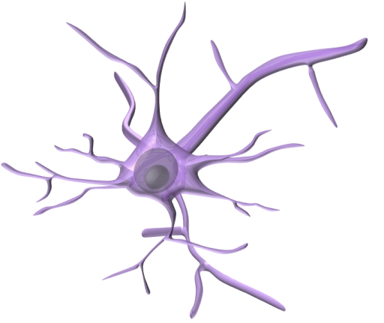
CNS Anatomy
NEURONE
Neurone
The excitable cells of the central nervous system come in a variety of shapes and sizes
All share some common features:
Soma (cell body)
Contains the nucleus and ribosomes
Axon
A long process (aka nerve fibre) that originates from the soma at the axon hillock
May branch off into collaterals and are generally covered in myelin
Dendrites
Highly branched outputs of the cell body that are not covered in myelin
Responsible for receiving signals from other neurons
Axon
Soma
Dendrites
Pyramidal Cell
Purkinje Cell
Golgi Cell

Slide 5
CNS Anatomy: Neurones & Neuroglia
EPENDYMA
Neurone
The excitable cells of the nervous system Exist in many shapes and sizes and are responsible for electrical transmission
Oligodendrocyte
A type of glial cell that produces myelin (a spiral structure rich in lipid)
The myelin has a high resistance and low capacitance and is responsible for high speed saltatory conduction
Astrocyte
The most abundant cell type in the mammalian brain thought to play an important role in synapse formation, maturation and plasticity
Microglia
Neuronal macrophages
Ependyma
Epithelial cells lining the ventricles
OLIGODENDROCYTE
Blood Vessel
Myelin
Node of Ranvier
ASTROCYTE
Axon
NEURONE
Dendrites
MICROGLIA

Slide 6
Summary: General Anatomy
Ultrastructure
Consists of spinal cord; brain stem; cerebellum and two cerebral hemispheres
Cerebrum anatomically & functionally separated into 4 lobes: frontal, parietal, temporal & occipital
Cell types: neurones
An electrically excitable cell that generally consists of a cell body (soma), an axon and numerous dendrites (thin processes)
Perform a diverse arrays of functions throughout the nervous system
Cell types: neuroglia
‘Accessory’ cells that perform numerous functions such as support, insulation and general homeostasis
Include astrocytes and oligodendrocytes

Slide 7
Lecture content
Anatomy of the central nervous system
Ultrastructure
Cell types: neurones
Cell types: neuroglia
Relevant pathways
Dopaminergic
Serotonergic
Noradrenergic
Neurotransmission
Resting membrane potential
Action potential
Synaptic transmission
Basic pathologies
Neurochemical disorders
Neurodegenerative disorders
Neurophysiological disorders

Slide 8
Monoamine pathways: Dopamine
Major locations
The nigrostriatal pathway runs from the susbstantia nigra pars compacta (SNc) to the striatum and plays an important role in movement
The mesolimbic pathway runs from the ventral tegmental area (VTA) to the Nucleus Accumbens (NAcc) and is widely thought be the brain reward pathway
The mesocortical pathway goes from VTA to the cerebrum and is important in executive functions and complex behavioural patterns
The tuberoinfundibular pathway runs from the arcuate nucleus to the medial eminence and regulates prolactin secretion
Pathophysiology
Parkinson’s disease
Schizophrenia
Mesocortical pathway
Nigrostriatal
pathway
Mesolimbic pathway
Tuberoinfundibular pathway

Slide 9
Monoamine pathways
SEROTONERGIC
NORADRENERGIC
Locus ceruleus
Raphe nuclei
Location
The majority of the serotonergic cell bodies are located in the Raphe nuclei (RN) and innervate almost every area of the brain
Neurones from the dorsal RN project to the striatum whereas those from the median RN project to the limbic system
Function
Emotions, neuroendocrine, circadian rhythms, feeding, sleeping.
Pathophysiology
Depression
Location
The locus ceruleus (LC) contains around 80% of the brain noradrenergic neurones
Projections from the LC innervate numerous regions of the brain including the hypothalamus, the limbic system and the cortex
Function
Neuroendocrine, anxiety, fear, reward
Pathophysiology
Addiction

Slide 10
Summary: Relevant Pathways
Dopaminergic
Nigrostriatal, mesolimbic, mesocortical & tuberoinfundibular pathways
Parkinson’s disease, schizophrenia
Serotonergic
Raphe nuclei
Depression
Noradrenergic
Locus ceruleus
Addiction

Slide 11
Lecture content
Anatomy of the central nervous system
Ultrastructure
Cell types: neurones
Cell types: neuroglia
Relevant pathways
Dopaminergic
Serotonergic
Noradrenergic
Neurotransmission
Resting membrane potential
Action potential
Synaptic transmission
Basic pathologies
Neurochemical disorders
Neurodegenerative disorders
Neurophysiological disorders

Slide 12
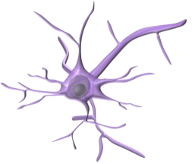
Neurotransmission: RMP
Resting membrane potential (RMP)
The four major physiological ions are potassium (K⁺), sodium (Na⁺), chloride (Cl⁻) and calcium (Ca²⁺)
Cell membranes are generally impermeable to these ions and their transportation is regulated by channels and pumps
This leads to an uneven distribution of these ions with high extracellular concentrations of Na⁺ and Cl⁻
And a high intracellular concentration of K⁺
There is also a very high concentration gradient for Ca²⁺
This difference in concentration is one factor that creates a potential difference across the membrane
Neuronal cells have a negative charge inside compared to outside and have a RMP of between -40 to -90mV
The positive and negative charges are concentrated around the membrane
Na⁺
140mM
Cl⁻
120mM
K⁺
Na⁺
Cl⁻
Ca²⁺
K⁺
Ca²⁺
2mM
2mM
OUT
0mV
IN
-70mV
K⁺
150mM
K⁺
Na⁺
Na⁺
Cl⁻
Cl⁻
Ca²⁺
Ca²⁺
10mM
5mM
0.1μM

Slide 13
Neurotransmission: Action potential
Action potential (AP)
Na⁺ and K⁺ play the most important roles in the generation of a neuronal AP
At the RMP voltage-gated Na⁺ channels (VGSCs) and voltage-gated K⁺ channels (VGKCs) are in the closed configuration
Membrane depolarisation causes opening of the VGSC and Na⁺ influx resulting in further depolarisation
The VGKC opens at a slower rate and causes the efflux of K⁺ from the cell causing membrane repolarisation
Na⁺
Na⁺
Na⁺
Na⁺
Na⁺
Na⁺
VGKC
OUT
-70mV
-30mV
IN
VGSC
K⁺
K⁺
K⁺
K⁺
K⁺
K⁺

Slide 14
Neurotransmission: Action potential
Action potential (AP)
The AP leaves an imbalance in the ionic concentrations, which need to be restored
The Na⁺-K⁺-ATPase (pump) performs the function of restoring the ion gradients
In the ‘resting’ configuration Na⁺ enters the vestibule and upon phosphorylation the ions are transported through the protein
The Na⁺ is removed from the cell in the ‘active’ configuration and K⁺ enters the vestibule
As the pump returns to the resting configuration the K⁺ is transported back into the cell
K⁺
K⁺
K⁺
K⁺
K⁺
Na⁺K⁺ATPase
OUT
IN
ATP
K⁺
Na⁺
Na⁺
Na⁺
Na⁺
K⁺
Na⁺

Slide 15
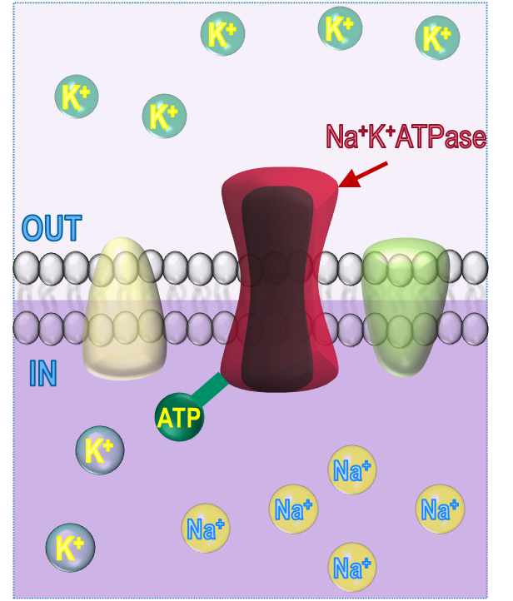
Neurotransmission: Saltatory conduction
SYNAPSE
PRESYNAPTIC TERMINAL
OLIGODENDROCYTE
POST-SYNAPTIC CELL
Saltatory conduction
Nodes of Ranvier
NEURONE

Slide 16
Neurotransmission: Synapse
Propagation of the action potential
2. NT release from vesicles
Ca²⁺
Ca²⁺
Na⁺
Na⁺
Na⁺
Na⁺
Na⁺
Ca²⁺
Ca²⁺
PRESYNAPTIC AXON TERMINAL
POST-SYNAPTIC CELL
4. Neurotransmitter reuptake
3. Activation of
postsynaptic receptors

Slide 17
Summary: Neurotransmission
Resting membrane potential (RMP)
Neurones have a RMP of around -70mV, which is determined by ion gradients (primarily K⁺)
In the resting state there is a high concentration of K⁺ inside the cell and a high concentration of Na⁺ outside the cell
Action potential (AP)
Depolarisation of the membrane caused by the opening of VGSC and the influx of Na⁺ ions
K⁺ efflux restores the membrane potential to ‘resting’ and the ion imbalance is corrected by the Na⁺/K⁺/ATPase
Synaptic transmission
At the synaptic terminal the AP activates VGCCs, which allow Ca²⁺ entry causing the subsequent exocytosis of neurotransmitter-containing vesicles
Neurotransmitters activate postsynaptic receptors and are then recycled either by enzymatic breakdown or neuronal reuptake

Slide 18
Lecture content
Anatomy of the central nervous system
Ultrastructure
Cell types: neurones
Cell types: neuroglia
Relevant pathways
Dopaminergic
Serotonergic
Noradrenergic
Neurotransmission
Resting membrane potential
Action potential
Synaptic transmission
Basic pathologies
Neurochemical disorders
Neurodegenerative disorders
Neurophysiological disorders

Slide 19
Neurochemical disorders: depression
SEROTONERGIC
NORADRENERGIC
Locus ceruleus
Raphe nuclei
Monoamine theory
↓ monoamines (e.g. NE, 5-HT)
Pharmacology
Tricyclic antidepressants (e.g. Imipramine, Clomipramine)
SSRIs (e.g. Fluoxetine)
MAOIs (e.g. Phenelzine, Moclobemide)
Reboxetine (NRI), Venlafaxine (SNRI)
Other hypotheses
↓ Neurotrophic factors (e.g. BDNF)
Abnormalities of the HPA axis
Genetic predisposition
Pharmacology
Nothing yet....

Slide 20
Neurochemical disorders: Schizophrenia
Mesocortical pathway
Nigrostriatal
pathway
Dopamine theory
↑ dopaminergic activity
Mesocortical (+ve symptoms)
Mesolimbic (-ve symptoms)
Pharmacology
Typical antipsychotics (e.g. Haloperidol, Chlorpromazine)
Atypical antipsychotics (e.g. Clozapine, Risperidone)
Mesolimbic pathway
Tuberoinfundibular pathway

Slide 21
Neurodegenerative disorders: Parkinson’s
Nigrostriatal tract
Degeneration of dopaminergic fibres of the nigrostriatal tract
↓ dopaminergic activity
↑ cholinergic activity
Pharmacology
Dopamine precursor (e.g. Levodopa)
Dopamine receptor agonists (e.g. Pergolide)
MAO-B inhibitors (e.g. Selegiline)
Antimuscarinics (e.g. Procyclidine)
Mesocortical pathway
Nigrostriatal
pathway
Mesolimbic pathway
Nucleus basalis of Meynert
Pedunculopontine nucleus
Tuberoinfundibular pathway

Slide 22
Neurodegenerative disorders: Alzheimer’s
Pathophysiology
β-amyloid plaques
Tau aggregation
↓ Cholinergic activity
↑ glutamatergic activity
Pharmacology
Cholinesterase inhibitors (e.g. Donepezil)
Glutamate (NMDA) receptor antagonist (Memantine)
Nucleus basalis of Meynert

Slide 23
Neurophysiological disorders: Epilepsy
Pathophysiology
Excessive neuronal activity
Genetic & acquired
Pharmacology
VGSC inhibitors (e.g. Phenytoin, carbamazepine)
GABA_{A} potentiators (e.g. Phenobarbital, clonazepam)
GABA breakdown/reuptake inhibitors (e.g. Valproate, tiagabine)
T-type Ca²⁺ channel inhibitors (e.g. Ethosuximide)
K_{v}7 K⁺ channel opener: retigabine
Other: levetiracetam (SVA2?), topiramate (multiple effects)

Slide 24
Summary: Pathologies
Neurochemical disorders
Depression is treated using tricyclic compounds, SSRIs, MAOIs and SNRIs
Schizophrenia treatment involves the usage of drugs that inhibit dopaminergic (typical) and serotonergic (atypical) activity
Neurodegenerative disorders
Parkinson’s disease is treated using drugs that increase dopamine availability or stimulate dopamine receptors
Alzheimer’s disease is treating using drugs that increase acetylcholine availability or drugs that inhibit glutamate receptors
Neurophysiological disorders
Epilepsy is treated using drugs that either increase inhibitory neuronal activity or drugs that reduce excitatory neurotransmission

Slide 25
Overall Summary
Anatomy of the central nervous system
Ultrastructure: PNS, CNS- Cerebral hemisphere, midbrain
Cell types: neurones- electrically excitable, soma, axons, dendrites
Cell types: neuroglia- oligodendrocytes, astrocytes, microglia
Relevant pathways
Dopaminergic: nigrostriatal, meso-limbic/cortical, tuberohypophyseal
Serotonergic: Raphe nuclei
Noradrenergic: locus ceruleus
Neurotransmission
Resting membrane potential: -70mV, high [Na⁺]_{out}, high [K⁺]_{in}
Action potential: Na⁺ influx, K⁺ efflux, restoration with Na⁺-K⁺-ATPase
Synaptic transmission: AP, vesicle exocytosis, receptor stimulation, neurotransmitter recycling
Basic pathologies
Neurochemical disorders: Schizophrenia
Neurodegenerative disorders: Parkinson’s, Alzheimer’s
Neurophysiological disorders: Epilepsy

