Slide 1
Drug targets: hormones Chris John

Slide 2
“CLASSIC” ENDOCRINE GLANDS
PITUITARY
PARATHYROIDS
THYROID
ADRENALS
PANCREAS
(GASTROINTESTINAL
TRACT)
GONADS

Slide 3
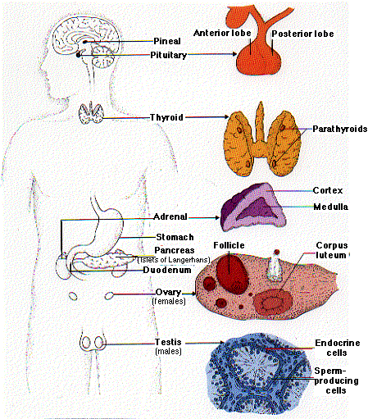
“CLASSIC” ENDOCRINE GLANDS
users.rcn.com/.../BiologyPages/E/Endocrines.gif

Slide 4
Hormone Mechanism of Action
Action of polypeptide/protein hormones
Where are the potential drug targets??
Mitochondria
Adenylate
Cyclase
ATP
Protein
Kinase A
cAMP
StAR protein
DNA
+
+
G-protein
ACTH R
Cholesterol
Adrenal Cortical
Cell (Nucleus)
Blood Capillary
Adrenal Cortical Cell (Cytoplasm)

Slide 5
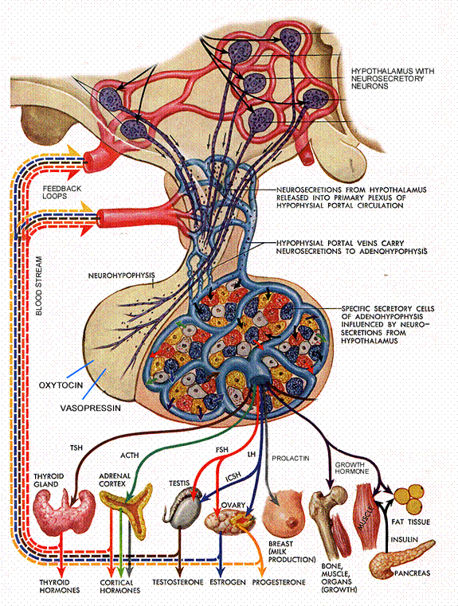
Hormone Mechanism of Action
Hormone replacement therapy?
Which pituitary hormones are directly
replaced if the individual is deficient?
http://alexandria.healthlibrary.ca/documents/notes/bom/unit_3/L-01%20Regulation%20of%20Pituitary%20Hormone%201.xml

Slide 6
Hormone Mechanism of Action
Steroid hormones
Where are the potential drug targets??
GR
DNA
New protein
New protein
mRNA
Ribosomes
Endoplasmic Reticulum
Target Cell
(Nucleus)
Blood Capillary
Target Cell (Cytoplasm)

Slide 7
Hormone Mechanism of Action
Hormone replacement therapy?
Which hormones are directly
replaced if the individual is deficient?
http://alexandria.healthlibrary.ca/documents/notes/bom/unit_3/L-01%20Regulation%20of%20Pituitary%20Hormone%201.xml

Slide 8
Hormone Mechanism of Action
Glucocorticoids
Estrogens
Testosterone
Thyroid hormones
Insulin
http://alexandria.healthlibrary.ca/documents/notes/bom/unit_3/L-01%20Regulation%20of%20Pituitary%20Hormone%201.xml

Slide 9
Endocrine Pharmacology
Depending on the specific population studied, the most highly prevalent conditions among adults (non-ethnic-specific) are:
Diabetes mellitus (6–22%)
Osteoporosis (6-7%)
Osteopenia (39-47%)
Hypo- or hyperthyroidism (1-5%).
Golden et al., (J Clin Endocrinol Metab 94: 1853–1878, 2009)

Slide 10
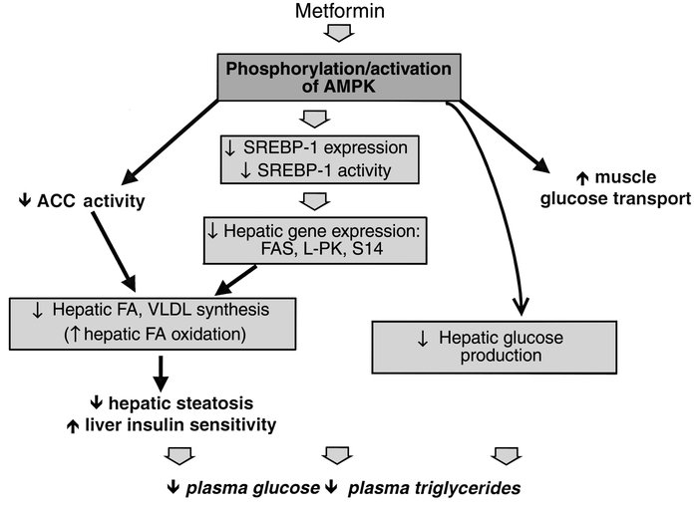
Endocrine Pharmacology
Diabetes Mellitus
Zhou et al., J Clin Invest. 2001; 108(8):1167–1174 doi:10.1172/JCI13505

Slide 11
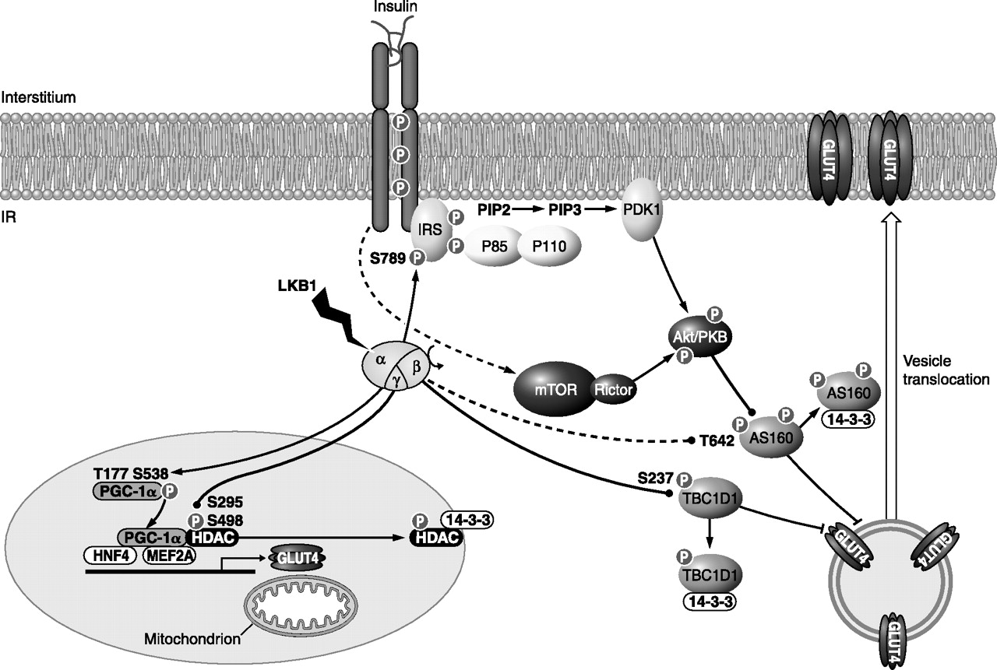
Endocrine Pharmacology
Diabetes Mellitus
Glucose uptake in skeletal muscle.
Steinberg G R , Kemp B E Physiol Rev 2009;89:1025-1078

Slide 12
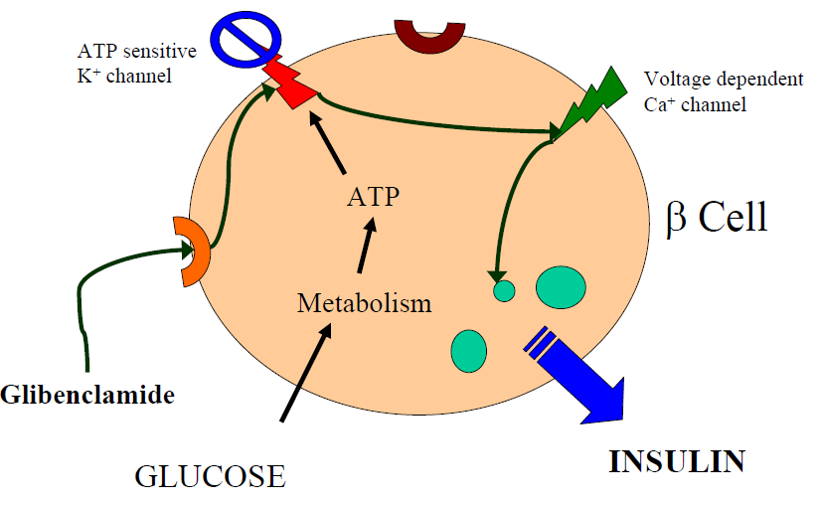
Endocrine Pharmacology
Diabetes Mellitus

Slide 13
Endocrine Pharmacology
Hyper-thyroidism
PLASMA
FOLLICLE CELL
FOLLICLE LUMEN
Uptake of iodide
- active transport
I⁻
I⁻
MIT
DIT
Thyroperoxidse
+ H₂0₂
T
Iodination
T
TG
T
T
MIT
Coupling reaction: storage in colloid
T
T3
T4
TG
T
T4
peroxidase
transaminase
protein
synthesis
T
T4
TG
TSH
T4
TG
T3
TSH receptor
T4
T3
T4
T₄
T3
Endocytosis & secretion
T₃
L
TG, thyroglobulin, a large glycoprotein, containing approximately 115 tyrosine (T) molecules is synthesized in the follicle cells and secreted into the colloid in the lumen; MIT, monoiodotyrosine; DIT, diiodotyrosine; T3, triiodothyronine; T4, thyroxine; L, lysosome.

Slide 14
Endocrine Pharmacology
Hyper-thyroidism
mechanisms of action of thiourylenes
Biochemical effect - hours
i) inhibition of thyroperoxidase
and hence T3/4 synthesis and
secretion
Clinical effect – weeks
Uptake of iodide
- active transport
I⁻
I⁻
MIT
DIT
X
Thyroperoxidse
+ H₂0₂
T
Iodination
T
TG
T
T
MIT
Coupling reaction: storage in colloid
T
X
T3
T4
TG
T
T4
peroxidase
transaminase
protein
synthesis
T
T4
TG
TSH
T4
TG
T3
TSH receptor
T4
T3
T4
T₄
T3
Endocytosis & secretion
T₃
L

Slide 15
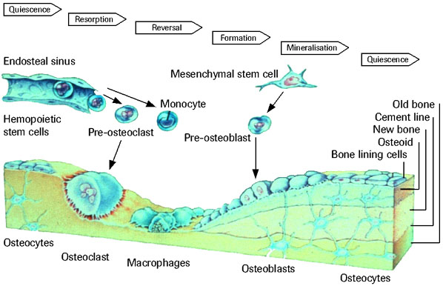
Endocrine Pharmacology
Osteoporosis
http://www.roche.com/pages/facets/11/ostedefe.htm

Slide 16
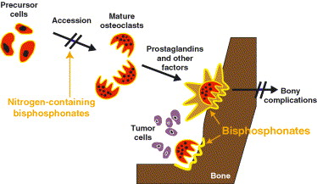
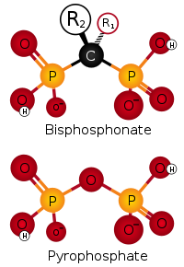
Endocrine Pharmacology
Osteoporosis
http://europeanurology.com/article/S0302-2838(03)00517-7/fulltext

