Slide 1
BSc Pharmacology
Database search skills and
Refworks
27 September 2012
Kate Perris
k.perris@imperial.ac.uk
Notes:
introduction

Slide 2
Training session outcomes:
Library resources – a brief refresher
Literature searching
  Selecting a database
  Building a search strategy
  OVIDSP (Medline) – Advanced features
  Find full-text articles from your list of references
Manage references using Refworks
Notes:
The areas I will be covering today include a brief refresher on the some key library resource and how to access them. We will then look at literature searching which involves building an effective search strategy and carrying out advanced searches on databases such as at OVIDSP, which you may have noticed has a new design. We will also look at Ovid which is an interface for a number of databases including Medline and a database called Embase among others.

Slide 3

Library Services - Review
Journals
Databases
Books
VPN
Medicine Subject pages
http://www3.imperial.ac.uk/library/subjectsandsupport/medicine
Notes:
Access Library website, this website provides links to resources provided by the library. Remind you how to access
Go to the ‘Digital Library’ page
Show Electronic journals list find the AMERICAN JOURNAL OF HEMATOLOGY
Show how to access databases e.g. Pubmed
Show how to find books and print journals via catalogue (just do a search for Haematology)
Show how to access from home
The Website has lots of information in different places as it caters for all subjects at Imperial. For this reason we have created a medicine subject pages which lists some of the key medicine resources along with descriptions and links straight to them.
We also have a medicine Blog designed for Medicine staff and students at Imperial, it pulls together relevant parts of the library website along with links to external resources.

Slide 4




Choosing a database
Core databases
Medline - Accessible via the database hosts - PubMed and OVIDSP
Embase - Accessible via the database host - OVIDSP
Web of Science
Cochrane Library
Notes:
Lets focus on some of the key resources we looked at on the medicine subject page. The most frequently used medical database is Medline which is available via various different interfaces. It is freely available through the PubMed interface is via the US National Library of Medicine, as Pubmed is free you can get access to Medline throughout your career. The College also pays for Medline via an interface called Ovid. Medline is a bibliographic database that lets you search millions of article references and abstracts in the fields of medicine, the health care system, and preclinical sciences. In terms the journals is covers, Medline does have a slight American bias.
The Ovid interface also provides access to other databases. One of these is called Embase. Embase covers more European journals and is especially strong on drugs and therapeutics.
We will focus on Medline Pubmed today but I will first give you an overview of some the other databases out there.
Web of knowledge an is an interface that allows you to search through a number of general databases that cover both science and humanities, it’s strengths are that it allows you to do citation searching, so you can see how many times and where a particular article has been cited. It also provides access to journal citation reports allowing you to find ‘journal impact factors’ from which you can see which journals are the most influential within a particular subject area.
I’ll show you how to search for haematology during the session. Another database you can access through Web of knowledge is ‘Web of Science’ from which you can search for journal articles and the proceedings of worldwide conferences.
Cochrane refers to Cochrane library, a free Evidence Based medicine resource that provides access to systematic reviews carried out by the Cochrane Collaboration (who are seen as the ‘Gold standard’). Cochrane also contains the worlds largest searchable register of randomised control trials.

Slide 5
Planning your search
Before you start searching…….
Make sure you have:
Asked a focused, answerable question
Broken your search down into its key concepts

Slide 6
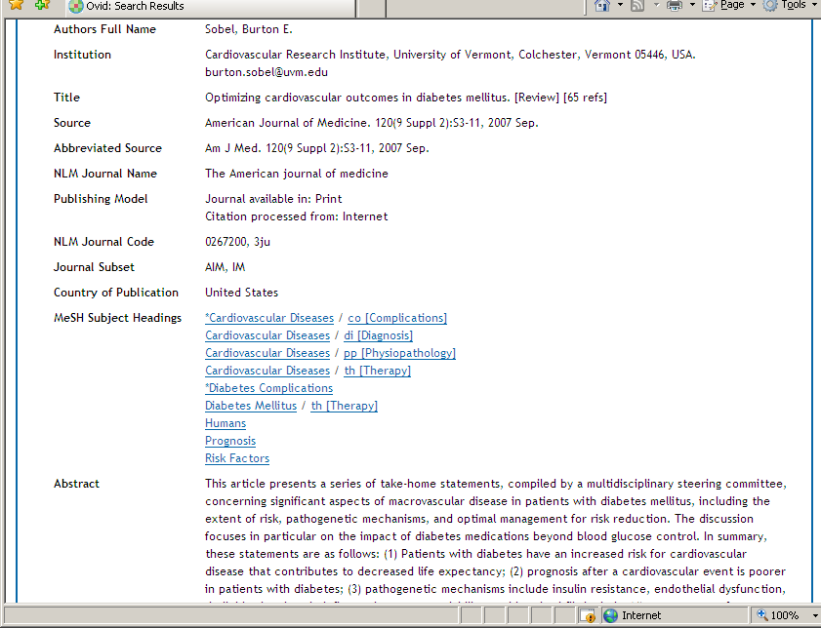
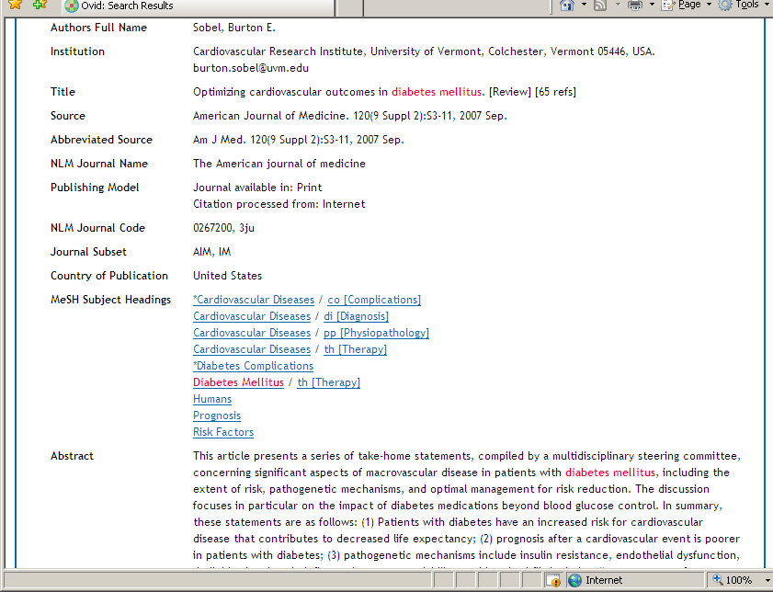
Planning your search
Do not recognise sentences like search engines such as Google.
Databases look for the appearance of single key words

Slide 7
Ask a focused, answerable question
Is health promotion a good thing?
How effective is sexual health promotion in HIV prevention?
Is acupuncture an effective treatment?
How effective is acupuncture in smoking cessation programs?

Slide 8
Planning your search
Break it down into separate keywords / subjects
Concept 1
Oxygen therapy
Concept 2
Lower respiratory tract infections
Concept 3
children
Effectiveness of oxygen therapy for lower respiratory tract infections in children

Slide 9
Choosing your search terms
There are 2 ways to go about searching a
database…..
Using free text-word terms
Using Subject Headings

Slide 10
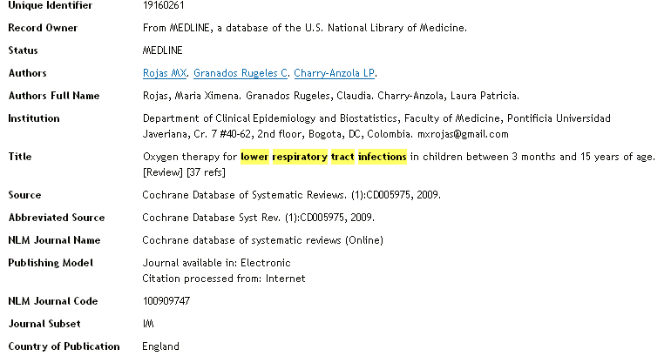
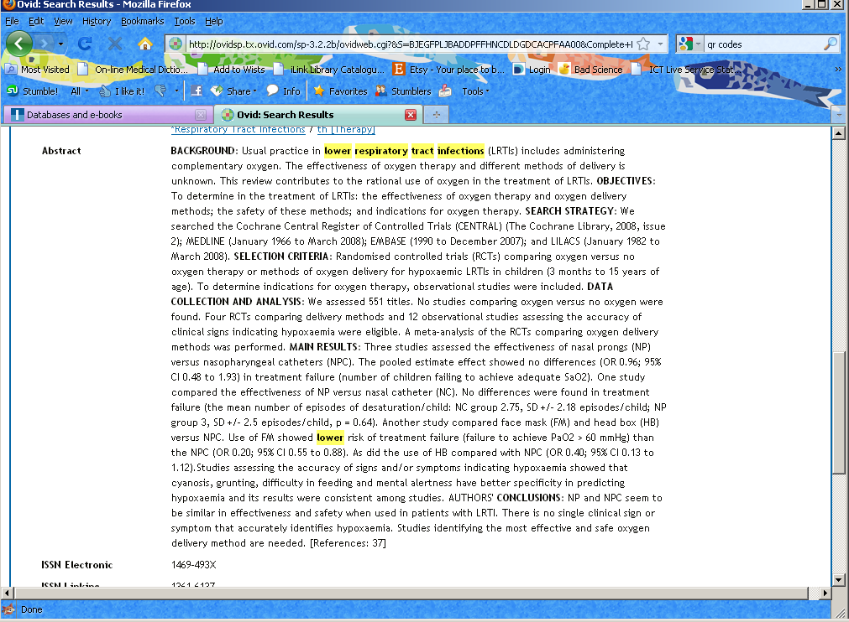
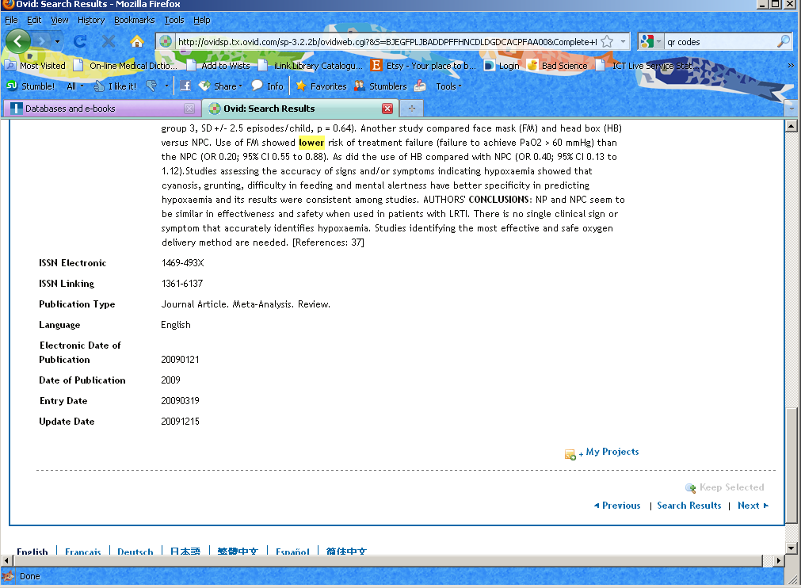
Text word Searching
Searches across the entire article reference

Slide 11
Synonyms and additional terms
Look out for spelling differences (e.g. British / US)
Plurals e.g. Pregnancy OR Pregnant OR Pregnancies etc
Synonyms such as Antiretroviral Drugs OR Antiretroviral Agents

Slide 12
Search techniques
Truncation symbol (usually $ or *) e.g.
e.g.haematolog* = haematology, haematological, haematologist, haematologists
2. Wild cards e.g. ? Organi?ation
Notes:
Databases may use slightly different symbols to replace letters but they all allow you to search using a symbol to replace one or a number of letters – check the help if you are unsure. Truncation lets you search for any words starting with a few letters. This will help you when look at similar concepts in one search. Wild cards will let you search for a missing letter or letters in the middle of a word. This helps with alternative spellings e.g. American. Don’t always need to use these, some databases like Pubmed will do a lot of this for you automatically, however it’s useful to bare this in mind as sometimes it will help you to increase your results. Also useful for databases available through Ovid.

Slide 13
Text word Searching
Use text-words when:
There is no appropriate subject heading
The database does not have a thesaurus
If you are looking for very recent material (it takes time to index new and recently added articles)
Things to remember:
Likely to retrieve irrelevant results
Use all variations or synonyms of a word to be comprehensive

Slide 14

Subject Headings
Heart Disease
Neoplasms
Diabetes
Notes:
Most databases have a thesaurus of terms for the subjects covered by the database. The database indexers go through each article in the database and decide what subjects it covers, they then match or assign the article subject headings from the fixed thesaurus. z

Slide 15
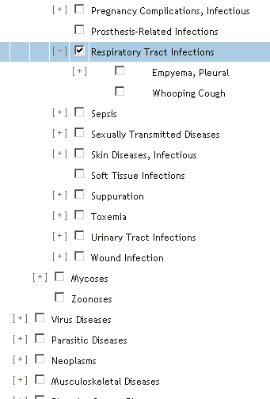
Subject Headings
Respiratory Tract Infections
Whooping Cough
Notes:
The subject headings sit in a tree like this going from larger to smaller headings so you can see that Diabetes Mellitus is a subset of Diabetes Mellitus but Diabetes Mellitus sits below Metabolic Diseases and Glucose Metabolism Disorders.

Slide 16
Subject Headings
MeSH (Medical subject Headings) OR Thesaurus
(Name varies across databases)
Controlled vocabulary: Articles indexed regardless of author’s terminology
Time delay while article are indexed
Notes:
MeSH = Medical Subject Headings are a particular set of controlled vocabulary to index articles. The big advantage is that you don’t have to second guess what terminology an author has used.
Articles get indexed by individuals. It can take a few month before that happens. In the meantime the article can be searched for by using keywords. It’s important to be aware of this. You don’t want to miss out on relevant articles. A combination of text word and subject searching is best.
Sometimes there will not be an appropriate subject heading for your search and you will have to use a text word search instead, you can’t be sure you have covered everything if you just truly on a subject heading search – how through you are depends on your purpose for searching and how essential it is that you don’t miss anything.

Slide 17

Combine Methods
For a comprehensive search use a combination of both methods
Searching a database is not an exact science.
Try different search combinations to get a good set of results.
Useful search tip
To find relevant subheadings, conduct a basic text-word search first, check records of relevant articles for the subheadings used.

Slide 18
Search techniques – using Boolean
The term ‘and’ will narrow your search
Concept 1
Oxygen
therapy
Concept 2
Lower respiratory tract infection
Concept 3
children
AND
AND
Items containing all words will now be searched for. Using ‘and’ will usually result in fewer but more relevant hits.
Notes:
Now you have your keywords picked out you need to decide how to link them together in your database search. To do this we use what are called ‘Boolean terms’. This is just a complex way of saying use the word AND and OR to link different concepts together. For the keywords on the screen you would use the word AND as you want to find articles are about each of these concepts. AND will therefore narrow your search by looking only for articles which include all of the terms, so this search will find only articles which include Cladribine, Hairy cell leukemia and review

Slide 19
Search techniques – using Boolean
The term ‘OR’ will broaden a search
Concept 1
Oxygen therapy
OR
Oxygen delivery
Concept 2
Lower tract respiratory infection
OR
LRTI
Concept 3
Children
OR
child
AND
AND
Items containing either word will now be searched for. Remember to Use all variations or synonyms of a word to be comprehensive.
Notes:
The other Boolean term was OR. This is used to allow you to expand each concept by adding additional keywords such as synonyms, plurals and spelling differences. So for the first concept a synonym of clabribine is (I believe) Leustatin. For a second concept our synonym could be a different spelling of leukaemia.
Obviously you could think of more. You expand a using the word ‘OR’ – this broadens your search increasing your results.

Slide 20
Setting Limits
  Publication year
  Publication / article type
  Age group
  Gender
  Language
Notes:
Setting limits
The options to set limits vary from database to database
Limits are a good way to get fewer results if you are getting too many. Limits also let you focus your search so if you are looking for info only on e.g. young adults you can limit by age, review article or clinical trial. It’s also useful to limit by language although most articles have an abstract in English so you may want to look at these. Usually you’ll be looking at the most recent research so limiting by years can also cut down the number of results.

Slide 21
Searching OVIDSP - Medline
The Medline database includes over 19 million citations for biomedical articles. It also includes links to many sites providing full-text articles.
Access OVIDSP via the library website:
www.imperial.ac.uk/library
Notes:
Pubmed is a freely available database so you can access it by just typing in pubmed.gov but if you access it via the library webpage it will recognise that you are an Imperial student and include the SFX link so you can access full text articles from journals that are paid for by Imperial. If you don’t do this it will only provide links to articles that are available free to anyone.
When searching it’s usually best to search for each concept in your search separately and then combine them. I’m going to show you about combining sets.
Access article called Hairy cell leukemia: current concepts to show SFX button

Slide 22
Search Questions
Noninvasive positive-pressure ventilation for cardiogenic pulmonary edema
Pulmonary Edema [MeSH] AND Positive-Pressure Respiration [MeSH]
Vital FMR, Saconato H, Ladeira MT, Sen A, Hawkes CA, Soares B, Burns KE. A., Atallah ÁN. (2008) Non-invasive positive pressure ventilation (CPAP or bilevel NPPV) for cardiogenic pulmonary edema, Cochrane Database of Systematic Reviews, Issue 3.
Availble from: http://onlinelibrary.wiley.com/o/cochrane/clsysrev/articles/CD005351/frame.html [Accessed 22nd September 2010]

Slide 23
Search Questions
Antibiotics for exacerbations of chronic obstructive pulmonary disease the value of antibiotics in exacerbations of chronic obstructive pulmonary disease (COPD)
Anti-Bacterial Agents [MeSH] AND Chronic obstructive pulmonary disease [MeSH] AND exacerbations (free text term, no MeSH available)
Felix SF Ram, Robert Rodriguez-Roisin, Alicia Granados-Navarrete, Judith Garcia-Aymerich, Neil C Barnes. (2006) Antibiotics for exacerbations of chronic obstructive pulmonary disease, Cochrane Database of Systematic Reviews, Issue 2. Available From:
http://onlinelibrary.wiley.com/o/cochrane/clsysrev/articles/CD004403/frame.html [Accessed 22nd September 2010]

Slide 24
Search Questions
Aspirin for the primary prevention of coronary heart disease
Aspirin[MeSH] AND Primary prevention [MeSH] AND coronary disease [MeSH]

Slide 25
Search Questions
Effectiveness of Oxygen therapy for lower respiratory tract infections in children
Maria Ximena Rojas-Reyes, Claudia Granados Rugeles, Laura Patricia Charry-Anzola. (2009) Oxygen therapy for lower respiratory tract infections in children between 3 months and 15 years of age, Cochrane Database of Systematic Reviews, Issue 3
http://onlinelibrary.wiley.com/o/cochrane/clsysrev/articles/CD005975/frame.html

Slide 26
Comprehensive Search Strategies
1 exp Oxygen Inhalation Therapy/
2 oxygen therapy.mp.
3 oxygen administration.mp.
4 oxygen delivery.mp.
5 OR/1-4
6 exp Respiratory Tract Infections/
7 (lower respiratory tract infection$ or LRTI$).mp.
8 lower respiratory infection$.mp.
9 exp Respiratory Syncytial Virus Infections/
10 exp Respiratory Syncytial Viruses/
11 (respiratory syncytial virus$ or RSV).mp.
12 exp pneumonia/
13 pneumonia.mp
14 OR/6-13
15 5 AND 14
16 limit 15 to ¨all child (0-18 years)¨
17 child/
18 infant/
19 (child or children or infant$ or pediatric or paediatric).mp [mp=title, original title, abstract, name of substance word, subject heading word]
20 OR/17-19
21 15 AND 20
22 16 OR 21

Slide 27

Reference management software package
Save and organise your references
Web based – available wherever you are
Create citations and a bibliography from saved references

Slide 28
Accessing RefWorks
#1-Go to the library homepage: http://www3.imperial.ac.uk/library
#2-Select Reference Management under the ‘Find Out About’ column
#3-Once you’re on the Reference Management page, select RefWorks from the column on the right
#4-Select Log in to RefWorks at the bottom of the RefWorks page

Slide 29
Further Support
Charing Cross
Kate Perris
k.perris@imperial.ac.uk
Tele: +44 (0)20 7594 0756
St Mary's
Jackie Cousins
j.cousins@imperial.ac.uk
Tele: +44 (0)20 7594 3691
Hammersmith
Michael Gainsford
m.gainsford@imperial.ac.uk
Tele: +44 (0)20 7594 1740
Contact your Liaison Librarian
Medicine Team:
Royal Brompton
Andrew Regan
a.regan@imperial.ac.uk
Tel: +44 (0)20 7594 8150
Chelsea & Westminster
James Lockley
j.lockley@imperial.ac.uk
Tel: +44 (0)20 3315 8109

