Slide 1
By Chris John

Slide 2
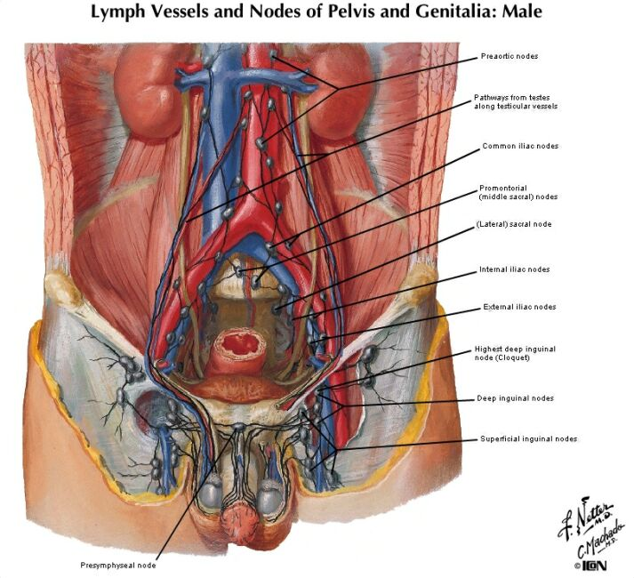
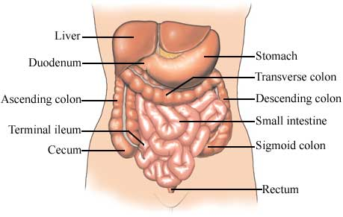
Introduction
What is ileal-lymphoid-nodular hyperplasia?
http://www.med.uottawa.ca/medweb/repro/semaine02%20-%20week02/cours02/e_images/24.jpg

Slide 3
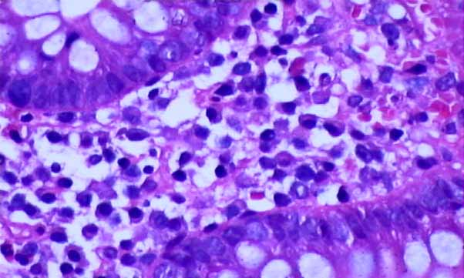
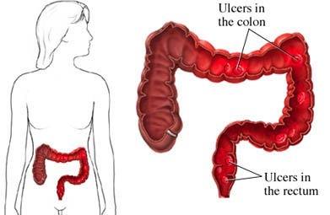
Introduction
What is non-specific colitis?
http://www.empowher.com/condition/colitis
http://cai.md.chula.ac.th/lesson/chula_patho/ChulaPatho/chulapatho/systemic/gi/mclinfm3.html

Slide 4
Introduction
What is pervasive developmental disorder?
Delay in development of multiple basic functions such as socialization, communication
Symptoms of PDD may include communication problems such as:
Difficulty using and understanding language
Difficulty relating to people, objects, and events; e.glack of eye contact
Unusual play with toys
Difficulty with changes in routine or familiar surroundings
Repetitive body movements or behaviour patternse.g. hand flapping
Unable to cuddle or be comforted
http://rickpdx.wordpress.com/page/9/?archives-list&archives-type=tags

Slide 5
Introduction
Ileal-lymphoid-nodular hyperplasia
Non-specific colitis
MMR vaccine?
Pervasive developmental disorder
Hypothesis:
MMR vaccination is related to enterocolitis and
subsequent neuropsychiatric dysfunction in children

Slide 6
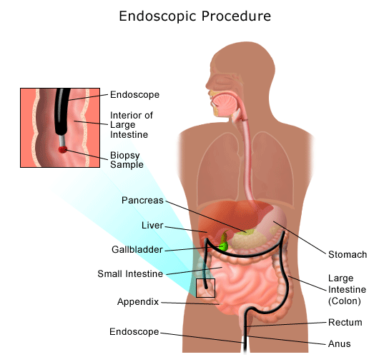
Methods
12 children – paediatric gastroenterology
History of PDD and intestinal symptoms
Investigations;
Clinical -
History (immunisations; infection)
Previous records
Psych assessment
EEG, MRI, lumbar puncture
Biopsy;
Terminal ileum
Ascending, descending,
transverse and sigmoid
colon
Rectum
Histology;
cf 4 normal/3 UC
http://www.chop.edu/export/system/galleries/images/hospital/conditions/ulcerative-colitis-125541.gif

Slide 7
Methods
12 children – paediatric gastroenterology
History of PDD and intestinal symptoms
Investigations;
Laboratory –
Thyroid
Serum long chain fatty acids
CSF lactate
Methylmalonic acid (8/12) vs 14 controls
Antiendomyseal antibodies/Fragile X
Stool samples – campylobacter/salmonella/shigella
Neurodegenerative
disease

Slide 8
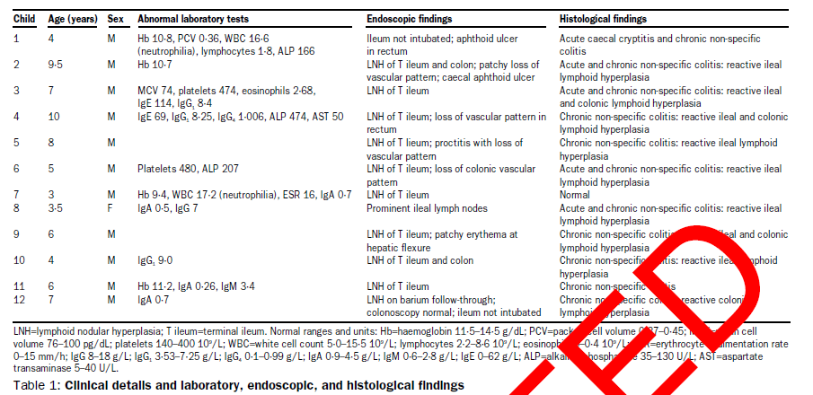
Results

Slide 9
Results
Common findings: Colitis and ileal-lymphoid-nodular hyperplasia
No neurological abnormalities

Slide 10
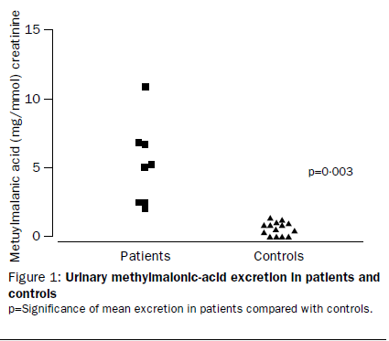
Results
Functional vitamin B12 deficiency - Myelinogenesis

Slide 11
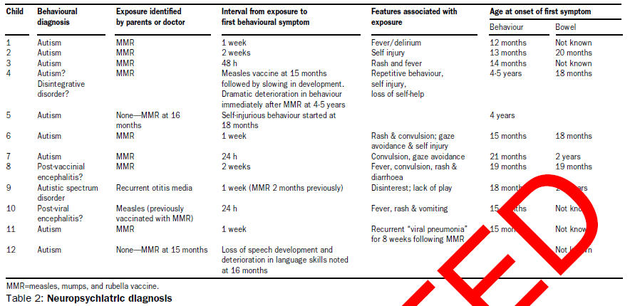
Results

Slide 12
Results
Onset of behavioural problems linked to MMR – 8/12
Onset of bowel problems - unclear

Slide 13
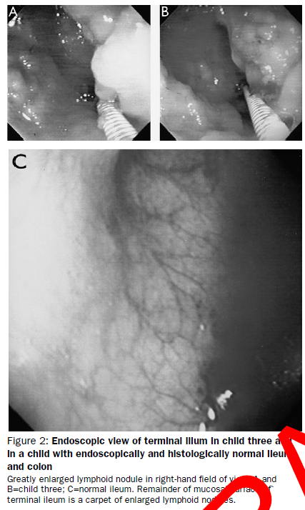
Results
Ileal-lymphoid-nodular hyperplasia

Slide 14
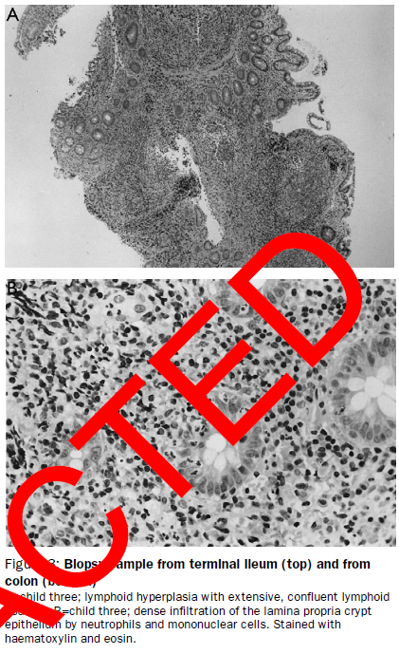
Results

Slide 15
Summary
Common findings: Colitis and ileal-lymphoid-nodular hyperplasia
No neurological deficit
Association between MMR and behavioural disorder onset
Previous evidence:
Coeliac disease and behavioural psychoses
Low alpha-1 anti-trypsin and autism
Abnormal intestinal permeability and autism
Anaemia/IgGa deficiency – inflamed/dysfunctional intestine linked
to behavioural changes
Autistic disorders – Incomplete breakdown and excessive absorption of gut derived peptides. Increased intestinal permeability due to inflammation

Slide 16
Summary
No underlying neurological abnormality ie exogenous influence
Removal of provocative antigen – children behavioural improvement
Children had consistent gi findings but heterogeneous behavioural changes
Some was rapid within weeks/months
Fudenberg: 15-20 autistic children within week of vaccination
Gupta: Striking association
Measles virus ad vaccination implicated as risk factors for Crohn’s

Slide 17
Discussion
Intestinal and behavioural pathologies may have occurred together by chance
Previous association between intestinal disorders and autism:
Coeliac disease and behavioural psychoses
Low alpha-1 anti-trypsin and autism
Abnormal intestinal permeability and autism
inflamed/dysfunctional intestine linked to behavioural changes
Autistic disorders –
1.Incomplete breakdown and excessive absorption of gut derived peptides.
2. Increased intestinal permeability due to inflammation
3. Vitamin B12 deficiency
No underlying neurological abnormality ie exogenous influence
Removal of provocative antigen – behavioural improvement
Fudenberg: 15-20 autistic children within week of vaccination
Gupta: Striking association
Genetic predisposition? Protection against infection

Slide 18
Critique - basic
Minimal introduction – no background as to why the study was conducted.
No hypothesis stated
Methods –
sample size was too small
Was the histology assessment carried out blind?
Results –
Tables were poorly described
Discussion too speculative – too much importance placed on simple association between MMR and autism

Slide 19
Critique - advanced
MMR link –
Not associated with a specific laboratory finding e.g. Vaccine viruses
Not associated with a specific clinical syndrome – too non-specific
Is there a selection bias?
Specific types of patients are referred to paediatric gastroenterology
How can you trust parent recall?
Are they accurately dating the onset of autism?
Consistent GI symptoms, but not behavioural symptoms
Behavioural changes seem to predate the the bowel symptoms in all cases
Virological studies – is there a persistent measles viral infection?

