Slide 1

The drug treatment of schizophrenia
BSc: Neurodevelopment, Mental Health and Mental Illness
January 2013
Thomas RE Barnes

Slide 2
SCHIZOPHRENIA
TREATMENT GOALS
ACUTE
  Behavioural disturbance
  Positive symptoms
  Initiating a therapeutic alliance
MAINTENANCE /RELAPSE PREVENTION
  Preventing relapse
  Maintaining antipsychotic efficacy and adherence
  Improving negative symptoms/cognitive deficits
  Establishing a therapeutic relationship
  Psychosocial reintegration

Slide 3
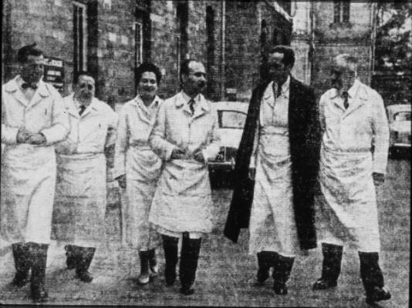
Dr Jean Delay
Dr Pierre
Deniker
Notes:
Saint Anne Hospital in Paris

Slide 4
FIRST-GENERATION ANTIPSYCHOTICS
Classification by chemical type | Representative drug
Phenothiazines
Aliphatic | chlorpromazine
Piperidine | thioridazine
Piperazine | trifluoperazine
Thioxanthines | flupenthixol
Butyrophenones | haloperidol
Diphenylbutylpiperidines | pimozide
Dibenzoxapines | sulpiride
Indoles | oxypertine

Slide 5
DOPAMINE PATHWAYS
Dorsal
Striatum
Frontal
cortex
Nucleus
accumbens
(Ventral striatum)
1
2
Olfactory
bulb
3
Pituitary
1. Nigrostriatal pathway: Substantia nigra to caudate and putamen (i.e. striatum). Parkinson’s disease, initiation of motor plans
2. Mesocortical & mesolimbic pathways Mesolimbic: ventral tegmental area in midbrain to limbic regions associated with reward, motivation, affect and memory. Include ventral striatum (nucleus accumbens), amygdala, hippocampus & medial prefrontal cortex. Mesocortical: VTA to frontal cortex, including dorsolateral prefrontal cortex. Reward and motivation
3. Tuberoinfundibular pathway Tuberal region to median eminence (infundibular region at top of pituitary stalk) Prolactin release

Slide 6
DOPAMINE THEORY OF SCHIZOPHRENIA
Psychostimulant agents (such as amphetamine and cocaine) that trigger release of dopamine (DA) are associated with:
  de novo psychosis Angrist et al 1970, 1974, Harris & Batki 2000
  Worsening of psychotic symptoms in patients with partial remission Angrist et al 1980, Wolkin et al 1994
L-DOPA aggravates the symptoms
  Parkinson's patients given L-DOPA get hallucinations
SPECT imaging reveals enhanced amphetamine-induced release of DA compared with controls
  Suggests presynaptic dopamine system abnormalities
Overall, suggests DA is overactive in schizophrenia

Slide 7
DOPAMINE THEORY OF SCHIZOPHRENIA
Evidence from postmortem and neuroimaging studies of a heightened synthesis of DA in people with schizophrenia when psychotic Seeman & Kapur 2000
?Too much DA released
?Too little metabolism of DA
?Increased numbers of D2 receptors?
?Inconsistent results with in-vivo, drug-naïve patients in SPET and PET studies
Antipsychotics are DA antagonists
  Clinical efficacy of these drugs correlates with their receptor affinity at the D2 receptor subtype

Slide 8
AFFINITY FOR D₂ RECEPTORS & CLINICAL POTENCY
IC₅₀
(mol/l)
10⁻⁷
Promazine
Chlorpromazine
Clozapine
Trazodone
Thioridazine
10⁻⁸
Molindone
Prochlorperazine
Moperone
Trifluoperazine
Thiothixene
10⁻⁹
Droperidol
Haloperidol
Fluphenazine
Pimozide
Trifluperidol
Benperidol
10⁻¹⁰
Spiroperidol
0.1
1
10
100
1000
Range and average clinical dose
for controlling schizophrenia (mg/day)
After Seeman 1986

Slide 9
SECOND-GENERATION ANTIPSYCHOTICS
Classification by chemical type | Representative drug
Dibenzazepines
Dibenzodiazepine | clozapine
Thienobenzodiazepine | olanzapine
Dibenzothiazepine | quetiapine
Benzisoxazoles | risperidone paliperidone
Benzamides | amisulpride
Benzisothlazoylpiperazines | ziprasidone
Imidazolidinone | sertindole
Carbostyril derivative | aripiprazole

Slide 10
RECEPTOR BINDING AFFINITIES OF
ANTIPSYCHOTICS
Haloperidol
Clozapine
Quetiapine
M
D₁
D₂
D₁
D₂
A₁
D₁
5HT_{2A}
H₁
5HT_{1A}
5HT_{2A}
5HT_{2A}
A₁
H₁
D₂
A₂
5HT_{1A}
A₂
Olanzapine
A₁
Risperidone
RECEPTOR
A_{1, 2} = α₁, α ₂ adrenergic
D_{1,2} = dopamine
H₁ = histamine
5HT _{1A, 2A} = serotonin
M = muscarinic
D₁
D₂
A₂
H₁
D₂
A₁
5HT_{2A}
M
A₁
H₁
5HT_{2A}
Adapted from Goldstein 1999

Slide 11
RELATIONSHIP BETWEEN D2 RECEPTOR OCCUPANCY, EPS AND RESPONSE
Clinical response
Elevated PL
100
EPS
haloperidol
78
72
65
% D2 Occupancy
50
0
Increasing dose
[Drug]
after, Farde et al, 1992, Nyberg et al 1996, Pickar et al 1996, Kapur et al 2000

Slide 12
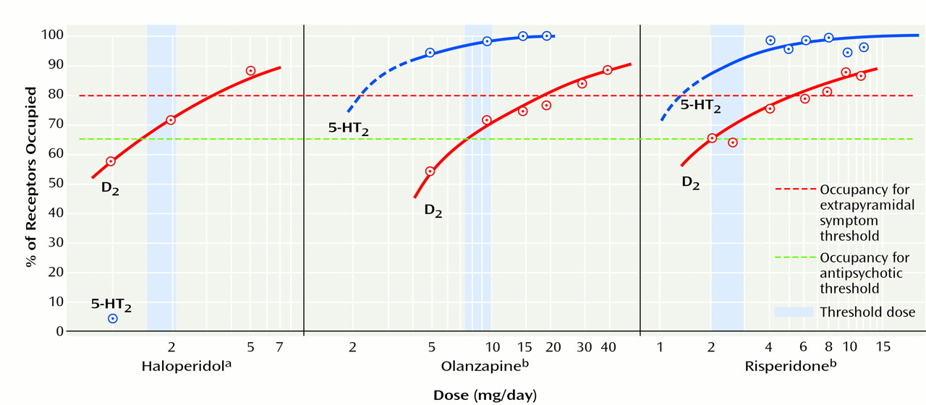
THRESHOLD OF D₂ RECEPTOR OCCUPANCY
Threshold for antipsychotic efficacy: > 65% D₂ receptor occupancy
>78% threshold level occupancy for EPS, including akathisia
Applies to both FGAs and SGAs
High 5-HT2A antagonism not protective
Kapur & Seeman. Am J Psych 2001;158:360-369

Slide 13
FIRST-EPISODE SCHIZOPHRENIA

Slide 14

FIRST-EPISODE SCHIZOPHRENIA
An individual trial of the antipsychotic of choice should be conducted:
Choice of first-line antipsychotic drug should be based on:
  The evidence for relative liability for side effects, particularly considering common and serious effects such as extrapyramidal motor syndromes and metabolic problems (B)
  Individual patient preference (S)
  Individual patient risk factors for side effects (B)
  Relevant medical history (S)
Antipsychotic medication should be initiated at the lower end of the recommended dosage range (A)
Following antipsychotic drug initiation, side effects should be closely monitored with regular, systematic and comprehensive assessment. Consideration should be given to the use of formal side effect checklists or rating scales. (B)

Slide 15
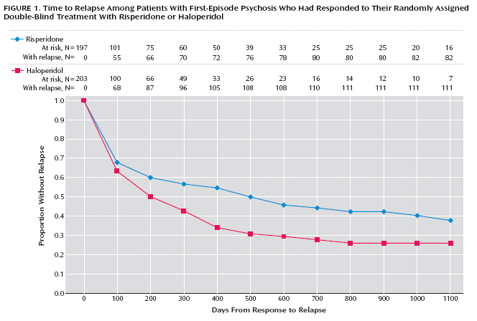
3-YEAR RCT OF FIRST-EPISODE PSYCHOSIS
RISPERIDONE vs HALOPERIDOL (N=555, mean age 25.4 years)
Risperidone: mean modal dose 3.3 mg
Haloperidol: mean modal dose 2.9 mg
Schooler et al. Am J Psychiatry 2005;162:947–953

Slide 16
EFFICACY OF SGAs AND FGAs (PRINCIPALLY HALOPERIDOL) IN THE
TREATMENT OF EARLY PSYCHOSIS: META-ANALYSIS
Comparison of discontinuation rates
Comparisons of symptoms scales at short term
(around 3 months)
Crossley NA, et al. Br J Psychiatry 2010;196:434–439.

Slide 17
ACUTE EPISODE

Slide 18
EFFICACY OF α- AND β- FLUPENTHIXOL IN SCHIZOPHRENIA
β
Placebo
α
Drug effect was confined to the "positive" symptoms: delusions, hallucinations, and thought disorder
Appeared only in 3rd and 4th weeks
Consistent with the hypothesis that dopamine-receptor blockade is the only requirement for antipsychotic activity
Johnstone et al Lancet 1978;1(8069):848-51

Slide 19
ONSET OF ANTIPSYCHOTIC EFFICACY
Change in clinical symptoms can be appreciated shortly after starting antipsychotic medication Robinson et al 2005
Non-response to antipsychotic medication in the first few weeks may be a predictor of eventual non-response
Correll et al 2005, Kinon et al 2007
About a half of first-episode patients achieve symptom remission for at least 2 years, although fewer meet criteria for full recovery
Crespo-Facorro et al 2006, Robinson et al 2004

Slide 20
DOPAMINE, REWARD & SALIENCE
DA has role in ‘reward’ and ‘reinforcement’
Involved in detecting new rewards in the environment
Enhance learning about these rewards and their associations
Increases in DA linked to ‘motivational salience’ of environmental stimuli
  Reward-associated stimuli grab attention
  Become focus of goal-directed behaviour

Slide 21
HYPOTHESIS LINKING DOPAMINE TO PSYCHOSIS AND ANTIPSYCHOTICS
Environmental/genetic
predispositions
Dysregulated firing and/or release of dopamine
Aberrant sense of novelty and abnormal assignment of salience to stimuli and internal representations
Patient stops medication – relapse occurs
Delusions: cognitive scheme developed to explain aberrant salient experience
Decrease in salience allows for symptom resolution by ‘extinction and unlearning’
Antipsychotics block dopamine and dampen salience of preoccupying symptoms
When this aberrant salience impacts on behaviour or causes distress – leads to attention
Antipsychotics ?dampen motivational salience of normal events
Kapur et al 2005

Slide 22
ACUTE PSYCHOTIC EPISODE
Regular combined antipsychotic medication should not be prescribed routinely, except for short periods when switching from one antipsychotic to another (B)
Regular review of the medication regimen should address:
  Therapeutic efficacy, in terms of change in clinical domains such as symptoms, behaviour and cognition (S)
  Side effects of treatment (S)
  Medication adherence (S)
  Physical health (S)
  The need to continue, change or stop medication, and the implications of the decision taken (S)

Slide 23
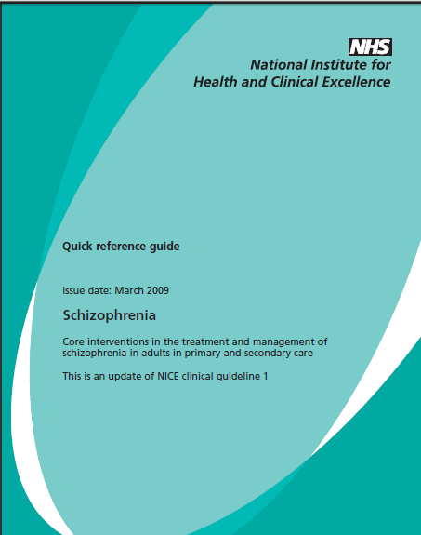
2009
All prescriptions for antipsychotic medication should be in the context of an individual therapeutic trial
Dosage within standard range
  At start of treatment give a dose at the lower end of the licensed range and slowly titrate upwards within the dose range given in the British National Formulary (BNF) or SPC
  Justify and record reasons for dosages outside the range given in the BNF or SmPC
Avoid combined antipsychotics
  Do not initiate regular combined antipsychotic medication, except for short periods (e.g. when changing medication)

Slide 24
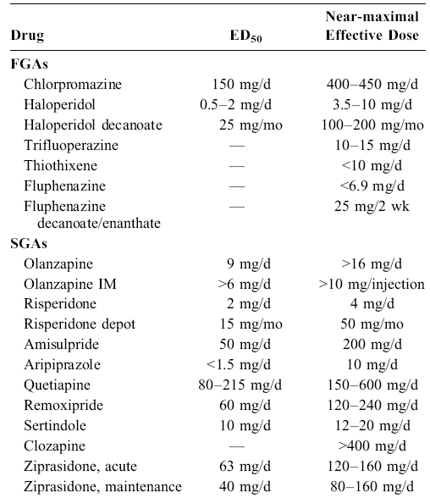
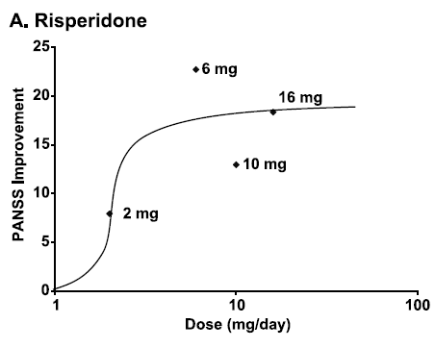
Dose-response curves for individual antipsychotics calculated from RCT data.
For each drug, identified the near-maximal effective dose (ED): the threshold dose necessary to produce all or almost all the clinical responses
No evidence that doses higher than these are more effective, generally or in any sub-populations (i.e. TRS)
Davis JM & Chen N. J Clin Psychopharmacol 2004;24:192–208

Slide 25
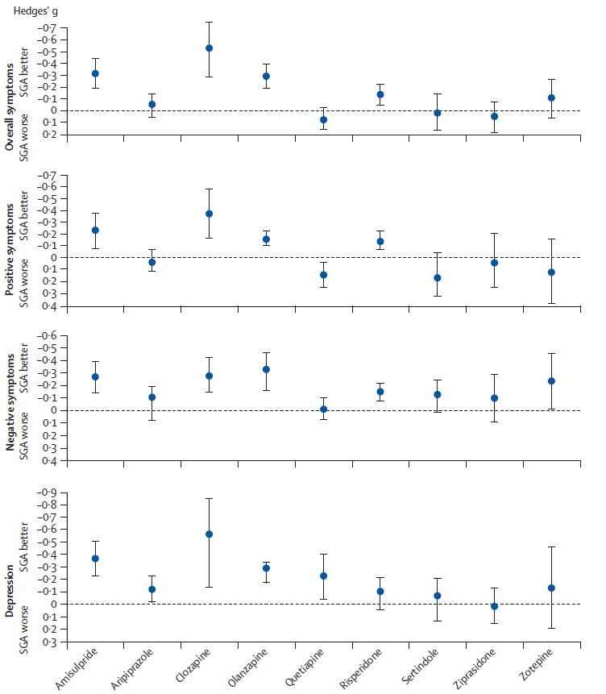
META-ANALYSIS OF RCTs OF SGAs v FGAs
Some SGAs (amisulpride, clozapine, olanzapine and risperidone) seemed better than FGAs in overall therapeutic efficacy: modest effect sizes.
Other SGAs not more effective than FGAs, even for negative symptoms.
Haloperidol: most common FGA comparator, and even at low dose, all SGAs showed a lower liability for EPS.
In few studies comparing SGAs with ‘low-potency’ FGAs such as CPZ and perphenazine, difference in EPS less clear
SGAs cannot be considered as a homogeneous class
Leucht S, et al. Lancet 2009;373:31–41

Slide 26
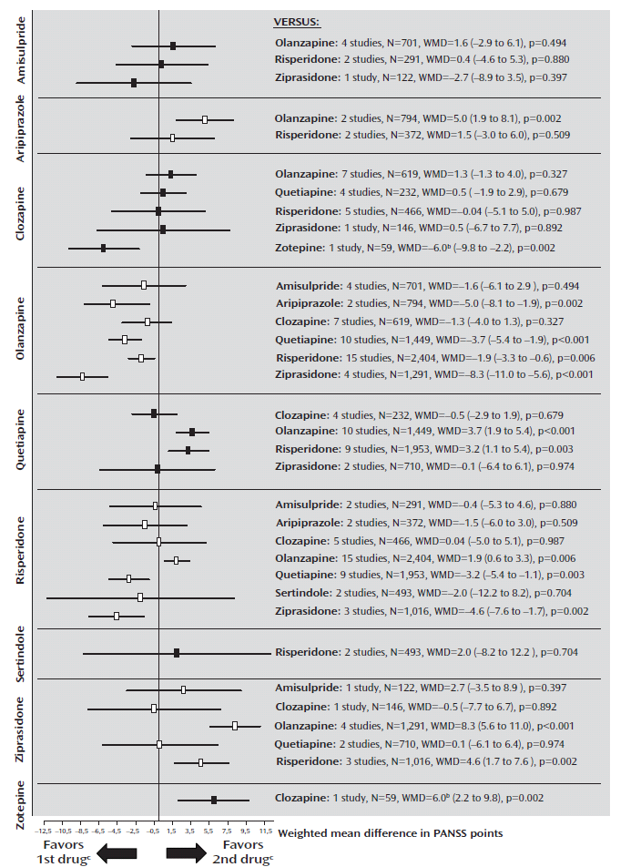
META-ANALYSIS OF RCTs COMPARING SGAs
HEAD-TO-HEAD
Olanzapine more efficacious than aripiprazole, quetiapine, risperidone, and ziprasidone
Risperidone superior to quetiapine and ziprasidone
Clozapine superior to zotepine and, in doses >400 mg/day, to risperidone.
Attributable to improvement in positive rather than negative symptoms.
Main implication: slightly greater efficacy for some drugs to be weighed against large differences in side effects and cost
Leucht S et al. Am J Psychiatry 2009; 166:152–163

Slide 27
RELAPSE PREVENTION

Slide 28
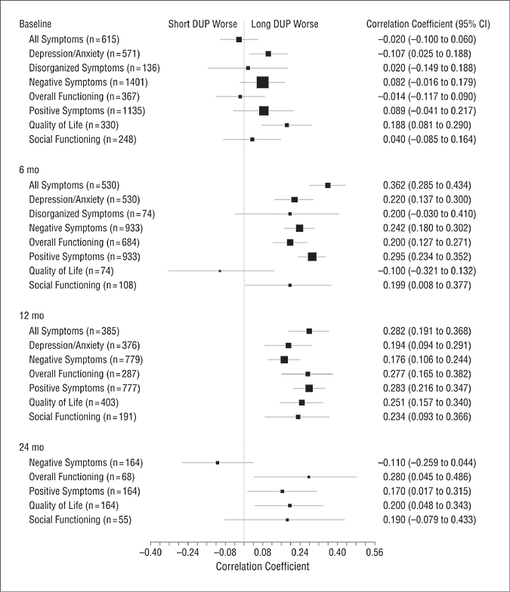
DOES ANTIPSYCHOTIC MEDICATION CHANGE
THE COURSE OF THE ILLNESS?
Meta-analysis of 26 eligible studies involving 4490 participants
Repeated relapse associated with decline and therefore prevention of relapse may improve outcome
  Curson D et al. Br J Psychiatry 1985;146:474
  Wyatt RJ. Schiz Res 1991;5:201
  Wiersma D et al. Schiz Bull 1998;24:75
Longer DUP associated with poorer subsequent response and outcome
  McGlashan & Johannessen. Schizophr Bull 1996;22:201
  Marshall, M. et al. Arch Gen Psychiatry 2005;62:975-983
Suggests that antipsychotic drug treatment is able to affect the natural course of schizophrenia
Antipsychotic medication, or at least some SGAs, may be neuroprotective, curbing disease progression. But mechanism remains unknown
  Lieberman JA et al. Arch Gen Psychiatry 2005;62:361
  Lieberman JA et al. Pharmacol Rev 2008;60:358
Marshall, M. et al. Arch Gen Psychiatry 2005;62:975-983

Slide 29
RELAPSE IN SCHIZOPHRENIA
WHO 15-yr follow-up study of cohort of first contact cases
Wiersma et al 1998
Evidence from FU studies that frequent episodes and prolonged relapse may:
  Impair prognosis
  Lead to reduced responsiveness to antipsychotics
Curson et al 1985, Ohmori et al 1999
Persistent
psychotic
symptoms (%)
After each relapse, 1 in 6 did not remit. Suicide in 11%

Slide 30
FGAs PREVENT RELAPSE
Despite the rise of community care and de-emphasis of hospital treatment, 70% of the costs of care for a patient with SMI are on unplanned inpatient care for relapse
40 years ago
MRC double-blind RCT
81 patients, stable on depot medication minimum of 8 weeks
Good adherence to treatment
Controlled for the effects of clinic attendance
Hirsch et al 1973

Slide 31
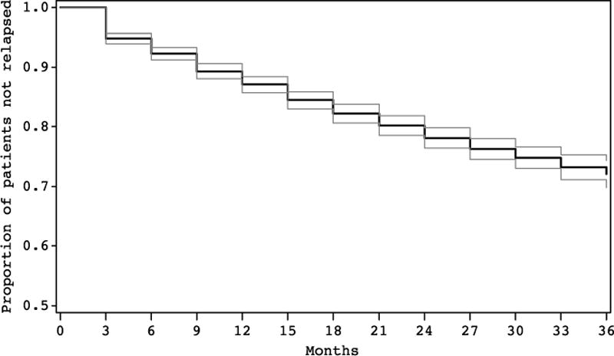
MAINTENANCE TREATMENT OF SCHIZOPHRENIA
EUROPEAN SOHO STUDY
Largest OP cohort study
Of 6,516 patients, 4,206 (65%) achieved remission, of whom 25% relapsed over 3-year FU
Rate of relapse constant, suggesting maintenance treatment required long-term
Main SOHO study: 7,658 patients, assigned to olanzapine, clozapine risperidone, quetiapine or haloperidol
  Olanzapine group achieved ‘minimally symptomatic’ status in a shorter period of time
Treuer T et al. Int J Clin Practice 2010;64:697
Kaplan-Meier estimates and 95% confidence bands of time to relapse for patients achieving a CGI severity score of mild or less
Suarez & Haro. Expert Rev Neurother 2008;8:873-80

Slide 32
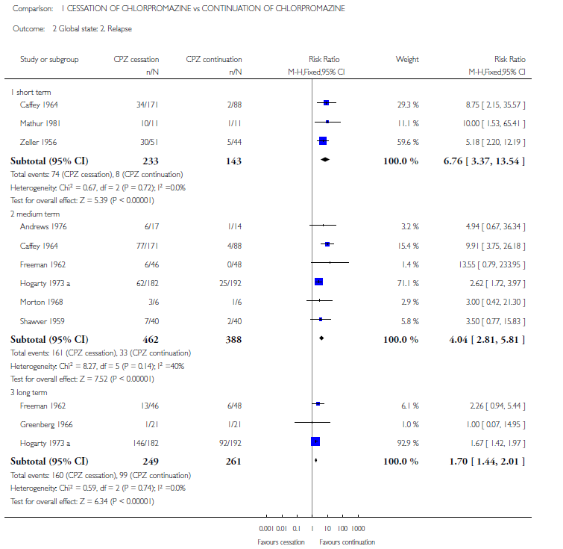
RELAPSE PREVENTION
DRUG DISCONTINUATION
Meta-analysis of all RCTs of schizophrenia, comparing withdrawal of CPZ with maintenance of antipsychotic drug treatment
Conclusion: For people with established illness, CPZ withdrawal shows significant increase in relapse across all time periods
Almerie MQ, et al. Cochrane Database Syst Rev. 2007 (1):CD006329

Slide 33
RELAPSE PREVENTION
DRUG DISCONTINUATION
Studies of drug withdrawal Gilbert et al 1995
66 studies of drug withdrawal: 1958 -1993
Incidence of relapse ranged from 0% to 100% (mean~50%)
Follow-up 2 months to 2 years (mean 6.3 months)
Mean rates of relapse:
  WITHDRAWAL groups: 53%
  MAINTENANCE groups:16%
Abrupt versus gradual discontinuation Viguera et al 1997
Review of 22 relevant patient cohorts
ABRUPT: Cumulative relapse rate 46% at 6m, 56% at 2 yrs
GRADUAL: Halved 6-month relapse rate

Slide 34
SCHIZOPHRENIA RELAPSE AFTER FGA DISCONTINUATION
AMONG PATIENTS IN LONG-TERM REMISSION
Investigators | n | Time in remission (years) | Follow-up off drug (months) | Relapse rate (%)
Hogarty et al 1976 | 41 | 2-3 | 12 | 65
Johnson 1976 | 23 | 1-2 | 6 | 53
Dencker et al 1980 | 32 | 2 | 24 | 94
Cheung 1981 | 30 | 3-5 | 18 | 62
Johnson 1979 | 60 | 1-4 | 18 | 80
Wistedt 1981 | 14 | 0.5 | 12 | 100

Slide 35
ANTIPSYCHOTIC DISCONTINUATION
Recognised discontinuation problems
Sweating, diarrhoea, nausea and vomiting (usually attributed to cholinergic rebound) and insomnia
Dystonia, akathisia, parkinsonism, ‘withdrawal dyskinesia’
Status of psychotic symptoms?
Dopamine supersensitivity/rebound psychosis
Chouinard et al 1978, Chouinard & Jones 1980, Moncrieff 2006
Relapse of the underlying illness
Combination: sudden drug termination alters the natural course of the illness Haddad et al 2000

Slide 36
LOW DOSE
CUMULATIVE RATES OF RELAPSE
ONE YEAR OF MAINTENANCE THERAPY (DEPOT)
Schooler et al 1997
Flu (2.5-10mg)
Flu (12.5-50mg)
Hal (25mg)
Hal (50mg)
Hal (100mg)
Hal (200mg)
Kane et al 2002
Hogarty et al 1988
Flu (mean 3.8mg)
Flu (mean 25mg)
Johnson et al 1987
Flu (mean 12mg)
Flu (mean 25mg)
Marder et al 1984, 1987
Flu (5-10mg)
Flu (25-50mg)
Kane et al 1983, 1986
Flu (1.25-5mg)
Flu (2.5-10mg)
Flu (12.5-50mg)
Fluphenazine
Haloperidol
20
40
60
80
Rate of relapse %

Slide 37
MAINTENANCE TARGETED/INTERMITTENT TREATMENT
RELAPSE AT 12 AND 24 MONTHS
Herz et al
1991
Carpenter
et al 1991
Jolley et al
1990
Gaebel et al
1993
Schooler et al
1997
C=continuous, T=targeted

Slide 38
SGAs v FGAs: RELAPSE RATES
SGA
% relapsed
Haloperidol
% relapsed
Risk reduction
(95% CI fixed)
Csernansky 2002 – risperidone n=365
23% 35%
Daniel 1998 – sertindole n=203
2% 11%
Speller 1997 – amisulpride n=60
18% 35%
Tamminga 1993 – clozapine n=39
4% 0%
Essock 1996 – clozapine n=124
17% 31%
Rosenheck 1999 – clozapine n=49
29% 29%
Tran 1998a – olanzapine n=55
22% 20%
Tran 1998b – olanzapine n=62
13% 21%
Tran 1998c – olanzapine n=690
13% 19%
159/1063 (15%) 139/584 (23%)
Pooled RD –0.08, 95% CI –0.12, –0.04,
p=0.0001, NNT = 13
-0.6
0
Risk reduction
Leucht S, et al. Am J Psychiatry 2003;160:1209-1222

Slide 39
RISPERIDONE V HALOPERIDOL
KAPLAN-MEIER ANALYSIS OF TIME TO RELAPSE
100
90
80
70
60
50
40
30
20
10
0
Risperidone (N=177; 4.9 ± 1.9 mg)
Haloperidol (N=188; 11.7 ± 5.0 mg)
°
Probability of remaining relapse-free (%)
°
Median duration of treatment
Risperidone 364 days
Haloperidol 238 days (p=0.02)*
100 200 300 400 500 600 700 800
Study duration (days)
Csernansky et al 2002

Slide 40
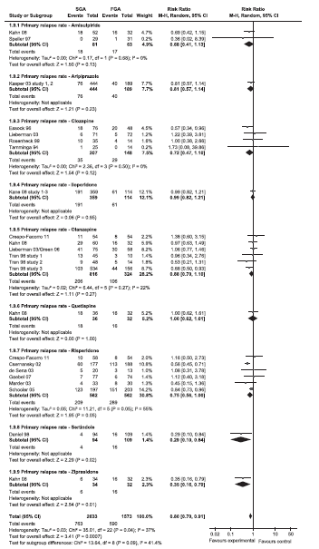
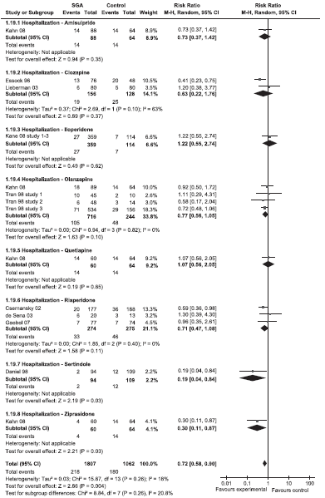
Meta-analysis of 23 RCTs (n=4,5050) lasting ≥6 months, comparing SGAs with FGAs in schizophrenia
Individually, SGAs not consistently superior to FGAs
As a group, SGAs:
  Sig. associated with fewer study-defined relapses and hospitalisations
  Modest but clinically-relevant effect size
  Trend-level superiority for dropout due to intolerability
  Kishimoto T et al. Mol Psychiatry 2011;1-14

Slide 41
EVIDENCE OF ANTIPSYCHOTIC EFFECTIVENESS
Controlled trials
Predominantly short-term comparisons of a new drug with placebo or active comparator, or both.
Patient cohorts not reflective of real-world population: e.g. exclude patients with co-morbid physical or psychiatric illness, women who may conceive, or those too unwell to give informed consent.
Patients reluctant to participate in placebo-controlled studies
Majority conducted by the pharmaceutical industry in order to garner data to support applications for product licences
Heres et al 2006, Kane and Leucht, 2008
Clinicians may therefore be sceptical about the generalisability of trial findings and their applicability to every day practice.
Pragmatic studies
Enrol a wide range of patients
Reflect conditions of clinical practice
Focus on real-life outcome measures, such as relapse, re-hospitalisation rates and treatment continuation
Bowen & Barnes Human Psychopharmacology 1994
Hofer et al. J Clin Psychopharmacol 2000; Hummer et al. J Clin Psychiatry 2003

Slide 42

Double-blind study: SGAs v FGA
1,493 pts with schizophrenia
Recruited at 57 US sites
Randomised to:
  perphenazine (8-32mg/day)
  olanzapine (7.5-30mg/day)
  quetiapine (200-800mg/day)
  risperidone (1.5-6mg/day)
  ziprasidone (40-160mg/day)
  Lieberman JA et al. N Engl J Med. 2005;353:1209-1223

Slide 43
TIME TO DISCONTINUATION FOR ANY REASON
1
Overall p-value = 0.004*
0.8
Overall p-value = 0.004
0.6
Proportion of patients without event
0.4
0.2
P<0.001 for olanzapine vs quetiapine
P=0.002 for olanzapine vs risperidone
0
0
3
6
9
12
15
18
Time to discontinuation for any cause (months)
Olanzapine
Quetiapine
Ziprasidone
Perphenazine
Risperidone
 | OLZ (n=330) | QUET (n=329) | RISP (n=333) | PER (n=257) | ZIPR (n=183)
Discontinued | 210 (64%) | 269 (82%) | 245 (74%) | 192 (75%) | 145 (79%)
Kaplan-Meier Median (mos) [95%CI] | 9.2 [6.9, 12.1] | 4.6 [3.9, 5.5] | 4.8 [4.0, 6.1] | 5.6 [4.5, 6.3] | 3.5 [3.1, 5.4]
Hazard ratios for Olanzapine | --- | 0.63 < 0.001* | 0.75 .002 | 0.78 0.021 | 0.76 0.028
Notes:
The Kaplan Meier median is the time by which half of the patients have discontinued
The hazard ratio for olanzapine vs. quetiapine is 0.63: at any given time, patients on olanzapine are 63% less likely to discontinue treatment compared to patients on quetiapine.
The Hazard ratio is from Cox proportional hazards regression, and is the ratio of the probability of discontinuing the phase at any timepoint for one treatment group vs. another.

Slide 44
FINDINGS
60-80% discontinued allocated treatment in 18 months
  Consistent with practice and clinical trials
Olanzapine most effective (discontinuation rate):
  Best efficacy, worst side effects
Efficacy of perphenazine (FGA) similar to quetiapine, risperidone and ziprasidone (SGAs)
  Slightly higher EPS
No difference in rates of emergent EPS
No differential effects of SGAs on symptoms, including negative symptoms
Differences in types and severity of side effects

Slide 45
CUtLASS STUDY DESIGN
Clinician is considering changing a patient’s antipsychotic medication - contacts CUtLASS
BAND 1
Change in medication due to inadequate response or side effects
BAND 2
Change in medication due to poor response. Clozapine considered
Eligible patient
DSM-IV Schizophrenia
Age 18-65 years
Patient randomised
SGAs
quetiapine risperidone amisulpride olanzapine
Patient randomised
FGAs
including sulpiride
clozapine

Slide 46
CUtLASS 1
SUMMARY OF FINDINGS
227 participants: 40% of expected sample size
Follow-up assessments on 81% at 1 year
75% power to detect difference of 5 points on QLS
Intent-to-treat comparison
Findings at 1-year FU: no disadvantage in using FGAs rather than non-clozapine SGA drugs in terms of:
  Quality of life
  Symptoms
  Costs of care
Not accounted for by inadequate power or by patterns of drug discontinuation.
No clear preference expressed for either class.
No statistically significant differential outcomes between patients recruited for reasons of treatment intolerance or broadly defined treatment resistance.

Slide 47
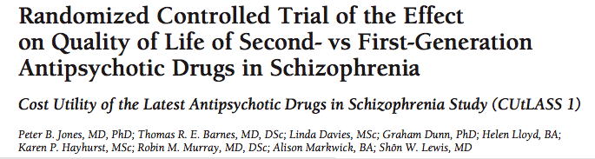
Estimate of difference
in QLS after imputation
of missing data, with
95% c.i. of difference
Hypothesis of 5
point advantage
for SGA excluded
Observed
Expected
Favours FGA
Equivalence
Favours SGA
DIFFERENCE IN QLS SCORES AT 1 YEAR

Slide 48
Primary objective
To compare one-year retention rates on low doses of haloperidol, olanzapine, quetiapine, amisulpride and ziprasidone in patients with recent-onset schizophrenia, schizoaffective and schizophreniform disorder.
Design
Multi-centre, open-label, randomised, comparative
16 European countries; >50 sites
Naturalistic
  Open, randomised, observational
  Non-selected patients
1-year randomised trial: 5-year cohort
Effectiveness of quetiapine, amisulpride, olanzapine, ziprasidone vs. low dose haloperidol

Slide 49
TIME TO TREATMENT DISCONTINUATION BECAUSE OF ANY CAUSE (A), INSUFFICIENT EFFICACY (B), SIDE-EFFECTS (C), AND NON-ADHERENCE (D)
Kahn R. S. et al. Lancet 2008; 371: 1085–97

Slide 50
Results
498 subjects
Rank ordering of the antipsychotics according to discontinuation, starting with the lowest:
  olanzapine, amisulpride, ziprasidone, quetiapine, haloperidol
No significant differences in efficacy between the treatment groups, as measured by psychopathological rating scale outcomes.
Differences in side effect profiles between drugs:
  Weight gain
    An increase during the follow-up period by 7% or greater of baseline body weight was least with ziprasidone (34%) and greatest with olanzapine (86%).
  EPS
    Akathisia incidence was lowest with olanzapine (10%) and highest with ziprasidone (28%)
    Parkinsonism incidence was highest with haloperidol (34%) despite the low-dose regimen.

Slide 51
MAINTENANCE MEDICATION RECOMMENDATIONS
FOR SCHIZOPHRENIA
Given the absence of reliable predictors of prognosis or drug response, pharmacological relapse prevention should be recommended for every patient diagnosed with schizophrenia for 1-2 years
Dixon et al 1995, PORT guidelines 1998, NICE Schizophrenia treatment guideline 2009
Arbitrary recommendation based on medium-term studies lasting less that 3 years
Recommend long-term maintenance despite lack of evidence Bosveld-van Haandel et al 2001

Slide 52
RELAPSE WITH FGAs FOLLOWING FIRST EPISODE
OF SCHIZOPHRENIA
Investigators | Duration of follow-up (years) | % relapsed
Rabiner et al 1986 | 1 | 29
Zhang et al 1994 | 1.5 | 35
Linszen et al 1994 | 1.5 | 17
Crow et al 1986 | 2 | 55
Rajkumar & Thara 1989 | 3 | 59
Kane et al 1982 | 3.5 | 69
Robinson et al 1999 | 5 | 82
Prudo et al 1987 | 5 | 80
McCreadie et al 1988;1992 | 5 | 70
Following response to treatment, 80% will have second episode within 5 years Prudo & Blum 1987

Slide 53
PREDICTION OF RELAPSE IN SCHIZOPHRENIA
Patient factors
Comorbid substance use
Poor insight into illness
Severe residual symptoms after treatment
Male gender
Younger than 40 years of age
Treatment factors
Poor adherence with medication regimen Ascher-Svanum et al 2006
Poor aftercare planning before discharge from inpatient care
Poor follow-through with aftercare
Poor interaction between the patient, family members, and carers Csernansky & Schuchart, 2002, Conley et al 2003
Predicting which patients will be rehospitalisation by clinical estimates or models often no better than chance.
Atakan etal 1990, Olfson et al 1999

Slide 54
SCHIZOPHRENIA: ADHERENCE TO MEDICATION
Mean rate of adherence
(%)
Non-adherence
40–60% oral antipsychotics
Haynes RB et al. Cochrane Database of Systematic Reviews 2008, Issue 2. Art. No.CD000011.
~25% depot preparations
Young et al 1999, Tattan & Creed 2001
First-episode patients: around 50% in first year of medication
Coldham EL, et al. Acta Psychiat Scand 2002;106:286-290
‘Roughly 50% of patients take less than 70% of prescribed doses’
Goff DC et al. J Clin Psychiatry 2011;72:e13
Cramer & Rosenheck 1998

Slide 55
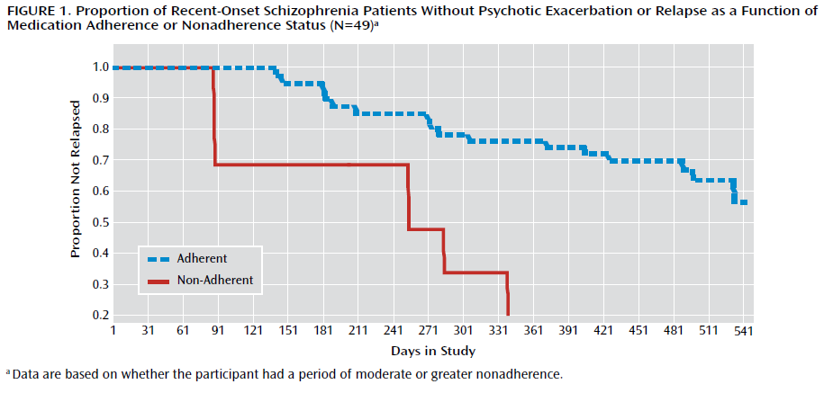
Cohort of 49 recent-onset schizophrenia patients on SGA medication over 18m
Medication adherence: self-report; clinician judgement; pill counts (every 1-2 wks); plasma drug levels (every 4 wks)
Significant risk of exacerbation/relapse in early treatment associated with:
  Periods of partial adherence (50-75% of prescribed dosage)
  Relatively brief periods (≥2 consecutive wks) of partial or full non-adherence
  Subotnik et al. Am J Psychiatry 2011;168:286

Slide 56
SCHIZOPHRENIA
ADHERENCE TO MEDICATION
Relapse
Non-adherence associated with 3.5 fold increased likelihood of relapse
Fenton et al 1997, Robinson et al 1999
In recent-onset schizophrenia, non-adherence associated with: increased frequency of relapse, persistent psychotic symptoms and increased risk of being admitted to hospital Morken et al. BMC Psychiatry 2008, 8:32
Rehospitalisation
Non-adherence accounts for 40% of rehospitalisation costs within 2 years Weiden & Olfson 1995
Time to remission
Repeated relapse, often associated with poor adherence, associated with increased difficulty or delay in achieving remission Leucht & Heres 2006
Attempted suicide
Risk of suicide attempt and mortality due to suicide significantly higher in patients with schizophrenia not adhering to medication
  Leucht & Heres 2006, Tiihonen et al 2006

Slide 57
RELAPSE OF SCHIZOPHRENIA
FGA DEPOTS VERSUS ORAL MEDICATION
Investigators | n | Duration (months) | Relapse % difference (oral minus depot)
Crawford & Forrest 1974 | 36 | 9 | 26
del Guidice 1975 | 82 | 12 | 45
Rifkin et al 1977 | 51 | 12 | 2
Falloon et al 1978 | 41 | 12 | -16
Hogarty et al 1979 | 105 | 24 | 25
Schooler et al 1979 | 214 | 12 | 9
McCreadie et al 1980 | 35 | 9 | 2
McCreadie et al 1983 | 28 | 10 | 12
Barnes et al 1983 | 36 | 12 | 2

Slide 58
100
Depot fluphenazine
70
Proportion of patients surviving (%)
50
Oral fluphenazine
30
0 6 12 18 24
Time in community (months)
Hogarty GE et al. Arch Gen Psychiatry 1979;36:1283–94

Slide 59
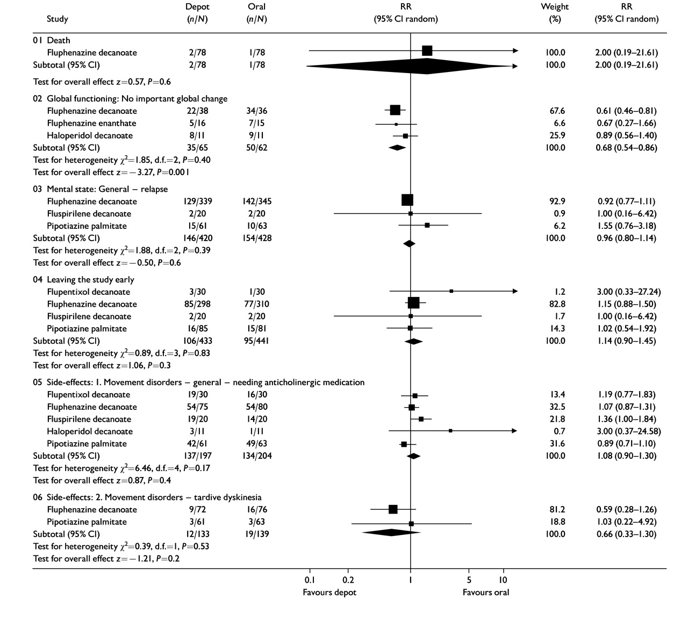
Meta-analysis of RCTs
NO clear difference between depot and oral antipsychotics on:
  Relapse
  Study attrition
  Side effects
Global improvement outcome favoured depot (NNT=4, CI=2-9)
Results variable and inconclusive Haddad et al 2009
Methodological issues may partly explain variable results:
  Selective recruitment in RCTs
Adams C et al. Br J Psychiatry 2001;179:290

Slide 60
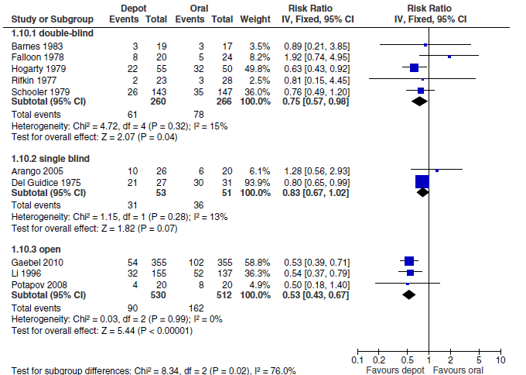
Meta-analysis: 10 studies (n=1,700)
Depot formulations sig. reduced relapses (NNT=10) and inefficacy dropout
Methodological problems so evidence subject to possible bias
Leucht S et al. Sz Res 2011;127;83
Meta-analysis: 23 studies (n=5,200)
Overall, depot formulations did NOT sig. reduce relapse/rehospitalisation
But FGA depots sig. superior to oral APs in preventing relapse
Kishimoto T. SIRS presentation, April 2012

Slide 61
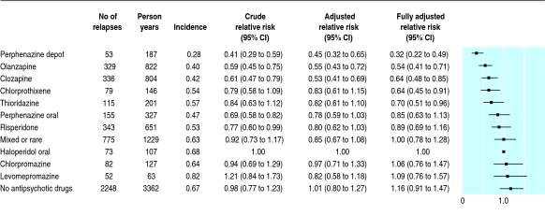
RELATIVE RISK OF REHOSPITALISATION BY TREATMENT
Tiihonen J et al. BMJ 2006;333:224
Finnish cohort, 2,230 consecutive inpatients with Sz: 1995 -2001
Perphenazine depot and clozapine: lowest risk of all cause discontinuation and rehospitalisation
Naturalistic data: better relapse prevention with depot than in RCTs
?Ecology of trials reduces ability to identify differences between depot and oral APs:
  Short-term, selection of medication adherent patients, hospitalisation reduced because of scrutiny in trial

Slide 62
DEPOT/LAI USE IN UK
LAIs prescribed for between a quarter and a third of patients, depending on clinical setting
Most commonly used: flupenthixol, risperidone and zuclopenthixol
Combined with oral antipsychotic in half of cases, commonly leading to high-dose prescribing
Barnes TRE et al. Br J Psychiat 2009;195:37-42
Proportion of patients with schizophrenia in
3 clinical settings receiving LAIs

Slide 63
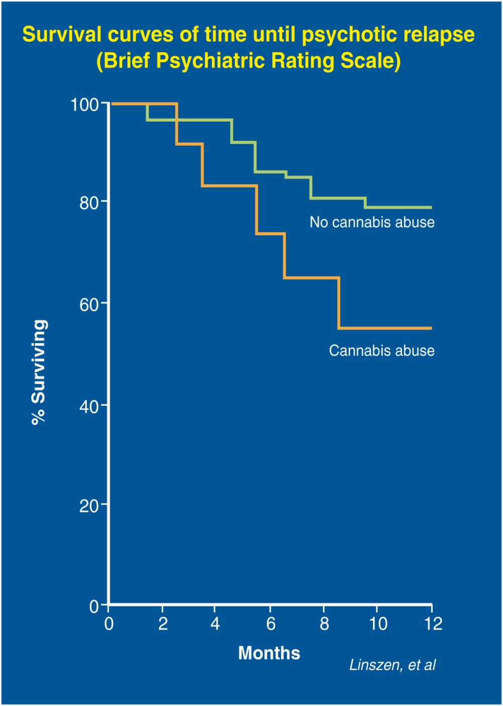
RELAPSE PREVENTION IN SCHIZOPHRENIA: COMORBID SUBSTANCE USE
15-month follow-up study of FEP
Wade et al 2006

Slide 64
Hunt et al 2002

Slide 65
IS MAINTENANCE MEDICATION FOR
RELAPSE PREVENTION REQUIRED FOR ALL PATIENTS
WITH SCHIZOPHRENIA?
Given the absence of reliable predictors of prognosis or drug response, pharmacological relapse prevention should be recommended for every patient diagnosed with schizophrenia for 1-2 years.
Dixon et al 1995, PORT guidelines 1998, NICE Schizophrenia treatment guideline 2009
Arbitrary recommendation based on medium-term studies lasting less that 3 years
Recommend long-term maintenance despite lack of evidence Bosveld-van Haandel et al 2001

Slide 66
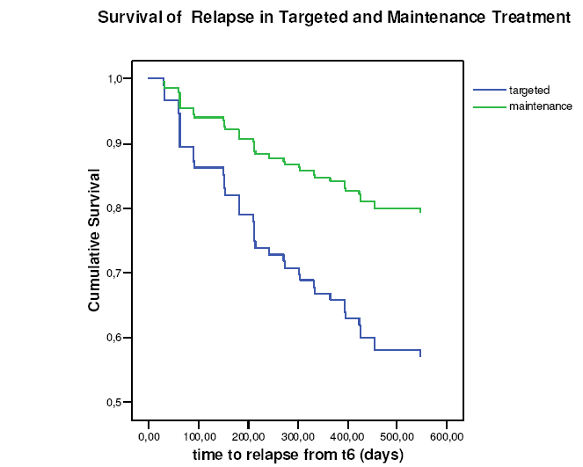
MESIFOS STUDY
Epidemiologically-derived sample (Netherlands)
157 first-episode patients
131 remitted in 6m and stable 6m
Randomised to:
  guided discontinuation (GD) or
  maintenance treatment (MT)
  for 18 months
Only feasible to take 50% off drug
30% had to re-start medication
Only 20% off drug for remaining observation period
Twice as many relapses in targeted (43%) as maintenance (21%) treatment group
Relapses ‘benign’: <1m, rarely hospitalised
Twice as many with regular job (27%) in GD group compared with MT group
Wunderink et al. J Clin Psychiatry 2007;68:654

Slide 67
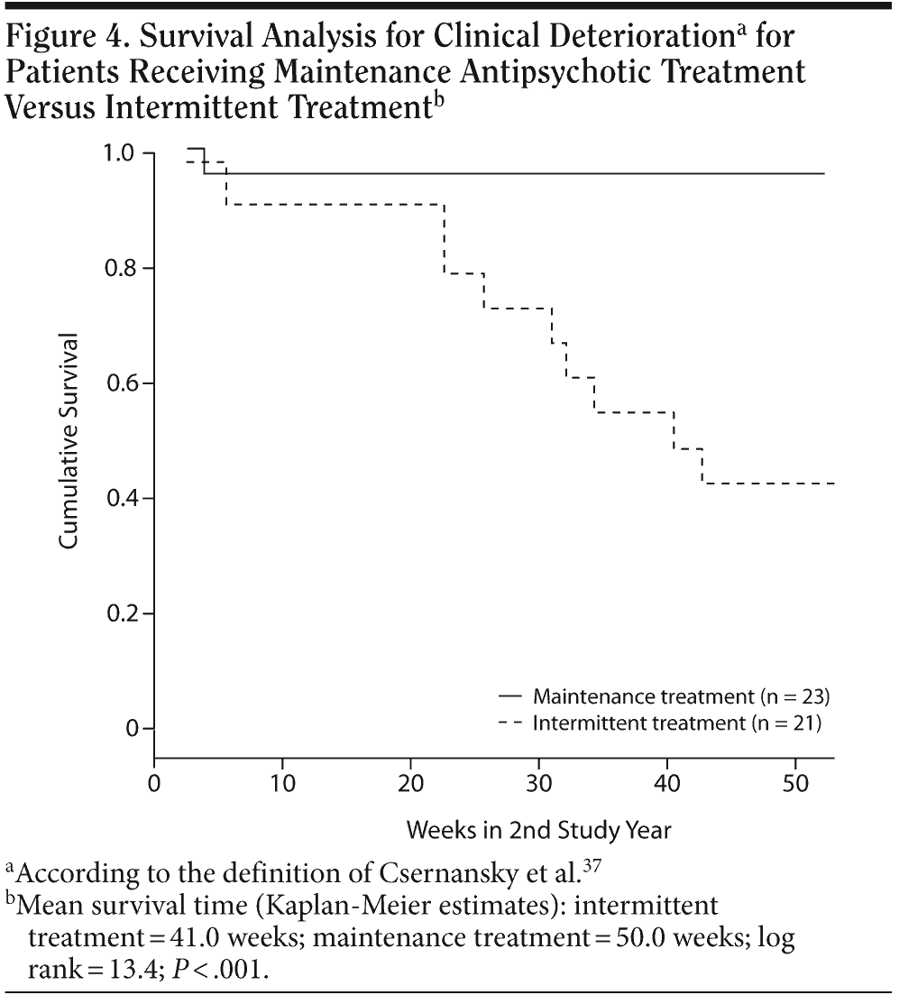
RCT: maintenance vs intermittent drug treatment with prodrome-based early intervention
After 1 year of antipsychotic maintenance treatment, 44 stable first-episode patients randomly assigned
12 months maintenance treatment or stepwise drug discontinuation/ targeted intermittent treatment
Rates of relapse (19% vs 0%; p=.04) and deterioration (up to 57% vs 4%, p<0.001) significantly higher in the intermittent treatment group, but quality-of-life scores comparable
Gaebel et al. J Clin Psychiatry 2011;72:205–218

Slide 68
RELAPSE PREVENTION: CONCLUSIONS 1
Adopt consistent definition of relapse in clinical trials:
After a first episode, patients are likely to benefit most from maintenance antipsychotic medication at standard dosage for up to five years
  20% will not have second episode in 5 years:
    ? Better prognosis
    ? Do they need medication
    ? Can we predict: no reliable predictors
More established illness demands continued maintenance with doses of antipsychotic medication prescribed within the recommended range. The clinical indications for safe discontinuation have not been determined
For those patients who are reluctant to continue with medication, gradual discontinuation is likely to succeed best in those who cooperate with monitoring and will reinstate full doses during pre-specified ‘prodromes'
Prodromal symptoms (or relapse signatures) vary but include insomnia, agitation, irritability, depression and anxiety, or overvalued ideation

Slide 69
RELAPSE PREVENTION: CONCLUSIONS 2
No evidence that higher antipsychotic dosage is better
The main advantage of depot formulations is the avoidance of covert non-adherence, and the main disadvantage is the slow titration if doses are too high or low
Pharmacological approaches need to be combined with addressing the reversible risk factors for relapse, such as medication adherence, substance use and a critical environment
Choice of drug group (FGA or SGA) may be less important in practice than finding the correct dose and formulation of an antipsychotic for the individual patient

Slide 70
CLOZAPINE

Slide 71
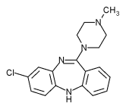
CLOZAPINE
EFFICACY IN TRS
Cochrane systematic review of 31 RCTs Wahlbeck et al 2000
Greater clinical improvement in TRS studies
Response to clozapine in 30-60% of schizophrenic illnesses failing to respond to other SGAs Iqbal et al 200
Pragmatic studies
CUtLASS 2
Advantage to clozapine rather than other SGA in terms of symptom improvement over 1 year Lewis et al 2006
CATIE: PHASE 2
For schizophrenia that has prospectively failed to improve with an SGA, clozapine was more effective than switching to another SGA. McEvoy et al 2006

Slide 72
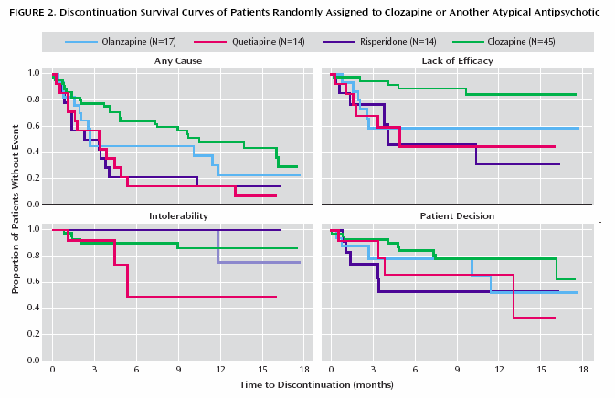
CATIE Phase 2: For those with schizophrenia who prospectively failed to improve with an SGA, clozapine was more effective than switching to another SGA

Slide 73
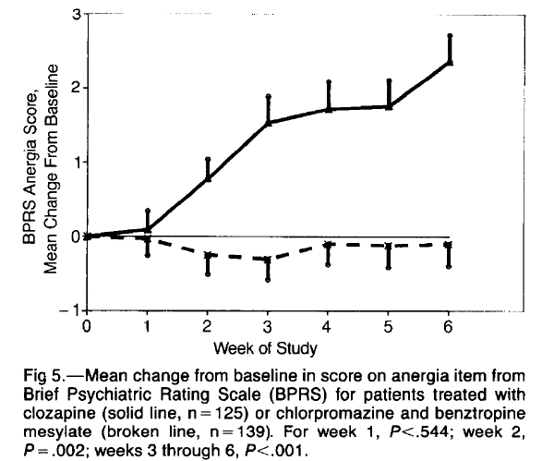
CLOZAPINE AND NEGATIVE SYMPTOMS
Cochrane Collaboration review: 52 trials (4746 participants) clozapine vs FGAs Essali et al 2010
Short-term data from the SANS negative symptom scores favoured clozapine
Potential confound: overlap between bradykinesia and anergia
Kane et al 1988

Slide 74
2009
Clozapine for TRS
Clozapine for people whose illness has failed to show a satisfactory response to adequate trials, in terms of dose, duration and adherence, of at least 2 other antipsychotic drugs
Clozapine augmentation with second antipsychotic
For people with schizophrenia whose illness has not responded adequately to optimised clozapine treatment
  Consider adding a second antipsychotic.
  An adequate trial of such augmentation may need to be up to 8–10 weeks.
  Choose a drug that does not compound the common side effects of clozapine

Slide 75
CLOZAPINE
40-70% of patients treated achieve only poor or partial response
Persistent positive, negative or residual symptoms and cognitive deficits despite clozapine monotherapy of adequate dosage and duration
  Meltzer HY et al. Hosp Community Psychiatry 1990;41:892–7
  Kontaxakis VP et al. Eur Psychiatry 2005;20:409-415
  Tollefson GD et al. Biol Psychiatry 2011;49:59-60

Slide 76
ADEQUATE TRIAL OF CLOZAPINE
Plasma drug level
Pre-dose (trough) threshold: 350 ng/ml for adequate trial
  Hasegawa et al 1993, Spina et al 2000, Vander Zwaag et al 1996, Olesen 1998
  Dettling et al 2000. Schulte PFJ. Clinical Pharmacokinetics 2003;42:607-618
Clozapine bioavailability
  Dose dependent (can the first pass be saturated)?
  Basis of cautious dose titration
  ?clozapine accumulation in some patients
Clozapine:norclozapine ratio
Norclozapine: potentially active metabolite
Longer plasma half-life
Clozapine:norclozapine ratio: mean 1.32 across dose range
  >3 suggests not ‘trough’ sample
  <0.5 suggests poor compliance in preceding day(s)
  Flanagan RJ. CPD Clinical Biochemistry 2006;7:3-18

Slide 77
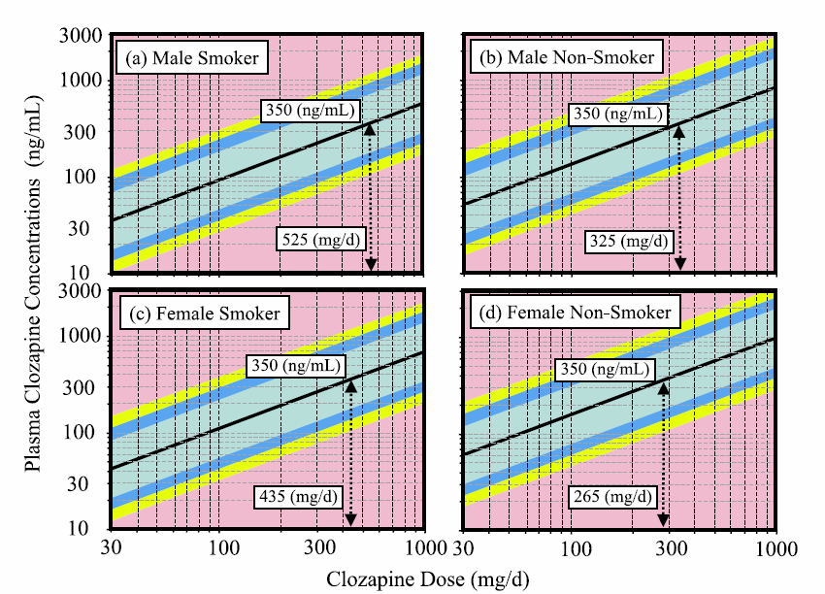
Nomograms: show the likelihood of observed plasma clozapine trough concentration for a given daily dose in a 40 year old patient with an average weight of 80 kg (male) or 70 kg (female) and a clozapine/norclozapine MR of 1.32
Rostami-Hodjegan et al. J Clin Psychopharmacol. 2004;24:70-8

Slide 78
ADEQUATE TRIAL OF CLOZAPINE
DURATION
Period recommended varies from 4 to 12 months
Meltzer 1992, Conley et al 1997
Review of studies of plasma drug monitoring and the time to response, concluded an adequate trial should be at least 8 weeks Schulte 2003
Response may be delayed longer in a proportion of patients: Meltzer 1992
  6 weeks: 30% of patients will respond
  3 months: another 20%
  6 months: further 10–20%
Reasonable to test clozapine monotherapy for 6 months Kerwin & Bolonna Adv Psychiatr Treat 2005;11:101–6

Slide 79
ANTIPSYCHOTIC SIDE EFFECTS

Slide 80
CLINICAL IMPACT OF SIDE EFFECTS
Physical morbidity and mortality
Negative attitudes to medication/poor adherence
Relapse
Confounds clinical assessment
ADVERSE EFFECTS
Persistent symptoms
Stigma
Reduced quality of life

Slide 81
RANGE OF ANTIPSYCHOTIC SIDE EFFECTS
Antimuscarinic (anticholinergic) symptoms
  Dry mouth
  Blurred vision
  Cognitive impairment
  Constipation
  Urinary Retention
Extrapyramidal symptoms
  Akathisia
  Dystonia
  Parkinsonism
  Tardive dyskinesia
Metabolic effects
  Weight gain
  Hyperglyceamia
  Dyslipidaemia
Cardiovascular effects
  Oedema
  Arrhythmia (sometimes QTc related)
  Cardiomyopathy
  Myocarditis
  Postural hypotension
Hyperprolactinaemia
  Galactorrhoea
  Gynaecomastia
  Menstrual abnormalities
  Decreased bone mineral density
Miscellaneous adverse effects
  Blood dyscrasias
  Photosensitivity
  Seizures
  Sedation
  Cerebrovascular events

Slide 82
100%
Extrapyramidal side effects
90%
Weight gain
80%
70%
Cardiac monitoring (ECG)
60%
Prolactin levels
50%
Blood pressure
40%
Glucose regulation
30%
20%
Lipids
10%
Sexual side effects
0%
Subjective experience of
Type of side effect
treatment
Derived from Cochrane Schizophrenia Group’s (CSG) register:
Published in English, January 2002-July 2007
Key outcome measures: efficacy and/or tolerability of antipsychotic drugs for acute psychotic illness/schizophrenia
Final sample consisted of 167 studies: 90 double-blind RCTs, 59 open-label studies

Slide 83
Side effect | N (% of total sample) | Elicited on general questioning | Elicited using ANNSERS checklist
Sedation | 72 (70) | 28 | 44
Hypersalivation | 59 (57) | 21 | 38
Sexual side effects | 57 (55) | 3 | 54
Daytime sleepiness | 53 (52) | 10 | 44
Loss of energy | 43 (42) | 4 | 39
Nocturnal enuresis | 40 (39) | 1 | 39
Memory problems | 39 (38) | 1 | 38
Lack of concentration | 39 (38) | 1 | 38
Headache | 36 (35) | 3 | 33
Constipation | 35 (34) | 8 | 27
Night time sleep problems | 33 (32) | 1 | 32
Dysphoria | 33 (32) | 3 | 29
Tachycardia | 31 (30) | 0 | 31
Weight gain | 2 (31) | 7 | 25
Postural hypotension | 28 (27) | 4 | 24
Cross-sectional study, N=103
Mean duration of clozapine therapy: 42 months, mean dose: 460 mg/day
Antipsychotic Non-Neurological Side Effects Rating Scale (ANNSERS*)
Yusufi B et al. Int Clin Psychopharmacol 2007;22:238-243, *Ohlsen RI et al. J Psychopharm 2008;22:323-329

Slide 84
ANTIPSYCHOTIC-INDUCED
MOVEMENT DISORDER
Early onset
Parkinsonism
Acute akathisia
Acute dystonia
Late onset
Chronic akathisia
Tardive dystonia
Tardive dyskinesia

Slide 85
DRUG-INDUCED PARKINSONISM
Signs
Rigidity
  Lead-pipe and cog-wheeling
Tremor
  Characteristic resting (4-6Hz), disappears on active movement
  Postural, outstretched arms (8-10Hz)
Bradykinesia
  Earliest and most common (up to 60%) manifestation
Subjective
Fatigue, weakness, stiffness
Apathy, diminished interest and initiative
Goetz and Klawans 1981, Yadalam 1993, Owens 1999

Slide 86
AKATHISIA SUBJECTIVE REPORT
Milder forms: vague feelings of apprehension, dysphoria, irritability, or general unease.
Feeling of restlessness, inner tension, discomfort
Urge to move the legs, and sometimes arms, trunk, etc.
Difficulty maintaining, or inability to maintain a posture, sitting or standing still, for more than a few minutes.
Mounting tension when required to stand still:
  Standing in line, cooking, etc.
Less commonly experienced
  Tension and discomfort in the limbs
  Parasthesiae and unpleasant pulling or drawing sensations in the muscles of the legs
  Braude, Barnes & Gore 1983, Barnes & Braude 1985, Chung & Chiu 1996

Slide 87

AKATHISIA OBJECTIVE FEATURES
Complex, semi-purposeful, stereotypic movements
Inability to remain seated, standing in one spot, or lying down for long periods.
Characteristic restless movements of limbs and trunk Braude, Barnes & Gore 1983
Barnes & Braude 1985
Sitting
Shuffling/tramping
Swinging one leg
‘Jiggling’ leg
Standing
Rocking from foot to foot
Walking on the spot
Pacing

Slide 88
AKATHISIA CLINICAL IMPLICATIONS
Confounds clinical assessment
Differential diagnosis of dysphoria
Exacerbation of psychotic illness/poor response to medication
Adverse effect on drug adherence
Behavioural disturbance/suicide

Slide 89
ACUTE DRUG-INDUCED DYSTONIA
Signs
Abnormal postures and repetitive movements
  Contorting, twisting muscle spasm, maintained or fleeting
Muscles of head and neck commonly affected, such as:
  trismus
  blepharospam
  oculogyric spasm
  torticollis
  dysarthria, dysphagia
Dystonic limb movements and gait
Subjective
Prodromal: unnerved, sense of something impending
Painful, and frightening
Fear falling victim to seizure, stroke, etc.

Slide 90
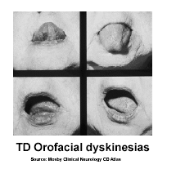
TARDIVE DYSKINESIA
Orofacial dyskinesia
  Protrusion or twisting of tongue.
  Smacking, pursing and sucking movements of lips.
  Puffing of the cheeks.
  Chewing and lateral movements of the jaw.
Trunk and limb dyskinesia
  Purposeless, choreiform, often stereotypic.
  Grunting and respiratory arrhythmias.
  Abnormalities of gait and posture.
Patients usually unaware

Slide 91
TARDIVE DYSKINESIA
DISABILITY
Physical handicap
Laryngeal/pharyngeal movements - interference with eating, swallowing, dysphagia, choking
Unintelligible speech
Respiratory dyskinesia - breathing difficulties
Disturbances of gait- falls and injury
Excess burden of mortality/morbidity - respiratory tract and cardiovascular disorders
Social handicap
Negative influence on social acceptability
(Barnes and Kidger 1978, Boumans et al 1994)

Slide 92
EPS LIABILITY AND POSSIBLE RECEPTOR MECHANISMS OF CURRENT SGAs
Amisulpride Dose dependent Selective D₂-like receptor
antagonism; Fast-off DA
Aripiprazole No dose Partial agonist at D₂ receptors dependence partial agonist at 5HT_{1A} potent 5-HT_{2A} antagonism
Clozapine No dose Low D₂ affinity; high 5-HT₂
dependence antagonism; Fast-off DA
Olanzapine Dose dependent High 5-HT₂, modest-off DA
to some extent muscarinic antagonism
Quetiapine No dose Low D₂ affinity; high 5-HT_{2A}, dependence fast-off DA
Risperidone Dose dependent Potent 5-HT_{2A} antagonism
Ziprasidone Dose dependent Potent 5-HT_{2A} antagonism to some extent

Slide 93
PREDICTION OF SIDE EFFECTS FROM RECEPTOR BINDING AFFINITIES
SEDATION
Clozapine and olanzapine have relatively high affinity for H₁ receptors, while risperidone has lower affinity.
But anti-adrenergic properties also relevant
HYPOTENSION
Quetiapine, clozapine, risperidone have high α₁ receptor affinity, olanzapine has lower α₁ receptor affinity
WEIGHT GAIN
?receptor interactions involving serotonin, histamine, dopamine, cannabinoid, histamine (H₁), serotonin (5-HT_{2A}, 5-HT_{2C}) muscarinic (M₃) and adrenergic receptors.
Possible genetic factors include 5-HT2C receptor gene (HTR2C) and cannabinoid 1 receptor gene (CNR1)

Slide 94
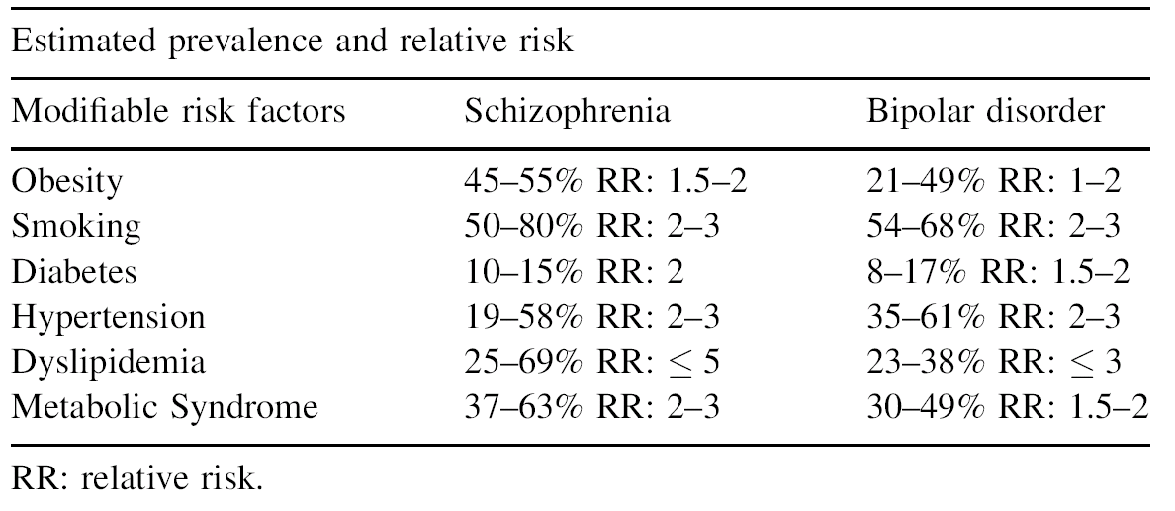
CVD RISK FACTORS IN PEOPLE WITH SMI
(De Hert et al 2009

Slide 95
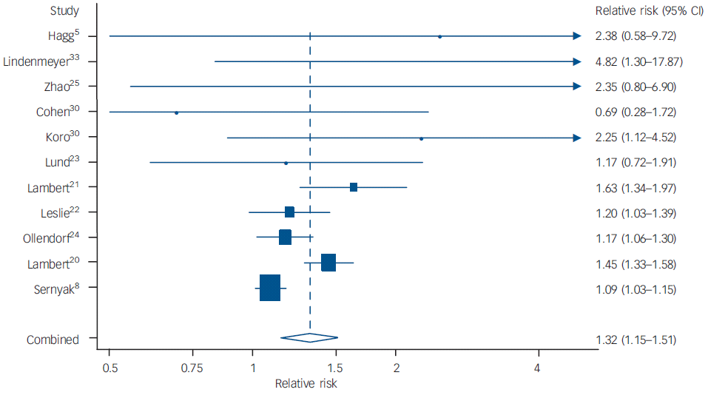
FGAs V. SGAs AND
RISK FOR DIABETES IN SCHIZOPHRENIA
Overall relative risk of a diagnosis of diabetes in people with schizophrenia
prescribed an SGA of 1.32 (95% CI 1.15–1.51) compared with FGA. Insufficient data to include amisulpride, aripiprazole and ziprasidone.
Smith M et al. Br J Psychiatry 2008;192:406–411

Slide 96
SCHIZOPHRENIA
METABOLIC SYNDROME
High levels of medical comorbidity and cardiovascular risk factors
The presence of ≥3 specific factors (hypertension, dyslipidaemia, obesity, raised fasting glucose) indicative of MS
Meta-analyses of 126 studies, 77 publications (n= 25,692)
  Overall rate of metabolic syndrome: 32.5%
  Strongest influence: illness duration (p<.0001)
  Highest rates seen in those prescribed clozapine (51.9%) and lowest in those unmedicated (20.2%) Mitchell et al. Schizophr Bull 2011
Patients with schizophrenia should receive regular monitoring and adequate treatment of cardio-metabolic risk factors

Slide 97
ANTIPSYCHOTICS AND WEIGHT GAIN
95% CI for estimated weight gain at week 10
6
5
4
3
2
1
0
-1
-2
-3
Placebo
Sertindole
Clozapine
Molindone
Haloperidol
Olanzapine
Ziprasidone
Risperidone
*Quetiapine
Fluphenazine
Polypharmacy
Chlorpromazine
Mesoridazine
Thioridazine/
*Extrapolated to week 10 from estimation at week 6
Allison et al (1999)

Slide 98
FGAs V. SGAs AND
RISK FOR DIABETES IN SCHIZOPHRENIA
Overall relative risk of a diagnosis of diabetes in people with schizophrenia prescribed an SGA of 1.32 (95% CI 1.15–1.51) compared with FGA
Insufficient data to include amisulpride, aripiprazole and ziprasidone
Smith M et al. Br J Psychiatry 2008;192:406–411

Slide 99
AP POLYPHARMACY AND DIABETES
Rate ratios of incident diabetes in relation
to the no. of different APs as modelled in
a Poisson regression
364 newly-admitted adults treated with SGAs
Patients on AP polypharmacy: higher rates of metabolic syndrome and lipid markers of insulin resistance.
Not independent associations: related to known risk factors such as BMI, older age, and FGA co-treatment
Correl CU et al. Schizophr Res. 2007;89:91
Antipsychotic drugs compared with reference, n | RR ratio (95% CI)
1 antipsychotic v 0 | 1.48 (1.44-1.51)
2 antipsychotics v 0 | 1.68 (1.61-1.76)
3 antipsychotics v 0 | 1.96 (1.82-2.10)
4 antipsychotics v 0 | 2.38 (2.13-2.65)
5 or more antipsychotics v 0 | 3.41 (3.03-3.83)
Danish register study: 345,937 patients prescribed APs (1996-2005) and 1,426,488 unexposed individuals
Kessing LV et al. Br J Psych 2010;197:266

Slide 100
ANTIPSYCHOTICS & SUDDEN UNEXPECTED DEATH: POTENTIAL CAUSES
Hyperpyrexia
Vasodilation and hypotension
Malignant hypotension
Epileptic seizures
Aspiration and asphyxia
  Possibly related to impaired gag reflex / laryngeal-pharyngeal dystonia.
Cardiotoxicity
  Increased risk of QTc prolongation.
  Dose dependent Warner et al 1996, Reilly et al 2000
  Abnormal repolarisation torsade de pointes VF

Slide 101
HEART RATE 60 BPM
QT/QTC 370/370

Slide 102
Ventricular tachycardia
Torsade de pointes

Slide 103
FACTORS ASSOCIATED WITH QTc PROLONGATION
Electrolyte disturbances
(K⁺, Ca²⁺, Mg²⁺)
Eating/drinking
Hypothyroidism
Sleeping
Obesity
QTc
Alcoholism
Drugs
Antiarrhythmics Anti-infectives
Vasodilatators/ Antimicrobial anti-ischaemics Antimalarial
Psychiatric drugs Antimycotic
Antidepressants Antihistamines
Antipsychotics etc.
Cardiac disease
Hypoglycaemia
Bednar et al 2001; Viskin 1999

Slide 104
CARDIAC SIDE EFFECTS
QTc PROLONGATION
Prolonging cardiac repolarization may increase the risk for re-entrant ventricular arrhythmias, notably torsade de pointes, through increased variability of heart rate
  Corrected QT interval (QTc), or "QT dispersion” (maximum QT interval minus minimum QT interval)
?Mediated via blockage of Human ether-à-go-go-related gene 1 (hERG1)
  Mediates the repolarizing I_{Kr} current in the cardiac action potential
Prolonged QTc (>2SDs of control mean: >456 msecs) in 8% of psychiatric patients
Alvarez & Pahissa. Curr Drug Saf 2010;5:97-104
Reilly JG et al. Lancet 2000;355:1048-1052

Slide 105
QT INTERVAL PROLONGATION WITH ANTIPSYCHOTIC DRUGS
No consensus on clinical significance
QT interval prolongation widely used surrogate marker for assessing risk of TdP
QT interval changes subject to measurement error
QT depends on HR so corrected QTc interval calculated
Bazett's formula most widely used but greatest variance
Other factors necessary to trigger arrhythmia in presence of QT prolongation?
  Electrolyte imbalance: such as hypokalaemia, diuretic use
  Coincident cardiac disease: bradycardia, CCF, long QT syndrome
  Other prescribed or illicit drugs: such as cocaine
  Restraint / extreme emotion or physical exertion: increase in circulating catecholamines and excess adrenergic and vagal activity
  Royal College of Psychiatrists 1997

Slide 106
CARDIAC SIDE EFFECTS
QTc PROLONGATION
Cases of TdP reported with antipsychotic drugs
QT interval >500 msecs
Increases risk for TdP and sudden cardiac death (SCD)
Discontinue offending drug
Correct any underlying electrolyte disturbances, particularly serum K⁺ and Mg²⁺ derangements
Before prescribing antipsychotics:
  Ask about family and personal history of SCD, presyncope, syncope and cardiac arrhythmias - cardiology consultation if history is positive

