Slide 1
Treatment of stimulant misuse
Dr Owen Bowden-Jones
Consultant Psychiatrist
Chelsea and Westminster Hospital

Slide 2
Overview
Cocaine
Why are we concerned about cocaine?
How does cocaine work?
What problems does it cause?
Which treatments work?
Novel Psychoactive Substances
Is drug use changing?
What are the new drugs?
How do we manage NPS?

Slide 3
Stimulants: True or False
Cocaine
Amphetamines
Cannabis
Alcohol
Heroin
Ketamine
Mephedrone
Codeine phosphate
Ecstasy
Amyl Nitrate
LSD
Diazepam

Slide 4
Why should we be worried about cocaine?

Slide 6
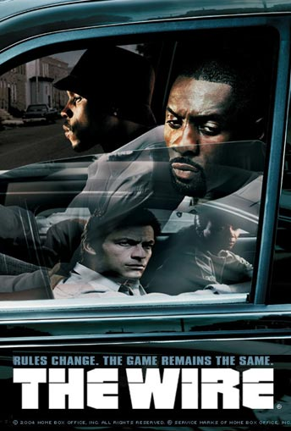

Slide 7
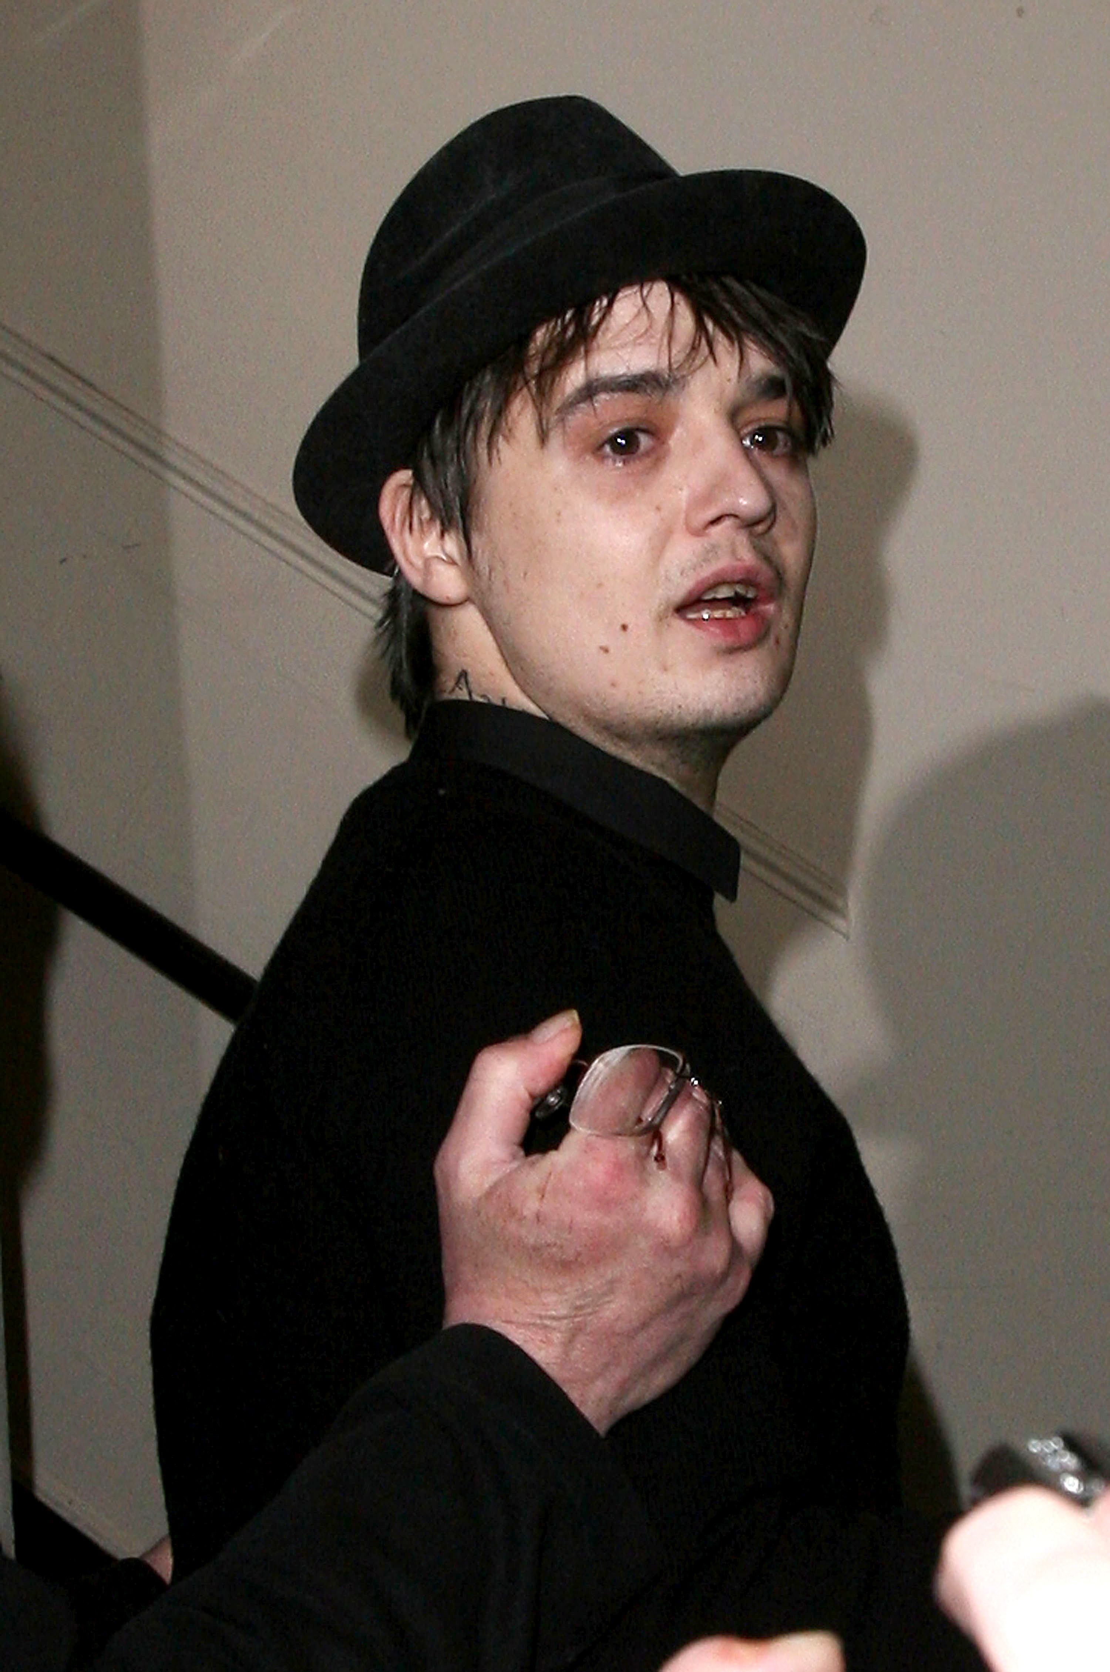

Slide 8
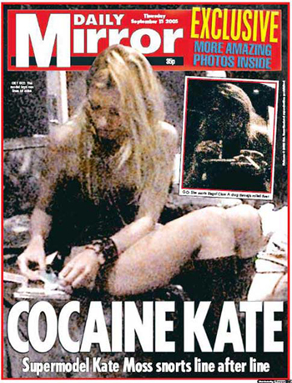

Slide 9
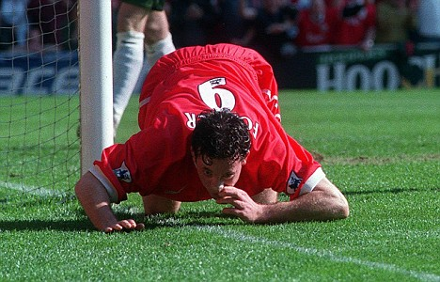

Slide 10
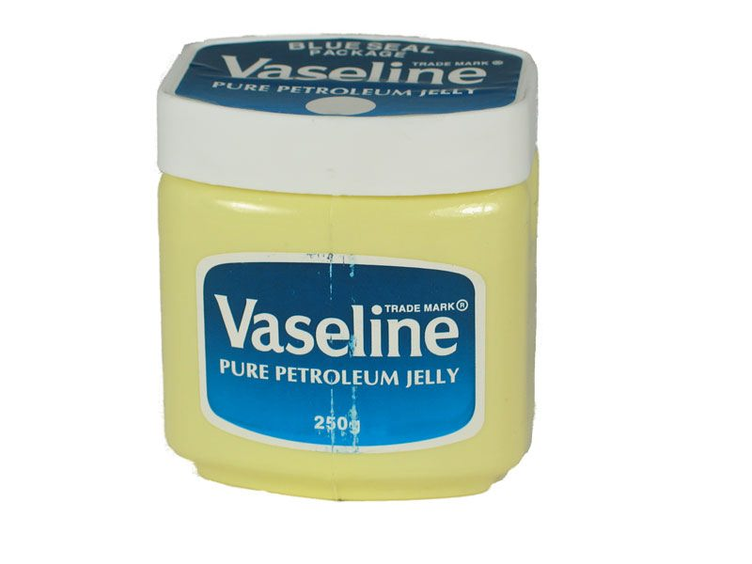
Council and police to get tough over cocaine use in bars, pubs and clubs
Licensing officers from Kensington and Chelsea Council will be warning bar, pub and club managers that they need to work harder to reduce cocaine use in their premises. The Council's licensing officers have been testing for cocaine use and out of the first 41 premises they tested, all but two had traces of the drug. The officers, accompanied by local Safer Neighbourhoods police officers, intend to visit all bars, pubs and clubs in the Royal Borough over the next six months. Premises that tested positive for cocaine have been offered advice on how to reduce drug use. They will be revisited and retested in the coming weeks. If officers still find traces of cocaine, and the licensee has made no effort to minimise or prevent drug use, then the police may apply to the Licensing Committee to review the premises' licence.

Slide 11
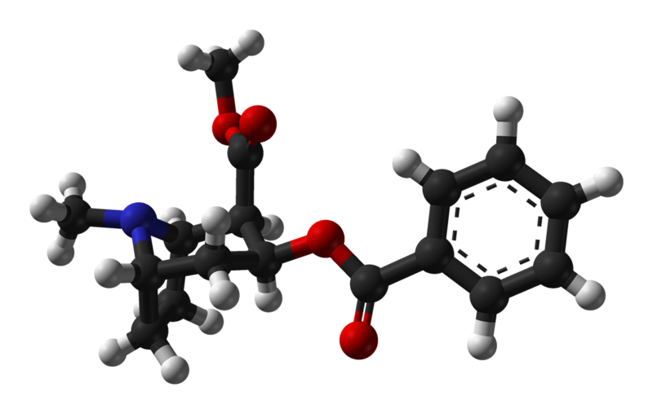
How does cocaine work ?
REWARD PATHWAYS
Certain natural behaviours make the individual feel ‘good’
Food, water, sex, nurturing
Important for survival of individual and species
Engaging in behaviour results in positive reinforcement (reward)

Slide 12
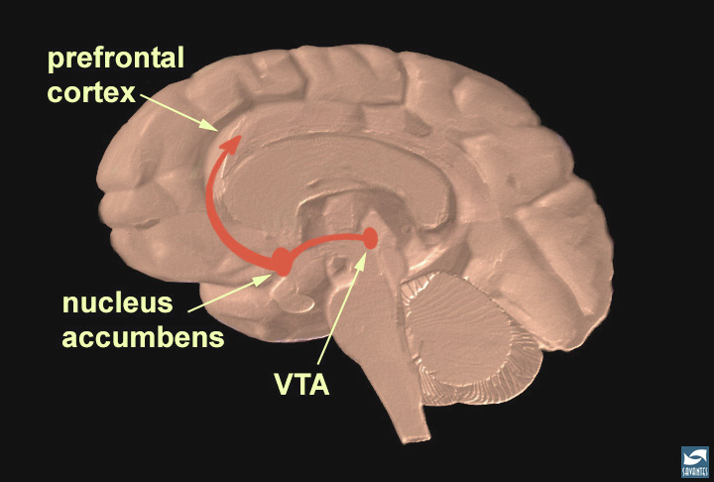
Notes:
Slide 11: The reward pathway
Tell your audience that this is a view of the brain cut down the middle. An important part of the reward pathway is shown and the major structures are highlighted: the ventral tegmental area (VTA), the nucleus accumbens, and the prefrontal cortex. The VTA is connected to both the nucleus accumbens and the prefrontal cortex via this pathway and it sends information to these structures via its neurons. The neurons of the VTA contain the neurotransmitter dopamine, which is released in the nucleus accumbens and in the prefrontal cortex (point to each of these structures). Reiterate that this pathway is activated by a rewarding stimulus. [Note: the pathway shown here is not the only pathway activated by rewards, other structures are involved too, but only this part of the pathway is shown for simplicity.]

Slide 13
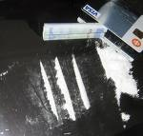
Response to selected behaviours (e.g. food)
Positive reinforcement
Repetition of behaviour
BUT CRUCIALLY
Mechanism in homeostasis
Switches off when we have had enough

Slide 14
How does cocaine lead to reward?
Central nervous system stimulant.
Ventral tegmental area (VTA) to Nucleus accumbens
Increases active dopamine by binding to dopamine transporter, prevents intra-synaptic recycling of dopamine

Slide 15
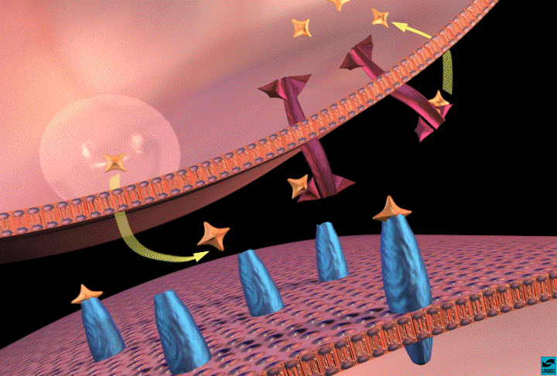
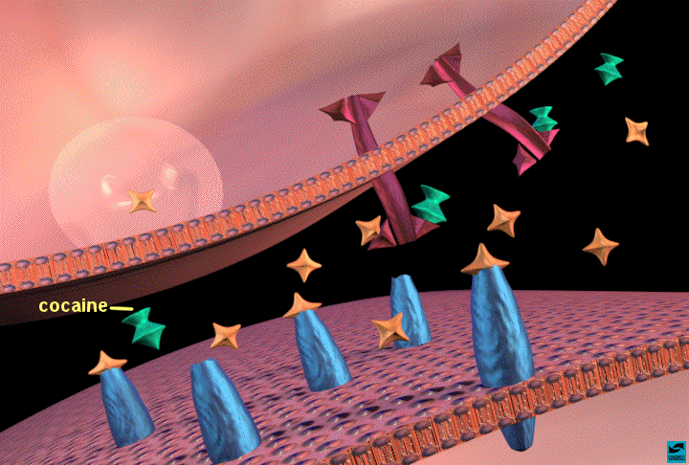

Slide 16
As use of substance continues, postulated that brain circuits modify to chronic exposure to drug.
Brain learns to re-set reward pathway at artificially elevated level
Reduction in available post-synaptic dopamine receptors
‘Natural’ behaviours can’t compete with drugs of abuse

Slide 17
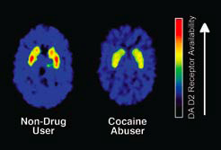
Chronic cocaine use

Slide 18
Short term effects
Psychological effects
Almost immediate (esp with smoked & injected)
Euphoria, mental alertness, pressure of speech, increased psychomotor activity, increase libido
Increase sensation (sight, sound, touch)
Decrease need for food & sleep
Perform simple physical & mental tasks more quickly

Slide 19
Short term effects
Physiological effects
Constriction of blood vessels
Dilated pupils
Increase temperature
Tachycardia, hypertension

Slide 20
Short term effects
Medical complications
CVS- arrhythmias (esp Ventricular), MI, hypertensive crisis
Resp- Non-specific chest pain, “crack lung”
Neuro- CVA, seizure, blurred vision, headache, coma
Abdom- Nausea, abdom pain, weight loss
Intranasal- loss of smell, nosebleeds, hoarseness, perforated nasal septum

Slide 23
Stimulant induced psychotic disorder
High dose, chronic use. Or during withdrawal
Delusions, hallucinations in any modality, paranoia, stereotyped compulsive behaviours
Usually self limiting
‘Stimulant delirium’- mental confusion, disorientation, perceptual disturbance and excitement following heavy period of use.
Stimulant withdrawal- depressed mood, fatigue, vivid unpleasant dreams, insomnia, increased appetite, psychomotor agitation or retardation. Occasional and unpredictable psychosis

Slide 24
Cocaine and ‘crack’
Cocaine hydrochloride
Powdered form
Easily water soluble
Intranasal, intravenous
‘Freebase’ cocaine (Crack)
Heated with ammonia / sodium bicarbonate and water to remove hydrochloride
Smokable. ‘Crackles’. (Also injected by clients)

Slide 27
Treatments
Little evidence base for pharmacological treatment of dependence
Antidepressants
Dopamine agonists (amantadine bromocriptine)
Disulfiram (aldehyde dehydrogenase inhibitor)
Antiepileptics (tiagabine, topiramate)
Baclofen (non-selective GABAb receptor agonist)
Adrenergic blockers (labetalol, carvedilol)
Dexamphetamine

Slide 28
Immunotherapies:Cocaine vaccine
Inject patient with medication designed to induce antibody reaction to cocaine
Inactivates cocaine before it crosses BBB.
First open-label trial underway 18 subjects
At 6 months post-injection, all had cocaine-specific antibodies present
Only very mild euphoric effects to cocaine exposure

Slide 29
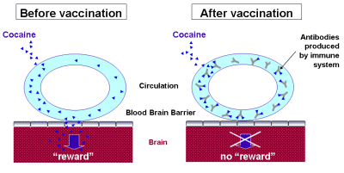

Slide 30
Psychosocial treatments
Supportive
Counselling, relaxation therapy, acupuncture
Re-educative
CBT, drug counselling, 12 step, cue-exposure, contingency management, community reinforcement approaches
Re-constructive
Dynamic psychotherapy, family therapy, interpersonal therapy

Slide 31
Psychological treatments for cocaine dependence
Cognitive behavioural therapy
Decreased cocaine use (Siqueland 1999)
Variable results when compared to 12 steps
Community reinforcement approach
Multi-modal- relapse prevention, skills training, 12 step approach
Variable results

Slide 32
Contingency management
Behavioural reinforcement
Voucher rewards for agreed behaviours
Developing evidence-base
Cost effective
Cochrane Review

Slide 33
Contingency management
Identify target behaviour (e.g. Urine samples free of illicit drugs)
Identify appropriate reward to reinforce behavioural change (e.g. voucher, privilege)
Reinforce desired behaviour when it occurs
Importance of rapid reinforcement
Value of variable reward
Length of effect?

Slide 34
Retention
Petry et al., 2000

Slide 35
Treatment of Cocaine Dependence
Retained throughout
Trial
Higgins et al., 1994

Slide 36
Percent positive for any illicit drug
Petry et al., 2000

Slide 37
Time until first heavy drinking episode
p<.05
Petry et al., 2000

Slide 38
New generation, new drugs

Slide 40
British Crime Survey
8.8% adults in England and Wales used an illicit drug in last year
23% 16-19 year olds used illicit drug in last year
Cannabis, Cocaine and Ecstasy
Year on year reduction in powder cocaine since 2008 (3.0%) to 2010 (2.1%)
Mephedrone 1.4% 16-59 yr in last year
4.4% 16-24 yrs
300,000 people

Slide 41
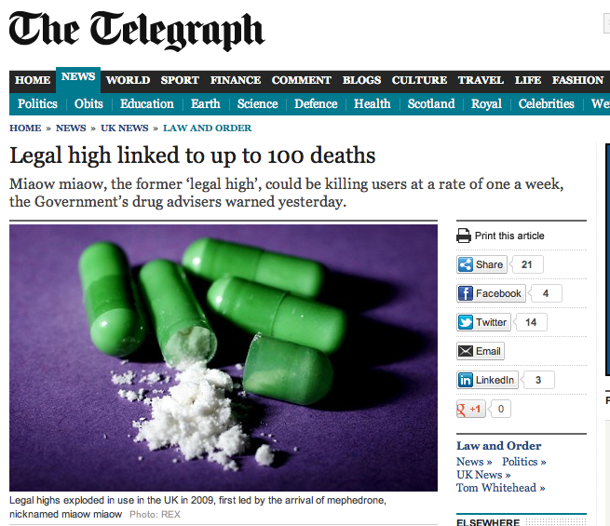
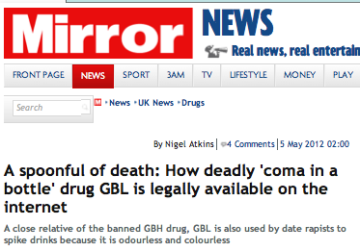

Slide 43
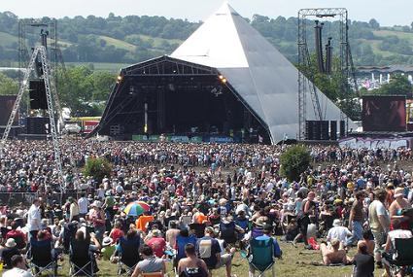

Slide 44
Guardian 2012

Slide 45
EMCDDA Annual Report 2012

Slide 46
EMCDDA 2011

Slide 47
EMCDDA Annual Report 2012

Slide 48
New generation, new access

Slide 50
www.erowid.org

Slide 51
Who are using these new substances ?

Slide 52
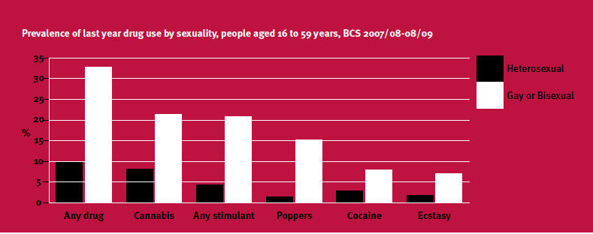
300,000 estimated Mephedrone users
UKDPC: Drugs and diversity 2010
Notes:
CONSIDERING FIRST THE GAY AND BISEXUAL COMMUNITY……

Slide 53
Drug use by ‘clubbers’
Drug | Percentage (lifetime)
Ecstasy | 89.5
Cocaine | 84.6
Ketamine | 66.1
Benzodiazepines | 42.0
Mephedrone | 41.3
GHB | 15.2
Crack | 13.6
Heroin | 6.7
Winstock et al. Addiction 2010, 106, 154-161
Notes:
CONSIDERING HETEROSEXUAL CLUB DRUG USERS

Slide 54
Mephedrone
Synthetic stimulant
Alert, euphoric, pro-social
Snorted, ‘bombed’, swallow in drink, injected
30-40 minute duration
Banned April 2010 following rapid increase in use

Slide 55
Mephedrone
Little research
Short-term
Post binge depression, anxiety
Severe paranoia, auditory hallucinations
Long term
Dependence
Memory deficits
Psychosis

Slide 56
Club
Drug
Clinic

Slide 57
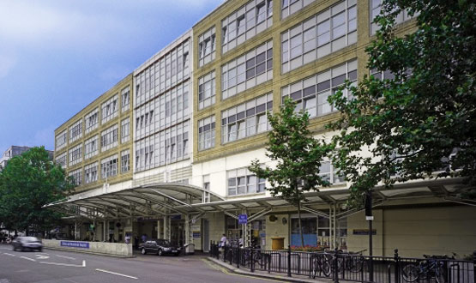
Drug Service
Sexual Health
Urology
LGBT

Slide 59
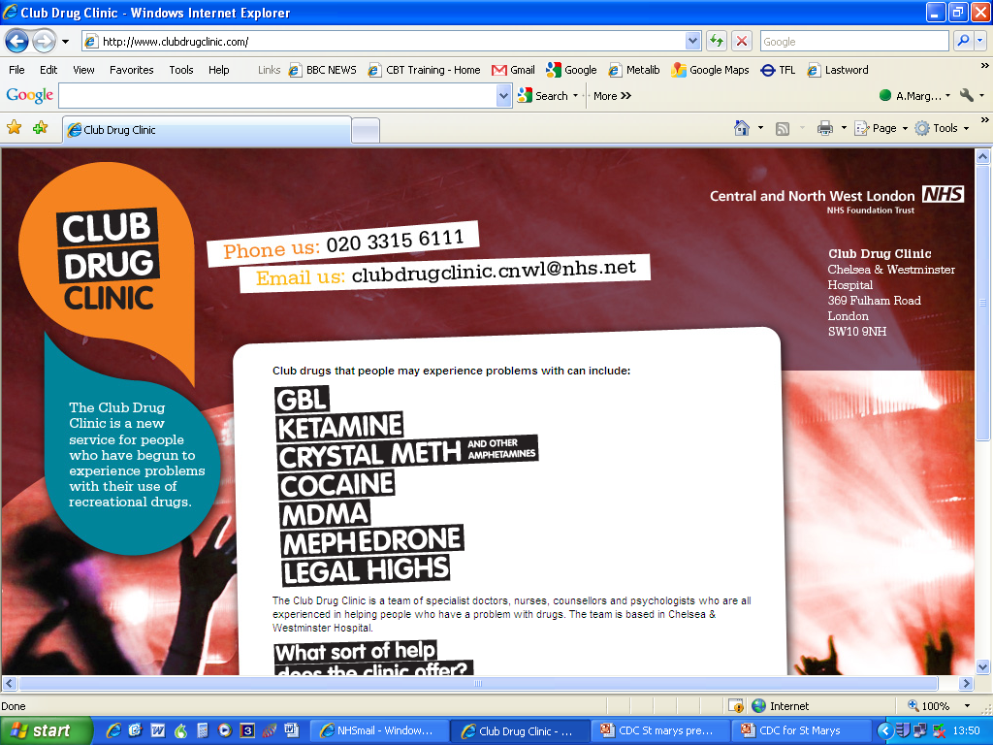

Slide 60
What to do if you think your patient is using club drugs
New population – clubbers, students, LGBT
Unexplained psychosis, rapid onset delirium, treatment resistant depression
Urine test may not be helpful
Ketamine- ask about bladder symptoms
Local drug service may not have knowledge
www.clubdrugclinic.com

Slide 61
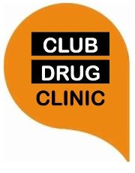
Owen.bowdenjones@nhs.net
Clubdrugclinic.cnwl@nhs.net
www.clubdrugclinic.com

