Slide 1

Sleep disorders
Sue Wilson
Senior Research Fellow
Neuropsychopharmacology
Burlington Danes building, Hammersmith campus
sue.wilson@imperial.ac.uk

Slide 2
Sleeping and waking: what goes wrong
insomnia
  not enough sleep or sleep of poor quality
  common, 7-12% of European population
hypersomnia
  excessive daytime sleepiness
  Varies with age and gender, 1-5%
parasomnia
  unusual happenings in the night (injurious ~ 0.5%)
other, eg:
  circadian rhythm disorders (sleeping at the wrong time)
  restless legs syndrome (RLS)/ periodic limb movement disorder
Full classification in ICSD (2001) International Classification of Sleep Disorders - Diagnostic and Coding Manual, American Academy of Sleep Medicine, Chicago.

Slide 3
What is insomnia?
Difficulty initiating or maintaining sleep, or sleep is chronically nonrestorative or poor in quality
In spite of adequate opportunity and circumstances for sleep
Daytime consequences eg fatigue (rarely sleepiness), impairment of concentration or memory, mood disturbance or irritability
Severity and duration criteria in DSM IV, ICD-10, ICSD

Slide 4
Clinical course of insomnia
Too much arousal at bedtime – triggers may be
    Psychological (eg stress, bereavement)
    Psychiatric (depression, anxiety)
    Circadian (depression, jet lag, shift work)
    Pharmacological (eg caffeine, stimulants, other drugs)
    Other illness (CV disorders, restless legs, PD, pain)
    Other sleep disorder
  BUT if trigger is alleviated, worry and /or poor sleep habits may perpetuate hyperarousal and chronic insomnia develops

Slide 5
Treating insomnia
It is important to treat insomnia because the condition
  causes decreased quality of life
  is associated with impaired functioning in many areas
  leads to increased risk of depression, anxiety and possibly cardiovascular disorders
  may impair recovery from other illness
How do we treat it?
  patient-guided
  by particular pattern of problem, ie sleep onset or maintenance insomnia
  by choice of treatments with evidence base
    Cognitive behavioural therapy
    Hypnotic drugs eg zolpidem, zopiclone

Slide 6
Hypersomnia : excessive daytime sleepiness
Common causes
  lack of sleep without any underlying disease (insufficient sleep syndrome)
  depression, neurological disorders, drug effects
Caused by primary sleep disorder
  fragmentation of nocturnal sleep
  (e.g. by breathing related disorders, movement disorder such as RLS, or parasomnias)
  intrusion of sleep phenomena into the awake state (e.g. in narcolepsy)
  disturbances of circadian rhythms (e.g. in delayed sleep phase syndrome, shift work sleep disorder).

Slide 7
Hypersomnia : excessive daytime sleepiness
Obstructive sleep apnoea syndrome, OSA
  Cessation of airflow with ongoing respiratory effort (often several hundred times a night)
  Results in interrupted sleep and daytime sleepiness
  Estimated 9% of women and 24% of adult men aged 30-60
  Treated with physical means
    Continuous positive airway pressure (CPAP)
    Occasionally mandibular advancement device

Slide 8
Obstructive sleep apnoea syndrome
Awake, airway slightly narrowed
During sleep, muscle tone ↓, snoring
Airway closes, resp. muscles continue to try and inhale
O2 levels drop until autonomic reflex causes an alarm signal which leads to awakening
Airway opens with a loud noise, transient increase in BP
Normal breathing resumes and patient falls asleep

Slide 9
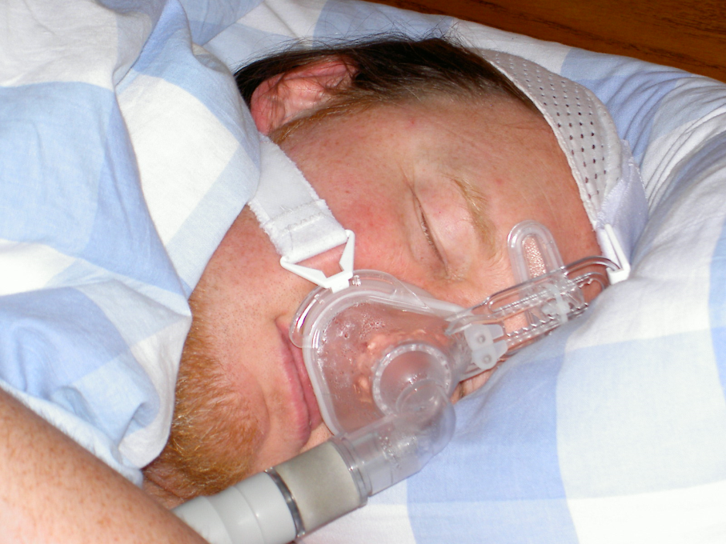
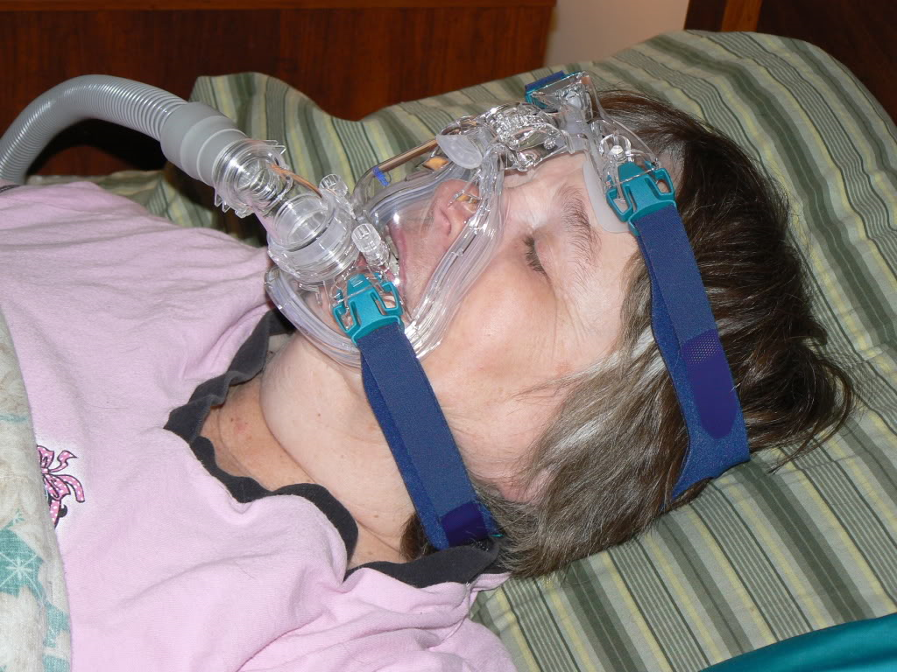
Continuous positive airway pressure (CPAP) for obstructive sleep apnœa
Nasal
Full face

Slide 10
Narcolepsy
excessive daytime sleepiness
sudden sleep attacks
cataplexy
other REM sleep phenomena eg sleep paralysis, hypnagogic hallucinations
poor night-time sleep
onset 2nd decade, peak age 14
prevalence ~ 47/100,000
in combination, the symptoms of narcolepsy often have a major impact on relationships, education, employment, driving, mood and quality of life.

Slide 11
Cataplexy
partial or generalised, bilateral loss of skeletal muscle tone and power
usually starts with face, or ‘weak at knees’
in response to emotion, esp amusement, anger,elation
awareness usually preserved throughout
attacks last less than a minute
can occur up to several times per day
irregular twitching of limbs or face as muscle tone returns

Slide 12

Aetiology of narcolepsy
+
Genetic
HLA phenotype
DQB1*0602
Environmental
Something that destroys
orexin cells in
tuberomamillary nucleus
of hypothalamus
in teens/ twenties
? Autoimmune attack

Slide 13
Treating narcolepsy
Daytime sleepiness treated with modafinil, stimulants
Next to hypersomnia, cataplexy is symptom most often treated with drugs
  Antidepressants (clomipramine, venlafaxine, SSRIs)
  Amphetamines improve cataplexy (but not modafinil)
  Recently, sodium oxybate (GHB) used, and has some ameliorating effects on hypersomnia also

Slide 14
Parasomnias
Non-REM sleep
Night terrors
Sleepwalking
Confusional arousals
Bruxism
Enuresis
Sleep starts
Sleep talking
Head-banging
REM sleep
Nightmares
REM sleep behaviour disorder (RBD)
Sleep paralysis
not recalled recalled

Slide 15
Parasomnias arising from deep non-REM sleep:
night terrors and sleepwalking
Usually strong family and childhood history
Night terrors
recurrent episodes of abrupt awakening, usually in first third of night, usually with a scream
intense fear and signs of autonomic arousal
unresponsiveness to comforting
no detailed recall
cause significant distress
incidence ~ 2% adults
Sleep walking
rare to present for treatment unless injured self or others
similar course to night terrors, often both in same subject

Slide 16
This patient had 1-5 terrors per night, preventing continuation of SWS
Night terrors causing sleep disruption
awake
REM
Stage 1
Stage 2
Slow wave sleep
0
1
2
3
4
5
6
7
8
9
23:00 03:00 07:00

Slide 17
Non-REM parasomnias:
Why do patients present and when should we treat?
Injury to self or partner
Potential danger
Daytime fatigue
Anxiety and disruption of sleep of partner, family, housemates

Slide 18
Non-REM parasomnias: treatment
No controlled studies in adults
Attention to trigger factors and safeguards against harm
Clonazepam said to be effective (case series n=69, number of responders and degree of response unspecified)
Smaller case series for paroxetine and imipramine (both effective immediately)
Case series for hypnotherapy in sleepwalkers
Clinical experience for citalopram

Slide 19
REM parasomnia: REM behaviour disorder
Violent complex behaviour at night
Subject recall 80-90%
2 abnormalities
  lack of atonia during REM sleep
  increased vividness and/or nasty content of dreams

Slide 20
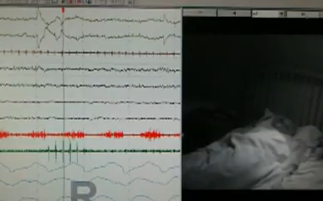
REM behaviour disorder
Rapid eye
movements
Snoring
Low muscle
activity
Still and quiet

Slide 21
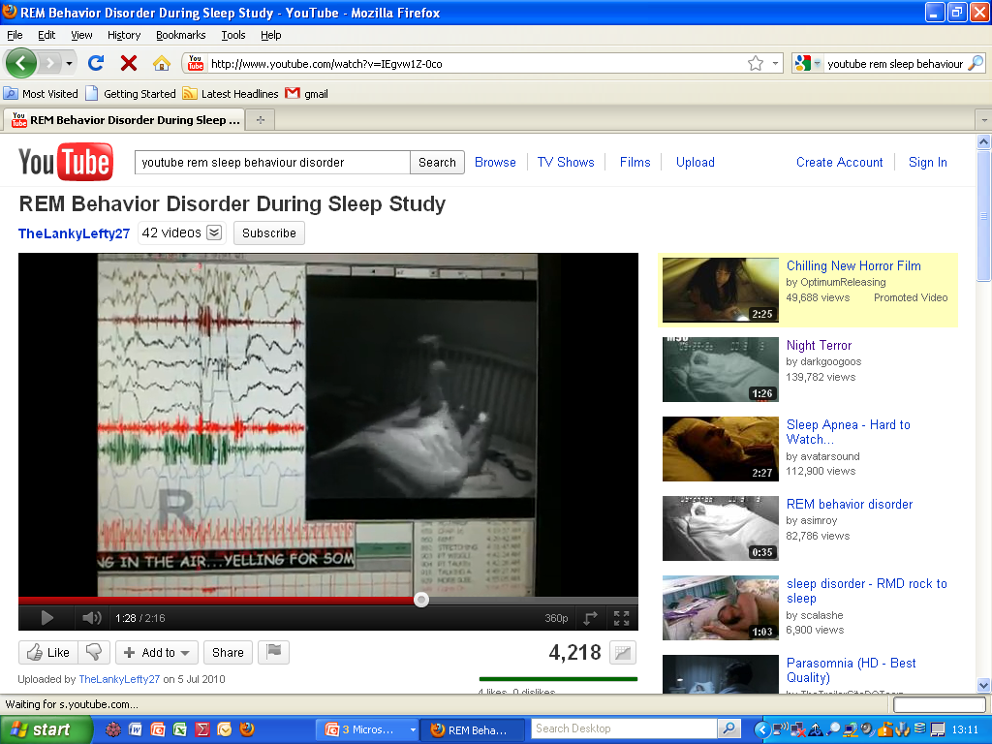
REM behaviour disorder
Punching the air violently and yelling
Woke and was dreaming of being attacked

Slide 22
REM behaviour disorder (RBD)
Incidence unknown (prob <1%), identified in 1980s, increasingly recognised
Older age group, steady rise after 55
M >> F (80-90% male except for those with MSA)
Idiopathic or associated with Parkinson’s disease (~50% of PD pts) , Lewy body dementia (~70%) , multiple system atrophy (>90%)
RBD may be the first manifestation of these disorders, antedating the onset of parkinsonism, cerebellar syndrome, dysautonomia, and dementia by several years.

Slide 23
Sleep paralysis
Intrusion of REM atonia (and sometimes dream imagery) into awake state
‘Awake but can’t move’
Exacerbated by
  irregular sleep routine /sleep deprivation
  alcohol
  anxiety / tension
Isolated prevalence ~3% (?) lifetime, unknown current, 20% in panic disorder and GAD
May be genetically determined

Slide 24
Circadian rhythm disorders
Sleep disorders where there is a mismatch between circadian rhythms and required sleep-wake cycle
Can result in
insomnia (if trying to sleep when innate circadian drive is to sleep)
hypersomnia (if trying to be awake when innate circadian drive is to sleep)
Notes:
24

Slide 25
Circadian rhythm disorders
Some (jetlag and shift work disorder) are due to lifestyle conflicting with the internal clock.
Others are inherent:
  delayed sleep phase syndrome: difficulty falling asleep till early hours and preferred late waking up time
  free running sleep disorder where there is a daily increment of sleep and wake times (getting later each day) – rare but often a problem in blind people without eyes
Notes:
25

Slide 26
Normal subject actigraphy

Slide 27
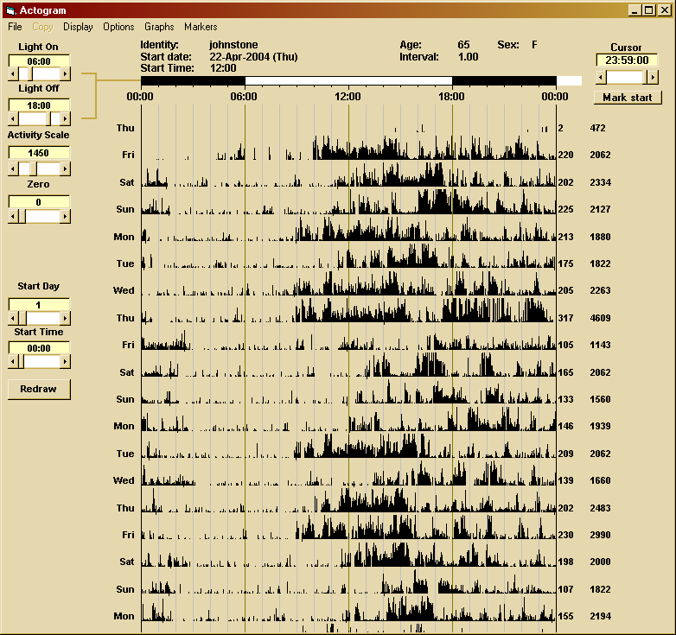
‘Problem’ circadian rhythm actigraphy
Notes:
27

Slide 28
Restless legs syndrome
A disorder characterized by an almost irresistible urge to move, usually associated with disagreeable leg sensations , worse during inactivity, and often interfering with sleep
(i) an urge to move the legs, usually accompanied or caused by uncomfortable and unpleasant sensations in the legs;
(ii) begins or worsens during periods of rest or inactivity such as lying or sitting
(iii) partially or totally relieved by movement, such as walking or stretching
(iv) worse in the evening or night than during the day or only occur in the evening or night.
Often associated with regular leg twitches in sleep (periodic limb movement syndrome)
Notes:
28

Slide 29
Periodic limb movements in sleep (PLMs)
Are a polysomnographic finding, recorded in the sleep laboratory
Stereotyped, periodic, jerking movements typically consisting of flexion of the ankle, knee, and hip
Occur regularly every 10-120 seconds in light sleep
Can be seen in about 10% of healthy subjects
If severe, can cause arousal and fragmented sleep, resulting in daytime symptoms
30% of people who have PLMs have RLS symptoms –
70% don’t
Notes:
29

Slide 30
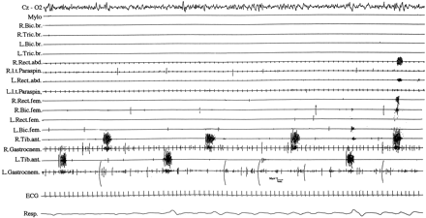
Periodic leg movements in sleep
2 min

Slide 31
Aetiology of restless legs syndrome
Unknown, but responds to dopaminergic drugs as in Parkinson’s disease
Disorder of brain dopamine system
Strong evidence for involvement of Fe in brain

Slide 32
Sleep problems in psychiatric disorders
  Depression highest incidence :
  • ~70% have insomnia, commonly improves as mood lifts
  • 10% experience hypersomnia
  GAD :
  • insomnia (initial) ~ 20-30%
  Panic disorder :
  • nocturnal panic attacks
  • sometimes initial insomnia when fearing these

Slide 33
Sleep problems in psychiatric disorders
  Post-traumatic stress disorder :
  • insomnia
  • parasomnias – nightmares, night terrors, sleepwalking
  Schizophrenia :
  • circadian rhythm disorder (‘free-running’)
  Dementias :
  • agitation at bedtime - ‘sundowning’
  • scheduling disorder (sleep in day)
  Substance misuse :
  withdrawal from opiates or alcohol
  • insomnia and circadian rhythm disorder
  • high risk factor for relapse
  • drugs/alcohol often previously used to initiate sleep

Slide 34
Reading list
British Association for Psychopharmacology consensus statement on evidence-based treatment of insomnia, parasomnias and circadian rhythm disorders
SJ Wilson, DJ Nutt, C Alford, SV Argyropoulos, DS Baldwin, AN Bateson, TC Britton, C Crowe, D-J Dijk, CA Espie1, P Gringras1, G Hajak1, C Idzikowski1, AD Krystal1, JR Nash1, H Selsick16, AL Sharpley1 and AG Wade
J Psychopharmacol. 2010 Nov;24(11):1577-60
http://www.bap.org.uk/pdfs/BAP_Sleep_Guidelines.pdf
Sleep Disorders
Sue Wilson, David Nutt . Oxford Psychiatry Library series. Oxford University Press 2008
Nutt D, Wilson S, Paterson L. (2008) Sleep disorders as core symptoms of depression. Dialogues Clin Neurosci. 2008;10(3):329-36.

Slide 35
Questions?

