Slide 1
Cognitive dysfunction in psychosis
Dr Verity Leeson

Slide 2
Background
Kraepelin (1896) first detailed psychotic disorder “dementia praecox” (premature dementia)
Characterised by progressive cognitive decline
Bleuler (1908) felt name was inappropriate because illness did not always present in young people or result in deterioration
Proposed new name “schizophrenia”

Slide 3
Background
Kraeplin’s concept of core cognitive dysfunction reinforced by new methods
Neuropsychological assessment:
Influential book on psychiatric disorders Diagnostic Psychological Testing (Rappaport et al, 1945)
sz patients have greatest impairment in “judgement, attention, concentration, planning ability and anticipation”
Further commented on memory difficulties and general intellectual inefficiency

Slide 4
Imaging studies:
CT show brain morphological abnormalities
(Johnstone et al, 1976)
Supported by MRI studies
fMRI/PET show functional differences
Pubmed: “cognition” AND “psychosis” OR “schizophrenia”
8664 articles (2010) 101896 articles (2012)

Slide 5
Prevalence
Considerable heterogeneity in sz presentation
Cognitive impairment may be more prevalent than other symptoms
Diagnostic manuals reference cognitive impairment
e.g. DSM-IV: characteristics of schizophrenia “involve a range of cognitive and emotional dysfunctions that include perception, inferential thinking, language and communication, behavioural monitoring, affect, fluency and production of thought and speech, hedonic capacity, volition and drive, and attention”

Slide 6
Cognition and DSM-V criteria
Should the diagnostic criteria of schizophrenia include reference to cognitive impairments?
Inclusion would increase the awareness of cognitive deficits in affected patients, among both clinicians and researchers
Would increase use of cognitive assessment
provides an index of functional and treatment outcomes
Would it facilitate the specificity and/or positive predictive power in identifying those individuals with schizophrenia?
Sufficient “point of rarity” with other disorders
What about those that consequently require re-classifying due to no impairment?
Alternative is to use as a specifier e.g. Diagnosis of “sz with moderate cog impairment”

Slide 7
Research Question
In terms of cognitive function, how should we define “impairment”?

Slide 8
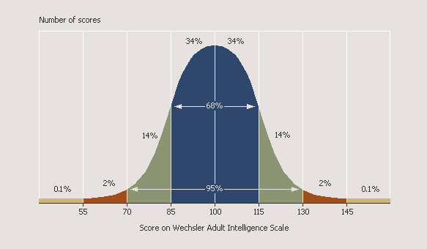
Defining “Impairment”
Falling below a specified threshold
Nithsdale Survey (Kelly et al, 2000). N=138 community sample
15% showed MMSE <24
West London FE Psychosis Study. N=138
Current IQ average 85; 24% scored 70 or below

Slide 9
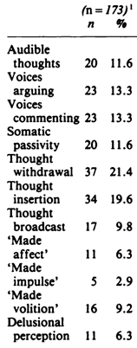
Defining “Impairment”
~600 sz pats on Repeatable Battery for the Assessment of Neuropsychological Status (RBANS)
(Wilk et al, 2004)
If criteria of scoring 1 SD below normal are employed, would correctly identify 80%
Compare this to first-rank symptoms:
(Malik et al,
1990)

Slide 10
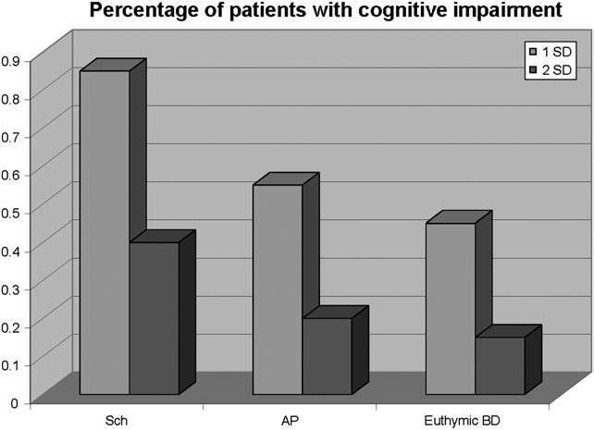
% below a specified cut-off across diagnoses
(Meta-analysis; Bora et al, 2010)

Slide 11
Defining “Impairment”
Below what is expected based on comparison with…
Healthy controls matched on age, sex, educational level, socioeconomic status, etc
Healthy parents, siblings, twin
267 twins tested for current IQ (Toulopoulou et al, 2007)

Slide 12
Defining “Impairment”
Declining from premorbid levels
Can estimate premorbid functioning
WTAR and NART irregular word reading tests can be used to estimate premorbid functioning
Tallies with full scale (current) IQ in healthy adults
Comparison of estimated premorbid and current IQ suggest 40-50% undergo a decline in IQ by at least 10 points (Weickert et al, 2000; Kremen et al, 2008)
But may reflect superior verbal skills
NART IQ found to deviate from measures of full scale IQ actually obtained years before the onset of psychosis (Russell et al, 2000)
Higher verbal IQ and lower performance IQ in patients than FSIQ matched controls (Kremen et al, 2001)

Slide 13
Defining “Impairment”
Very difficult to obtain information before and after illness onset
Kremen et al, 2010
Used birth cohort data (Subset of 12,094 live births who lived in region where research being carried out)
Screened medical records → 170 potential sz
71 had sz spectrum disorder on assessment
26 consented, of which 10 had completed Peabody Picture Vocab test in childhood

Slide 14
Defining “Impairment”
Some sources of premorbid assessment
Conscript studies
Swedish military use IQ test
Those scoring in lowest IQ band 9x more likely to be diagnosed later with sz than those in highest IQ band (David et al, 1997)
Israeli military use cognitive test
54,000 male 17 year olds
Risk of sz increased with decreasing IQ score (Reichenberg et al, 2006)
Suggests cognitive impairment prior to illness
But these adolescents could have been in prodrome

Slide 15
Defining “Impairment”
Birth Cohort Studies
1946 child developmental study (UK)
Relationship between cognitive function (ages 8, 11 and 15) and later sz
Poor performance on non-verbal tests best predictor (Jones et al, 1994)
Philadelphia birth cohort study (USA)
Quartiles based on IQ assessment at ages four and seven
30-60% increase in schizophrenia risk per unit decrease in ability category
At age 4, scoring in the deficient range was 5x more likely to develop schizophrenia than those in superior range (Cannon et al, 2000)

Slide 16
Defining “Impairment”
2 meta-analyses (Aylward et al, 1984; Woodberry et al, 2008) of psychometric measures of intelligence in individuals who later develop sz
Average IQ 90 -95
Suggests that cognitive impairment does not arise de novo at the onset of psychosis
Thus, although further decrement may occur, individuals have premorbid cognitive impairement

Slide 17
The Course of the Cognitive Deficit
Premorbid functioning
at risk mental state and Prodrome
First Episode psychosis
Established schizophrenia

Slide 18
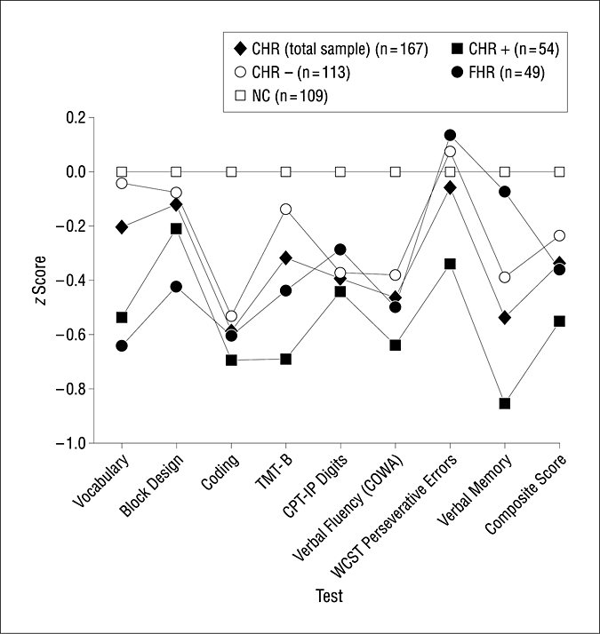
Psychosis High-Risk Profile
North American Prodrome Longitudinal Study (NAPLS)
304 clinical high risk individuals, 52 family high risk, 193 controls
Global cognitive functioning CHR=FHR
Premorbid assessment worse in those that progressed to psychosis
(Seidman et al, 2010)

Slide 19
Course: Prodrome
Cognitive functioning may decline throughout the prodrome – mixed evidence
Bilder et al (2006)
Adolescents who later developed sz showed drop in standard aptitude assessment scores between 11th and 12th grades
Reichenberg et al (2006)
Israeli conscripts, risk for development of sz spectrum disorders was associated with declining IQ scores over 2 years
Jahshan et al (2010)
High-risk subjects who converted to psychosis showed deterioration in working memory and processing speed over a 6-month follow-up

Slide 20
Course: First-episode Psychosis (FEP)
Clear evidence of deficit in FEP
Mesholam-Gately et al (2009) meta analysis
43 studies, 2,204 patients & 2,775 controls
medium to large impairments across 10 cognitive domains

Slide 21
Course: Established Schizophrenia
Cross sectional studies
Equivalent levels of impairment in patients across illness duration (Hyde et al, 1994; Mockler et al, 1997)
Cognitive function changes at the same rate as healthy controls (Eyler Zorrilla et al, 2000)
Differences may reflect historically changing practice
Longitudinal studies
Mainly report static course (Rund, 1998; Kurtz, 2005)
Attrition a problem in studies with longer follow-up periods
Normal change may mask deterioration (practice effect)

Slide 22
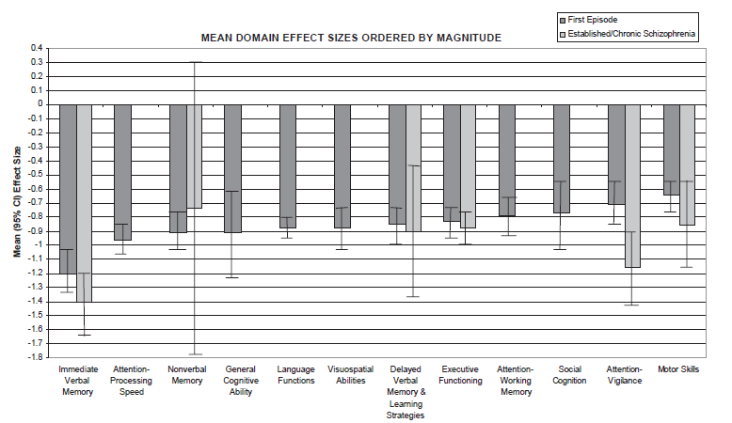
FE vs Established Schizophrenia meta-analyses (Mesholam-Gately et al, 2009 & Heinrichs and Zachzanis, 1998)

Slide 23
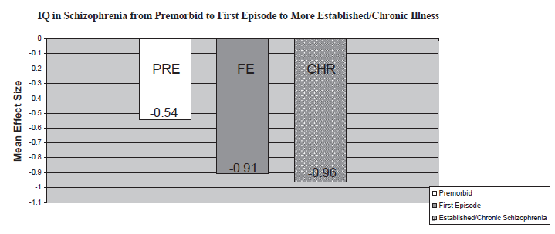
IQ in Premorbid, FE and Established Schizophrenia
3 meta-analyses of IQ: premorbid (Woodberry et al, 2008), first-episode (Mesholam-Gately et al, 2009) and established schizophrenia (Heinrichs and Zachzanis, 1998)

Slide 24
Course: Established Schizophrenia
Thus, majority of studies suggest cognitive performance is static across illness
Exception are studies of older institutionalised patients (review Rajji and Mulsant, 2008)
e.g.~300 sz patients, aged 65+, Repeat testing on clinical dementia rating over a 30 month period (Harvey et al, 1999)
30% changed from mild impairment to moderate or severe
Only 7% improved in their cognitive functioning

Slide 25
Characteristics of the Cognitive Deficit
Specific areas of interest
Severity of impairments
Relationship between performance on different domains
heterogeneity

Slide 26
General or Specific Impairment?
Evidence from other illnesses shows that performance on certain tests may be affected by deterioration in specific brain regions
Much sz research has focused on ‘‘localising’’ neuropsychological tests
Sustained attention, executive functioning, memory, working memory, social cognition, processing speed

Slide 27
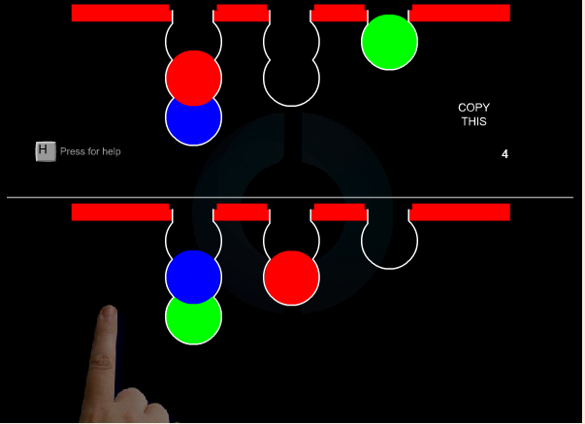
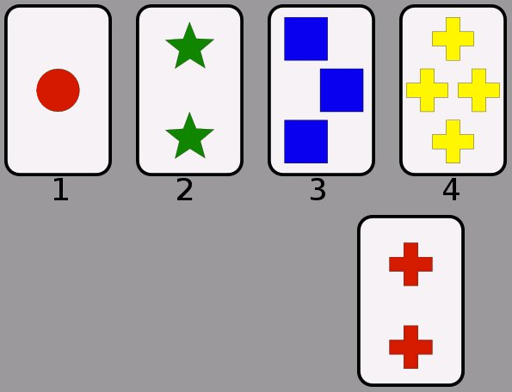
Domains of Interest –the difficulty of localising deficits
Executive Function - “cognitive control”
Executive functions encompass a number of abilities,
ability to initiate, plan, and sequence behaviours
ability to abstract a principle or problem-solving strategy
ability to be cognitively flexible (i.e. switch cognitive sets)

Slide 28
Domains of Interest - Executive Functions
Johnson-Selfridge et al (2001) meta-analysis of 71 studies
effect size of -1.45 for schizophrenia patients and -0.40 for other psychiatric patients relative to controls on measures of executive functioning
Shallice (1991)
all sz pats have problems with processes tapped by executive tests and some have additional widespread impairment
→ Kremen et al (2001)
compared matched sz and controls, categorised as low-average or average IQ
Only executive function was poorer in sz in both IQ subgroups

Slide 29
Domains of Interest - Executive Functions
Significant IQ decrements do not occur in many cases of frontal lobe injury in adults
(Warrington et al, 1986)
Poor performance on tests such as the Wisconsin card sort test correlates with lower IQ in sz
(Goldstein et al, 1996)
Does poor WCST performance reflect a generalised intellectual deficit

Slide 30
Domains of Interest - Episodic Verbal Memory
Memory for personal events, time specific
FE cohort demonstrated memory and executive impairment but memory deficits observed in a subset of otherwise neuropsychologically normal patients
(Bilder et al, 2000)
Meta-analysis of 204 studies in sz reported largest effect size for memory functions
(Heinrichs and Zakzanis, 1998)

Slide 31
Domains of Interest - Episodic Verbal Memory
However, deficit may reflect “executive” difficulty
California verbal learning task allows the use of categorisation in list learning
Relationship between use of semantic organisational strategies and reduced learning capacity (Kristian Hill et al, 2004)
Are we documenting memory or executive deficit (or general intellectual deficit)?

Slide 32
Specific Cognitive Domains
Performance impaired across tests sensitive to ‘‘localised’’ impairments in frontal, temporal, hippocampal, parietal, striatal, & cerebellar functions!
Mulitfactorial nature of tests a barrier
Differences in reliability and sensitivity of tests can mimic selective deficits (Chapman and Chapman, 1973)
“an attempt to understand the nature of the information processing impairment of schizophrenia should precede an attempt to localise it” (Frith)

Slide 33
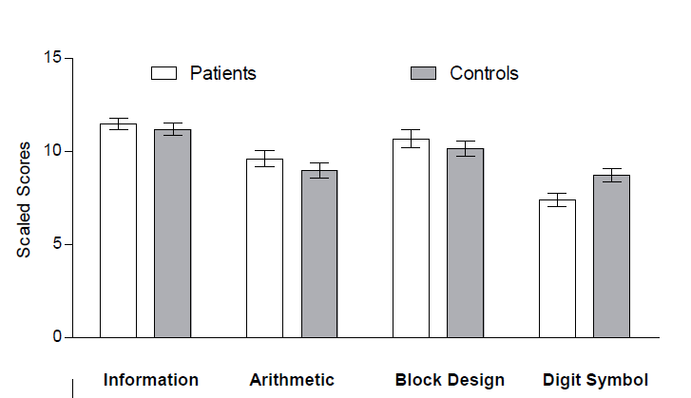
Domains of Interest – Processing Speed
Speed at which cognitive operations can be executed
Wilk et al (2005)
Sz and controls one-to one matched for FSIQ, controls show better performance on subtests dependent on processing speed
(Leeson et al, 2010)

Slide 34
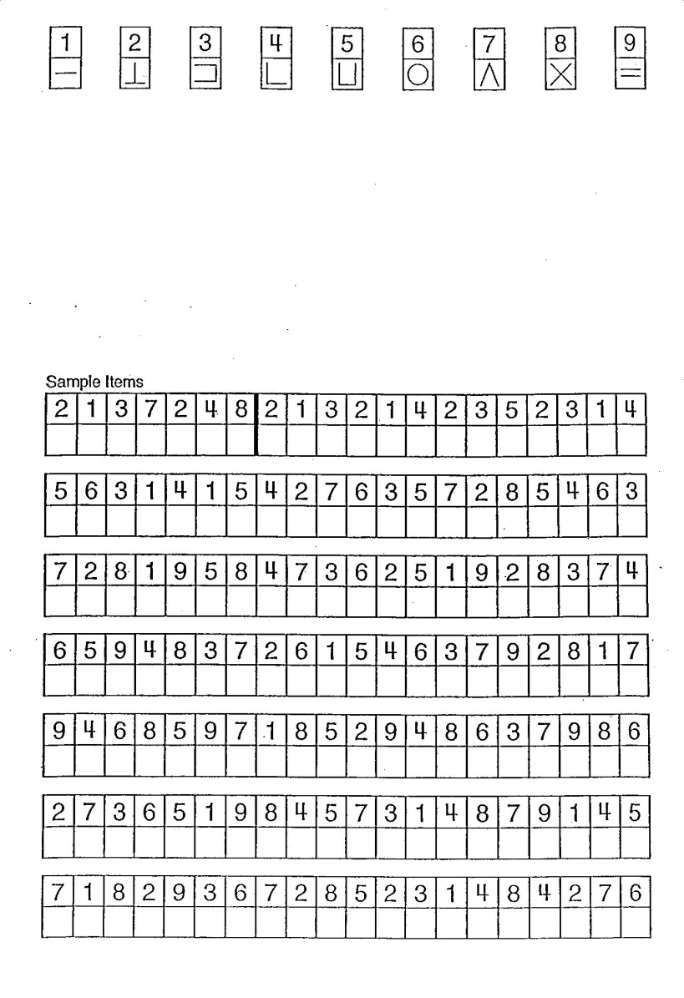
Domains of Interest – Processing Speed
Particularly digit symbol substitution task
2 reviews showed deficits on digit symbol test have larger effect size than other cognitive functions
(Henry and Crawford, 2005; Dickinson et al, 2007)
Not a discrete impairment, information processing deficiency
(Dickinson, 2008)

Slide 35
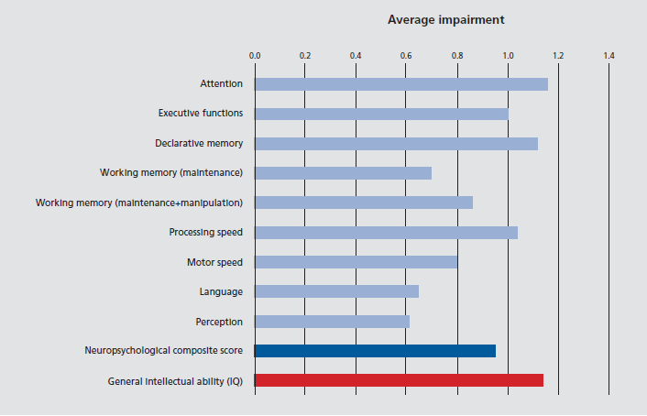
Severity
Data from 2 meta-analyses: 9624 sz, 8640 controls (Reichenberg, 2010)

Slide 36
Heterogeneity of Cognitive Function
Underperformance as a group does not necessarily equate to homogeneity of functioning
Some sz patients may be unimpaired
May be different profiles within population
Efforts to define subgroups by cognitive and related clinical phenomena often utilise cluster analyses

Slide 37
Cluster Analysis
Most show a large cluster of patients with generalised cognitive impairment
(Heinrichs and Awad, 1993; Weickert et al, 2000)
3 clusters emerge:
Cognitively normal
Generalised impairment
Verbal-memory impaired (list learning, working memory)
Cognitively normal patients had less severe negative and general psychopathology symptoms relative to those with broadly based impairment (Amari et al, 2010)

Slide 38
Research Question
What mechanisms could be responsible for poorer neuropsychological performance in patients when compared to controls?

Slide 39
MacCabe (2008)
Cognitive deficits could be
Direct, causal risk factors for schizophrenia
Factors involved in the etiology but not causal themselves
Early symptoms of the disorder itself, which predate the onset of psychotic symptoms
Core symptoms of the disorder that arise concurrently with the onset of psychotic symptoms
A consequence of the symptoms
The adverse effects of drug treatment
The effect of a chronically impoverished social and occupational environment
Or any combination of these mechanisms

Slide 40
Mechanisms : Etiological
Direct, causal risk factors for schizophrenia
Factors involved in the etiology but not causal themselves
Cognitive impairment predates symptoms
suggests that poor cognitive function is either directly causal or associated with causal factors that are involved in etiology
How can one determine whether etiological factors are causal risk factors or non-causal
Many of the known risk factors for sz are also risk factors for poor cog function
Include socioeconomic group, parental educational, pregnancy and birth complications, migration or minority status
What about other risk factors? Genes or environment
Familial liability
Ethnicity
Drug use

Slide 41
Cannabis and Cognition
Cannabis use is associated with increased risk of sz
(Moore et al, 2007)
Cannabis users have an earlier age at onset of psychosis than never-users
(Compton et al, 2009)
Early onset is usually associated with poor outcome
Pat with sz who use cannabis have higher IQs than those who do not
(D’Souza et al, 2005)
Poor cognition is linked to earlier age at onset
(DeLisi, 1992)

Slide 42
Cannabis and Cognition
Cannabis use, cognition & outcome in 99 FE psychosis patients from West London
Leeson et al (2012)
Age at first cannabis use predated prodrome onset in 95% of users
Linear relationship between age at first cannabis use and age at psychosis onset (r=0.5)
 | Never-users |  | Cannabis Users |  | Comparison
 | Mean | SD | Mean | SD | F | df | p
Age at psychosis onset (years) | 27.12 | 10.68 | 21.97 | 5.80 | 9.71 | 1,98 | 0.002
WTAR Premorbid IQ | 88.91 | 11.73 | 95.54 | 12.79 | 6.33 | 1,98 | 0.013

Slide 43
Cannabis and Cognition
Those who develop psychosis in the context of cannabis use have fewer neurodevelopmental risk factors, manifest in premorbid cognition
Cannabis use may represent an independent vulnerability factor
Cessation led to best outcome

Slide 44
Mechanisms: Symptoms
Early symptoms of the disorder itself, which predate the onset of psychotic symptoms
Core symptoms of the disorder that arise concurrently with the onset of psychotic symptoms?
Most compelling evidence is for deficits predating onset, but birth cohort studies suggest they predate other symptoms by many years
Prevalence suggests cognitive deficits are central feature of sz – symptoms?
More enduring than positive / negative symptoms

Slide 45
Mechanisms: Relationship with Symptoms
A consequence of the symptoms
Correlation between symptoms and cognition?
Some evidence that IQ related to concurrent negative symptoms
But, WAIS subtests predicted negative symptom severity 10 years later (Stirling et al, 2003)
Goldberg et al (1993)
Symptomatic improvement with clozapine, no associated improvement in cognitive functioning
"This suggests that certain cognitive deficits are relatively independent of psychotic symptoms in schizophrenia, and are probably central and enduring features of the disorder.”
“Cognitive disability appeared to have been rate-limiting in the sample's rehabilitation"

Slide 46
Relationship with Symptoms
Cognitive deficits causing symptoms an obvious pairing
Theoretical model of information processing abnormalities
Inability to generate spontaneous (willed) intentions → poverty of action, perseveration and inappropriate action
Inability to monitor beliefs and intentions of others → delusions of reference, paranoid delusions, third-person hallucinations
(Frith, 1992)
Delusions as a consequence of semantic memory dysfunction
(McKenna, 1991)
Formal thought disorder arising from semantic memory disorganisation
(Spitzer et al, 1993)

Slide 47
Relationship with Symptoms
Do symptoms produce artifactual “deficits”?
may manifest as a result of reduced motivation, distraction, blunted affect, etc
Deficits an epiphenomenon of the illness state

Slide 48
Mechanisms: Medication
The adverse effects of drug treatment
Most studies conducted on medicated patients
Neuroleptic and anticholinergic drugs can have marked cognitive-impairing effects
However, severe cognitive impairment seen in drug free patients
(Blanchard & Neale, 1994)
Also in drug-naive
(McCreadie et al, 1997; Saykin et al, 1994)

Slide 49
Mechanisms: Impoverished Environment
The effect of a chronically impoverished social and occupational environment
Evidence of impairment predating illness onset indicates that this does not entirely explain deficit
Does institutionalisation explain drop off in geriatric sz?
Social withdrawal
Lack of social experience
Selection bias may occur in cross-sectional studies

Slide 50
Influence of Institutionalisation: Late Onset Schizophrenia
Some people develop schizophrenia after age 65
Review comparing early-onset sz during later life & late-onset sz of comparable age showed no difference in cognitive profiles
(Rajji and Mulsant, 2008)
Implies that any decline occurring in geriatric sz patients is not due to years of illness or institutionalisation

Slide 51
Relationship with Outcome

Slide 52
Relationship with Outcome
A number of factors may be considered outcome including
Residual symptoms
Relative change in symptoms when compared to earlier in the course of the illness
Subjective quality of life
Social and occupational function
Pharmacological treatment may ameliorate positive symptoms but full recovery often not achieved

Slide 53
Cognition and Clinical Remission
Emsley et al (2007)
462 FEP in a randomized, double-blinded trial of risperidone vs haloperidol over 2-4yrs
109 (23.6%) had a reduction to mild levels on the key PANSS symptoms for at least 6 months
Remission group was not different on composite cognitive scores – neither baseline score or change over time
2 strongest predictors of remission were shorter DUP and treatment response at 6 week

Slide 54
Outcome: Symptoms
Most consistent finding is for negative symptoms
(Carlsson et al, 2006; Leeson et al, 2009, Stirling et al, 2003)
Leeson et al found that IQ at FE predicted negative symptoms one year later, even after accounting for the level of negative symptoms at FE
Stirling et al found a measure of general cognitive ability predicted negative symptom severity 10 years later

Slide 55
Outcome: Social and Occupational Function
Pats with relatively preserved cognition
show higher levels of functioning in the community
maintain their functional status for longer periods of time
(McKibbin et al, 2004)
A number of cognitive measures including IQ had the highest correlation with total hours worked over subsequent 12 months
(Gold et al, 2002)

Slide 56
Outcome: Social and Occupational Function
Reviews show cognitive deficits predict residual dysfunction in social, occupational and independent living activities
(Green, 1996; Green et al, 2000; Green et al, 2004)
20–60% of variance in outcomes is explained by cognitive deficits
Longitudinal studies suggest that cognitive deficits play an important role in the ability of patients to benefit from psychosocial rehabilitation (e.g supported employment, CBT, skills training
(Woonings et al, 2002, Brekke et al, 2007, Kurtz et al., 2008)

Slide 57
Outcome: Quality of Life
Studies of objective quality of life look at frequency and quality of social interactions, recreational engagement
Considerably overlaps with functioning
Little work on subjective quality of life
Satisfaction with ones own life

Slide 58
Outcome: Quality of Life
Meta-analysis of 20 cross-sectional studies examining cognition and QoL, both objective and subjective
(Tolman and Kurtz, 2012)
Positive relationship found between cognitive measures and objective QoL
Non-significant or inverse relationships between cognitive skills and subjective QOL
May be that those individuals with stronger cognitive abilities may have greater insight into their illness and functional disability, enabling negative social comparison and thus lower subjective life satisfaction

Slide 59
End

