Slide 1


Neuropsychopharmacology of Bipolar Disorder
Part 1
Professor Allan Young
Imperial College London

Slide 2

Historical origins of Bipolar Disorder
Mania and melancholia were recognised in the early stages of scientific medicine by Hippocrates in the 5th century BC.
He was also the first physician to refer to them as ‘brain disorders’^{1,2}
“And men ought to know that from nothing else but thence [from the brain] come joys, delights, laughter and sports, and sorrows, griefs, despondency, and lamentations. And by this, in an especial manner, we acquire wisdom and knowledge, and see and hear, and know what are foul and hat are fair, what are bad and what are good, what are sweet, and what unsavoury... And by the same organ we become mad and delirious, and fears and terrors assail us... All these things we endure from the brain, when it is not healthy... In these ways I am of the opinion that the brain exercises the greatest power in the man. This is the interpreter to us of those things which emanate from the air, when it [the brain] happens to be in a sound state.” ³
1. Marneros A. J Affect Disord 2001;67:229–40; 2. Marneros A, Angst J. Bipolar disorders: 100 Years After Manic–
Depressive Insanity. London: Kluwer, 2000; 3. The Genuine Works of Hippocrates, trans. Francis Adams. 1886:2;344–45.

Slide 3
Psychiatric Disorders: Common and Disabling Conditions
Digestive
disorder (6%)
Musculoskeletal
disorders (4%)
2%
Bipolar disorder
Respiratory
disease (8%)
Endocrine
(4%)
Other
non-communicable
diseases (7%)
10%
Major Depression
Sense
organ
impairment
(10%)
Neuropsychiatric
disorders (28%)
2%
Schizophrenia
2%
Dementia
4%
Substance-use and alcohol-use disorders
Cardiovascular
disease (22%)
3%
Other mental disorders
1%
Epilepsy
Cancer (11%)
2%
Other neurological disorders
Contribution (%) by different non-communicable
diseases to disability-adjusted life-years worldwide in 2005
3%
Other neuropsychiatric disorders
Prince et al 2007 Sep 8;370 (9590):859-77

Slide 4
A Spectrum of Affective Disorders
Mania
Depression
Normal fluctuation
Unipolar Depression
Bipolar II
Bipolar I

Slide 5
What is Bipolar Disorder?
An Affective (Mood) disorder involving both mania and depression:
  Bipolar I - manic / mixed episodes & ‘almost always’ episodic depressions
  Bipolar II - Recurrent major depressions with hypomanic episodes
  Bipolar Spectrum- Subsyndromal symptomatology
Rapid cycling Bipolar Disorder- at least 4 episodes per year.
Notes:
From mark taylor slide deck
Bipolar disorder is so-called because it affects both poles (extremes) of the mood spectrum
The two types of mood disorder that are considered to be at opposite poles of the mood spectrum are:
Depression, in which there is persistent low mood
Mania, in which there is persistent elevated mood

Slide 6
Bipolar I Disorder: Natural History
Early onset
Chronic
  Frequently before 25 years of age
  Lifetime prevalence is 0.6% for bipolar I disorder, 0.4% for bipolar II disorder and 1.4% for sub-threshold bipolar disorder
Severe mood episodes
  In a 12-month period, 68.8% of patients with bipolar II and 74.5% of patients with bipolar I disorder rated mood episodes as clinically severe
Manic/depressive symptoms
  Symptoms of mania associated with an increased risk for substance abuse
  Symptoms of depression associated with severe functional impairment
Merikangas et al. Arch Gen Psychiatry 2011;68:241–251.

Slide 7
Lifetime and 12-month prevalence of bipolar disorder in USA
Bipolar disorder tends to persist throughout life¹
 | Prevalence, mean (SD)²
 | Any bipolar disorder | Bipolar I | Bipolar II | Bipolar NOS
Lifetime | 4.4 (24.3) | 1.0 (13.2) | 1.1 (10.6) | 2.4 (23.3)
12-month | 2.8 (18.9) | 0.6 (9.2) | 0.8 (9.9) | 1.4 (15.1)
Lifetime cases receiving no current medication:
Bipolar I disorder: 46.8%
Bipolar II disorder: 59.9%
Bipolar disorder NOS: 75.3%
N=9,282 (aged ≥18 years); US population
¹Muller-Oerlinghausen. Lancet 2002;359:241–247;
²Merikangas et al. Arch Gen Psychiatry 2007;64:543–552;

Slide 8
Lifetime and 12-month prevalence of bipolar disorder in ROW
Epidemiological Study in 11 countries in Americas, Europe and Asia
 | Prevalence, mean¹
 | Any bipolar disorder | Bipolar I | Bipolar II | Bipolar NOS
Lifetime | 2.4 % | 0.6 | 0.4 | 1.4
12-month | 1.5% | 0.4 | 0.3 | 0.8
:75% of BPS met criteria for other disorders, most commonly anxiety disorders
:less than 50% receiving MH care
:in low income countries, less than 25% receiving MH care
N=61, 392 adults in the community
¹Merikangas et al. Arch Gen Psychiatry. 2011;68(3):241–251

Slide 9
Classification of mood disorders according to DSM-IV
Mood disorders
Bipolar disorders
Depressive disorders
Bipolar I
disorder
Bipolar II
disorder
Bipolar
disorder
NOS
Cyclothymic
disorder
Major
depressive
disorder
Dysthymic
disorder
Depressive
disorder
NOS*
Recurrent
Single
episode
*NOS, not otherwise specified
American Psychiatric Association 2000
Notes:
9

Slide 10
Classification of Mood Disorders
Unipolar
single episode
Unipolar
Unipolar
recurrent
Dysthymia
Bipolar I
Bipolar
Bipolar II
Cyclothymia
Unipolar-
Hyperthymic

Slide 11
Diagnostic classification: an enduring crisis
“A scientific theory is declared invalid only if an alternate candidate is available to take its place” Kuhn (1962 )
Essentially descriptive: constructed in the age of steam
Syndromes (poorly validated) equated with Diseases
Heterogeneity and Pleiotropism conspire against this
Very few categories meet validity standards
Operational criteria rescued psychiatry in the 1970s
Reliability reasonable in research settings, poor in clinical ones
DSM revision taking place with limited focus and within silos – a better steam engine…..
Poor utility of diagnostic categories for specific treatment selection, neurobiological research
Thomas S. Kuhn The Structure of Scientific Revolutions Third Edition The University of Chicago Press Chicago and London 1962
Notes:
Coined the term “Paradigm Shift” 50 yrs ago this year
11

Slide 12
Limitations of DSM-IV and ICD-10
Diagnostic Criteria
Recurring depression not recognized as a potential precursor of bipolar disorder
  May be incorrectly diagnosed as major depressive disorder
4-day duration for hypomania diagnosis is too long
  Common duration is 1–3 days
Drug-induced hypomania excluded
Lack of recognition of subsyndromal forms of mania may result in
  Misdiagnosis (e.g. personality disorders)
  Delay to appropriate treatments and worsening prognosis
Mixed symptoms insufficiently characterized
Akiskal. J Clin Psychopharmacol 1996;16(2 Suppl. 1):4S–14S; Akiskal. J Affect Disord. 2006;96(3):197–205

Slide 13
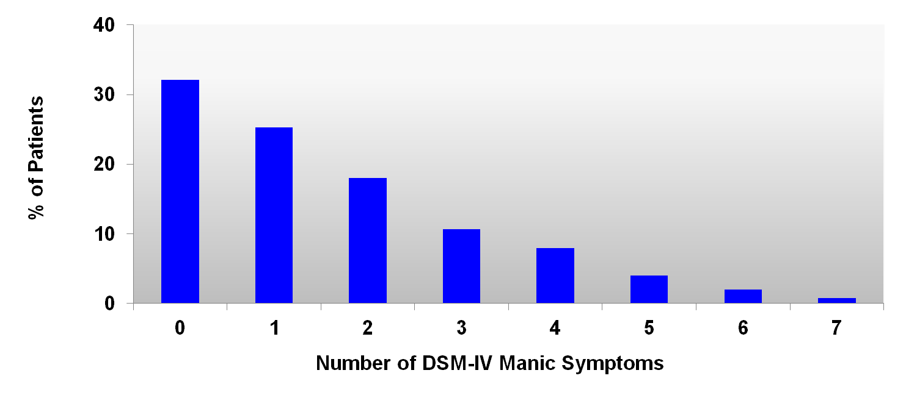
Manic Symptoms Common in Patients with Bipolar Depression
Number of DSM-IV Manic Symptoms During an Index Episode of Bipolar Depression in STEP-BD (N=1380)
Bipolar I (n=401)
Bipolar II (n=979)
No mania
(31%)
Subsyndromal mania
(54%)
Full mixed episode
(15%)
Goldberg JF, et al. Am J Psychiatry. 2009, 166(2): 173-181.
STEP-BD = Systematic Treatment Enhancement Program of Bipolar Disorder
Notes:
Key points
Of 1380 individuals, only 31.2% of the subjects had no manic symptoms during their
depressive episode
Concomitant manic symptoms were present at a subsyndromal level (1-3 associated manic symptoms) in 54% of the subjects
15% of the subjects had full mixed episodes (4-7 associated manic symptoms)
Mania symptoms frequently occur with bipolar depressive episodes, but may easily be overlooked if they appear less prominent than depressive features
Background
The primary objective of this study was to determine the frequency and the clinical correlation of manic symptoms during episodes of bipolar depression
2/3 of the subjects with bipolar depressed episodes had concomitant manic symptoms, most often racing thoughts, psychomotor agitation, and distractibility
Reference
Goldberg JF, Perlis RH, Bowden CL, et al. Manic symptoms during depressive episodes in 1,380 patients with bipolar disorder: findings from the STEP-BD. Am J Psychiatry. 2009;166(2):173-181.
Abstract:
Method: From among 4,107 enrollees in the National Institute of Mental Health’s Systematic Treatment Enhancement Program for Bipolar Disorder (STEP-BD), 1,380 individuals met criteria for bipolar I or II depressive syndromes at the time of enrollment and were assessed for concomitant manic symptoms. Illness characteristics
were compared in patients with pure bipolar depressed episodes and those with mixed depressive presentations.
Results: Two-thirds of the subjects with bipolar depressed episodes had concomitant manic symptoms, most often distractibility, flight of ideas or racing thoughts, and psychomotor agitation. Patients with any mixed features were significantly more likely than those with pure bipolar depressed episodes to have early age at illness onset, rapid cycling in the past year, bipolar I subtype, history of suicide attempts, and more days in the preceding year with irritability or mood elevation.

Slide 14
BPII: Phenotype and diagnosis
Problems of diagnosis – retrospective history of hypomania may be unreliable
But…
  Diagnostic stability high - switch rates into mania are low
  High inter-rater reliability has been reported
  Bipolar II tends to “breed true” despite genetic heterogenity
1. Vieta & Suppes, 2008

Slide 15
Bipolar Disorder &
Borderline Personality Disorder
Bipolar Disorder | Borderline Personality Disorder
Onset in teens or early 20s | No defined onset
Spontaneous mood changes | Mood changes precipitated by internal or external events
Euthymic, dysphoric, anxious and elated mood shifts | Euthymic, dysphoric, anxious and angry mood shifts but elated mood is rare
Episodic impulsivity and risk-taking | Chronic impulsivity and risk-taking
Episodic suicide attempts related to depressive episodes | Recurrent suicidal gestures associated with both depression and internal/external precipitants
Self-mutilation rare | Self-mutilation common
Endorse ‘depressed mood’ as descriptor | Endorse ‘emptiness’ as descriptor
Family history of bipolar I or II or recurrent depression | Family history negative for bipolar I, II and recurrent depression
Adapted from Yatham L, et al. Bipolar Disord 2005: 7 (Suppl. 3): 5–69.

Slide 16
Age of Onset of Bipolar Disorder
25
20
15
10
5
0
≤ 7
8-10
11-13
14-16
17-19
20-22
23-25
26-28
29-31
32-34
35-37
38-40
41-43
44-46
≥ 47
Age of Onset
Notes:
16
[Keywords] 629, Coryell, global, 03/09/2002, Monte Carlo, Monaco, bipolar, Zyprexa, Olanzapine, outcomes, findings, course, disorders, Kelli Carson, Lilly, Eric Hoefflin###

Slide 17
Misdiagnosis of Bipolar Disorder: NDMDA Survey (2000)¹
Patients were incorrectly
diagnosed with:
  Unipolar depression 60%
  Anxiety disorders 26%
  Schizophrenia 18%
  Borderline or antisocial PD 17%
  Alcohol abuse/dependence 14%
  Schizoaffective disorder 11%
69%
Misdiagnosed
35% were symptomatic for more than
10 years before correct diagnosis
10+ years
1. Hirschfeld RMA, et al. J Clin Psychiatry. 2003;64(2):161-174.
Notes:
17
slide 17
Key Point:
In this survey, bipolar patients had most often been diagnosed with unipolar depression. However, other disease states may also have overlapping symptomatology with bipolar disorder. My point would be that the “misdiagnosis” is mainly an artefact of current diagnostic systems…
Reference:
1. Hirschfeld RMA, et al. J Clin Psychiatry. 2003;64(2):161-174.

Slide 18
Timeline of Bipolar Disorder
Diagnosis of bipolar disorder (30.0)
Mood swings & symptoms of depression (18.0)
Full episode of depression (21.1)
Full episode of mania (24.3)
Symptoms of mania (21.3)
15
20
25
30
Any symptoms of mental illness (17.5)
Medical treatment (24)
Diagnosis – not bipolar
Diagnosis – bipolar
Age, (Median)
Adapted from Berk et al, JAD 103, 1–3, 181–186, 2007

Slide 19
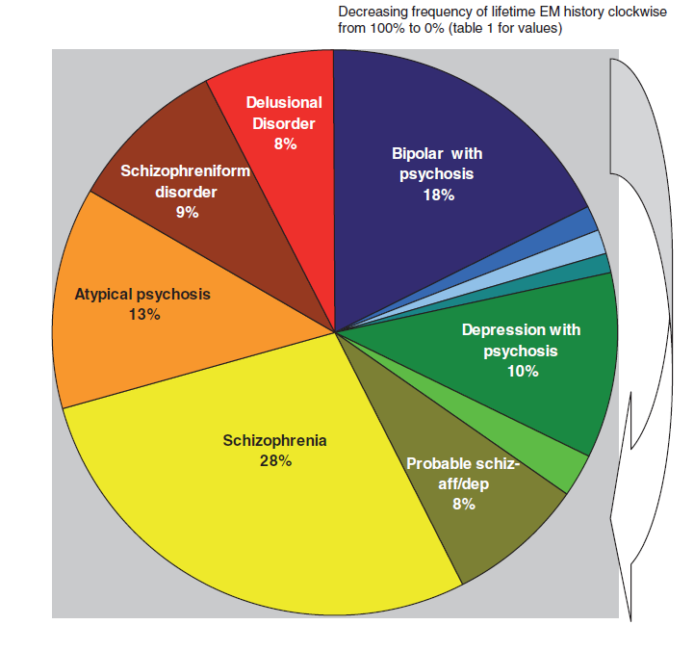
DSM III-R Diagnoses in FEP cohort
Macmillan et al, Early Intervention in Psychiatry 2007

Slide 20
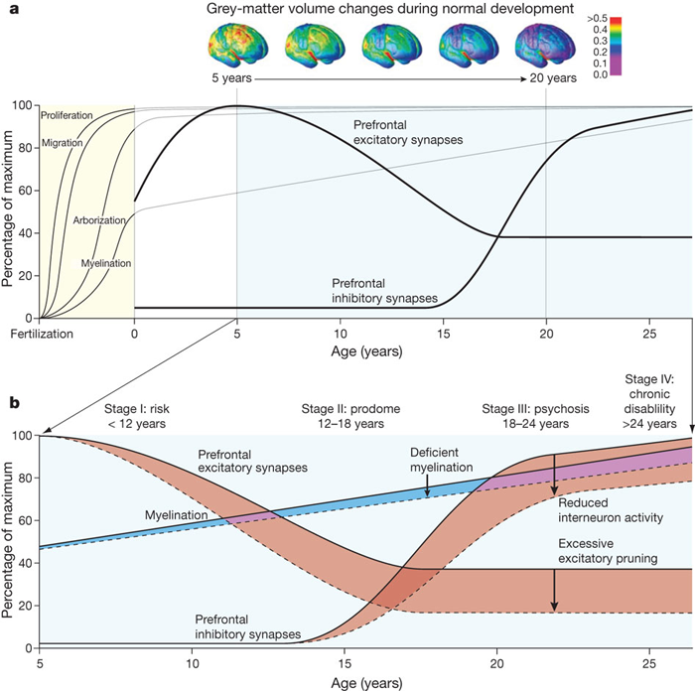
Neurodevelopmental-staging model of psychosis
(T.R. Insel, Nature 2010; 468;187-193)

Slide 21
Diagnostic stability of first-episode psychotic disorders after 2 Years
Bipolar I (manic) (32.6%)
Bipolar I (mixed) (18.3%)
Schizophrenia (9.3%)
Major depressive (14.5%)
Delusional disorder (6.6%)
Psychosis NOS (12.0%)
Brief psychosis (3.4%)
Schizophreniform (3.4%)
Initial diagnosis
0
10
20
30
40
50
60
70
80
90
100
(prevalence)
Stable diagnosis at 2 years (%)
Salvatore et al 2007
Notes:
21
21
Not sure where Initial Diagnosis is supposed to be – is it a heading or axis label? SG
21

Slide 22
Conversion from depression to bipolar disorder: 20-year follow-up
DE (UP) to BP (n=309)
Cumulative
proportion
surviving
1.0
Total (N=309)
1% annual switch
to BP1
  risks: male
  gender
  early onset
0.5% switch
to BP2
  Risks: female, +
  family history,
  later onset
0.9
Men (N=74)
Women (N=235)
0.8
0.7
0.6
0.5
0.4
0.3
0.2
0.1
0.0
0
10
20
30
40
50
Years since onset of first episode
Angst et al 2005

Slide 23
Predictors of transition to bipolarity
Item Sensitivity Specificity (%)
Antidepressant-induced 32 100
hypomanic switching
Family history of bipolar 56 98
Hypersomnia/retardation 59 88
Depression with psychosis 42 85
Postnatal onset 58 84
Younger onset (<26) 71 68
Strober and Carlson, 1982, Akiskal et al, 1983, Coryell et al, 1995

Slide 24
High rates of Bipolarity in young adults with recurrent depression
High rates of Pharmacological Hypomania
Duration criteria of hypomania limit diagnosis
N=87
Smith et al J Affect Disord In Press

Slide 25
What does Bipolar Disorder cost ?
Mood Disorders in Europe cost over 113 Billion Euro in 2010 (Gustavsson A et al, Eur Neuropsychopharmacol. 2011 Oct;21(10):718-79.)
Das Gupta and Guest (BJPsych 2002, 180: 227-233)
Estimated an annual social and economic cost of approximately £2 billion in the UK;
10% of this attributable to National Health Service (NHS) resource use, of which 35% was attributable to hospital admissions.
McCrone et al (www.kingsfund.org.uk/publications ) estimated that the total socio-economic cost for bipolar disorder and related conditions in 2007 to be £5.2 billion,
£1.6 billion of which was comprised of total service costs.
Total service costs included, not only health care services but also social care, criminal justice services, informal care from family members and costs associated with lost employment.
Notes:
From mark taylor slide deck
Bipolar disorder is so-called because it affects both poles (extremes) of the mood spectrum
The two types of mood disorder that are considered to be at opposite poles of the mood spectrum are:
Depression, in which there is persistent low mood
Mania, in which there is persistent elevated mood

Slide 26

UK annual cost of Bipolar Disorder is about £2 billion (1999/2000 prices)
Breakdown of annual costs in bipolar disorder (%)
1.4
0.6
Hospital admissions
2.6
GP prescribed drugs
14.5
Community MH care
Ambulance transport
34.9
Outpatient attendance
0.3
Ward attendance
Day hospital attendance
GP consultations
14.3
Special hospitals
GP-initiated tests
0.4
4.3
26.8
Adapted from Das Gupta & Guest (2002)
Notes:
26

Slide 27
The annual cost of managing Bipolar Disorder in the UK, 2009/2010
Only 7.4% of annual NHS costs associated with the management of bipolar disorder are for primary care prescribing
Total costs to the UK NHS: 342 million pounds
Hospitalisations (admissions & day attendances) account for 60% of NHS cost
*
*Hospitalisation data derived from
HES 2009 Hospitalisation figures.
Adapted from Young, A. et al.
Poster Presentation BAP 25-28th July 2010, Harrogate, UK
Young AH, et al, Journal of Affective Disorders2011 Oct;133(3):450-6.

Slide 28
Bipolar Disorder is Multidimensional
Mania
Subsyndromal mania (hypomania)
Mania
Euthymia
Recurrence prevention
Subsyndromal depression
(dysthymia)
Depression
Notes:
Bipolar disorder is characterised by recurrent episodes of mood disorder, including depression, mania, or mixed episodes in which both depression and mania co-occur

Slide 29
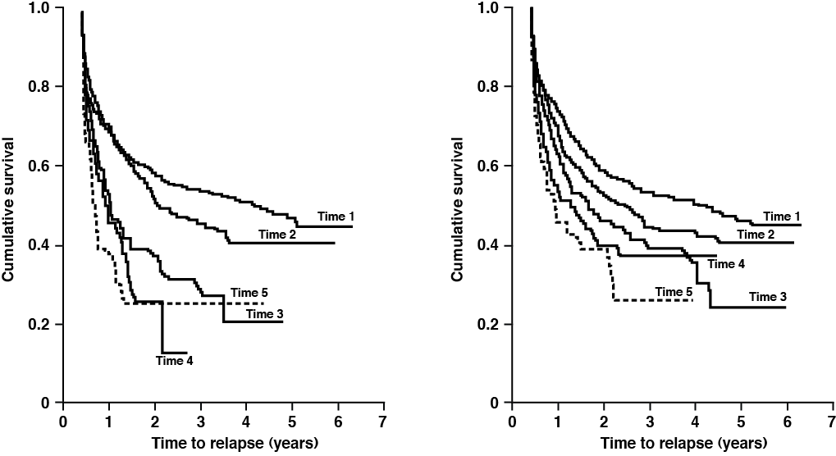
Bipolar Disorder:
Initial Progression of Recurrence
For women, the rate of relapse leading to hospitalisation increased with the number of previous episodes
Men
Women
Kessing LV, et al. Br J Psych. 2004;185:372–377.

Slide 30
Sub-Syndromal Symptoms in Maintenance Treatment for Bipolar Disorder
The presence of sub-syndromal symptoms was associated with relapse into an episode of the same polarity
Post-hoc analysis of two 18-month maintenance randomised controlled trials for bipolar I disorder assessed sub-syndromal symptoms in patients receiving lithium, lamotrigine or placebo
First-observed sub-syndromal symptoms | Subsequent mood episode
 | Depression | Mania/ hypomania/ mixed | No subsequent mood episode
Depressive, n (%) | 160 (63)* | 41 (16) | 54 (21)
Manic/mixed, n (%) | 24 (26) | 59 (65)* | 8 (9)
No emergent subsyndromal symptoms, n (%) | 5 (9) | 11 (19) | 41 (72)*
*p<0.001
Sub-syndromal depressive symptoms defined as Hamilton Depression Rating scale (HAM-D17) score ≥8; sub-syndromal manic/mixed defined as a YMRS score ≥8 with or without a HAM-D17 score ≥8.
Frye MA, et al. J Clin Psychiatry 2006;67:1721–1728.

Slide 31
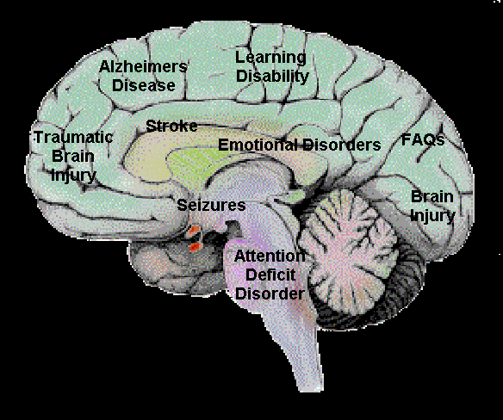

What can Neurocognition tell us?

Slide 32
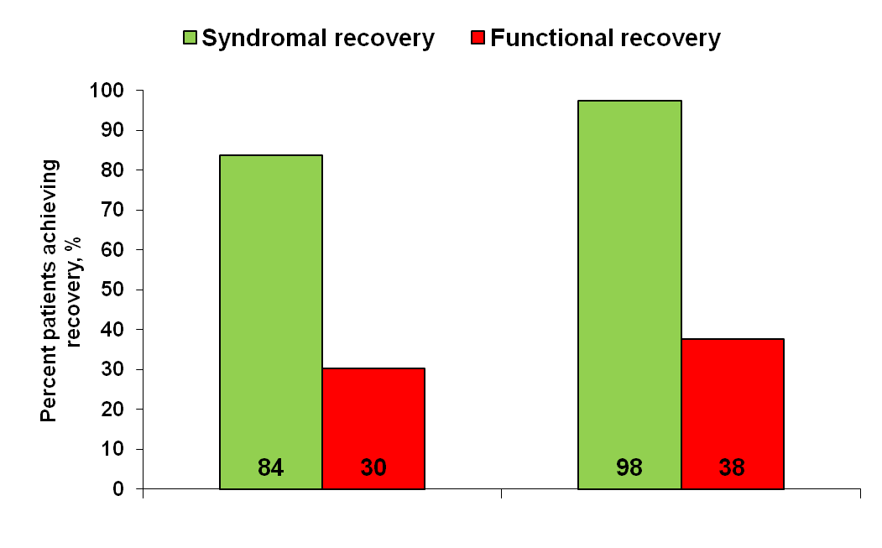
Functional Impairment in Bipolar Disorder
Syndromal recovery was attained soon after hospitalisation, but only one out of three patients achieved functional recovery 24 months later
6 months¹
2 years¹
Syndromal recovery: no longer meeting criteria for an ongoing Diagnostic and Statistical Manual of Mental Health Disorders – Fourth Edition (DSM-IV) illness episode, as described by Frank et al.²
Functional recovery: comparison of ratings on the Modified Vocational Status Index (vocational status) and Modified Location Code Index (living situation) at entry vs. 6- and 24-month follow-up, required return to at least baseline levels of both measures.
1. Tohen M, et al. Am J Psychiatry 2000;157:220–228; 2. Frank E, et al Arch Gen Psychiatry 1991;48:851–855.

Slide 33
Functional Outcomes in Bipolar Disorder
Syndromal outcomes²
Functional outcomes²
Multiple domains¹
  Interpersonal
  Occupational
  Cognitive
  QOL & HR-QOL
  Non-linear relationship
  Sub-syndromal symptoms may play an important role
HR-QOL = health-related quality of life
Unmet needs to assess²
  Types and impact of cognitive dysfunction
  Relationship between cognitive dysfunction and symptomatic as well as functional outcomes
  Pharmacologic and psychosocial interventions that minimise cognitive deficits
  Pharmacologic treatments with minimal adverse health effects
  Interventions for bipolar depression and relapse prevention of depression
1. Tohen M, et al. Am J Psychiatry 2000;157:220–228;
2. Keck, PE. J Clin Psychiatry. 2006;67:e17.

Slide 34
Cognitive Impairment Effect sizes
(Iverson and Young, 2011).
Bars represent effect sizes (Cohen’s d) for the five cognitive domain scores. Downward bars were used to illustrate lower performance in depressed patients (n = 100) compared to individually and precisely matched control participants (n = 100). By convention, Cohen’s effects sizes are interpreted as follows: -.2 = small, -.5 = medium, and -.8 = large.

Slide 35
Neurocognitive prediction of functional outcome
Green, M.F.; Kern, R.S.; Braff, D.L.; and Mintz, J. Neurocognitive Deficits and Functional Outcome in Schizophrenia:
Are We Measuring the “Right Stuff”? Schizophrenia Bulletin, 26(1): 119-136, 2000.
Neurocognition Outcome
Neurocognition Outcome
Card Sorting
Community/
Daily Activities
Secondary Verbal Memory
Social Problem Solving/
Instrumental Skills
IImmediate Verbal Memory
Psychosocial
Skill Acquisition
Vigilance
Verbal Fluency
Community/
Daily Activities
Psychomotor Ability and Reaction Time
Social Problem
Solving/
Instrumental Skills
Early Visual Processing
Psychosocial
Skill Acquisition
2-3 studies
4 or more studies

Slide 36
Neurocognition in 1st, 2nd, 3rd episode patients and controls
Lopez-Jaramillo et al Bipolar Disorders 2010: 12: 557–567

Slide 37
Response to adjunctive CBT
Patients guidelines suggest should receive therapy
Typical cases benefiting from therapy
Scott et al, BJP, 2006
Notes:
37

Slide 38
Ventricular and periventricular volumes in first- versus multiple-episode bipolar disorder
Strakowski Am J Psychiatry. 2002;159(11):1841-7.
Notes:
Day 2 session 1 - Jack's copy
22/01/2013 15:51
38

Slide 39
Comparison of biochemical markers between Bipolar patients in early and late state
Kauer StAnna 2008; Andreazza 2008

Slide 40
Neuroprotection
Li – protective against glutamate/NMDA, Ca, beta-amyloid amongst others
Increases gray matter volume
Valproate – protective against oxidative stress, haemorrhage, glu-excitotoxicity
Lamotrigine, Riluzole, memantine
Atypicals neuroprotective – Olz, Qtp, Rsp
Early intervention in bipolar disorder, part II, therapeutics, Salvadore et al, Early Intervention in Psychiatry, 2008;2:136-146

Slide 41
A staging model
Stage
Definition
Interventions
0
Increased risk of severe mood disorder (eg family history, abuse, substance use)
No specific symptoms currently
Mental Health Literacy
Self-Help
1a
Mild or non-specific symptoms of mood disorder
Mental Health Literacy
Family Psychoeducation
Substance abuse, CBT
1b
Prodromal features: Ultra High Risk
1a plus Therapy for episode: ? phase specific or MS
Accepted Risk
Rx Simplicity
Prognosis
Rx response
2
First Episode Threshold Mood Disorder
1b & case management, vocational rehabilitation
3a
Recurrence of sub-threshold mood symptoms
2 & emphasis on maintenance meds and psychosocial strategies
3b
First threshold relapse
2a & relapse prevention strategies
3c
Multiple relapses
3b & Combination mood stabilisers
4
Persistent unremitting illness
3c & clozapine and other tertiary therapies.
McGorry ANZ JP 2006; Berk et al. Bipolar Disord 2007; Berk et al. J Affective Disord 2007
Notes:
Day 2 session 1 - Jack's copy
22/01/2013 15:51
41

Slide 42
Treatment of early bipolar episodes
Key principles:
Treatment needs may differ by stage
Treatment more benign and effective in earlier stages (depends on pattern of disorder)
Difficult to recognise early bipolar – include all depressions?
No clear evidence-based guidelines – cf schizophrenia
Presence of psychotic symptoms important
Relapse prevention critical – optimal strategy?
Commitment to treatment/ duration of treatment important
Suicide prevention important

Slide 43
Increased Mortality From Medical Causes in Mental Illness
Increased risk of death from medical causes in schizophrenia and 20% (10-15 yrs) shorter lifespan¹
Bipolar and unipolar affective disorders also associated with higher SMRs from medical causes²
  1.9 males/2.1 females in bipolar disorder
  1.5 males/1.6 females in unipolar disorder
Cardiovascular mortality in schizophrenia increased from 1976-1995, with greatest increase in SMRs in men from 1991-1995³
SMR = standardized mortality ratio (observed/expected deaths).
1. Harris et al. Br J Psychiatry. 1998;173:11. Newman SC, Bland RC. Can J Psych. 1991;36:239-245.
2. Osby et al. Arch Gen Psychiatry. 2001;58:844-850.
3. Osby et al. BMJ. 2000;321:483-484.

Slide 44
National Database Analysis: prevalence of physical health conditions amongst patients with mental illness
Higher rates of ischaemic heart disease, stroke, high blood pressure and diabetes are seen among people with schizophrenia or bipolar disorder compared with the rest of the population
People with schizophrenia
People with bipolar disorder
People without schizophrenia or bipolar disorder
Percentage
The results of the national data analysis covering England and Wales
Hippisley-Cox J and Pringle M (2005) Health inequalities experienced by people with schizophrenia and manic depression: analysis of general practice data in England and Wales. Disability Rights Commission. Equal treatment: closing the gap, July 2006

Slide 45
Mortality in Bipolar Disorder
*
Standardised Mortality
Ratio
*
*
*
*
Cancer
Vascular
Diseases
Accident
or
Intoxication
Suicide
Other
Causes
Total
220 bipolar inpatients followed for 22 years or more.
*P < 0.001 vs treated patients.
Angst J et al. J Affect Disord. 2002;68(2-3):167-181.
Notes:
45
Besides preventing new mood episodes, long term treatment also improves other important aspects as shown in the Zurich cohort study: The excessive suicide mortality (30x elevated when compared to the general population can be lowered to approximately 6 x in patients receiving maintenance treatment ( which is still to much and a challenge, but better than 30x). Also the rate of deaths from cerebro- and cardiovascular illness and cancer decreases significantly with maintenance treatment. The reason is unknown, I may have to do with cell protective effects of mood stabilisers or simply with a more controlled and healthy life style

Slide 46
Diagnostic and Therapeutic Challenges in Bipolar Disorder
Bipolar disorder is one of the world’s most
disabling conditions¹
Psychiatric comorbidities¹
  Substance abuse
  Anxiety disorder
  Axis II disorders
  Cardiovascular disease
  Diabetes
  Communicable diseases
  Physical illness
Physical comorbidities²
Functioning³
  Rates of functional recovery are extremely low
Residual symptoms^{3,4}
  Presence of residual symptoms is a predictor of poor outcomes and poor quality of life
1. Merikangas KR, et al. Arch Gen Psychiatry 2011;68:241–251; 2. Prince M, et al. Lancet 2007;370:859–877;
3. Harvey, PD. J Clin Psychiatry 2006;67(Suppl. 9):14–18; 4. Weinstock LM, et al. Compr Psychiatry 2010;51497–51503.

Slide 47
Conclusions
Bipolar Disorders are common and costly illnesses
Accurate diagnosis of BD is frequently delayed
The outcome for patients is frequently poor
The annual cost of managing Bipolar Disorder is considerable
Hospitalisation costs may account for 60% of the overall direct costs
Cognitive Impairment is a likely determinant of outcome
Bipolar Disorders are highly comorbid and these patients are particularly challenging
Bipolar Disorder is under-recognised by psychiatrists in patients with Major Depressive Episodes
Therapeutic strategies should be based on accurate diagnosis
and then optimised management should improve the outcome of the illness

Slide 48
Neuropsychopharmacology of Bipolar Disorder
Part 2
Professor Allan Young
Imperial College London

Slide 49
Bipolar Disorder is Multidimensional
Mania
Subsyndromal
Mania
(hypomania/ hyperthymia)
Hypomania
Substance and or alcohol
abuse/dependence
Mixed
Maintenance
Subsyndromal
Depression
(May be more chronic than this schematic suggests)
Depression
Notes:
49

Slide 50
Bipolar Disorder: Phases of Treatment
Acute treatment: | Until clinical response: ideally symptomatic remission. May last six –twelve weeks.
Continuation phase: | On-going treatment ‘from the point of clinical response to the point at which spontaneous recovery might be expected in untreated patients’. Addresses ‘tail of vulnerability’ after remitted symptoms. Duration depends on natural course of illness. May involve management of post-mania depression.
Maintenance phase: | ‘Prevents or attenuates future mood episodes’. Maintenance differs from pure ‘prophylaxis’ as it may address symptomatic periods.
Ghaemi, 2004
Goodwin and Jamison, 2007
Notes:
Reference
Goodwin FK and Jamison KR (2007). Manic-Depressive Illness: Bipolar Disorder and Recurrent Depression. 2nd Edition. New York: Oxford University Press. Part V Treatment: Chapter 17: Fundamentals of Treatment. ‘Stages of Treatment’ pp702-703.
.

Slide 51
Treatment Challenges in Bipolar Disorder
Bipolar disorder is often unrecognised and undiagnosed
Comorbidities are common and can hinder diagnosis
The predominant phase is depression which can lead to misdiagnosis
Long-term protection against manic and depressive symptoms
The several subtypes: bipolar I and II, rapid cycling, mixed states
Evans, 2000; Hirschfeld et al, 2003; Hirschfeld et al, 2003b; Judd et al, 2002; Judd et al, 2003; Citrome & Goldberg, 2005; Kupka et al, 2007.
Notes:
References
Evans D (2000). Bipolar disorder: diagnostic challenges and treatment considerations. J Clin Psychiatry 61(Suppl13):26–31;
Hirschfeld RM, 2003. The efficacy of atypical antipsychotics in bipolar disorders. J Clin Psychiatry 64(Suppl8):15–21;
Hirschfeld RM, Calabrese JR, Weissman MM et al. 2003. Screening for bipolar disorder in the community. J Clin Psychiatry 64(1):53–59;
Judd LL, Akiskal HS, Schettler PJ et al, 2002.. The long-term natural history of the weekly symptomatic status of bipolar I disorder. Arch Gen Psychiatry 59(6):530–537;
Judd LL, Akiskal HS, Schettler PJ et al, 2003. The comparative clinical phenotype and long term longitudinal episode course of bipolar I and II: a clinical spectrum or distinct disorders? J Affect Disord 73(1-2):19–32.
Citrome L and Goldberg JF, 2005. The many faces of bipolar disorderL how to tell them apart. Postgrad Med 117(2):15–16,19–23.
Kupka RW, Altshuler LL, Nolen WA et al, 2007. Three times more days depressed than manic or hypomanic in both bipolar I and bipolar II disorder. Bipolar Disord 9(5):531–535.
51

Slide 52
Key Requirements for Individualised Treatment
Accurate characterisation of bipolar disorder
Identification and treatment of Physical/Psychiatric co-morbidities
Pharmacological Efficacy
Adverse
Effects
Improved Social Support
Minimise
non-concordance
Psychoeducation
Psychological Treatments
Meaningful remission: optimal functioning and quality of life

Slide 53
Psychoeducation During Maintenance Treatment
100
Treatment group
80
Control group
60
n=120
p<0.003
Patients (%)
40
20
0
6
12
18
24
Time to recurrence (months)
Colom et al,2003.
Notes:
References
Colom F, Vieta E, Martínez-Arán A et al, 2003. A Randomized Trial on the Efficacy of Group Psychoeducation in the Prophylaxis of Recurrences in Bipolar Patients Whose Disease Is in Remission. Arch Gen Psychiatry 2003;60:402-407.

Slide 54
Pharmacological Therapies for Acute Mood Disorders
A Time Line
1940
1950
1960
1970
1980
1990
2000
(Electro-
Convulsive
Therapy)
Lithium
Second
generation antidepressants
Next-generation
antipsychotics
Antidepressants
Quetiapine
Olanzapine
Clozapine
MAOIs
MARIs
SSRIs, SNRIs
NARIs
RIMAs
NASSA
Anticonvulsants
Carbamazepine
Valproate
Lamotrigine

Slide 55
Guidelines on the Treatment of Bipolar Disorder
Department of Veterans Affairs, Department of Defense (US) Management of Bipolar Disorder Working Group: VA/DoD clinical practice guidelines for management of bipolar disorder in adults. | 2010
World Federation of Societies of Biological Psychiatry Treatment guidelines on bipolar disorders. | 2004/2009/2010
British Association for Psychopharmacology Evidence-based guidelines for treating bipolar disorder: recommendations from the British Association for Psychopharmacology. | 2009
Canadian Network for Mood and Anxiety Treatments (CANMAT) Guidelines for the management of patients with bipolar disorder. | 2009
National Institute for Health and Clinical Excellence (NICE) Bipolar disorder: the management of bipolar disorder in adults, children and adolescents, in primary and secondary care. | 2006
Royal Australian and New Zealand College of Psychiatrists Australian and New Zealand Clinical Practice Guidelines | 2004
American Psychiatric Association Practice guidelines for the treatment of patients with bipolar disorder, second edition | 2002
Notes:
References
Canadian Network for Mood and Anxiety Treatments (CANMAT) and International Society for Bipolar Disorders (ISBD) collaborative update of CANMAT guidelines for the management of patients with bipolar disorder: update 2009. Bipolar Disord 11(3):225-55.
Department of Veterans Affairs, 2010. Management of Bipolar Disorder Working Group: VA/DoD clinical practice guidelines for management of bipolar disorder in adults. http://www.healthquality.va.gov/Management_of_Bi.asp
Grunze H, Kasper S, Goodwin G et al, 2004. World Federation of Societies of Biological Psychiatry (WFSBP) guidelines for the biological treatment of bipolar disorders, part III: Maintenance treatment. The World Journal of Biological Psychiatry 5: 120-135
Grunze H, Vieta E, Goodwin G et al, 2009. The World Federation of Societies of Biological Psychiatry (WFSBP) Guidelines for the Biological Treatment of Bipolar Disorders: Update 2009 on the Treatment of Acute Mania. The World Journal of Biological Psychiatry 10: 85-116
Goodwin GM; Consensus Group of the British Association for Psychopharmacology, 2009. Evidence-based guidelines for treating bipolar disorder: revised second edition--recommendations from the British Association for Psychopharmacology. J Psychopharmacol.23(4):346-88.
National Institute for Health and Clinical Excellence, 2006: http://guidance.nice.org.uk/CG38
American Psychiatric Association, 2002. http://psychiatryonline.org/content.aspx?bookid=28&sectionid=1669577
Royal Australian and New Zealand College of Psychiatrists Clinical Practice Guidelines Team for Bipolar Disorder, 2004. Australian and New Zealand clinical practice guidelines for the treatment of bipolar disorder. Aust N Z J Psychiatry. 38(5):280-305.
Yatham LN, Kennedy SH, Schaffer A et al, 2009. Canadian Network for Mood and Anxiety Treatments (CANMAT) and International Society for Bipolar Disorders (ISBD) collaborative update of CANMAT guidelines for the management of patients with bipolar disorder: update 2009. Bipolar Disord 11(3):225-55.

Slide 56
Advantages and Problems with Guidelines
They provide summaries of the existing evidence base for treatment.
They provide an expert consensus on treatments.
BUT
It is difficult to keep guidelines up to date.
They may not provide advice on off-label prescribing.
The evidence base is very limited for special groups e.g. young and elderly.
The evidence base is often very limited for difficult to treat patients.
The evidence base is limited for treatment of those with co-morbidities.

Slide 57
General principles and Guidelines for Treatment
Key Points
Bipolar Disorder is a multidimensional, chronic illness.
Treatment programmes should be considered for each phase:
the acute episode/acute recovery
continuation
maintenance
Full and accurate diagnosis of bipolar disorder and its comorbidities is essential.
Other treatment modalities e.g.psychoeducation, act synergistically with medication.
Treatment guidelines are available but have certain limitations.

Slide 58
DSM-IV Criteria for a Manic Episode
A distinct period of abnormally and persistently elevated, expansive or irritable
mood, lasting at least 1 week (or any duration if hospitalisation is needed)
Three* or more symptoms are present to a significant degree and persist:
Increased self-esteem or grandiosity
Decreased need for sleep
More talkative than usual/pressure to keep talking
Flight of ideas/subjective experience of racing thoughts
Distractibility
Increased goal-directed activity
Excessive involvement in pleasurable activities with high potential for painful results
*or four, if only irritability is present
American Psychiatric Association 1994
Notes:
Reference
American Psychiatric Association. Diagnostic and Statistical Manual of Mental Disorders, 4th edition (DSM-IV). Washington DC: American Psychiatric Association, 1994.

Slide 59
Mixed Mania and Mixed Depression
Mania
Mixed
States
Depression
↓
Hopelessness
Impulsivity
Suicide Risk
Meets both DSM-IV criteria for mania and depression
(American Psychiatric Association, 1994)
N.B. Manic patients often experience ‘sub-syndromal’ depressive symptoms and vice versa
(Swann et al, 2009)
Notes:
Reference
American Psychiatric Association. Diagnostic and Statistical Manual of Mental Disorders, 4th edition (DSM-IV). Washington DC: American Psychiatric Association, 1994.
Swann AC, Steinberg JL, Lijffijt, M et al, 2009. Continuum of depressive and manic mixed states in patients with bipolar disorder: quantitative measurement and clinical features. World Psychiatry 8 166–172.

Slide 60
The Characterisation of Mania
Is the manic episode in the context of bipolar disorder?
Is it secondary to organic illness?
Is it a mixed episode?
What is the pattern of the broader bipolar illness?
Is there co-morbid alcohol and/or substance misuse or anxiety disorder?
Is there physical comorbidity or pregnancy?
What are the associated risks?

Slide 61
Constructing an Initial Treatment Plan
Not already on medication | Initiate oral (atypical) antipsychotic or valproate If mania less severe, lithium or carbamazepine Consider an oral benzodiazepine Tapered discontinuation of antidepressants
Inadequate control with good treatment adherence | Increase anti-manic agent to highest well-tolerated dose Add an agent from a different class
Poor adherence | Perceived or actual side effects? –minimise these. Other reasons? Address, if possible.
Need for parenteral treatment | Follow established local protocols Lowest doses necessary for shortest time necessary Do not escalate antipsychotic dose for sedation only
BAP Guidelines, 2009
Notes:
Reference
Goodwin GM and the Consensus Group of the British Association for Psychopharmacology. Evidence-based guidelines for treating bipolar disorder: revised second edition--recommendations from the British Association for Psychopharmacology. J Psychopharmacol 23(4):346-88.

Slide 62
Randomised Placebo-Controlled Trials in Mania
Response Rates
Brecher & Huizar, 2003
Haloperidol
Smulevich et al., 2005
Pooled effect
Tohen et al., 1999
Olanzapine
Tohen et al., 2000
Pooled effect
Brecher & Huizar, 2003
Response =
≥50% improvement in Young Mania Rating Scale score
Quetiapine
Paulsson & Huizar, 2003
Pooled effect
Vieta et al., 2002
Risperidone
Smulevich et al,. 2005
Hirschfeld et al., 2004
Pooled effect
Keck et al., 2003
Aripiprazole
Sachs et al., 2006
Pooled effect
Bowden et al., 1994
Lithium
Paulsson & Huizar, 2003
Pooled effect
Pope et al., 1991
Valproate
semisodium
Bowden et al., 1994
Pooled effect
Weisler et al., 2004
Carbamazepine
Weisler et al., 2005
Pooled effect
0.1
1
10
100
Favours placebo Relative risk Favours drug
Smith et al, 2007
Notes:
Reference
Smith LA, Cornelius V, Warnock A et al, . 2007. Pharmacological interventions for acute bipolar mania: a systematic review of randomized placebo-controlled trials. Bipolar Disord 9:551–560.

Slide 63
Atypical antipsychotics Approved in Bipolar Mania
Studies demonstrating efficacy in comparison with placebo
QTP = quetiapine; OLZ = olanzapine; RIS = risperidone; AR = Aripiprazole; ZIP = ziprasidone; ASN = Asenapine
Placebo = grey shadow.
Response rate (%)
QTP¹
QTP²
OLZ³
OLZ⁴
RIS⁵
RIS⁶
ARI⁷
ARI⁸
ZIP⁹
ZIP¹⁰
ASN⁴
1 Bowden et al, 2005; 2 McIntyre et al, 2005; 3 Tohen et al, 1999; 4 McIntyre et al, 2009;
5 Khanna et al, 2005; 6 Hirschfeld et al, 2004; 7 Keck et al, 2003. 8 Sachs et al, 2006;
9 Keck et al, 2003; 10 Potkin et al, 2005; 11 Yildiz, et al, 2011.
Notes:
References
Bowden CL, Grunze H, Mullen J et al, 2005. A randomized, double-blind, placebo-controlled efficacy and safety study of quetiapine or lithium as monotherapy for mania in bipolar disorder. J Clin Psychiatry 66:111−121.
McIntyre RS, Brecher M, Paulsson B et al, 2005. Quetiapine or haloperidol as monotherapy for bipolar mania--a 12-week, double-blind, randomised, parallel-group, placebo-controlled trial. Eur Neuropsychopharmacol 2005;15:573–585.
Tohen M, Sanger TM, McElroy S et al, 1999. Olanzapine versus placebo in the treatment of acute mania. Olanzapine HGEH Study Group. Am J Psychiatry 1999;156:702–709.
McIntyre RS, Cohen M, Zhao J et al, 2009. A 3-week, randomized, placebo-controlled trial of asenapine in the treatment of acute mania in bipolar mania and mixed states. Bipolar Disord 11:673–686.
Khanna S, Vieta E, Lyons B et al, 2005. Risperidone in the treatment of acute mania: double-blind, placebo-controlled study. . Br J Psychiatry 2005;187:229–234.
Hirschfeld RM, Keck PE Jr, Kramer M et al, 2004. Rapid antimanic effect of risperidone monotherapy: a 3-week multicenter, double-blind, placebo-controlled trial. Am J Psychiatry 161:1057–1065.
Keck PE, Marcus R, Tourkodimitris S et al, 2003. A placebo-controlled, double-blind study of the efficacy and safety of aripiprazole in patients with acute bipolar mania.
Am J Psychiatry 160:1651–1658.
Sachs G, et al, 2006. Aripiprazole in the treatment of acute manic or mixed episodes in patients with bipolar I disorder: a 3-week placebo-controlled study. J Psychopharmacol 2006;20:536–546.
Keck PE Jr, Versiani M, Potkin S et al, 2003. Ziprasidone in the treatment of acute bipolar mania: a three-week, placebo-controlled, double-blind, randomized trial. Am J Psychiatry 2003;160:741–748.
Potkin SG, Keck PE Jr, Segal S et al, 2005. Ziprasidone in acute bipolar mania: a 21-day randomized, double-blind, placebo-controlled replication trial. J Clin Psychopharmacol 25:301–310;.
Yildiz A, Vieta E, Leucht S et al, 2011. Efficacy of antimanic treatments: meta-analysis of randomized, controlled trials. Neuropsychopharmacology 36:375–389.

Slide 64
WFSBP Guidelines on the Treatment of Mania
Evidence Base and Recommendations
Treatment | Evidence Base | Recommendation
Aripiprazole | A | 1
Risperidone | A | 1
Valproate | A | 1
Asenapine | A | 2
Carbamazepine | A | 2
Haloperidol | A | 2
Lithium | A | 2
Olanzapine | A | 2
Quetiapine | A | 2
Ziprasidone | A | 2
ECT | C1 | 4*
*Reserved for treatment resistance and special circumstances, e.g. pregnancy
Grunze et al, 2009
Notes:
Reference
Grunze H, Vieta E, Goodwin GM et al, 2009. The World Federation of Societies of Biological Psychiatry (WFSBP) guidelines for the biological treatment of bipolar disorders: update 2009 on the treatment of acute mania. World J Biol Psychiatry 10(2):85-116.

Slide 65
Combination therapy: the Advantages and Disadvantages
FOR
AGAINST
  Application of different mechanisms of action and receptor-binding profiles
Drug interactions
Sub-optimal dosing of both agents
More complex treatment regimens
Decreased adherence
Increased side effects
Cost
Bowden 2004; Goodwin & Vieta 2005; Suppes et al 2005
Notes:
Reference
Bowden CL, 2004. Making optimal use of combination pharmacotherapy in bipolar disorder.J Clin Psychiatry 65 Suppl 15 21-24.
Goodwin GM and Vieta E, 2005. Effective maintenance treatment--breaking the cycle of bipolar disorder. Eur Psychiatry 20 (5-6): 365-71.
Suppes et al, 2005. Challenges in the management of bipolar depression. J Clin Psychiatry 66 Suppl 5 11-16.

Slide 66
Addition of Antipsychotic to Lithium/Valproate
Risperidone + Li/Val
Olanzapine + Li/Val
Quetiapine + Li/Val
Aripiprazole + Li/Val
Placebo + Li/Val
100
90
80
p=0.002
p<0.05
p<0.001
p=0.005
p<0.01
70
68%
63%
60
53%
59%
54%
Response rate at endpoint (%)
45%
50
41%
49%
40
30%
33%
30
20
10
0
Sachs et al, 2002
Yatham et al,
2003.
Tohen et al,
2002
Sachs et al,
2004.
Vieta et al,
2008.
For all studies except one, response = ≥50% reduction YMRS total score,
Sachs et al. 2002, response = ‘much improved/very much improved’ on CGI-I
1=Sachs et al, 2002; 2=Yatham et al, 2003; 3=Tohen et al, 2002; 4=Sachs et al, 2004; 5=Vieta et al, 2008
Notes:
66
66
References
Sachs GS, Grossman F, Ghaemi SN et al, 2002. Combination of a mood stabilizer with risperidone or haloperidol for treatment of acute mania: a double-blind, placebo-controlled comparison of efficacy and safety. Am J Psychiatry 159:1146–1154.
Yatham LN, Grossman F, Augustyns I et al, 2003. Mood stabilisers plus risperidone or placebo in the treatment of acute mania. International, double-blind, randomised controlled trial. Br J Psychiatry 182:141–147.
Tohen M, Chengappa KN, Suppes T et al, 2002. Efficacy of olanzapine in combination with valproate or lithium in the treatment of mania in patients partially nonresponsive to valproate or lithium monotherapy. Arch Gen Psychiatry 59:62–69.
Sachs G, Chengappa KN, Suppes T et al, 2004. Quetiapine with lithium or divalproex for the treatment of bipolar mania: a randomized, double-blind, placebo-controlled study. Bipolar Disord 6:213–223.
Vieta E, T'joen C, McQuade RD et al, 2008. Efficacy of adjunctive aripiprazole to either valproate or lithium in bipolar mania patients partially nonresponsive to valproate/lithium monotherapy: a placebo-controlled study. Am J Psychiatry 165:1316–1325.

Slide 67
Treatment-resistant Mania
‘In most studies, failure to respond to a specified number of prior treatments (typically two or three) is used as the threshold for treatment resistance.’
But the designation requires are other considerations/conditions:
Absence of antidepressants
Adequate dose and duration of treatments
Adequate compliance
Should we consider failure to respond to one or more combination treatments as a more useful criterion?
Gitlin, 2006
Notes:
Reference
Gitlin M, 2006. Treatment-resistant bipolar disorder.
Mol Psychiatry 11, 227–240.

Slide 68
Electroconvulsive Therapy in Mania
British Association for Psychopharmacology Guidelines
‘Electro-convulsive therapy may be considered for manic patients who are severely ill and/or whose mania is treatment
resistant, those patients who express a preference for ECT
and patients with severe mania during pregnancy’
BUT NO RANDOMISED PLACEBO CONTROLLED DATA
(BAP, 2009).
Notes:
Reference
Goodwin GM and the Consensus Group of the British Association for Psychopharmacology. Evidence-based guidelines for treating bipolar disorder: revised second edition--recommendations from the British Association for Psychopharmacology. J Psychopharmacol 23(4):346-88.

Slide 69
Electroconvulsive therapy in Mania
Literature Review
Associated with remission/marked improvement in 80% of manic patients.
An effective treatment in those poorly responsive to pharmacotherapy.
High frequency or prolonged courses of ECT are not required.
The seizure threshold seems lower in manic than in depressed patients.
Unknowns:
Relapse following response to ECT.
Cognitive consequences of ECT.
Relative merits of unilateral versus bilateral ECT.
Mukherjee et al, 1994
Notes:
Reference
Mukherjee S, Sackeim HA, Schnur DB. Electroconvulsive
therapy of acute manic episodes: a review of 50 years’ experience.
Am J Psychiatry 1994; 151: 169–176.

Slide 70
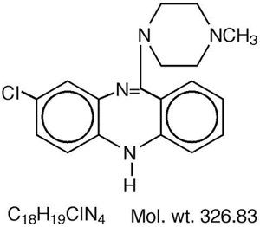
Clozapine for treatment-resistant mania
No large double blind RCTS in mania.
Uncontrolled data suggest antimanic efficacy.
Treatment-resistant patients with bipolar disorder may be more responsive to clozapine than treatment resistant patients with schizophrenia.
(Ciapparelli et al, 2003)
Doses for optimal effect in bipolar disorder may be less than for treatment-resistant schizophrenia.
(Fehr et al, 2005).
Notes:
References
Ciapparelli A, Dell’Osso L, Bandettini di Poggio A et al, 2003. Clozapine in treatment-resistant patients with schizophrenia, schizoaffective disorder, or psychotic bipolar disorder: a naturalistic 48-month follow-up study. J Clin Psychiatry 64: 451–458.
Fehr BS, Ozcan ME, Suppes T et al, 2005. Low doses of clozapine may
stabilize treatment-resistant bipolar patients. Eur Arch Psychiatry
Clin Neurosci 255: 10–14.

Slide 71
The Pharmacological Management of Mania
Key Points
Successful treatment first requires accurate characterisation of the episode
of mania and the broader bipolar illness.
2. Guidelines recommend agents based on their efficacy and acceptability.
3. Guidelines recommend atypical antipsychotics or valproate first-line.
4. Lithium/valproate combined with an antipsychotic improves efficacy.
5. ECT and clozapine may be used in cases of treatment resistance.

Slide 72
Depression is Burdensome in Bipolar Disorder
9%
6%
1%
2%
32%
53%
50%
46%
Bipolar I Disorder
Bipolar II Disorder
n=146
n=86
Depressive
Symptoms
Manic/ hypomanic
Symptoms
Time cycling or mixed
Time
asymptomatic
Judd et al 2002; Judd et al, 2003
Notes:
References
Judd LL et al, 2002. The long-term natural history of the weekly symptomatic status of bipolar I disorder. Arch Gen Psychiatry 59: 530-537.
Judd LL et al, 2003. A prospective investigation of the natural history of the long-term weekly symptomatic status of bipolar II disorder. Arch Gen Psychiatry 60: 261-269.

Slide 73
Bipolar Depression
Comparison with unipolar depressive episodes
Younger age of onset
Higher recurrence rates than MDD
Shorter episode and cycle length
More inter-episode mood shifts
Mixed states, atypical features, psychosis and psychomotor retardation
Sex ratio equal
More frequent substance abuse, co-morbid anxiety and obsessive-compulsive symptoms
More mania in first degree relatives
Higher monozygotic twin concordance
Adapted from Goodwin and Jamison, 2007 and Baldessarini et al, 2010
Notes:
Reference
From Table 1-1. Overview of reported differences between bipolar and unipolar depression. Page 10-11. Part 1: Chapter 1: Conceptualizing Manic-Depressive Illness: The Bipolar-Unipolar Distinction and the Development of the Manic-Depressive Spectrum. Goodwin FK and Jamison KR (2007). Manic Depressive Illness. Bipolar Disorders and Recurrent Depression. 2nd Edition. New York: Oxford University Press.
Baldessarini RJ, Vieta E, Calabrese JR et al, 2010. Bipolar Depression: Overview and Commentary. Harvard Rev Psychiatry 8:143–157.

Slide 74
Treating Bipolar Depression as Major Depression
Potential Consequences of antidepressant monotherapy
Little evidence to support the use of antidepressant monotherapy
Antidepressant monotherapy may be ineffective (e.g. McElroy et al, 2010)
No antidepressant monotherapy explicitly approved by the U.S. F.D.A..
Manic switching in Bipolar Disorder
An antidepressant-specific switch risk: estimates vary between 6%-25%.
(Recent evidence for protective effect of concomitant mood stabiliser is equivocal.)
(Bottlender et al, 2001, Tondo et al, 2010; Baldessarini et al, 2010)
Cycle acceleration in Bipolar Disorder
More research required.
(Licht et al, 2008)
Notes:
References
Baldessarini RJ, Vieta E, Calabrese JR et al, 2010. Bipolar Depression: Overview and Commentary. Harvard Rev Psychiatry 8:143–157.
Bottlender R, Rudolf D, Strauss A, Moller HJ (2001). Mood-stabilisers reduce the risk of developing antidepressant-induced maniform states in acute treatment of bipolar I depressed patients. Journal of
Affective Disorders 63, 79–83.
Licht RW, Gijsman H, Nolen WA et al, 2008. Are antidepressants safe in the treatment of bipolar depression? A critical evaluation of their potential risk to induce switch into mania or cycle acceleration. Acta Psychiatr Scand 118 (5) 337-346.
McElroy SL, Weisler RH, Chang W et al, 2010. A double-blind, placebo-controlled study of quetiapine and paroxetine as monotherapy in adults with bipolar depression (EMBOLDEN II). J Clin Psychiatry 71(2):163-74.
Tondo L, V´azquez G, Baldessarini RJ, 2010. Mania associated with
antidepressant-treatment: comprehensive meta-analytic review.
Acta Psychiatr Scand 121(6):404-14.

Slide 75
Antidepressants for Bipolar Depression: Remission
An Updated meta-analysis
Study
Antidepressant
n/N
Placebo
n/N
Fixed relative risk
(95% CI)
Fixed relative risk
(95% CI)
Nemeroff et al 2001
Imipramine and paroxetine
29/69
15/43
1.20 (0.74, 1.97)
Shelton & Stahl 2004
Risperidone and paroxetine
5/20
1/10
2.50 (0.34, 18.63)
Tohen et al 2003
Olanzapine and OFC
40/82
115/351
1.49 (1.14, 1.95)
Sachs et al 2007
Adjunctive antidepressants
32/163
40/169
0.83 (0.55, 1.25)
Total Number
334
573
1.20 (0.98, 1.47)
0.1
0.2
0.5
1
2
5
10
Favours
placebo
Favours
antidepressant
Sidor & MacQueen 2011
Notes:
Reference
Sidor MM and MacQueen GM, 2011. Antidepressants for the acute treatment of bipolar depression: a systematic review and meta-analysis. J Clin Psychiatry 72 (2) 156-167

Slide 76
Adjunctive Sertraline/Bupropion/Venlafaxine
Comparison of response and switch rates
Ten week treatment course:
Sertraline: 50-200 mg cv placebo
Bupropion: 75-450 mg cv placebo
Venlafaxine: 37.5-375 mg cv placebo
In addition to a mood stabilizer:
Lithium
Carbamazepine
Valproate
Response criterion: a fall to <50% of initial
Inventory of Depression Symptomatology
(Hypo)mania was defined as a
Young mania Rating Scale Score of >13; Clinical Global Impression-BP Mania>2.
*
n=62
n=55
n=67
Post et al, 2006
Notes:
76
Reference
Post RM, Altshuler LL, Leverich GS et al, 2006. Mood switch in bipolar depression: comparison of adjunctive venlafaxine, bupropion and sertraline. Br J Psychiatry 189 124-131

Slide 77
The STEP-BD Study
The Systematic Treatment Enhancement Programme for Bipolar Disorder
Multi-site clinical research programme conducted across the USA
Sponsored by the National Institute of Mental Health
Bipolar I and II Disorder, Bipolar Disorder NOS, cyclothymia and schizoaffective disorder (bipolar type), entering in any mood state.
Of first 2000 participants, 522 (35%) met criteria for major depression.
Aimed to study:
Course and outcome of bipolar disorder in adults
Phenomenology
Treatment effectiveness

Slide 78
STEP-BD: Lessons for Bipolar Depression
1. (Certain) antidepressants added to mood stabilisers are no more effective than placebo in the treatment of bipolar depression.
2. (Certain) antidepressants do not induce mania more frequently than placebo in mood stabiliser-treated patients with no such history.
3. When considering adjuvant antidepressant treatment, subsyndromal manic symptoms may indicate increased risk of relapse and an exacerbation of manic symptoms.
4. In treatment resistant bipolar depression, lamotrigine outcomes are sufficiently promising to warrant further investigation.
Adapted from Peters and Nierenberg, 2011
Notes:
Reference
Peters AT and Nierenberg AA, 2011. Stepping back to step forward: lessons from the systematic treatment enhancement program for bipolar disorder (STEP-BD). J Clin Psychiatry 72 (10) 1429-1431.

Slide 79
Adjunctive Antidepressants in Bipolar I/II Depression
STEP-BD 26-week RCT of paroxetine/bupropion or placebo with mood stabiliser.
Patients (%)
Sachs et al, 2007
Sachs et al 2007
Notes:
79
Reference
Sachs GS, Nierenberg AA, Calabrese et al, 2007 . Effectiveness of adjunctive antidepressant treatment for bipolar depression. N Eng J Med. 356(17):1711-22.

Slide 80
STEP-BD: Lessons that Inform Clinical Practice
1. (Certain) antidepressants added to mood stabilisers are no more effective than placebo in the treatment of bipolar depression.
2. (Certain) antidepressants do not induce mania more frequently than placebo in mood stabiliser-treated patients with no such history.
3. When considering adjuvant antidepressant treatment, subsyndromal manic symptoms may indicate increased risk of relapse and an exacerbation of manic symptoms.
4. In treatment resistant bipolar depression, lamotrigine outcomes were sufficiently promising to warrant further investigation.
Adapted from Peters et al, 2011
Notes:
Reference
Peters AT and Nierenberg AA, 2011. Stepping back to step forward: lessons from the systematic treatment enhancement program for bipolar disorder (STEP-BD). J Clin Psychiatry 72 (10) 1429-1431.

Slide 81
Subsyndromal Manic Symptoms in Bipolar Depression
A ‘Depressive Mixed State’
142 bipolar (type I or II) patients with an major depressive episode.
Presence or absence of concurrent subsyndromal manic symptoms.
Subsyndromal manic symptoms highly prevalent (76.1%)
Associated with significantly:
increased severity of depression/dysphoria
longer episode duration
more suicidal ideation and behaviour
Overt irritability and psychomotor agitation were the most prevalent.
(Judd et al, 2012).
Exacerbated by antidepressant treatment? (Goldberg et al, 2007).
Notes:
Reference
Judd LL, Schettler PJ, Akiskal H et al, 2012. Prevalence and clinical significance of subsyndromal manic symptoms, including irritability and psychomotor agitation, during bipolar major depressive episodes.
J Affect Disord 138(3):440-448.
Goldberg JF, Perlis RH, Ghaemi SN et al, 2007. Adjunctive Antidepressant Use and Symptomatic Recovery Among Bipolar Depressed Patients With Concomitant Manic Symptoms: Findings From the STEP-BD. Am J Psychiatry 164:1348–1355

Slide 82
Initial Pharmacological Treatment of Bipolar Depression
British Association for Psychopharmacology Guidelines
Severe Depression, psychosis, high suicide risk* pregnancy* inanition* Moderate Depression Mild Depression and/or Previous Mood Instability | Consider ECT* Quetiapine Quetiapine or Lamotrigine SSRI/other antidepressant. Not TCA. Not monotherapy. Consider lithium or possibly valproate. Quetiapine or Lamotrigine | Antipsychotic if psychotic symptoms present. For all levels of severity, if Bipolar I Disorder, add an antimanic agent e.g. lithium, valproate antipsychotic. | On maintenance treatment: before initiating these changes, first: optimise treatment with reference to therapeutic ranges. ensure existing treatment protects against mania.
Goodwin et al, 2009
Notes:
Reference
Goodwin GM and the Consensus Group of the British Association for Psychopharmacology. Evidence-based guidelines for treating bipolar disorder: revised second edition-recommendations from the British Association for Psychopharmacology. Journal of Psychopharmacology 23 (4) 346-388

Slide 83
Summary Slide from WFSBP: Monotherapies
Medication | Category of evidence | Recommendation Grade | Dose Range (daily)
Quetiapine | A | 1 | 300-600mg
Fluoxetine | B | 3 | 20-50mg
Lamotrigine | B | 3 | 50-200mg
Olanzapine | B | 3 | 5-20mg
Valproate | B | 3 | Serum level 70-90mg/l
A = Full evidence from controlled studies
B = Limited positive evidence from controlled studies
1 = Category A evidence and good risk-benefit ratio
3 = Category B evidence
Grunze et al, 2010
Notes:
Reference
Grunze H, Vieta E, Goodwin GM et al, 2010. The World Federation of Societies of Biological Psychiatry (WFSBP) Guidelines for the biological treatment of bipolar disorders; update 2010 on the treatment of acute bipolar depression. The World Journal of Biological Psychiatry 11: 81-109.

Slide 84
EMBOLDEN I & II Acute Phase:
Study Flow
EMBOLDEN I
EMBOLDEN II
Quetiapine
300 mg/day
(n=265)
Quetiapine
300 mg/day
(n=245)
Quetiapine
600 mg/day
(n=268)
Quetiapine
600 mg/day
(n=247)
Washout
(5–28 days)
Lithium
(n=136)
Washout
(5–28 days)
Paroxetine
20 mg/day
(n=126)
Placebo
(n=133)
Placebo
(n=122)
Enrolment
Randomisation
Acute phase
(8 weeks)
Enrolment
Randomisation
Acute phase
(8 weeks)
Young A et al 2010; McElroy S et al 2010
Notes:
84
84
References
Young AH, McElroy SL, Bauer M et al, 2010. A double-blind, placebo-controlled study of quetiapine and lithium monotherapy in adults in the acute phase of bipolar depression (EMBOLDEN I). J Clin Psychiatry 71 (2): 150-162.
McElroy SL, Weisler RH, Chang W et al, 2010. A double-blind, placebo-controlled study of quetiapine and paroxetine as monotherapy in adults with bipolar depression (EMBOLDEN II). J Clin Psychiatry 71(2):163-74.

Slide 85
EMBOLDEN I & II Acute Phase:
Change in MADRS Total Score
EMBOLDEN I
EMBOLDEN II
Study week
Study week
LSM change from baseline
1
2
3
4
5
6
7
8
1
2
3
4
5
6
7
8
*
***
*
**
*
**
**
***
**
***
Improvement
*
**
**
***
***
***
***
***
*p<0.05; **p<0.01; ***p<0.001 vs placebo; Intention to treat; last observation carried forward.
Young A et al 2010; McElroy S et al 2010
Notes:
85
85
References
Young AH, McElroy SL, Bauer M et al, 2010. A double-blind, placebo-controlled study of quetiapine and lithium monotherapy in adults in the acute phase of bipolar depression (EMBOLDEN I). J Clin Psychiatry 71 (2): 150-162.
McElroy SL, Weisler RH, Chang W et al, 2010. A double-blind, placebo-controlled study of quetiapine and paroxetine as monotherapy in adults with bipolar depression (EMBOLDEN II). J Clin Psychiatry 71(2):163-74.

Slide 86
Lamotrigine in the treatment of bipolar depression
MADRS response* rates in six lamotrigine multicentre studies
Study | Patient population | Response rate (%)
 |  | Lamotrigine | Placebo | p value (vs placebo)
Calabrese et al 1999 | Bipolar I (n=195) | 54 | 29 | <0.05
SCAA2010 | Bipolar I and II | 50 | 49 | 0.89
SCA40910 | Bipolar I | 46 | 39 | 0.36
SCA30924 | Bipolar I | 46 | 40 | 0.42
SCA100223 | Bipolar II | 54 | 46 | 0.21
LamLit Study** | Bipolar I (n=84) and II (n=40) | 52 | 32 | 0.03
*Response=50% improvement over baseline in MADRS total score
Pooled relative risk of response for monotherapy trials: 1.22 (CI: 1.06-1.41) (Geddes et al, 2009)
**Lamotrigine adjunctive to lithium therapy (van der Loos et al, 2009)
Notes:
86
References
Geddes JR, Calabrese JR and Goodwin GM 2009. Lamotrigine for treatment of bipolar depression: independent meta-analysis and meta-regression of individual patient data from five randomised trials. Br J Psychiatry. 194(1):4-9.
van der Loos ML, Mulder PG, Hartong EG, 2009. Efficacy and safety of lamotrigine as add-on treatment to lithium in bipolar depression: a multicenter, double-blind, placebo-controlled trial. J Clin Psychiatry 70(2):223-231.
86

Slide 87
Summary Slide from WFSBP: Combined Therapies
Highest categories of evidence and recommendation
Medication | Category of evidence | Recommendation Grade | Reference
Olanzapine and Fluoxetine | B | 3 | 1,2
Lamotrigine and Lithium | B | 3 | 3
Modafinil and on-going treatment | B | 3 | 4
N-acetyl cysteine and lithium or valproate | B | 3 | 5
FEWP* and carbamazepine | B | 3 | 6
B = Limited positive evidence from controlled studies
3 = Category B evidence
*Free and Easy Wanderer Plus –a Chinese Polyherbal Medicine
Grunze et al, 2010
Notes:
Reference
Grunze H, Vieta E, Goodwin GM et al, 2010. The World Federation of Societies of Biological Psychiatry (WFSBP) Guidelines for the biological treatment of bipolar disorders; update 2010 on the treatment of acute bipolar depression. The World Journal of Biological Psychiatry 11: 81-109.
For those wanting more information on FEWP:
Qin F, Wu XA, Tang Y et al, 2011. Meta-analysis of randomized controlled trials to assess the effectiveness and safety of Free and Easy Wanderer Plus, a polyherbal preparation for depressive disorders. J Psych Res 45(11):1518-1524.
Zhang LD, Zhang YL, , Xu SH et al, 1994. Traditional Chinese medicine typing of affective disorders and treatment. American Journal of Chinese Medicine, 22 (1994), pp. 321–327.

Slide 88
BAP Guidelines on Antidepressants in Bipolar Depression
Not to be used ‘uncritically’ as first-line medicines, due to doubts
re. efficacy and potential to destabilise mood.
2. Risk of switch may increase with active antidepressant treatment.
(Caution against tricyclics/dual action agents, unless patients fail to
respond to initial treatment).
3. The risk of switch appears lessened with lithium, valproate or an antipsychotic.*
4. Consider discontinuation of antidepressant after as little as 3 months.
*But see Tondo et al, 2010.
Goodwin et al, 2009
Notes:
Reference
Goodwin GM and the Consensus Group of the British Association for Psychopharmacology. Evidence-based guidelines for treating bipolar disorder: revised second edition-recommendations from the British Association for Psychopharmacology. Journal of Psychopharmacology 23 (4) 346-388.
Tondo L, V´azquez G, Baldessarini RJ, 2009. Mania associated with
antidepressant-treatment: comprehensive meta-analytic review.
Acta Psychiatr Scand 121(6):404-14.

Slide 89
Inadequate Treatment Response
Other Strategies
Few data exist to guide treatment choices.
BAP Guidelines suggest following experience in unipolar depression.
Possible options:
Lamotrigine
Electroconvulsive therapy
Goodwin et al, 2009
Notes:
Reference
Goodwin GM and the Consensus Group of the British Association for Psychopharmacology. Evidence-based guidelines for treating bipolar disorder: revised second edition-recommendations from the British Association for Psychopharmacology. Journal of Psychopharmacology 23 (4) 346-388

Slide 90
First RCT in Treatment Resistant Bipolar Depression
STEP-BD: Augmentation of antidepressants
4. ‘In treatment resistant bipolar depression, lamotrigine outcomes were sufficiently promising to warrant further investigation.’
 |  | Recovery rate
Lamotrigine | n=21 | 23.8%
Inositol | n=23 | 17.4%
Risperidone | n=22 | 4.6%
Adapted from Peters et al, 2011; Data from Nierenberg et al, 2006
Notes:
Reference
Peters AT and Nierenberg AA, 2011. Stepping back to step forward: lessons from the systematic treatment enhancement program for bipolar disorder (STEP-BD). J Clin Psychiatry 72 (10) 1429-1431.
Nierenberg AA, Ostacher MJ, Calabrese JR et al, 2006. Treatment-Resistant Bipolar Depression: A STEP-BD Equipoise Randomized Effectiveness Trial of Antidepressant Augmentation With Lamotrigine, Inositol, or Risperidone. Am J Psychiatry 163:210–216.

Slide 91
The Pharmacological Management of Bipolar Depression
Key Points
Bipolar Depression is the major component of the burden of disease.
2. It differs from MDD and it should be approached differently-especially mixed states.
3. Quetiapine is a first-line recommendation in the BAP guidelines and the only agent given an A1 rating by the WFSBP Guidelines for bipolar depression.
4. Concerns regarding antidepressant efficacy, the possibility of switch and rapid- cycling influence treatment decisions: Great caution with TCA/dual action antidepressants. Mood stabiliser prescription may reduce risk of switch Shorter courses of antidepressant than in MDD.
5. Limited evidence for combination strategies and for treatment resistance.

Slide 92
Long-term Treatment Goals
Daily Living
Activities
Efficacy:
Effective symptom control across all symptom domains
Social Integration
Patient Satisfaction
Improved Quality of Life
Occupational
Rehabilitation
Good tolerability
Physical Health

Slide 93
Barriers to Stability
Inadequate efficacy
Poor adherence to treatment
Co-morbidities: ‘psychiatric’ and ‘physical’
Lack of family and/or social support
Stressful life events

Slide 94
Potential Consequences of Multiple Episodes
Declining response
to lithium treatment
Increased suicide rates
Multiple
episodes
Disability
Increased cardiovascular
morbidity?
Impaired
Quality of Life
Cognitive
impairment
and changes in
brain structure
Notes:
Reference
Ekman CJ, Lind J, Rydén E et al, 2012. Manic episodes are associated with grey matter volume reduction - a voxel-based morphometry brain analysis. Acta Psychiatr Scand 122(6):507-515.
Fagiolini A, Kupfer DJ, Rucci P et al, 2004. Suicide attempts and ideation in patients with bipolar I disorder. J Clin Psychiatry 65(4):509-14
Lόpez-Jaramillo C, Lopera-Vàsquez J et al, 2010. Effects of recurrence on the cognitive performance of patients with bipolar I disorder: implications for relapse prevention and treatment adherence. Bipolar Disor d 12(5):557-67
Kessing LV, Andersen PK, 2005. Predictive effects of previous episodes on the risk of recurrence in depressive and bipolar disorders. Curr Psychiaty Rep 7(6):413-20.
Scott J, Paykey E, Morriss R et al, 2006. Cognitive-behavioural therapy for severe and recurrent bipolar disorders: randomised controlled trial. Br J Psychiatry 188:313-20.
Swann AC Bowden CL, Calabrese JR et al, 1999. Differential effect of number of previous episodes of affective disorder on response to lithium or divalproex in acute mania. Am J Psychiatry 156(8):1264-1266.
Gutiérrez-Rojas L, Jurado D, and Gurpegui M., 2010. Factors associated with work, social life and family life disability in bipolar disorder patients. Psychiatry Research 186 (2011) 254–260.
Slomka JM. Piette JD, Post EP et al, 2012. Mood disorder symptoms and elevated cardiovascular disease risk in patients with bipolar disorder. J Affect Disord 138(3):405-408.

Slide 95

Guidelines on Maintenance Therapy:
British Association for Psychopharmacology
First Line
Lithium
Aripiprazole
Quetiapine
Valproate Olanzapine
Second Line
Carbamazepine
Combination
Therapy
Prevention of
Mania
→
Failure of
Prophylaxis or Rapid Cycling
Prevention of Depression
First Line
Quetiapine
Lamotrigine
Second Line
Lithium
Combination
Therapy
→
Goodwin et al, 2009
Notes:
Reference
Goodwin G and the Consensus Group of the British Association for Psychopharmacology. Evidence-based guidelines for treating bipolar disorder:revised second edition-recommendations from the British Association of Psychopharmacology. J of Psychopharmacology 23 (4) 346-388.

Slide 96
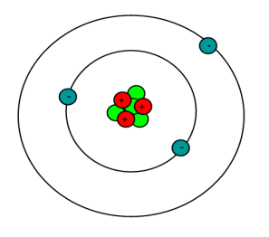
Lithium
Prevents manic recurrence; less effective against depression.
Effective probably in only a minority of patients in monotherapy.
(Goodwin et al, 2009)
Levels of greater than 0.6mmol/L generally needed in prophylaxis. Higher levels may benefit patients with predominantly manic symptoms.
(Severus et al, 2008)
Lithium probably reduces risk of suicide.
(Cipriani et al, 2005 ; Baldessarini et al, 2006)
Notes:
Reference
Goodwin G and the Consensus Group of the British Association for Psychopharmacology. Evidence-based guidelines for treating bipolar disorder:revised second edition-recommendations from the British Association of Psychopharmacology. J of Psychopharmacology 23 (4) 346-388.
Severus WE, Kleindienst N, Seemὓller F et al, 2008. What is the optimal serum lithium level in the long-term treatment of bipolar disorder--a review? Bipolar Disorder 10 (2) 231-237.
Baldessarini RJ, Tondo L, Davis P et al, 2006. Decreased risk of suicides and attempts during long-term lithium treatment: a meta-analytic review. Bipolar Disord 8(5 Pt 2):625-639.
Cipriani A, Pretty H, Hawton K et al, 2005. Lithium in the prevention of suicidal behavior and all-cause mortality in patients with mood disorders: a systematic review of randomized trials. Am J Psychiatry 162(10):1805-1819

Slide 97
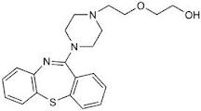
Quetiapine
Quetiapine prevents both manic and depressive recurrence.
The mood stabiliser ‘Holy Grail’?
FDA approval for maintenance treatment in bipolar disorder.

Slide 98
EMBOLDEN I & II Continuation Phase: Study Flow
Quetiapine 300 mg/day (n=141)
Quetiapine
300 mg/day
Placebo (n=143)
Quetiapine 600 mg/day (n=150)
Quetiapine
600 mg/day
Placebo (n=151)
Randomisation
Acute phase
Week 0
Continuation phase
Week 52
Mean MADRS 6.7
Mean YMRS 1.8
Young et al, 2012
Notes:
98
98
Reference
Young AH, McElroy SL, Olausson B et al, 2012. A randomised, placebo-controlled 52-week trial of continued quetiapine treatment in recently depressed patients with bipolar I and bipolar II disorder. The World Journal of Biological Psychiatry. 2012

Slide 99
EMBOLDEN I and II: Continuation Study
Patients with bipolar I and II disorder (recently depressed)
Followed for 26-52 weeks
Results: For quetiapine treated group compared to placebo,
Risk (any mood episode) sig. reduced: HR 0.51 (95% CI: 0.38-0.69); p=0.001
Risk (depressive episode) sig. reduced: HR 0.43 (95% CI: 0.30-0.62); p=0.001
No significant reduction in hypomanic/manic events.
Lower risk of recurrence of mood episodes in both bipolar I and II subgroups.
Young et al, 2012
Notes:
Reference
Young AH, McElroy SL, Olausson B et al, 2012. A randomised, placebo-controlled 52-week trial of continued quetiapine treatment in recently depressed patients with bipolar I and bipolar II disorder. The World Journal of Biological Psychiatry. 2012

Slide 100
SPaRCLE Study
Enrolment in acute episode or after recent
(≤26 weeks) episode
Randomisation when stable
≥4 weeks
Lithium (0.6-1.2 mEq/L; 600-1800 mg/day)
Quetiapine (open label)
(300-800 mg/day)
Quetiapine (300-800 mg/day)
Placebo
Documented
treatment
0-26 weeks
Acute
treatment
0-20 weeks
Stable
period
4 weeks
Up to 104 weeks
Pre-randomisation phase
Randomised phase
Weisler et al, 2011
Notes:
Reference
Weisler RH, Nolen WA, Neijber A et al, 2011. Continuation of quetiapine versus switching to placebo or lithium for maintenance treatment of bipolar I disorder. (Trial 144: a randomised controlled study). J Clin Psychiatry 72 1452-1464.

Slide 101
SPaRCLE Study: Time to Recurrence (Any Mood event)
1.0
QTP vs PLA
QTP vs LI
LI vs PLA
HR
0.29
0.66
0.46
95% CI
0.23, 0.38
0.49, 0.88
0.36, 0.59
p-value
<0.001
<0.01
<0.001
0.8
ITT population
0.6
Proportion of patients event free
0.4
0.2
Quetiapine (n=404)
Placebo (n=404)
Lithium (n=364)
0.0
0
24
48
72
104
Time (weeks)
Weisler et al, 2009
Notes:
Reference
Weisler RH, Nolen WA, Neijber A et al, 2011. Continuation of quetiapine versus switching to placebo or lithium for maintenance treatment of bipolar I disorder. (Trial 144: a randomised controlled study. J Clin Psychiatry 72 1452-1464.

Slide 102
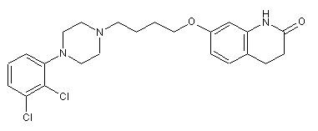
Aripiprazole
FDA approval for maintenance treatment in bipolar disorder.
Aripiprazole prevents manic recurrence.
Antidepressant prophylaxis not demonstrated.
Notes:
Reference
Fountoulakis KN, Vieta E, Schmidt F, 2011. Aripiprazole monotherapy in the treatment of bipolar disorder: a meta-analysis. J Affect Disord 133(3): 361-370.

Slide 103
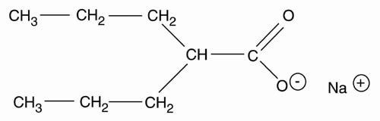
Valproate
No primary analysis of RCT data supports valproate monotherapy in maintenance treatment.
Secondary analysis of a large scale study does supports efficacy against mood episodes, especially depression.
(Bowden et al, 2000)
Often recommended for patients who predominantly experience mania due to its efficacy against acute mania.
Notes:
Reference
Bowden CL, Calabrese JR, McElroy SL et al, 2000. A randomized, placebo-controlled 12-month trial of divalproex and lithium in treatment of outpatients with bipolar I disorder. Divalproex Maintenance Study Group. Arch Gen Psychiatry 57(5):481-9.

Slide 104
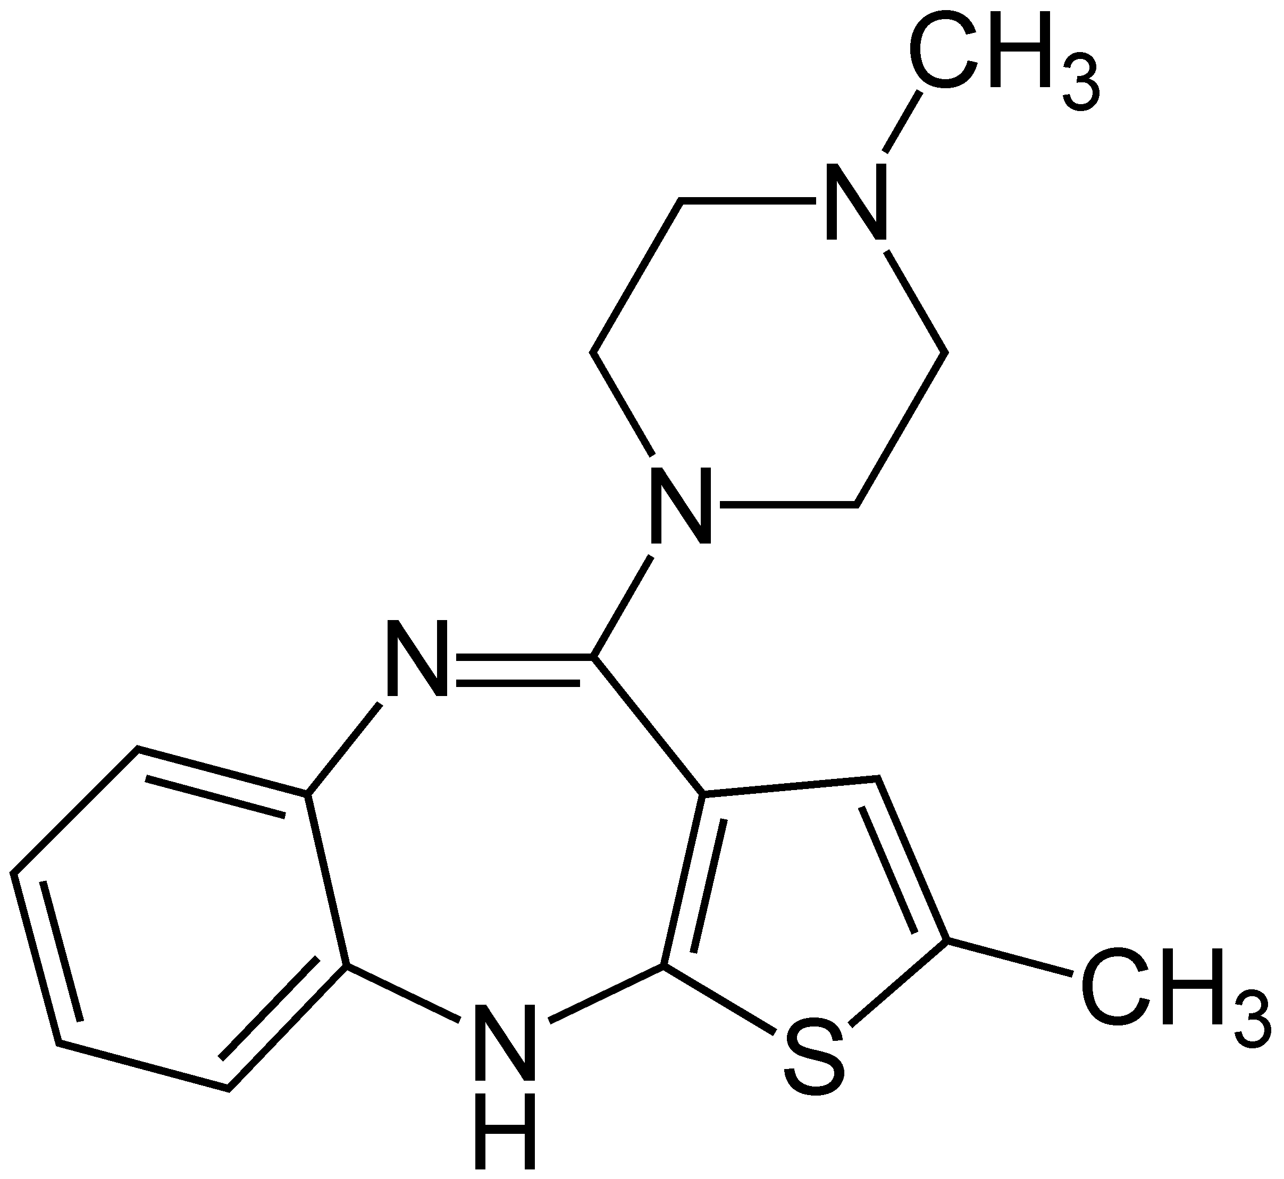
Olanzapine
FDA approved for maintenance treatment.
Maintenance efficacy established:
Olanzapine/Placebo (Tohen et al, 2006)
Combination design (Tohen et al, 2004)
Olanzapine/Lithium (Tohen et al, 2005)
Efficacy greater in preventing mania than depression. (More efficacious than lithium in preventing mania.)
Notes:
References
Tohen M, Calabrese JR, Sachs GS et al, 2006. Randomised, placebo-controlled trial of olanzapine as maintenance therapy in patients with bipolar I disorder responding to acute treatment with olanzapine. Am J Psychiatry 163 247-256.
Tohen M, Chengappa KNR, Suppes T et al, 2004. Relapse prevention in bipolar I disorder; 18-month comparison of olanzapine plus mood stabilizer v mood stabilizer alone. Br J Psychiatry 184: 337-345.
Tohen M, Greil W, Calabrese JR et al, 2005. Olanzapine versus lithium in the maintenance treatment of bipolar disorder: a 12-month randomised, double-blind, controlled clinical trial. Am J Psychiatry 162 1281-1290.

Slide 105
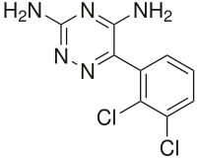
Lamotrigine
Approved by FDA for maintenance treatment on basis of two 18 month parallel double-blind trials comparing lamotrigine to lithium or placebo:
patients recently manic/hypomanic (Bowden et al, 2003)
patients recently depressed (Calabrese et al, 2003)
In a combined analysis:
32% reduction in mood episodes cv placebo.
better than placebo in delaying both mood episodes.
less efficacious than lithium in delaying mania.
Subsequent data largely follow this pattern.
Gitlin and Frye, 2012
Notes:
References
Bowden CL, Calabrese JR, Sachs G et al, 2003. A placebo-controlled 18 month trial of lamotrigine and lithium maintenance treatment in recently manic or hypomanic patients with bipolar I disorder. Arch Gen Psychiatry 60 392-400.
Calabrese JR, Bowden CL, Sachs G et al, 2003. A placebo-controlled 18 month trial of lamotrigine and lithium in maintenance treatment in recently depressed patients with bipolar I disorder. J Clin Psychiatry 64 1013-1024.
Gitlin M and Frye MA, 2012. Maintenance therapies in bipolar disorders. Review Article. Bipolar Disord 14 (Suppl 2) 51-65.

Slide 106
Combination therapy: the Advantages and Disadvantages
FOR
AGAINST
  Application of different mechanisms of action and receptor-binding profiles
Drug interactions
Sub-optimal dosing of both agents
More complex treatment regimens
Decreased adherence
Increased side effects
Cost
Bowden 2004; Goodwin & Vieta 2005; Suppes et al 2005
Notes:
Reference
Bowden CL, 2004. Making optimal use of combination pharmacotherapy in bipolar disorder.J Clin Psychiatry 65 Suppl 15 21-24.
Goodwin GM and Vieta E, 2005. Effective maintenance treatment--breaking the cycle of bipolar disorder. Eur Psychiatry 20 (5-6): 365-71.
Suppes et al, 2005. Challenges in the management of bipolar depression. J Clin Psychiatry 66 Suppl 5 11-16.

Slide 107
Combination Treatment
Successful maintenance treatment often requires combination therapy.
However, there are few data to guide choice.
The Balance Study:
330 patients with bipolar I disorder
Random open assignment to:
lithium
valproate
lithium and valproate in combination

Slide 108
The BALANCE Study
Primary Outcome – New Treatment/Hospital Admission
Geddes et al, 2010
Notes:
Reference
Lewis S, Geddes JR, Goodwin GM et al, 2010. Lithium plus valproate combination therapy versus monotherapy for relapse prevention in bipolar I disorder (BALANCE): a randomised open-label trial.
Lancet 30;375(9712):385-95

Slide 109
Rapid Cycling
Four or more affective episodes or polar switches in one year.
Most available data from extrapolation or secondary analyses of bipolar I disorder trials.
No clear basis for managing rapid cycling as a distinct sub-group with particular treatment approaches.
BAP Recommendations:
1. Identify and treat any contributing conditions/treatments,
e.g hypothyroidism, antidepressants.
2. Assess effectiveness of treatment over periods of 6 months.
3. Discontinue ineffective treatments.
Goodwin et al, 2009
Notes:
Reference
Goodwin G and the Consensus Group of the British Association for Psychopharmacology. Evidence-based guidelines for treating bipolar disorder:revised second edition-recommendations from the British Association of Psychopharmacology. J of Psychopharmacology 23 (4) 346-388.

Slide 110
Treatment Resistance: Clozapine
Clozapine
Little randomised controlled trial evidence
Widely considered as an important agent in treatment resistance.
Clozapine as adjunct to ‘treatment as usual (TAU)’ –randomised but not blinded.
38 bipolar I disorder and schizoaffective patients.
Treatment period 6 months.
Significantly decreased symptoms by ≥30% in 82% (cv 57% of TAU patients).
Suppes et al, 1999
Notes:
Reference
Suppes T, Webb A, Paul B et al, 1999. Clinical outcome in a randomised 1-year trial of clozapine versus treatment as usual for patients with treatment-resistant illness and a history of mania. American Journal of Psychiatry 156 1164-1169,

Slide 111
Treatment Resistance: Electroconvulsive Therapy
Recent literature review
‘Continuation and maintenance ECT are valuable treatment modalities to prevent relapse and recurrence of mood disorders in patients who have responded to an index course of ECT.
Continuation and Maintenance ECT are underused and insufficiently studied
despite positive clinical experience of more than 70 years.’
Petrides et al, 2010
Notes:
Reference
Petrides G, Tobias KG, Kellner CH et al, 2011. Continuation and Maintenance Electroconvulsive Therapy for Mood Disorders: Review of the Literature. Neuropsychobiology 64:129–140.

Slide 112
Treatment Resistance: Electroconvulsive Therapy
Selected studies
16 month prospective study of 22 patients with affective disorder:
Reduced hospitalisation from 44% to 7% of the year
45% reached full remission
27% achieved partial remission (DSM-III-R criteria)
(Vanelle et al, 1994).
Successful maintenance for bipolar patients failing on pharmacotherapy
(Petrides et al, 1994).
Rapid-cycling illness (Fink, 1991).
[
Notes:
Reference
Vanelle JM, Loo H, Galinowski A et al, 1994. Maintenance ECT in intractable manic-depressive disorders. Convuls Ther. 10(3):195-205.
Petrides G, Dhossche D, Fink M, Francis A et al, 1994. Continuation ECT: relapse prevention in affective disorders. Convulsive Therpay 10 189-194.etrides et al, 1994
Fink M, 1991. ECT in the long-term follow-up of BPD. Biological Psychiatry 30 1172.

Slide 113
Adherence
The Effect of Lithium Withdrawal: a thought experiment
Six months stable on Li
No Lithium
Lithium
*(Stopped)
STOP
Probability of remaining well
1.0
0.8
0.6
0.4
Risk brought forward 23 months
0.2
0
3
6
9
12
15
18
21
24
27
30
Time (months)
Goodwin, 1994
Notes:
Reference
Goodwin GM, 1994, Recurrence of mania after lithium withdrawal. Implications for the use of lithium In the treatment of bipolar affective disorder. Br J Psychiatry 164 149-152

Slide 114
Maintenance treatment
Key Points
Maintenance medication is only part of a larger rehabilitative programme.
In recent years, atypical antipsychotic agents have been added to the evidence-based armamentarium of maintenance treatments.
Treatment choice is theoretically dependent on which pole is most dominant.
However, combination therapy is often required –but few data are available except the recent BALANCE trial.
Treatment plans should include assessment and encouragement of treatment adherence.

