Slide 1
Stroke: epidemiology, risk factors and genetics
Pankaj Sharma MD PhD FRCP

Slide 2
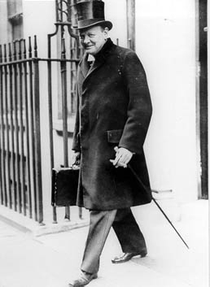
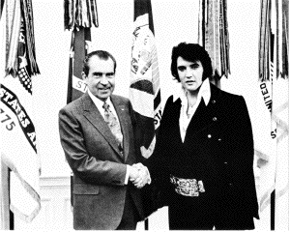
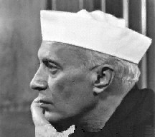
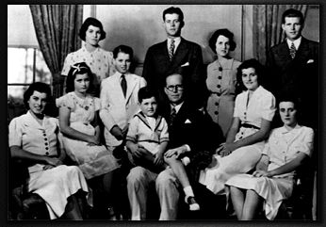


Slide 3
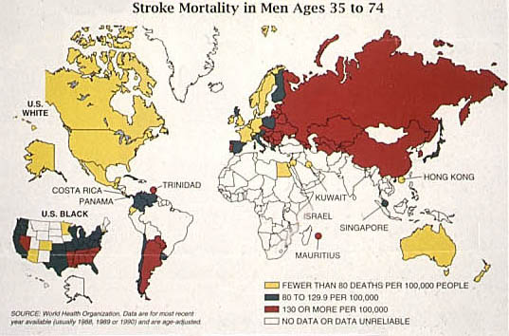
Notes:
Global
1st disability
2nd dementia
3rd death
6% NHS budget (X2 CHD)

Slide 4
Definition
Stroke is a clinically defined syndrome causing focal neurological symptoms which last greater than 24 hours
(TIA<24 hours but management is similar)

Slide 5
UK
  Consumes 6% of NHS budget
  300/100,000 cases
USA
  550,000 new cases/yr
  5 million patients
  60% require residential care
  $40 billion/yr
India
  By 2050, 80% of the global burden of new strokes of 15 million will occur in countries such as India

Slide 6

Vascular Disease: The Human Cost
Condition | UK annual incidence
Myocardial infarction | 231,000
Unstable angina | 180,000
Stroke, first | 145,000
Transient ischaemic attack | 30,000
Peripheral arterial disease | 102,000
Notes:
Why target atherothrombosis?
The various manifestations of atherothrombosis – heart attack, unstable angina, stroke, transient ischaemic attack (TIA), and peripheral arterial disease (PAD) – affect a staggering number of patients each year and account for approximately two fifths of all deaths and almost a third of premature deaths (i.e. in people under 75 years old)
Note: The BHF 2004 statistics for diseases of the circulatory system encompass; all heart disease*, stroke and ‘other diseases of the circulatory system’.
*(rheumatic heart disease, hypertensive disease, coronary heart disease, other heart disease including heart failure)
References:
1. a&b BHF Coronary Heart Disease Statistics, May 2006 (www.heartstats.org last accessed 03/04/07)
2. McDonagh MS, Bachmann LM, Golder S, Kleijnen J, ter Riet G. A rapid and systematic review of the clinical effectiveness and cost-effectiveness of glycoprotein IIb/IIIa antagonists in the medical management of unstable angina. Health Technology Assessment 2000; 4: 1–95
3. Stroke Association. Facts and Figures about Stroke http://www.stroke.org.uk/media_centre/facts_and_figures/index.html, 2004 (last accessed 01/03/07)
4. Scottish Intercollegiate Guidelines Network. Guideline 64: Management of Patients with Stroke. http://www.sign.ac.uk/guidelines/fulltext/64/section1.html. 2002. (Last accessed 01/03/07)
5. National Institute for Health and Clinical Excellence. Clopidogrel and modified-release dipyridamole in the prevention of occlusive vascular events. Technology Appraisal 90 May 2005

Slide 7
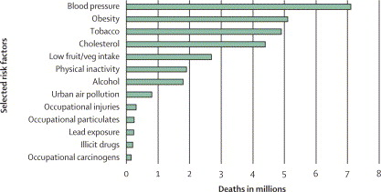
Cardiovascular disease risk factors

Slide 8
Aetiology
Ischaemic
Atherosclerotic
Lacunar
Haemorrhagic
AVM
Aneurysms
SAH
Cardio-embolic
Carotid embolic
Haematological
Inflammatory
Metabolic
Dissection
Genetics

Slide 9
Common causes
Age
Male sex
High BP
Cigarette smoking
Diabetes mellitus
High cholesterol

Slide 10
Blood pressure

Slide 11
BP & risk of first-ever stroke
7 prospective observational studies: 843 events; 405,500 individuals
Notes:
BP and stroke risk is log-linear
Reducing BP 5mmHg , 42% reduction in stroke risk (meta-analysis Lancet 1990)
My even be a stronger relationship
takes no account of fluctuations and errors inherent in BP measurement
(regression dilution bias)
resulting in underestimation of the strength of relationship
may result in increasing th gradient of relationship by 60%)

Slide 12
Classes of Anti-HT
Diuretics
Beta-blockers
Alpha-blockers
Calcium channel blockers
ACE inhibitors
ATIIR antagonists
Notes:
B and CCA > alpha (BP trialists, Lancet 2000)
ACE < others 15% increase risk of stroke with lisinopril cf. Diuretic (but mainly because 40% increase stroke rate in African Americans where BP not controlled.

Slide 13
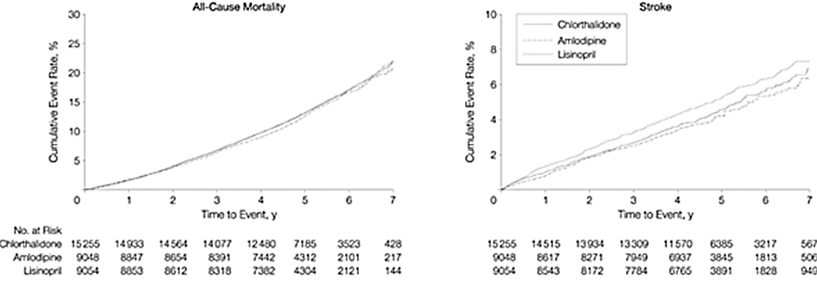
ALLHAT
33,357 subjects
>55 yrs/old
HT+1 other CHD
chlorthiazide or amlodipine or lisinopril
~5 year follow-up
secondary outcomes were similar across all groups
ALLHAT JAMA 2002;288;2981-97

Slide 14
Cholesterol & stroke

Slide 15
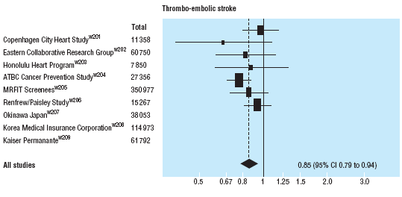
Cholesterol & statins
↓ 1mm/L in LDL Cholesterol = ↓ 15% in ischaemic stroke
BMJ 2003; 326; 1423-29

Slide 16
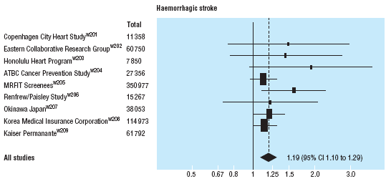
↓ 1mm/L in LDL Cholesterol = ↑ 19% in haemorrhagic stroke

Slide 17
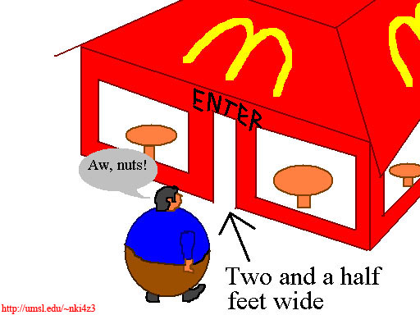

Slide 18
Obesity
BMI > 30kg/m3
  Male 63%; female 55%
Waist > 42 inch (102cm)
  Female 32 inch
Obesity effects BP, DM, dyslipidemia
Stroke 2003; 34; 1586-92

Slide 19
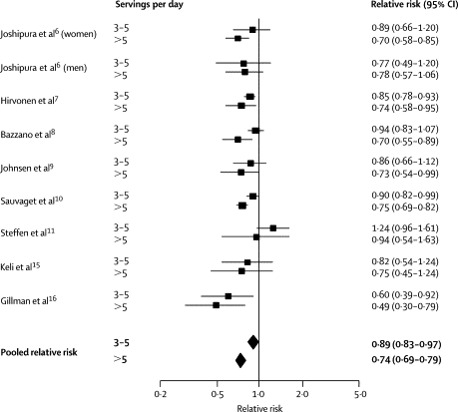
Stroke & 3-5 servings of fruit & vegetables / day
Lancet 2006; 367; 320-326

Slide 20


Slide 21
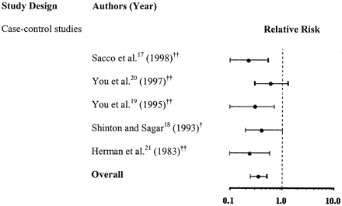
RR of stroke of high vs. low exercise
Stroke 2003; 34; 2475-81

Slide 22
Genetic evidence for ischaemic stroke
Animal studies
Rubattu et al. Nature Genet. 1996;13:429-34
Jeffs et al. Nat.Genet. 1997;16:364-7
Coyle et al. Stroke 1984;15:711-6
Human studies
Kiely et al. Stroke 1993;24:1366-71
Graffagnino et al. Stroke 1994;25:1599-604
Brass et al. Stroke 1992;23:221-3
Joutel et al. Nature 1996;383:707-10
Gretarsdottir S et al. Nat.Genet 2003; 35: 131-38
Notes:
Work from rodent models has demonstrated the extent of stroke heritability and as such the animal literature is well ahead of parallel human work.
Several genome-wide studies have identified multiple chromosomal regions potentially containing stroke influencing genes (Rubatto), or genes that affect infarct size (Jeffs & Coyle).
Human studies have also suggested a genetic causes of stroke with several finding positive family histories and at least one confirming an increased prevalence in MZ cf. DZ twins.
Success has been made with Mendelian inherited disorders of stroke as well with a genome-wide scan for common stroke in humans

Slide 23
complex disorders_{(stroke)} = (genes)^{n} ± environment

Slide 24
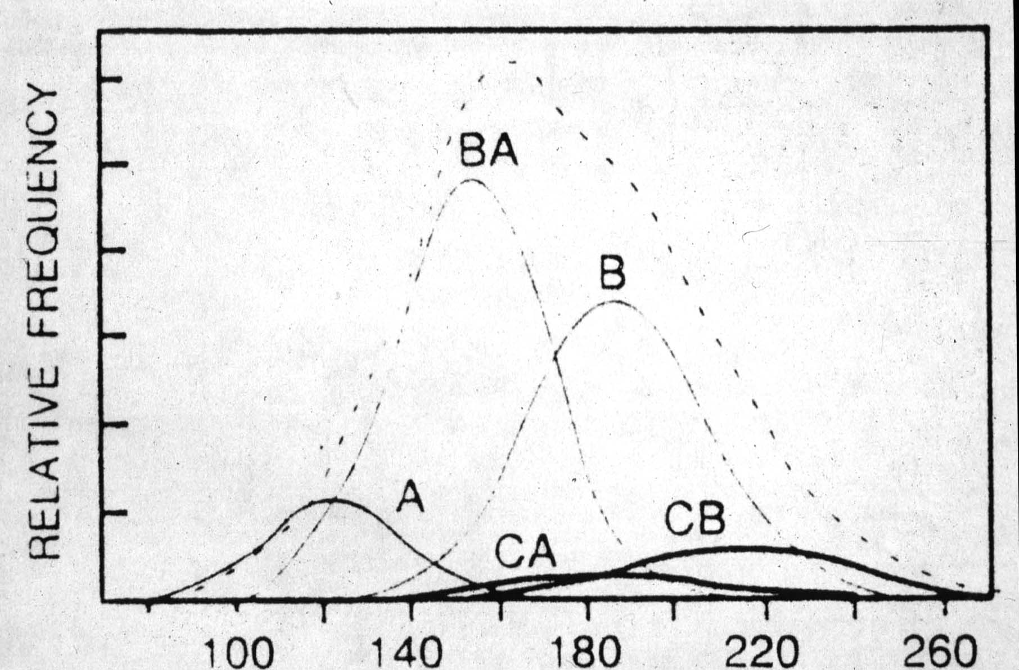
Notes:
Observed distribution of quantitative trait……
….composed of a number of rare single gene disorders….
……or common alleles acting in the presence of appropriate environmental factors.

Slide 25
Association studies
Controls
Affecteds

Slide 26
Meta-analyses
increase statistical power
allow plausible candidate genes to be excluded
causative genes to be identified with reliability
genetic risks to be quantified with a greater degree of precision

Slide 27
Methods
All candidate genes to date for ischaemic stroke
MEDLINE, EMBASE, BIDS, OVID & SILVERPLATTER
  Letters and abstracts
  References of identified publications searched
For duplicate publications the smaller dataset was ignored

Slide 28
Methods (2)
Inclusion criteria
neuroimaging (MRI/CT)
Caucasians
dichotomous trait
Exclusion criteria
quantitative traits
intermediate phenotypes
children (<16 years age)
Notes:
Cases were required to have neuroimaging to confirm the diagnosis and, to maintain genetic ethnic homogeneity, only studies on Caucasians were included.

Slide 29
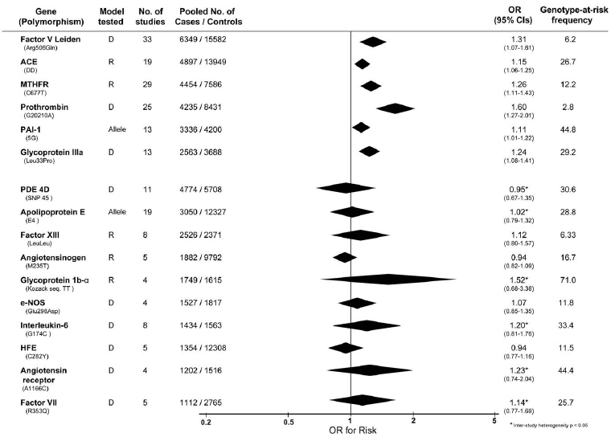
PLoS ONE 2010

Slide 30
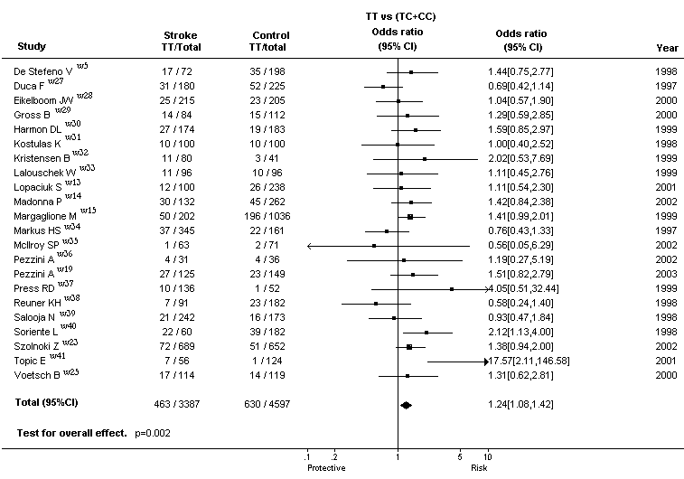
MTHFR/C677T

Slide 31
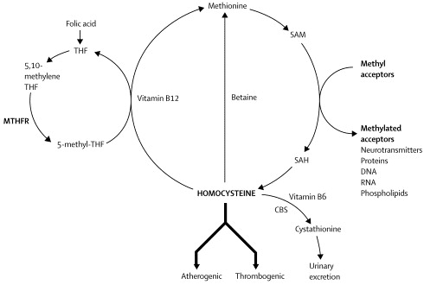
Metabolic Pathway of Homocysteine

Slide 32
Link between Homocysteine and Stroke events
Smoking, high BP, age, male, alcohol
High Hcy
Stroke
Causal
Stroke
Smoking, high BP, alcohol
male sex, age
High Hcy
Marker (Confounded)
Sub-clinical atheroma
High Hcy
Reverse causality
Notes:
Why controversial, because the Hcy-stroke association in observational studies, can follow any of these three models. The first model is causal relationship of the Hcy- stroke association.
The second model, is a positive association, but this derived by confounding by other CVR with which Hcy is highly correlated.
and a third model in which this is a positive association due to reverse causality bias, which is the case when a molecule is a simply reflect of the atherosclerotic burden.
And Why is important to determine whether Hcy is causal or not? First, if is causal specific intervention that leads to Hcy reductions will decrease the stroke risk. And this is important, based on the substantial % of the population exposed to high levels of Hcy. and third reason, is that now we know that there is cheap- no patent intervention that reduce Hcy, and therefore the posible benefit of this intervention has a great relevance in terms of public health.

Slide 33
Randomised Intervention as Test for Causality:
Mendelian randomization
Pharmacological
Mendelian
Subjects
Subjects
Drug
Placebo
CC-Genotype
TT-Genotype
Lower Hcy
Higher Hcy
Lower Hcy
Higher Hcy
Lower
event
rate
Higher
event
rate
Lower
event
rate
Higher
event
rate
Notes:
So, how can we test causality. A well known tool, since the second half of this century, to evaluate the causal role of risk factor, is a clinical trial. In which you RANDOMIZED subjects to receive or not an intervention that specifically decrease Hcy. And if Hcy is causal these subject should have a lower event rate or event risk. We know that several RCT are undergoing to evaluate this hypothesis, so what can we do in the meantime?...... We can use genetics in a similar fashion to RCT to test causality of associations from observational studies. How does it work?
Let me explain this approach knowns as mendelian randomization. When a the levels of an environmental exposure (e.g. Hcy) are determined by a genetic variation, such as the MTHFR/C677T, a RCT arise. This is because the distribution of the genotype or allele occurs at RANDOM process at the time of gamete formation, by the Mendel Second Law. Therefore, any known and unknown confounding variable of the Hcy-stroke association should be equally distributed among the different genotypes, which is akin to a RCT. In addition, because the exposure in this case (is to have the genotype) is fixed through the time, bias due measurement error or biological variability of the exposition is therefore largely avoided.
To summarize, Mendelian approach, largely overcome confounding, reverse causality and regression dilution bias, important limitations of the observational epidemiology.

Slide 34
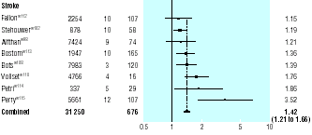
Homocysteine stroke risk: prospective Studies
Total Subj. years Stroke
Odds Ratio for a first Stroke event conferred by 5 μmol/L of increase in Homocysteine levels.
OR=1.59 (1.29-1.96)
Wald DS, 2002
Notes:
After this shot introduction into the Hcy metabolism, let me show the evidence from non-genetic observational studies that have indicated that Hcy is associated with increase risk of stroke. As reported in this meta-analysis of prospective studies that have evaluated the Hcy-stroke association.
But first let me ilustrate the components of this figure knowns as Fores plot. Here in the left side of the figure you have the individual studies, the total No of subjects, the follow up duration and the number of incident (new) stroke cases. In the right side, you have the individual results of each study in terms of risk in this case, Odds ratio for stroke. This is line indicates that there is no association (OR=1). So, The results in this side of the figure indicate an increase in risk, while the results in this side means a decrease in risk. The boxes represent the weight that each study contribute to the summary results. The horizontal lines represents the 95%CI. Therefore as you can the study with highest weight (biggest box) also has the narrowest CI. And here you have the summary OR, which is not an arithmetical mean of the individual results, but is a weighted results according to the variance of each study (lower the variance the highest the weight).
As you can see, we have 8 prospective studies, involving 31,000 subjects with a weighted mean follow up of 5 years and 676 stroke cases.
However, whether this association is causal or not remains controversial.

Slide 35
Triangulation between Genotype, Biochemical risk marker and Event rate: Mendelian randomization
MTFHR/C677T
Genotype % Hcy levels
TT 10 High
CT 43 Medium
CC 47 Low
(Intermediate Phenotype=IP)
Hcy
5μmol/L difference
OR 1.59
Genotype
Stroke
Notes:
Now, let me take you in detail through this strategy. Here in this part of the triangle we have the Hcy-stroke association from observational studies. Here we have the Genotype-IP association, and here we have the genotype-disease association.
So, if this association is causal, subjects that carrier a genotype (TT) which is associated with long-term elevation of Hcy, should have an increase in risk proportional to difference in the IP and also to the risk observed in observational studies. As described in this equation, if the Hcy-stroke risk assocaition follows a log-linear relationship.
Therefore, The first step will be to calculate in a robust and very precise manner the effect of the genotype on the IP. To do that, we have conduced a Systematic review of all studies, regardless of the design that evaluate the MTFHR-Hcy association and pooled under meta-analytic techniques.

Slide 36
MTHFR polymorphism and plasma Homocysteine
TT vs CC
Mean difference
1.93μmol/L (1.38-2.47)
Test for overall efect= P<0.0001
Notes:
Here we have the results of this systematic review of 42 studies that have examined the effect of MTHFR on Homocysteine in healthy subjects at the time of blood sampling. This figure represents data from ~15.000 subjects combined in a meta-analysis to evaluate the WMD for subjects with the TT genotype in comparison to CC-genotype subjects. Here you can see, that subjects with the TT-genotype have a 1.93 increase in Hcy levels in comparison to CC-subjects. Results which is highly significant.

Slide 37
Triangulation between Genotype, Biochemical risk marker and Event rate
Hcy
TT vs. CC
1.93 μmol/L
5μmol/L difference
RR 1.59
Genotype
Stroke
Predicted increment in risk
1.20 (95%CI: 1.14-1.26)
For TT subjects in comparison with CC-subjects
Lancet 2005; 365: 224-232
Notes:
So, knowing the difference in the IP due to the genotype we predict that the increase in risk for the TT individuals will be of 20% (with CI from 14-26%).
So… do these subjects have such a increase in risk?
To answer that we conduct a second systematic review of all genetic association studies evaluating the MTHFR-stroke association, and pooled them in a meta-analysis.

Slide 38
MTHFR polymorphism and Risk of Stroke
TT vs CC
1.26 (1.14-1.40)
Test for overall effect= P<0.0001
Lancet 2005; 365: 224-232
Notes:
There are 31 studies involving ~14, 000 subjects. The summary OR is 1.26 among TT homozygotes compared with CC-genotype subjects. Results again that is highly significant, as denoted by the P-value of <0.0001. So, TT genotype subjects do have an increase in risk of stroke very close to the value that we predicted.

Slide 39
PLoS ONE 2010

Slide 40
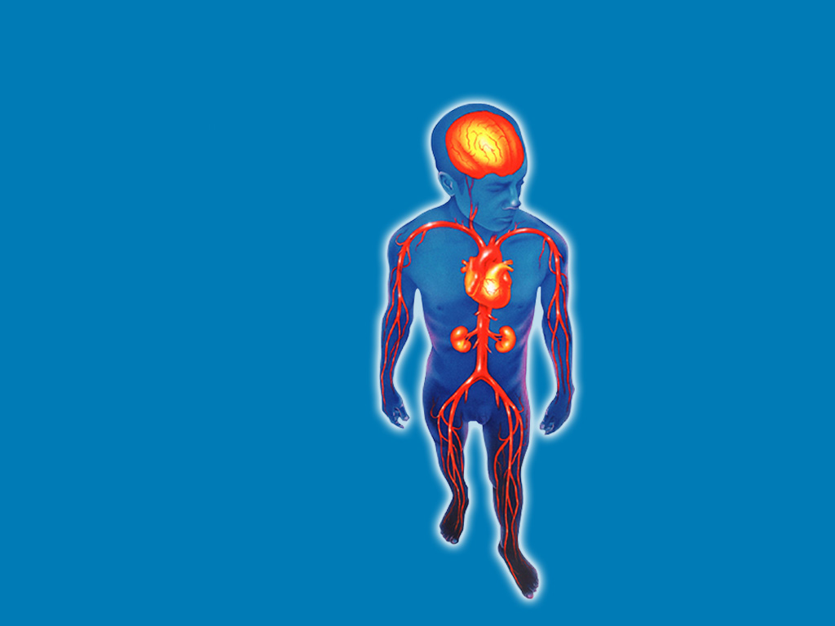
Atherothrombosis affects many vascular beds
Ischaemic stroke
Transient ischaemic attack
Myocardial infarction
Angina:
Stable
Unstable
Peripheral arterial disease:
Intermittent claudication
Rest pain
Gangrene
Necrosis
Renovascular disease
1. Adapted from: Drouet L. Cerebrovasc Dis 2002; 13(Suppl 1): 1–6.
Notes:
Atherothrombosis is a progressive, generalised condition with many clinical manifestations which can affect the coronary, cerebral, peripheral and renal circulations – either acute or chronic and often at multiple locations in a single patient.
Stenosis in an atherosclerotic artery may give rise to angina, a transient ischemic attack (TIA) or intermittent claudication.
Atherothrombosis of the cerebral arteries may result in TIA or ischaemic stroke
Atherothrombosis in the coronary arteries is the major cause of acute coronary syndrome (ACS), defined as unstable angina and non Q-wave myocardial infarction
In the peripheral arteries, thrombosis superimposed on atherosclerosis can contribute to the progression of peripheral arterial disease, producing intermittent claudication (leg pain on walking that is relieved by rest) as well as ischaemic necrosis and, potentially, loss of the limb
Reference:
1. Drouet L. Cereobrovasc Dis 2002; 13(suppl 1): 1–6.

Slide 41
PLoS ONE 2010

Slide 42
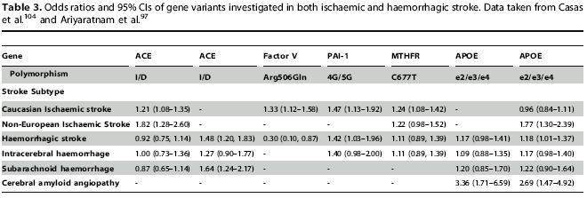
Comparative analysis
PLoS Med 2007
PLoS ONE 2008
Thromb Haem 2009

Slide 43
Number Needed to Treat
Intervention NNT Cost ($)
Stroke Units 18 Nil
Aspirin 83 60
Anti-HT# 17 200
Aspirin + dipyridamole 53 13,500
Statin 59 32,000
Clopidogrel 62 57,000
Thrombolysis 16 28,000
Surgery 26 140,000
# Elderly HT treated for 10yrs
Middle-aged HT NNT=50

Slide 44
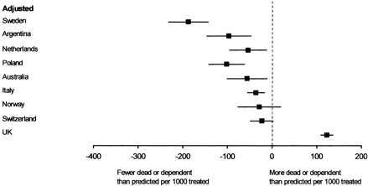
Comparing Mortality and Morbidity from IST

