Slide 1
Dementia drug development and policy
BSc in Neuroscience
Dr Craig Ritchie

Slide 2

The Faces of Alzheimer’s
‘We learn about the disease by looking into the eyes of victims – and their families’
Recap
Drug Development
Policy
Time Magazine
August 26, 2002

Slide 4
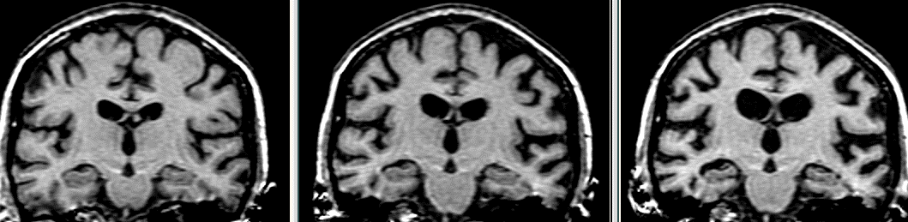

Slide 5
H
Time 0 18months 36months
Serial coronal MRI of mild AD
Notes:
The first of these images on the left is when the patient only just fulfilled AD criteria – the next two scans at 18 months and 3 years later show the devastating brain volume loss with early involvement of the medial temporal lobe – this is the “signal” we want to capture – either for diagnosis or for tracking change

Slide 6
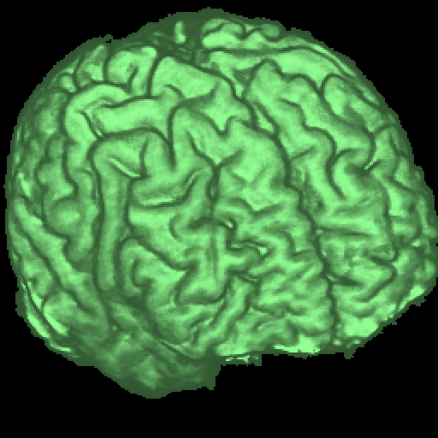
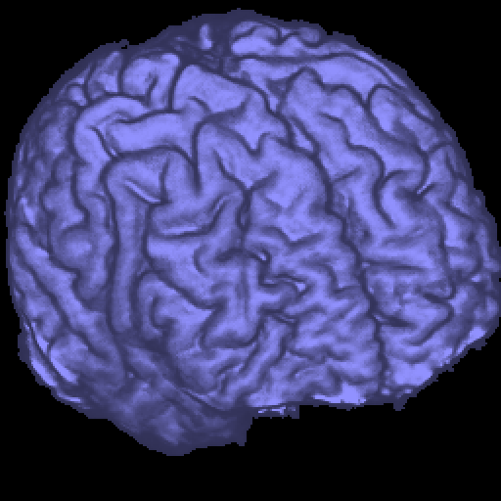
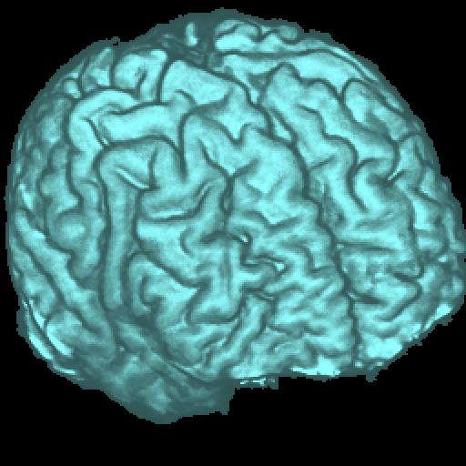
Registration
Scan 1
Scan 2
Complex brain structure
Nick Fox - IoN, UCL
Notes:
Registration – the spatial alignment of serial imaging – allows small differences to be detected and quantified with higher precision

Slide 7
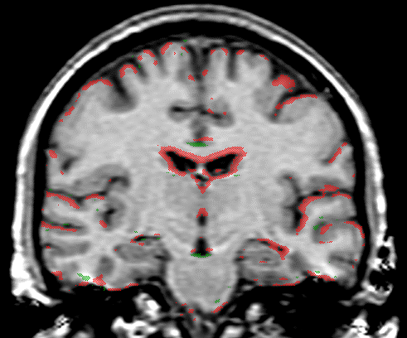
Early AD
Scan 2 - Scan 1
1 year interval
Red shows loss of brain tissue
Nick Fox - IoN, UCL
Notes:
In this slide one sees an overlay (in red and green) of the difference between two scans (1 year apart) of an individual with mild AD – in red one sees the areas of brain volume loss – note the diffuse nature of change and the marked ventriculat enlargement

Slide 8
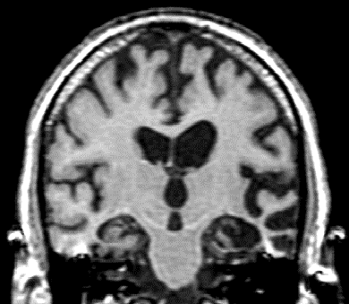
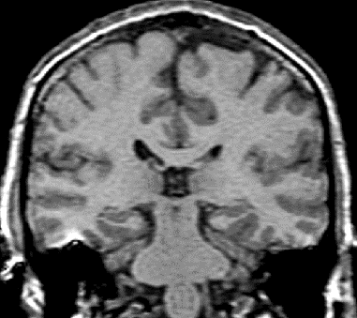

Slide 9
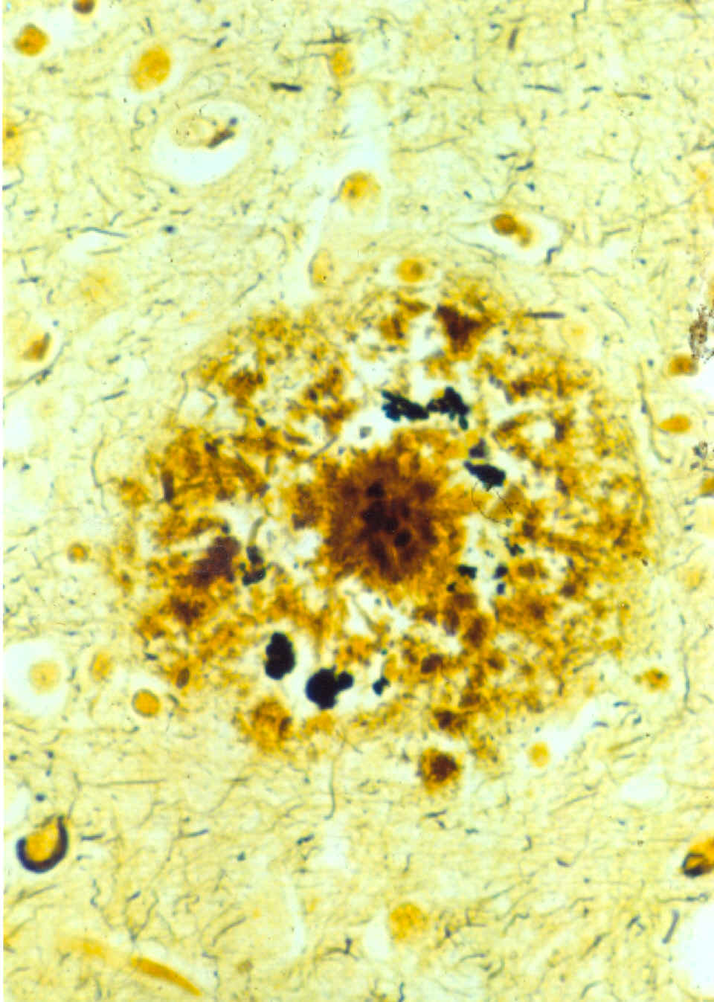
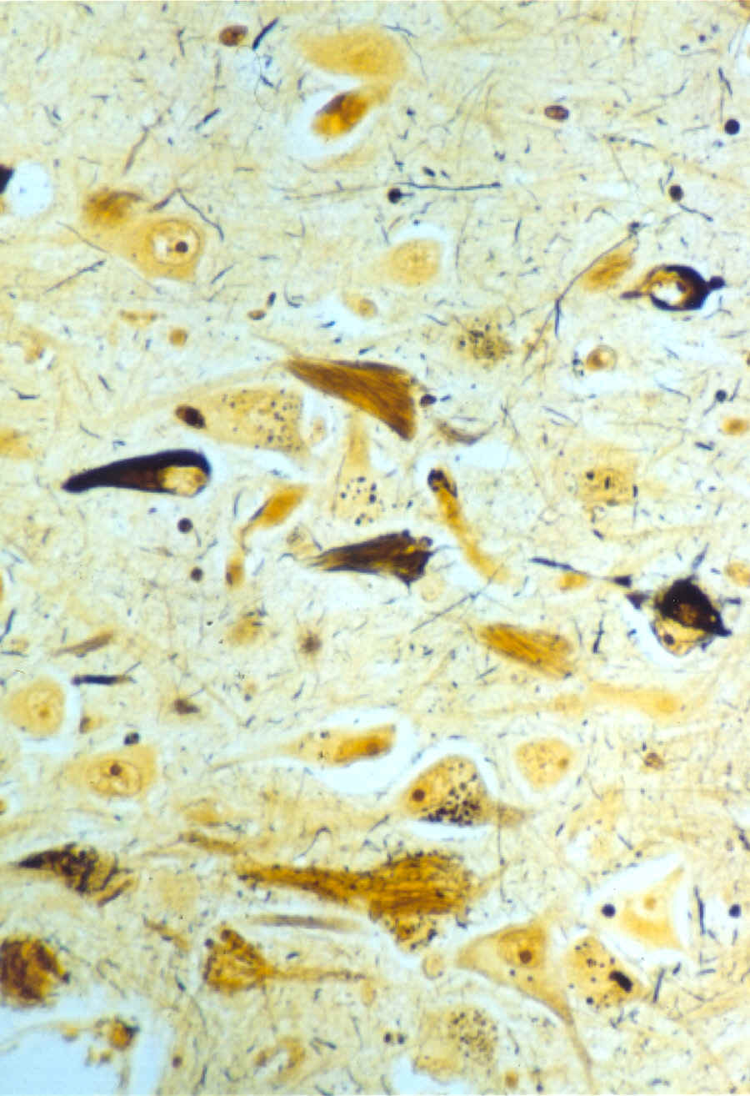
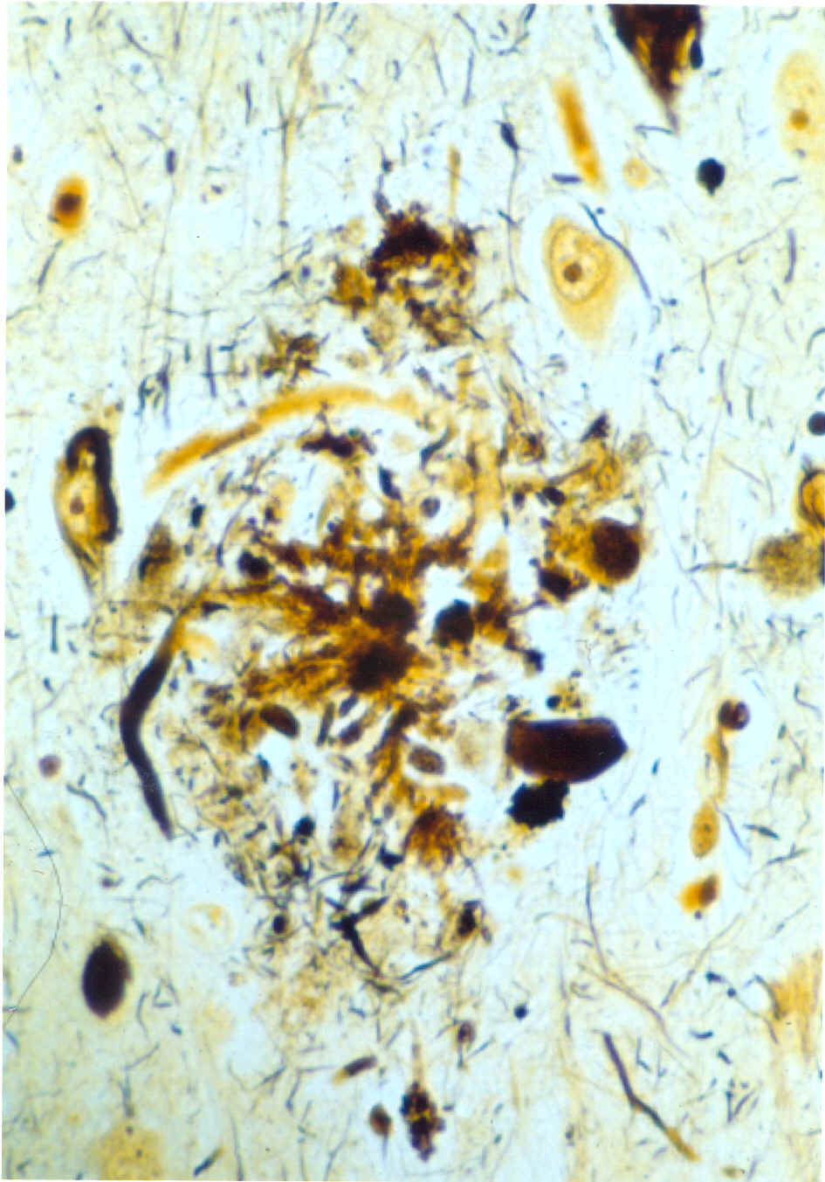
Alzheimer’s Disease Microscopy
Amyloid
Plaque
Neurofibrillary
Tangle
Neuritic
Plaque
β-amyloid
glycolipids
α-1 chymotrypsin
ApoE
ApoJ
vitronectin
PHF tau (70-90 x 15-20 nm)
Straight filaments (12-18 nm)
Hyperphosphorylated tau
ferritin polypeptide
proteoglycans
β-amyloid
Hyperphosphorylated tau
Swollen neurites

Slide 10

Biochemical
Amyloid plaque probably relatively inert
  hall mark of disease – gravestone.
  may even be a physiological mechanism to make toxic elements inactive.
Aggregated Aβ is key constituent of amyloid plaque
The aggregation of Aβ is what does the damage
Aβ comes from a normal parent protein – APP
In AD – APP is metabolised ‘differently’

Slide 11
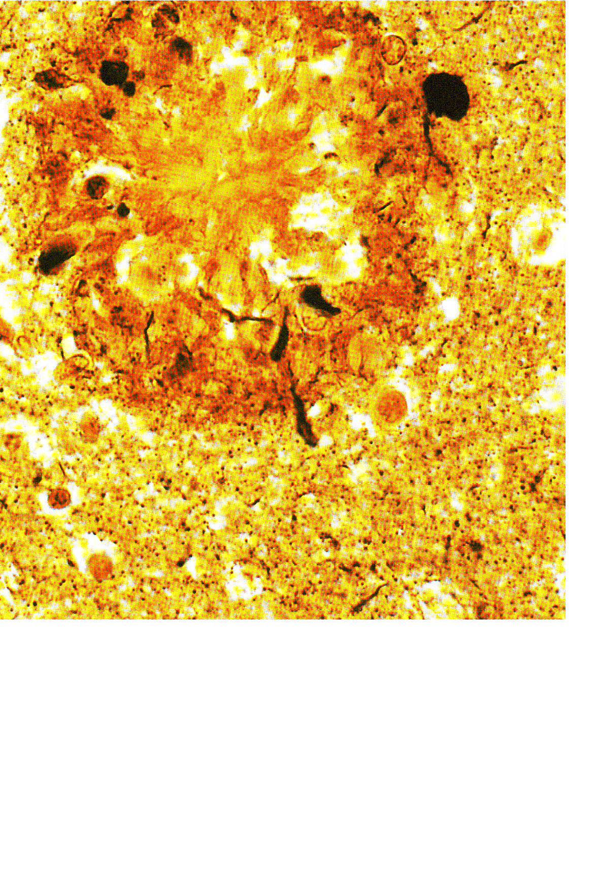
Amyloidosis
LRP
N
1
Cognitive decline
IDE
β
Lumen
672
672
Amyloid plaque
γ
711 / 713
Cytoplasm
C
770
770
APP
β-stub
Aβ_{40/42}
Aβ but not APP levels increase (turnover issue)

Slide 12
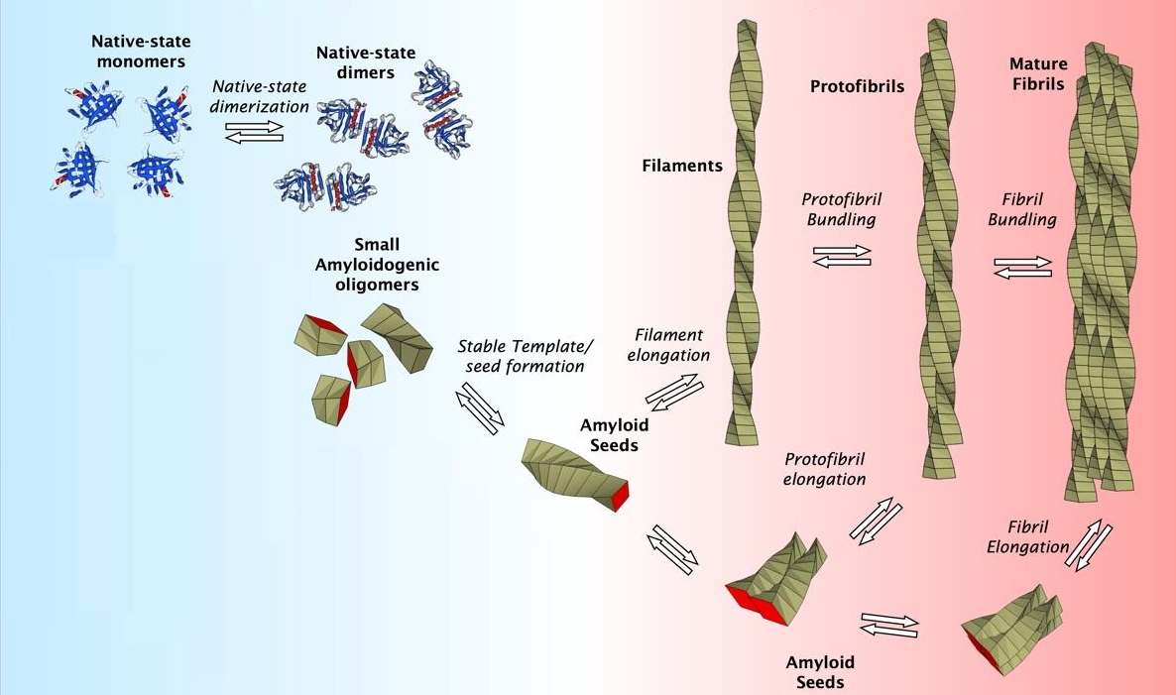
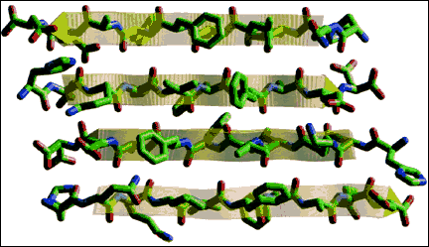
Fibril formation
7-10 nm
- concentration
acidic pH
metal ions
oxidative stress
β sheets
Adapted from: talaga.rutgers.edu/research/index.php
- Aβ₁₋₄₂ aggregates much more readily

Slide 13
Tau Hyperphosphorylation
Second key pathological lesion
  May be downstream effect of Aβ toxicity to mitochondria
  Tau and phospho-tau are measurable in CSF and elevations of both have been associated with Alzheimer’s disease.

Slide 14
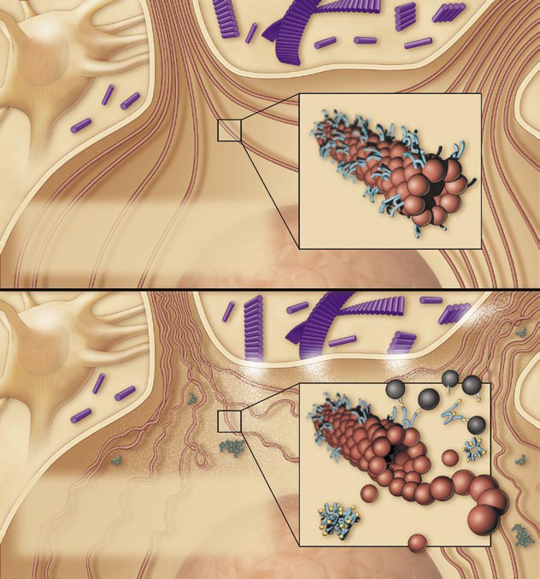
Tau
microtubule
In healthy neurons, tau proteins bind
and stabilize the microtubules that
transport large molecules along the
neuron’s axon and dendrites.
tau
tubulin
Hyperphosphorylated tau detach from the microtubules and form paired helical filaments and tangles.
PHF
Disruption of cellular transport
Adapted from: Wolfe MS (2006) Scientific American 294 (5), 72-79.

Slide 15
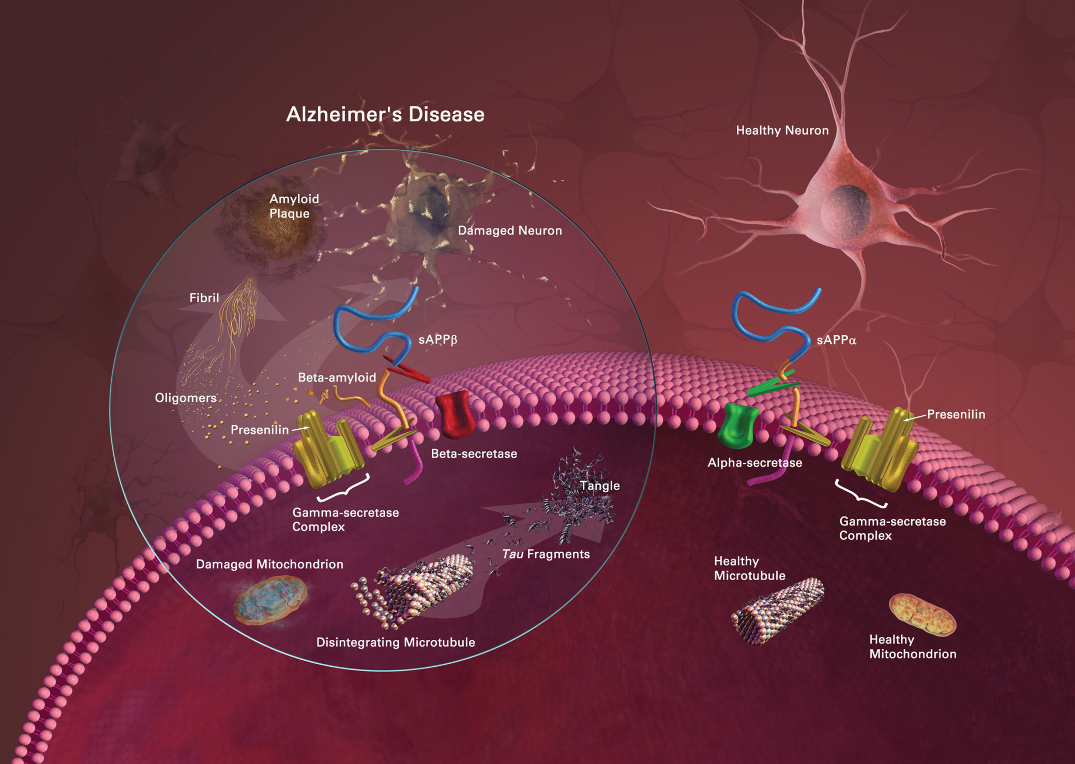

Slide 16
Recognise pathological sequence
Aβ Oligomerisation
Tau hyperphosphorylation
Mitochondrial Dysfunction
Neuroinflammation
ANY COMBINATION OF ABOVE
Sequence of:
  Synaptotoxicity
  Neurotoxicity
  Neurodegeneration

Slide 17
Clinical Changes
Normal
At Risk
Incipient
Dementia
Dementia
Disease

Slide 18
Clinical Changes
Normal
At Risk
Incipient
Dementia
Dementia
Disease

Slide 19
Clinical Changes
At Risk
Incipient
Dementia
Dementia
Disease
Oligomerisation
Glial activation
Tau pathology
Synaptotoxicity
Neurotoxicity

Slide 20
Clinical Changes
At Risk
Incipient
Dementia
Dementia
Disease
Oligomerisation
Glial activation
Tau pathology
Neurodegeneration
Plaque formation

Slide 21
Clinical Changes
At Risk
Incipient
Dementia
Dementia
Disease
Neurodegeneration
Plaque formation
Oligomerisation

Slide 22
Clinical Changes
At Risk
Incipient
Dementia
Dementia
Disease
Oligomerisation
Glial activation
Tau pathology
Synaptotoxicity
Neurotoxicity
Oligomerisation
Glial activation
Tau pathology
Neurodegeneration
Plaque formation
Neurodegeneration
Plaque formation
Oligomerisation

Slide 23
Clinical Changes
At Risk
Incipient
Dementia
Dementia
Disease
Oligomerisation
Glial activation
Tau pathology
Synaptotoxicity
Neurotoxicity
Oligomerisation
Glial activation
Tau pathology
Neurodegeneration
Plaque formation
Neurodegeneration
Plaque formation
Oligomerisation

Slide 24
Symptomatic Treatments
May be evidence of effect at early synaptotoxic stage.
Proven efficacy at later stage when neurodegeneration has advanced.
May be different ‘symptomatic’ drugs at different stages of disease.
Disease modifying treatments may also have a symptomatic profile

Slide 25
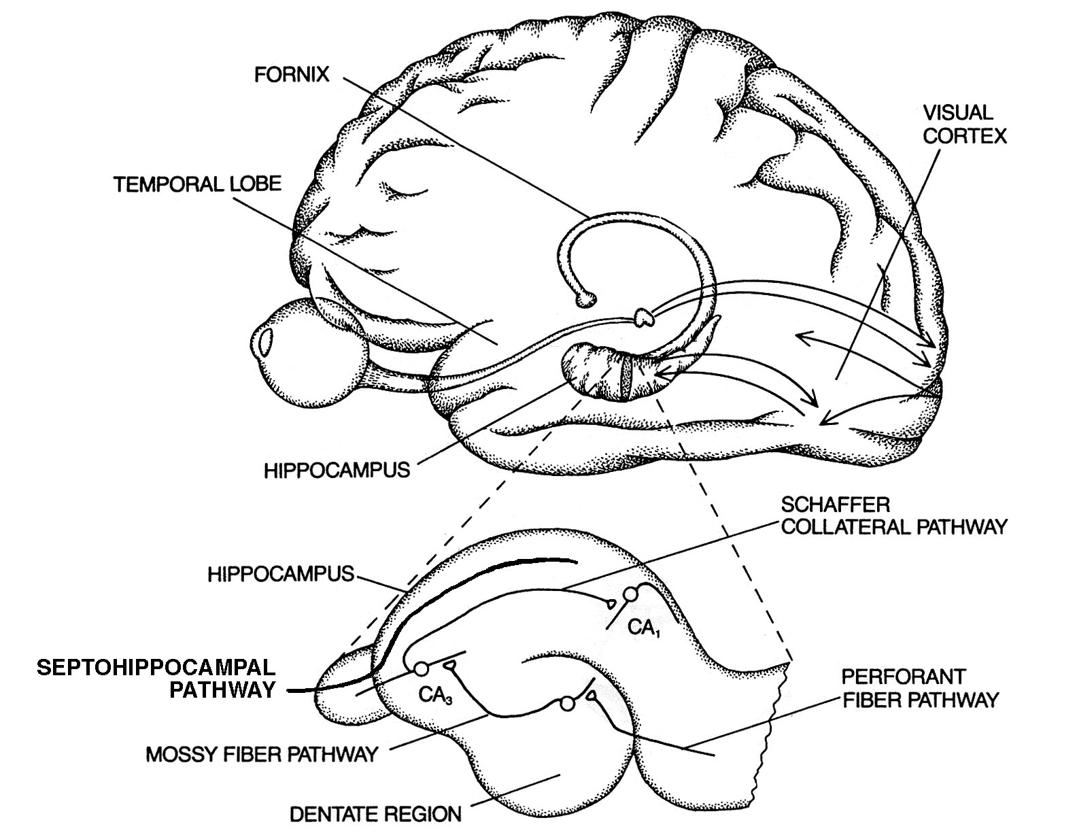
Alzheimer’s disease and memory
The hippocampus is important in memory and learning
Cholinergic
Pathways
Basal Forebrain
Nuclei
Degeneration of basal forebrain nuclei, decreased cholinergic input and hippocampal dysfunction, contribute to cognitive deficits in Alzheimer’s Disease
AD patients have impairments of memory and learning
Notes:
Acetylcholine is the neurotransmitter for two types of cholinergic receptors, muscarinic and nicotinic. Treatments targeting this site have widespread effects. Alpha 7 nicotinic receptors are located in the cerebral cortex, basal forebrain, and hippocampus. Treatments targeting this receptor may have more specific effects and benefits and avoid the side effects of muscarinic cholinergic stimulation.
AChE inhibitors increase cholinergic function and thereby hippocampal function. AChE I’s are approved for mild to moderate AD patients and include donepezil (ARICEPT) as market leader, galantamine (REMINYL) as market challenger, rivastigmine (EXELON) as twice daily treatment. EBIXA (memantine) is not an AChE I. Memantine is a low affinity NMDA antagonist approved for more severely affected AD patients…they have opened up the potential market for co-prescribing with AChEI’s.
Galantamine’s positioning is in having both cholinergic & nicotinic effects. The FDA has not allowed this claim in the PI (and the efficacy is not better than AChEI’s). It is a weak non-selective modulator at the nicotinic alpha4beta2 & alpha7 receptor sites. It maybe that the alpha4beta2 is more involved in attention, than memory.

Slide 26
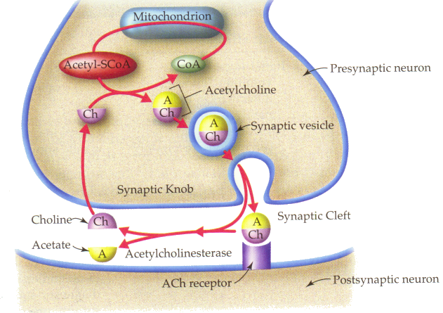
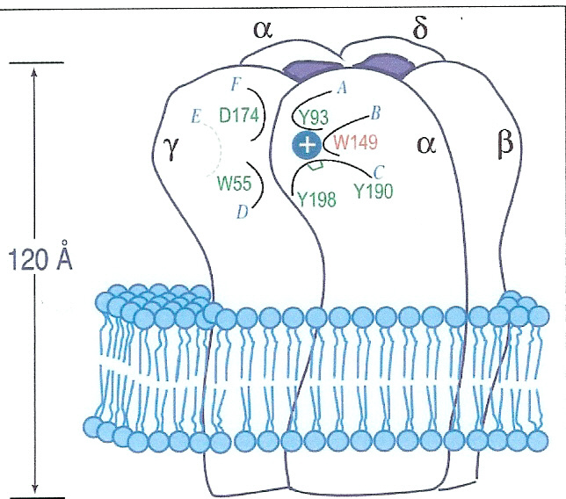
The cholinergic synapse

Slide 27
What do acetyl-cholinesterase inhibitors do (and not do) ?
Acetyl CoA
+
Choline
Limitations
Symptomatic improvement only
Gradual loss of efficacy
Potential for tolerance with repeated doses
Presynaptic nerve terminal
AChEI = acetylcholinesterase inhibitors
CAT
Acetylcholine (ACh)
AChEI
(donepezil,
rivastigmine and
galanthamine)
M receptor
N receptor
Acetylcholinesterase
Choline +
acetate
ACh
Postsynaptic
nerve terminal
Notes:
Component title: Strategies for increasing cholinergic function: AChEIs
Description: AChE inhibitors are the only modern agents approved for the treatment of AD, and have represented the most promising therapeutic approach to date. The AChE enzyme is responsible for breaking down ACh in the synaptic cleft. By inhibiting this enzyme, AChE inhibitors increase the level of ACh available in the synaptic cleft to stimulate cholinergic receptors, and thus enhance cholinergic function (Francis et al., 1999; Nordberg 1998). Despite different pharmacological profiles, there appears to be little difference between conventional (single-mechanism) AChE inhibitors, such as donepezil, rivastigmine and tacrine, in terms of their effects on clinical measures such as ADAS-COG (Nordberg and Svensson, 1998).
These treatments clearly improve symptoms, but there is uncertainty that these drugs show long-term efficacy and consistency of results between trials (Flicker, 1999).

Slide 28
Other effects
Butyl-cholinesterase (Rivastigmine)
Allosteric Potentiating Ligand (Galanthamine)

Slide 29
New drugs being developed which affect the cholinergic system
Dimebon
  Entering Phase 3
  Also mitochondrial protection and NMDA antagonist.
More specific α7 agonists
Agonists on β4α2 nicotinic receptors
Other cholinesterase inhibitors
Other receptor targets that lead to increase cholinergic transmission
  H3 antagonists
  5HT4 agonists
Other vehicles and dosing regimes for current therapies
  Higher dose donepezil
  Rivastigmine patches
  Pro-drugs

Slide 30
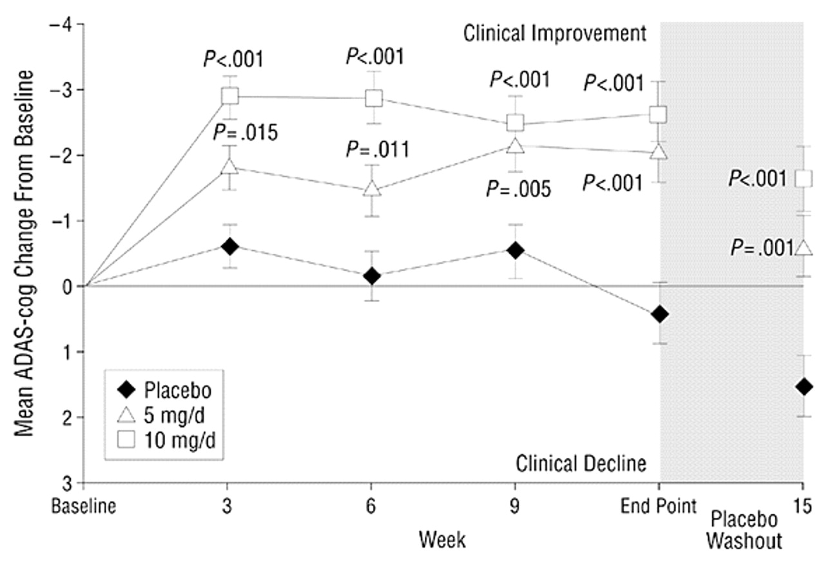

Least squares mean ({+/-} SEM) change from baseline in the Alzheimer's Disease Assessment Scale-Cognitive Subscale (ADAS-cog) scores for patients with mild to moderately severe Alzheimer disease receiving 5 mg/d and 10 mg/d of donepezil hydrochloride and placebo
Rogers, S. L. et al. Arch Intern Med 1998;158:1021-1031.
Copyright restrictions may apply.

Slide 31
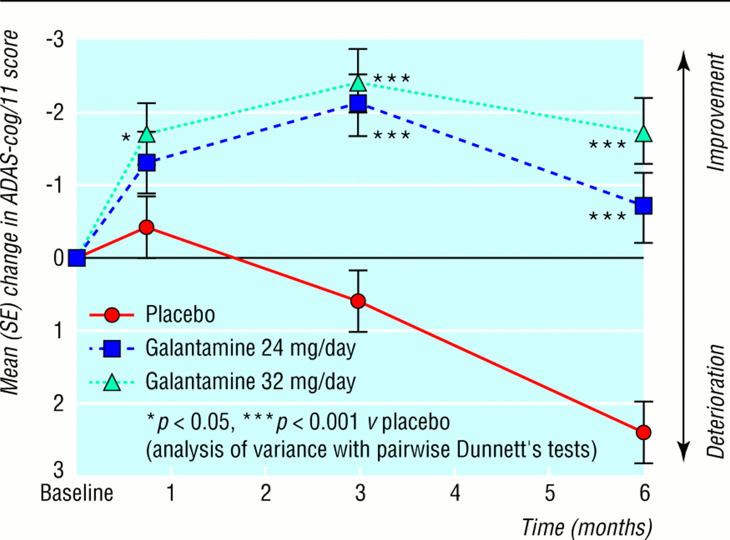

Galantamine’s effect over 24 weeks
Wilcock, G. K et al. BMJ 2000;321:1445
Copyright ©2000 BMJ Publishing Group Ltd.

Slide 32
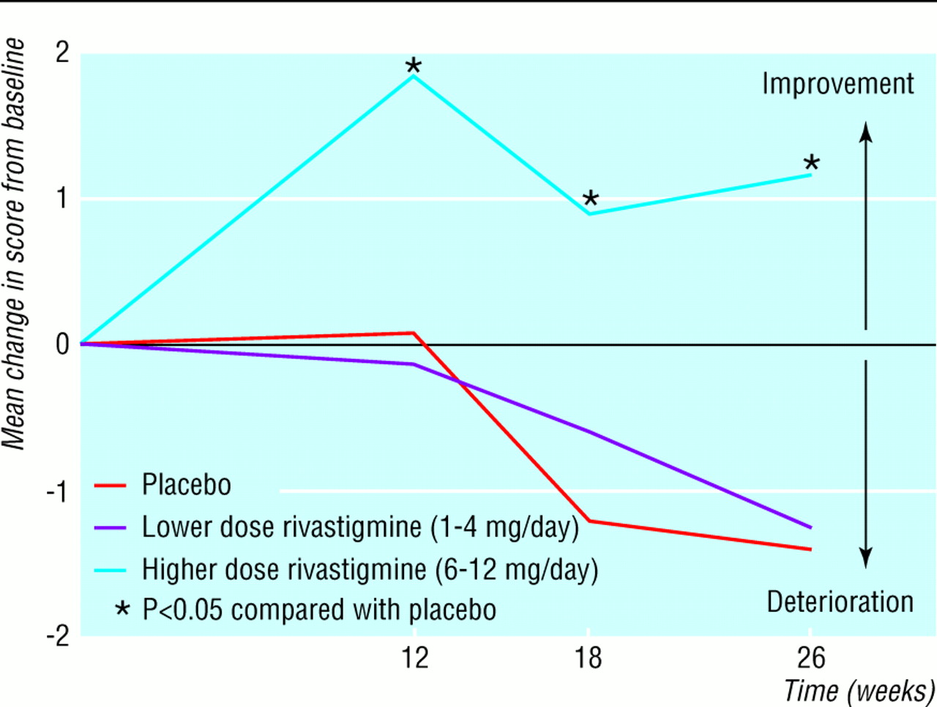
Rivastigmine at 26 weeks
Rosler, M. et al. BMJ 1999;318:633-640
Copyright ©1999 BMJ Publishing Group Ltd.

Slide 33
Glass ceiling of effect:
Measuring cognitive symptoms in AD clinical trials:
  Compare a group of patients on drug with those on ‘placebo’
  Rating scales to measure symptoms –’ADAS-Cog’

Slide 34
Donepezil
Homogeneity between studies and significant evidence of interaction between dose and efficacy
Galantamine
Homogeneity between studies and no significant evidence of interaction between dose and efficacy
Rivastigmine
Homogeneity between studies and significant evidence of interaction between dose and efficacy
Ritchie et al (2004)
American Journal of Geriatric Psychiatry

Slide 35
Other domains for symptomatic treatments
Depression / behavioural symptoms – antidepressants
  Citalopram – less PK interactions
Psychotic symptoms
  Antipsychotics – extreme caution (associated with excess mortality) as well as specific problems in LBD.
  Start low, go slow and review frequently.
  AChEI’s (esp Rivastigmine)

Slide 36
Other domains for symptomatic treatments
Agitation
  Benzodiazepines
Sleep disturbance
  Benzodiazepines and ‘Z’ drugs e.g. Zopiclone (now recognised to have similar problems to Benzos)
Sun downing
  Trazodone
Emotional incontinence
  Carbamazepine

Slide 37
Other considerations
Non pharmacological intervention for BPSD (Behavioural and Psychological Symptoms of Dementia)
ABC Charts
  Antecedents
  Behaviour
  Consequences
Sleep disturbance
  Sleep Hygiene

Slide 38
TRIAL DESIGN
(FOR ALZHEIMER’S DEMENTIA)
Some generic principles and then dementia specific.

Slide 39
Trial design
Population
  Stage of disease +/- dementia
  High risk of inaccurate diagnosis early with current tools.
  Low chance of showing a disease modifying effect in late disease when dementia present.
Outcomes
  Cognitive
  Functional
  Other secondary
  Biomarkers (surrogates)
Trial Methodology
  Size
  Duration
  Slope analysis / randomised withdrawal / delayed disability

Slide 40
Preclinical Development
Identification of target
  May be pre-existing
  May be a new target (risk)
Screen new molecules
  (New Chemical Entities –NCE’s)
  Stronger Intellectual Property
    High throughput screening
    Develop structured ‘screening assays’ for both pharmacodynamic and pharmacokinetic properties
Identify ‘candidate’ molecule and back ups

Slide 41
Toxicology
Laboratory
  Ames Test
  Cell lines
Animal
  2 species (often mouse and dog)
  May be primate, mini-pig
  Strict ethical conduct
  Single ‘toxic’ dose
  Chronic dosing

Slide 42
Why animal testing?
Vital safety information before human studies.
  NOAEL (No Adverse Event Level) – at least 10 fold decrease for human use.
  Identify target organ for toxicology (e.g. kidney, eye, liver etc.)
    Educates Phase 1 testing program
  Can sacrifice all animals for detailed pathology
  Failure to undertake animal testing would cause immeasurable increased risk to humans.

Slide 43
Phase 1 testing (First in Human)
Healthy volunteer
  Key readouts are
  Safety profile and ADME studies (PK)
    CMAX, half life, metabolites (active and reactive)
Single dose (MWTD – Maximum well tolerated dose)
Multiple dosing
Fed / fasted
IV/Oral
Special populations (elderly, renal or hepatic impairment)
Seldom do any ‘efficacy’ readouts in this.
Bridging studies

Slide 44
Phase 2 testing
(First in disease population)
Phase 2a
  Small (n~100)
  Key readout
    Safety, population PK (enriched PK)
    Will include efficacy outcomes but not ‘no-go’ if lack of efficacy (trend [p<0.1] causes excitement)
    Dose finding
  Design educated by findings from animal studies and from Phase 1 studies of MWTD and NOAEL.
  Costly!

Slide 45
Phase 2(b)
Much larger than 2a
Used information from toxicology, Phase I and Phase 2a to refine safety outcomes and dosing.
N~600
Key readout may now be efficacy and powered accordingly.
May constitute a ‘pivotal’ study.
Results from this critical to Phase 3 development.
Key readout ‘efficacy’
Lack of efficacy would kill drug at this stage.

Slide 46
Phase 3 (Pivotal) studies
These are the large and reported (highly cited studies)
Safety exposure (4,000 patient months exposure – at least)
  To determine rates of more rare side effects not expected to arise in early stage trials.
  Probably single dose versus placebo (or active comparator where placebo unethical)
    May be equivalence study.
Efficacy
  Needs to adhere to regulatory guidelines (FDA, EMEA, TGA etc.
  Must meet these criteria before moving to dossier submission and marketing approval.

Slide 47
Dossier Submission
The Full IB (Investigator’s Brochure)
All trial results in full (and raw data often requested)
All toxicology
Mechanism of action
Manufacturing processes
All trials must be conducted to ICH-GCP
All assays must be conducted in GLP accredited labs
All manufacture must be done in GMP accredited labs
License may have caveats needed to be identified in Phase 4 testing

Slide 48
What is ICH-GCP?
INTRODUCTION
  Good Clinical Practice (GCP) is an international ethical and scientific quality standard for designing, conducting, recording and reporting trials that involve the participation of human subjects.
  Compliance with this standard provides public assurance that the rights, safety and well-being of trial subjects are protected, consistent with the principles that have their origin in the Declaration of Helsinki, and that the clinical trial data are credible.
  The objective of this ICH GCP Guideline is to provide a unified standard for the European Union (EU), Japan and the United States to facilitate the mutual acceptance of clinical data by the regulatory authorities in these jurisdictions.
  The guideline was developed with consideration of the current good clinical practices of the European Union, Japan, and the United States, as well as those of Australia, Canada, the Nordic countries and the World Health Organization (WHO).
  This guideline should be followed when generating clinical trial data that are intended to be submitted to regulatory authorities.
  The principles established in this guideline may also be applied to other clinical investigations that may have an impact on the safety and well-being of human subjects.

Slide 49
2.THE PRINCIPLES OF ICH GCP
2.1 Clinical trials should be conducted in accordance with the ethical principles that have their origin in the Declaration of Helsinki, and that are consistent with GCP and the applicable regulatory requirement(s).
2.2 Before a trial is initiated, foreseeable risks and inconveniences should be weighed against the anticipated benefit for the individual trial subject and society. A trial should be initiated and continued only if the anticipated benefits justify the risks.
2.3 The rights, safety, and well-being of the trial subjects are the most important considerations and should prevail over interests of science and society.
2.4 The available nonclinical and clinical information on an investigational product should be adequate to support the proposed clinical trial.
2.5 Clinical trials should be scientifically sound, and described in a clear, detailed protocol.
2.6 A trial should be conducted in compliance with the protocol that has received prior institutional review board (IRB)/independent ethics committee (IEC) approval/favourable opinion.

Slide 50
2.THE PRINCIPLES OF ICH GCP
2.7 The medical care given to, and medical decisions made on behalf of, subjects should always be the responsibility of a qualified physician or, when appropriate, of a qualified dentist.
2.8 Each individual involved in conducting a trial should be qualified by education, training, and experience to perform his or her respective task(s).
2.9 Freely given informed consent should be obtained from every subject prior to clinical trial participation.
2.10 All clinical trial information should be recorded, handled, and stored in a way that allows its accurate reporting, interpretation and verification.
2.11 The confidentiality of records that could identify subjects should be protected, respecting the privacy and confidentiality rules in accordance with the applicable regulatory requirement(s).
2.12 Investigational products should be manufactured, handled, and stored in accordance with applicable good manufacturing practice (GMP). They should be used in accordance with the approved protocol.
2.13 Systems with procedures that assure the quality of every aspect of the trial should be implemented.

Slide 51
Phase 4 testing
‘Post Marketing’
  Regulatory requirement for more trials.
  Commercial impetus to show advantage over competitor.
  Seeding trials
  Ongoing pharmacovigilance
    Avandia (Rosiglitazone)

Slide 52
Regulatory approval may not be the end of it.
Licensed drugs then have to be ‘approved’ by NICE etc.
Outcomes for FDA/EMEA not necessarily those for NICE
  Balance regulatory efficacy and safety data with cost effectiveness data required by ‘commissioners’

Slide 53
Who does drug trials
PHASE
1
PHASE
2
PHASE
3
TARGETS
TOX
Big Pharma
NHS
Biotech
Academic

Slide 54
Research into Clinical Practice
What can we tell patients?
  Communicating risk of side effects has to be balanced against benefit.
  Hard to tell conclusively if patient on Rx is benefiting.
  Identification of patients most likely to benefit pre-treatment OR those ‘responding early in the course of treatment is a priority area for research.

Slide 55
CONCLUSIONS
These remain exciting times in terms of AD research.
Field has moved a long way in 20 years but solving one problem usually identifies many more.
Key areas for the future
  Alzheimer’s Disease Modifying Treatments (ADMT’s)
  Better symptomatic treatments
  Better outcome measures both clinical and biological
  Early diagnostic tests (ideally neuropsychological and plasma, then imaging then CSF)

Slide 56
Group Work
4 scenarios up to end Phase 1
To design, finance and report on Phase 2/3 program
Each company starts of with £5M
4 companies
Read scenario and present Phase 2 design to regulators and City Financiers
Receive feedback
Design Phase 3
Present Phase 3 – have you got a drug??

Slide 57
Groups
Regulators
Financiers
Company A
Company B
Company C
Company D
Each company should elect CEO, CMO and CFO – also regulatory expert and KOL (consultant)

Slide 58
Scenario Company A
AD Drug Symptomatic Rx
Mode of action
  Potent acetyl-cholinesterase inhibitor
  Predicted dose range from pre-clinical 10μmol
Toxicology
  Renal failure (mice) at 50mg/kg
Phase 1
  Half life – 3 hours
  MWTD – 50mg (nausea and vomiting)
  10mg bd – steady state [plasma] of 20μmol
Key considerations for Phase 2
  Dose, outcome measures, duration of study/studies
  ‘Me too’ drug – similar MOA to drugs that will be generic soon

Slide 59
Scenario Company B
AD Drug ADMT (Alzheimer’s disease modifying treatment)
Mode of action
  Prevents aggregation of Amyloid beta and neuroprotective
  Predicted dose range from pre-clinical not clear
  Very, very potent at clearing amyloid in transgenic mice and improve cognition
Toxicology
  Renal failure (mice) at 30mg/kg
  Deafness in dogs at 10mg/kg
Phase 1
  Half life – 7 hours
  MWTD – not found; 800mg was well tolerated
  800mg – steady state [plasma] of 40μmol (Note exceeded dog NOAEL)
Key considerations for Phase 2
  Safety - ?need more toxicology
  Dose, outcome measures, duration of study/studies
  Potential ‘block buster’

Slide 60
Scenario Company C
AD Drug Symptomatic Rx (Though may have ADMT properties)
Mode of action
  Potent acetyl-cholinesterase inhibitor (also protects mitochondria and NMDA receptors) = “Rich Pharmacology”
  Predicted dose range from pre-clinical 10μmol
  Already licensed product for other indication
Toxicology
  Hepatotoxic (beagles) at 50mg/kg (conducted in Russian labs in 1970’s)
Phase 1
  Half life – 3 hours
  MWTD – 50mg (headache) – only in single dose studies
  2mg bd – steady state [plasma] of 20μmol (Russia – 1975)
Key considerations for Phase 2
  6 month IIT – effective at 5mg bd for 6 months
  Dose, outcome measures, duration of study/studies
  Phase 1 and toxicology ‘package’

Slide 61
Scenario Company D
AD Drug Alzheimer’s Disease Modifying Treatment
Mode of action
  Monoclonal antibody
  Passive immunisation (binds Aβ in periphery to draw out of plaque centrally)
Toxicology
  Unknown as MAB – MOA can only be ‘tested in man / primates’
Phase 1
  Not commenced as can only test in AD population
  Issues re. consent and ‘potential benefit’
Key considerations for Phase 1/2
  Previous MAB in AD associated with cerebral HRG
  Need to run ‘dose finding’ studies in AD population
  Potential ‘Block Buster’
  Major safety concerns of technology

Slide 62
Targets: From ‘Mice to Men’
MPAC’s – Metal Protein Attenuating Compounds
  Aβ aggregation requires metal ions zinc and copper
  With age (and more pronounced in AD) – these ions in wrong compartment:
  MPAC’s are ‘ionophores’ that restore correct homeostatic balance of these metals.
  Net effect: Reduced aggregation and formation of Aβ oligomers

Slide 63
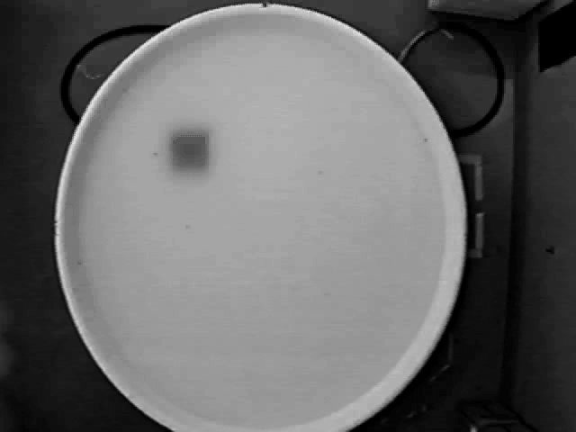

Slide 64
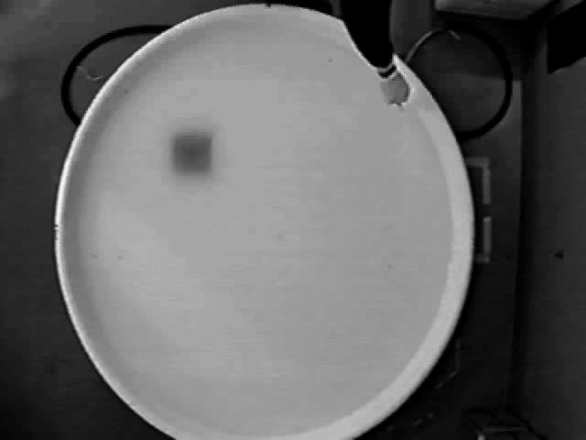

Slide 65
PBT2 rapidly improves Morris Water Maze performance in PS1/APP transgenic mice
p= 0.035
p= 0.019
p= 0.073
p= 0.004
p= 0.004
7 month old females. Operator blinded.
Testing commenced after 4 days treatment. Trials were at daily intervals.

Slide 66
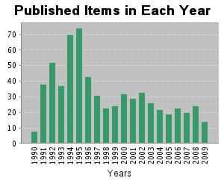
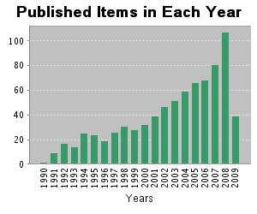
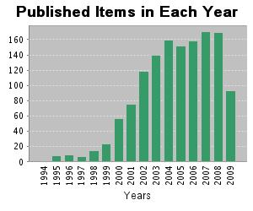
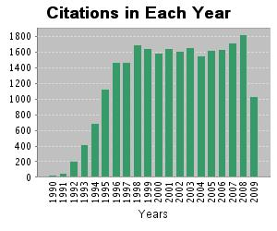
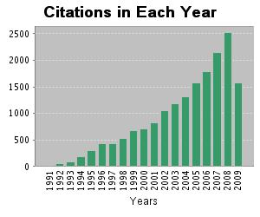
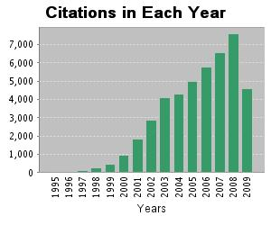
A Growing Academic Interest
Publications and Citations of 3 leading targets in Alzheimer’s Disease
Monoclonal Antibodies
Metals
γ-Secretase
Results found: | 1,115
Sum of the Times Cited [?] : | 44,463
View Citing Articles View without self-citations
Average Citations per Item [?] : | 39.88
h-index [?] : | 99
645 papers; 25,000 Citations
786 papers; 18,000 Citations
1,357 papers; 44,000 Citations

Slide 67
Safety, efficacy, and biomarker findings of PBT2 in targeting Aβ as a modifying therapy for Alzheimer’s disease: a phase IIa, double-blind, randomised, placebo-controlled trial
Lars Lannfelt, Kaj Blennow, Henrik Zetterberg, Stellan Batsman, David Ames, John Harrison, Colin L Masters, Steve Targum, Ashley I Bush, Ross Murdoch, Janet Wilson, Craig W Ritchie, on behalf of the PBT2-201-EURO study group*
Lancet Neurol 2008; 7: 779–86

Slide 68
12-week Multicentre Double Blind RCT
Dose | 0 mg, 50mg or 250mg PBT2 capsules, orally once daily for 12 weeks
Objectives | Primary: To assess the safety & tolerability of PBT2 Secondary: To assess the effect of PBT2 on AD biomarkers To determine the impact of PBT2 on cognitive activity associated with early AD
Key Patient Selection Criteria | NINCDS/ADRDA criteria for probable AD MMSE 20 - 26 or ADAS-cog 10 - 25 Stable AChEI for > 4 months with clinical evidence of deterioration Memantine excluded
68

Slide 69
Flowchart of Patient Enrollment & Completion
Assessed for Eligibility (n=88)
Excluded (n=10)
Did not meet entry criteria (n=10)
Randomised (n=78)
Placebo (n=29)
Withdrawal (n=1)
ineligible
Completed (n=28)
PBT2 50mg (n=29)
Withdrawal (n=1)
ineligible
(excluded medication)
Completed (n=28)
PBT2 250mg (n=29)
Withdrawal (n=2)
(Carer illness;
noncompliance)
Completed (n=27)
69

Slide 70
Baseline Patient Characteristics
 | Placebo (n=29) | PBT2 50mg (n=20) | PBT2 250mg (n=29) | Overall (n=78)
Age (Mean years) | 71.6 | 72.4 | 72.1 | 72
% Female | 52% | 45% | 52% | 50%
% ApoE e4 | 72% | 80% | 76% | 76%
MMSE Mean (SD) | 22.2 (2.65) | 23.2 (2.75) | 23.5 (2.69) | 23.0 (2.72)
ADAS-cog Mean (SD) | 18.9 (6.40) | 18.9 (7.51) | 18.7 (5.58) | 18.8 (6.34)
70

Slide 71
Primary Objective: Safety & Tolerability
No significant findings or trends in any of the safety parameters measured.
  Thorough neurological and ophthalmological assessment revealed no safety concerns
No PBT2-related SAEs (2 SAEs in placebo group)
Treatment Emergent AE incidence ≥ 1 per patient:
  PBT2 50mg 50%
  PBT2 250mg 62%
  Placebo 48%
Severity and profile of AEs similar across all groups. Majority of AEs were rated mild intensity (74%)
Summary:
  Safety and tolerability profile of PBT2 is comparable to that of placebo
71

Slide 72
Incidence of Adverse Events number of patients (%)
Treatment Emergent AE | Placebo (N=29) | PBT2 50mg (N=20) | PBT2 250mg (N=29)
Headache Dizziness Somnolence Fall Back Pain Neck Pain Fatigue Hypertension | 4ª (14%) 4 (14%) 2 (7%) 1 (3%) 0 0 2 (7%) 0 | 2^{b} (10%) 1 (5%) 1 (5%) 2 (10%) 1 (5%) 0 0 1 (5%) | 7^{c} (24%) 2 (7%) 1 (3%) 0 2 (7%) 2 (7%) 2 (7%) 2 (7%)
ª1 deemed related
^{b}2 deemed related
^{c}3 deemed related
72

Slide 73
Biomarker Change at 12 Weeks from Baseline: PBT2 250mg compared with Placebo
Biomarker | Cerebrospinal Fluid | Plasma
Aβ42 | -56 pg/mL (95% CI -96, -16.5) p=0.006 | NS*
Aβ40 | -514 pg/mL (95%CI -1116.2, 87.4) p=0.092 | NS*
Total Tau | No change | Not assayed
P-Tau | No change | Not assayed
Zinc, Copper | Levels BLQ | NS*
* NS = Non-significant change
73

Slide 74
PBT2 250mg demonstrates statistically significant reduction in CSF Aβ42
n=28
n=18
n=25
LSMean Change (±SE) from Baseline at Week 12 (pg/mL)
p = 0.006
13% change compared to placebo
74

Slide 75
PBT2 250mg demonstrates reduction in CSF Aβ40
n=28
n=18
n=25
LSMean Change (±SE) from Baseline at Week 12 (pg/mL)
p=0.09
8% change compared with placebo
75

Slide 76
Cognition Change at 12 Weeks:
PBT2 250mg Compared with Placebo
Neuropsychological Test Battery (NTB): |  | p value
 | Composite z-score | p = 0.193
 | Memory z-score (Wechsler Memory Scale; Verbal Paired Associates immediate & delayed; Rey Auditory Verbal Learning immediate & delayed) | p = 0.838
 | Executive z-score* (Wechsler Memory Scale Digit Span; Controlled Word Association Test; Category Fluency Test; Trail Making Test Parts A & B) | p = 0.042
 | Significant Findings from NTB Executive Function component tests: Category Fluency: increase of 2.8 words (95% CI 1.0, 5.4) Trail Making Part B: improvement of -48.0 secs (95% CI -83, -13) | p = 0.041 p = 0.009
76

Slide 77
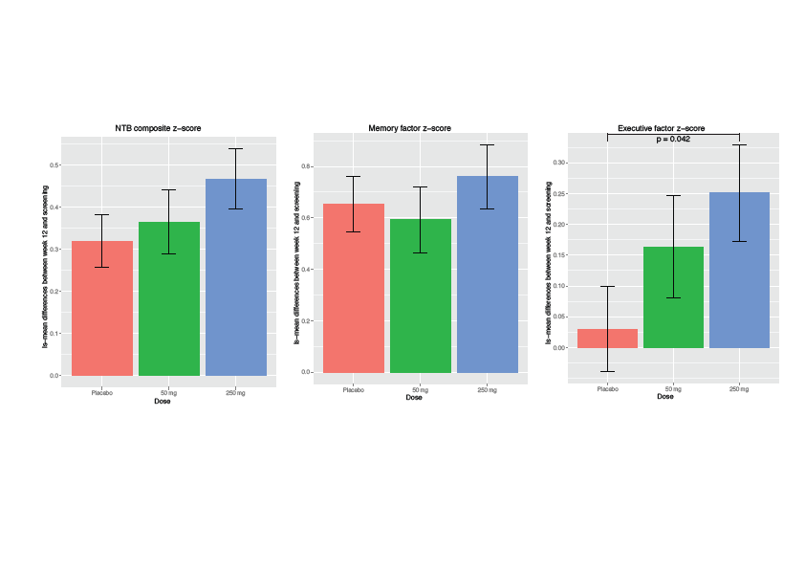
Post erratum Composite, Memory and Executive Factor Z-scores.

Slide 78
PBT2 250mg demonstrates statistically significant improvement in Executive Function z-score
What led to the erratum
Executive Z-score consists of:
  Wechsler Memory Scale Digit Span
  Controlled Word Association Test
  Category Fluency Test
  Trail Making Test Part A
  Trail Making Test Part B
COWAT (Controlled Word Association Test)
  List as many words beginning with a given letter – repeated with 3 letters
  Analysis should be based on total of all 3 letters:
    In calculation of COWAT component this was done
    In calculation of Executive Z-Score this was NOT done and each letter’s score contributed to Z-score.
    This meant that the neutral COWAT made 3x the contribution it should have.
Strong improvements in category fluency and Trails B now shown to have mediated a significant effect on the Executive Function Z-Score
78

Slide 79
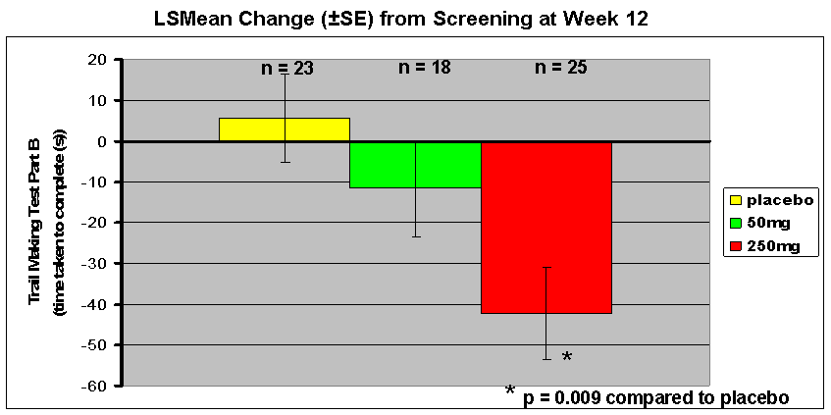
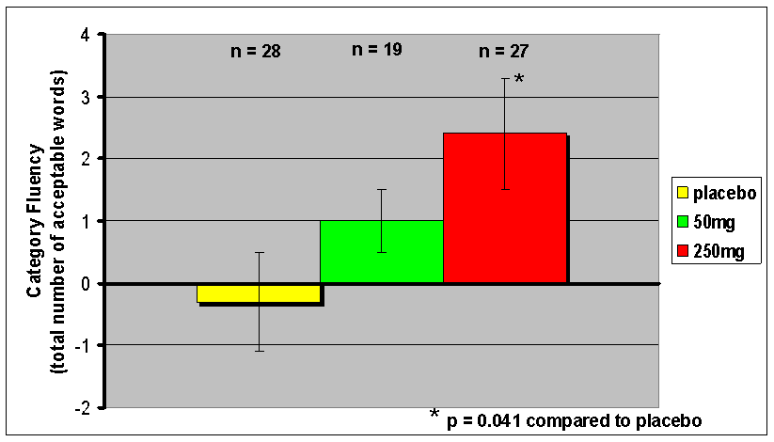
PBT2 250mg demonstrates statistically significant improvement in executive tests
Trail Making Part B:
Quicker by 48.0 seconds
(95% CI 13, 83)
p=0.009
Category Fluency:
Increase of 2.8 words
(95% CI 1.0, 5.4)
p=0.041
79

Slide 80
Conclusions
Primary Objective
Safety:
PBT2 50mg and 250mg were safe and well tolerated in this 12 week study in mild AD patients
Secondary Objectives
Biomarkers:
250mg PBT2 demonstrated statistically significant reduction of CSF Aβ₄₂ after 12 weeks of treatment compared with placebo
Cognition:
250mg PBT2 demonstrated statistically significant improvement in Executive Function z-score after 12 weeks of treatment compared with placebo
Post Hoc Analysis
Cognition
250mg PBT2 leads to a greater proportion of patients achieving NTB scores signifying cognitive improvement.
Biomarker
Ongoing
80

Slide 81
Conclusions
Primary Objective
Safety:
PBT2 50mg and 250mg were safe and well tolerated in this 12 week study in mild AD patients
Secondary Objectives
Biomarkers:
250mg PBT2 demonstrated statistically significant reduction of CSF Aβ₄₂ after 12 weeks of treatment compared with placebo
Cognition:
250mg PBT2 demonstrated statistically significant improvement in Executive Function z-score after 12 weeks of treatment compared with placebo
Post Hoc Analysis
Cognition
250mg PBT2 leads to a greater proportion of patients achieving NTB scores signifying cognitive improvement.
Biomarker
Ongoing
81

Slide 82
Next Steps
The corrected analysis and post hoc findings thus far, further support the commitment to develop PBT2 for the treatment of Alzheimer’s disease.
The planning for a Phase IIb study of PBT2 in patients with mild AD to assess cognition after 6 months treatment is currently underway.
82

Slide 83
Authors and Acknowledgements
Authors
Lars Lannfelt (Chief Investigator)
Kaj Blennow
Henrik Zetterberg
Stellan Batsman
David Ames
John Harrison
Colin Masters
Steve Targum
Ashley Bush
Noel Faux
Ross Murdoch
Janet Wilson
Craig Ritchie
Investigators
Lars Lannfelt
Christer Nilsson
Sture Eriksson
Eva Pilenvik
Lennart Minthon
Kristina Are
Anders Haglund
Stellan Batsman
Karyn Boundy
David Ames
Henry Brodaty
Michael Woodward
Susan Kurrle
Peter Drysdale
Steve Macfarlane
Acknowledgements
DSMB members
Roger Bullock (Chair)
Peter Passmore
Jorgen Seldrup
Statistician
Mark Shaw, Quintiles, UK
From Prana Biotechnology Ltd
Elisabeth Gautier
Caroline Herd
Fiona Vaughan
Principal scientists, clinical & scientific advisors
Kevin Barnham
Roberto Cappai
Robert Cherny
Rudy Tanzi
Jeffrey Cummings
Paul Adlard
David Finkelstein
George Mihaly

Slide 84
PUBLIC POLICY:
Summary of Current Therapies
All much of a muchness
ACh and NMDA receptors are only targets of licensed therapies.
Limited to modest symptomatic effect.
Delaying symptom progression may reduce cost of institutional care.
Recent NICE guidance suggested to use only in mild-moderate AD (MMSE 10-20) and did not recommend Memantine at all (unless in clinical trials).
Dilemma – Licensed but not sanctioned

Slide 85
Public Policy
We have reviewed what we learnt about AD thus far.
NICE Guidance
  Tension with efficacy
  Health Economics and QALY’s
Public policy
  DeNDRoN
  National Audit Office
  That funny paper from IoP

Slide 86
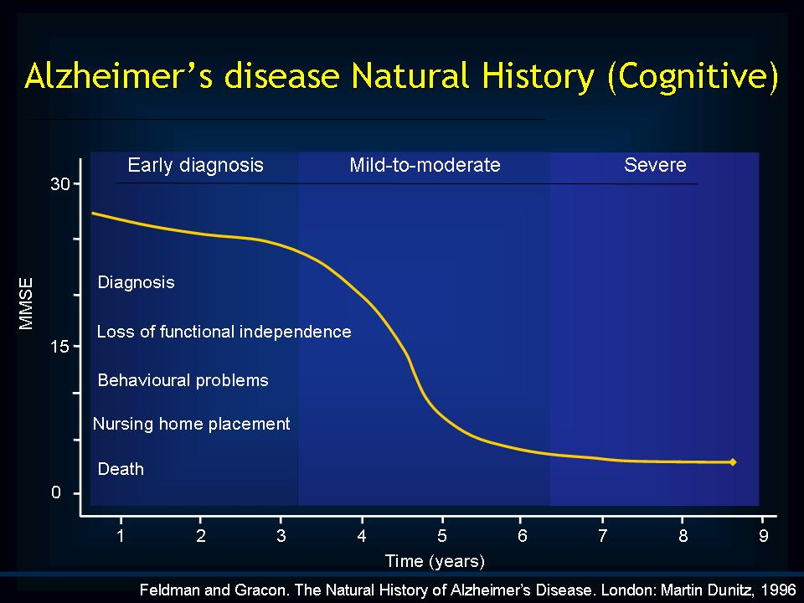
NICE Guidance (2007)
AChEI’s for moderate disease
Not cost effective for mild disease
QALY’s

Slide 87
QALY
QALY stands for Quality Adjusted Life Year.
"The essence of a QALY is that it takes a year of healthy life expectancy to be worth 1, but regards a year of unhealthy life expectancy as worth less than 1.
Its precise value is lower the worse the quality of life of the unhealthy person
Health care interventions are measured both by the number of extra years of life, and by the increased quality of life, that they can achieve.
Thus an intervention that provides 10 years of extra life at full health would have a QALY value of 10, and an intervention that improves quality of life from 0.5 to 0.8 for a person with a predicted further life expectancy of 30 years, would have a QALY value of 9. [0.3 (0.8-0.5) multiplied by 30].
Once the QALY value of a health care intervention is calculated and its cost is known it is then possible to calculate the cost per QALY of each intervention and provide a direct comparison between interventions. The general idea is that a high priority health care activity is one where the cost per QALY is as low as it can be.

Slide 88
QALY
Some examples of Cost per QALY calculations:
  Hospital dialysis for end-stage renal disease for patients aged 55 – 64 years (compared with no treatment) £45, 000
  Coronary artery bypass graft for patients with mild angina (compared with medical management) £26,000
  Breast cancer screening programme £6,800
  Cervical cancer screening (women aged 20-59 years) £200
Donepezil for mild AD – ‘£50,000 - £75,000’

Slide 89
QALY
Several objections have been made against QALYs. These include:
  1. Many healthcare interventions are not the subject of a QALY assessment and direct comparisons between the cost -effectiveness of different treatments is not possible.
  2. QALYs are based on population-level information. They do not take into account the personal response of individuals to their illness and their views of their need for treatment.
  3. QALYs are ageist.
    Individuals who have a greater span of life ahead of them, typically a younger person, would gain more from treatment on the basis of their predicted life expectancy in comparison with an older person who would have fewer years to benefit from a particular healthcare treatment. So a one -off life-saving intervention performed on a one-year old with a life expectancy of 80 years has a better QALY rating than the same intervention performed on a 70 year old.

Slide 90
Health Economics in Dementia
QALY calculations have a ‘health’ outcome and a ‘economic’ input.
To improve QALY
  Reduce cost = cost of intervention – saving from improving health
  Improve effectiveness
  Intervene effectively earlier

Slide 91
Effectiveness
Input better measures of effectiveness
  Cognition (restricted concept)
  QOL (Hard and historically problematic in drug trials)
  Institutionalisation (where most of cost is in dementia)
  Composite measure of all
Licensing ‘efficacy’ trials though do not need to measure these so generally low quality data from RCT’s

Slide 92
NICE Updated 2011
Absolutely no new data BUT
Completely reversed decision on mild Alzheimer’s dementia and allowed Memantine for severe.

Slide 93

National Audit Office Report
Recognised the huge problems currently and in the future with dementia.
Advocated massive investment in care and research
Head of the National Audit Office Sir John Bourn :
For too long dementia has not been treated as a high priority. Todays report shines a light on how significant an issue dementia is and how much scope there is to improve the way in which people who suffer from dementia are treated.
"Our rapidly ageing population means that costs for addressing dementia will continue to increase and, without redesign, services for people with dementia are likely to become increasingly inconsistent and unsustainable. Dementia can no longer be set aside. The issues raised in this report need to be addressed as a matter of urgency."

Slide 94
Other ‘policy’ Initiatives
National Dementia Strategy
RCPsych memory Clinic Accreditation
CQUIN Targets and Policy Statements
  Eg use of antipsychotics in dementia

Slide 95
H
Time 0 18months 36months
Serial coronal MRI of mild AD
Notes:
The first of these images on the left is when the patient only just fulfilled AD criteria – the next two scans at 18 months and 3 years later show the devastating brain volume loss with early involvement of the medial temporal lobe – this is the “signal” we want to capture – either for diagnosis or for tracking change

Slide 96
Presymptomatic AD:
atrophy precedes diagnosis
90%
85
Normal range: 95%CI
80
Symptoms
Brain Volume / TIV
75
Diagnosis
70
65
0
500
1000
1500
2000
2500
Time since first scan (days)
Measured using BSI – Fox et al 2001

Slide 97
Dementia Strategy
Living well with dementia: A National Dementia Strategy - 2009
Too late!
Must make distinction between Alzheimer’s disease and Alzheimer’s dementia.
Strategy focussed almost entirely on prevalent cases.
What strategy is being considered for incident cases and early detection?

Slide 98
Three Themes
Improving public and professional awareness
Early diagnosis and intervention
High quality care and support

Slide 99
Clinical Changes
Normal
At Risk
Incipient
Dementia
Dementia
Disease

Slide 100
Early diagnosis and intervention
Early diagnosis and intervention:
  Specialist memory assessment for all new cases
  Single point of referral (simple and rapid)
  Making the diagnosis well
  Breaking the diagnosis well
  Immediate and direct provision of treatment and support

Slide 101
Early recognition of disease
Identification of Incipient Alzheimer’s Dementia
Missed opportunity for forward thinking to service set up for early diagnosis.
  Cochrane Collaboration
  ADNI
  Europe-wide intitiatives on predicting MCI-Dementia predictors

Slide 102
Dementia Strategy
Based in the here and now
Does not predict advances
  Playing catch up with service delivery years behind therapeutic and diagnostic breakthroughs.
  Bias towards prevalent as opposed to incident cases
  No mention of research (DeNDRoN)
  No positive comment on role of neurologist

Slide 103

Dementia Strategy
Positive aspects
  That it was commissioned
  A national (English) approach will generally lift service delivery for those with dementia
  Focus the minds of HealthCare purchasers and create standards to wave in the face of managers.

Slide 104
Impact on service delivery?
Yes
May help to set bar for minimal service
  Should not preclude though innovation and progress

Slide 105
Parallel Processes
RCPsych Accreditation
  Section 1: Management
    Service Planning and Commissioning
    Staff Support and Supervision
    Complaints and Untoward Incidents
    Supporting Vulnerable People
  Section 2: Resources Available To Support Assessment And Diagnosis
    Resources
    Staff Training, Development, Supervision and Supports
    Joint Working
    Liaison
    Quality Assurance and Service Development
    The Clinic Environment (where applicable)

Slide 106
  Section 3: Referral and Access
    Referral and Access
    Capacity, Consent and Patient Confidentiality
    Assessment and Diagnosis: General
    Assessment and Diagnosis: Specific Conditions
    Support for People and their Carers
  Section 4: On-Going Care Management and Follow-Up
    Care Management
    Follow-Up

Slide 107
Summary
Several ‘statutory’ documents available or in drafting:
  NICE
  NAO
  Dementia UK
  Dementia Strategy
  RCPsych
  Reflecting the urgent need for action in care for patients with dementia
  Forward proofing against advances in technology.

Slide 108

Integration of approach
The future
  This problem needs to be solved
  ‘Public policy’ interfacing with clinical research
  Cannot rely on commercial sources to fund necessary research
  Dementia Tsar to coordinate clinical, academic, NGO and social care.

Slide 109
The near future
With a better understanding of disease there is now a greater opportunity and optimism for better identification and management of patients.
However:
  No new drugs for 10+ years
  Clinical practice for 15+ years essentially unaltered

Slide 110
What do we need to do (Step 1):
Identify specific clinical deficiencies in the prodromal dementia state associated with Alzheimer’s disease.
Develop measures that will be able to accurately gauge progression and hence response to intervention.
Develop better, more accurate diagnostic tests and diagnostic test batteries (Cochrane Collaboration)

Slide 111
What do we need to do (Step 2):
Once we have better definitions of the population and the way to measure change then:
Intervene with disease modifying agents.
Intervene with large, population based risk factor modification studies.

Slide 112
What do we need to do (Step 3):
Start preparing clinical services for a changed approach to managing patients:
This anticipates:
  Early identification
  More comprehensive diagnostic work up
  More aggressive intervention
  Leading on population based interventions:
    Health Heart = Healthy Mind
Bolster research environment in NHS

