Slide 1
Clinical presentation of dementia and differential diagnosis
Dr Craig Ritchie
Senior Lecturer, Centre for Mental Health
Honorary Consultant and R&D Director
West London Mental Health Trust
November 2012

Slide 2

Overview of Presentation
Dementia – an introduction
  Clarification of terminology
    Classification
      ICD 10
      DSM IV
      NINCDS-ADRDA
  Epidemiology
      (Disease and Dementia)

Slide 3

Classification
Alzheimer’s disease is NOT the same thing as Alzheimer’s dementia
  Alzheimer’s disease is a pathological diagnosis.
  Alzheimer’s dementia is a clinical syndrome thought to be due to underlying Alzheimer’s disease.

Slide 4
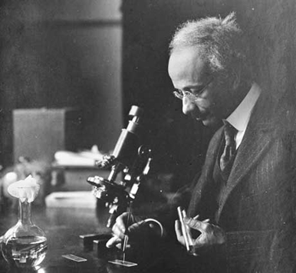
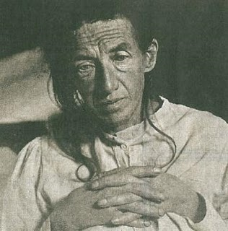
Alzheimer’s disease post mortem diagnosis

Slide 6
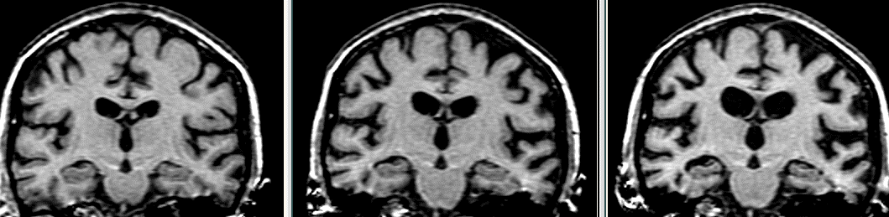

Slide 7
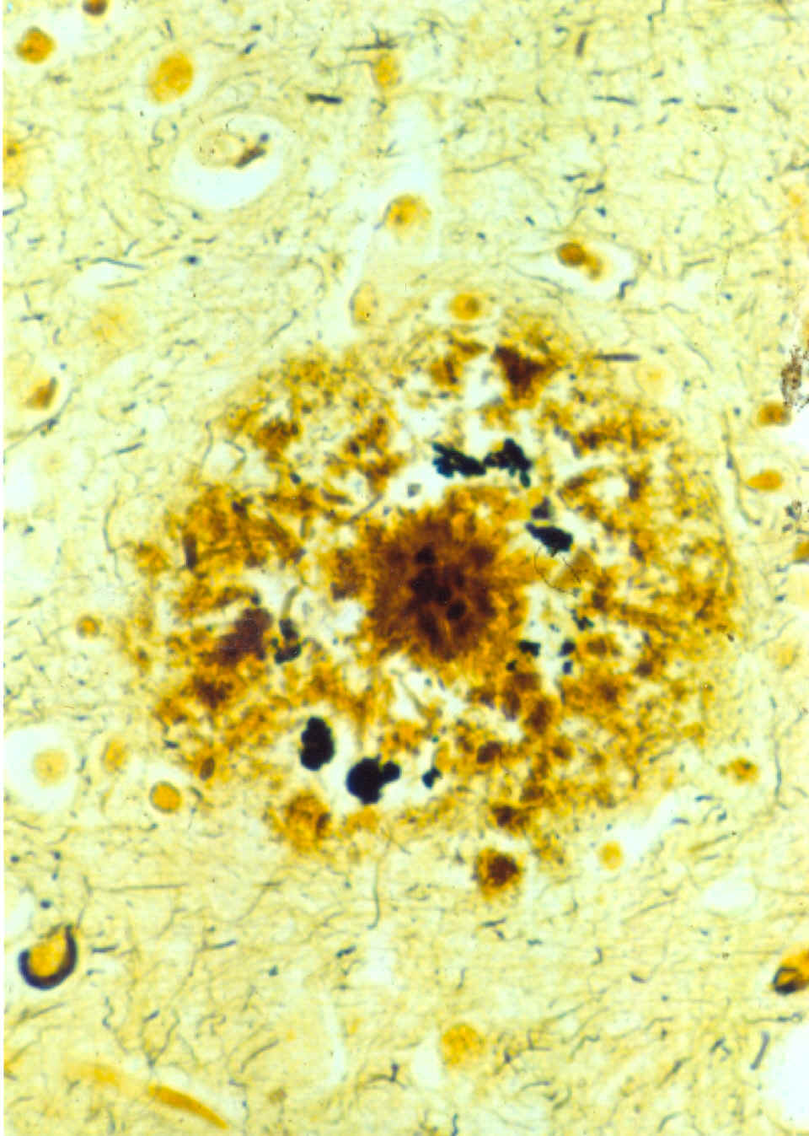
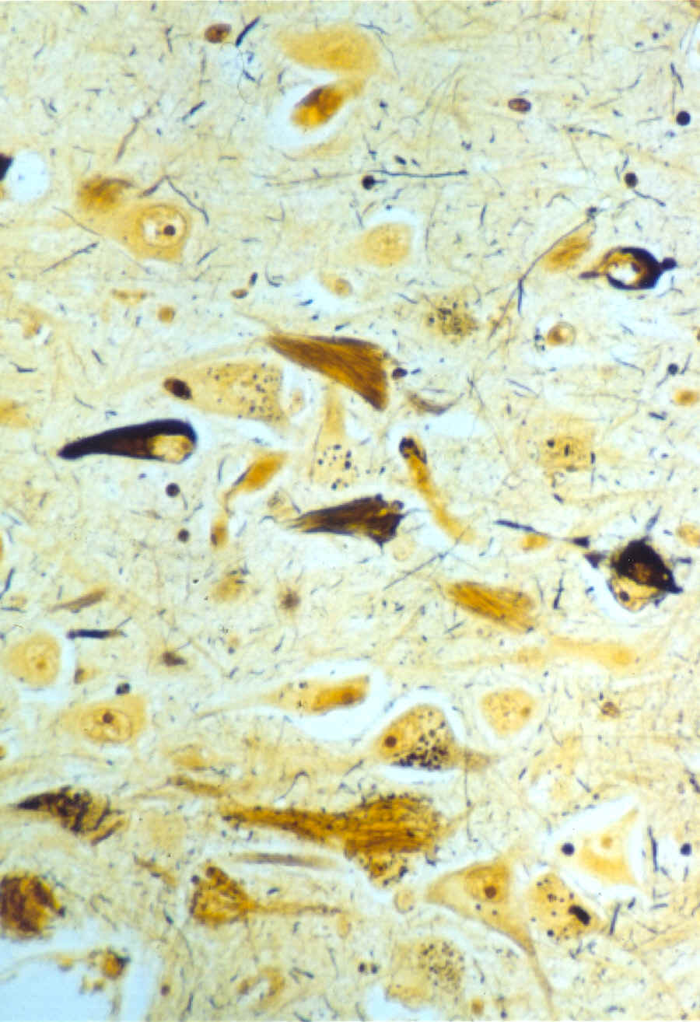
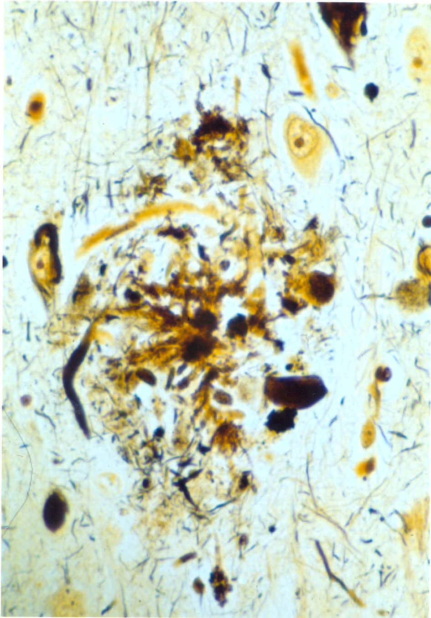
Alzheimer’s Disease Microscopy
Amyloid
Plaque
Neurofibrillary
Tangle
Neuritic
Plaque
β-amyloid
glycolipids
α-1 chymotrypsin
ApoE
ApoJ
vitronectin
PHF tau (70-90 x 15-20 nm)
Straight filaments (12-18 nm)
Hyperphosphorylated tau
ferritin polypeptide
proteoglycans
β-amyloid
Hyperphosphorylated tau
Swollen neurites

Slide 8
Diagnostic Criteria
CERAD Criteria (The Consortium to Establish a Registry for Alzheimer’s Disease)
  The Neuropathology assessment packet includes the following data forms:
  A. Demographic Data
  B. Clinical History
  C. Gross Examination of the Brain
  D. Cerebral Vascular Disease: Gross Findings
  E. Microscopic Vascular Findings
  F. Major Non-vascular Microscopic Findings
  G. Microscopic Evaluation of Hippocampus and Neocortex
  H. Assessment of Neurohistological Findings
  I. Neuropathological Diagnosis
  J. Final Assessment
  Also Reagan and Khachaturian Criteria

Slide 9
DSM-IV Dementia of the Alzheimer’s Type
A. The development of multiple cognitive deficits manifested by both:
1.Memory impairment (impaired ability to learn new information or to recall previously learned information)
2.One or more of the following cognitive disturbances:
(a) aphasia (language disturbance)
(b) apraxia (impaired ability to carry out motor activities depite intact motor function)
(c) agnosia (failure to recognize or identify objects despite intact sensory function)
(d) disturbance in executive functioning (i.e., planning, organizing, sequencing, abstracting)
B. The cognitive deficits in criteria A1 and A2 each cause significant impairment in social or occupational functioning and represent a significant decline from a previous level of functioning.
C. The course is characterized by gradual onset and continuing cognitive decline.
D. The cognitive deficits in Criteria A1 and A2 are not due to any of the following:
(1) other central nervous system conditions that cause progressive deficits in memory and cognition (e.g., cerebrovascular disease, Parkinson's disease, Huntington's disease, subdural hematoma, normal-pressure hydrocephalus, brain tumor)
(2) systemic conditions that are known to cause dementia (e.g., hypothyroidism, vitamin B or folic acid deficiency, niacin deficiency, hypercalcemia,neurosyphilis, HIV infection)
(3) substance-induced conditions
E. The deficits do not occur exclusively during the course of a delirium.

Slide 10
DSM-IV Codes
290.0 Dementia of the Alzheimer’s Type, With Late Onset, Uncomplicated.
290.10 Dementia of the Alzheimer’s Type, With Early Onset, Uncomplicated.
290.11 Dementia of the Alzheimer’s Type, With Early Onset, With Delirium.
290.12 Dementia of the Alzheimer’s Type, With Early Onset, With Delusions.
290.13 Dementia of the Alzheimer’s Type, With Early Onset, With Depressed Mood.
290.20 Dementia of the Alzheimer’s Type, With Late Onset, With Delusions.
290.21 Dementia of the Alzheimer’s Type, With Late Onset, With Depressed Mood.
290.3 Dementia of the Alzheimer’s Type, With Late Onset, With Delirium.

Slide 11
ICD-10 General Criteria for Dementia
DEMENTIA
G1. Evidence of each of the following:
(1) A decline in memory, which is most evident in the learning of new information, although in more severe cases, the recall of previously learned information may be also affected. The impairment applies to both verbal and non-verbal material. The decline should be objectively verified by obtaining a reliable history from an informant, supplemented, if possible, by neuropsychological tests or quantified cognitive assessments. The severity of the decline, with mild impairment as the threshold for diagnosis, should be assessed as follows:
Mild: a degree of memory loss sufficient to interfere with everyday activities, though not so severe as to be incompatible with independent living. The main function affected is the learning of new material. For example, the individual has difficulty in registering, storing and recalling elements in daily living, such as where belongings have been put, social arrangements, or information recently imparted by family members.
Moderate: A degree of memory loss which represents a serious handicap to independent living. Only highly learned or very familiar material is retained. New information is retained only occasionally and very briefly. The individual is unable to recall basic information about where he lives, what he has recently been doing, or the names of familiar persons.
Severe: a degree of memory loss characterized by the complete inability to retain new information. Only fragments of previously learned information remain. The subject fails to recognize even close relatives.

Slide 12
ICD-10 General Criteria for Dementia
(2) A decline in other cognitive abilities characterized by deterioration in judgement and thinking, such as planning and organizing, and in the general processing of information. Evidence for this should be obtained when possible from interviewing an informant, supplemented, if possible, by neuropsychological tests or quantified objective assessments. Deterioration from a previously higher level of performance should be established. The severity of the decline, with mild impairment as the threshold for diagnosis, should be assessed as follows:
Mild. The decline in cognitive abilities causes impaired performance in daily living, but not to a degree making the individual dependent on others. More complicated daily tasks or recreational activities cannot be undertaken.
Moderate. The decline in cognitive abilities makes the individual unable to function without the assistance of another in daily living, including shopping and handling money. Within the home, only simple chores are preserved. Activities are increasingly restricted and poorly sustained.
Severe. The decline is characterized by an absence, or virtual absence, of intelligible ideation.
The overall severity of the dementia is best expressed as the level of decline in memory or other cognitive abilities, whichever is the more severe (e.g. mild decline in memory and moderate decline in cognitive abilities indicate a dementia of moderate severity).

Slide 13
ICD-10 General Criteria for Dementia
G2. Preserved awareness of the environment i.e. absence of clouding of consciousness during a period of time long enough to enable the unequivocal demonstration of G1.
When there are superimposed episodes of delirium the diagnosis of dementia should be deferred.
G3. A decline in emotional control or motivation, or a change in social behaviour, manifest as at least one of the following:
(1) emotional lability;
(2) irritability;
(3) apathy;
(4) coarsening of social behaviour.
G4. For a confident clinical diagnosis, G1 should have been present for at least six months; if the period since the manifest onset is shorter, the diagnosis can only be tentative.

Slide 14
Specific Criteria for Alzheimer’s Dementia
A. The general criteria for dementia (G1 to G4) must be met.
B. There is no evidence from the history, physical examination or special investigations for any other possible cause of dementia (e.g. cerebrovascular disease, Parkinson's disease, Huntington's disease, normal pressure hydrocephalus), a sysytemic disorder (e.g. hypothyroidism, vit. B12 or folic acid deficiency, hypercalcaemia),or alcohol- or drug-abuse.
Comments: The diagnosis is confirmed by post mortem evidence of neurofibrillary tangles and neuritic plaques in excess of those found in normal ageing of the brain.
The following features support the diagnosis, but are not necessary elements: Involvement of cortical functions as evidenced by aphasia, agnosia or apraxia; decrease of motivation and drive, leading to apathy and lack of spontaneity; irritability and disinhibition of social behaviour; evidence from special investigations that there is cerebral atrophy, particularly if this can be shown to be increasing over time. In severe cases there may be Parkinson-like extrapyramidal changes, logoclonia, and epileptic fits.

Slide 15
Specific Criteria for Alzheimer’s Dementia
Specification of features for possible subtypes. Because of the possibility that subtypes exist, it is recommended that the following characteristics be ascertained as a basis for a further classification: age at onset; rate of progression; the configuration of the clinical features, particularly the relative prominence (or lack) of temporal, parietal or frontal lobe signs; any neuropathological or neurochemical abnormalities, and their pattern.
The division of AD into subtypes can at present be accomplished in two ways: first by taking only the age of onset and labeling AD as either early or late, with an approximate cut-off point at 65 years; or secondly, by assessing how well the individual conforms to one of the two putative syndromes, early or late onset type.
It should be noted that it is unlikely that a sharp distinction exists between early and late onset type. Early onset type may occur in late life, just as late onset type may occasionally have an onset under the age of 65. The following criteria may be used to differentiate F00.0 from F00.1, but it should be remembered that the status of this subdivision is still controversial.
F00.0 Dementia in Alzheimer's disease with early onset
1. The criteria for dementia in Alzheimer's disease (F00) must be met, and the age at onset being under 65 years.
2. In addition, at least one of the following requirements must be met:
(a) evidence of a relatively rapid onset and progression;
(b) in addition to memory impairment, there is aphasia (amnesic or sensory), agraphia, alexia, acalculia, or apraxia (indicating the presence of temporal, parietal and/or frontal lobe involvement).

Slide 16
Specific Criteria for Alzheimer’s Dementia
F00.1 Dementia in Alzheimer's disease with late onset
  The criteria for dementia in Alzheimer's disease (F00) must be met and the age at onset must be 65 or more.
  In addition, at least one of the following requirements must be met:
    evidence of a very slow, gradual onset and progression (the rate of the latter may be known only retrospectively after a course of 3 years or more)
    predominance of memory impairment G1.1, over intellectual impairment G1.2 (see general criteria for dementia).
F00.2 Dementia in Alzheimer's disease, atypical or mixed type
Use this term and code for dementias that have important atypical features or that fulfil criteria for both early and late onset type of Alzheimer's disease.
Mixed Alzheimer's and vascular dementia is also included here.
F00.9 Dementia in Alzheimer's disease, unspecified

Slide 17
NINCDS-ADRDA
Criteria for Diagnosis of Probable Alzheimer's Disease:
Dementia established by clinical examination, and documented by a standard test of cognitive function (e.g. Mini-Mental State Examination, Blessed Dementia Scale, etc.), and confirmed by neuropsychological tests.
Significant deficiencies in two or more areas of cognition, for example, word comprehension and task-completion ability.
Progressive deterioration of memory and other cognitive functions.
No loss of consciousness.
Onset from age 40 to 90, typically after 65.
No other diseases or disorders that could account for the loss of memory and cognition.

Slide 18
NINCDS-ADRDA (2)
A Diagnosis of Probable Alzheimer's Disease is Supported By:
  Progressive deterioration of specific cognitive functions: language (aphasia), motor skills (apraxia), and perception (agnosia).
  Impaired activities of daily living and altered patterns of behavior.
  A family history of similar problems, particularly if confirmed by neurological testing.
  The following laboratory results:
  Normal cerebrospinal fluid (lumbar puncture test).
  Normal electroencephalogram (EEG) test of brain activity.
  Evidence of cerebral atrophy in a series of CT scans.
Other Features Consistent with Alzheimer's Disease
  Plateaus in the course of illness progression.
  CT findings normal for the person's age.

Slide 19
NINCDS-ADRDA (3)
Associated symptoms, including: depression, insomnia, incontinence, delusions, hallucinations, weight loss, sex problems, and significant verbal, emotional, and physical outbursts.
Other neurological abnormalities, especially in advanced disease: including: increased muscle tone and a shuffling gait.
Features That Decrease the Likelihood of Alzheimer's Disease:
  Sudden onset.
  Such early symptoms as: seizures, gait problems, and loss of vision and coordination.

Slide 20
Summary
In general – all criteria need DECLINE in cognitive symptoms with amnestic symptoms as core plus (at least) one other domain.
Require functional decline (distinction MCI)
Require absence of other possible aetiology

Slide 21

More than Cognition
Behavioural
  Withdrawn
  Pacing
  Agitated
Neuropsychiatric
  Depressed
  Psychotic
    Delusions
    Hallucinations

Slide 22
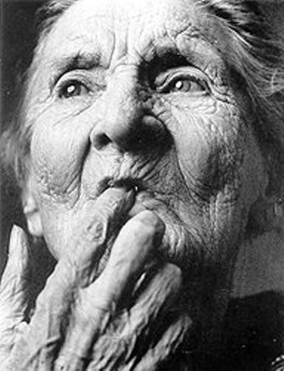
Epidemiology
Prevalence and incidence
Risk Factors
Concept of MCI
Disease and Dementia Temporal Changes

Slide 23
Prevalence of Alzheimer’s disease
60
50%
50
40
30%
Prevalence (%)
30
20
16%
8%
10
2%
4%
1%
0
60-64
65-69
70-74
75-79
80-84
85+
95+
Age (years)
Kurz A. Eur J Neurol 1998; 5(Suppl 4): S1-8
Wimo A et al. Int J Geriatr Psychiatry 1997; 12: 841-56

Slide 24
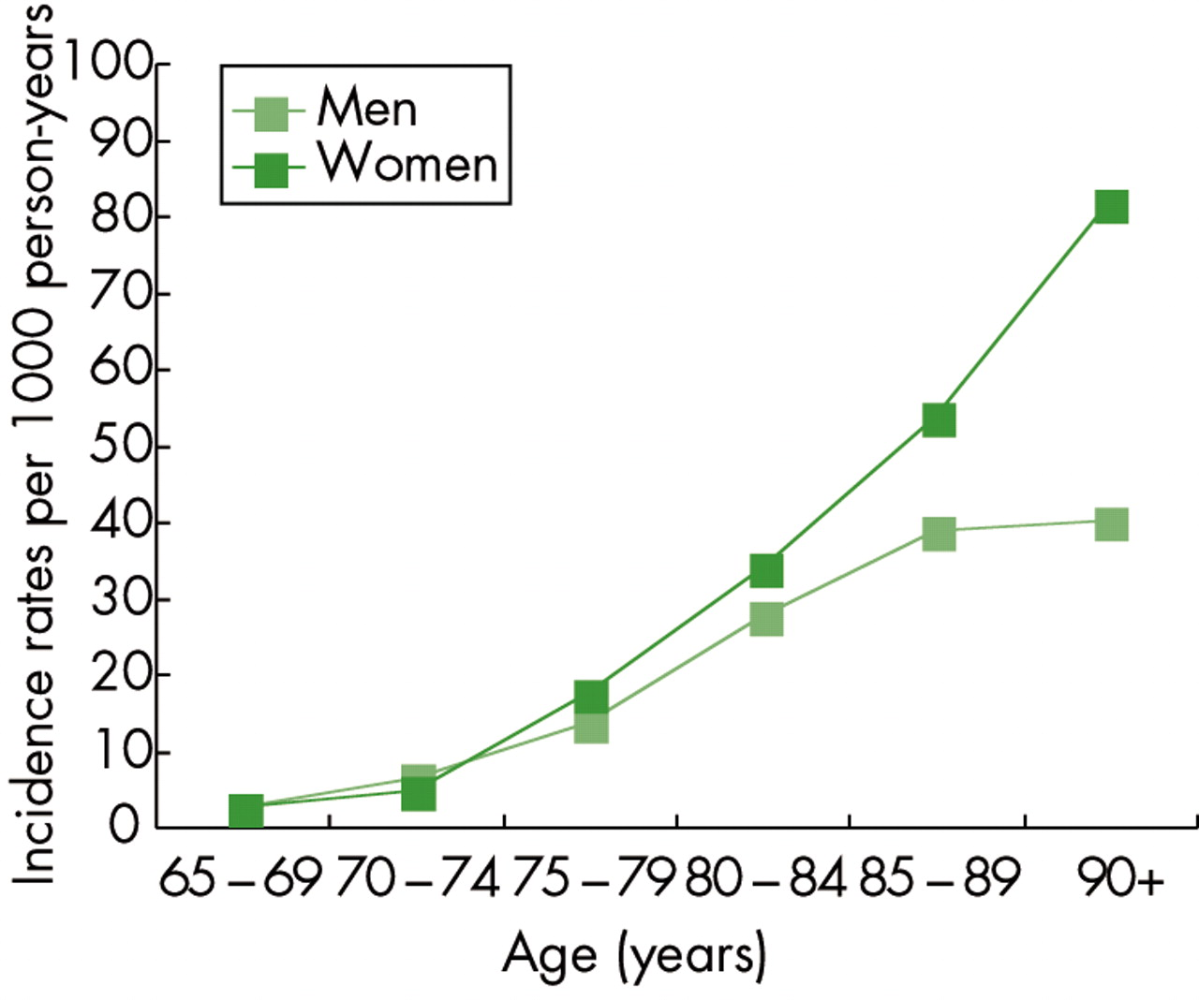
van der Flier and Scheltens 2005 JNNP

Slide 25
Dementia epidemiology
6% of individuals over 65¹
20% of individuals over 80
790,000 cases in UK²
Average GP will see 1-2 new cases each year
Lobo et al 2001
Alzheimer’s society, 2007
Notes:
25

Slide 26
Dementia- epidemiology
Alzheimer’s dementia 50%
Vascular dementia 20%
Mixed AD/Vascular 20%
Dementia with Lewy bodies 5%
  Antemorbid diagnosis correct 70-80%

Slide 27
Dementia- epidemiology
Common causes of Early Onset Dementia (EOD) (ie dementia before 65)
  Alzheimer’s disease- 34%
  VaD – 18%
  Frontotemporal Dementia (FTD)- 12%
  Alcohol related dementia – 10%
  Huntington’s disease - 5%

Slide 28
Dementia- epidemiology
Dementia very rare before age 40
Prevalence doubles every 5 years from age 40
Affects 1% of people aged 65 to 74
Costs in UK £13.5 billion (2006)
Growing evidence for risk factors: genetic, clinical and environmental.
  Window of opportunity for non-pharmacological risk modification

Slide 29
Risk Factors
Age
ApoEε4, TOMM40 other genes
Head injury with sustained loss of consciousness
Diabetes and cardiovascular disease and diet in men.
Obesity, depression, cholinergic burden and diet in woman.

Slide 30
Clinical Changes
Normal
At Risk
Incipient
Dementia
Dementia
Disease

Slide 31
Clinical Changes
Normal
At Risk
Incipient
Dementia
Dementia
Disease
IDENTIFIED EPIDEMIOLOGICAL RISK

Slide 32
Clinical Changes
Normal
At Risk
Incipient
Dementia
Dementia
Disease
INTERVENTION FOR IDENTIFIED EPIDEMIOLOGICAL RISK

Slide 33
Clinical Changes
Normal
At Risk
Incipient
Dementia
Dementia
Disease
INTERVENTION FOR IDENTIFIED EPIDEMIOLOGICAL RISK

Slide 34
The Concept of MCI
Mild Cognitive Impairment
Dementia always preceded by ‘MCI’
MCI does not always lead to dementia.
Very unstable ‘diagnosis’ and represents a very closely temporally related stage of illness.
  Matthew, 2008 (JAGS)

Slide 35
Other Dementias
Topics to cover:
  Early and Atypical AD
  Other common dementias
    Vascular Dementia
    Lewy Body Dementia
    Fronto-temporal dementia
  More rare dementias and dementias associated with other neurological disorders
  Neuroimaging
  Biomarkers

Slide 36
Early and Atypical AD
Early AD may be ‘Wild Type’ or secondary to a Fully Penetrant Autosomal Dominant genetic mutation.
Presenilin 1 and Presenilin 2 mutations in or around the cleavage site of APP.
APP gene mutations manifest greater likelihood of BACE activity to generate Aβ42
Represent <1% of all AD cases and tend to develop in patients <50.
Uncertainty if have more malignant course of decline.

Slide 37
Atypical AD
Posterior Cortical Atrophy
  (Terry Pratchet)
  Effects posterior/parietal lobe function in preference to mesial temporal. Visuospatial rather than amnestic problems predominate.
Frontal Variant of AD
  Earlier presentation with executive dysfunction – less likely to have language difficulties (seen in FTLD) and tends to be onset at ages normally associated with late-onset AD (FTLD Patients tend to have younger age of onset)

Slide 38
Vascular Dementia
Has suffered through lack of clear diagnostic guidelines and overlap in pathology, clinical presentation and risk factors with AD.
NINDS-AIREN Criteria

Slide 39
NINDS-AIREN Criteria
I. The criteria for the clinical diagnosis of probable vascular dementia include all of the following:
Dementia defined by cognitive decline from a previously higher level of functioning and manifested by impairment of memory and of two or more cognitive domains (orientation, attention, language, visuospatial functions, executive functions, motor control, and praxis), preferable established by clinical examination and documented by neuropsychological testing; deficits should be severe enough to interfere with activities of daily living not due to physical effects of stroke alone.
Exclusion criteria: cases with disturbance of consciousness, delirium, psychosis, severe aphasia, or major sensorimotor impairment precluding neuropsychological testing. Also excluded are systemic disorders or other brain diseases (such as AD) that in and of themselves could account for deficits in memory and cognition.
Cerebrovascular disease, defined by the presence of focal signs on neurologic examination, such as hemiparesis, lower facial weakness, Babinski sign, sensory deficit, hemianopia, and dysarthria consistent with stroke (with or without history of stroke), and evidence of nof relevant CVD by brain imaging (CT or MRI) including multiple large vessel infarcts or a single strategically placed infarct (angular gyrus, thalamus, basal forebrain, or PCA or ACA territories), as well as multiple basal ganglia and white matter lacunes, or extensive periventricular white matter lesions, or combinations thereof.
A relationship between the above two disorders, manifested or inferred by the presence of one or more of the following: (a) onset of dementia within 3 months following a recognized stroke; (b) abrupt deterioration in cognitive functions; or fluctuating, stepwise progression of cognitive deficits.

Slide 40
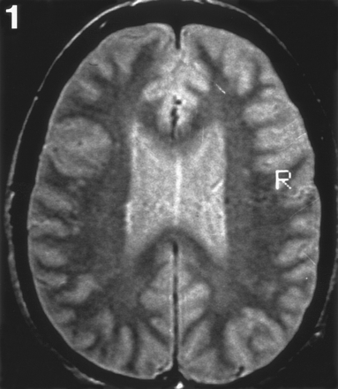
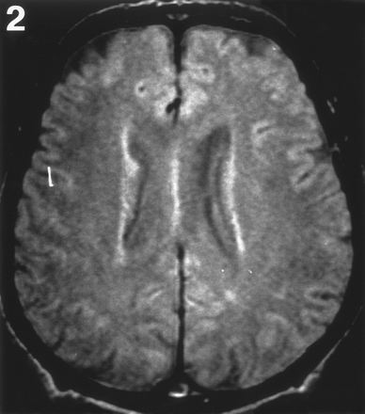
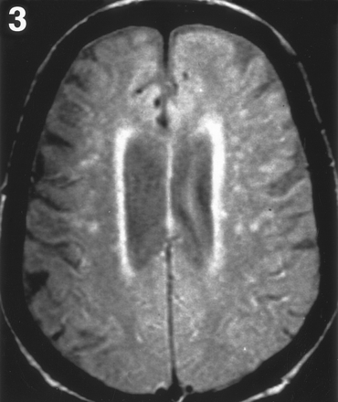
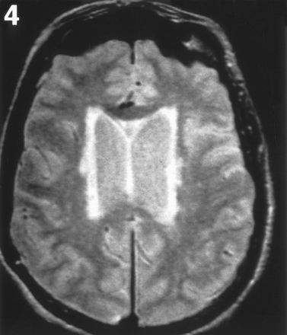
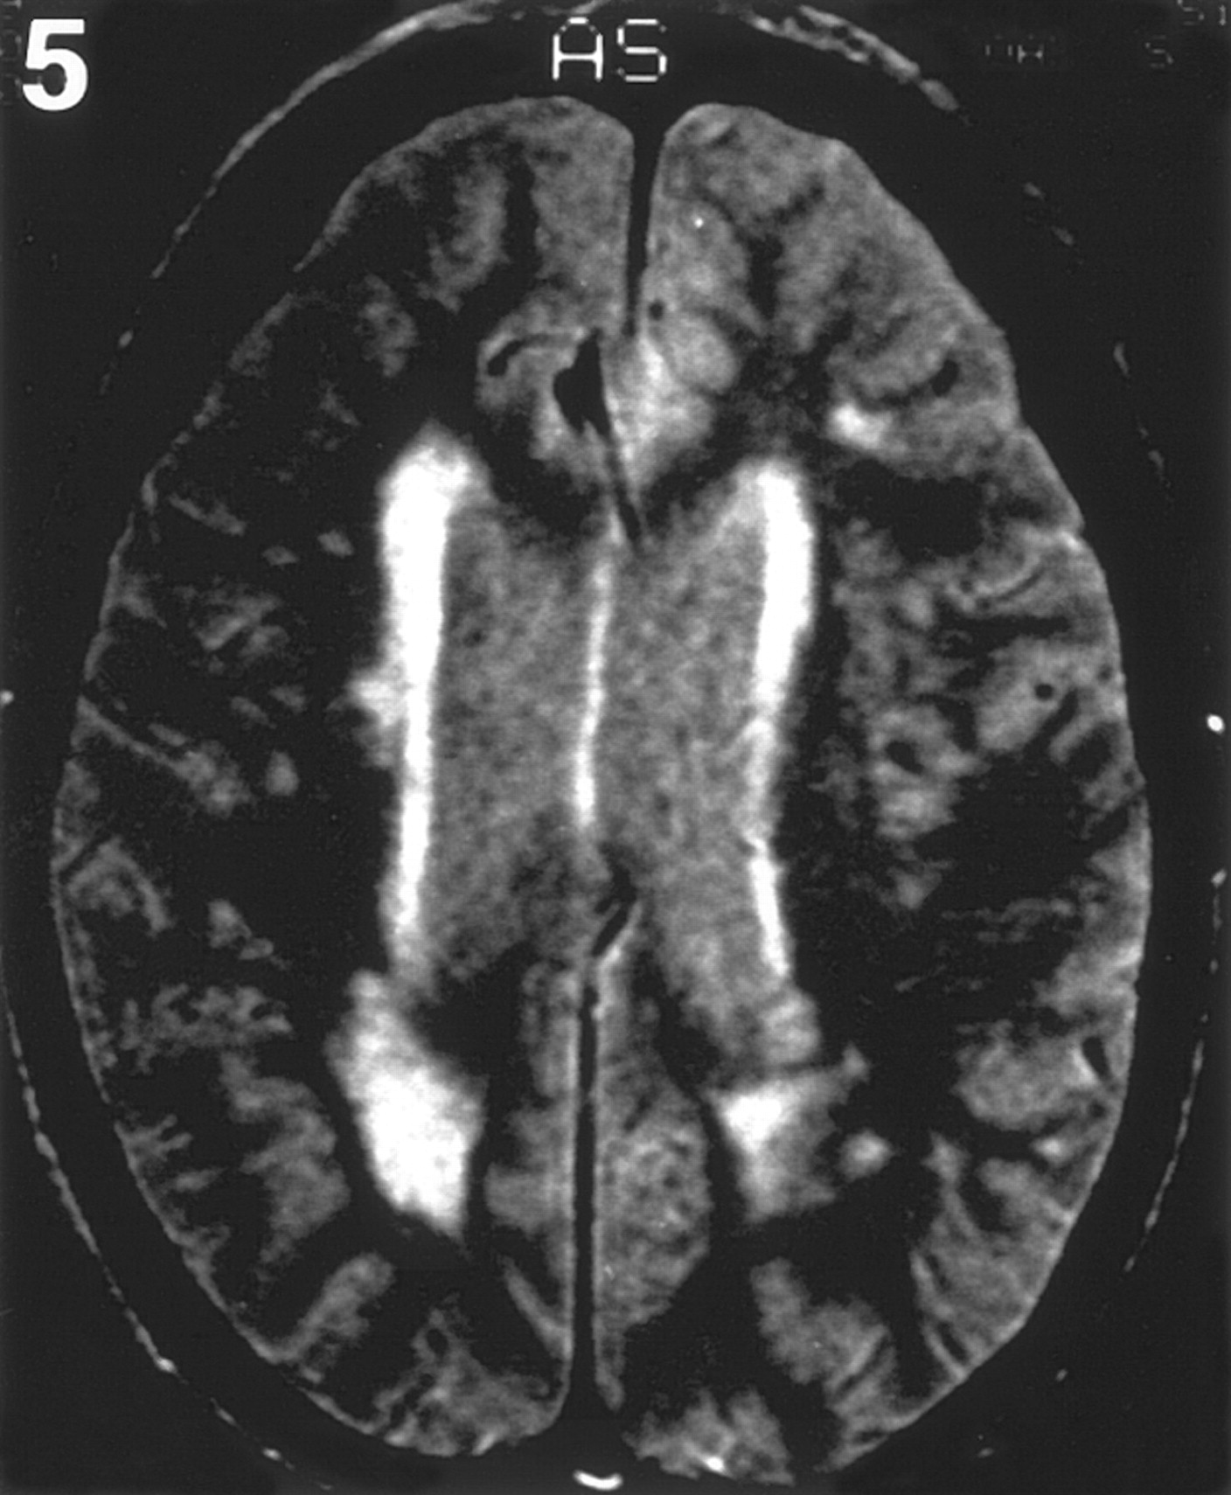
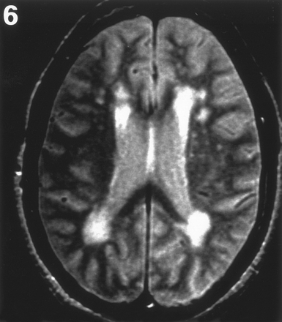
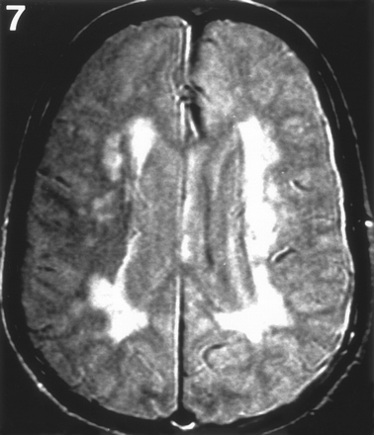
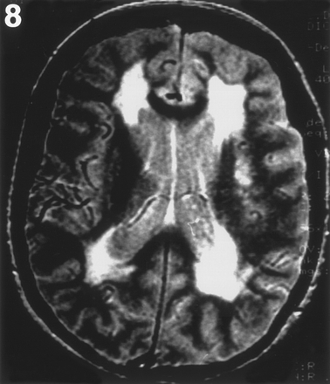
Reference images for classifying WML grade for the ARIC Study.
Discontinuous periventricular rim or minimal "dots" of subcortical white matter
Thin continuous periventricular rim or few patches of subcortical WML
Thicker continuous periventricular rim with scattered patches of subcortical WML
Thicker shaggier periventricular rim and mild subcortical WML, may have minimal confluent periventricular lesions
Mild periventricular confluence surrounding frontal and occipital horns
Moderate periventricular confluence surrounding frontal and occipital horns
Periventricular confluence with moderate involvement of centrum semiovale
Periventricular confluence involving most of centrum semiovale

Slide 41
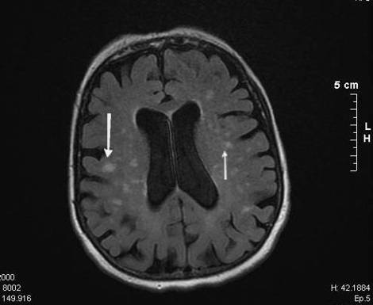
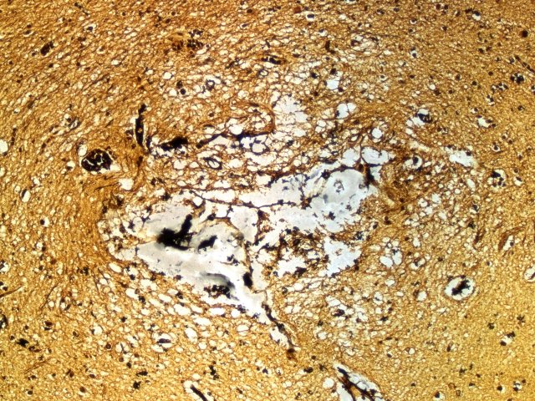
Lacunar Infarcts

Slide 42
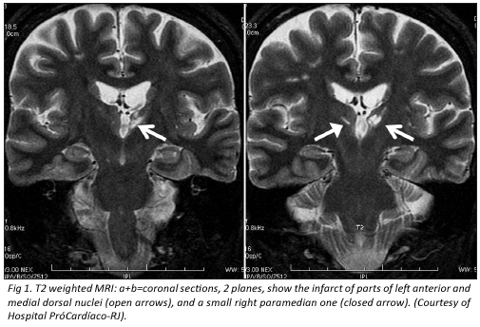
Strategic Infarct (Thalamus)

Slide 43
NINDS-AIREN Criteria (2)
II. Clinical features consistent with the diagnosis of probable vascular dementia include the following:
Early presence of gait disturbance (small-step gait or marche a petits pas, or magnetic, apraxic-ataxic or parkinsonian gait)
History of unsteadiness and frequent, unprovoked falls
Early urinary frequency, urgency, and other urinary symptoms not explained by urologic disease
Pseudobulbar palsy
Personality and mood changes, abulia, depression, emotional incontinence, or other subcortical deficits including psychomotor retardation and abnormal executive function.
III. Features that make the diagnosis of vascular dementia uncertain or unlikely include
(a) Early onset of of memory deficit and progressive worsening of memory deficit and progressive worsening of memory and other cognitive functions such as language (transcortical sensory aphasia), motor skills (apraxia), and perception (agnosia), in the absence of corresponding focal lesions on brain imaging;
(b) Absence of focal neurological signs, other than cognitive disturbance
(c) Absence of cerebrovascular lesions on brain CT or MRI.

Slide 44
NINDS-AIREN Criteria (3)
IV. Clinical diagnosis of possible vascular dementia may be made in the presence of dementia (section I-1) with focal neurologic signs in patients in whom brain imaging studies to confirm definite CVD are missing; or in the absence of clear temporal relationship between dementia and stroke; or in patients with subtle onset and variable course (plateau or improvement) of cognitive deficits and evidence of relevant CVD.
V. Criteria for diagnosis of definite vascular dementia are (a) clinical criteria for probablevascular dementia; (b) histopathologic evidence of CVD obtained from biopsy or autopsy; (c) absence of neurofibrillary tangles and neuritic plaques exceeding those expected for age; and (d) absence of other clinical or pathological disorder capable of producing dementia.
VI. Classification of vascular dementia for research purposes may be made on the basis of clinical, radiologic, and neuropathologic features, for subcategories or defined conditions such as cortical vascular dementia, subcortical vascular dementia, BD, and thalamic dementia.
The term "AD with CVD" should be reserved to classify patients fulfilling the clinical criteria for possible AD and who also present clinical or brain imaging evidence of relevant CVD. Traditionally, these patients have been included with VaD in epidemiologic studies. The term "mixed dementia," used hitherto, should be avoided

Slide 45
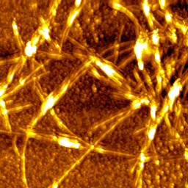
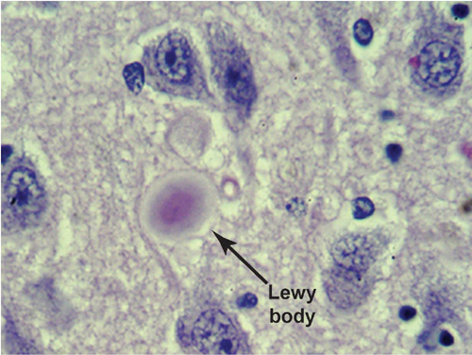
Dementia with Lewy Bodies
Lewy Body is an aggregation of mis-folded α-synuclein. It is a cytoplasmic inclusion body associated with both Parkinson’s disease (when located in Basal Ganglia) and Dementia if in Cortices.

Slide 46
Lewy Body Dementia
Consensus criteria for the clinical diagnosis of probable and possible dementia with Lewy bodies
The central feature required for a diagnosis of dementia with Lewy bodies (DLB) is progressive cognitive decline of sufficient magnitude to interfere with normal social or occupational function. Prominent or persistent memory impairment may not necessarily occur in the early stages but is usually evident with progression. Deficits on tests of attention and of frontal-subcortical skills and visuospatial ability may be especially prominent.
Two of the following core features are essential for a diagnosis of probable DLB, one is essential for possible DLB.
  Fluctuating cognition with pronounced variations in attention and alertness.
  Recurrent visual hallucinations which are typically well formed and detailed.
  Spontaneous motor features of parkinsonism.
Features supportive of the diagnosis are:
  Repeated falls
  Syncope
  Transient loss of consciousness
  Neuroleptic sensitivity
  Systematised delusions
  Hallucinations in other modalities.
A diagnosis of DLB is less likely in the presence of:
Stroke disease, evident as focal neurological signs or on brain imaging.
Evidence on physical examination and investigation of any physical illness, or other brain disorder, sufficient to account for the clinical picture.

Slide 47
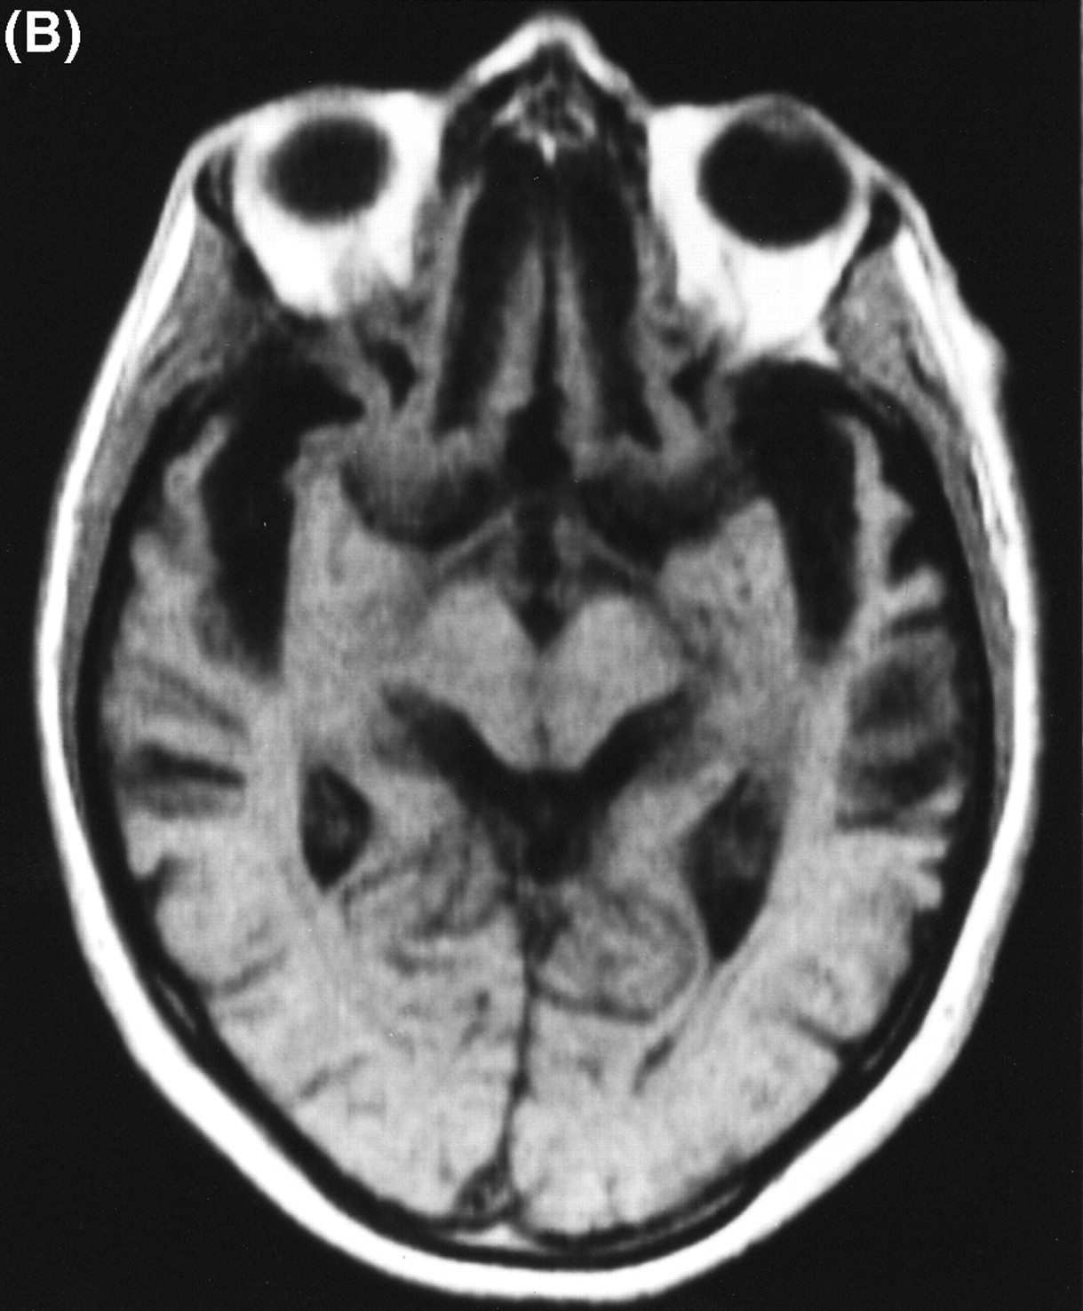
Fronto Temporal Dementia
Less common (<5%)
Tends to affect younger patients – tends to come into contact with neurologists in UK cf Psychiatrists.

Slide 48
Frontotemporal Dementia
Personality and behaviour change
Lack insight, and lose the ability to empathise with others. This can make them appear selfish and unfeeling become extrovert when they were previously introverted, or withdrawn when they were previously outgoing behave inappropriately - for example, making tactless comments, joking at the 'wrong' moments, or being rude. lose their inhibitions - for example, exhibiting sexual behaviour in public become aggressive be easily distracted develop routines - for example, compulsive rituals.
Language difficulties
The person with fronto-temporal dementia may experience language difficulties, including: problems finding the right words a lack of spontaneous conversation circumlocution, using many words to describe something simple a reduction in or lack of speech.
Changes in eating habits
The person may overeat and/or develop a liking for sweet foods.
Later stages
The rate of progression of fronto-temporal dementia varies enormously, ranging from less than two years to over ten years.
In the later stages, the damage to the brain is usually more generalised, and symptoms usually appear to be similar to those of Alzheimer's disease. People affected may no longer recognise friends and family, and may need nursing care.

Slide 49
FTD Diagnostic Criteria
FTD: Clinical profile
□
Frontotemporal dementia (FTD):
Character change and disordered social conduct.
Instrumental functions relatively well preserved.
Progressive nonfluent aphasia (PA):
  Disorder of expressive language is the dominantfeature initially and throughout the disease course. Other aspects of cognition are intact or relatively well preserved.
□
Semantic aphasia and associative agnosia dementia (Semantic dementia, SD):
  Impaired understanding of word meaning and/or object identity.

Slide 50
Other Less Common Dementias
Neurodegenerative:
  Progressive Supranuclear Palsy (PSP)
  CorticoBasilar Degeneration
  Huntington’s Disease (HD)
  Wilson’s disease (WD)
Inflammatory
  Multiple sclerosis
  Systemic lupus erythromatosis
  Sarcoidosis
  Vasculitis

Slide 51
Other causes
Infective Aetiology
  Human immunodeficiency virus
  Herpes simplex virus
  JC papova virus- progressive multifocal leukoencephalopathy
  Measles (subacute sclerosing panencephalitis)
  Cerebral abscess
  Prion diseases
Nutritional
  Thiamine deficiency
  B12 deficiency
Malignancy
  Primary (e.g. glioma, meningioma)
  Metastatic
  Paraneoplastic ( esp. small cell lung, breast, ovary)

Slide 52
Other causes
Normal pressure hydrocephalus
Substance misuse (e.g. alcohol, benzodiazepines)
Heavy metal poisoning (arsenic, lead, mercury)
Cerebral autosomal dominant arteriopathy with subcortical infarcts and leukoencephalopathy (CADASIL)
Some “treatable” dementias (very rare)
  vitamin deficiency (B1, B12)
  syphilis
  normal pressure hydrocephalus
  hypothyroidism
  cerebral tumours (especially meningiomas)
  subdural haematoma

Slide 53
Neuroimaging
The role of neuroimaging in clinical practice and research:
Exclude rarities (eg tumours)
Support (but rarely refutes) clinical diagnosis
Track changes over time to aid diagnostic accuracy.
New techniques to identify pre-manifest disease
Differentiate between subtypes of dementia (Vascular, LBD and AD)

Slide 54
Neuroimaging to Track Changes
Cross-sectional imaging is fraught with interpretation difficulties:
  Large overlap between volumes in AD and normal aging.
Longitudinal assessment to observe atrophy more dynamically.

Slide 56
H
Time 0 18months 36months
Serial coronal MRI of mild AD
Notes:
The first of these images on the left is when the patient only just fulfilled AD criteria – the next two scans at 18 months and 3 years later show the devastating brain volume loss with early involvement of the medial temporal lobe – this is the “signal” we want to capture – either for diagnosis or for tracking change

Slide 57
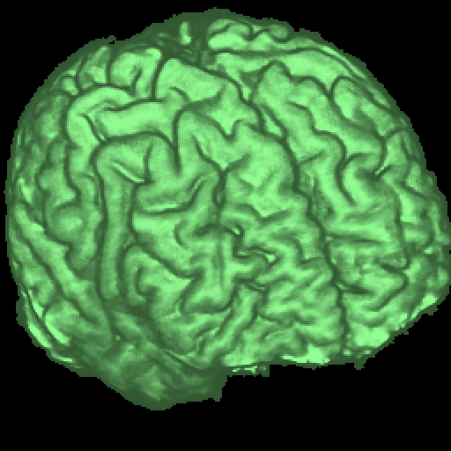
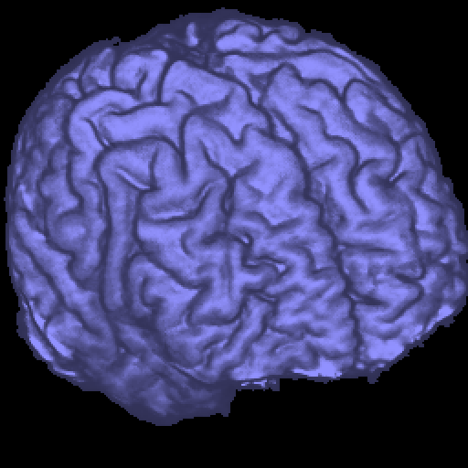
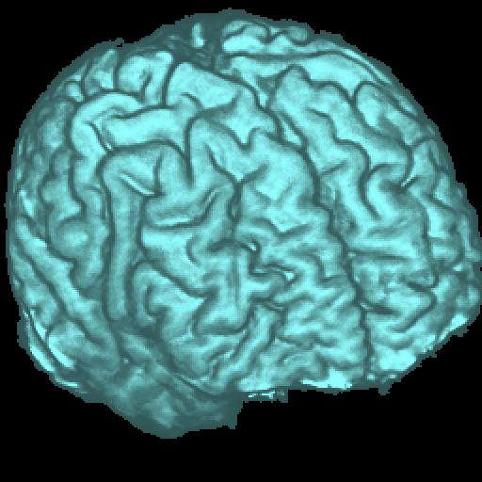
Registration
Scan 1
Scan 2
Complex brain structure
Nick Fox - IoN, UCL
Notes:
Registration – the spatial alignment of serial imaging – allows small differences to be detected and quantified with higher precision

Slide 58
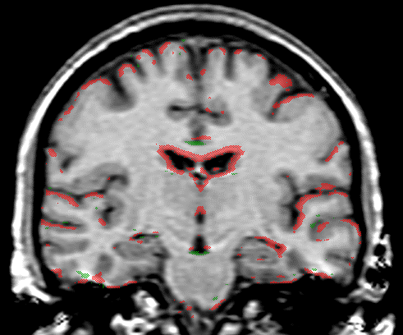
Notes:
In this slide one sees an overlay (in red and green) of the difference between two scans (1 year apart) of an individual with mild AD – in red one sees the areas of brain volume loss – note the diffuse nature of change and the marked ventriculat enlargement

Slide 59
Brain Volume vs. Time
Healthy Ageing
101.0
99.0
97.0
95.0
%
93.0
91.0
89.0
0
500
1000
1500
Days from first scan

Slide 60
AD: brain volume vs. time
100
%
98
96
94
92
90
88
86
0
500
1000
1500
Days from first scan

Slide 61
Presymptomatic AD:
atrophy precedes diagnosis
90%
85
Normal range: 95%CI
80
Symptoms
Brain Volume / TIV
75
Diagnosis
70
65
0
500
1000
1500
2000
2500
Time since first scan (days)
Measured using BSI – Fox et al 2001

Slide 62
Clinical Changes
Normal
At Risk
Incipient
Dementia
Dementia
Disease

Slide 63
Imaging to identify pre-manifest disease
Clinical Changes
Normal
At Risk
Incipient
Dementia
Dementia
Disease

Slide 64
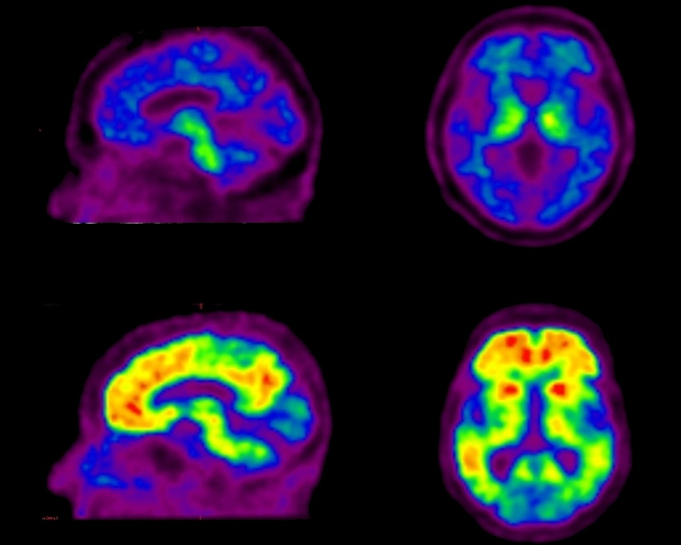
PIB-PET Neuroimaging
3.5
Control
Alzheimer’s
Disease
0.0
HC
MCI
AD
177
57
53
Age
73.6 ± 7.6
77.4 ± 7.5*
74.0 ± 8.7
MMSE
28.8 ± 1.2
27.1 ± 2.3*
20.5 ± 4.9*
Gender (M/F)
87/90
28/29
23/30
%ApoE ε4

Slide 65
Percentage of PiB+ volunteers
HC
MCI
AD
PiB +ve or “AD-like”
PiB -ve or “HC-like”
Significant differences between the three groups (p<0.001)

Slide 66
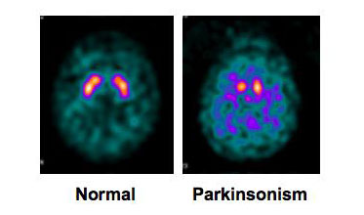
Differential Diagnosis
DAT Scan and Lewy Body Disease
  I-FP-CIT (DaT-SCAN), a pre-synaptic dopamine transporter marker
Excellent discrimination between LBD (reduced) and AD (normal).

Slide 67
Biomarkers
Biomarkers can be used to:
  Make diagnosis of disease pre-dementia/symptom development.
  Aid prognosis
  Determine reponse to treatment(s)
  Track response to treatment or as surrogate marker of pharmacological impact on disease process.

Slide 68
Non-Imaging Biomarkers
Multiple markers proposed as biomarkers of disease:
  CSF
    Tau /p-Tau
    Aβ
    Synaptophysin
    Neprilysin
  Plasma
    Aβ
    Neuroinflammatory Markers

Slide 69
CSF Biomarkers
Aβ from cortical APP, kidneys and platelets – preferentially sequestered into amyloid plaque.
Net result is that in AD observe – reduction in CSF (and plasma) Aβ.
This may well be early stage phenomena
Conversely – reflecting neuronal damage CSF Tau elevates at a later stage. This is non-specific – pTau more specific AD as reflects the phosphorylated moiety.
The P-Tau/Aβ ratio may be good index of disease in pre-dementia stage.
Formal validation as diagnostic tests ongoing.
Not used routinely in clinical practice.

Slide 70
Summary
Many causes of dementia.
Need to develop better methods of distinguishing between them:
  Differing prognosis
  Probably different reactions to newer more specific disease modifying agents
Services need to keep pace with growing numbers and growing demand of patients and carers for better assessment and management.

