Slide 1
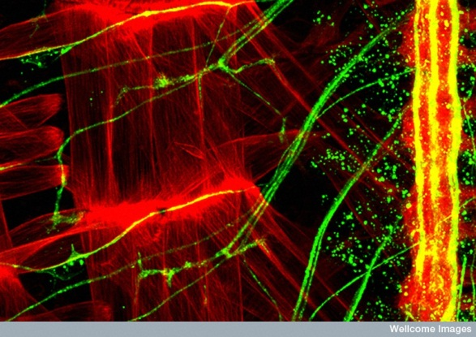
Synapse structure and remodelling
(Credit Dr Andrea H. Brand, Wellcome Images)

Slide 2
General Learning objectives of this Lecture
To understand:
a synapse - structure and function, diversity
the process and mechanisms of synaptogenesis
synapse maturation
synapse plasticity and its importance to brain function

Slide 3
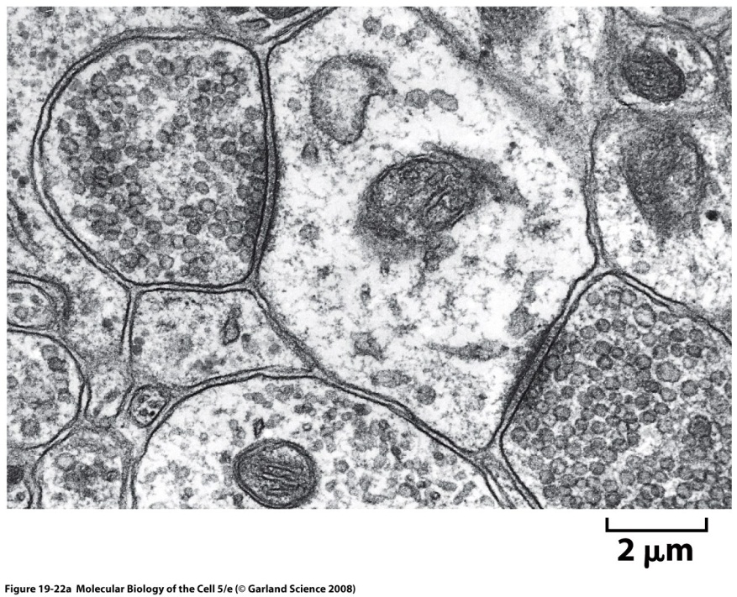
Synapse structure

Slide 4
Why study synapses?

Slide 5
Complex!
Human brain has about 84 billion neurons, 1000-10,000 synapses per neuron

Slide 10
Synaptogenesis
rapid
numerous
most during early postnatal period
not hardwired

Slide 11
Initial contact
Axon growth
Guidance
Exploratory growth cone
Filapodia
http://www.ipmc.cnrs.fr/~duprat/neurophysiology/video.htm

Slide 12
Developing a synapse
Pre and post synaptic events
Local protein synthesis
Adhesion
Cytoskeleton remodelling

Slide 13
match neurons
holds together
keep all components in the synaptic region

Slide 14
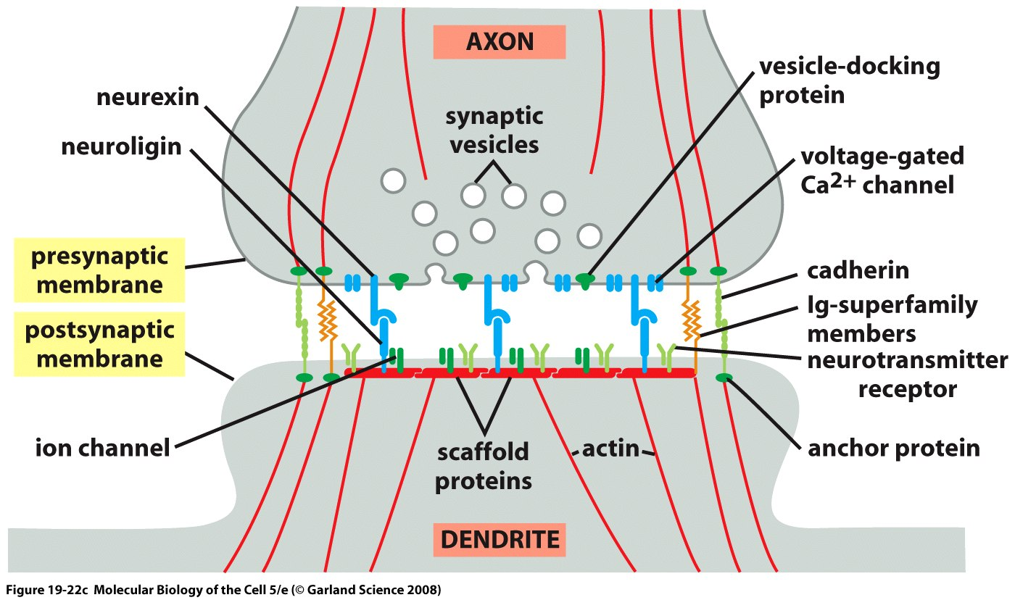
Adhesion
In vitro and in vivo experiments

Slide 15
Scaffold proteins at synapses
Can link to the cytoskeleton
100s of proteins (diversity, robustness and flexibility)

Slide 16
Clinical relevance: psychiatric disorders?
E.g. point mutation in Neuroligin-3 linked to autism
e.g. Neuroligin-2 null mice: inhibitory synapses dysfunction and they are more anxious
(review: Neuroligins and neurexins link synaptic function to cognitive disease, Nature. 2008 Oct)

Slide 19
Some remaining synaptic adhesion questions
Neural activity regulate the cadherin/actin complex?
What is the role of the different adhesion proteins subtypes (inc 20+ cadherin subtypes)?
Can/does adhesion regulate neuronal gene transcription?

Slide 20
15 minute break
Relax
Meet your neighbours
Review your notes
Ask questions

Slide 21
Synapse maturation
Pre synapses
Post synapse inc NT receptors
Electrical activity
Extrinsic factors

Slide 26
Synapse modulation
morphological changes inc. adhesive and ECM
extrinsic factors, from glia and neurons: neurotrophins, Wnts etc
activity-induced changes
Can involve local protein synthesis (e.g. LTP in Hippocampus: polyribosomes shift from shaft to spines in dendrite & PKMzeta mRNA)

Slide 29
How do spines develop on the postsynaptic neuron?
??
spine can develop before synapse (adult mouse cortex, Knott et al., 2006)
Pre and post synaptic dep and independent
size of spine head correlates with synaptic strength
local Ca2+ signalling

Slide 30
Dendritic spines are very dynamic
presynaptic cell does not move
move even when a synapse has matured: why?
To regulate synaptic function? Regulate local Ca²⁺ signalling?
actin-based
could regulate actin-bound molecules e.g. CaMKII (poss. involved in LTP)

Slide 31
Regulating spine morphology
Synaptic activity NTs etc.
PSD proteins
Adhesion
Cytoskeleton
Glial wrappings

Slide 32
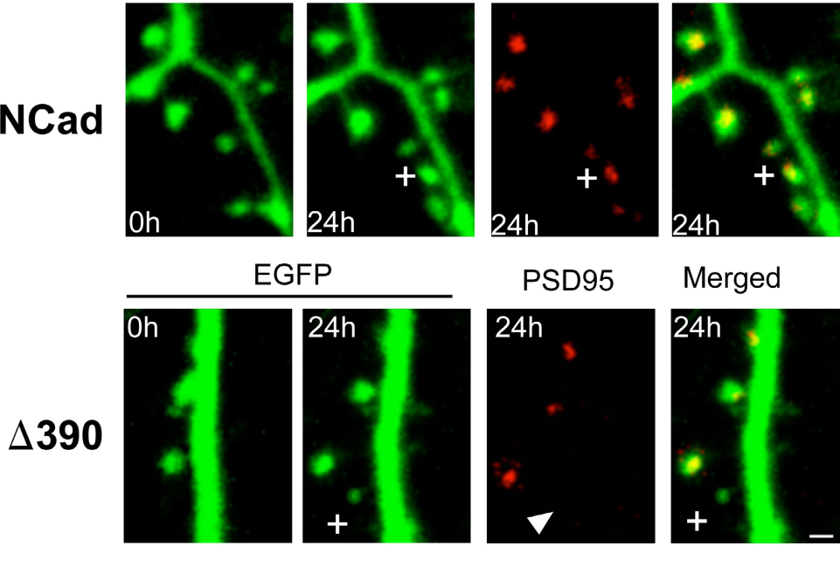
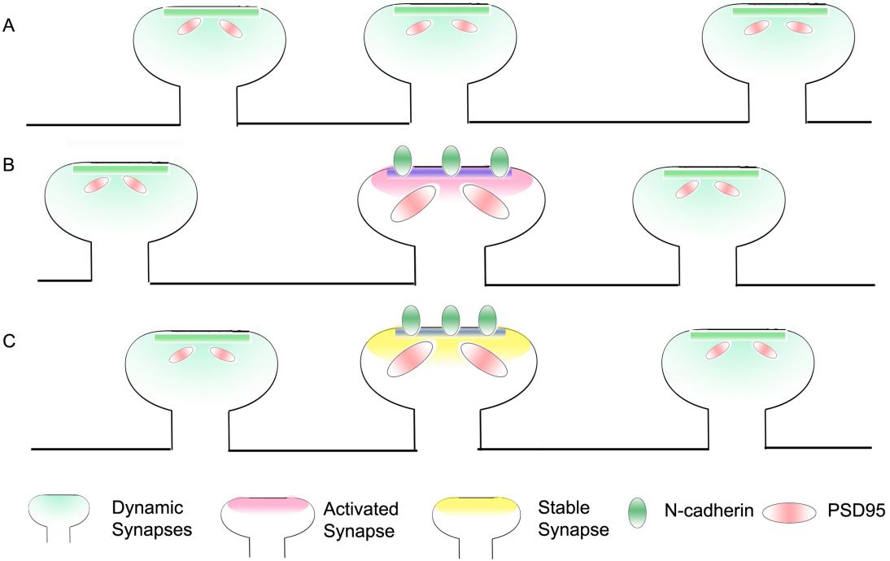
N Cadherin can promote spine stability
Mendez et al., J. Cell Biology 2010
Expt: Biolistics in hippocampal slice cultures
(390 mutant N-Cad lacks extracellular domain)
(Comment by Arikkath, J Cell Biology 2010)

Slide 34
(Review:The mystery and magic of glia: a perspective on their roles in health and disease. Barres BA.
Neuron. 2008)

Slide 37
Activity regulated modulation of synaptic strength
Change synapse strength in response to afferent activity: LTP and LTD
‘silent’ synapses are reawakened or culled
others can be silenced (LTD = ‘forgetting’?)

Slide 40
LTD: the basis of forgetting?
LTD = Long-term depression
weakening of a synapse for hours-days
studied in the cerebellum and hippocampus
probably based on a reduction in NT receptors on postsynaptic neuron

Slide 42
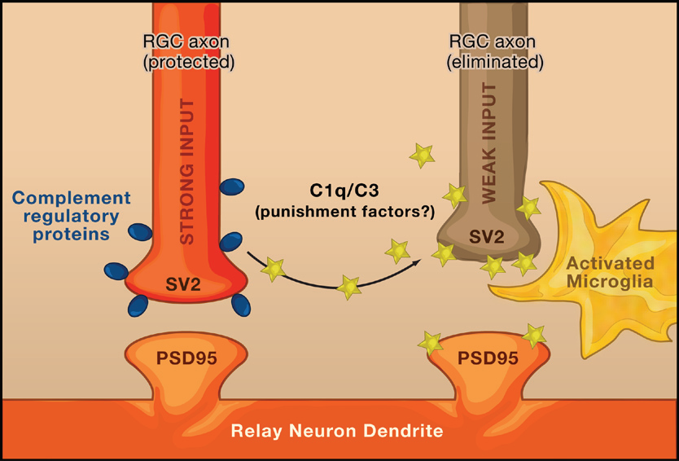
Refining neural circuits
Complement tags
unwanted synapses in mice
(Stevens et al., Cell 2007)
Drosophila: caspase activity after dendrites severed
= ‘pruning’, marks dendrites for phagocytosis
(Williams et al., Nature Neuroscience, Oct 2006)
Is mechanism similar
in humans?
(Fourgeaud & Boulanger LM, Cell 2007)

Slide 44
Synapses can stabilise axon branches
Meyer and Smith, J. Neurosci. 2006: Filmed Zebrafish retinal ganglion cells in situ
red = axons green =presynaptic vesicles
very dynamic turnover of axons and vesicles
synapse at site of new branches
stable branches had synapses
branches did not retract beyond a synapse

Slide 47
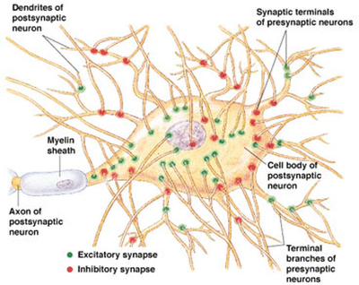
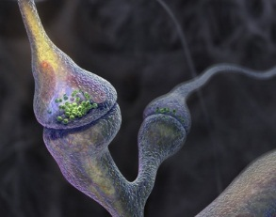
Next steps
The ‘connectome’

Slide 48
Learning outcomes
Define a synapse and its functions
Describe the structure of a typical chemical synapse in the CNS
Describe the events that occur in the pre- and postsynaptic regions when an action potential reaches the presynaptic terminal
Describe the role of adhesion in synapse formation and modulation
Describe the role of glia during synapse formation and functioning
Appreciate the plasticity of the synaptic structure, the importance of this to learning and memory and its possible clinical relevance

